Slide 1
SAL 603
NHL 3rd Line Playoff Analysis
Python for Sport Analytics
Final Project
Luke Ponticello

Slide 2
Research Questions: - How much does the 3rd Line of an NHL team contribute to playoff success? - What notable and different assets does this line bring that a 1st Line does not? - What factors of a Stanley Cup winning 3rd line separate it from a fellow contending playoff teams ?
FORWARD LINES OVERVIEW
1st : Line of the team's top skaters and is relied on for scoring. They play significant minutes and possess the speed and skill most likely to get pucks behind the goalie.
2nd: Support of the first line – providing secondary scoring-offensively minded players often specializing in their shot, puck handling, and pursuit of the net.
3rd: A defensively oriented group of forwards that may also possess keen scoring ability- they are usually specialists in the realm of forechecking, faceoffs, and blocking passing lanes and shots when in their own zone.
4th: Useful in physical and high energy situations. These players often are called upon to kill penalties, hit in abundance, and stand their ground in the defensive zone. Their short time on the ice gives rest to top players and can be utilized to wear down the opponent’s top players.

Slide 3





Teams of Research
2020-2024 Stanley Cup Champions

Slide 4
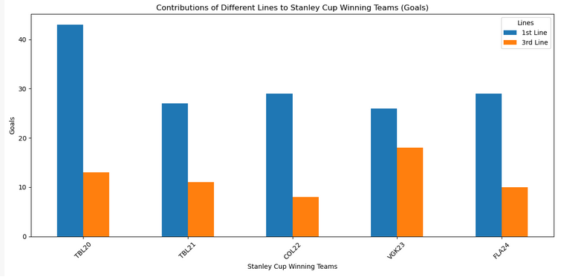
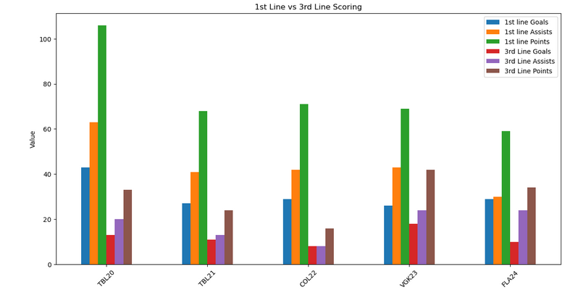
1st Line Scoring vs. 3rd Line Scoring (Playoffs)
The difference between Colorado in ‘22 and Las Vegas in ‘23 shows a top-heavy team in the Avalanche that was able to score enough to let the bottom six play defensively. Sporting Landeskog, Mackinnon, and Rantanen on the 1st line this wasn’t farfetched. In Las Vegas we have a 3rd line that is a bit of an outlier and shows excellent depth scoring by their 3rd line led by William Karlsson

Slide 5
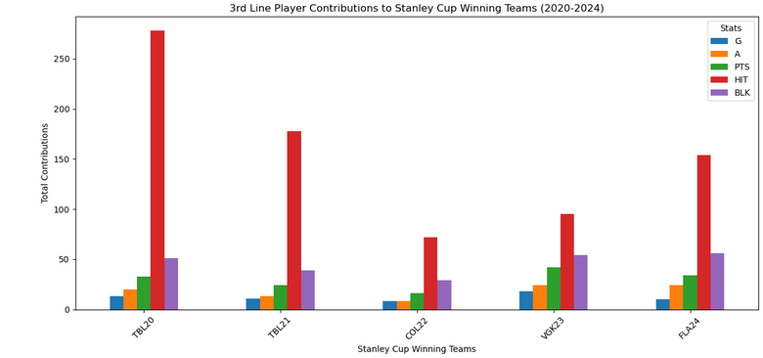
3rd Line Contributions (Playoffs)

Slide 6
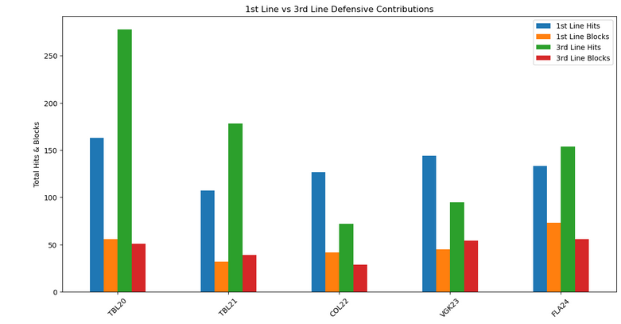
Defensive Contributions Compared

Slide 7
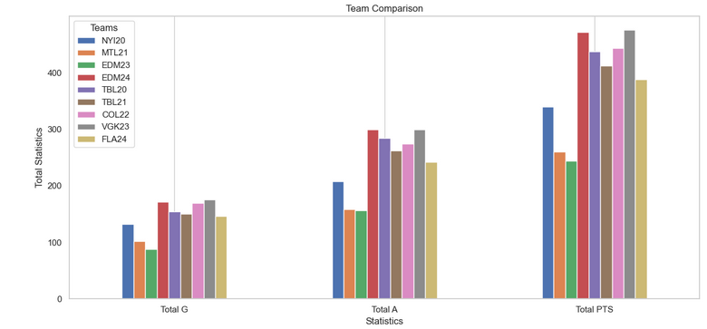



Contenders Compared to Winners (Playoff Team Totals Scoring)
Contenders

Slide 8
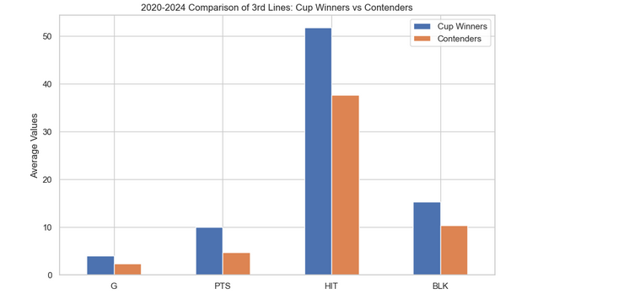
3rd Line Averages Contenders vs. Winners
We notice that the avg. points generated from the 3rd line is crucial as scoring from the contenders clearly is not even.

Slide 9
Advanced Statistics Overview
- Corsi For (CF)
the total number of shot attempts (including shots on goal, missed shots, and blocked shots) that a team generates while a player is on the ice
- Fenwick For (FF)
a metric focused solely on unblocked shot attempts generated by a team while a player is on the ice
- Corsi Against (CA)
the total number of shot attempts allowed by a team while a particular player is on the ice
- Fenwick Against (FA)
shot attempts against a team that include only unblocked shots (excluding blocked shots)
Time on Ice Per 60 minutes (TOI/60)
average amount of ice time a player receives in a game, measured per 60 minutes of game time on all areas (powerplay/penalty kill/4on 4)

Slide 10
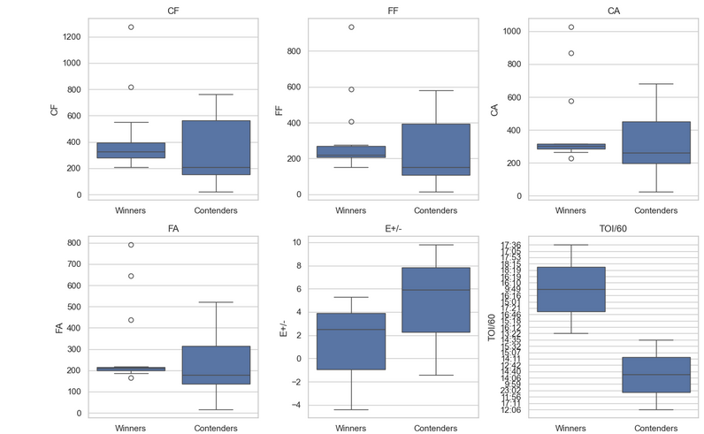
Advanced Statistics (3rd lines)
- Corsi For (CF)
- Fenwick For (FF)
- Corsi Against (CA)
- Fenwick Against (FA)
- Expected Plus/Minus (E+/-)
- Time on Ice Per 60 minutes (TOI/60)

Slide 11
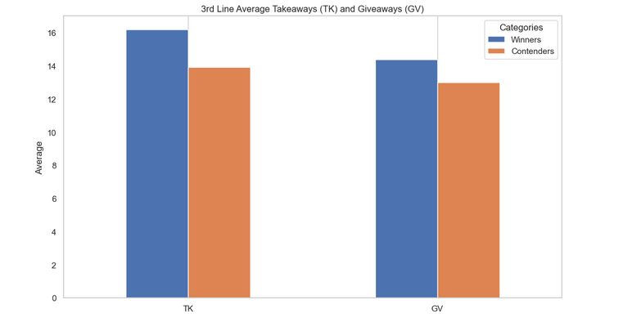
Average Takeaways & Giveaways
Winners vs. Contenders

Slide 12
Conclusion
3rd line players are crucial to success in the NHL playoffs where they don’t stack up offensively as a playoff caliber 1st line they make up for defensively.
Hitting and Blocking shots reign truly important especially in Tampa Bay’s 2020 run as these metrics clearly separate third line players apart from 1st liners even given the major discrepancies in ice time.
3rd lines are dependent on keeping the high danger scoring away from the net : we see this through the relatively low Corsi Against and Fenwick Against in comparison to the Contending teams that did not win a championship.
TOI/60 shows that the Stanley Cup winning teams feel much more comfortable allowing their 3rd lines/and their individual players handle roles and situations at times throughout the games. I think this could also explain the more average (TK) and (GV) – because they’re on the ice more often.

