Slide 1

Introduction
- Machine Learning (ML) algorithms are used to make a prediction or classification. Based on some input data, which can be labelled or unlabelled, the algorithm will produce an estimate about a pattern in the data..
- Quantum Machine Learning (QML) explores the application of quantum computing technologies to develop and enhance machine learning algorithms. QML leverages the principles of quantum mechanics, such as superposition, entanglement, and quantum interference, to process and analyze data in ways that are fundamentally different from classical computing.

Slide 2
Objectives
- Compare feature importance in classical ML and QML to identify differences in what inferences can be made from the data.
01
- Highlight new inferences gained from QML approaches, showcasing how quantum techniques provide new perspectives on data analysis.
02
- Discuss finding and continue refining QML models and explore larger, more complex real-world data.
03

Slide 3
Methodology
Construct classical ML Model and QML Model
Using Support Vector Classifier and Variational Quantum Classifier
Make inferences from the data using feature importance.
Measure feature importance in the change in model performance, when the feature is omitted from the data.

Slide 4
The Data: Iris Data Set
Composition: 150 instances across 3 species (Setosa, Versicolour, Virginica), each with 50 samples.
Features: sepal length/width, petal length/width (measured in cm).
Key Insight: High class correlation especially noted in petal measurements, facilitating species differentiation.
No Missing Values: Ensures dataset integrity and consistency for analysis.
Historical Significance: Introduced by R.A. Fisher in 1936, it remains a foundational dataset for pattern recognition.
Application: Ideal for demonstrating machine learning algorithms, especially in classification tasks.

Slide 5
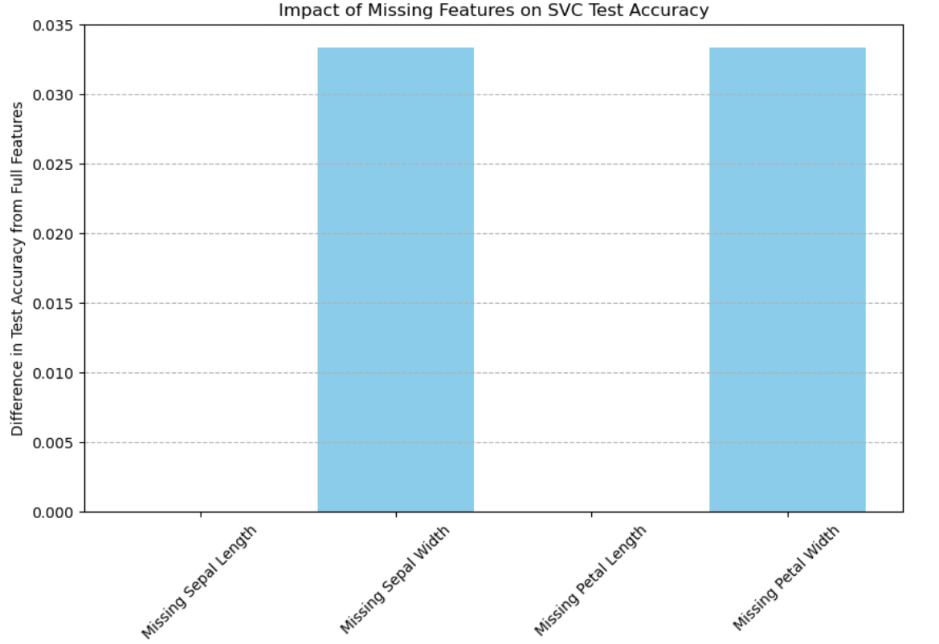
Insights from Classical Model
Sepal Width and Petal Width are the most important features, removal causes greatest change in model accuracy.
Removal of Sepal Length, Petal Length, had no effect on model performance.

Slide 6
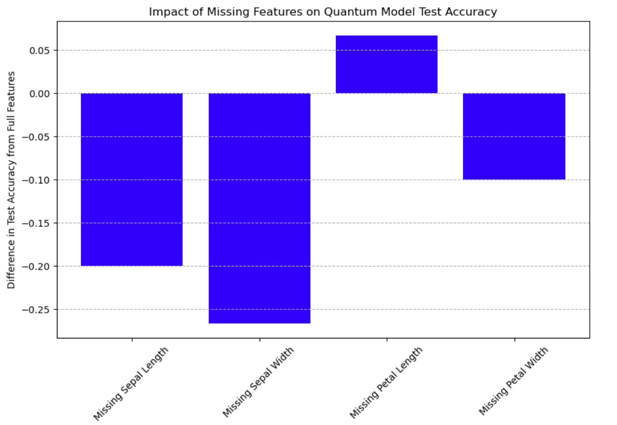
Insights from Quantum Model
Removal of Sepal Length, Sepal Width, and Petal length actually increases accuracy.
Only the removal of Petal Length causes a decrease in the model’s accuracy.

Slide 7
Comparative Analysis
Quantum Sensitivity to Feature Reduction: The quantum model uniquely improved in performance with the removal of certain features (Sepal Length, Sepal Width, and Petal length )
Critical Feature Identification: While both models highlight the importance of 'Petal Length', the quantum model's performance is more significantly impacted by its removal, indicating a difference in how quantum models weigh feature contributions.

Slide 8
Future Directions
- Continue to refine, explore and improve more complex QML Models.
- explore more ways to make inferences from QML’s processes.

