Slide 1


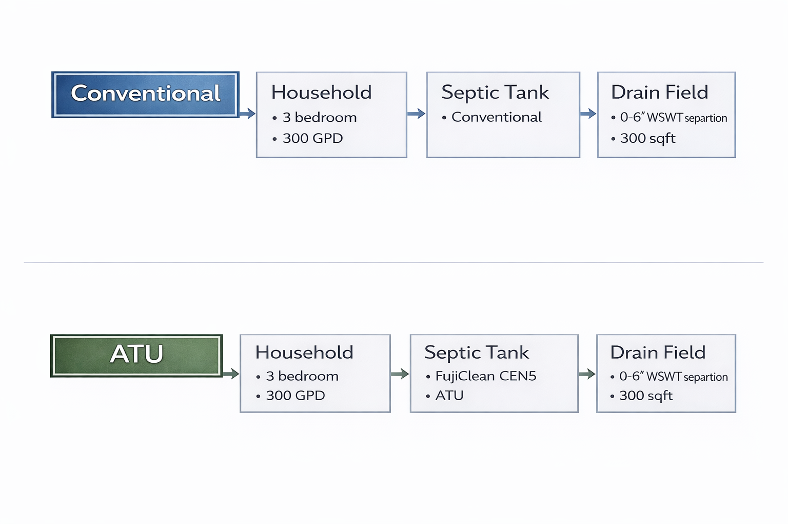
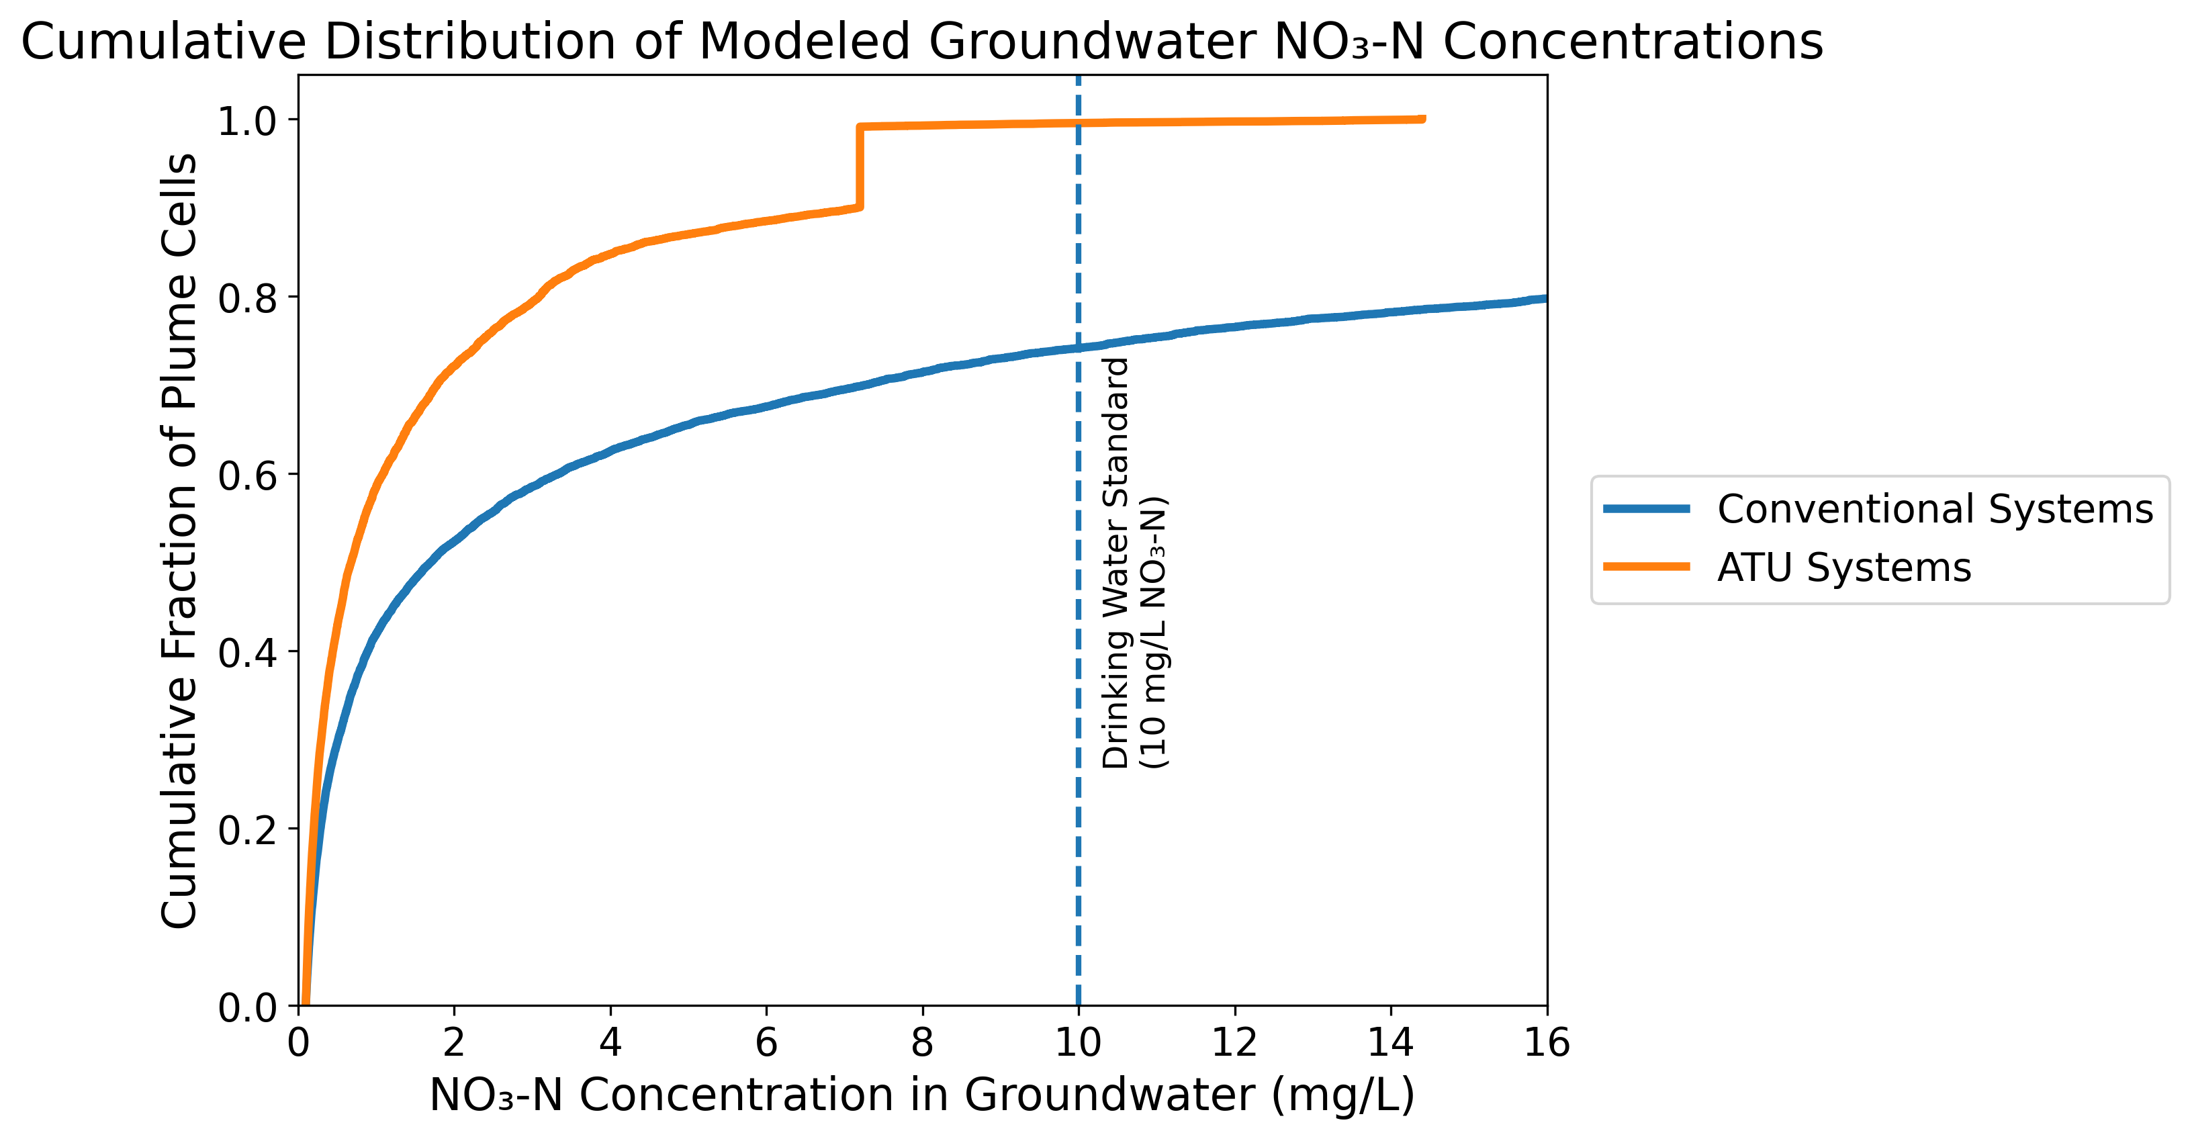
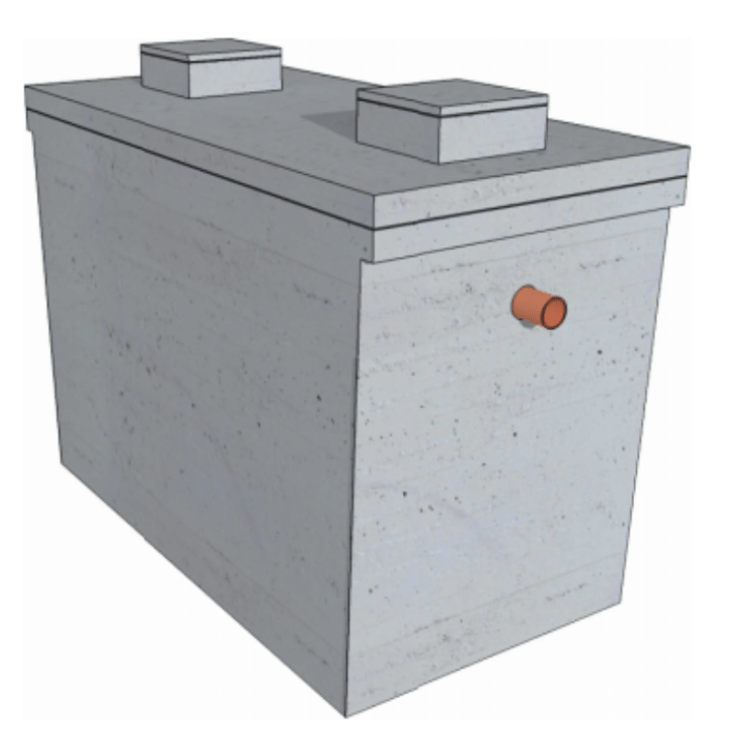
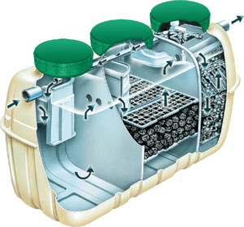
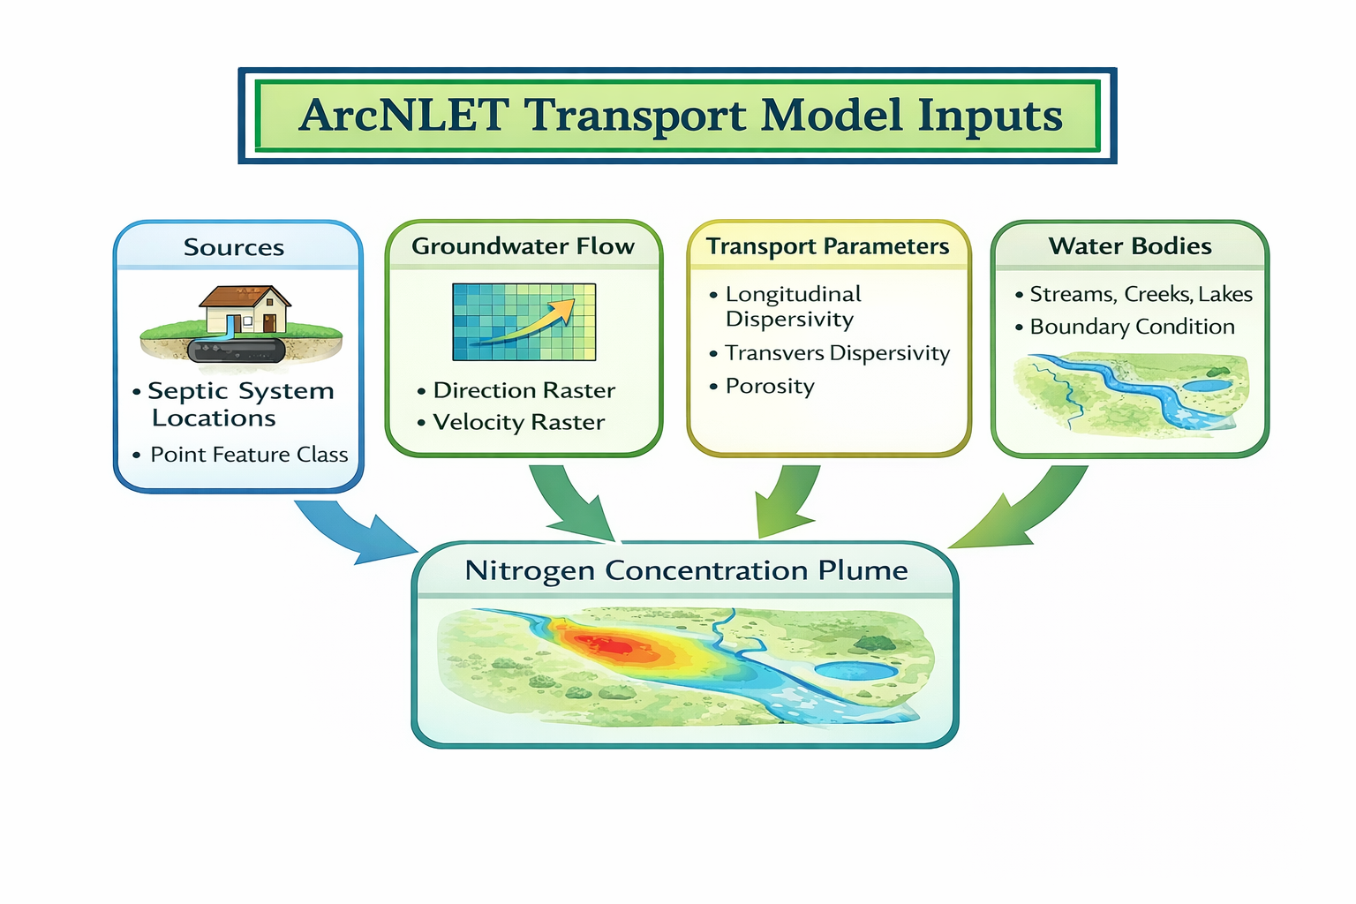
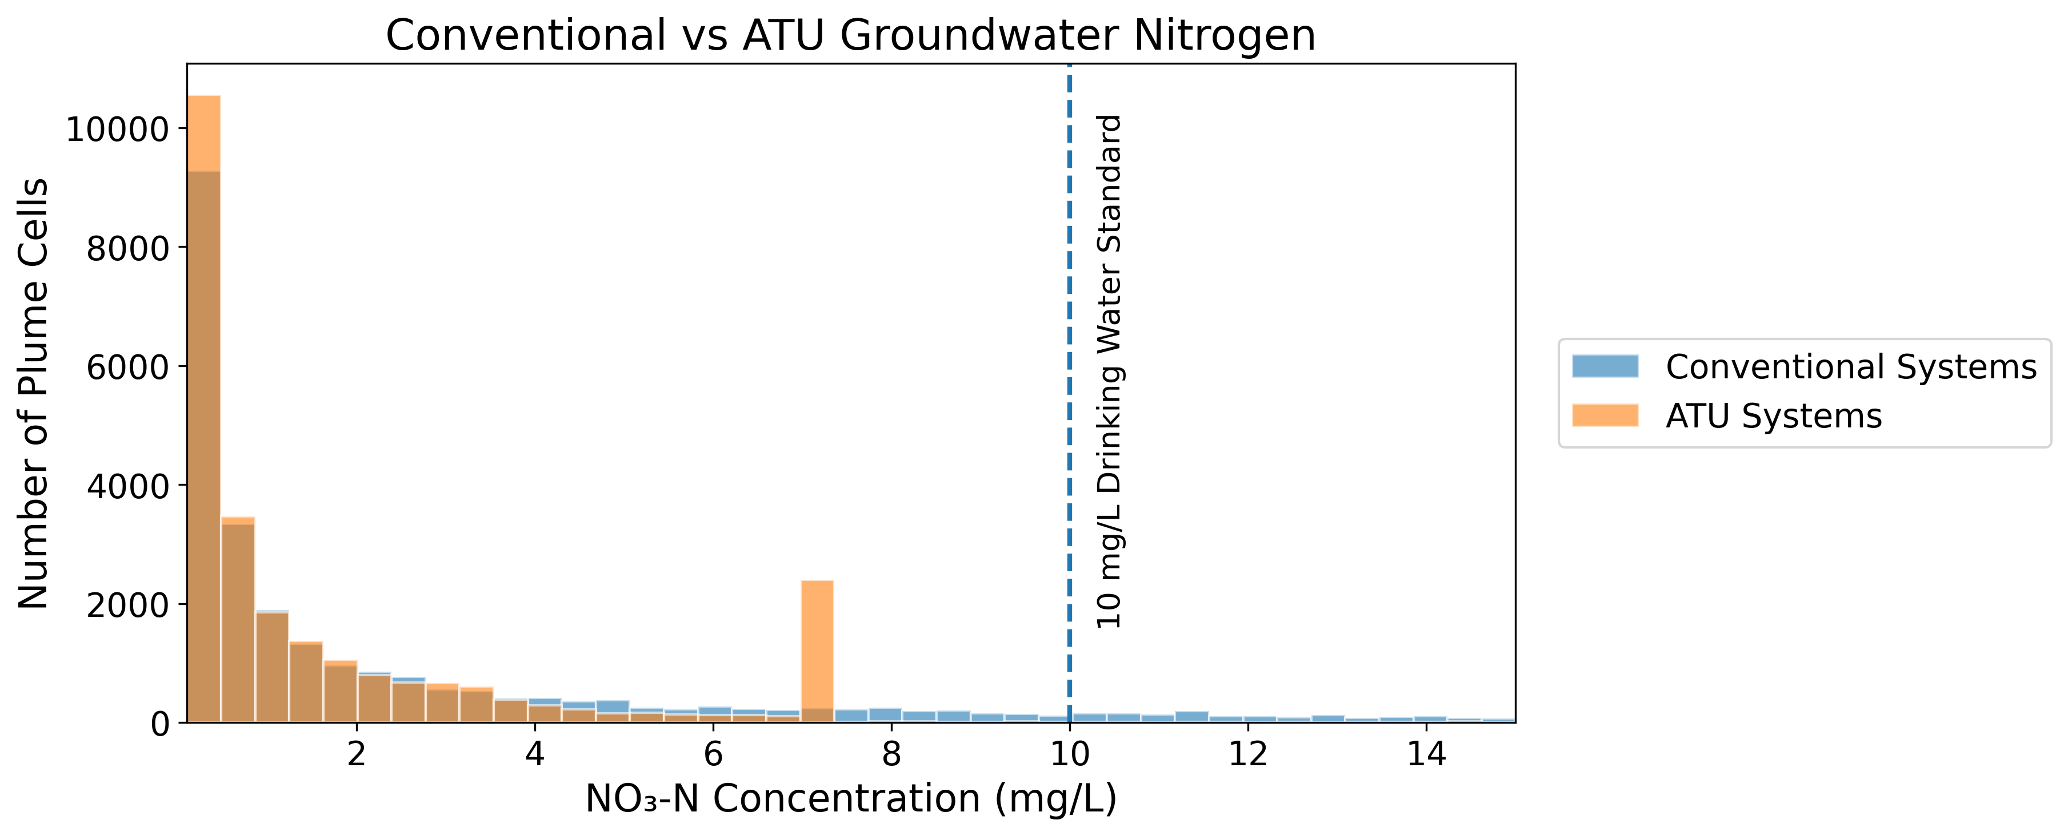
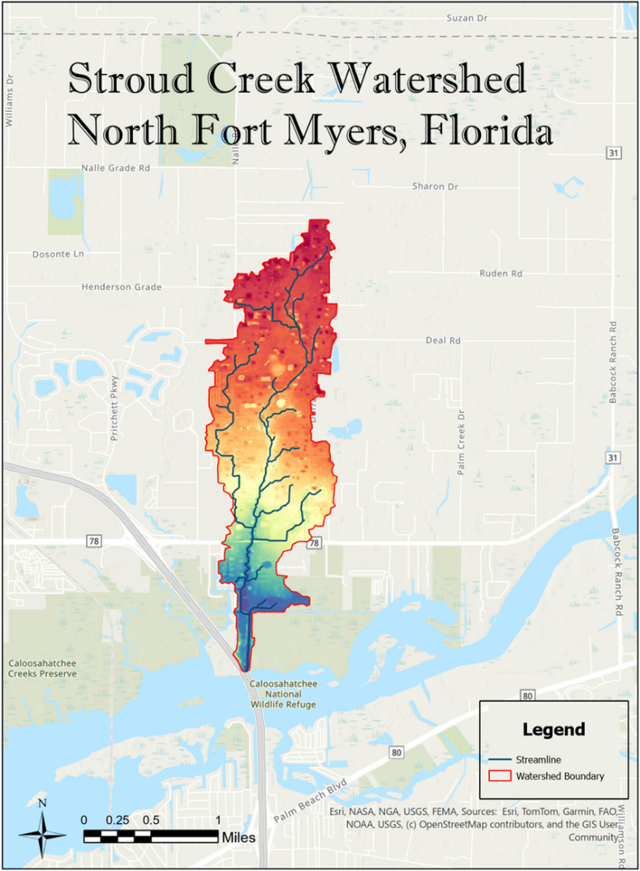
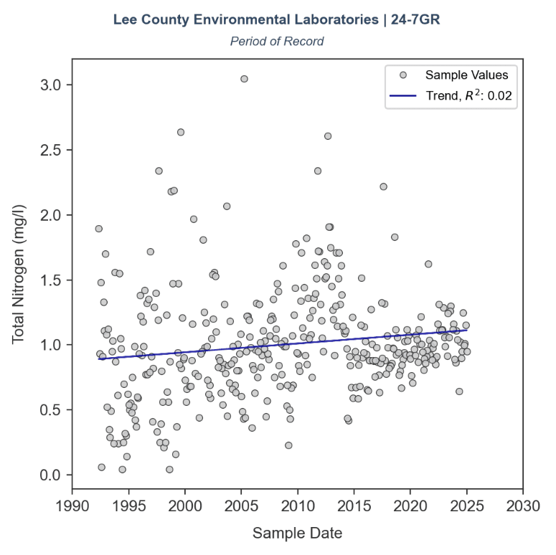
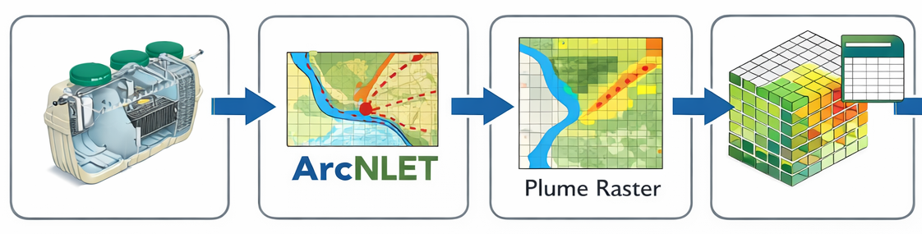
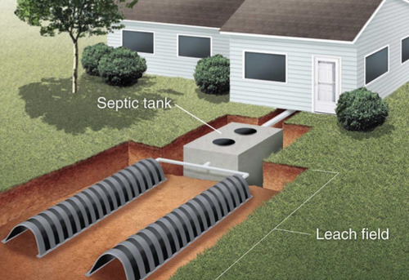

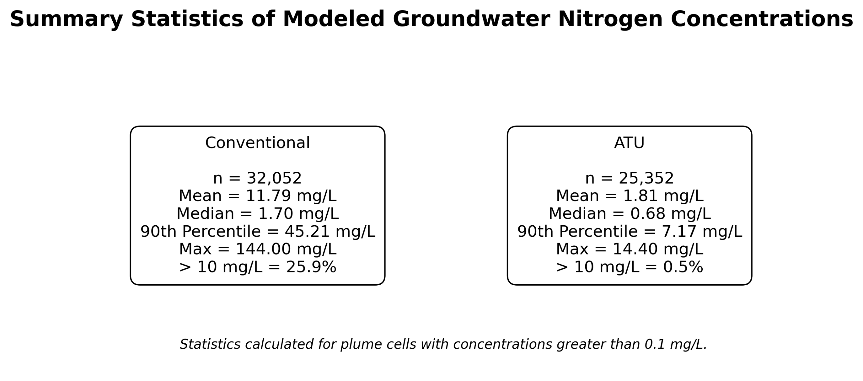
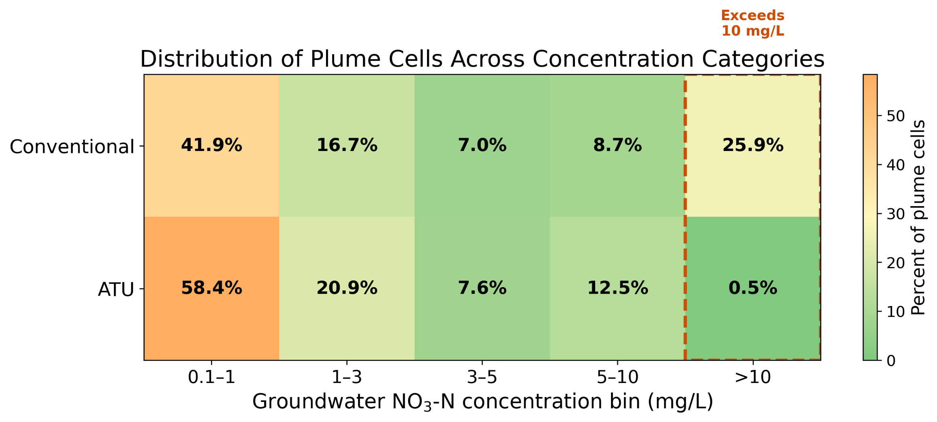
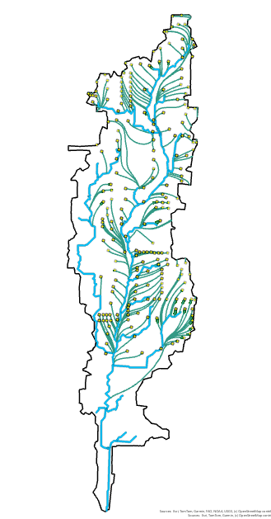
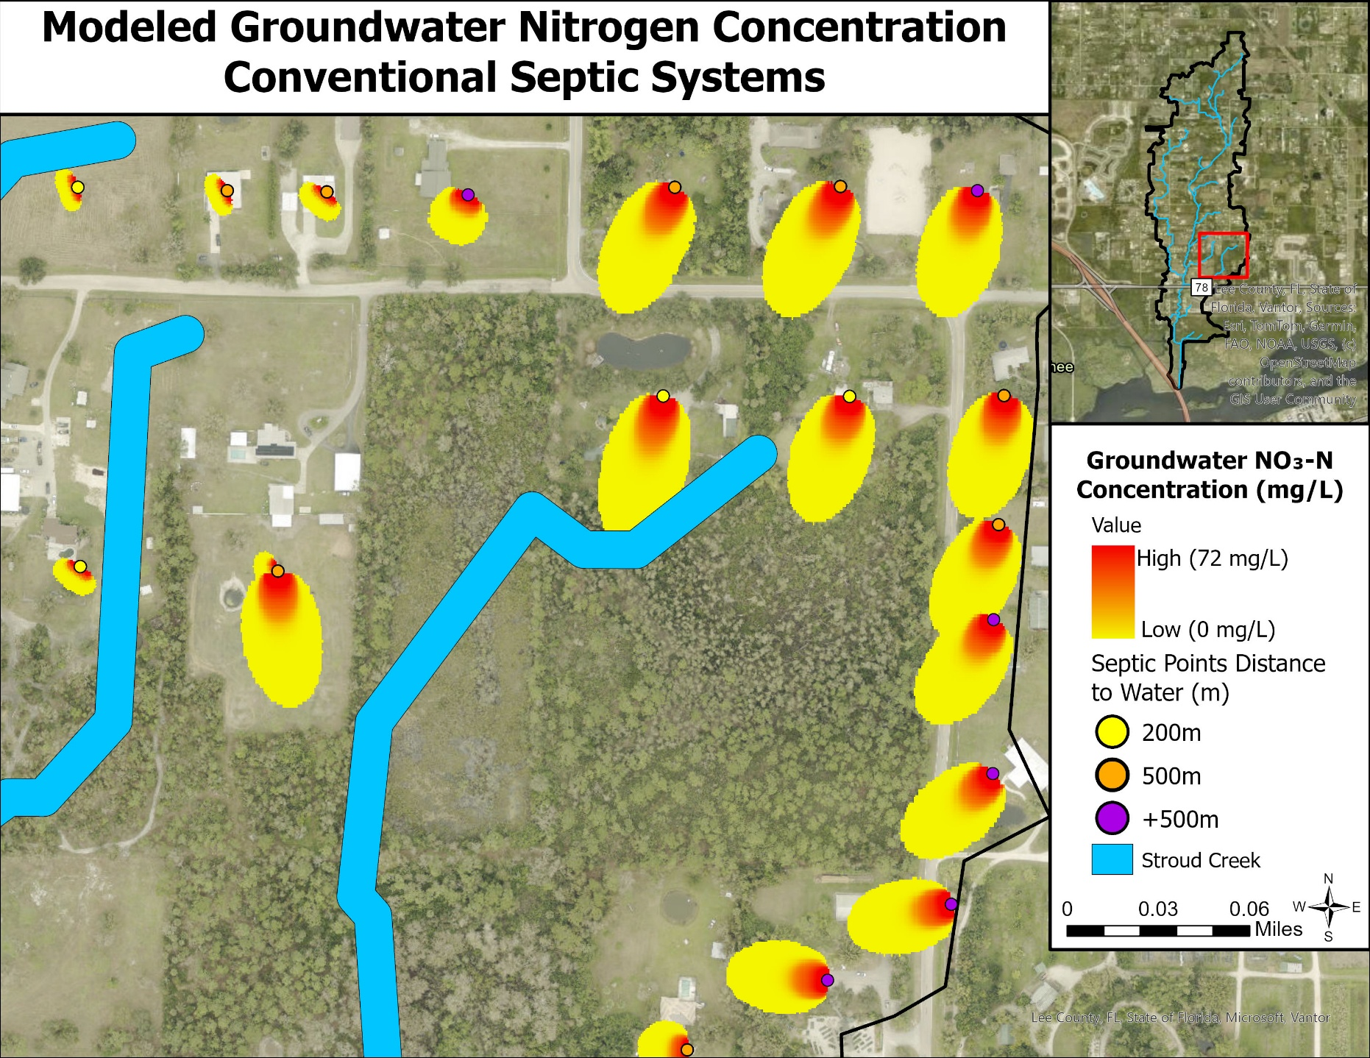
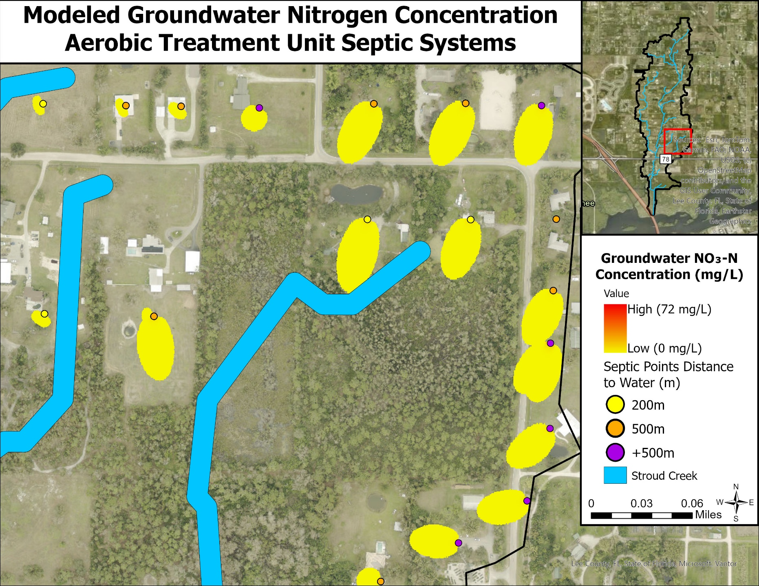
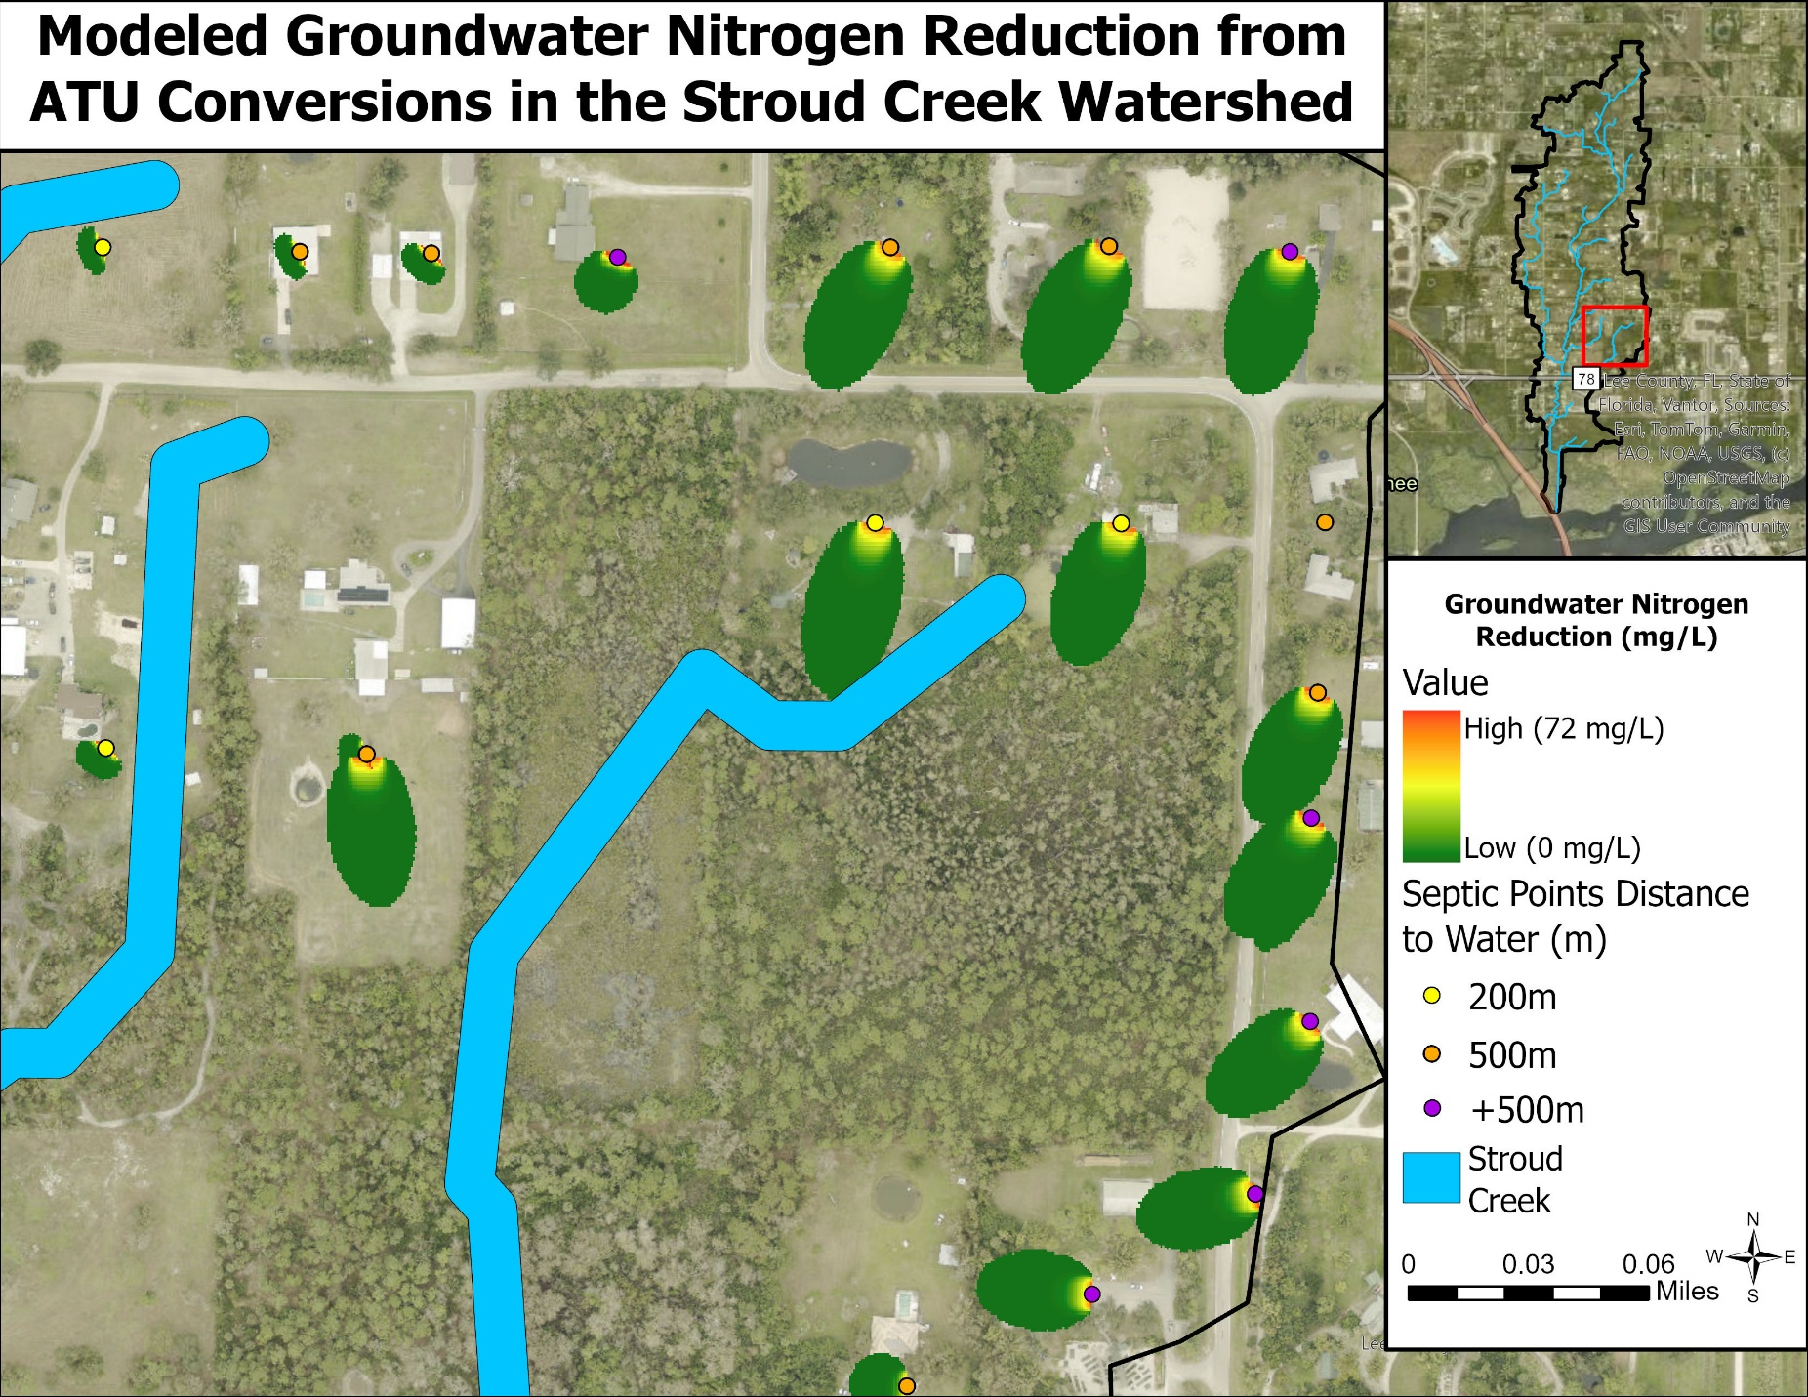
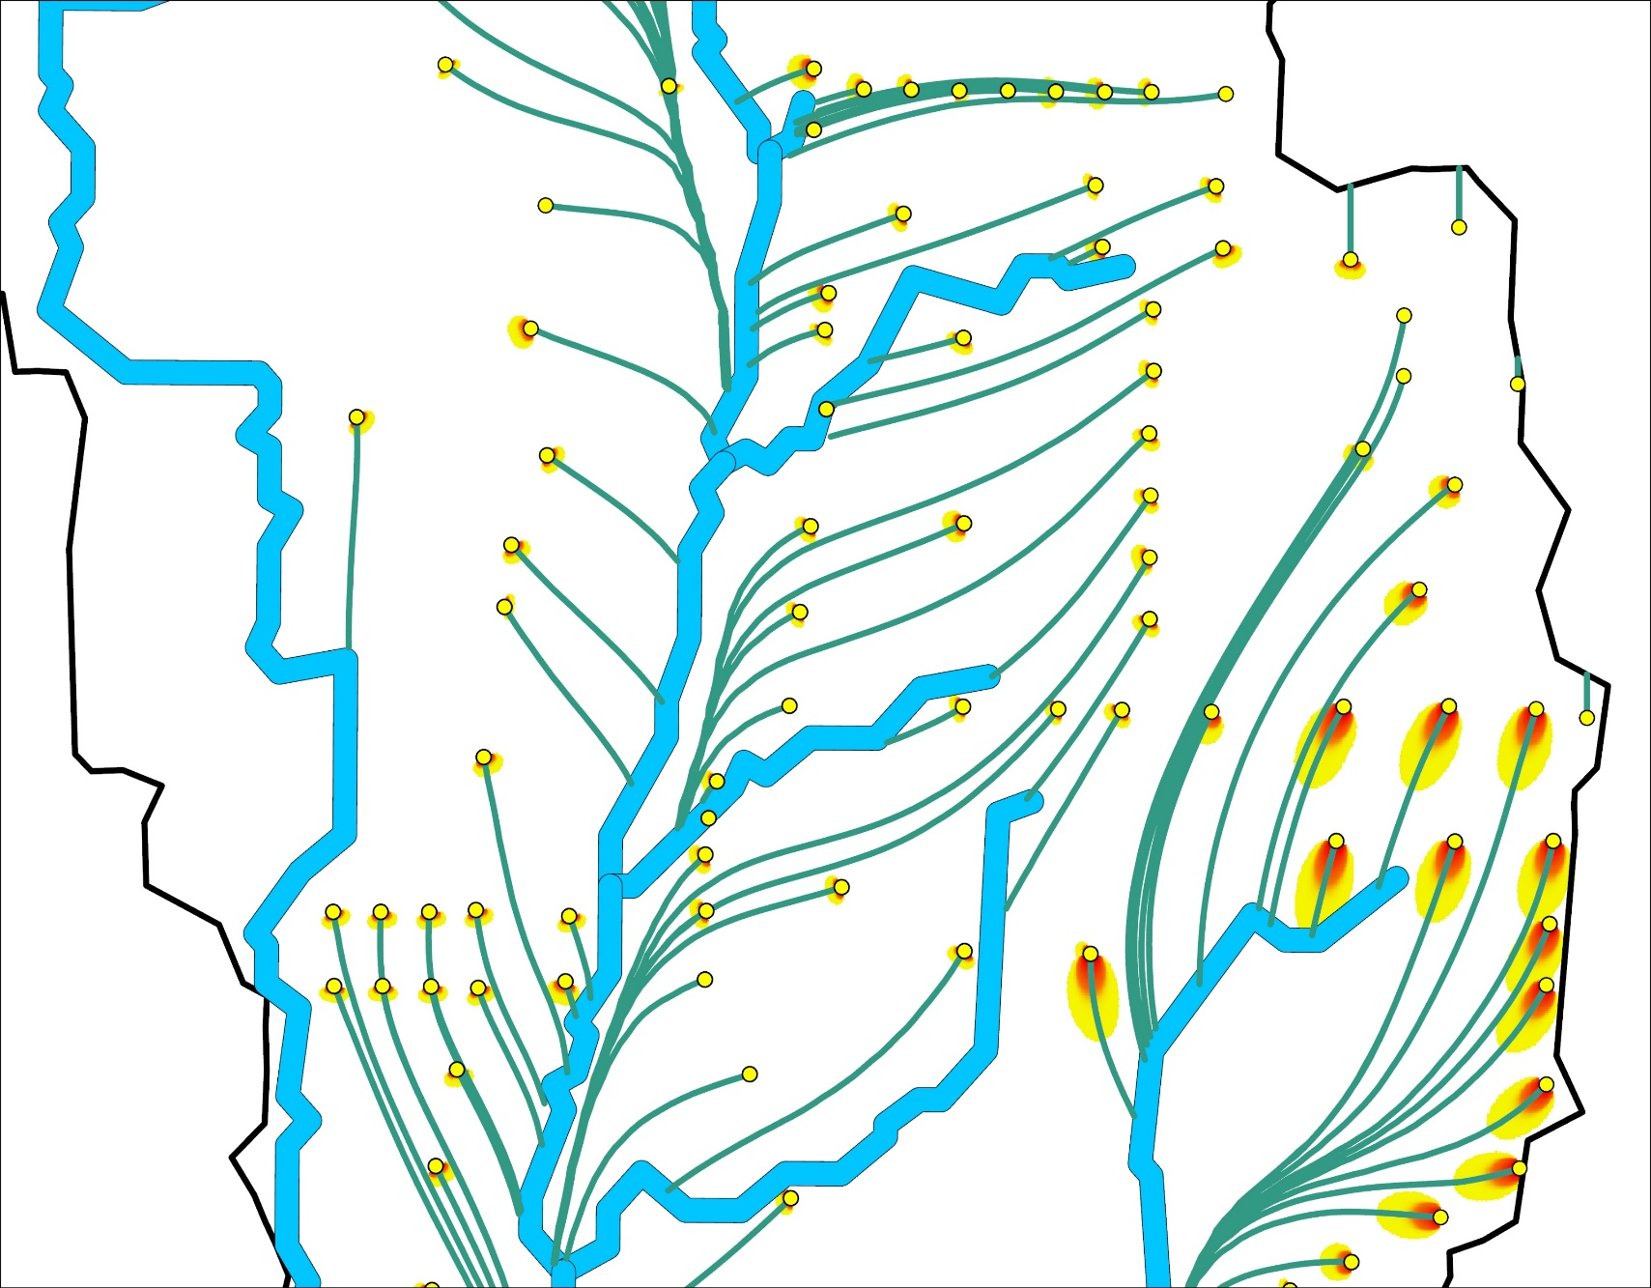
Nitrogen Pollution Reduction in Lee County Surface Water and Groundwater Through the Replacement of Old Conventional Septic Systems with Aerobic Treatment Units
Luke Richard Roides
Masters in Civil Engineering | Sustainable Water Engineering | Faculty Advisor: Dr. Ahmed Elshall
Scan for report and dataset
Introduction
Scenario Design
Results and Discussion (Continued)
• ~30% of Florida residents rely on septic systems, many of which are aging and poorly separated from the wet season water table, allowing nitrogen to directly enter groundwater
• Elevated groundwater nitrogen contributes to water quality degradation, eutrophication, and risks to public health
• This study evaluates whether Aerobic Treatment Units (ATUs) can reduce groundwater nitrogen concentrations.
Figure 4. Conventional septic system with 72 mg/L NO₃-N input and aerobic treatment units (ATUs) with 90% reduction of NO₃-N input
Study Area
Figure 1. Conventional and ATU septic tank
Methods
Septic Systems
ArcNLET Model
Plume Raster
TN Quantification
Figure 2. Modeling framework
Figure 5. Study area
Figure 6. Stroud Creek TN sampling data
Figure 7. Summary statistics of modeled groundwater nitrogen concentrations
Results and Discussion
Conclusion
• Conventional septic systems produce higher and more extensive groundwater nitrogen plumes, while ATU systems significantly reduce concentrations
• ATU conversion shifts the entire distribution of groundwater nitrogen downward, resulting in substantially fewer exceedances of drinking water standards
• ATUs provide a measurable and effective strategy for improving groundwater quality in regions reliant on onsite wastewater treatment
Figure 3. Transport modeling using ArcNLET
Notes:
Advection
Dispersion
Dilution
Minimal vadose zone assumed with legacy systems
Abstract
Lee County has experienced urbanization dating back to the 1950s. Residential construction at the time had little to no regard for the future of what Lee County was going to become. Many of the wastewater treatment systems that were constructed for residential properties, known as septic systems, were installed with little to no regulatory enforcement or environmental considerations. Many of these systems are still in use today. A high number of these septic systems cannot meet the treatment requirements of today’s standards and lack separation from the ground water table. These old septic systems are directly contaminating groundwaters and excess runoff can impact nearby surface waters. Harmful pollutants found in human wastewater, like nitrogen, can cause several environmental and public health impacts. The study objective is to project the reduction of these pollutants from replacing outdated septic systems with new advanced treatment unit septic systems known as aerobic treatment units (ATUs).
Approximately 30% of Florida's population rely on septic systems as their form of wastewater treatment with more than 2.6 million systems in use.
Septic Systems contribute nitrogen to groundwater
Aerobic Treatment Units (ATUs) reduce nitrogen in wastewater effluent prior to discharging into the ground.
Legacy systems often have little to no wet season water table separation. This leads to direct nitrogen loading to groundwater

