Slide 1
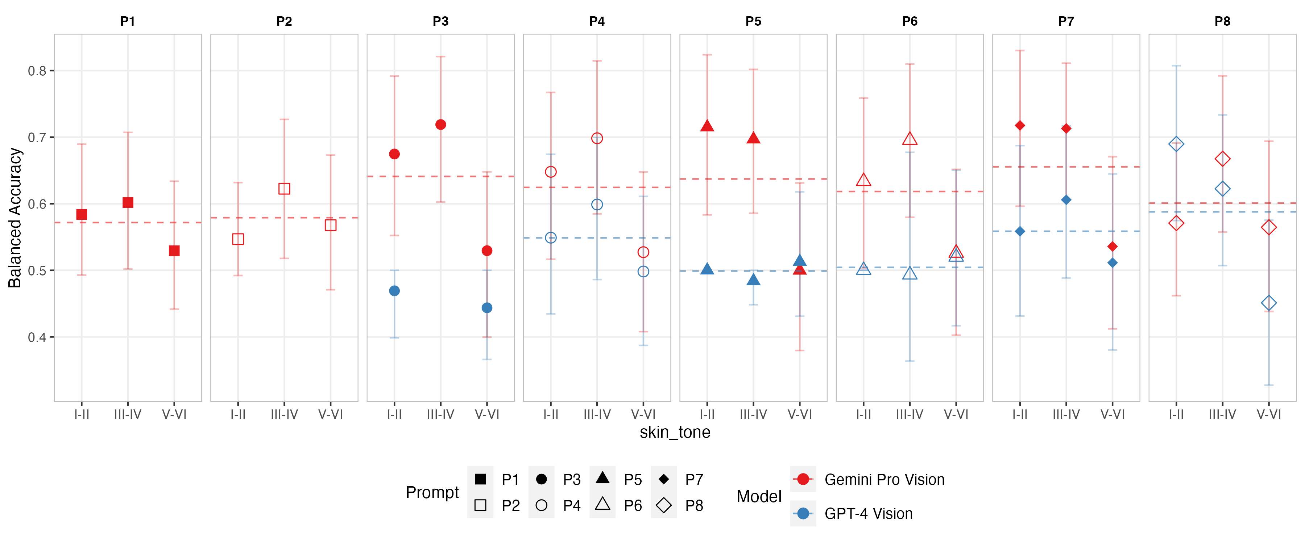
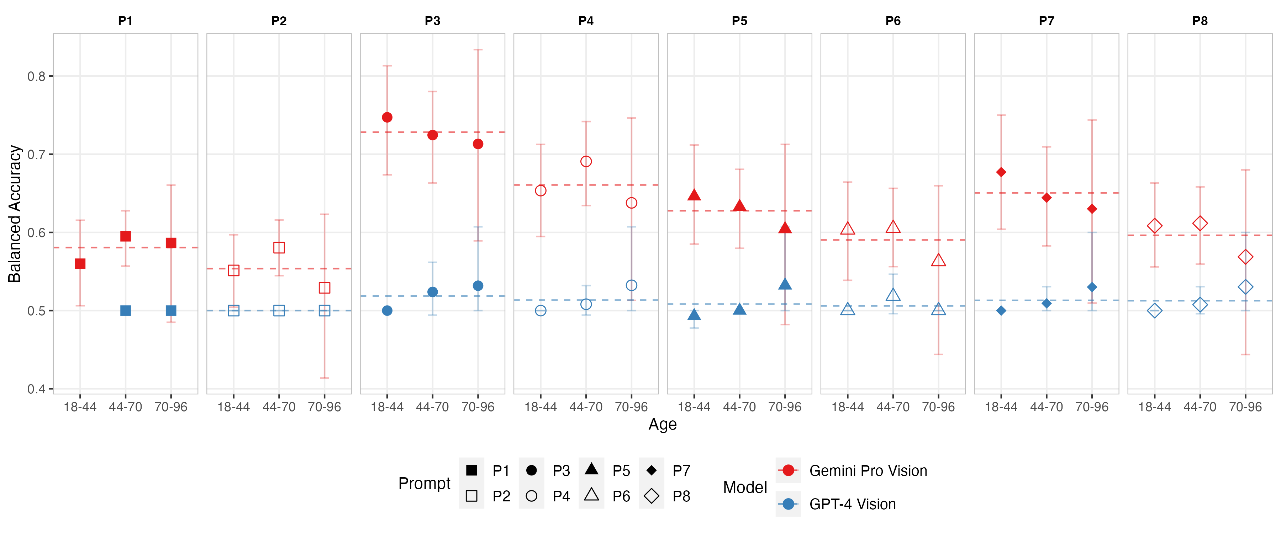
A
Dermatology
Skin Tone
B
Age
Radiology
Age Group

Slide 2


A
Dermatology
B
Radiology

