Slide 1
Investment Assignment
Group 31

Slide 2
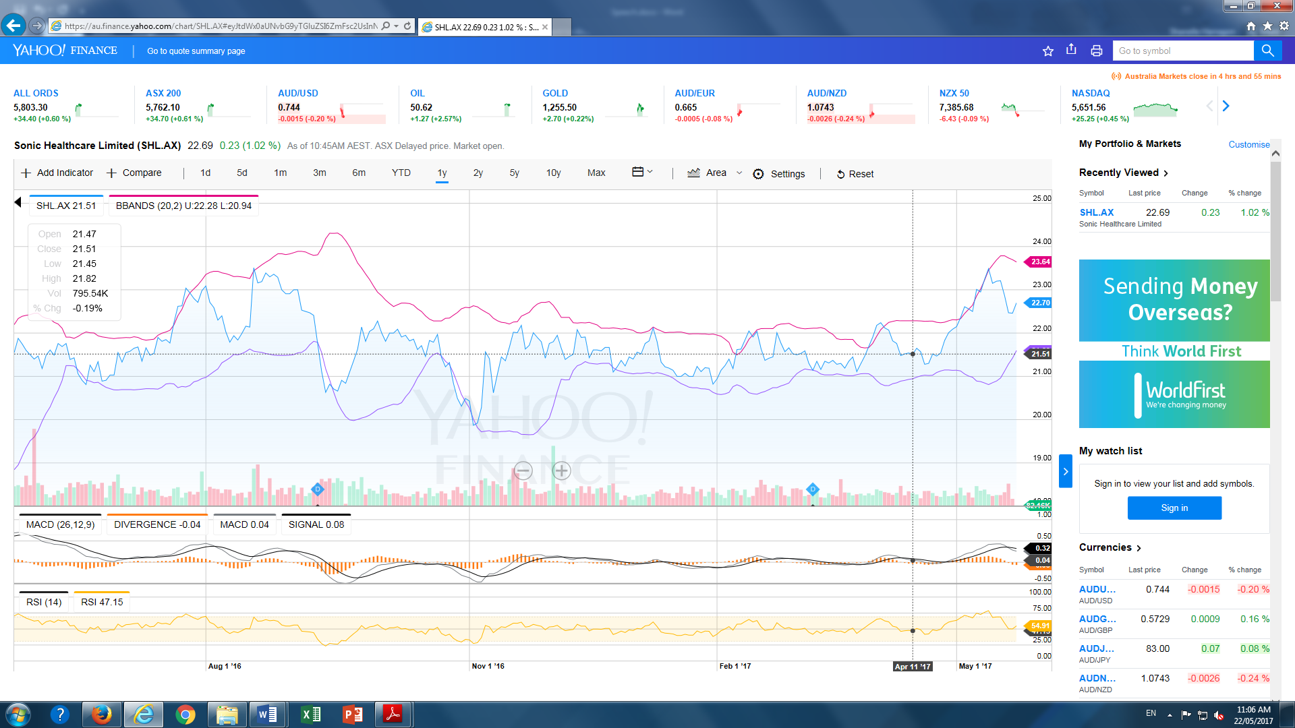
Healthcare
Sector | Stock | Buying |  |  |  | Selling |  |  |  | Fees | Final Value |  | WO/ BF |  | W/ BF
 |  | Price | Volume | Value |  | Price | Volume | Value |  |  |  |  | Change ($) | Change (%) | Change ($) | Change (%)
Health Care | CSL | $128.02 | 54 | $6,913.08 |  | $134.72 | 9 | $1,212.48 |  | 20 | $1,192.48
 |  |  |  |  |  | $132.70 | 20 | $2,654.00 |  | 20 | $2,634.00
 |  |  |  |  |  | $130.89 | 25 | $3,272.25 |  | 20 | $3,252.25
 |  |  |  |  |  |  | Total | $7,138.73 |  | Total | $7,078.73 |  | $225.65 | 3.264% | $165.65 | 2.396%
 | JHC | $2.16 | 40 | $86.40 |  | $2.24 | 40 | $89.60 |  | 20 | $69.60 |  | $3.20 | 3.704% | -$16.80 | -19.444%
 | SRX | $15.21 | 15 | $228.15 |  | $16.17 | 15 | $242.55 |  | 20 | 222.55 |  | $14.40 | 6.312% | -$5.60 | -2.455%
 | RHC | $70.65 | 40 | $2,826.00 |  | $72.02 | 40 | $2,880.80 |  | 40 | 2840.8 |  | $54.80 | 1.939% | $14.80 | 0.524%
 | SHL | $21.47 | 138 | $2,962.86 |  | $22.66 | 138 | $3,127.08 |  | 40 | 3087.08 |  | $164.22 | 5.543% | $124.22 | 4.193%
Total Invested | $13,016.49
Brokerage Fees | $180.00
Value Before Fees | $13,478.76
Profit before Fees | $462.27
Value After Fees | $13,298.76
Profit After fees | $282.27
Industry | Result | ASX industry | ASX Total
Health Care | 2.169% | 0.98% | -11.75%
Porfolio | -0.025%

Slide 3
Energy
Sector | Stock | Buying |  |  |  | Selling |  |  |  | Fees | Final Value |  | WO/ BF |  | W/ BF
 |  | Price | Volume | Value |  | Price | Volume | Value |  |  |  |  | Change ($) | Change (%) | Change ($) | Change (%)
Energy | WPL | $33.79 | 168 | $5,676.72 |  | $32.57 | 168 | $5,471.76 |  | 20 | $5,451.76 |  | -$204.96 | -3.611% | -$224.96 | -3.963%
 | ORG | $7.49 | 189 | $1,415.61 |  | $7.85 | 189 | $1,483.65 |  | 20 | 1463.65 |  | $68.04 | 4.806% | $48.04 | 3.394%
Total |  |  |  | $7,092.33 |  |  |  | $6,955.41 |  | 40 | $6,915.41 |  | -$136.92 | -1.931% | -$176.92 | -2.495%
Industry | Result | ASX industry | ASX Total
Energy | -2.495% | -0.77% | -11.75%
Porfolio | -0.025%
Total Invested | $7,092.33
Brokerage Fees | $40.00
Value Before Fees | $6,955.41
Profit before Fees | -$136.92
Value After Fees | $6,915.41
Profit After fees | -$176.92

Slide 4
Utilities
Sector | Stock | Buying |  |  |  | Selling |  |  |  | Fees | Final Value |  | WO/ BF |  | W/ BF
 |  | Price | Volume | Value |  | Price | Volume | Value |  |  |  |  | Change ($) | Change (%) | Change ($) | Change (%)
Utilities | APA | $9.05 | 550 | $4,977.50 |  | $9.40 | 550 | $5,170.00 |  | 40 | $5,130.00 |  | $192.50 | 3.867% | $152.50 | 3.064%
 | AGL | $28.34 | 175 | $4,959.50 |  | $27.56 | 175 | $4,823.00 |  | 20 | 4803 |  | -$136.50 | -2.752% | -$156.50 | -3.156%
Total |  |  |  | $9,937.00 |  |  |  | $9,993.00 |  | 60 | $9,933.00 |  | $56.00 | 0.564% | -$4.00 | -0.040%
Industry | Result | ASX industry | ASX Total
Utilities | -0.040% | 1.23% | -11.75%
Porfolio | -0.025%
Total Invested | $9,937.00
Brokerage Fees | $60.00
Value Before Fees | $9,993.00
Profit before Fees | $56.00
Value After Fees | $9,933.00
Profit After fees | -$4.00

Slide 5
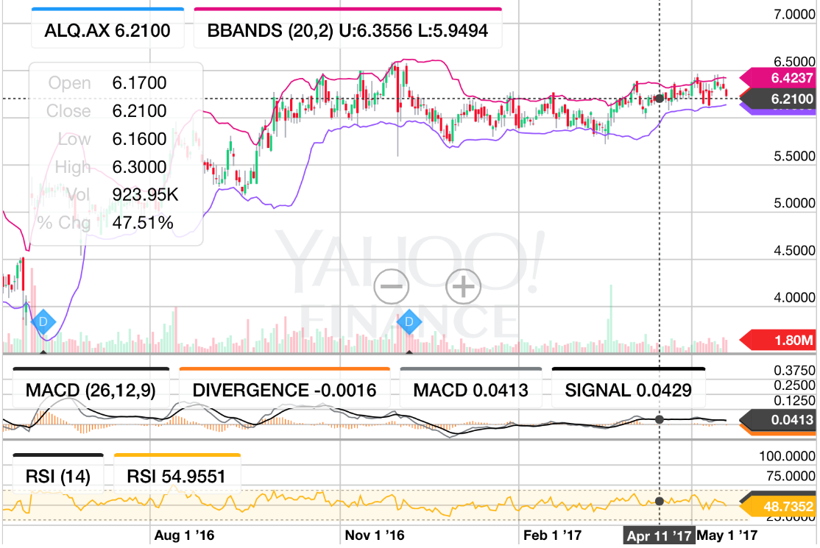
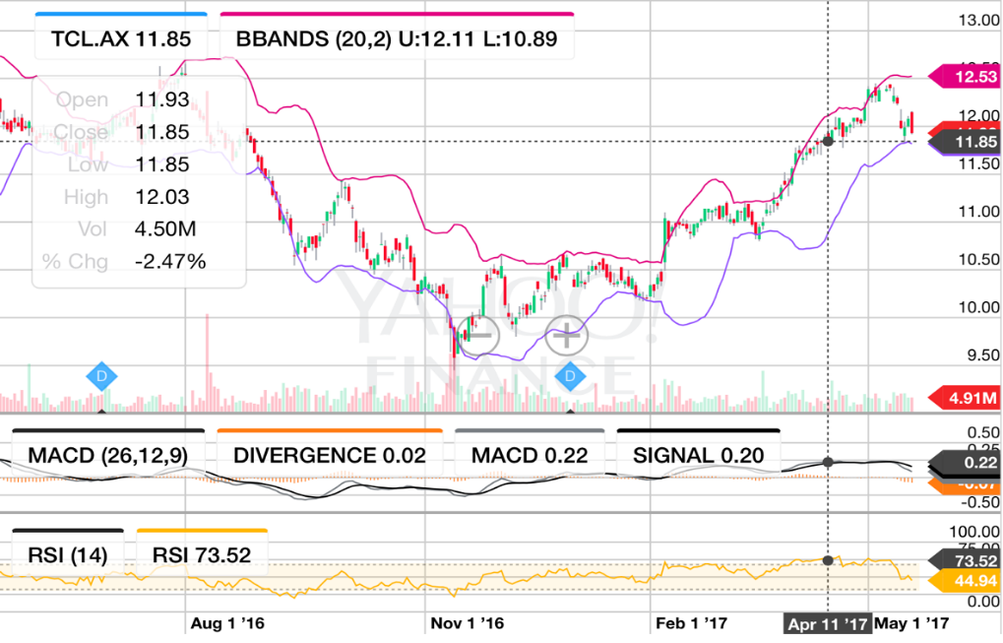
Industrials
Sector | Stock | Buying |  |  |  | Selling |  |  |  | Fees | Final Value |  | WO/ BF |  | W/ BF
 |  | Price | Volume | Value |  | Price | Volume | Value |  |  |  |  | Change ($) | Change (%) | Change ($) | Change (%)
Industrial | TCL | $11.84 | 374 | $4,428.16 |  | $12.32 | 374 | $4,607.68 |  | 20 | $4,587.68 |  | $179.52 | 4.054% | $159.52 | 3.602%
 | ALQ | $6.18 | 479 | $2,960.22 |  | $6.27 | 479 | $3,003.33 |  | 20 | $2,983.33 |  | $43.11 | 1.456% | $23.11 | 0.781%
Total |  | 14.9975 | 458 | $7,388.38 |  | 15.11 | 458 | $7,611.01 |  | 40 | $7,571.01 |  | $222.63 | 3.013% | $182.63 | 2.472%
Total Invested | $7,388.38
Brokerage Fees | $40.00
Value Before Fees | $7,611.01
Profit before Fees | $222.63
Value After Fees | $7,571.01
Profit After fees | $182.63
Industry | Result | ASX industry | ASX Total
Industrials | 2.472% | 4.98% | -11.75%
Porfolio | -0.025%

Slide 6
Materials
Sector | Stock | Buying |  |  |  | Selling |  |  |  | Fees | Final Value |  | WO/ BF |  | W/ BF
 |  | Price | Volume | Value |  | Price | Volume | Value |  |  |  |  | Change ($) | Change (%) | Change ($) | Change (%)
Materials | AMC | $15.11 | 243 | $3,671.73 |  | $15.50 | 123 | $1,906.50 |  | 40 | $1,866.50
 |  |  |  |  |  | $15.90 | 120 | $1,908.00 |  | 20 | $1,888.00
 |  |  |  |  |  |  | Total | $3,814.50 |  | Total | $3,754.50 |  | $142.77 | 3.888% | $3,754.50 | 2.254%
 | BSL | $12.39 | 303 | $3,754.17 |  | $12.00 | 150 | $1,800.00 |  | 40 | $1,760.00
 |  |  |  |  |  | $11.60 | 153 | $1,774.80 |  | 40 | $1,734.80
 |  |  |  |  |  |  | Total | $3,574.80 |  | Total | $3,494.80 |  | $3,574.80 | -4.778% | $3,494.80 | -6.909%
Total |  |  |  | $7,425.90 |  |  |  | $7,389.30 |  | 140 | $7,249.30 |  | -$36.60 | -0.493% | -$176.60 | -2.378%
Total Invested | $7,425.90
Brokerage Fees | $140.00
Value Before Fees | $7,389.30
Profit before Fees | -$36.60
Value After Fees | $7,249.30
Profit After fees | -$176.60
Industry | Result | ASX industry | ASX Total
Materials | -2.378% | 0.56% | -11.75%
Porfolio | -0.025%

Slide 7
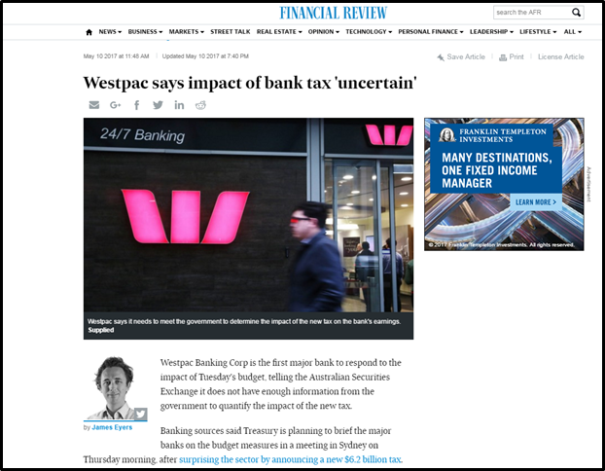
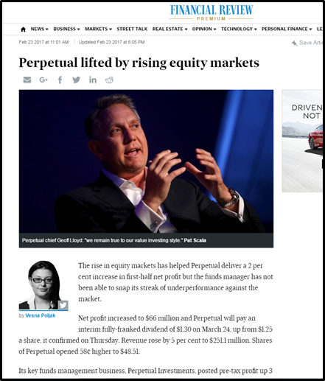

Financials
Sector | Stock | Buying |  |  |  | Selling
 |  | Price | Volume | Value |  | Price | Volume | Value
Finance | WBC | $34.51 | 116 | $4,003.16 |  | $32.20 | 116 | $3,735.20
 | PPT | $53.00 | 75 | $3,975.00 |  | $55.04 | 75 | $4,128.00
 | MFG | $25.15 | 300 | $7,545.00 |  | $25.40 | 300 | $7,620.00
Total |  |  |  | $15,523.16 |  |  |  | $15,483.20
Sector | Stock
Finance | WBC
 | PPT
 | MFG
Total
Total Fees | Final Value |  | Without Fees |  | With Fees
 |  |  | Change ($) | Change (%) | Change ($) | Change (%)
40 | $3,695.20 |  | -$267.96 | -6.694% | -$307.96 | -7.693%
20 | $4,108.00 |  | $153.00 | 3.849% | $133.00 | 3.346%
20 | 7600 |  | $75.00 | 0.994% | $55.00 | 0.729%
80 | $15,403.20 |  | -$39.96 | -0.257% | -$119.96 | -0.773%
Total Invested | $15,523.16
Brokerage Fees | $80.00
Value Before Fees | $15,483.20
Profit before Fees | -$39.96
Value After Fees | $15,403.20
Profit After fees | -$119.96
Industry | Result | ASX industry | ASX Total
Financials | -0.773% | -5.73% | -11.75%
Porfolio | -0.025%

Slide 8
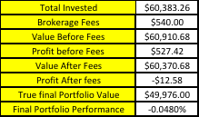
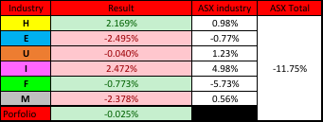
Portfolio Performance
Sharpe Ratio | With RF Rate | Without RF Rate
Performance | 0.017 | -0.202

