Slide 1
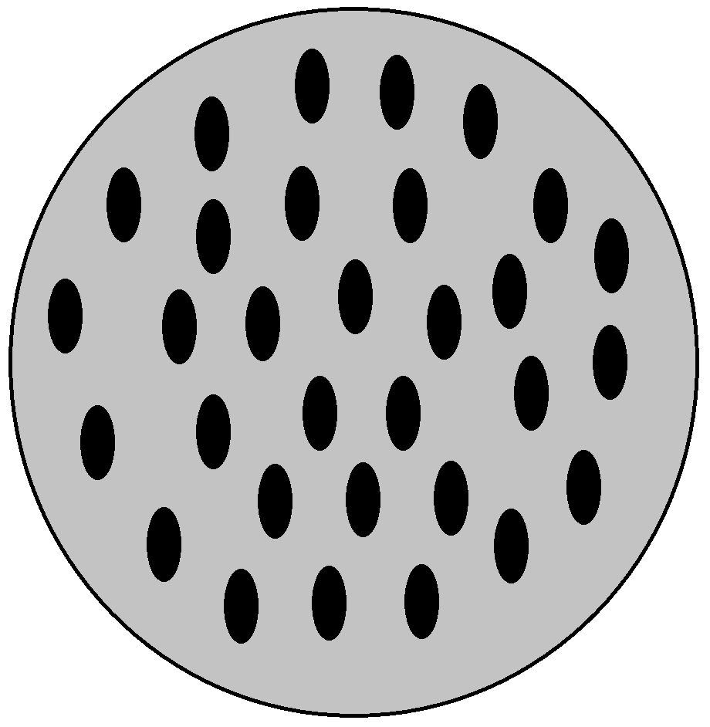
Stochastic PU Jet
Contaminated HS Jet
Stochastic PU Jet
HS Vertex
PU Vertices
Proton Bunch
Proton Bunch

Slide 2
