Slide 1
A Component-Level Analysis of UI Contrast Accessibility under Simulated Colour Vision Deficiency (CVD) Conditions
Luke Vassallo · 6.3A · Research Design

Slide 2
RESEARCH FOUNDATION
Hypothesis & Research Aim
Hypothesis
Research Questions
Simulated CVD conditions will reveal measurable contrast differences across UI component categories.
Do UI components meet WCAG contrast thresholds under CVD simulation?
Research Aim
Does contrast performance vary significantly across component categories?
Evaluate contrast performance at the component level under simulated CVD conditions.
Which UI component categories are most vulnerable to contrast degradation?

Slide 3
RESEARCH DESIGN
Research Approach
Philosophical Stance
Reasoning
Pragmatism — focused on practical, observable outcomes
Deductive approach — hypothesis-driven testing
Method
Design
Quantitative, mono-method — contrast ratio measurement
Cross-sectional study — single time-point evaluation

Slide 4
LITERATURE CONTEXT
Existing Metrics & Research Gap
Established Approaches
This Study's Contribution
Vaughan & Ortiz (2026)
WCAG contrast ratio (CR)
Pass/fail thresholds (4.5:1, 3:1)
Page-level pass rates and failure percentages
Jamil et al. (2024)
CVD simulation models (DaltonLens)
Sajek et al. (2025)
CIELAB / $\Delta E$ (perceptual colour difference)
Measures colour variation, not accessibility compliance
Alsaeedi (2020)
WAA, CER (page-level accessibility metrics)
Aggregated evaluation scores
WCAG Contrast Ratio (CR)
Pass/fail thresholds per component (4.5:1, 3:1)
Component-Level Evaluation
Failure Rate (FR), Contrast Loss (CL)
Identified Limitations
Component Vulnerability Score (CVS)
Page-level metrics hide component-level issues
Perceptual metrics not aligned with WCAG compliance
Simulaiton used without functional accessibility evaluation
Component Comparison Metric

Slide 5
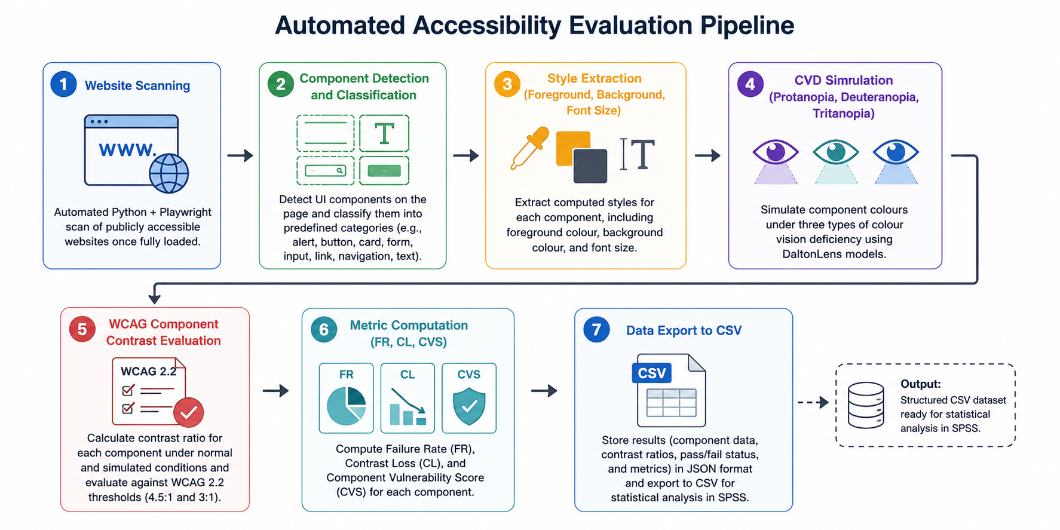
METHODOLOGY
The pipeline processes each website automatically, extracting UI component styles, applying three CVD simulation transforms, and evaluating WCAG 2.1 contrast ratios at the individual component level.

Slide 6

DATASET
Experiment at Scale
22,950
24
UI Components
Websites
Extracted and evaluated
Real-world, diverse domains
10
3
Categories
CVD Conditions
Different UI component types
Protanopia, Deuteranopia, Tritanopia
Component categories include: Alert, Button, Card, Form, Header, Input, Link, Navigation, Text, and Other.

Slide 7
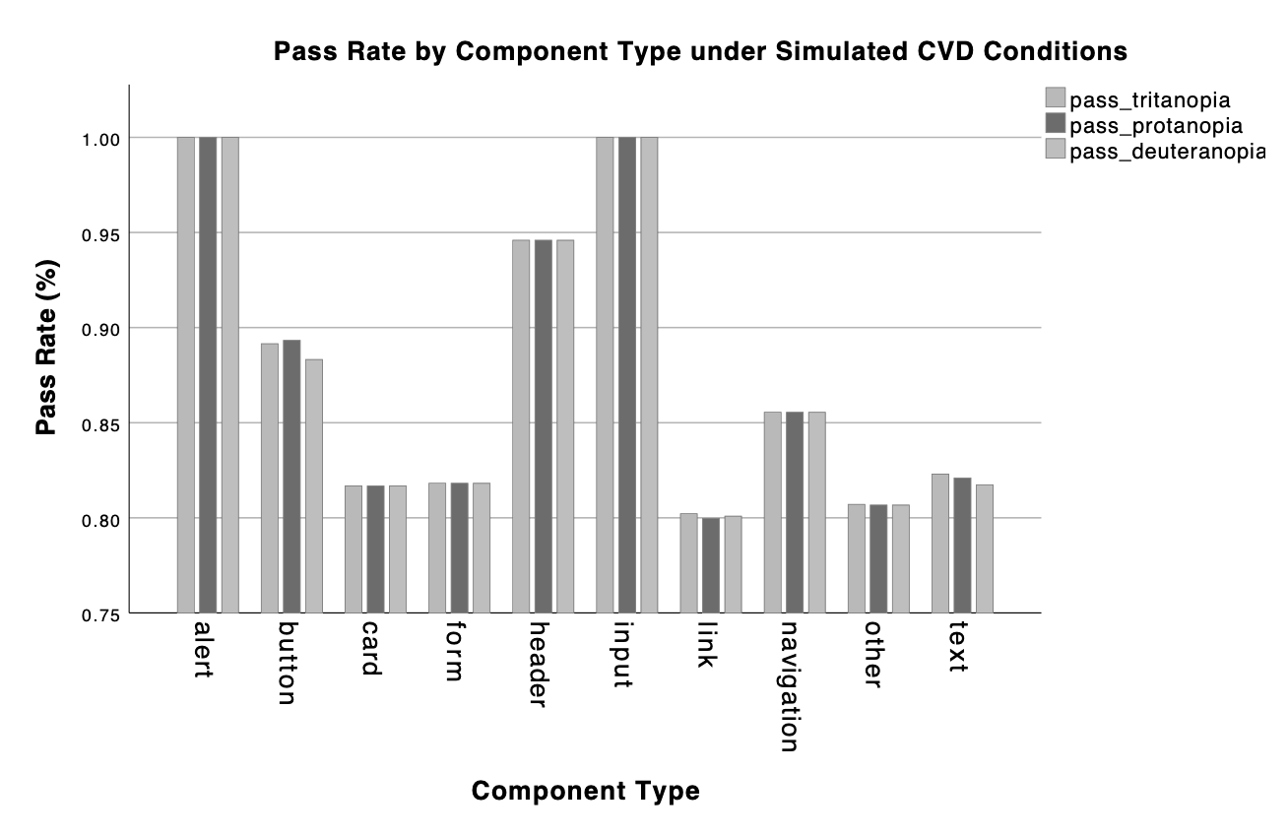
ANALYSIS
Variables & Statistical Methods
Primary Variables
Statistical Methods
01
Contrast Ratio (CR)
Pass / Fail
Descriptive Statistics
Continuous measure per WCAG 2.1
Binary outcome against AA threshold
Mean and standard deviation per category
02
One-Way ANOVA
Comparison between category groups.
03
Tukey HSD Post-Hoc
Pairwise comparisons with error control
04
Effect Size (η²)
Magnitude of observed differences

Slide 8

RESULTS
Key Findings
85% Pass Rate
Mean CR ≈ 11
Overall compliance across all components and CVD conditions
Well above the WCAG AA threshold of 4.5:1
Minimal CVD Variation
Contrast ratios remained stable across all three simulated conditions
WCAG contrast ratios demonstrated strong resilience under CVD simulation, suggesting luminance-based measurement is largely robust to CVD simulation.

Slide 9
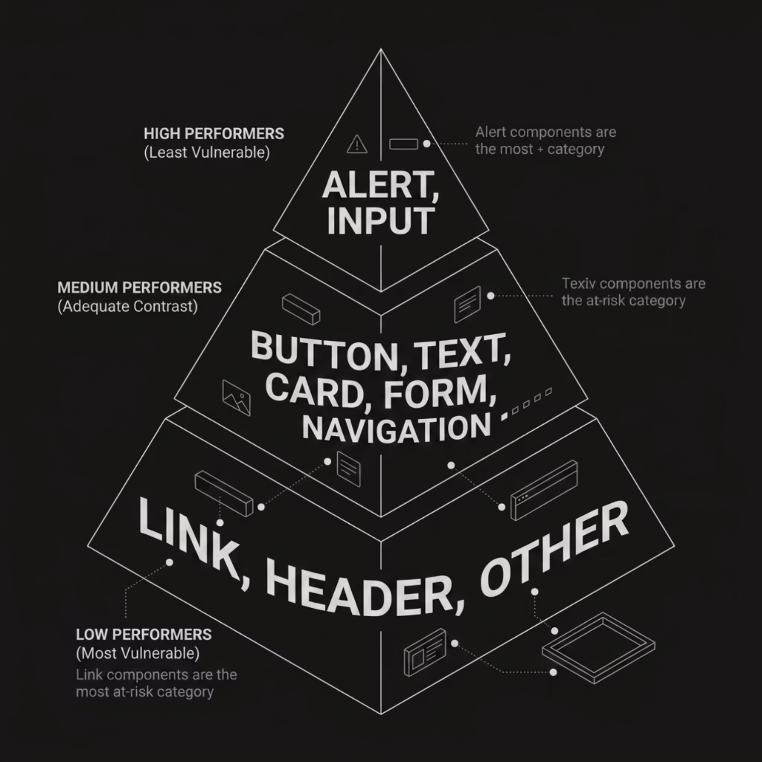

COMPONENT ANALYSIS
Contrast Performance by Component Category
Component Vulnerability Score (CVS)
Link components emerged as the most vulnerable category, consistently recording the lowest contrast ratios across CVD conditions. Headers and 'Other' components also showed elevated risk.
Key Insight
Despite an overall high pass rate, component-level analysis reveals meaningful variation — validating the need for granular evaluation beyond page-level scores.

Slide 10
CLOSING
Conclusions & Future Directions
Conclusions
Limitations
WCAG provides a robust baseline; contrast is largely stable under CVD simulation
Component-level differences persist and are masked by overall scoring
Luminance-only WCAG metric; perceptual colour models not applied
Static UI states only (no hover/focus)
Unequal sample sizes across categories
Link components warrant targeted accessibility intervention
Future Work
Dynamic UI state testing (hover effects)
User studies with CVD participants
Adaptive accessibility tooling
Link Component contrast improvements

