Slide 1

Spotify User Churn Prediction
ECE 1513 - Xing Liu, Lijin Gao, Azure Lin

Slide 2
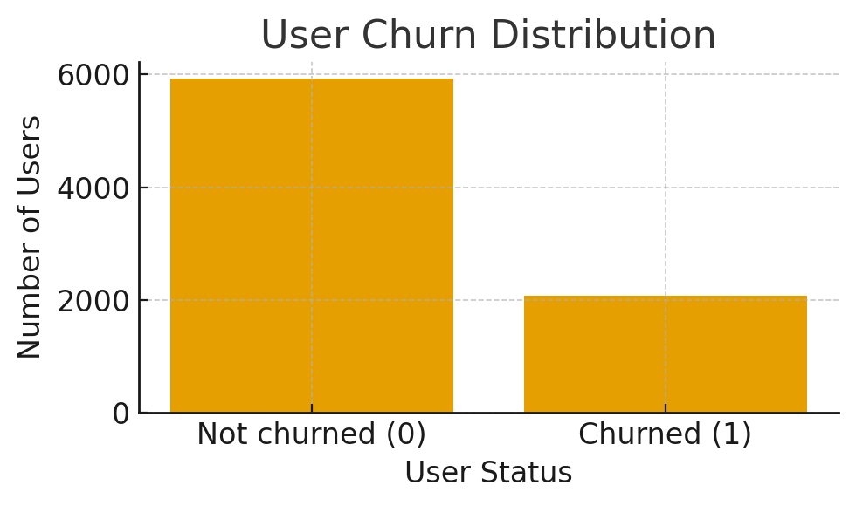
Problem Definition and Core Challenges
Objective
Identify high-risk churn users
Solution
One-hot code categorical features
Use F1 score / Recall for evaluation
Hyperparameter tuning
Challenge
Mix of data types: Numerical / Categorical
Imbalanced Target Variable:

Slide 3

Model Selection and Evolution Process
Principle of Model Selection： Balance between complexity, performance, and interpretability
Tree-based Model:
Neural Network:
Regularized Logistic Regression (Final Model):
Pros:
Clear Visualization
Highly Interpretable
Cons:
Overfitting
Pros:
Track data non-linearity
Cons:
High training cost
Model black box
Pros:
Highly Interpretable
Highest F1 score
Low training cost
Cons:
- Inability of capturing non-linearity

Slide 4
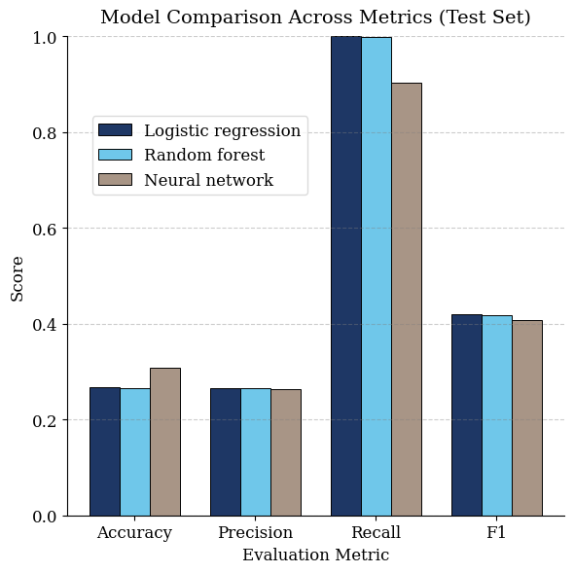
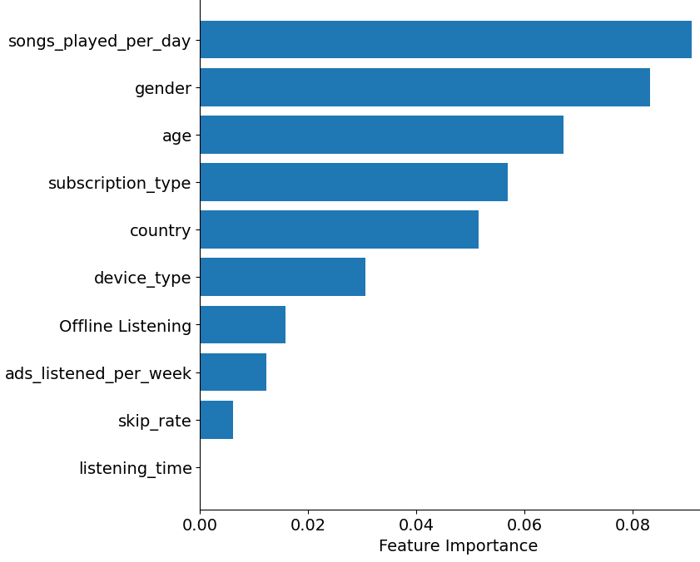
Result and Conclusion
Model Performance
All models achieve similar performance
Logistic regression is the best (F1 = 0.419)
Feature Importance & Business Insight
Top churn drivers: songs played per day, gender, age
Future Improvement: collecting time series features

Slide 5
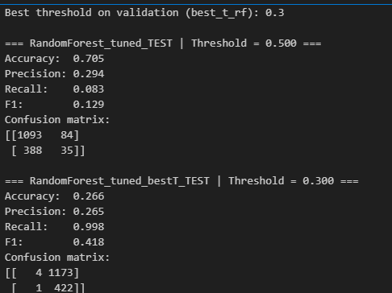
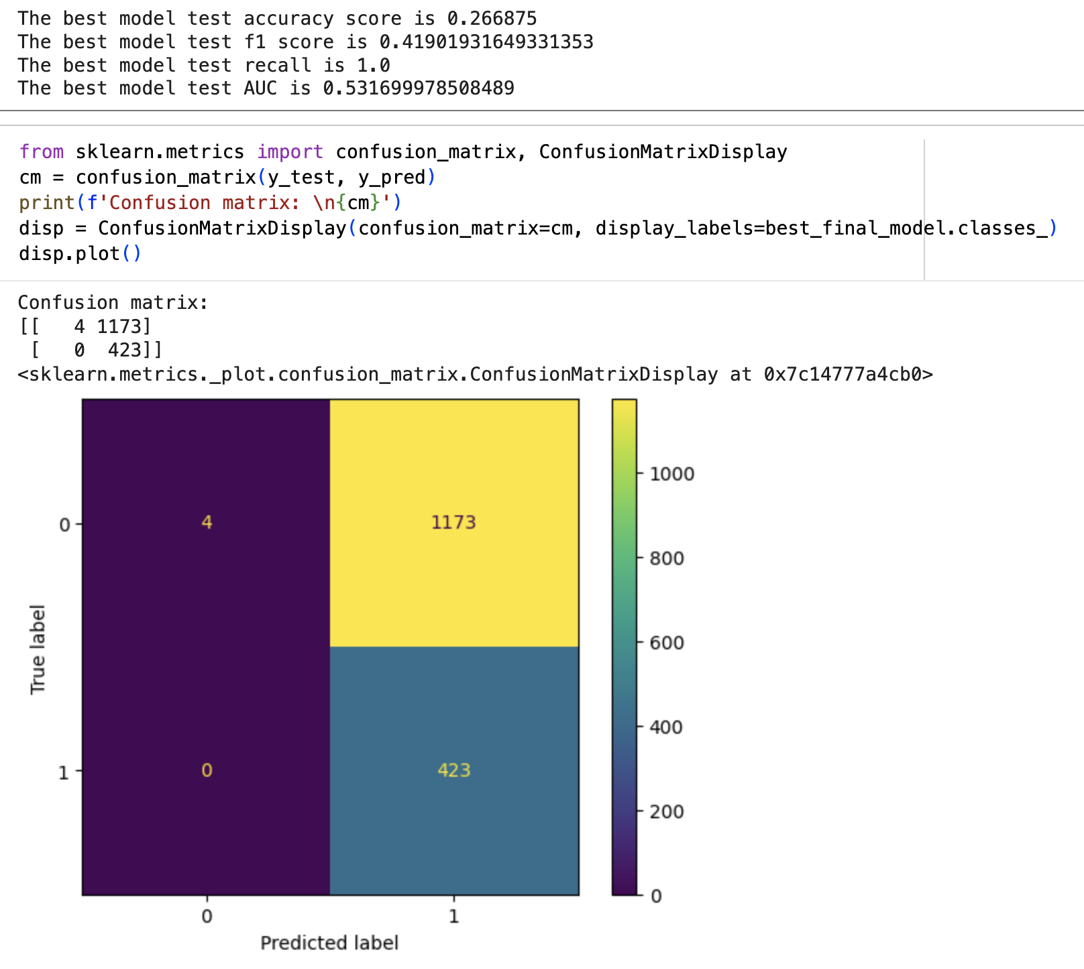
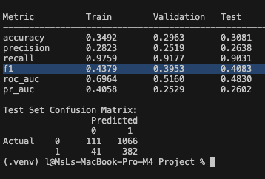
Appendix and reference
Data loaded from: https://www.kaggle.com/datasets/nabihazahid/spotify-dataset-for-churn-analysis/data

