Slide 1
ARI2129 · Computer Vision
Watershed Segmentation.
A topographic method for partitioning images — where pixels become terrain and water carves the boundaries.
AUTHORS LUKE CAMILLERI · JAKE DESIRA · KURT ABELA · TRISTIN BEZZINA · NATHAN VELLA
Notes:
Hi, we're presenting watershed segmentation. We'll go through how that works, do a small worked example, talk about where it breaks, and end with where it's actually used.

Slide 2
Introduction
What is image segmentation?
Splitting an image into regions that mean something — a tumour, a cell, a building, a road. Almost every computer vision task starts with this question: what is where?
DOMAIN · 01
DOMAIN · 02
DOMAIN · 03
Medical imaging
Remote sensing
Industrial · vision
Delineating tumour boundaries in CT and MRI scans, separating cells in histology slides.
Identifying land cover, water bodies, and built environment in satellite imagery.
Particle sizing in fluid flow; instance segmentation for autonomous driving.
02 — Introduction
Notes:
recap on segmentation — it's just splitting an image into meaningful regions. Tumours in a scan, cells in a slide, roads in satellite photos. Everything in CV starts here.

Slide 3
Topographical Metaphor
A greyscale image is a terrain.
Bright pixels = mountains. Dark pixels = valleys.
If it rained on this landscape, where would the water go?
SCHEMATIC
intensity = elevation
↑ water rises
1D cross-section of an image as terrain — simplified.
03 — From image to landscape
Notes:
Stop thinking of the image as numbers in a grid think of it as terrain. Bright = high, dark = low.

Slide 4
Key Definitions
Words you'll hear throughout this talk.
01 / VALLEY FLOOR
02 / DRAINAGE REGION
03 / THE BOUNDARY
Regional minimum
Catchment basin
Watershed line
A flat patch in the landscape where every step you take outward goes uphill — the bottom of a valley.
All the pixels whose water would flow downhill into the same valley. One basin per valley.
The ridge between two valleys — where water could fall either way. Exactly where we want our segmentation boundary.
04 — Vocabulary
Notes:
A regional minimum is just a valley floor everywhere you can step from it goes uphill. A catchment basin is the whole drainage area: all pixels whose water flows into the same valley. And the watershed line is the ridge between two valleys water could fall either way. That ridge is exactly where we want our boundary to land.

Slide 5
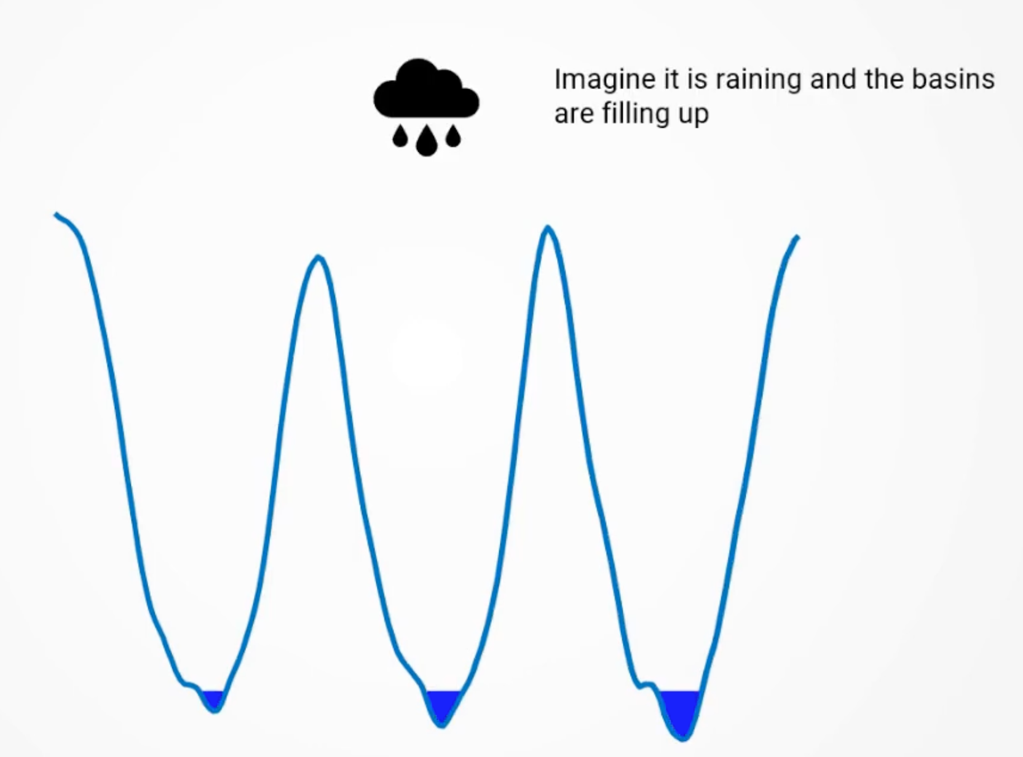
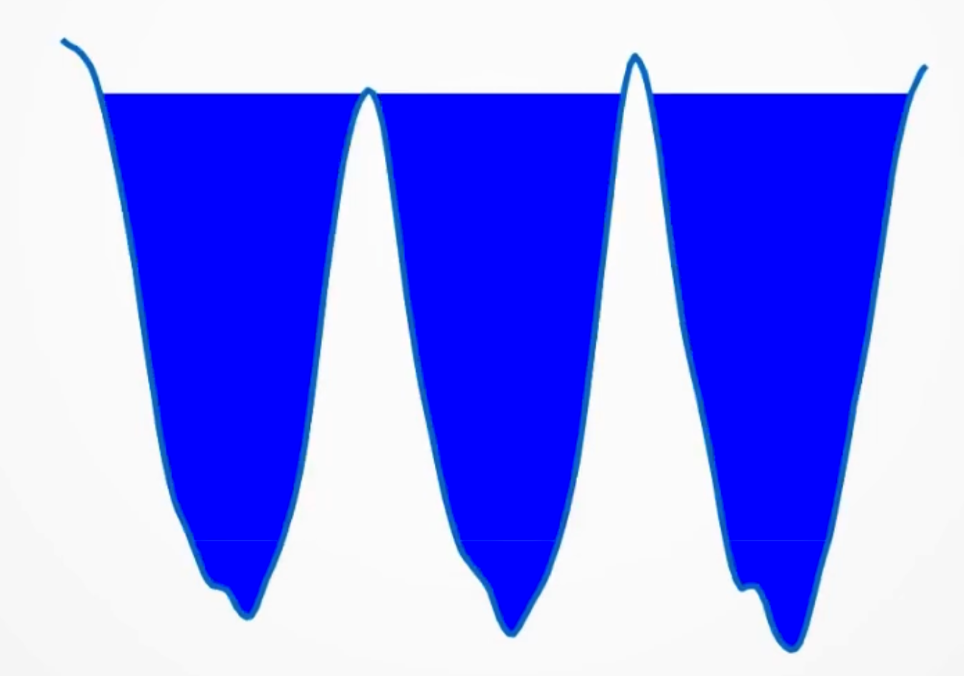
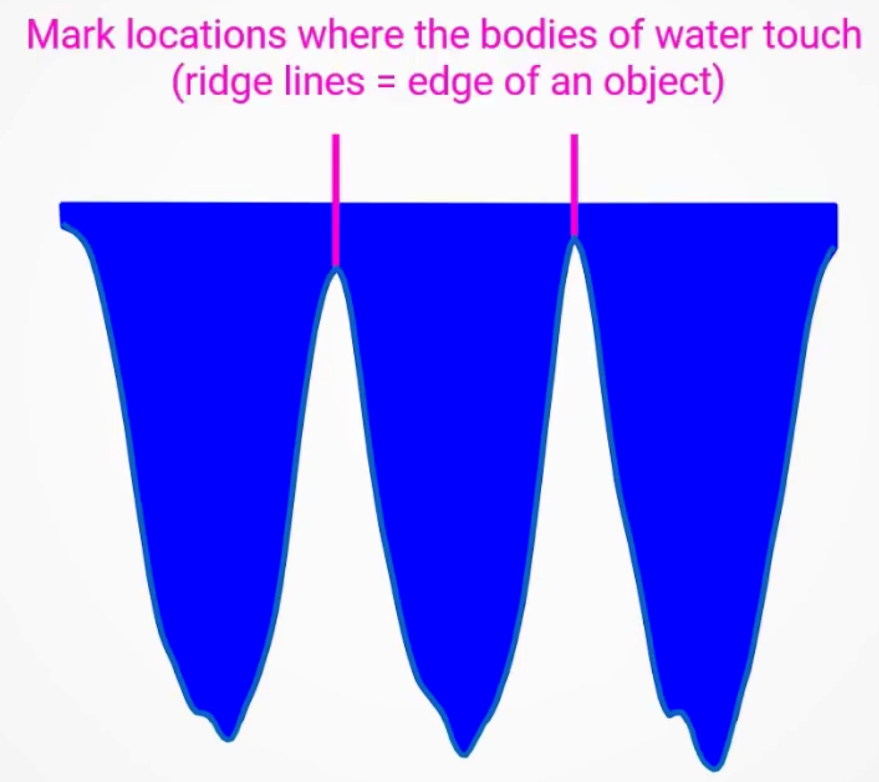
The Flooding Simulation
STEP BY STEP
Submerge the terrain from below.
STAGE 01 · H IS LOW
STAGE 02 · H RISING
STAGE 03 · DAM BUILT
Deepest minima flood first — isolated lakes appear.
Two lakes are about to touch.
Dams are built where neighbouring basins would touch becoming the watershed boundaries
flooded at level h = { every pixel with intensity ≤ h }
Not just a metaphor — this is a constructive definition that maps onto an efficient flooding algorithm.
05 — Flooding
Notes:
Now the actual flooding. Imagine slowly submerging the landscape from below. Water rises uniformly. The deepest valleys fill up first as isolated lakes. As the water keeps rising, those lakes expand. The key moment is when two lakes are about to touch right then we build a one-pixel wall between them. That wall is part of the watershed line. We keep going until everything is underwater, and the walls are the segmentation.

Slide 6
Why Gradient?
THE OBVIOUS APPROACH FAILS
Watershed on the image directly? Almost never.
F · RAW INTENSITY
G(F) · GRADIENT MAGNITUDE
Run watershed on f
Run watershed on g(f)
darkest pixel
edges = peaks of g(f)
Basins seed inside the object (darkest pixel) — boundaries land in the wrong place.
Basins seed in flat interiors; ridges fall exactly on the edges.
06 — Why we don't use raw intensity
Notes:
So why not just throw watershed at the raw image? Sounds reasonable, right? Problem: objects in real images aren't defined by their darkest pixel, they're defined by their edges. A dark cell on a bright background has its darkest pixel deep inside the cell — nowhere near the actual boundary. So watershed on the raw image puts the lines in the wrong place. The fix is from Beucher and Meyer, 1993. Don't run watershed on the image; run it on the gradient of the image. The gradient is high at edges and low in flat regions, so now basins seed inside objects, and ridges land right on edges.

Slide 7
The Morphological Gradient
WHAT WE RUN WATERSHED ON
The morphological gradient.
g(f) = (f ⊕ B) − (f ⊖ B)
DILATION
EROSION
THEIR DIFFERENCE
(f ⊕ B)(x) = max{ f(y) : y ∈ Bₓ }
(f ⊖ B)(x) = min{ f(y) : y ∈ Bₓ }
Local intensity spread
Maximum intensity in the local neighbourhood B around x.
Minimum intensity in that same neighbourhood.
Zero on flat regions. Large wherever intensity changes rapidly — i.e. at edges.
B is a small structuring element (typically 3×3). Smaller B → finer edges; larger B → coarser boundaries. It is a scale knob.
07 — Morphological gradient
Notes:
Quick formula. The morphological gradient is dilation minus erosion. Dilation just means 'take the max in a small neighbourhood'. Erosion means 'take the min in that same neighbourhood'. Their difference measures how much intensity varies locally — zero in flat areas, big at edges. The neighbourhood B is usually 3 by 3. Smaller B catches fine detail, larger B picks up bigger boundaries.

Slide 8
The Flooding Algorithm
THE ALGORITHM · LINEAR-TIME WITH ORDERED QUEUES
Pop pixels low-to-high. Three cases. That's it.
CASE 01
CASE 02
CASE 03
No labelled neighbours yet.
All labelled neighbours belong to the same basin.
Labelled neighbours come from two or more basins.
→ Seed a new basin Bₖ.
→ Assign p to that basin.
→ Mark p as WSHED.
A fresh regional minimum has been found.
The pixel is interior to a region.
The dam between two merging lakes.
Repeat until every pixel is labelled.
Complexity: linear-time in common grey-level implementations (bucket / ordered queues).
08 — Algorithm
Notes:
Now the actual algorithm. We process pixels in order of their gradient value, lowest first. For each pixel we look at its neighbours that already have labels. Three cases. One — no labelled neighbours yet: this is a new minimum, start a new basin. Two — all labelled neighbours are the same basin: easy, the pixel joins that basin. Three — labelled neighbours come from two or more different basins: that's a meeting point, so mark it WSHED. That's the entire algorithm. Quick note on complexity: when you implement this with bucket queues or grey-level queues — like Vincent and Soille's version — the runtime is essentially linear in the number of pixels

Slide 9
Worked Example · Input + Gradient
STEP 1 · COMPUTE G ON A TINY 1D IMAGE
Seven pixels, two dark objects, one bright peak.
INPUT · f
DEFINITION
3
1
2
8
2
1
3
g(pᵢ) = max(window) − min(window)
Window = 3 pixels, mirror padding.
p1
p2
p3
p4
p5
p6
p7
GRADIENT · g(p)
PIXEL
WINDOW
MAX
MIN
G(P)
REGIONAL MIN?
p1
3, 3, 1
3
1
2
Yes
p2
3, 1, 2
3
1
2
Yes
p3
1, 2, 8
8
1
7
—
p4
2, 8, 2
8
2
6
Yes
p5
8, 2, 1
8
1
7
—
p6
2, 1, 3
3
1
2
Yes
p7
1, 3, 3
3
1
2
Yes
g = [ 2, 2, 7, 6, 7, 2, 2 ]
p4 is a minimum in g — gradient measures spread, not height.
09 — Worked example · gradient
Notes:
Let's do a worked example so it sticks. Tiny 1D image: 3, 1, 2, 8, 2, 1, 3. You can read this as two dark objects — the two 1s — with a bright peak of 8 between them. We'd expect two regions with a boundary at the peak. Step one, compute the gradient. We slide a three-pixel window and take max minus min. For p3 the window is 1, 2, 8, so g = 7. For p4 the window is 2, 8, 2, so g = 6. For p1, p2, p6, p7 it's just 2. The full gradient is 2, 2, 7, 6, 7, 2, 2. Look at where the peaks of g land — p3 and p5 — exactly the steep slopes. And the bright peak p4 is actually a local minimum of g, which will matter in a second.

Slide 10
Worked Example · Flood + Result
STEP 2 · FLOOD LOWEST G FIRST
Two basins plus an extra one — over-segmentation in miniature.
STEP
H
PIXEL
DECISION
STATE [P1 … P7]
1
2
p1
No labels → seed B1
[ B1, --, --, --, --, --, -- ]
2
2
p2
Neighbour p1 = B1 → assign B1
[ B1, B1, --, --, --, --, -- ]
3
2
p6
No labels → seed B2
[ B1, B1, --, --, --, B2, -- ]
4
2
p7
Neighbour p6 = B2 → assign B2
[ B1, B1, --, --, --, B2, B2 ]
5
6
p4
No labels → seed B3
[ B1, B1, --, B3, --, B2, B2 ]
6
7
p3
Two basins (B1, B3) → WSHED
[ B1, B1, W, B3, --, B2, B2 ]
7
7
p5
Two basins (B3, B2) → WSHED
[ B1, B1, W, B3, W, B2, B2 ]
RESULT
B1
B1
W
B3
W
B2
B2
p1
p2
p3
p4
p5
p6
p7
Three basins from two objects — that extra basin around the peak is over-segmentation in miniature. We fix it next.
10 — Worked example · flood
Notes:
Now flood. Process pixels in order of g, lowest first. At g = 2 we have four tied: p1, p2, p6, p7. p1 starts B1, p2 joins. p6 starts B2, p7 joins. At g = 6, p4 has no labelled neighbours yet — p3 and p5 are still unprocessed — so p4 starts a third basin, B3. Finally at g = 7, p3 sees B1 and B3 as neighbours, two different basins, so it becomes a watershed pixel. Same for p5. End result: B1 is the left object, B2 is the right object, and B3 is just the peak — an extra region we didn't want. That's a tiny taste of over-segmentation, and it's coming for us in a big way in real images.

Slide 11
Application Bubble Segmentation
SAME IDEA IN 2D · SIMPLIFIED SCHEMATIC
Why g(f) wins on a real image.
WATERSHED ON F · RAW INTENSITY
WATERSHED ON G(F) · GRADIENT
Lines cut through bubble interiors.
Ridges trace bubble contours.
Dark centres seed basins → red dams cut bubbles in half.
Red contours = watershed lines on g(f). Blue dots = basin seeds.
Schematic only — based on the canonical bubble demo from Beucher & Meyer (1993). Not a real micrograph.
11 — Bubble example
Notes:
Same idea but in 2D. The classic demo from Beucher and Meyer is a greyscale image of soap bubbles. We're showing a simplified schematic, not a real micrograph. On the left, watershed on the raw image: the darkest pixel of each bubble is in its centre, so basins seed in the middle and the watershed lines cut right through bubble interiors. Useless. On the right, on the gradient: the gradient is high along the bubble walls, so the walls themselves become the watershed lines, and we get clean outlines of every bubble.

Slide 12
Over-Segmentation
THE CATCH
Every local minimum becomes a region.
WHY
TYPICAL 256×256 IMAGE
In theory, k regional minima give exactly k basins. Clean.
In practice, k is huge. Real images contain thousands of tiny dips in the gradient — from noise, texture, JPEG artefacts — and watershed gives each one its own basin.
10,000+
basins from noise, texture, and JPEG artefacts. The output is unusable.
THE FIX (NEXT SLIDE)
Tell the algorithm where the regions are. We call these hints markers.
12 — Over-segmentation
Notes:
Here's the big practical problem. Theoretically watershed gives you a clean partition, but on real images it's a disaster. Real images have thousands of tiny dips in the gradient — noise, texture, JPEG artefacts — and every dip becomes its own basin. A normal 256 by 256 image can give you over ten thousand regions. Completely unusable. The fix is on the next slide.

Slide 13
Markers
THE FIX
A marker says: “a region is here.”
INTERNAL MARKERS
EXTERNAL MARKERS
MARKER IMPOSITION
Inside each object
On the background
Geodesic reconstruction
One blob per foreground object. Each seeds that object's basin.
Pixels you're sure are not part of any object. Form a single basin that absorbs everything outside.
Modify g so its only minima sit at marker locations. Every other minimum is lifted out of the way.
Regional_Minima(g*) = M_fg ∪ M_bg
13 — Markers
Notes:
The fix is markers. A marker is just a small blob of pixels that says 'a region I care about is here'. Two types. Internal markers go inside the objects you want — one per object. External markers go on the background and form a single basin for everything outside. You can place them by hand, like a radiologist clicking on lesions, or compute them automatically. Either way, you decide how many regions come out, instead of letting noise decide for you. To force watershed to respect the markers, we use geodesic reconstruction to lift every other minimum out of g.

Slide 14
Standard Pipeline
MARKER-CONTROLLED WATERSHED IN 5 STEPS
Putting it all together.
STEP 1
STEP 2
STEP 3
STEP 4
STEP 5
Compute g(f)
Internal markers
External markers
Impose to g*
Watershed on g*
→
→
→
→
Morphological gradient of the input.
One inside each object of interest.
On the background.
Lift spurious minima via geodesic reconstruction.
Clean, marker-controlled segmentation.
Pipeline above is a simplified schematic. Real CT not shown.
14 — Pipeline
Notes:
Once you have markers, modify the gradient itself so its only valleys sit at those marker locations. That's geodesic reconstruction — every other minimum is filled in until it isn't a minimum anymore. Then you run plain watershed on this modified gradient, g-star, and you get exactly the number of regions you marked, plus one for the background. The classic application from Kaur and Jindal in 2011 is lung CT: plain watershed makes a fragmented mess, but with markers it produces a clean outline of the lung. We're showing the pipeline as a schematic, not a real CT scan.

Slide 15
Failure Cases
THREE WAYS IT GOES WRONG
Where watershed breaks.
FAILURE 01
FAILURE 02
FAILURE 03
Over-segmentation
Boundary leakage
Noise sensitivity
Spurious minima from noise or texture each seed a basin. Hundreds of regions where only a few objects exist.
At low-contrast edges, the gradient ridge is too shallow. Floodwater spills — two objects merge into one.
Gradient operators amplify high-frequency noise — small perturbations create new minima everywhere.
15 — Failure modes
Notes:
Three failure modes. One — over-segmentation, which we just covered: noise and texture each seed their own basin, so you can get hundreds of regions where you wanted three. Markers fix this. Two — boundary leakage: when the edge between two objects has low contrast, the gradient ridge between them is too shallow, water spills over, and two objects merge into one. Clinically that's a missed boundary, which means a missed lesion. Three — noise sensitivity: gradient operators amplify high-frequency noise, creating spurious minima everywhere. On the reliability number: our study notes cite Gilani et al. 2025 reporting catastrophic failure rates of 20 to 33 percent for marker-free watershed on skin lesion images. That's a real concern. We're phrasing it cautiously on the slide and we'll re-verify the source before submission.

Slide 16
When Not To Use Alternatives
REACH FOR SOMETHING ELSE WHEN…
Don't use watershed when…
LOW-CONTRAST EDGES
NO RELIABLE MARKERS
HEAVY NOISE / TEXTURE
Gradient ridges are too shallow — boundary leakage merges objects.
Without seeds, you over-segment into thousands of basins.
Gradient amplifies it — spurious minima everywhere.
ALTERNATIVE I · GRAPH CUTS
ALTERNATIVE II · ACTIVE CONTOURS
Global energy minimisation
Snakes / level sets
Smoothness + data term, minimised globally via max-flow / min-cut. Globally optimal where watershed is greedy. Peng & Liu hybrid: 2.44 s → 0.63 s on 256×256.
Deform a curve to minimise an energy functional. Region-based variants need no precise initialisation. Always produces continuous boundary curves.
16 — When not to use
Notes:
When does it actually break in practice? Three signals: low-contrast edges, no way to get reliable markers, or heavy noise and texture. If any of these describe your image, consider an alternative. Graph cuts treat segmentation as a global optimisation problem and solve it with max-flow min-cut. They give a globally optimal solution where watershed is greedy. Peng and Liu have a nice hybrid where watershed pre-segments and graph cut finishes the job, cutting runtime from 2.4 seconds to 0.6 on small images. Active contours start with a curve near the boundary and deform it to minimise an energy function. They always give continuous boundaries, which watershed doesn't always do. Both alternatives are slower than watershed, though — so watershed is still the right choice when conditions are good.

Slide 17
Real-World Applications
WHERE THIS GETS USED TODAY
From CT scans to self-driving cars.
MEDICAL IMAGING
DERMATOLOGY
Lung lobe segmentation from CT
Dermoscopic lesion boundaries
Kaur & Jindal (2011) — marker-controlled watershed for anatomical structure delineation.
Gilani et al. (2025) — applied to skin lesions; also source of the reliability audit on the previous slide.
INDUSTRIAL
AUTONOMOUS DRIVING
Real-time particle sizing
Instance segmentation backbone
adaptive watershed for measurement in dynamic fluid flows.
Bai & Urtasun (2017) — Deep Watershed Transform replaces the hand-crafted gradient with a learned CNN energy map.
17 — Applications
Notes:
Where this gets used today. Medical imaging — Kaur and Jindal use marker-controlled watershed for lung lobe segmentation in CT. Dermatology — Gilani et al. apply it to dermoscopic lesion boundaries, and that's the study that produced the reliability audit we just talked about. Industrial — Niu et al. use an adaptive version for real-time particle sizing in fluid flow. And autonomous driving — Bai and Urtasun in 2017 build an instance segmentation system that uses watershed as the backbone but replaces the hand-crafted gradient with a learned CNN. So even modern deep-learning pipelines still use the watershed framework — they just upgrade the surface it floods.

Slide 18
Quick Reference
IF YOU REMEMBER NOTHING ELSE…
What to take away.
g(f) = (f ⊕ B) − (f ⊖ B)
Apply watershed to g(f), not to f.
KEY IDEAS
COMMON MISCONCEPTIONS
Image as 3D terrain · intensity as elevation.
Flood from below; build dams where lakes meet.
Apply to gradient g(f) — boundaries are edges.
Naive watershed over-segments. Use markers.
Geodesic reconstruction imposes Regional_Minima(g*) = M_fg ∪ M_bg.
Watershed has no concept of objects — it follows gradient structure.
More regions ≠ better segmentation.
Distance transform is not watershed — it is used to compute markers for it.
Bright peaks can be regional minima in g.
Marker-free watershed is not clinically reliable.
18 — End
University of Malta
Notes:
To wrap up: the image is terrain. Flood from below and build dams where lakes meet. Run it on the gradient g(f), not the raw image, so boundaries land at edges. Naive watershed over-segments — use markers to control the number of regions. Watershed has no concept of objects, only gradient structure, so things like bright peaks can be regional minima in g. And marker-free watershed is fast but not clinically reliable. Thanks — happy to take questions.

