Slide 1

Context as Memory: Scene-Consistent Interactive Long Video Generation with Memory Retrieval
SIGGRAPH Asia 2025, arXiv:2506.03141
指導學長：鍾閎凱／吳彥翔
報告人：電機三 賴禹衡／電機三 陳政年

Slide 2
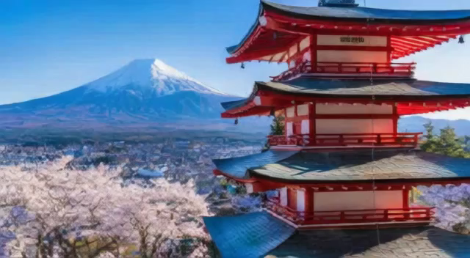
Overview
Goal
Temporal consistency in long video generation
Previous works
Limited context window size with only recent frames as context
Compressing all history frames as context
Constructing extra 3D representations
Methods
Directly add some of the history frame as context frame
Use camera attributes as extra condition and for history selection.

Slide 3
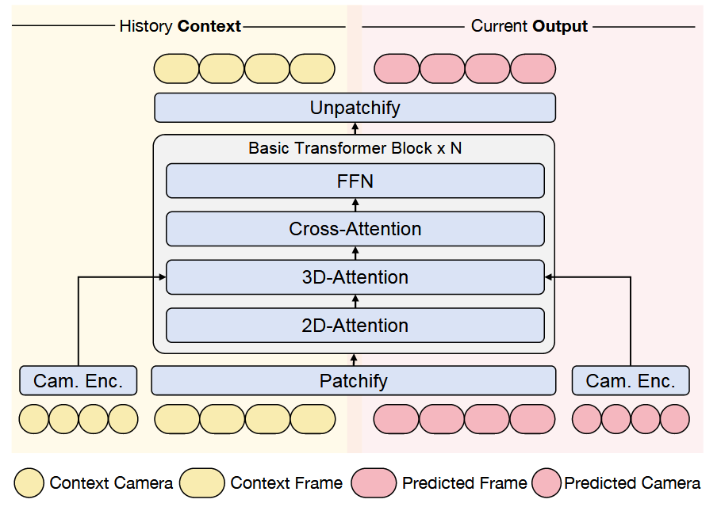
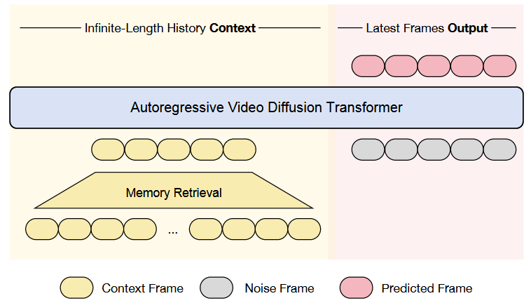
Methods
Camera conditioning
Followed ReCamMaster
Using MLP to inject camera attributes in between 2D and 3D attention by direct addition
History conditioning
Injecting history context through concatenation along the frame dimension

Slide 4
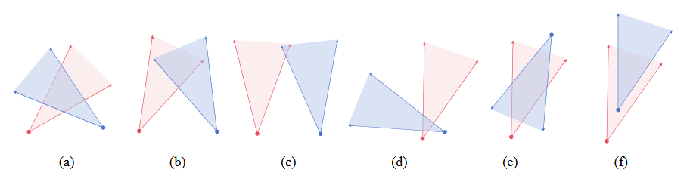
Methods
Camera-trajectory-based memory retrieval
Camera attributes is from user input conditioning
Restrict the camera movement to XY plane, rotation to Z axis
Checking if there is an overlapping region of Fields of View (FOV) from two cameras
Eliminate cases where the cameras are too distant or too near by calculating the distance of predicted frame’s camera and intersection point
If still too much history frames…
Select only one frame from adjacent history frames being selected
Select the frames that are most spatially or temporally apart

Slide 5
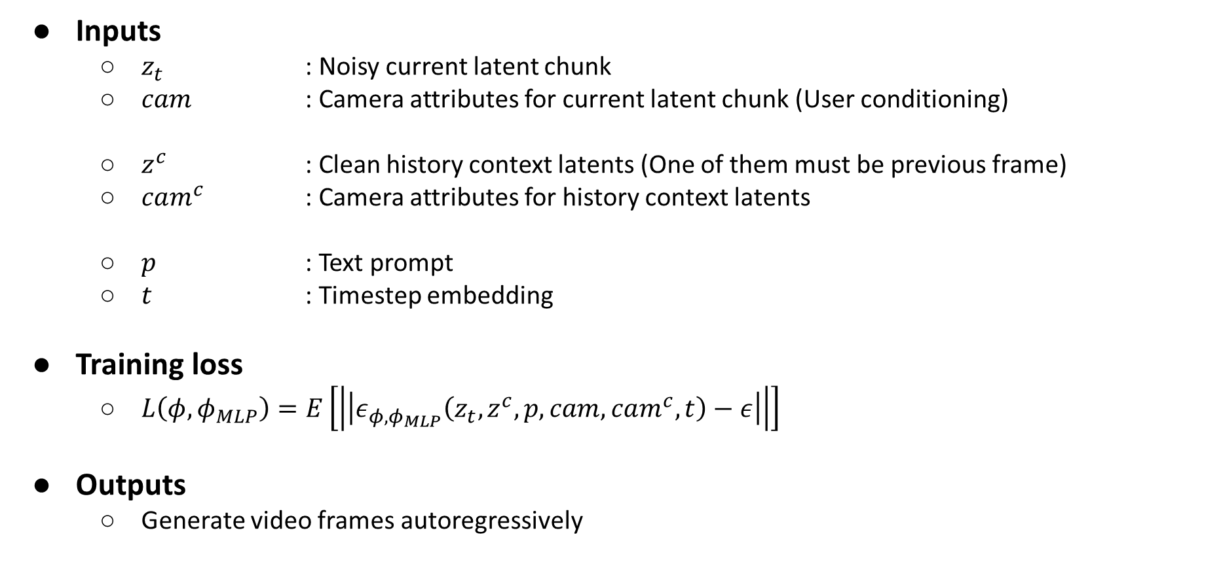
Training and Inferencing
Inputs
$z_{t}$ : Noisy current latent chunk
𝑐𝑎𝑚 : Camera attributes for current latent chunk (User conditioning)
$z^{c}$ : Clean history context latents (One of them must be previous frame)
$cam^{c}$ : Camera attributes for history context latents
𝑝 : Text prompt
𝑡 : Timestep embedding
Training loss
$L\left(φ,φ_{MLP}\right)=E\left[\left|\left|ε_{φ,φ_{MLP}}\left(z_{t},z^{c},p,cam,cam^{c},t\right)−ε\right|\right|\right]$
Outputs
Generate video frames autoregressively

Slide 6
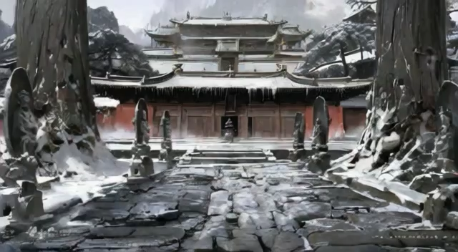
Dataset Collection
Collection & Synthesis
Created dataset using Unreal Engine 5 simulation environment.
Generated randomized camera trajectories navigating through various scenes
Annotation
Captions annotated by a multimodal LLM
Simplification
Limited camera position changes to a 2D plane
Restricted rotation to the z-axis only

Slide 7
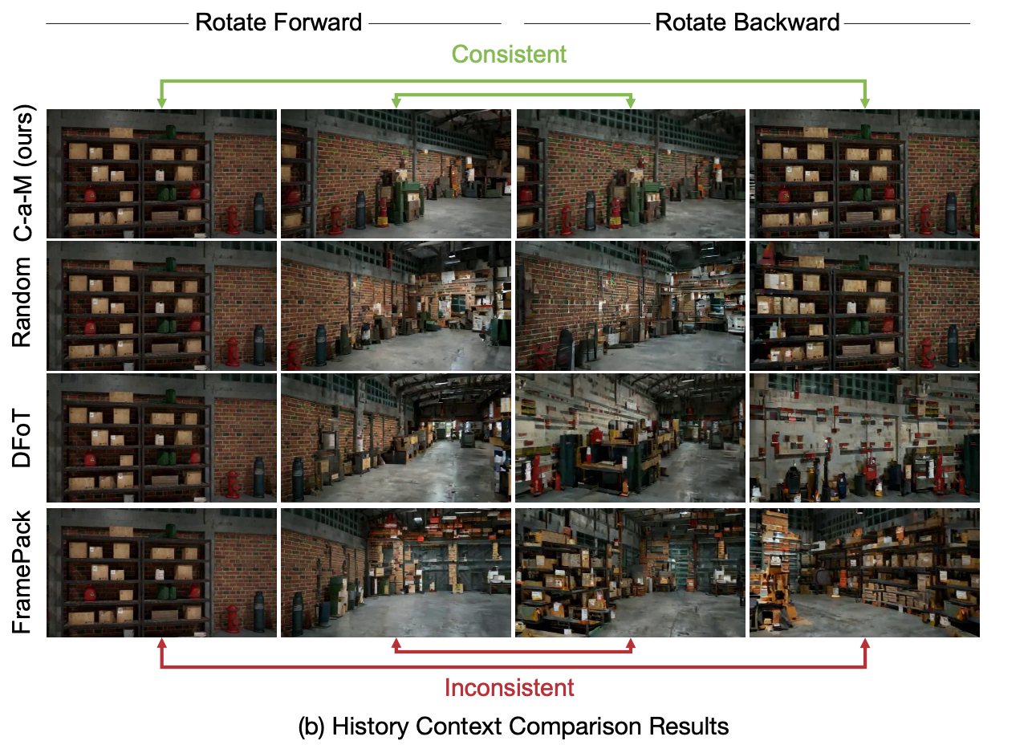
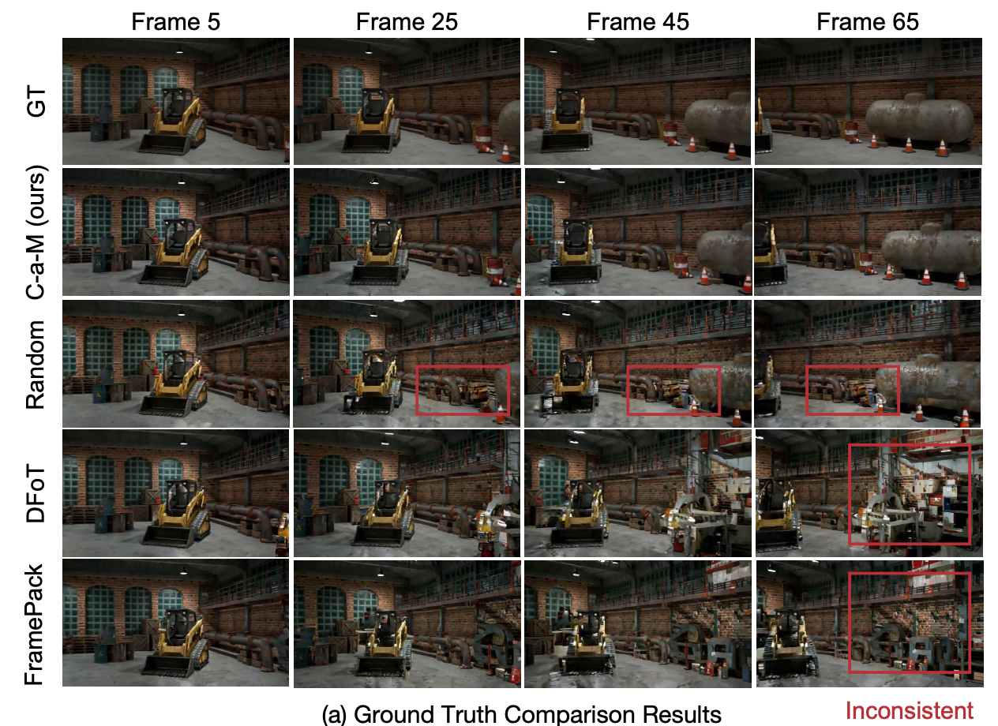
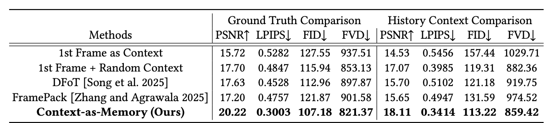
Experiment - Comparing Models
Several ways to retrieve memory
Random: Using the first frame + random historical frames
DFoT: Using a fixed-size window of most recent frames
FramePack: Compress previous context into two frames
C-a-M : Camera-trajectory-based search

Slide 8
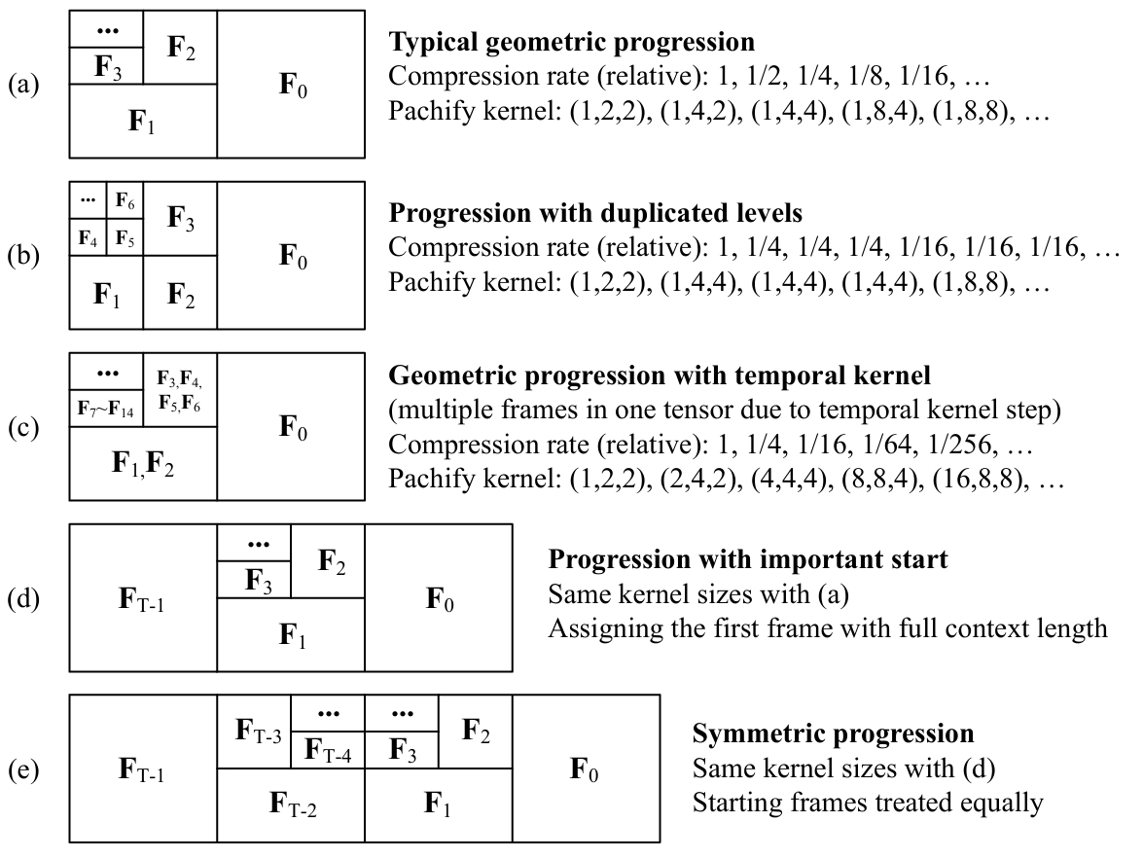
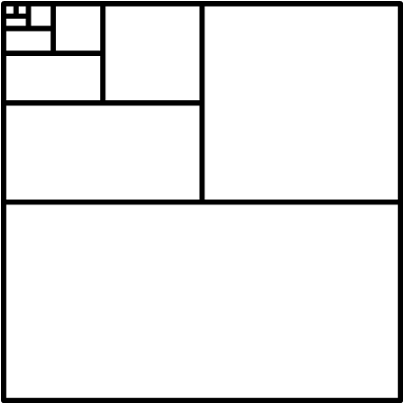
Experiment - Comparing Models
Several ways to retrieve memory
Random: Using the first frame + random historical frames
DFoT: Using a fixed-size window of most recent frames
FramePack: Compress previous context
into two frames

Slide 9
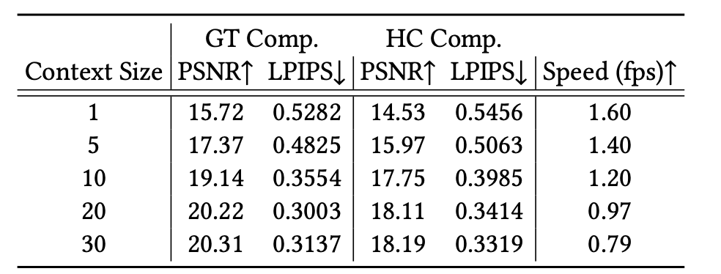
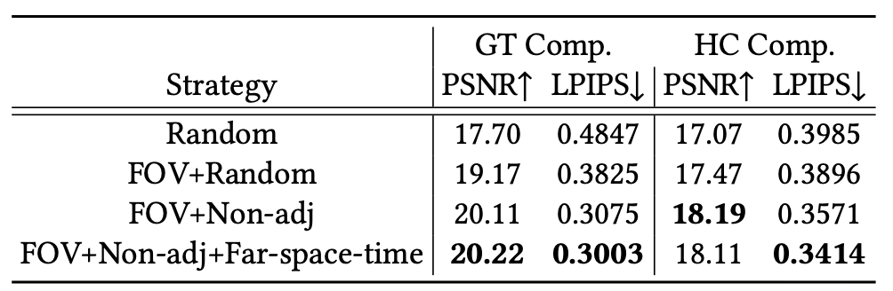
Ablation Study
Context Size
Larger context sizes contain more information and lead to better memory capability
higher computational overhead
Retrieval Strategy
Non-adj : only one frame from a continuous sequence
Far-space-time : frames with more distance in time or space are more likely selected

Slide 10
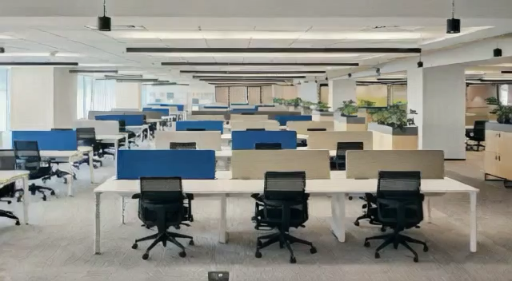
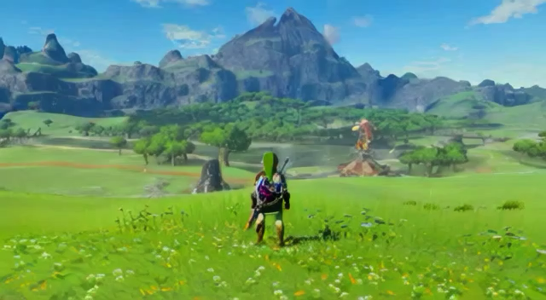
Open Domain Scenarios
Rotate Forward and back

Slide 11
Conclusion
Contributions
Context as Memory
Avoid high computational overhead
Memory Retrieval to select truly valuable context
Limitations
Limited generation capabilities for complex trajectories
Struggle to effectively identify truly relevant context frames in complex scenarios

