Slide 1
GameFactory: Creating New Games with Generative Interactive Videos
ICCV 2025 Highlight, arXiv:2501.08325
指導學長：鍾閎凱／吳彥翔
報告人：電機三 賴禹衡／電機三 陳政年

Slide 2
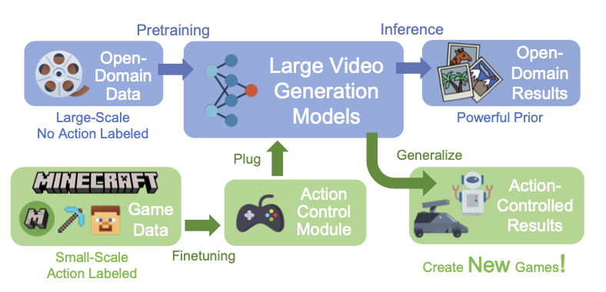
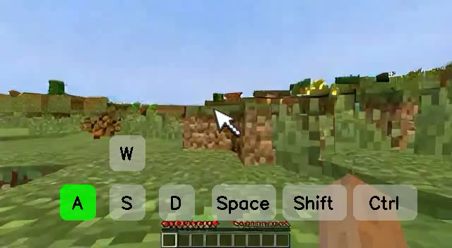
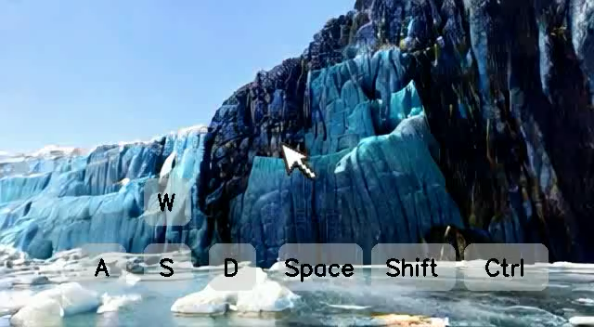
Overview
Goal
A framework for action-controlled and scene-generalizable game video generation
Previous works
Lacks Scene Generalization: generates specific game, limiting the potential for developing new games
Biased Action: collecting real human gameplay action, overlooking rare action combinations, such as moving backward
Methods
Using video generation models trained on open-domain videos
Disentangle the learning of game style and action control

Slide 3
GF-Minecraft Dataset Collection
Collection
Collecting 70 hours of Minecraft gameplay video
Capturing videos across different scenes, weather conditions, and times of day.
Unbiased Action
Rare action combinations, such as moving backward, jumping in place, or standing still with mouse movements
Randomly combined each action (e.g., pressing two keys simultaneously)
Annotation
Captions annotated by a multimodal LLM, MiniCPM-V
Notes:
we uniformly sampled the frequency and dura-
tion of each action and randomly combined them to enhance action generalization (e.g., pressing two keys simultaneously or
combining keyboard and mouse operations).

Slide 4
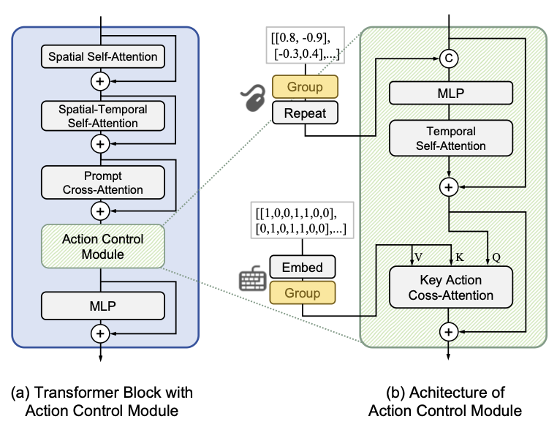
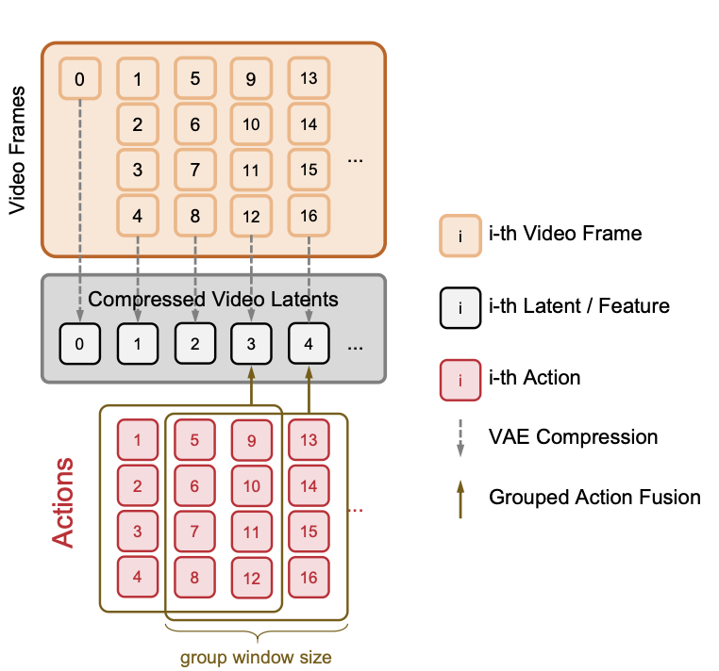
Methods – Action Controlled
Action Control Module
Input action includes both continuous mouse movement and discrete keyboard action
Grouping Actions with a Sliding Windows
Avoid mismatch between action and latent
Captures delayed action effects
Notes:
jump command influences multiple subsequent frames Repeat: make dimension same as latent

Slide 5
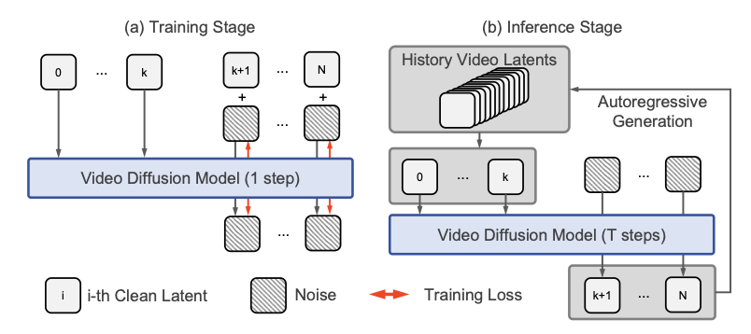
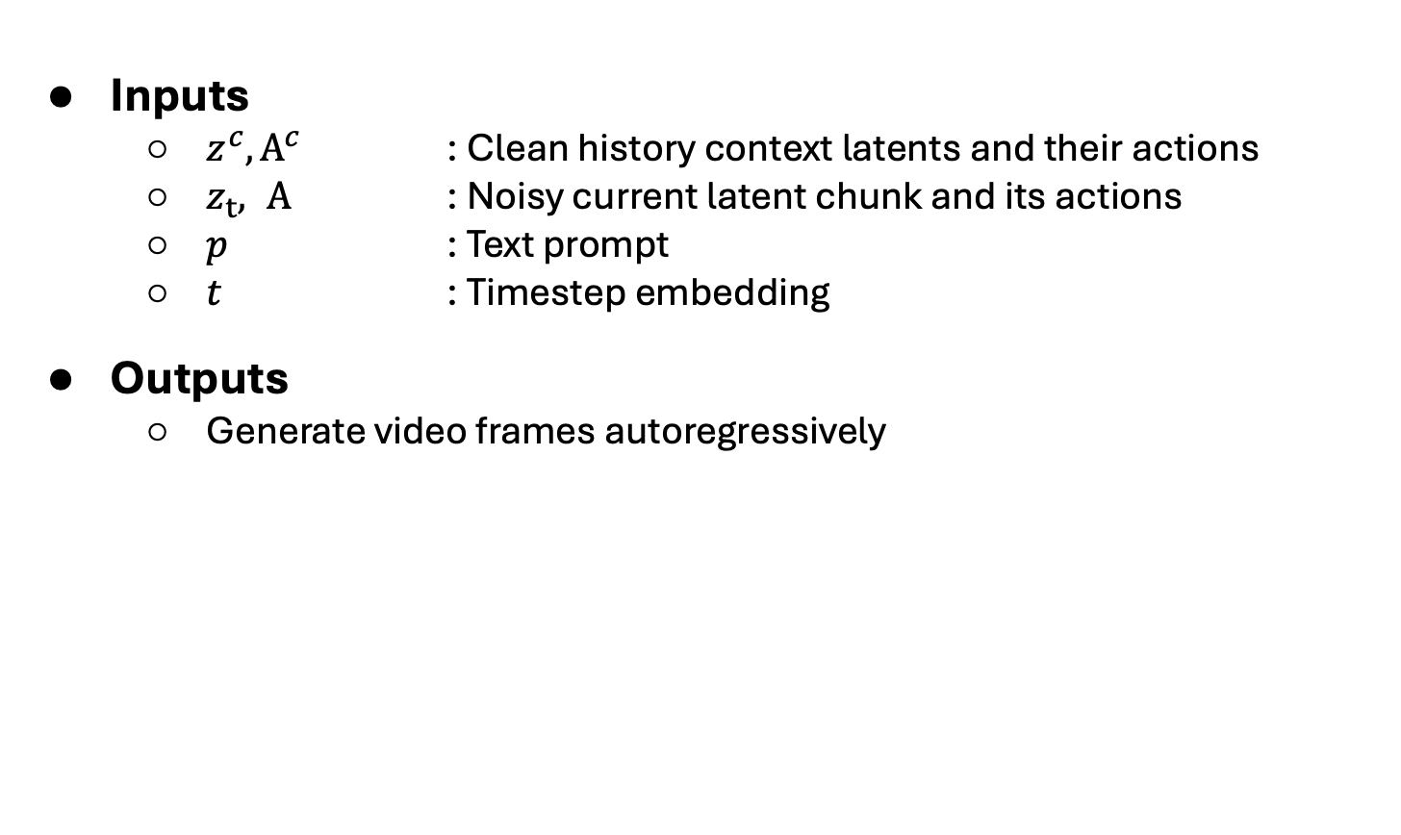
Methods – Autoregressive Generation
Inputs
$z^{c}, A^{c}$ : Clean history context latents and their actions
$z_{t}, A$ : Noisy current latent chunk and its actions
𝑝 : Text prompt
𝑡 : Timestep embedding
Outputs
Generate video frames autoregressively
Notes:
jump command influences multiple subsequent frames Repeat: make dimension same as latent

Slide 6
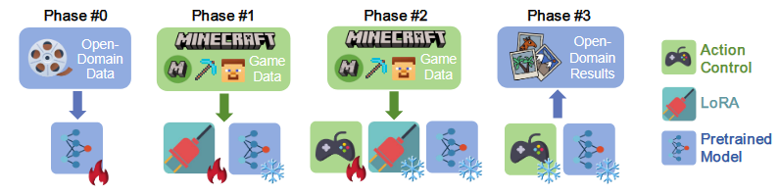
Methods – Multiphase Training
Goal
Finetuning with single-game dataset degrades scene generalizability from pretrained model
Disentangle the learning of game style and action control
Training phases
#0 : Model pretraining
#1 : Tune LoRA as domain adapter to fit game videos
#2 : Tune action control module
#3 : Inference on open domain

Slide 7
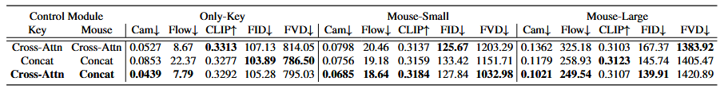
Experiment – Action Controllability
Discrete keyboard inputs
Cross-attention outperforms
Category-based signal benefits from similarity based cross-attention
Continuous mouse movement
Concatenation outperforms
Cross-attention tends to reduce the influence of magnitude

Slide 8
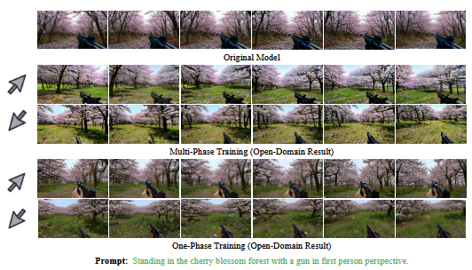
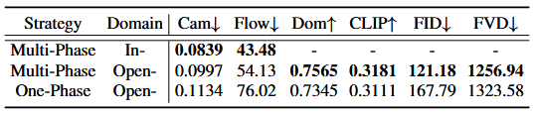
Experiment – Scene Generalization
Action following
Cam, Flow
Multi-phase outperforms
Scene generation
Dom, CLIP, FID, FVD
Multi-phase outperforms

Slide 9

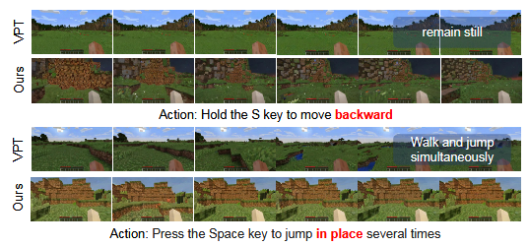

Experiment – GF-Minecraft Dataset
Compare with VPT
VPT dataset is with human player’s bias
GF-Minecraft outperforms

Slide 10
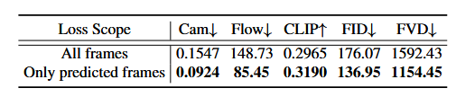
Experiment – Long Video Generation
Compare different scope for computing loss
Computing only predicted frames’ loss outperforms

Slide 11
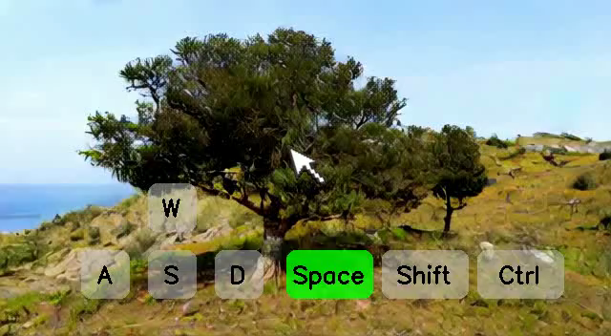
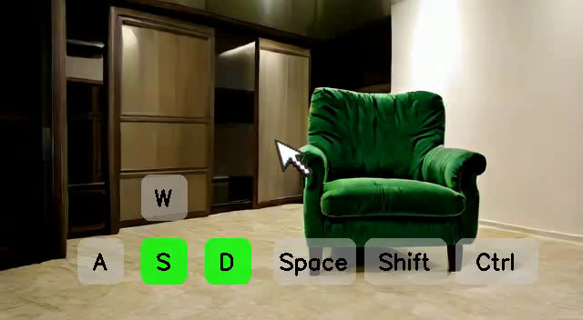
Conclusion
Action-control and scene-generalizable video generation
Domain adapter and multi-phase disentangling training strategy
An unbiased action-annotated game video dataset GF-Minecraft

