Slide 1
DeepVerse: 4D Autoregressive Video Generation as a World Model
arxiv:2506.01103
指導學長：鍾閎凱／吳彥翔
報告人：電機三 賴禹衡／電機三 陳政年

Slide 2
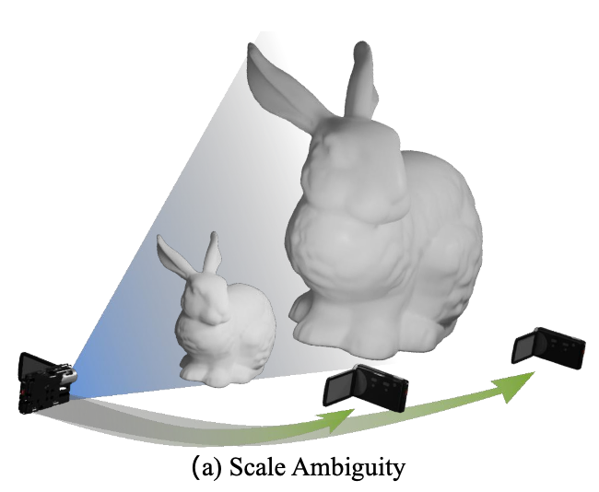
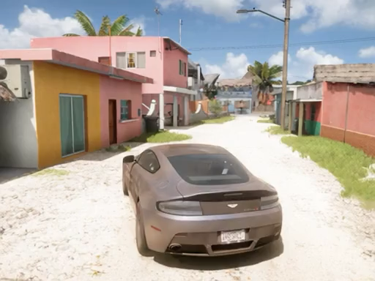
Overview
Goal
Build an autoregressive 4D world model that constructs spatiotemporal geometry
enhance prediction accuracy
reduce drifting
address the forgetting issue over extended temporal horizons.

Slide 3
Overview
Goal
Build an autoregressive 4D world model that constructs spatiotemporal geometry

Slide 4
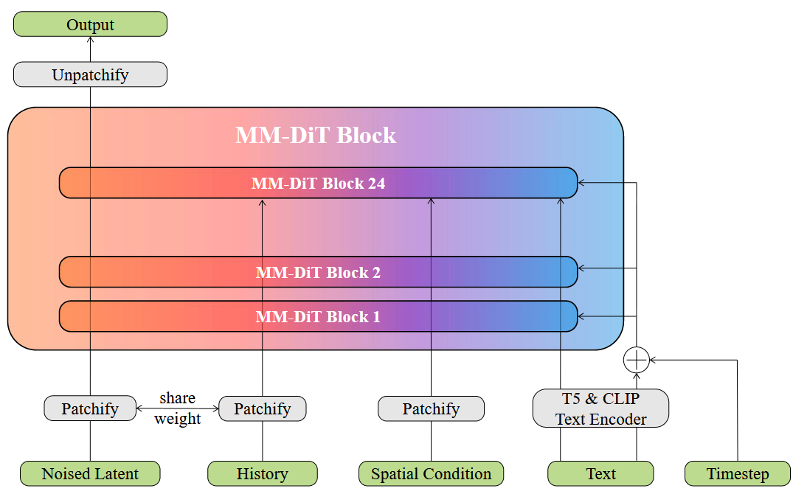
Overview of the architecture
Model architecture

Slide 5
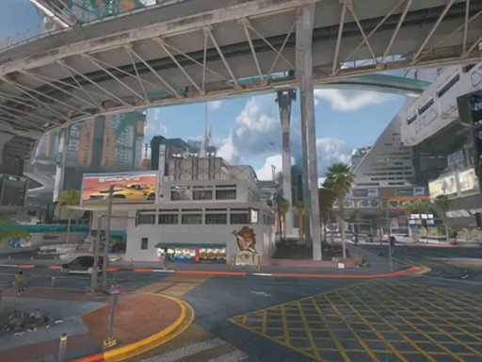
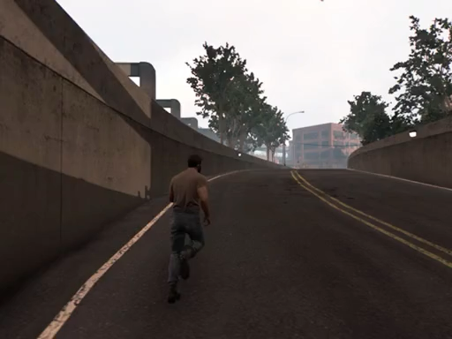
Method
4D Representation
decompose 3D coordinates into depth and viewpoint components (using Aether, ICCV 25)
General Control
Use text as control to keep pre-trained strengths and easily map to new controllers.
Spatial Condition
Retrieve the most spatially relevant historical state and encode it as the spatial condition for prediction.
“The character ran down the road,
moving steadily forward.”
Notes:
from a memory pool (using camera pose and spatial proximity)

Slide 6
Method
4D Representation
decompose 3D coordinates into depth and viewpoint components (using Aether, ICCV 25)
General Control
Use text as control to keep pre-trained strengths and easily map to new controllers.
Spatial Condition
Retrieve the most spatially relevant historical state and encode it as the spatial condition for prediction.
“The character ran down the road,
moving steadily forward.”
Notes:
from a memory pool (using camera pose and spatial proximity)

Slide 7
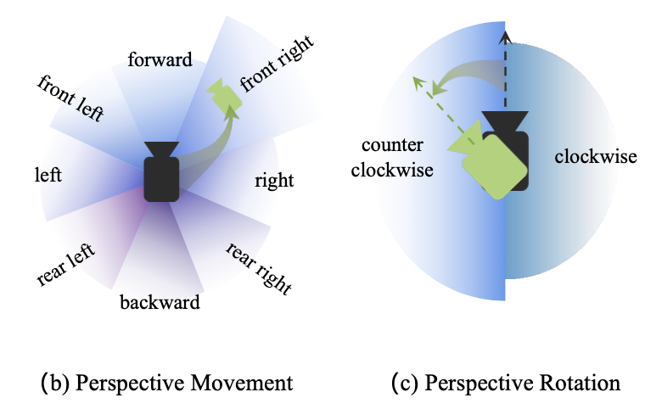
Dataset Construction
Collection & Synthesis
10M gameplay frames
synthetic data with camera parameters, depth maps (using Aether, ICCV 25)
Filtering
Remove clips with excessive rotation/rapid transitions or minimal movement
Annotation
construct textual descriptions directly from camera movements/rotations
Qwen-VL generates first-person descriptions for viewpoint transitions or third-person narratives for character actions and movements

Slide 8


Experiment – Architecture revisit
Final model architecture
Visited
Stays the same as original

Slide 9
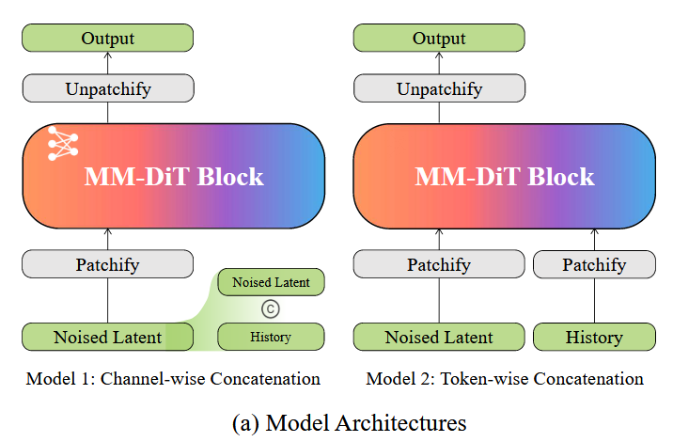
Experiment – two model architecture
Model 1
Concat current latent with history latent -> Patchify the whole temporal sequence -> Input token
Less input tokens, each with coarse-grained temporal feature
Model 2
3D VAE to compress temporal feature -> Patchify each output independently from temporal sequence -> Input token
More input tokens, each with fine-grained temporal feature

Slide 10
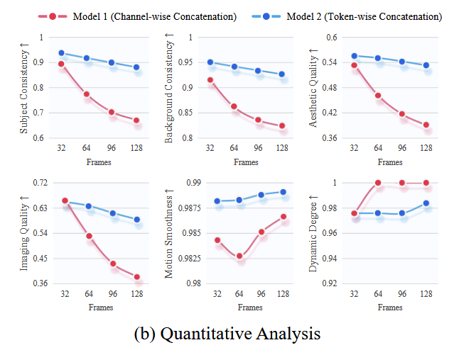
Experiment – comparing two models
VBench results
Token-wise model (model 2) outperforms
Channel-wise model (model 1) exacerbates error accumulation, particularly under extended scenarios

Slide 11
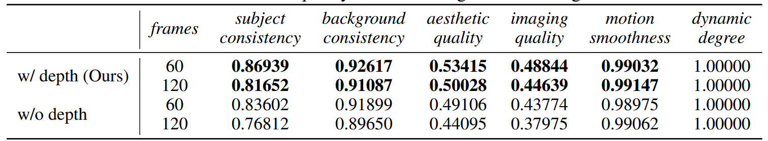
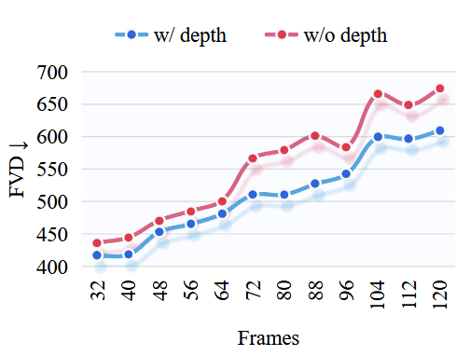
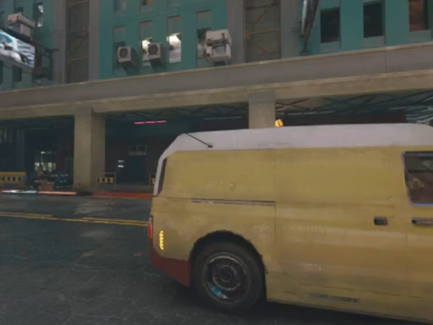

Experiment – ablation on depth
FVD, Vbench, and visual results
Model with depth outperforms, alleviating the drift phenomenon
With depth
Without depth

Slide 12
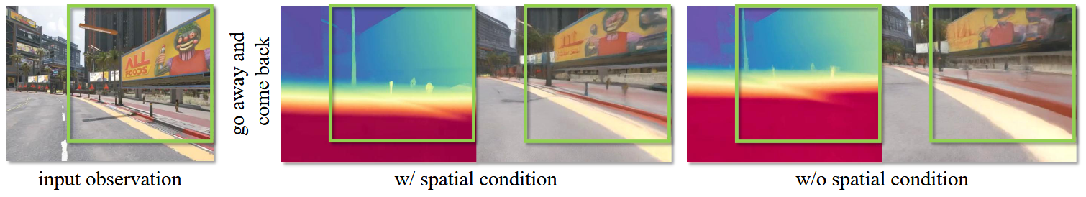
Experiment – ablation on spatial conditioning
Visual results
Model with spatial conditioning outperforms

Slide 13
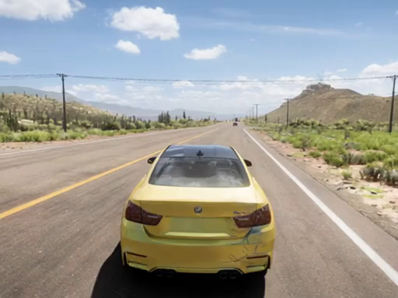
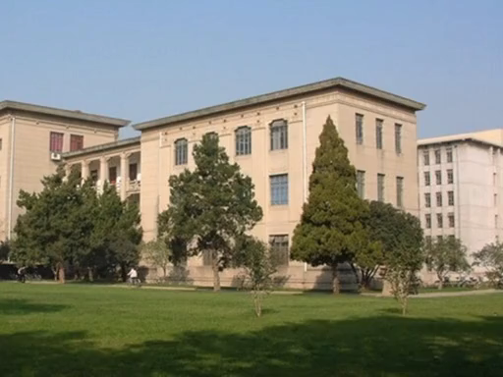
Conclusion
Contributions
4D world modeling (Depth, Raymap as state input)
Geometry retrieval mechanism
Token-wise concatenation model
Limitation
Trained on synthetic data, generalization capability to real-world scenarios remains limited

Slide 14
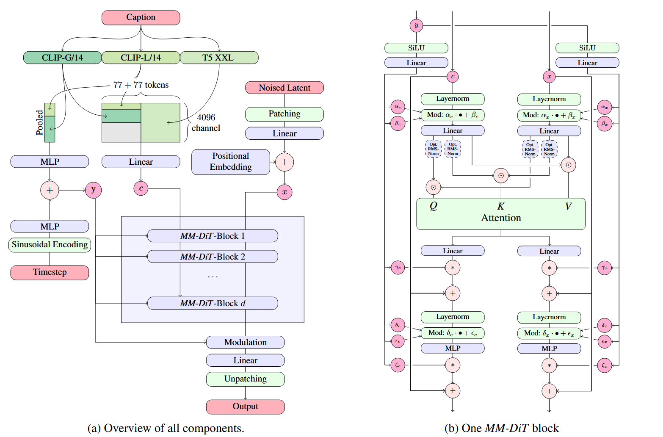
Appendix – MM-DiT
Model architecture

