Slide 1
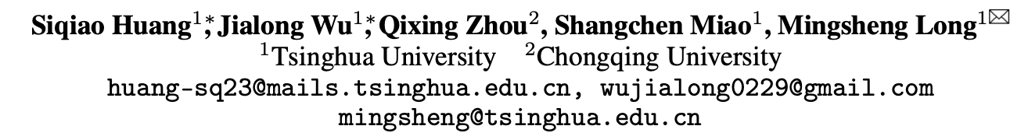
Vid2World: Crafting Video Diffusion Models to Interactive World Models
arxiv:2505.14357

Slide 2
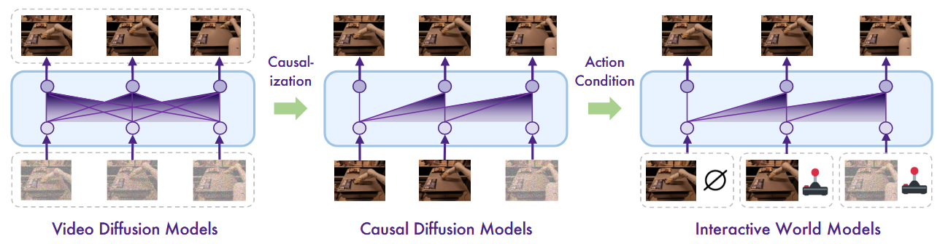
Overview
Inability of causal generation
Lack of action conditioning

Slide 3
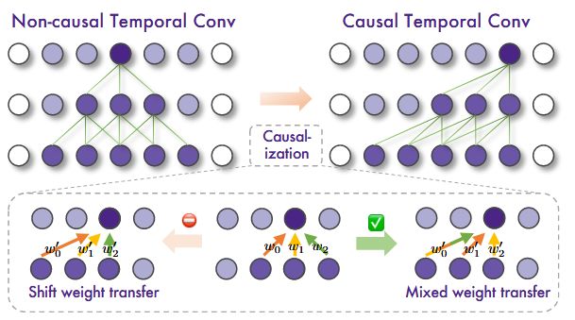
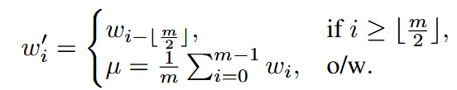
Video Diffusion Causalization
Temporal Convolution Layers
Mixed weight transfer

Slide 4
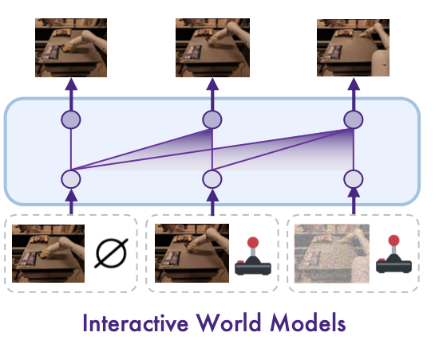
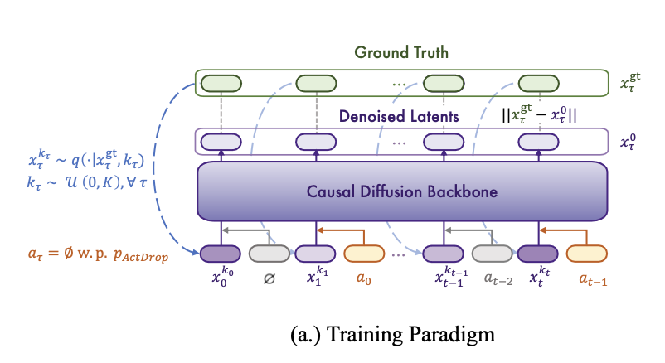


Causal Action Guidance - training
Vid2world
When predicting the t-th frame $o_{t}$, the embedding of $a_{t−1}$ as action is added to the model’s representation at temporal position
Adding dropout encourages the model to learn the score functions conditioned on all possible subsets of the action sequences.
Notes:
每一幀的動作嵌入：每個幀根據其對應的動作生成，使模型能夠根據當前的動作來影響下一幀的生成過程。
動作隨機丟失 (Action Dropout)：在訓練過程中，隨機丟棄某些幀的動作，使得模型在訓練過程中學會處理有動作與無動作的情境。

Slide 5
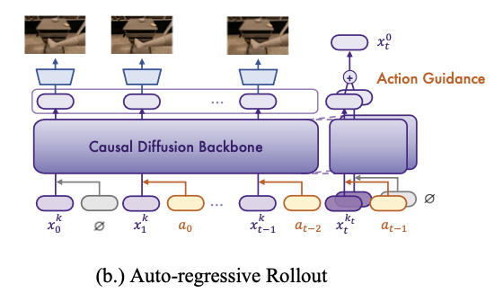
Causal Action Guidance - sampling
Vid2world
To add flexibility to the level of control in the generated frames, extend classifier-free guidance to action-conditioned generation in auto-regressive setting
At inference time, guide the model’s generation to help the model support counterfactual reasoning conditioned by the most recent action the agent takes.

Slide 6
GameFactory: Creating New Games with Generative Interactive Videos
ICCV 2025 Highlight, arXiv:2501.08325

Slide 7
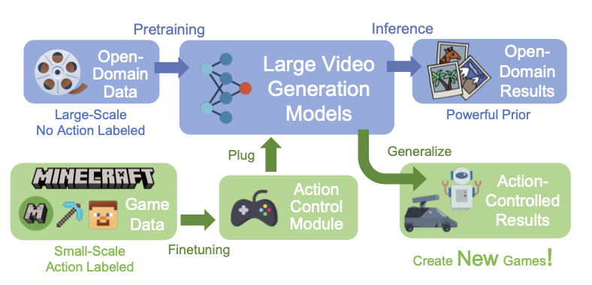
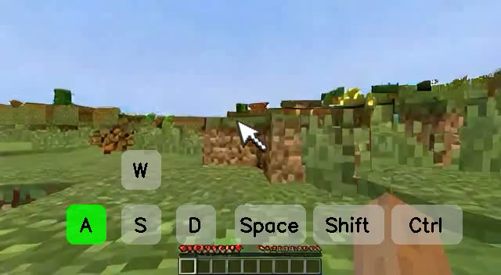
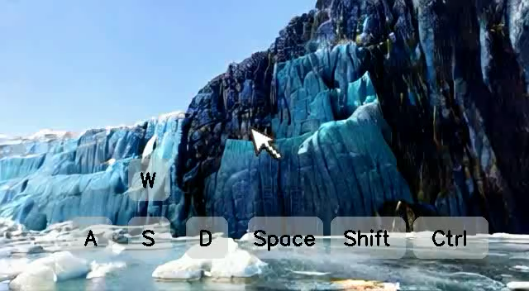
Overview
Goal
A framework for action-controlled and scene-generalizable game video generation
Methods
Using video generation models trained on open-domain videos
Disentangle the learning of game style and action control

Slide 8
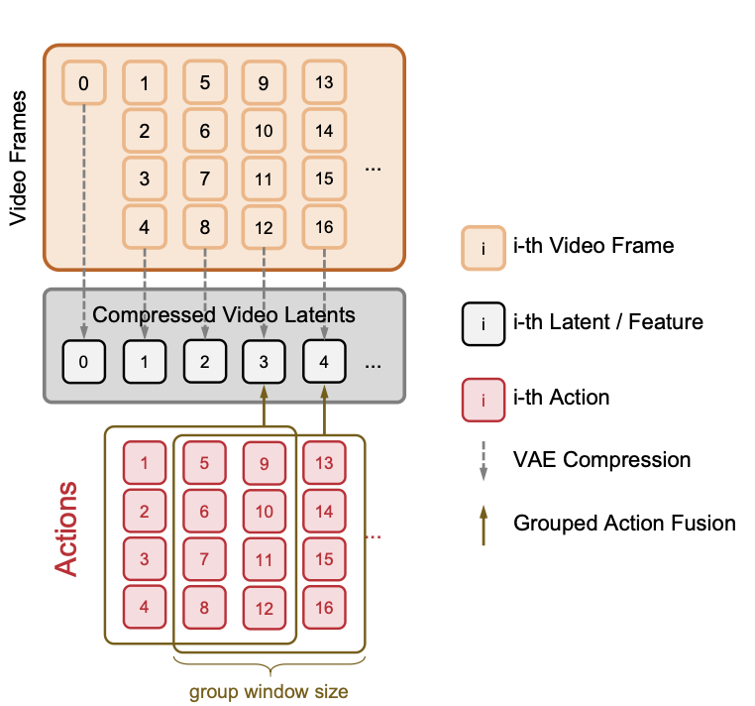
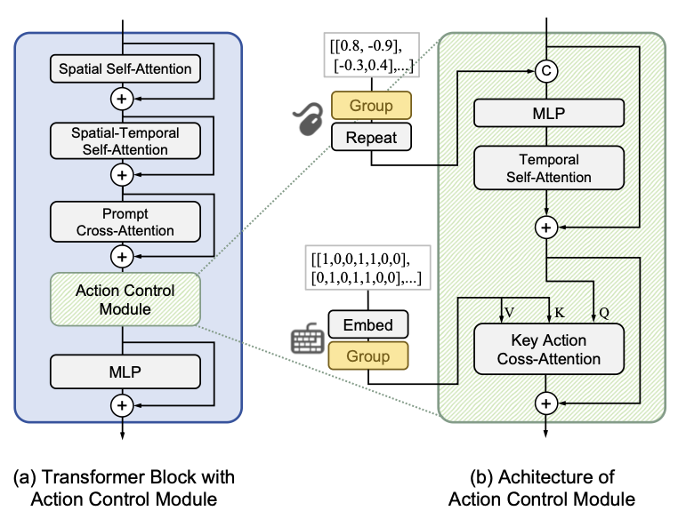
Methods – Action Controlled
Action Control Module
Input action includes both continuous mouse movement and discrete keyboard action
Grouping Actions with a Sliding Windows
Avoid mismatch between action and latent
Captures delayed action effects
Notes:
jump command influences multiple subsequent frames Repeat: make dimension same as latent

Slide 9
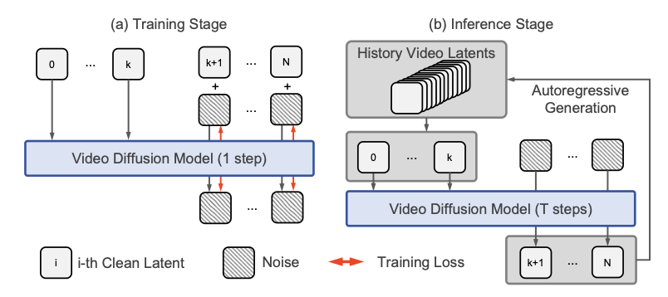
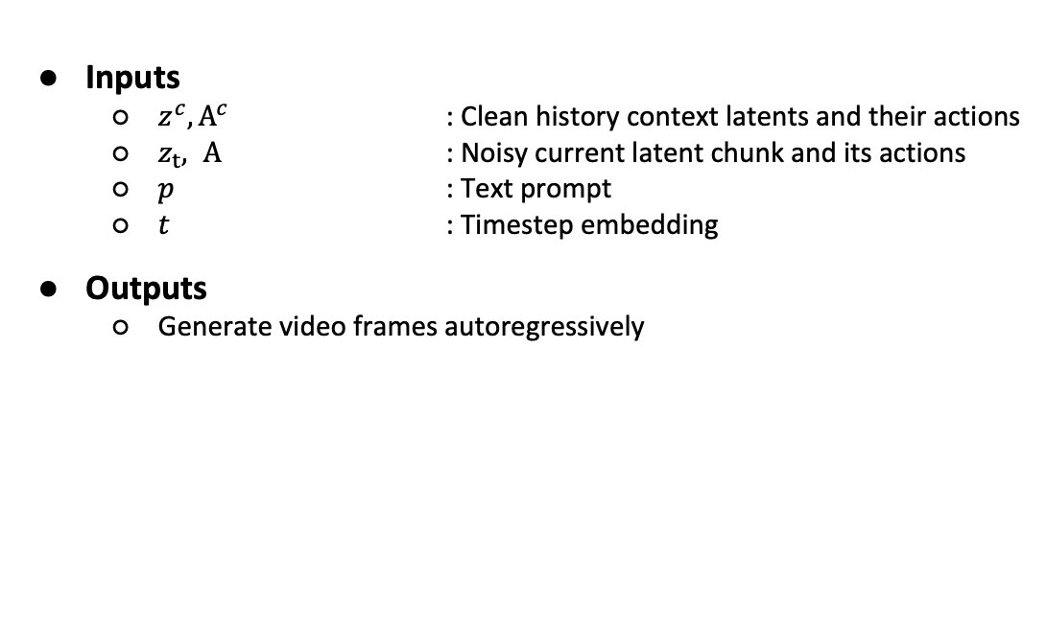
Methods – Autoregressive Generation
Inputs
$z^{c}, A^{c}$ : Clean history context latents and their actions
$z_{t}, A$ : Noisy current latent chunk and its actions
𝑝 : Text prompt
𝑡 : Timestep embedding
Outputs
Generate video frames autoregressively
Notes:
jump command influences multiple subsequent frames Repeat: make dimension same as latent

Slide 10
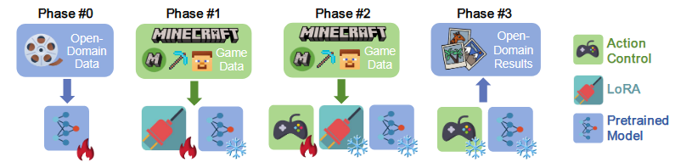
Methods – Multiphase Training
Goal
Finetuning with single-game dataset degrades scene generalizability from pretrained model
Disentangle the learning of game style and action control
Training phases
#0 : Model pretraining
#1 : Tune LoRA as domain adapter to fit game videos
#2 : Tune action control module
#3 : Inference on open domain

