Slide 1
Pre-training Auto-regressive Robotic Models with 4D Representations
ICML 2025, arXiv:2502.13142
指導學長：鍾閎凱／吳彥翔
報告人：電機三 賴禹衡／電機三 陳政年

Slide 2
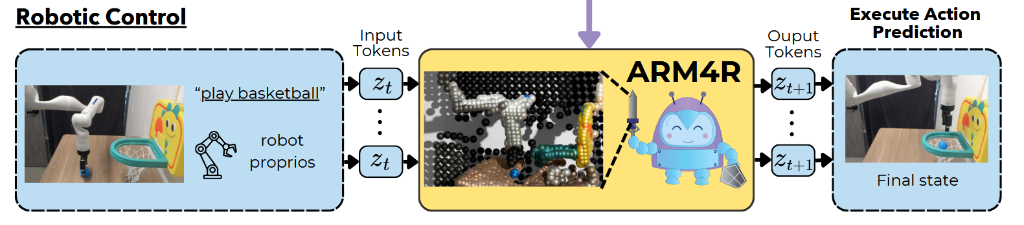
Overview
Goal
Establish a powerful robotic foundation model
Barriers / Previous works
Lack of robotic datas -> To take advantage of human datas
With human datas, lack of effective representations may degrade model generalizability
For VLMs, the pre-training objective doesn’t match the action prediction objective -> To construct a representation that can bridge the gap

Slide 3
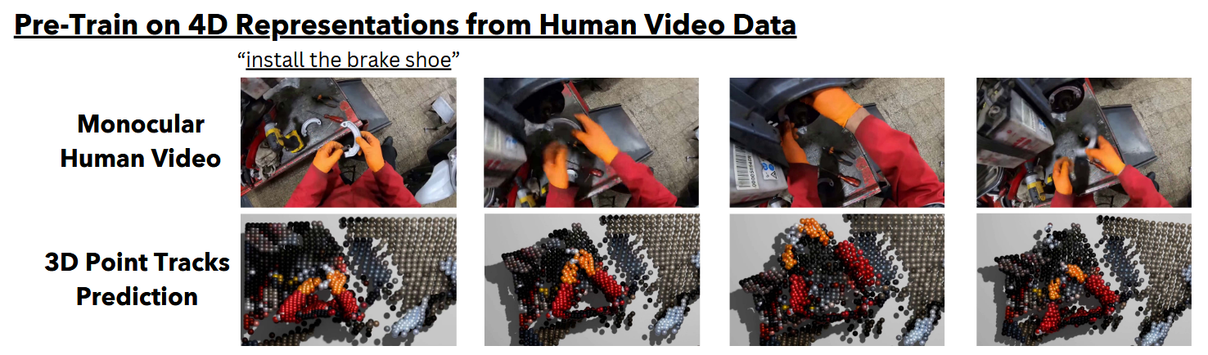
Method – Representation
4D Scene representation
3D point tracking problem
Initialize g^2 points that correspond to same real world point throughout video
Benefits – they are quite the same
3D point tracking and robot motion share the same SE(3) linear action on 3D points, and their representations differ only up to a linear transformation in this shared space.

Slide 4
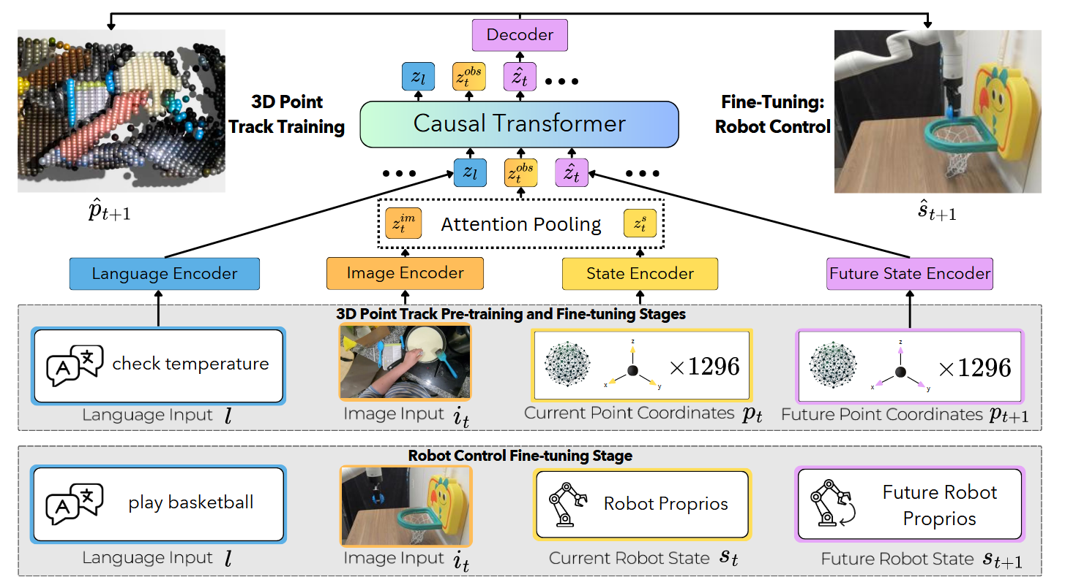
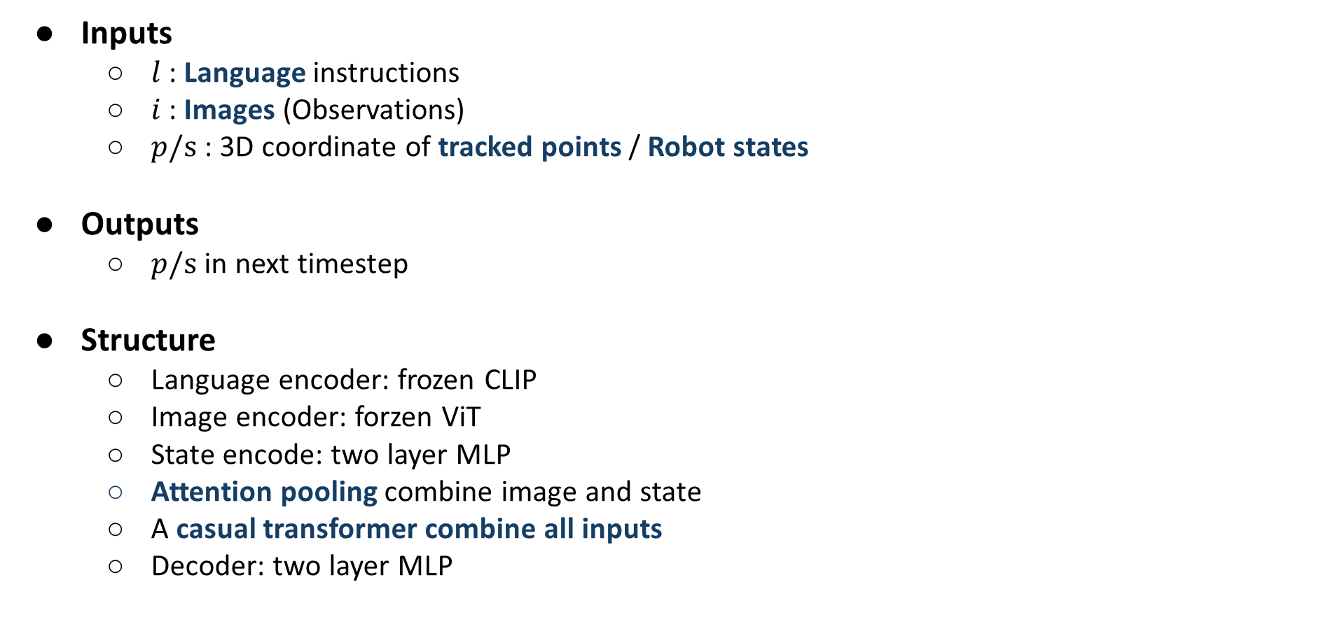
Method – Architecture
Inputs
$l$ : Language instructions
$i$ : Images (Observations)
$p/s$ : 3D coordinate of tracked points / Robot states
Outputs
$p/s$ in next timestep
Structure
Language encoder: frozen CLIP
Image encoder: forzen ViT
State encode: two layer MLP
Attention pooling combine image and state
A casual transformer combine all inputs
Decoder: two layer MLP

Slide 5
Method – Training
Stage 1
Pre-train with human videos
Learn 3D point tracking
GT annotations for point track are extracted with another model
Stage 2
Finetune with robot videos (same setting as downstream application)
Learn 3D point tracking
Tuning with 5%~10% data count of stage 1
Stage 3
Finetune with robot videos
Learn predict robot state

Slide 6
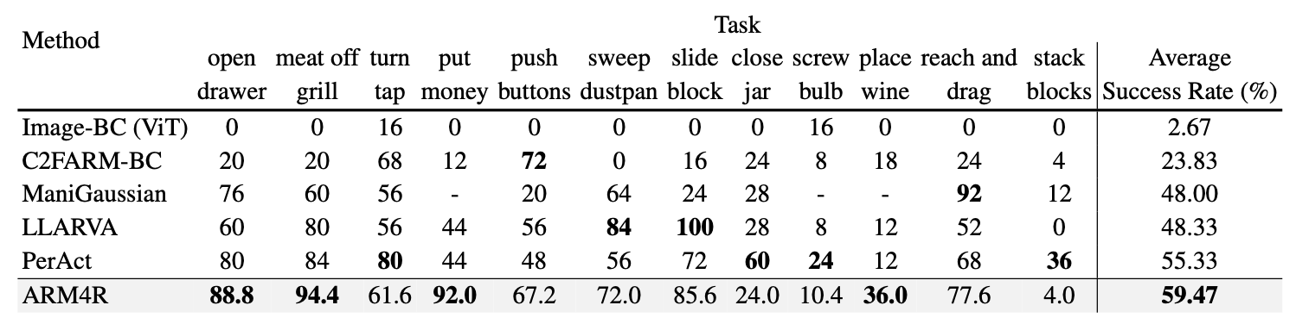
Experiment – RLBench
2D/3D comparison
Image-BC: 2D
PerAct: 3D voxel
ManiGaussian: 3D temporal tracking
Other VLA:
LLARVA: pre-trained language decoder
Notes:
Dynamic Gaussian splatting

Slide 7
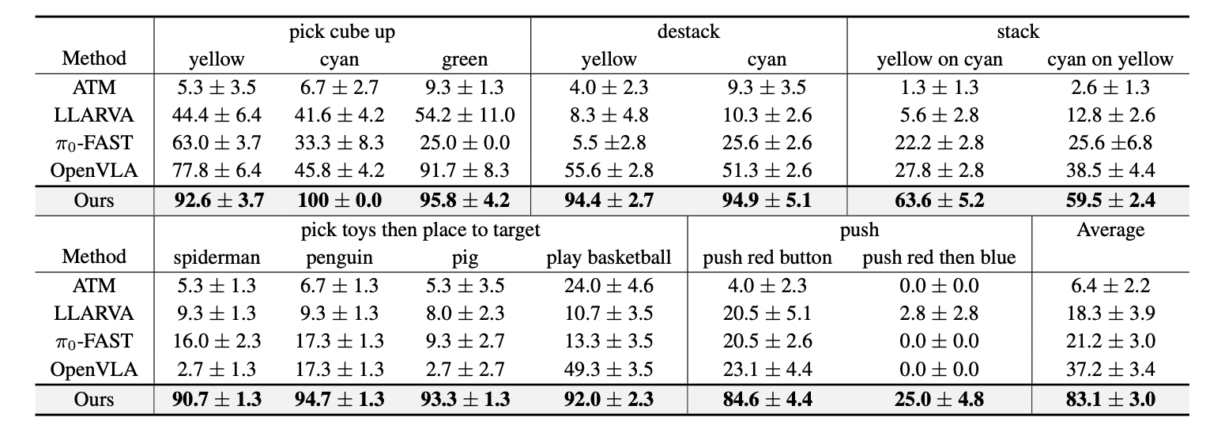
Experiment – Real Robot evaluation
Compare with other VLA:
ATM: predict 2D trajectories
LLARVA: 2D point as auxiliary task
OpenVLA: real world dataset

Slide 8
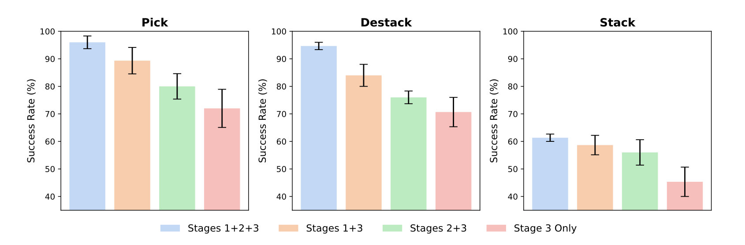
Ablation Study
Different Stages:
Stage 1: Human video pre-training
Stage 2: Robotic fine-tuning
Stage 3: Robotic control fine-tuning

Slide 9
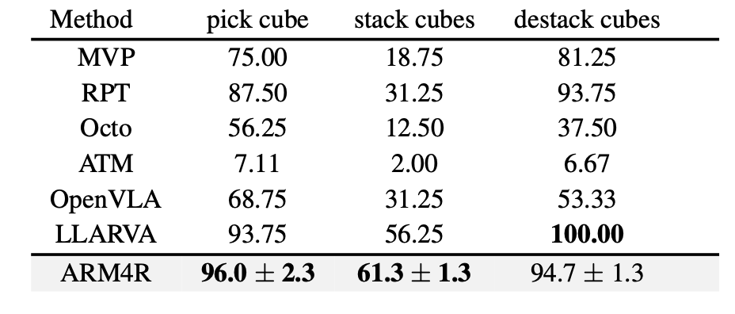
Experiment – the effectiveness of pretraining
Different pretraining method
MVP: Pretrained vision encoder on human data
RPT: Pretrained on visual and proprioceptive states
Octo/OpenVLA/LLARVA: Pretrained on OpenX dataset
ATM: Pretrains a 2D point track transformer
Notes:
importance of using low-level representations as opposed to language decoders that
were pre-trained on high-level vision-language tasks.

Slide 10
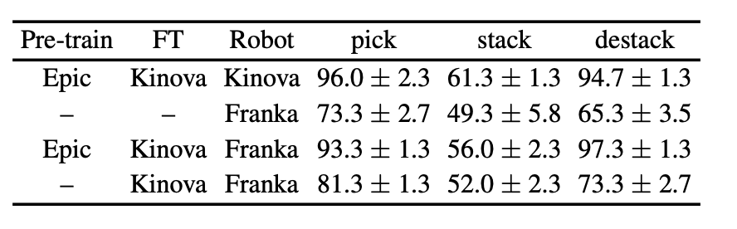
Experiment – Cross-Robot setting
Cross-Robot Generalization
•Testing whether Kinova-trained visual + control policy can transfer to Franka.
•Epic pre-training + Kinova FT → +19.6% improvement on Franka tasks.
•4D trajectories provide robot-invariant geometric representations.

Slide 11
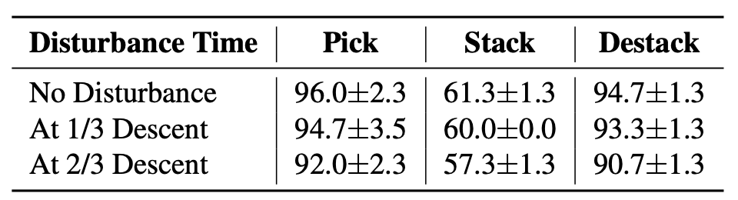
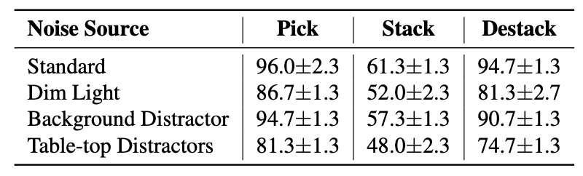
Experiment – disturbance
Dynamic environment
Manually move the cube in different stages
Other Noise
Ambient Light: reduce 50%
Background Distractor: People walking by
Table top Distractor: 2 random objects placed near target

Slide 12
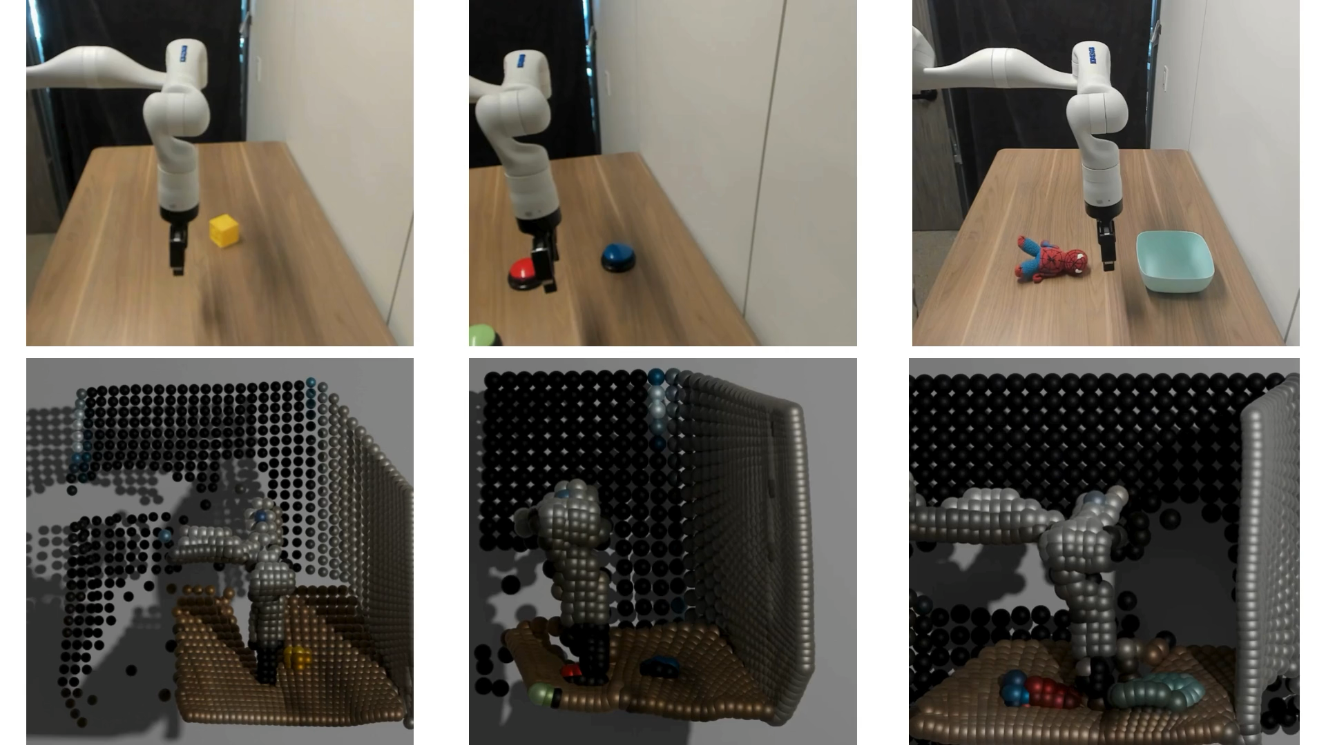
Conclusion
Pretraining on Human video is highly effective for robotic learning
Pretraining on Human video can outperform robotics-only
Potentially inaccurate predictions due to a lack of invariance to camera intrinsics and motion.

