Slide 1
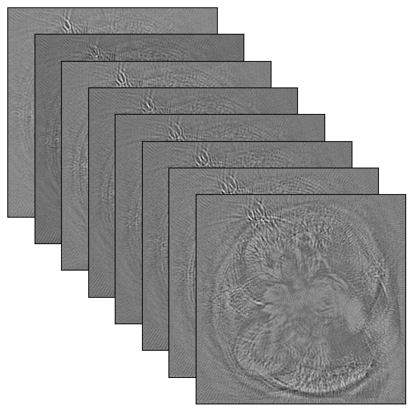

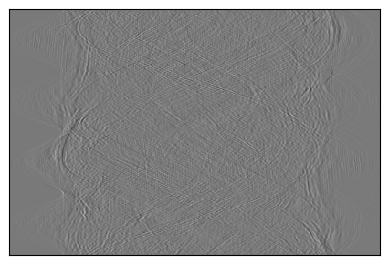
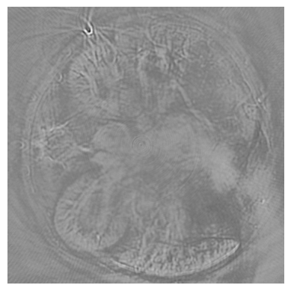
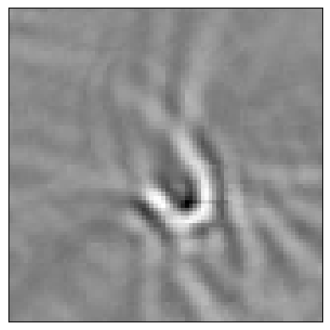
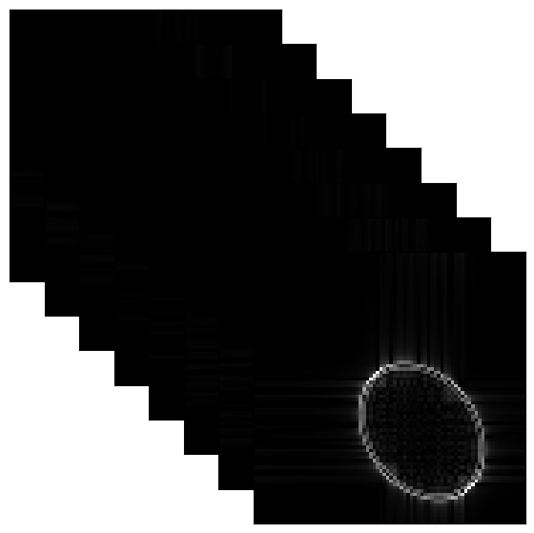
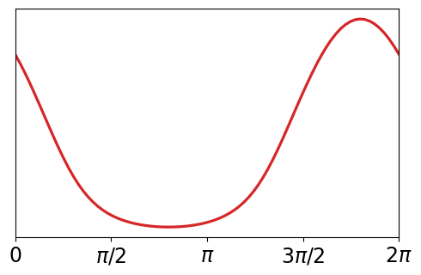
Delay-and-sum
Crop
Sinogram
Stacks of small patches
WienerNet
Image stack
Merge
patches
R
V_{a}, V_{b}
Delays
Deblurred patches
Reconstructed image
Wavefront
PSF stack

