Slide 1
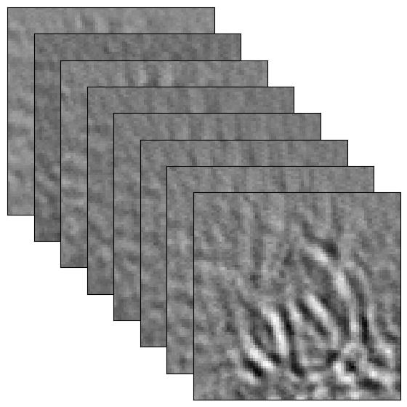
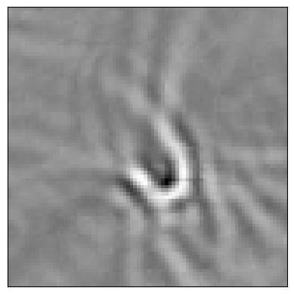
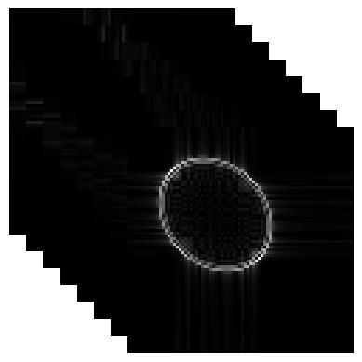
WienerNet
Denoising
Network
Wiener
Deconvolution
Observation
Reconstruction
PSF

