Slide 1

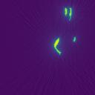

WienerNet
Denoising Network
Wiener
Deconvolution
Observation
Reconstruction
PSF

