Slide 1
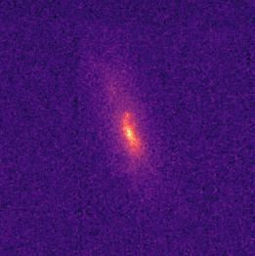


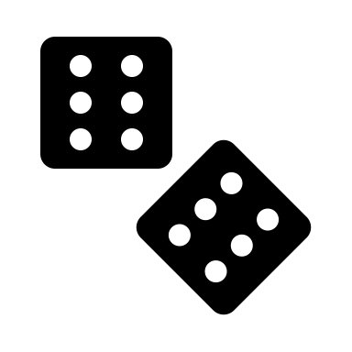
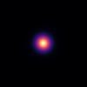
Image Simulations
Unrolled ADMM Network (N layers)
COSMOS dataset
Ground Truth
…
Layer 1
Layer 2
Layer N
deblurring
deblurring
deblurring
Convolve,
add noise
…
denoising network
denoising network
denoising network
Randomize shear & rotation
Observation
Reconstruction
hyperparameter subnetwork
Randomize shear, seeing
Gaussian MLE
Gaussian MLE
Gaussian MLE
PSF

