Slide 1
Machine Learning aided Record Linkage
Final Project for the Data Architecture course
Francesco Porto (816042) francesco stranieri (816551) Mattia Vincenzi (860579)

Slide 2


Outline
Record Linkage
Python Record Linkage Toolkit
Record Linkage Pipeline
Our project
Experiment 1: Full Index vs Block Index
Experiment 2: Training and Testing the models

Slide 3
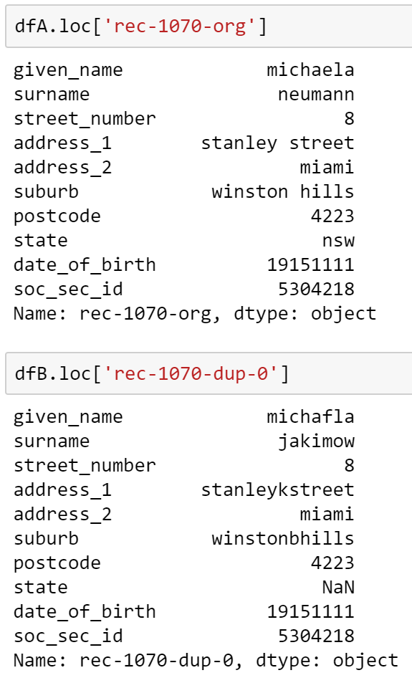
Record Linkage
Record Linkage is the process of finding records in one or more datasets/databases that refer to the same entity across different data sources.
Traditionally: apply a set of fixed rules
Our project: use Machine Learning methods to obtain better results

Slide 4
Python Record Linkage Toolkit
Simple framework for Record Linkage in Python
Record linkage is seen as a pipeline:
Preprocessing: clean the datasets [optional]
Indexing: create pairs of records (candidate links)
Comparison: compare record pairs via different algorithms, thresholds, etc.
Classification: classify record pairs into matches or non-matches
Evaluation: evaluate classification results
Preprocessing
Indexing
Comparison
Classification
Evaluation
Documentation available at the following address: https://recordlinkage.readthedocs.io/en/latest/index.html

Slide 5
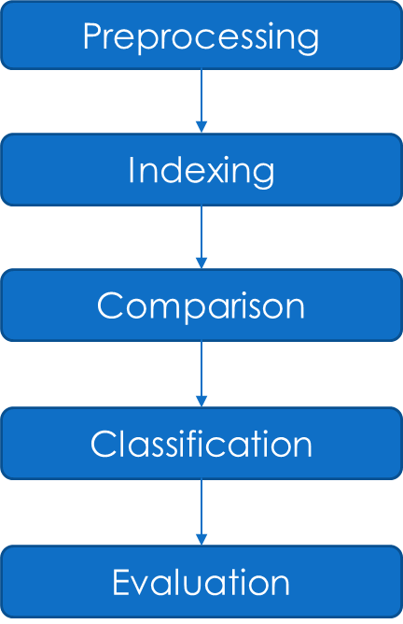
Record Linkage pipeline – Prepocessing
Optional phase
Required only if dataset is not clean
Input: «dirty» dataset(s)
Output: «cleaned-up» dataset(s)
We did not perform this phase in our experiments

Slide 6
Record Linkage pipeline - Indexing
Create pairs (R1, R2) such that:
R1 belongs to the first dataset
R2 belongs to the second dataset
Input: dataset(s)
Output: «candidate links» (the search space for our models)
Different methods for Indexing, will be explained later

Slide 7
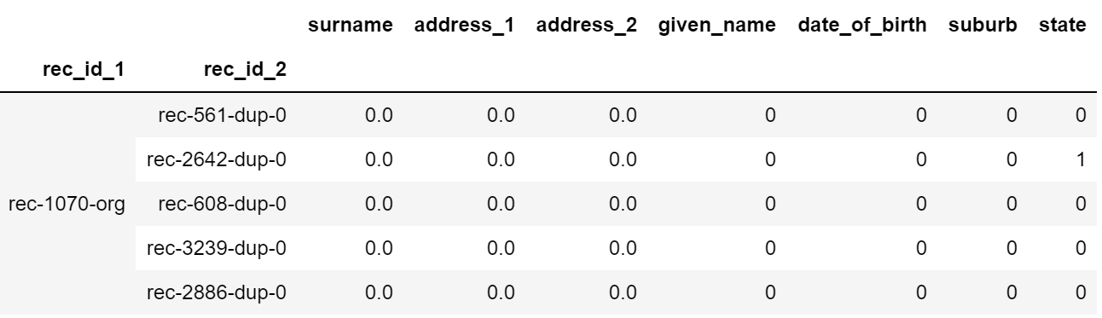
Record Linkage pipeline - Comparison
Requires, for each pair of attributes:
A metric
A threshold
Return measures of similarity between each record pair from the candidate links

Slide 8
Record Linkage pipeline - Classification
Classify candidate links into matches or non-matches, according to the results of the Comparison phase
i.e. : if the two records agree on at least 4 attributes, they are classified as match (deterministic approach)
Machine learning can be used! We decided to use:
Naive Bayes (SL)
Expectation-Conditional-Maximisation (UL)

Slide 9
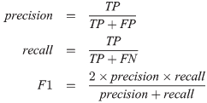
Record Linkage pipeline - Evaluation
Evaluate (and compare) the results of the classification phase:
Precision
Recall
F-score

Slide 10
Our project - Overview
Two experiments will be presented:
Comparison between Indexing methods (Full index vs Block index)
Does the number of candidate links matter? How much?
Is the tradeoff between speed and quality of results worth it for our models?
Training and Testing our ML models
Are the models re-usable?
Is it viable in real-case scenarios? Why?

Slide 11
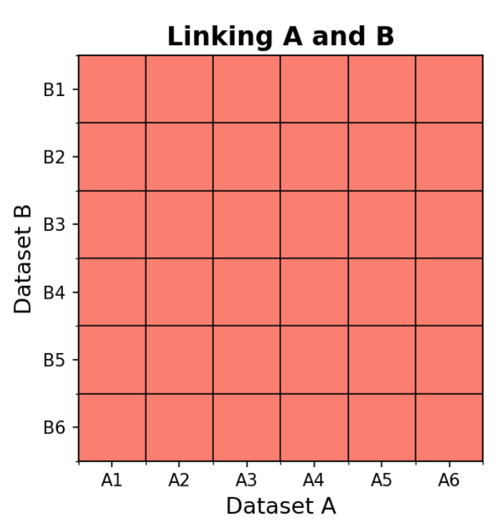
Our project – Experiment 1: Full Index vs Block Index
Two types of Indexing methods are available:
Full Index: make the cartesian product of records
No a-priori assumptions on datasets
Block Index: only find a subset of the cartesian product, according to some dataset attributes that must match
Requires at least an attribute that match exactly
Full Index visualized

Slide 12
Our project – Experiment 1: Datasets used
Throughout the experiments, we will use FEBRL (Freely Extensible Biomedical Record Linkage) datasets
In this experiment we used the febrl4 dataset
10000 records (5000 original and 5000 duplicates)
One duplicate per original
Dataset1 contains the original 5000 records
Dataset2 contains the duplicate 5000 records
Has true links (required to train and test our algorithms)

Slide 13
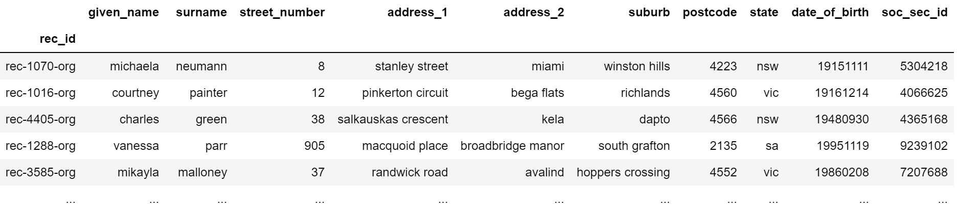
Our project – Experiment 1: Dataset used (1)

Slide 14
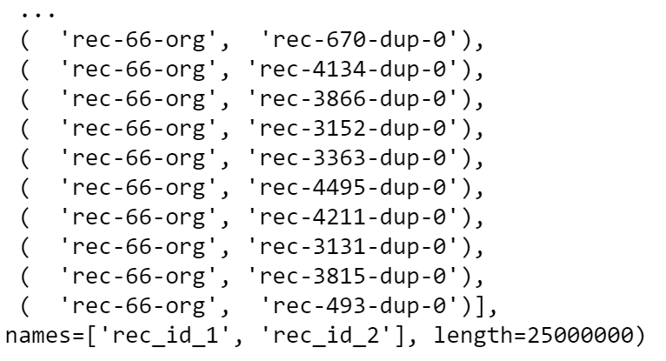
Our project – Experiment 1: Indexing
A Full Index was used
We obtained the cartesian product of the two dataset (5000 * 5000 = 25 000 000 records): the candidate links

Slide 15
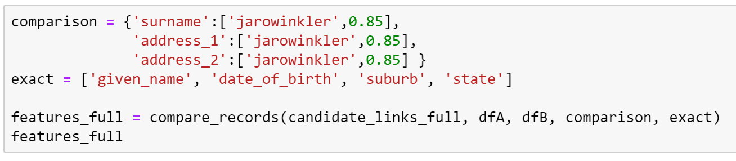
Our project – Experiment 1: Comparison
We require some attributes to match exactly between each candidate link, while we allow mismatches for other attributes
These parameters have been fixed for all our experiments
Note: no cardinality reduction is performed in this phase!

Slide 16
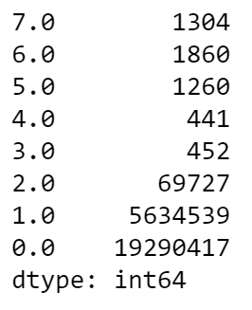
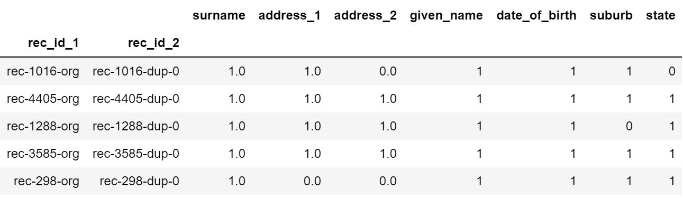
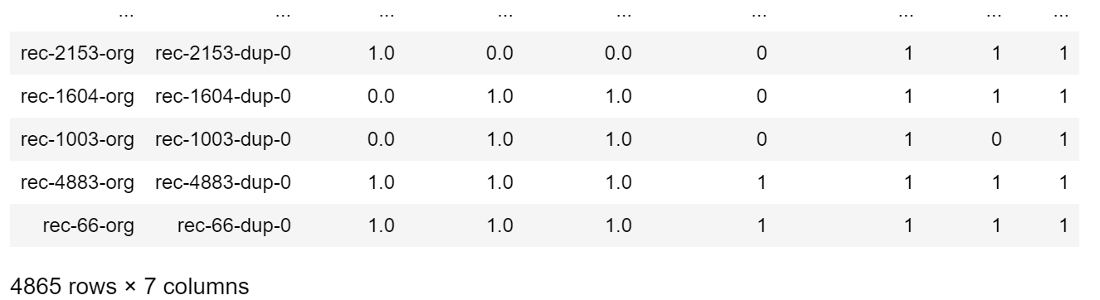
Our project – Experiment 1: Classification (Determinstic)
We consider as matches only records with at least 4 (matching exactly or not exactly) attributes
4865 matches out of 5000

Slide 17
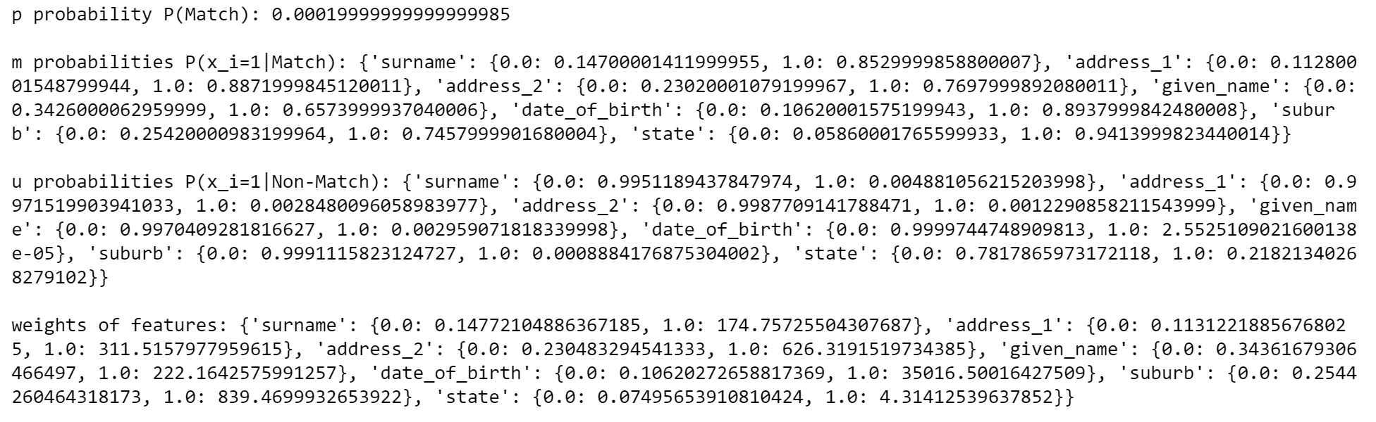
Our project – Experiment 1: Classification (Naive Bayes)
Supervised Learning Algorithm
4958 matches found out of 5000

Slide 18
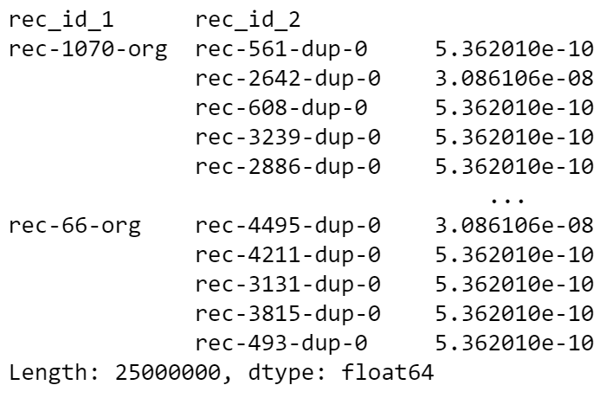

We can also see the probability of a match for each record pair

Slide 19
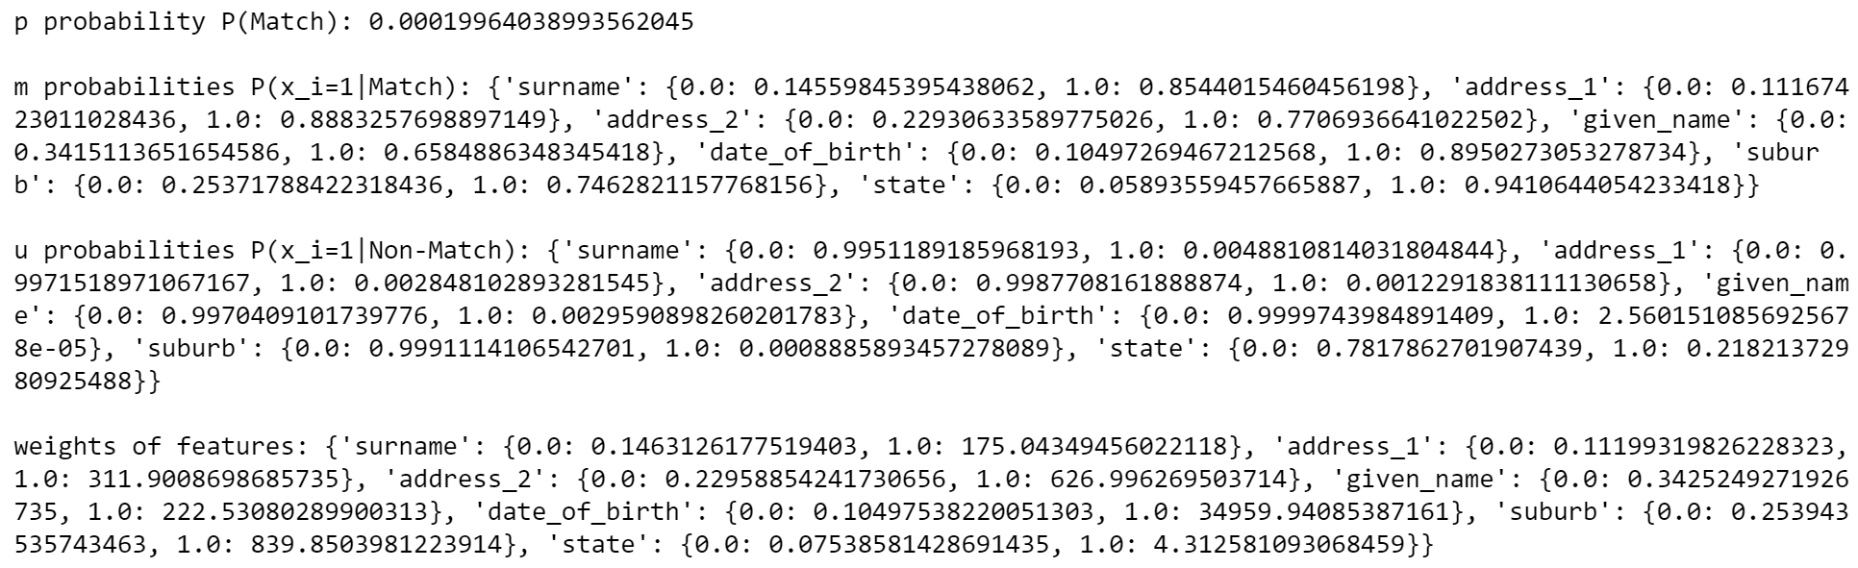
Our project – Experiment 1: Classification (ECM)
Unsupervised Learning Algorithm
Also finds 4958 matches
Same as Naive Bayes, although with (slightly) different probabilities

Slide 20
Our project – Experiment 1: Block index
We repeat the same steps above, although we use a Block Index in the Indexing phase
All the candidate links we obtain must match on (at least one of):
Surname
Date of birth
Soc_Sec_Id

Slide 21
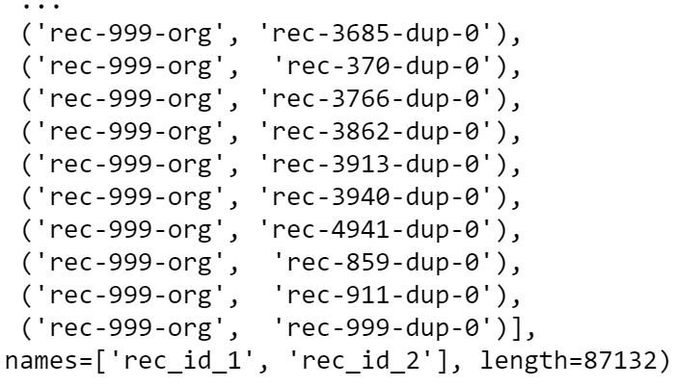
We obtained 87132 candidate links
As a reminder, with the Full Index we obtained 25.000.000
That’s the 0,0035%

Slide 22
Our project – Experiment 1: Block Index (Time Comparison)
We perform the Comparison and Classification phases as we did before
Will the results change?
 | Full Index | Block Index
Indexing time | 160 s | 0.56 s
Naive Bayes training time | 150 s | 0.23 s
ECM training time | 92 s | 0,29 s

Slide 23
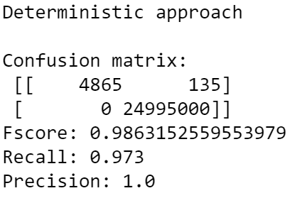
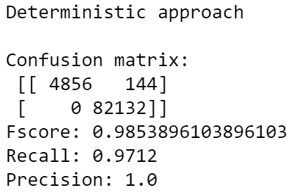
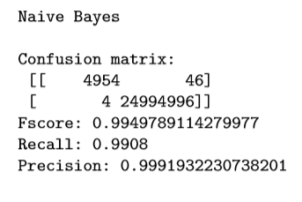
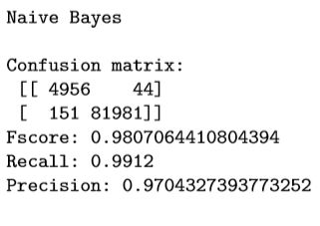
Our project – Experiment 1: Evaluation and Final Remarks

Slide 24
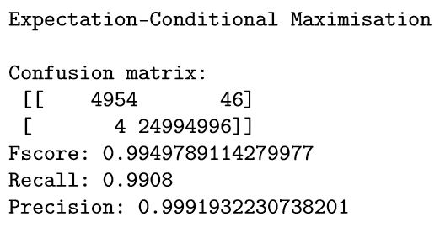
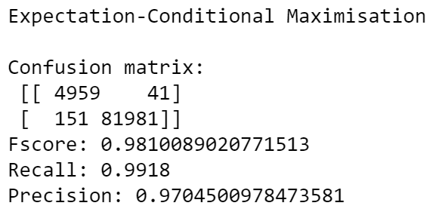
While the results may be biased since the dataset is very «toy-like» we do not notice any relevant difference in the confusion matrix
We think that Block index shall be preferred for its faster execution time, especially on bigger datasets

Slide 25
Our project – Experiment 2: Training and Testing our models
We will tackle the following questions:
Are they models re-usable?
Are they viable in real-case scenarios? Why?
We will train our models on a FEBRL dataset, then test the models on another one, with different duplicate distributions, errors, etc.
We will actually be doing data deduplication (a special case of record linkage)
We will be linking a dataset to itself, in order to find duplicates

Slide 26
Our project – Experiment 2: Dataset
As training set, we used the febrl2 dataset
5000 records (4000 original and 1000 duplicates)
Up to 5 duplicates per record (Poisson distribution)
Has true links (required to train models)
As testing set, we used the febrl3 dataset
5000 records (2000 original and 3000 duplicates)
Up to 5 duplicates per record (Zipf distribution)
Has true links (required to test our models)

Slide 27
Our project – Experiment 2: Training and Testing
For the training set, we do perform:
Indexing via Block Index
Comparison, using the same attributes as above
Classification limited to training
After that, on the testing set, we do perform:
Indexing via Block Index
Comparison, using the same attributes as above
Classification, testing only, since we already have the models
Evaluation

Slide 28
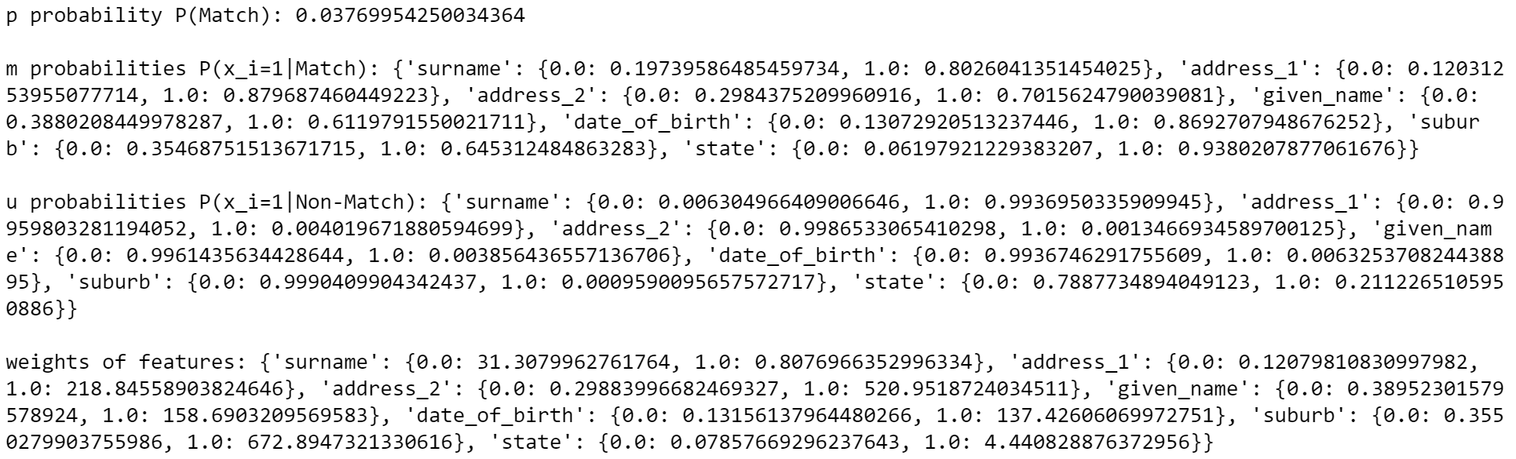
Our project – Experiment 2: Obtaining the model (Naive Bayes)

Slide 29
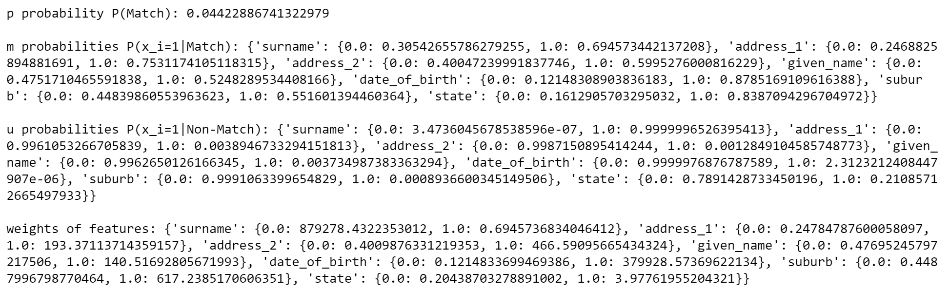
Our project – Experiment 2: Obtaining the model (ECM)

Slide 30
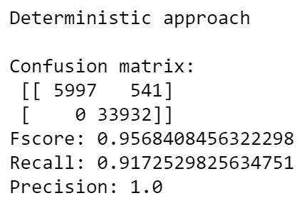
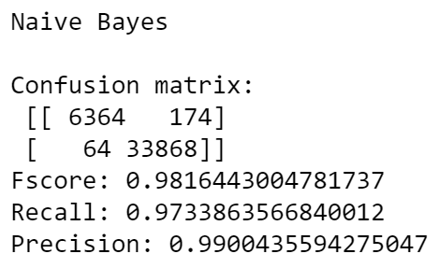
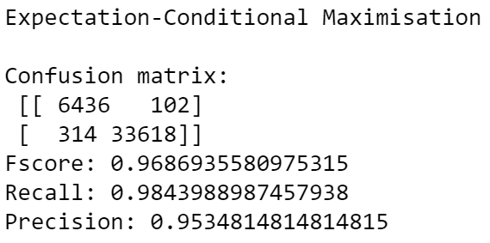
Our project – Experiment 2: Evaluation and Final Remarks
Is the model re-usable across different datasets having the same attributes? We think so!
Are they viable in real-case scenarios? Why? Yes, but they may not always be feasable since the true links are required!

