Slide 1
Feed forward Neural Networks
Luke

Slide 2
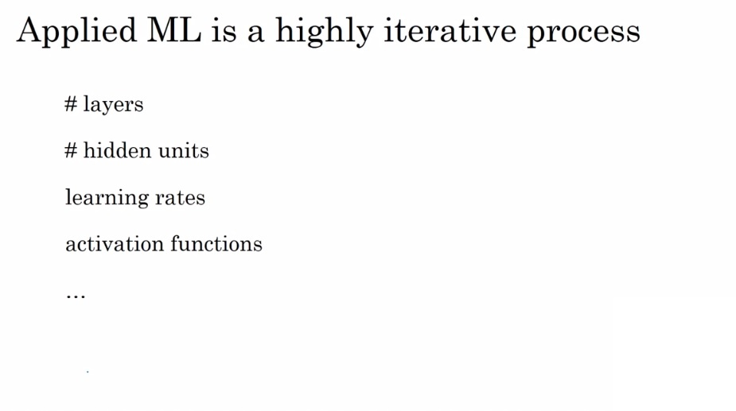
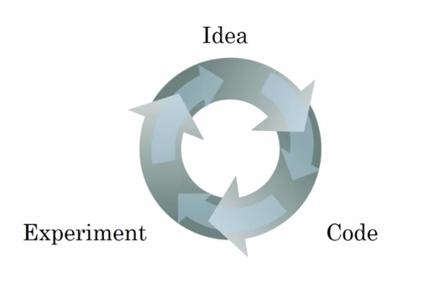
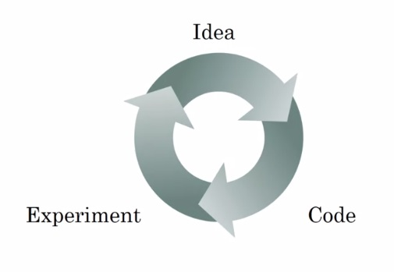
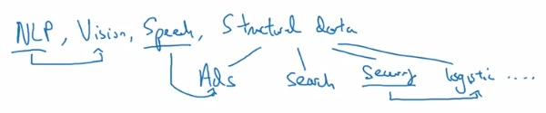
Deep learning takes a long time

Slide 3
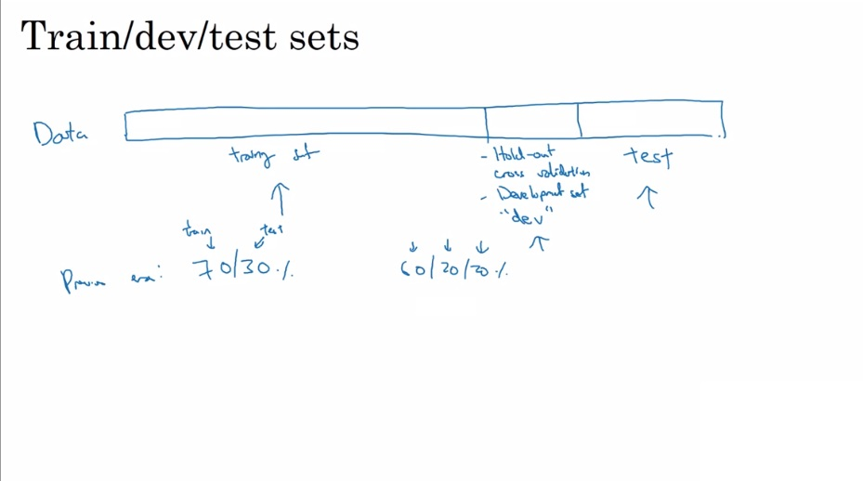
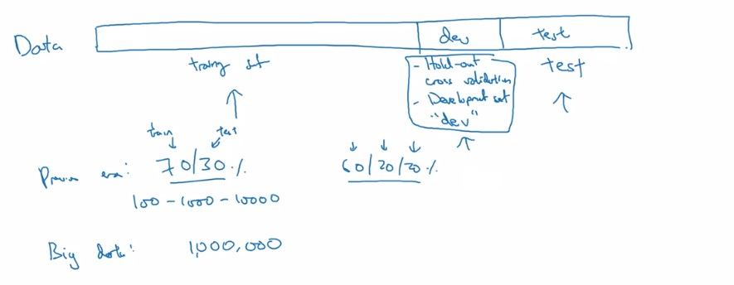

Data partitioning
Previous
10,000 10,000
98/1/1%
99.5/.25.25 %
99.5/.4/.1 %

Slide 4
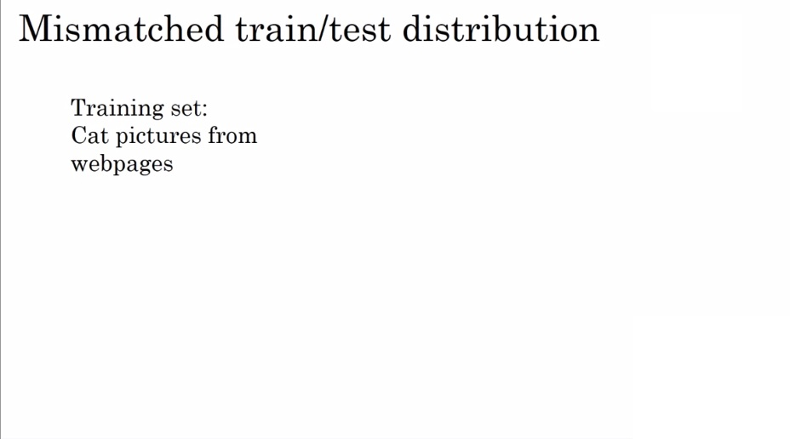
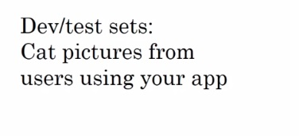
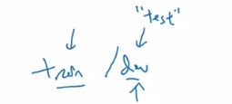

Data mismatch
Make sure dev and test sets come from the same distribution
Not having a test set is also acceptable. (only using a training and dev set)

Slide 5
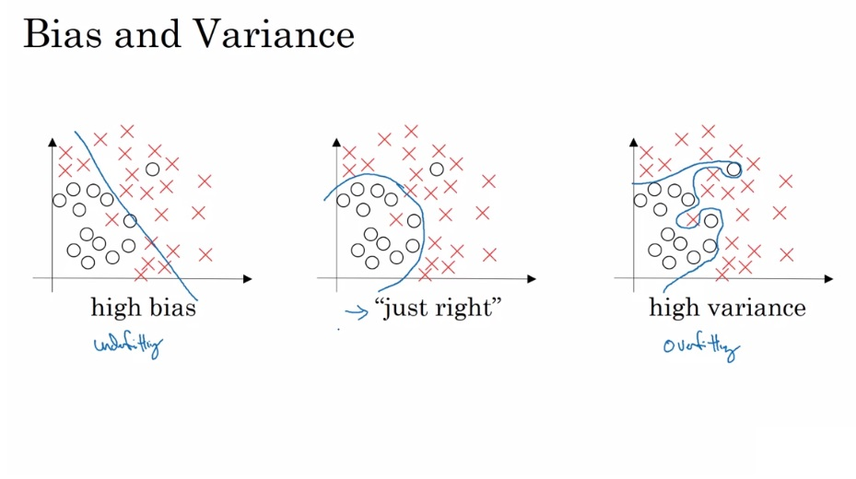
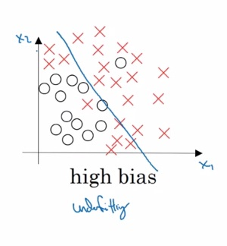
Machine learning balancing act

Slide 6
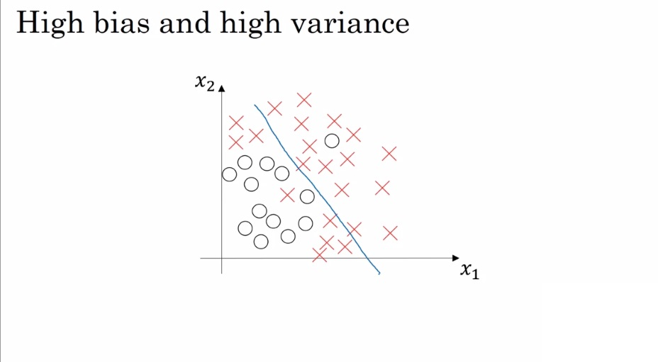
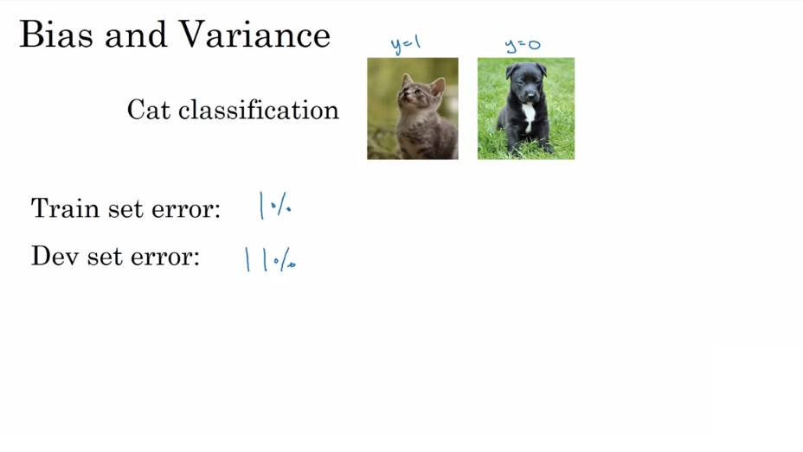
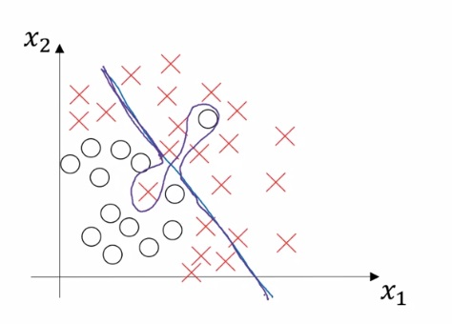
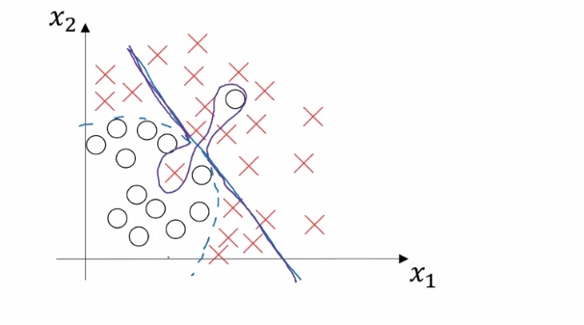


Bias and variance
0.5%
1%
Low bias
Low variance
High variance
High bias
Both high bias
And high variance
Assuming human error = 0%
Optimal error / Bayes error: ~ 0%
What if Bayes error ~ 15%?
Blurry images

Slide 7
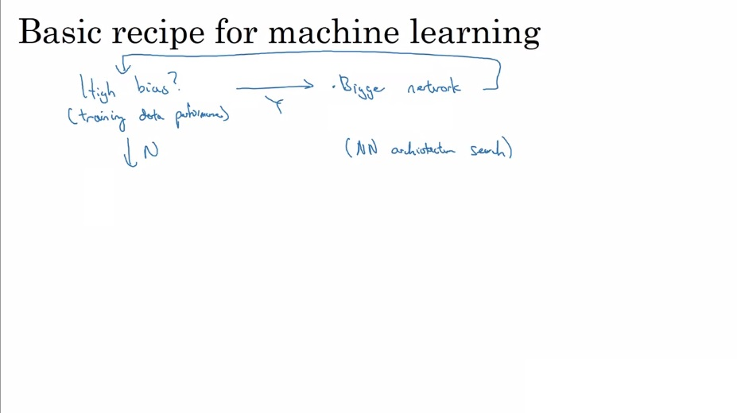
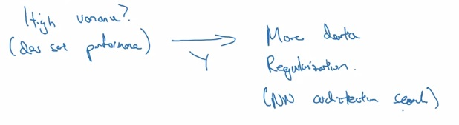
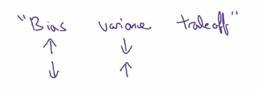
How to fix bias and variance problems
Train longer
More data will not help with a high bias problem,
while a more complex network will only worsen a
high variance problem

Slide 8
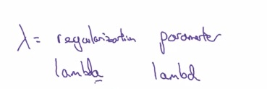
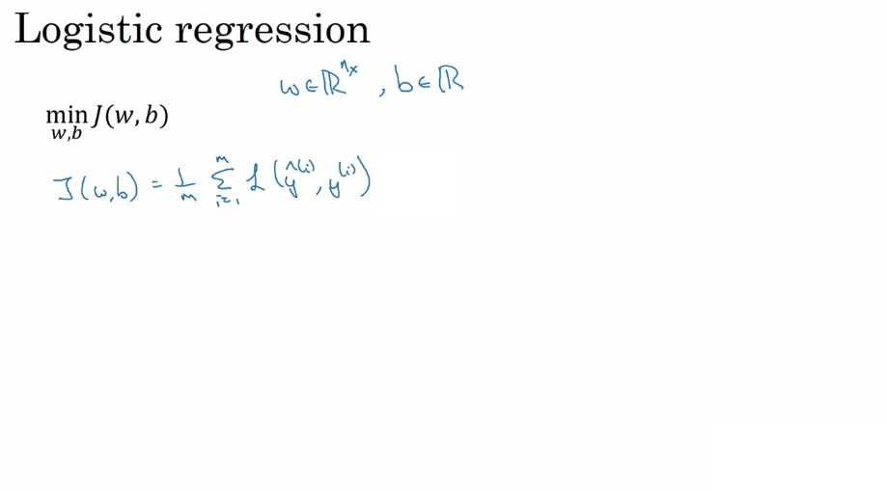

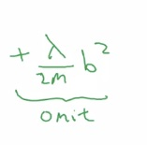
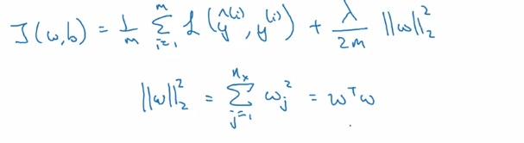

Regularization
L2 regularization
Using the L2 norm
Or the Euclidean norm
L1 → w will be sparse
(lots of zeros)
“model compression”
L1 regularization:

Slide 9
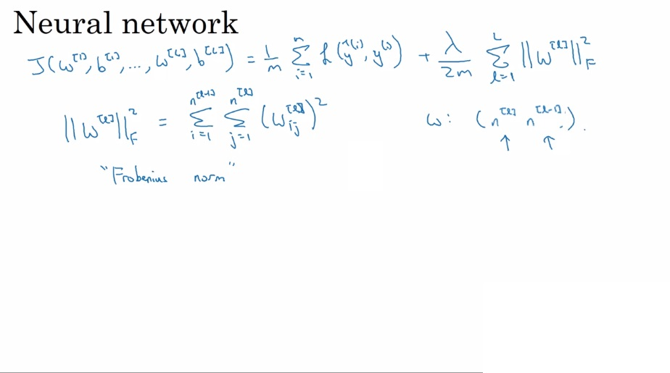
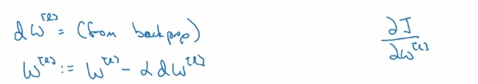




NN regularization
Gradient
Descent:
L2 regularization is also known as weight decay

Slide 10
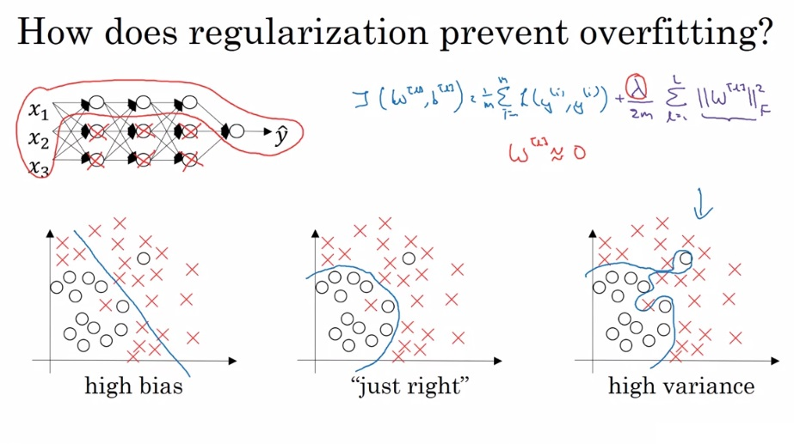
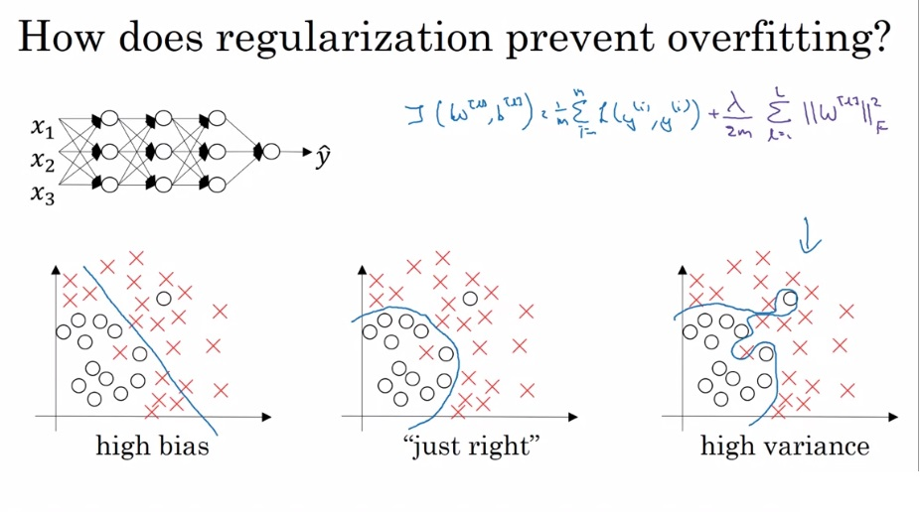
Why does regularization work?
Not actually canceling
hidden units, just reducing
their effect
What if we make lambda big?
Danger! High bias!

Slide 11
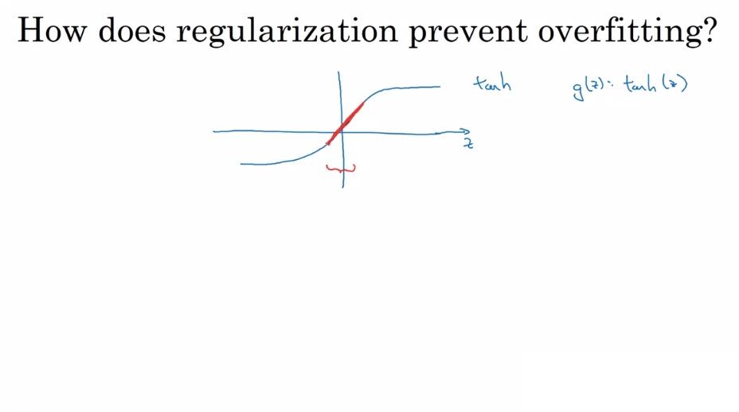
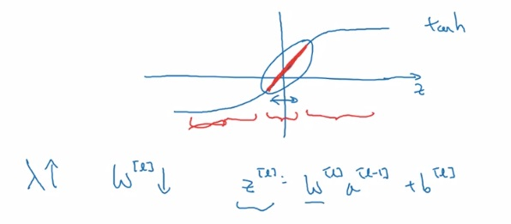
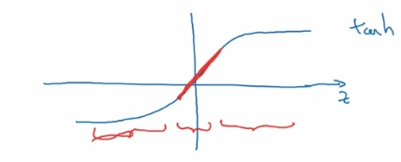
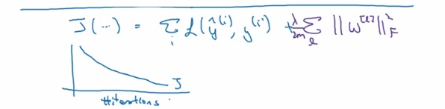
More regularization examples
Every layer is then approximately linear and less likely
to be a complicated non-linear function

Slide 12
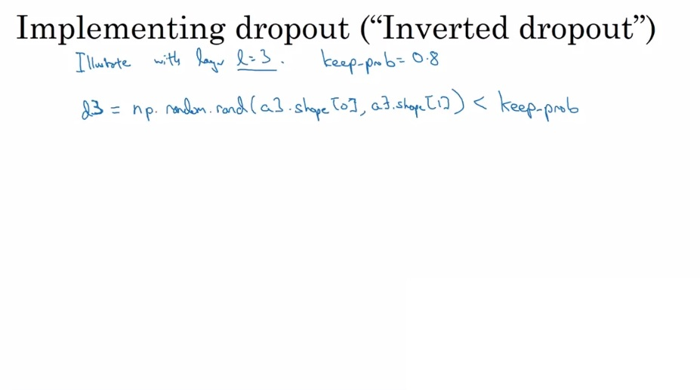
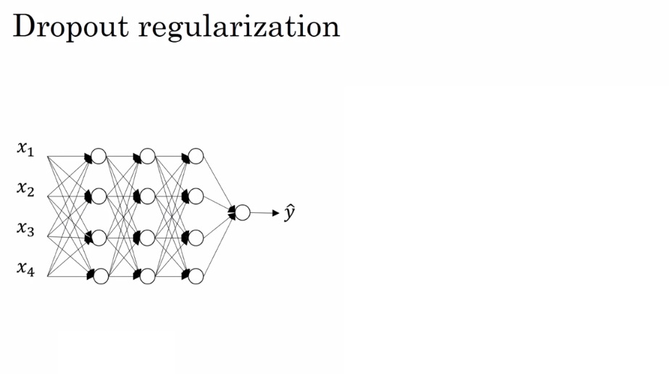
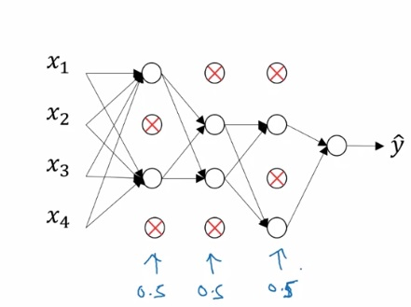
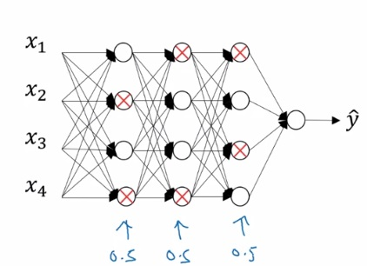


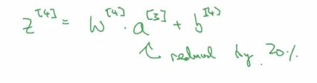

Dropout
To correct or not reduce the expected value of a3
Different training examples will be
zeroed out
Different units will be zeroed out on
Different iterations of gradient descent

Slide 13
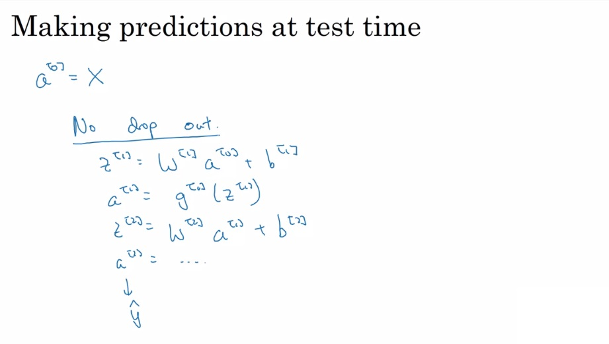
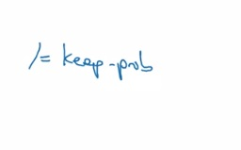
Dropout test time
No need to add a scaling parameter
because of this

Slide 14
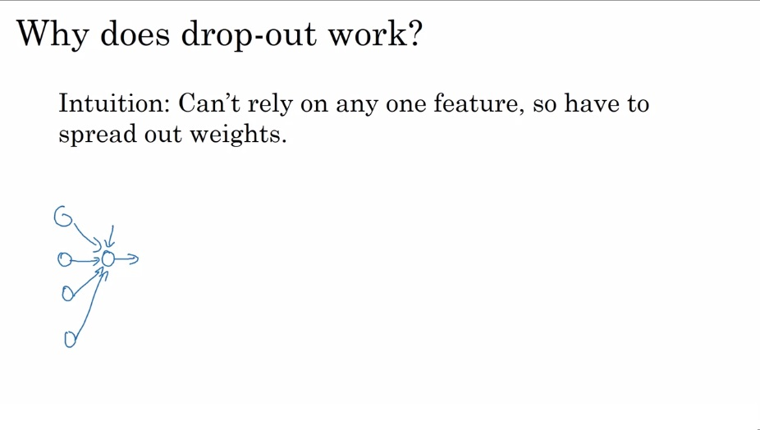
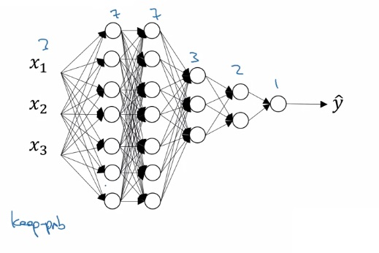
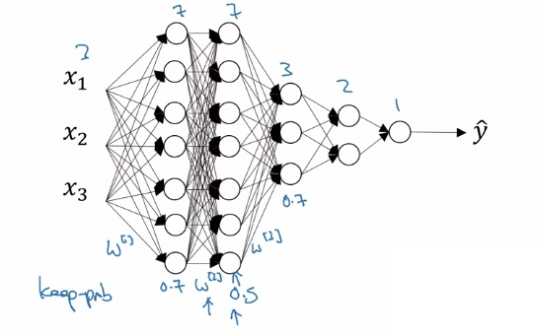
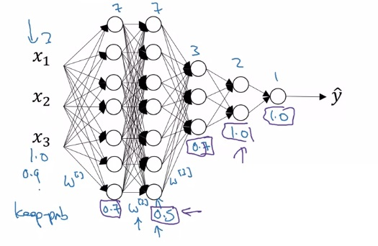
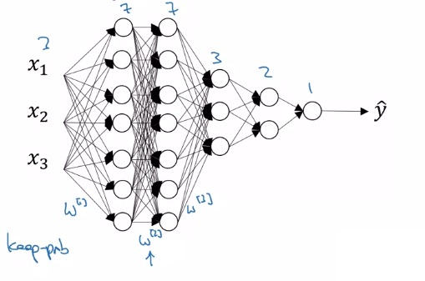
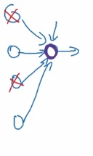
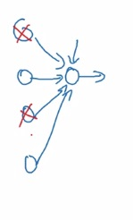
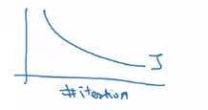
Dropout intuition
By more evenly distributing the weights, the squared
norm shrinks, similar to L2 regularization
Computer vision
Almost always makes
Use of dropout
Downside:
J is no longer well-defined

Slide 15
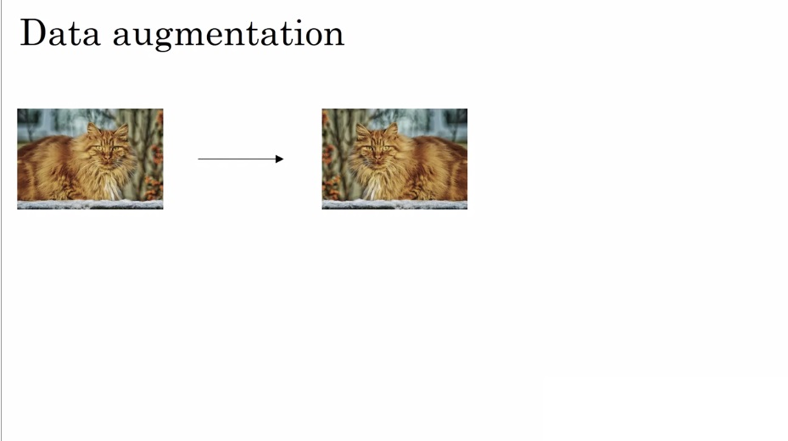

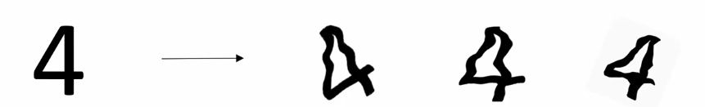
Other ways to regularize

Slide 16
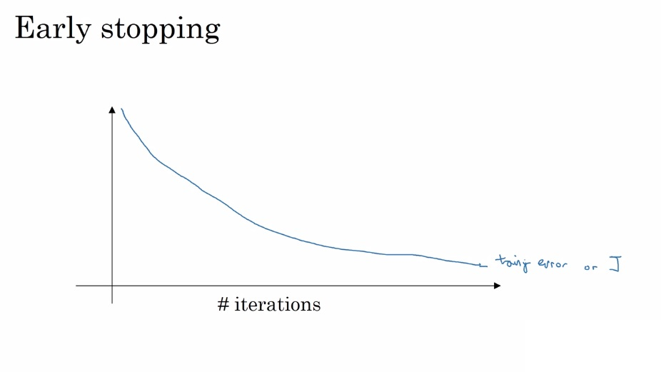
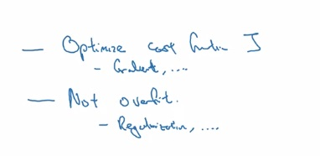
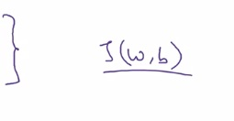




Early stopping
Against the principle of Orthogonalization
Cannot work on the two tasks independently

Slide 17




Normalization

Slide 18






Why normalization?

Slide 19













The trouble with deep neural networks
Exponentially increasing
Or decreasing as a
function of network
depth

Slide 20








Deep Learning weight initialization
More hyperparameters~
Xavier initialization
Bengio initialization
He initialization

Slide 21






Gradient checking- numerical approximations
“two-sided difference”
If theta = 1

Slide 22


Debugging backprop

Slide 23







Debugging backprop
Compute the Euclidean distance between the vectors!

Slide 24





Implementing gradient checking
Dropout samples the cost function rather completely
computing it

Slide 25
Random intialization

