Slide 1
Hyperparameter tuning, batch norm, softmax, deep learning frameworks
Luke

Slide 2
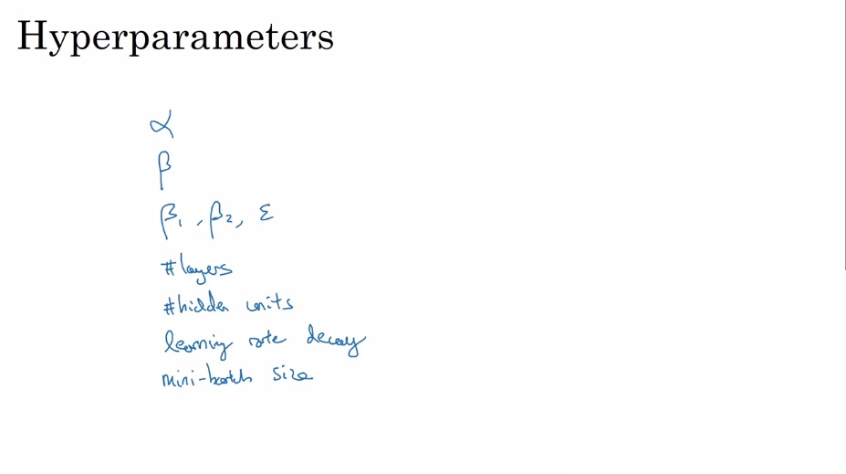
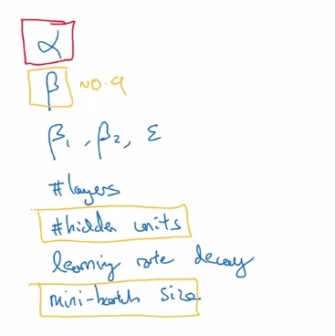
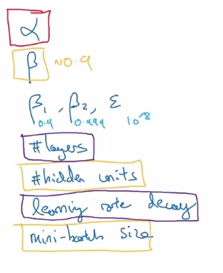
Omg so many choices

Slide 3
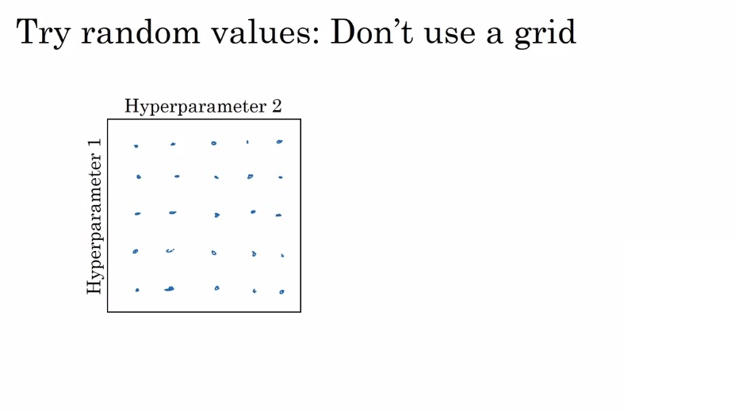
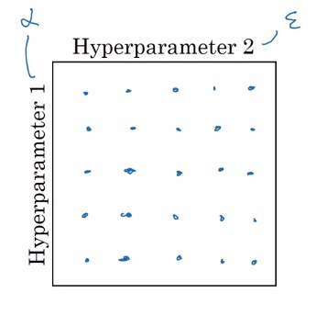
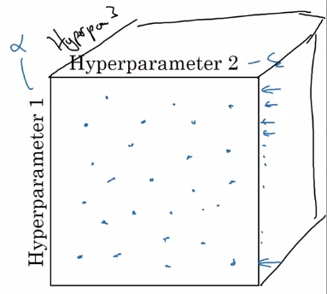
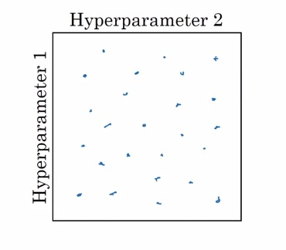
Hyperparameter search

Slide 4
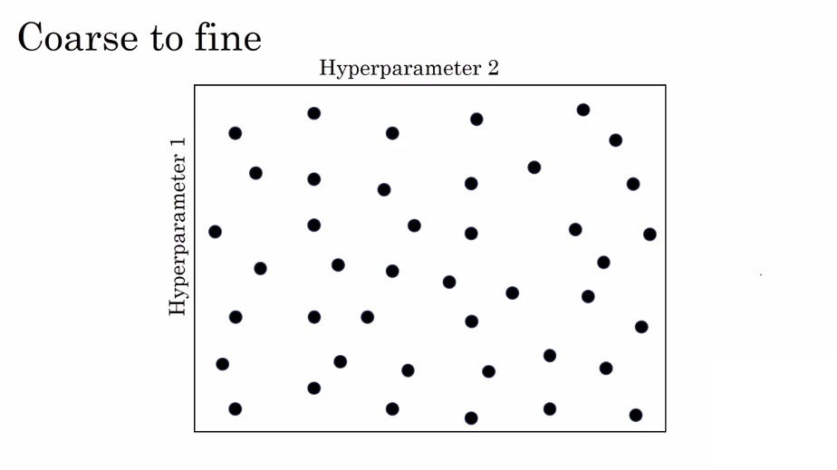
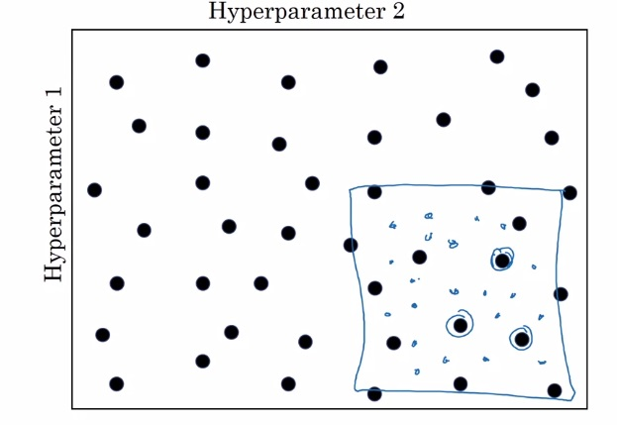
Coarse to fine sampling scheme

Slide 5
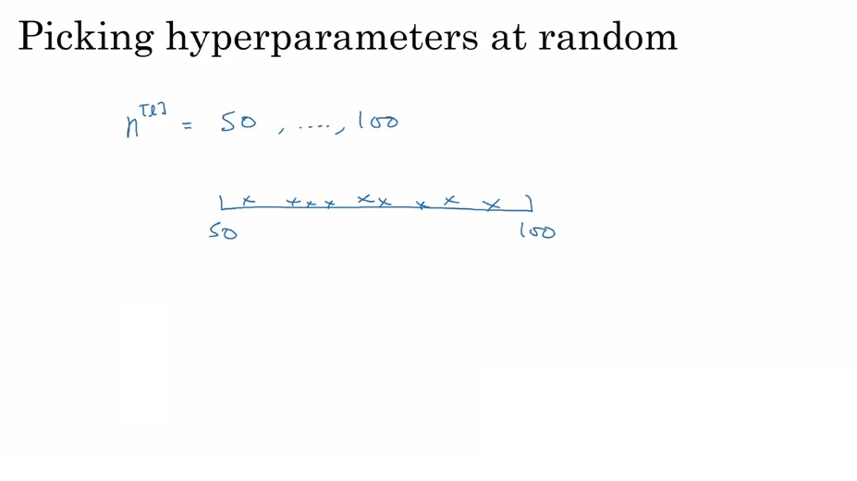
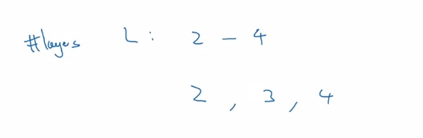
Scaling your hyperparameters

Slide 6
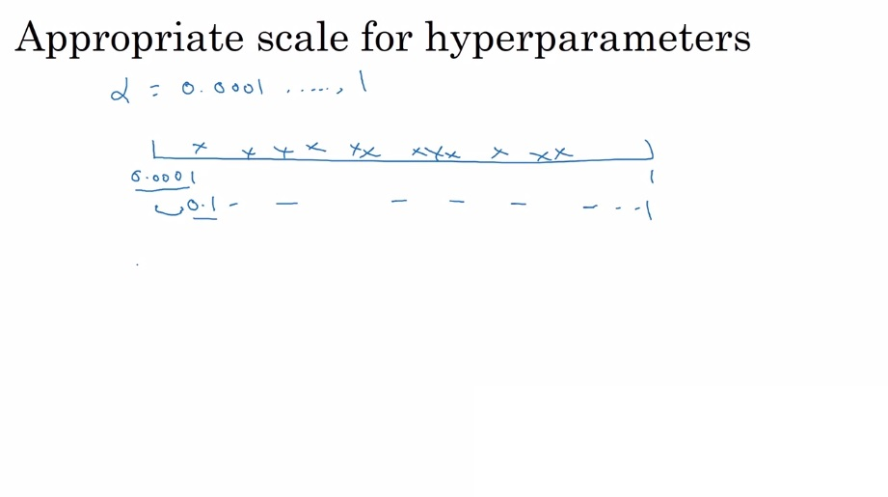
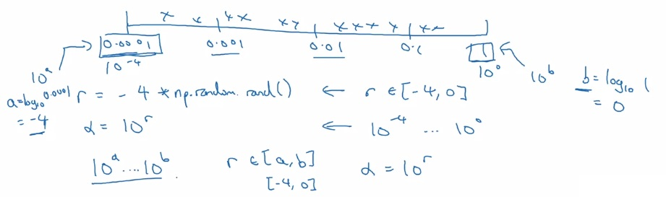


Hyperparameter search
Use the log-scale
Instead!

Slide 7
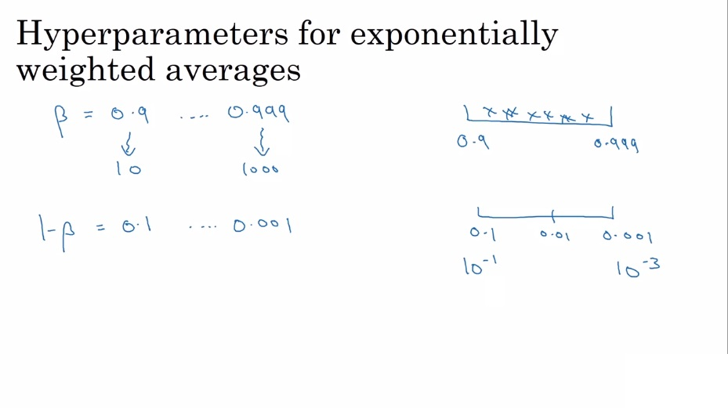
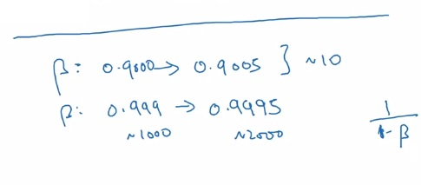
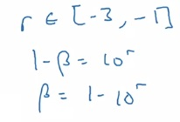
EWA beta

Slide 8
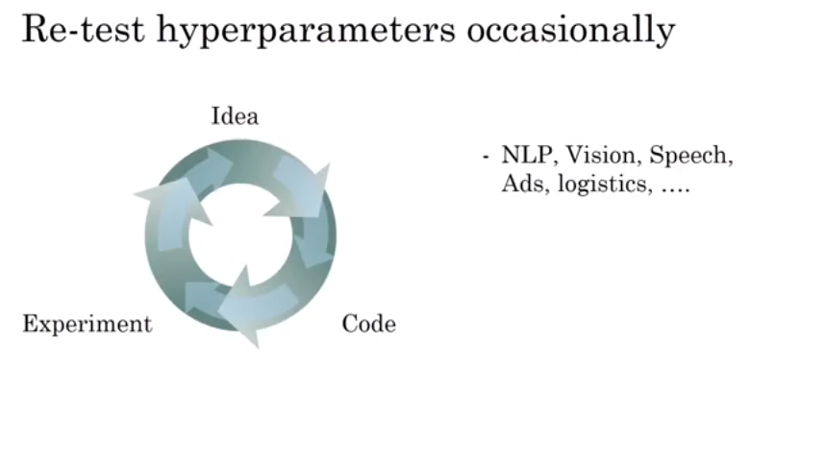
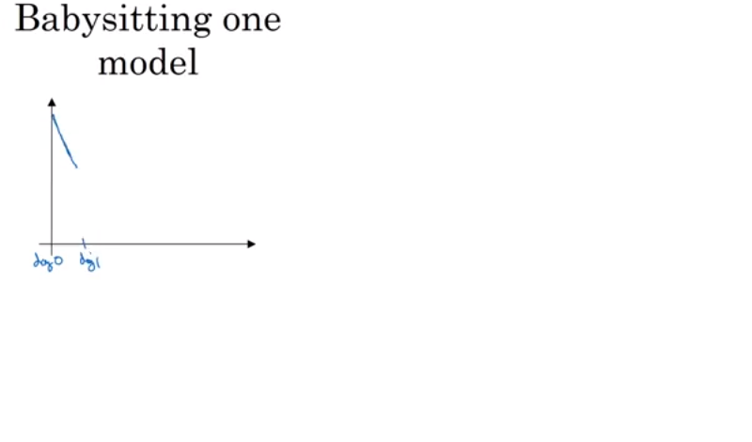
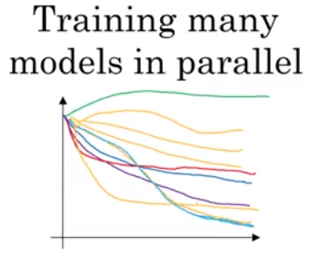
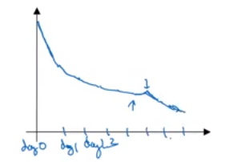
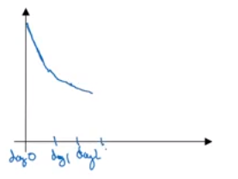
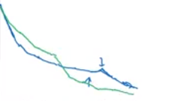

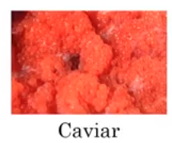
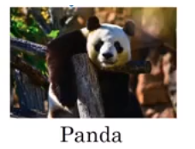
Panda and caviar
Think of this decision as
A function of how much
Computing power you
Have access to!

Slide 9
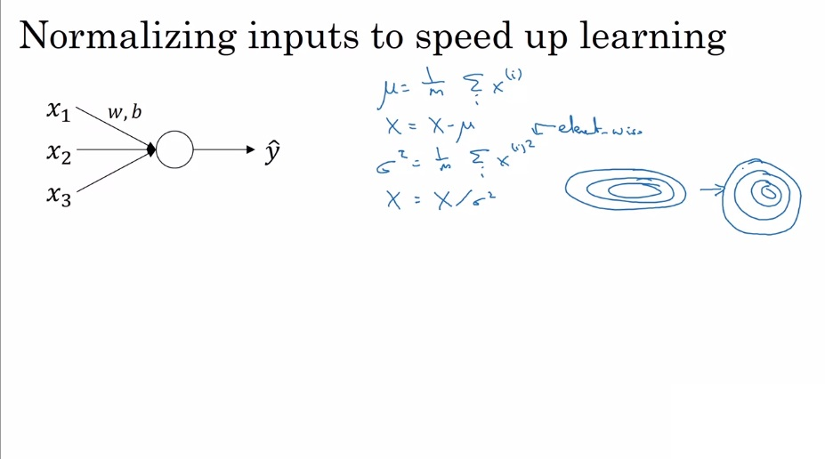
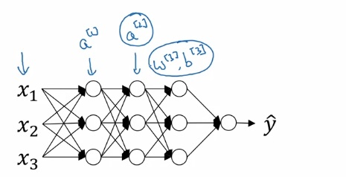
Batch normalization
Can we normalize the values of a given hidden layer
to train the next layer’s parameters faster?
Hint: yes

Slide 10
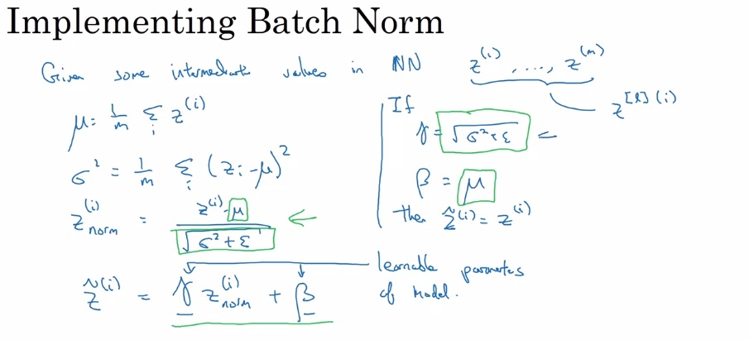
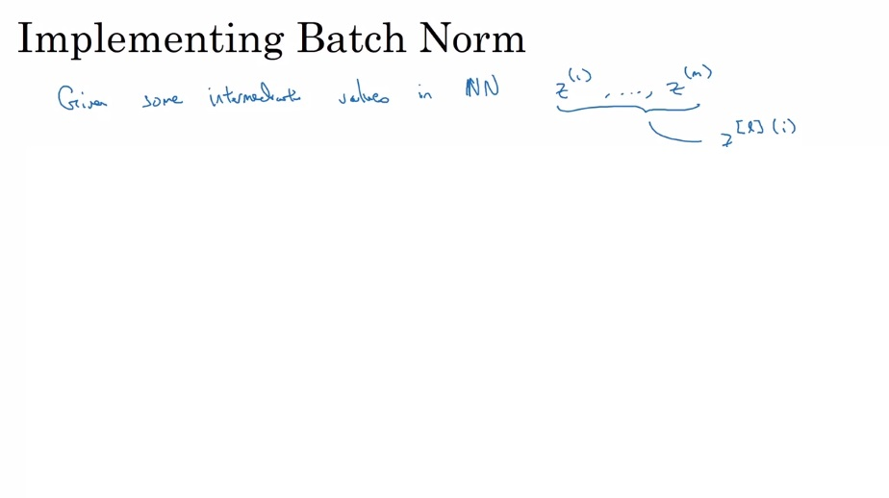
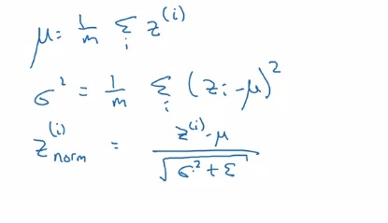
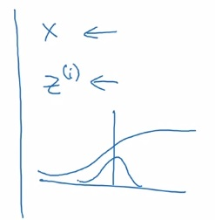

Batch norm implementation
Now the input to our activation
function has mean = 0 and variance =1
Now the NN can set the mean and variance to be whatever it wants
So now just use Z~ instead of Z

Slide 11
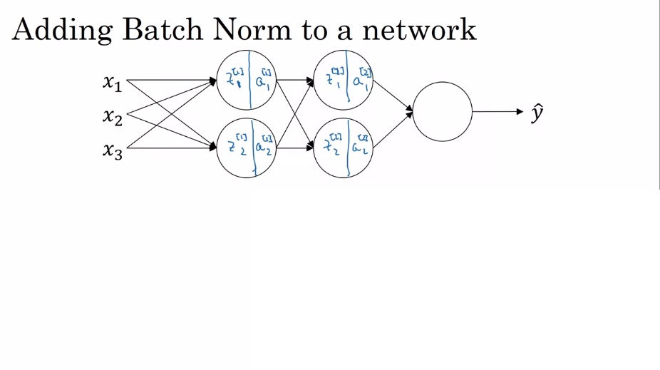
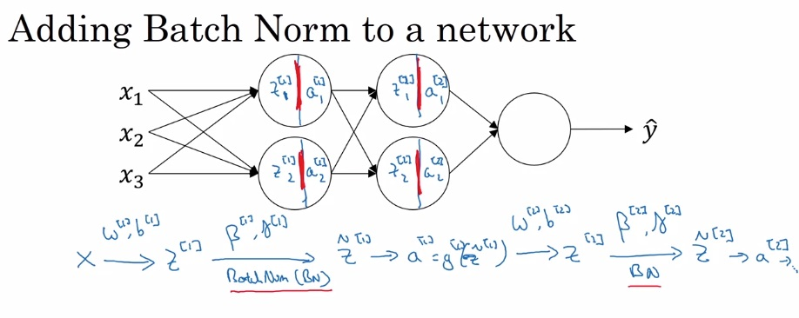
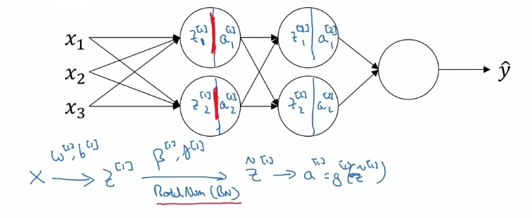


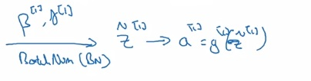
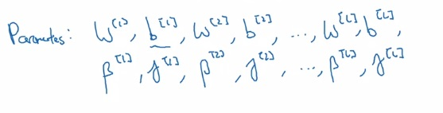

Making batch norm work
Beta unrelated to betas from optimizers!

Slide 12
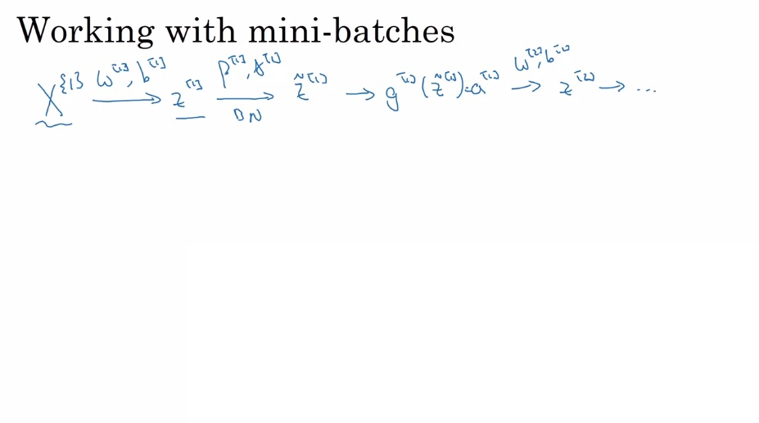
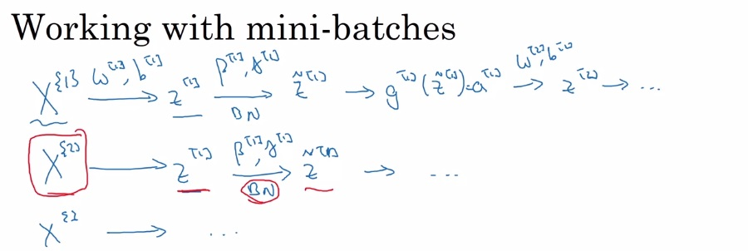
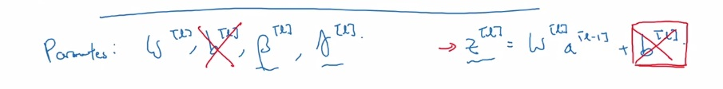
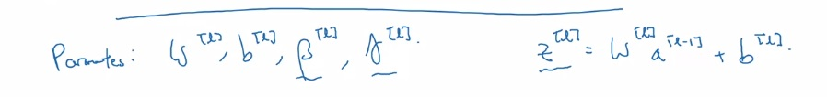
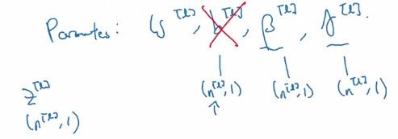
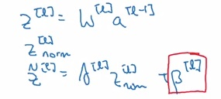
Mini-batch Batch norm

Slide 13
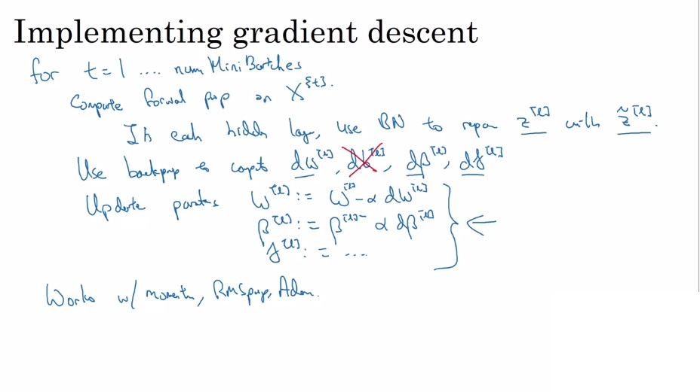
Gradient descent for batch norm

Slide 14
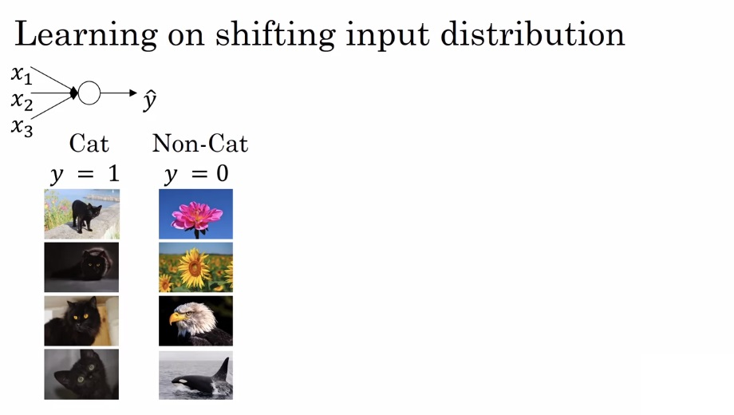
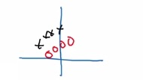
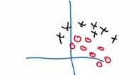
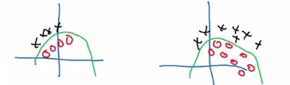
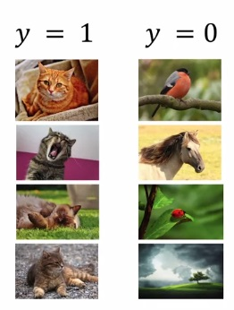
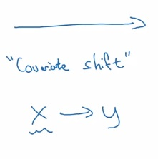
The magic of batch normalization

Slide 15
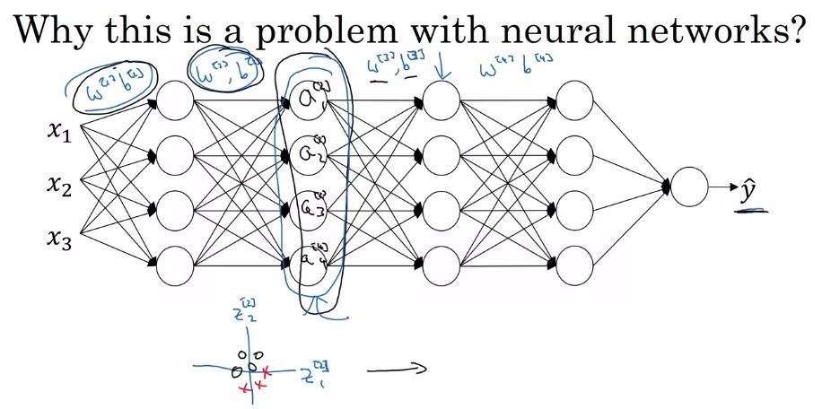
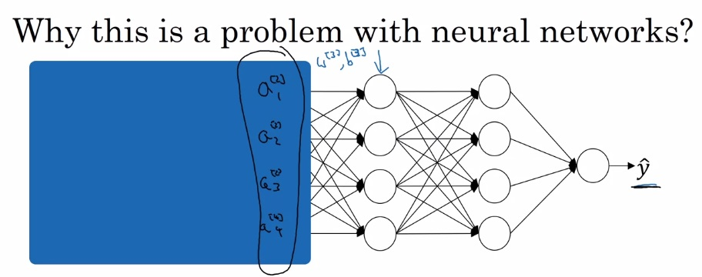





Covariate shift in neural networks
“stabilizing” the earlier
layers
Even if the exact
Z values change,
The mean and the variance will remain
Relatively the same

Slide 16

Extra effect of batch norm
A larger mini-batch size reduces this effect because it results in
a better approximation of the mean and variance

Slide 17






Testing with batch norm
How do we compute the mean and variance
with no mini-batches at test time?
Estimate them using exponentially weighted moving
averages

Slide 18





Softmax classification
Or, (0, …, C-1)

Slide 19












The softmax activation function
element-wise!
(4, 1)

Slide 20


What is softmax capable of?

Slide 21




How to train a nn with a softmax layer

Slide 22










Softmax loss/cost function
An example of maximum likelihood estimation
One hot encoded vectors!

Slide 23



Multi-class gradient descent

Slide 24


Finally no more “from scratch” coding

Slide 25

Tensorflow as an automation differentiator

Slide 26




Tensorflow code

Slide 27
Coarse to fine sampling scheme

