Slide 1

딥러닝 스터디 (Model-Compression)
열려라 참깨팀 : 임서진 조원

Slide 2
Model Compression
[ Model Compression ]
= It is a method of reducing redundancy or increasing efficiency to improve model efficiency.
[ Model Compression kinds ]
(1) Pruning : It is a method of reducing direct model size by removing neurons of low importance from the model.
(1-1) The computational volume reduction and model size reduction rate are significant due to model optimization.
(1-2) Model learning and pruning processes are complex and take a very long time, and different application methods are required for each task.
(2) Quantization : It is a lightweight technique that speeds up calculation and memory access by expressing the parameters of the model in lower bits.

Slide 3
Quantization
Lighten calculation and memory access by expressing the model's parameters in lower bits.
keras model’s parameters(i.e. weights, bias, …) are each represented by a float32. Since float32 has 32 bits of memory, Quantization makes it lighter by expressing it lower than 32 bits.
<Objectives and Features >
To reduce the model size
Decrease Memory bandwidth requirement
Int8 operation is much faster than float32
Supports only forward passes for quantified operators rather than speeding up trains

Slide 4
Quantization – advantages/disadvantages
< Advantages >
Model Size Reduction (Storage Capacity Efficiency)
RAM memory bandwidth savings
Speed up inference speed
Streamline power consumption
< Disadvantages > Model accuracy degraded

Slide 5
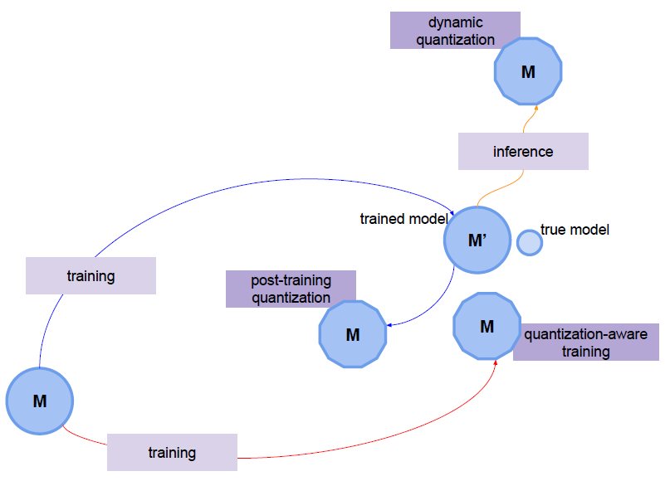
Quantization - Types of techniques
Post Training Quantization
= To quantize the Post Training mode
= A technique to apply quantize after training. Parameter size Small drop in accuracy in large models and parameter size Not suitable in small models.
- Dynamic quantization / Static quantization
Quantization Aware Training
= Simulate quantization through learning
= Quantize during the training process.
= Simulate how it behaves when quantified by adding Fake quantization node.

Slide 6
Quantization – Dynamic Quantization
The simplest quantization technique
Quantification progresses only for the weight of the model
Activations are dynamically quantified when inferring
< Process >
Activations read, write to memory in floating point form
This technique uses quantified kernels to change only the weights in the model from float32 to int8. In addition, weights are converted from int8 to float32 using floating-point kernel only at the time of inference.
Activation is always stored as a floating point. Therefore, operators that support quantified kernels processing dynamically quantified the activation to 8 bits before processing, and then dequantized again after processing.

Slide 7
Quantization – Dynamic Quantization
Quantized Kernels
(model’s weight)
(Float32 -> Int8)
Floating-point kernel
(model’s weight)
(Int8 -> Float32)
Inference
Weights are quantified after training and activations are dynamically quantified at the reference time.

Slide 8
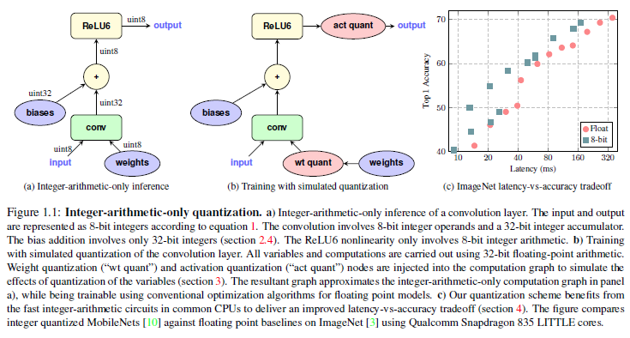
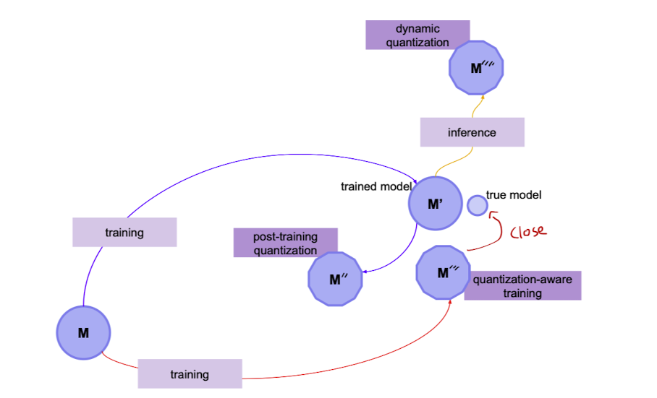
Quantization Aware Training
Quantification while learning the weights and activations of the model
Quantize the training process.
Place Fake-quantification modules/modes where quantization occurs
Rewind the simulation to see how it is done afterwards.
At this time, the accuracy of the training quantization model is minimized considering that the original training loss is performed badly and has been quantified.
Has the most accurate accuracy

Slide 9
Pruning
It is a way to remove unimportant parameters out of many of the network's parameters.
(1) Sorting neurons to create a rank by setting certain criteria
(2) Eliminates neurons that cannot exceed a certain threshold depending on the ranking
(2-1) During this process, many parameters are removed because it affects all the neurons connected to the back.
(2-2) This results in a slightly less accurate Pruned network than before.
(2-3) Too much pruning will compromise the network, making it impossible
(3) Corrupt networks are re-trained after pruning to restore accuracy
Pruning also does not store neurons that have been cut off once

Slide 10
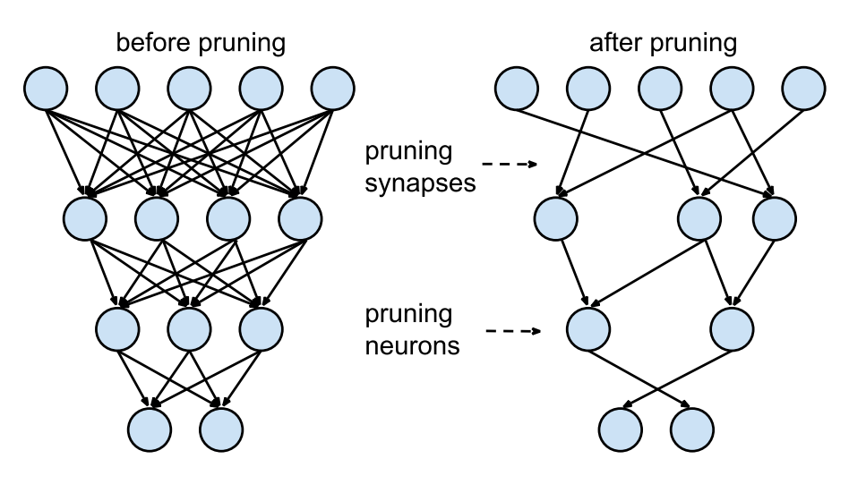
Pruning
A popular method in the discussion tree as well as the neural network.
“ Weight Sum” = Means averaging with weights
< Advantages >
Speeds inference (because parameters are reduced)
Regularization increases generalization performance
< weakness >
Loss of information
Granularity affects the effectiveness of hardware acceleration designs (too sparse to reduce hardware acceleration efficiency)

Slide 11
Pruning – How to proceed
100
(1) Restrict Properties
Depth of the tree, maximum number of Leaf Nodes, maximum number of nodes partitioned
: Limit tree depth through max_depth.
(2) Adjusting “min_sample_split” parameters
: Determines the minimum number of data contained in a node
<ex> * max_depth : 4
* min_sample_split : 8
70
60
40
30
10
40
70
3
7
70

Slide 12
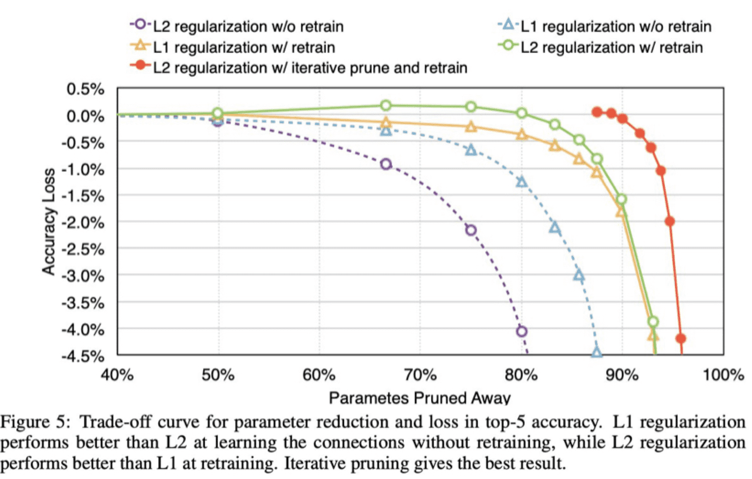
Pruning – Regularization
<Regularization > = Reduces complexity to reduce overfitting or variance
L1 normalization and L2 normalization can be applied and overall L2 normalization yields good pruning results
> L1 normalization removes many connections, which does not compensate well for accuracy loss in the retraining phase.
-> L2 normalization is a relatively large weight if the loss function is constrained
L1 normalization penalizes weights in proportion to the sum of the absolute weights and causes the lower-importance weights to zero

Slide 13
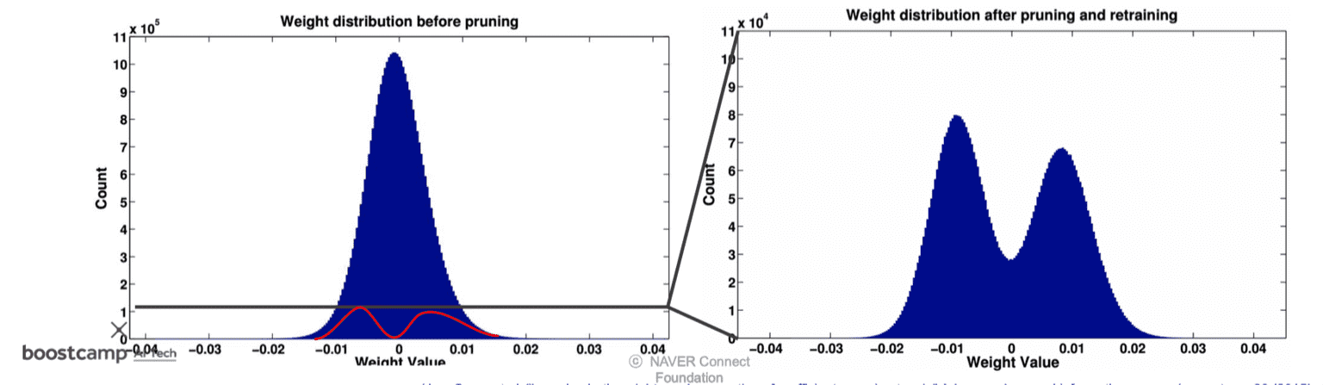
Pruning – (ex)
Photos before and after Pruning significantly reduce the weight distribution around zero.
= > Truncating information around 0 that you think is meaningless.

Slide 14
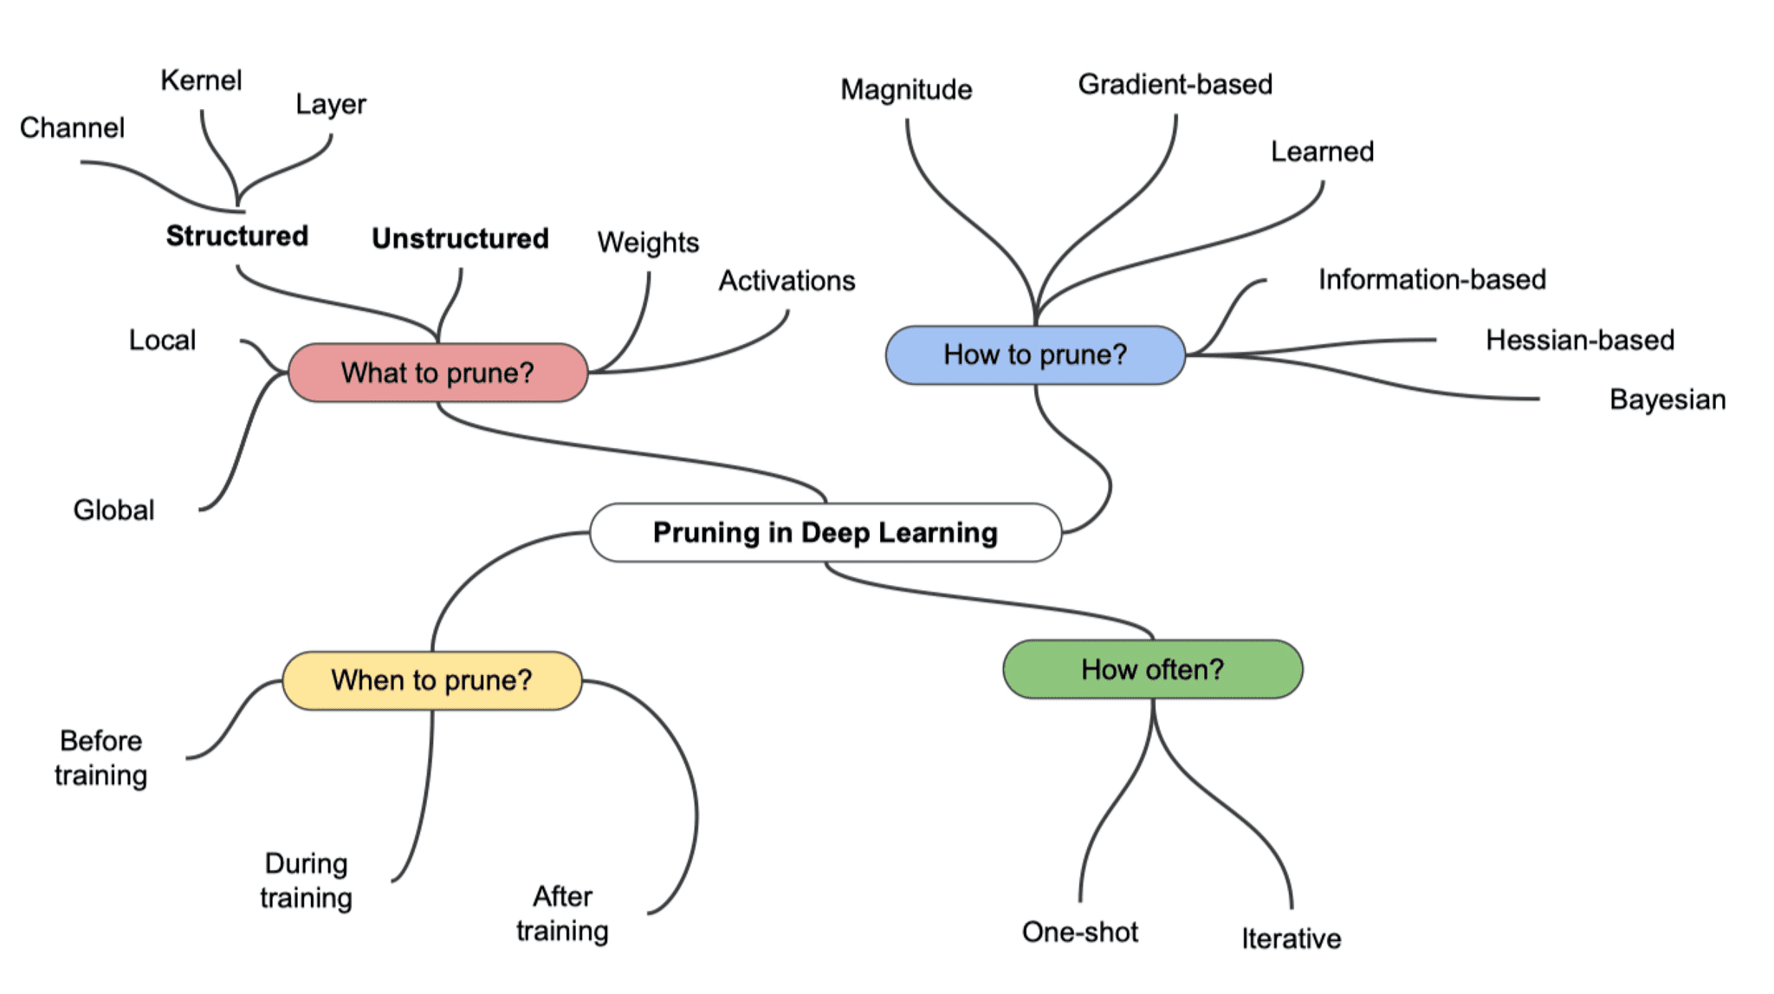
Pruning - Techniques
What to prune : What to cut out.
(1) Unstructured : Randomly cut individual weights
= Weight of 0 is usually removed after pruning.
(2) Structured : Hold the unit and cut it at once.
= Produces good optimization per hardware unit because it is pruned and cut by specification unit
= After pruning, there will be some left with zero weight
How to prune : How to cut out.
When to prune : When to cut.
How often : How often are you going to cut it out?

Slide 15
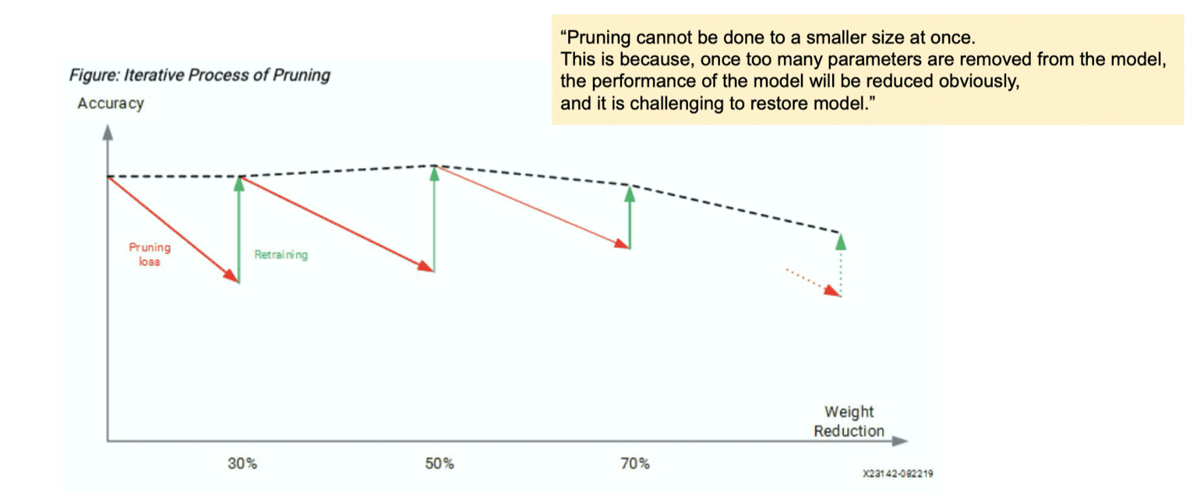
How often – iterative pruning
Pruning is not performed at once, but after pruning, it goes through retaining (fine tuning or from scratch) several times.
If performed at once, all the weights will be cut off and performance will be reduced dramatically.
To avoid performance degradation, the method of restoring performance over and over again and then pruning metallurgical is primarily used.

Slide 16
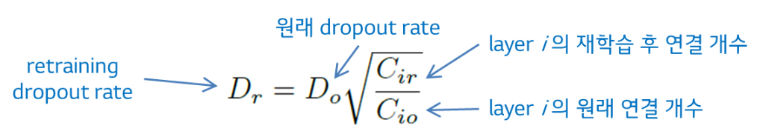
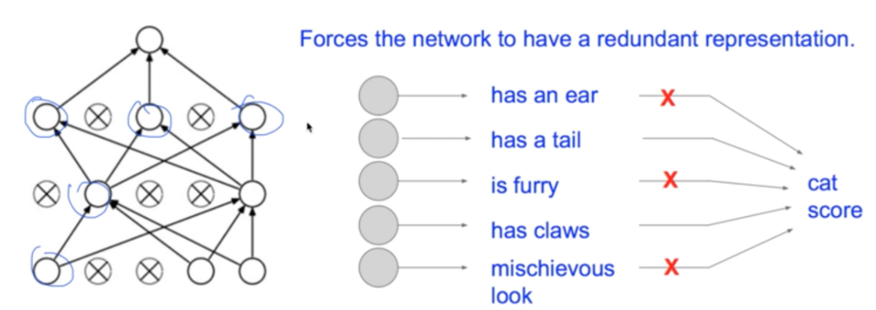
Dropout Ratio Adjustment
Pruning has already reduced the capacity of the model, so it applies a lower dropout ratio to reduce the dropout during retraining
Dropout: One of the ways to solve the overfitting of a model by partially omitting neurons in the neural network. (Dropout's weight changes frequently)
This means zeroing out the rest of the neurons by participating only a fraction of the weights contained in the layer.

Slide 17
reference
딥러닝 Quantization(양자화) 정리 (velog.io)
Dropout 이란 무엇인가 :: 알고풀자 (tistory.com)
Quantization (velog.io)
TFLite 뽀개기 (3) - Quantization (da2so.github.io)
모델 경량화 1 - Pruning(가지치기) | aalphaca's devlog (blogik.netlify.app)

Slide 18
Thank you!

