Slide 1
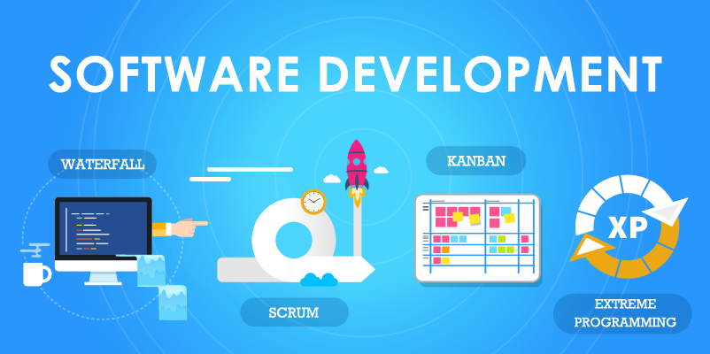
Comparative analysis of software lifecycle models

Slide 2
Contents of the presentation
Brief descriptions of 4 software lifecycle models
- waterfall model
- iterative model
- spiral model
- V-model
Pros and cons of each model
Result

Slide 3
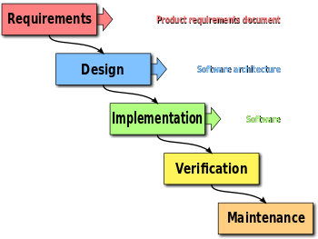
Brief description of Waterfall model
The waterfall model is a relatively linear approach for development of the software.
The process looks like flow, which sequentially moves "down" through the phases of requirements analysis, development, implementation, testing, integration and support.
This approach isn't enough flexible and iterative.

Slide 4
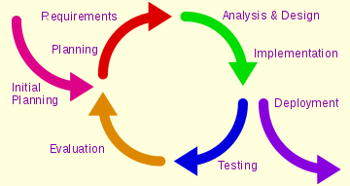
Brief description of Iterative model
The iterative model is approach, where works are in progress parallel with uninterrupted analysis of results and correction previous phases of work.
The project with such approach in each phase of evolution pass repeating cycle PDCA (plan-do-check-art cycle)
This approach is variability and flexible.

Slide 5
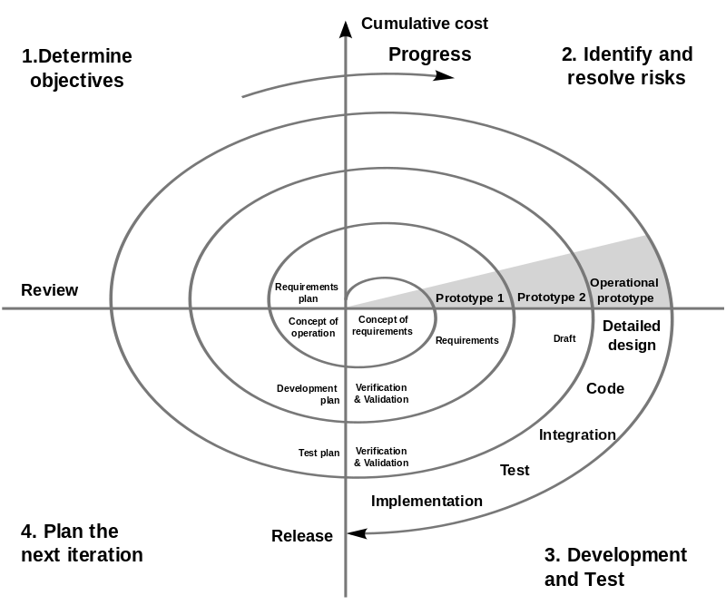
Brief description of Spiral model
The spiral model is combination of linear and iterative approach with special attention to the risks, which are affect for project.
The goals and characteristics of project are revision on each turn of spiral. Thus details of project become more deepen, what allow to choose the most reasonable variant.

Slide 6
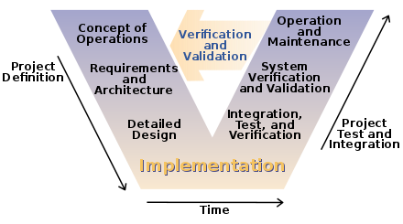
Brief description of V-model
In software development, V-model is use for definition of software development unified procedure.
This model may be considered as variation of the waterfall model, where development tasks go from top to bottom on the left side of the letter V, and testing tasks go upwards on the right side of the letter V.

Slide 7
Pros and cons of each model
 | Pros | Cons
Waterfall model | The formalization of this model may reduce risks of the project | Not enough flexible and visibility, lack communication between phases, impossibility to start next phase without finally end of the previous phase.
Iterative model | Flexibility and adaptability, less human resource and time for project, estimate of risks is adequate and timely | The main problem is definition right moment to transition on the next phase – must be define the time limit for each phase
Spiral model | Flexibility and adaptability, less human resource and time for project, estimate of risks is adequate and timely, not complete work will be finish on the next iteration | The main problem is definition right moment to transition on the next phase – must be define the time limit for each phase
V-model | The formalization of this model may reduce risks of the project | Not enough flexible and visibility, lack communication between phases, impossibility to start next phase without finally end of the previous phase.

Slide 8
Result
Model and criteria | Waterfall model | Iterative model | Spiral model | V-model
Approach | Linear | Iterative | Linear+Iterative | Linear
Visibility | Low | High | High | Low
Quality | Low (due to the lack actual communication between stages) | High (due to the continuous connection between stages) | High (due to the combination waterfall model and iterative model) | Low (due to the lack actual communication between phases)
Risks | High | Low | Low | High
Ability to handling changes | Low (any change on the development or testing phase is cause to return on the development phase) | High (any change may be add, develop and testing practically at the same time without stopping of process) | High (by reason of the combination waterfall model and iterative model) | Low (any change on the development or testing phase is cause to return on the development phase)
Project time | Can’t be estimated (by reason of the previous item and impossibility to start next phase without finally end of the previous phase) | May be estimated (by reason of the previous item and customer’s possibility to get the product by iterations) | May be estimated (by reason of the combination waterfall model and iterative model) | Can’t be estimated (by reason of the previous item and impossibility to phase next stage without finally end of the previous phase)

