Slide 1
KANBAN
Just in time

Slide 2

Contents of the presentation
1. What is Kanban
2. Main principles
3. Main practices
4. Main roles
5. Modern-Day Kanban
6. Summary

Slide 3
1. What is Kanban
Kanban is a workflow management method designed to help you visualize your work, maximize efficiency and be agile.
From Japanese, Kanban is literally translated as billboard or signboard. Originating from manufacturing, it later became a territory claimed by agile software development teams.
Work items are visualized to give participants a view of progress and process, from start to finish.

Slide 4
1. What is Kanban
Taiichi Ohno, an industrial engineer at Toyota, developed Kanban to improve manufacturing efficiency.
In software development, the aim is to provide a visual process management system which aids decision-making about what, when, and how much to produce. Kanban is commonly used in software development in combination with other methods and frameworks such as Scrum.

Slide 5
2. Main principles
Kanban is based on 4 basic principles.
Start With What You Do Now
Agree to Pursue Incremental, Evolutionary Change
Respect the Current Process, Roles & Responsibilities
Encourage Acts of Leadership at All Levels

Slide 6
2. Main principles
Start With What You Do Now
Kanban’s flexibility allows it to be overlaid on existing workflows, systems and processes without disrupting what is already successfully being done.
It will highlight issues that need to be addressed and help to assess and plan changes so their implementation is as non-disruptive as possible.

Slide 7
2. Main principles
Agree to Pursue Incremental, Evolutionary Change
The Kanban methodology is designed to meet minimal resistance and thus encourages continuous small incremental and evolutionary changes to the current process.
In general, sweeping changes are discouraged because they usually encounter resistance due to fear or uncertainty.

Slide 8
2. Main principles
Respect the Current Process, Roles & Responsibilities
Kanban recognizes that existing processes, roles, responsibilities, and titles have value and are, generally, worth preserving. The Kanban method does not prohibit change, but neither does it prescribe it as a ‘universal panacea’.
It is designed to promote and encourage incremental, logical, changes without triggering a fear of change itself.

Slide 9
2. Main principles
Encourage Acts of Leadership at All Levels
It reminds you that some of the best leadership comes from everyday acts of people on the front line of their teams.
It is important that everyone fosters a mindset of continuous improvement in order to reach optimal performance on a team/department/company level. This can’t be a management level activity.

Slide 10
3. Main practices
There are three core practices that need to be present to successful implementation:
Visualize the Workflow
Limit Work in Progress
Manage Flow

Slide 11
3. Main practices
Visualize the Workflow
The first and most important thing for you is to understand how the flow of work currently functions.
To visualize your process with a Kanban system, you will need a board with cards and columns. Each column on the board represents a step in your workflow. Each Kanban card represents a work item.
When you start working on item X, you pull it from “To Do” column and when it is completed, you move it to “Done”. This way you can easily track progress and spot bottlenecks.

Slide 12
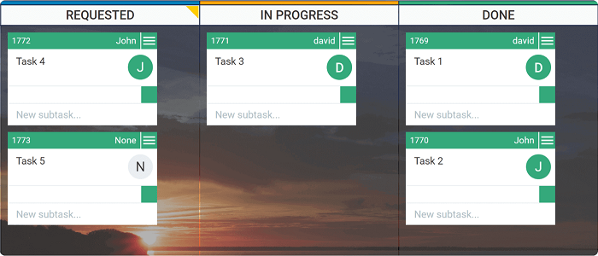
Main practices
Visualize the Workflow – Kanban board

Slide 13
3. Main practices
Limit Work in Progress - WIP
A primary function of Kanban is to ensure a manageable number of active items in progress at any one time. If there are no work-in-progress limits, you are not doing Kanban.
Limiting WIP means that a pull system is implemented on parts or all of the workflow. Setting maximum items per stage ensures that a card is only “pulled” into the next step when there is available capacity. Such constraints will quickly illuminate problem areas in your flow so you can identify and resolve them.

Slide 14
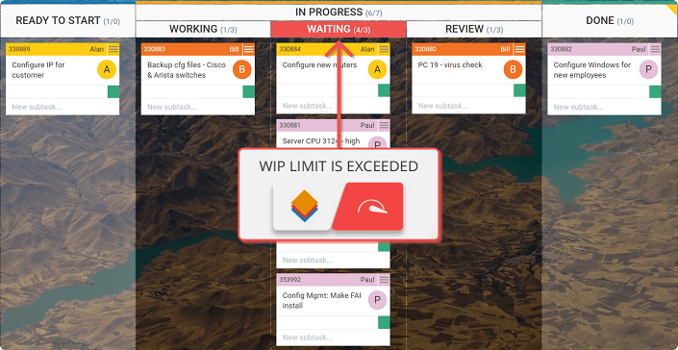
3. Main practices
Limit Work in Progress – WIP

Slide 15
3. Main practices
Manage Flow
The whole idea of implementing a Kanban system is to create a smooth healthy flow. By flow, we mean the movement of work items through the production process.
So, managing the flow is about managing the work but not the people. So instead of micro-managing people and trying to keep them busy all the time, we should focus on managing the work processes and understanding how to get that work through the system faster.

Slide 16
4. Main roles
The roles have a lot less significance to Kanban compared to the roles in Scrum.
A major proof of this is the fact that although these roles have been present from the early days of the Kanban method, they are almost never mentioned.
There are two primary roles that can be implemented by teams practicing Kanban:
Service Delivery Manager (SDM)
Service Request Manager (SRM)

Slide 17
4. Main roles
The Service Delivery Manager in Kanban
The Service Delivery Manager is a role dedicated to improving the efficiency of your workflow. Also known as Flow manager, it is not meant to be an equivalent to the scrum master, although the roles have some similarities.
The service delivery manager has to make sure that work items flow and facilitate change and continuous improvement.
In this context, the SDM shouldn’t be a distinctive job title, but an add-on to the current responsibilities of a team member.

Slide 18
4. Main roles
The Service Delivery Manager in Kanban
The Service Delivery Manager usually has two primary functions:
To make sure that work items flow
To facilitate change and continuous improvement activities
The responsibilities may vary depending on the needs of your specific organization but here’s a summary of what they can be:
Collecting data about the work items on the Kanban board and discussing it with the team
Asking questions until the team has identified a true root cause for a given problem
Making sure that errors are not repeated more than once

Slide 19
4. Main roles
Service Request Manager
The Service Request Manager is another under-the-radar Kanban role that can be assigned as an add-on to a team member. It has similar functions to those of the product owner in Scrum, as she is responsible for understanding the clients’ needs and expectations.

Slide 20
4. Main roles
Service Request Manager
The primary goal of an SRM should be to serve as a risk manager and facilitator.
To describe it with actual responsibilities, it is associated with:
Ordering work items from the backlog and facilitating prioritization of what comes next
Owning the policies for the system which frame decisions together
Improving corporate governance, consistency of process, and reducing personnel risk associated with a single individual

Slide 21
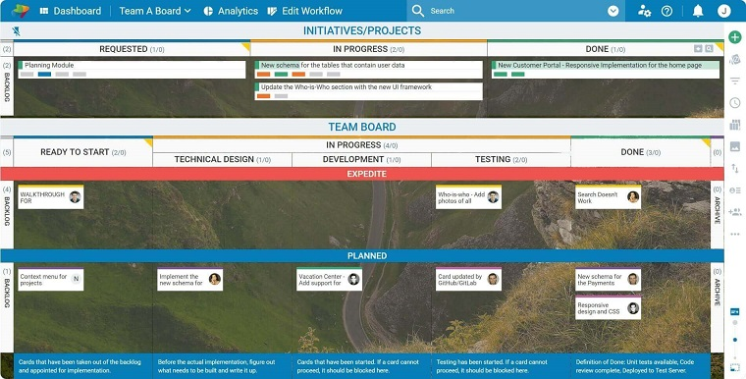
5. Modern-Day Kanban
With the development
of technology,
Kanban has been also
continuously improving.
Digital Kanban board
solutions have been
developed to overcome
the problems arising
in remote teams.

Slide 22
6. Summary
Trying to learn what is Kanban could be hard at first but now that you know what it is, you can make the most out of the main benefits of Kanban:
Physical and digital Kanban boards help you visualize your work
Kanban is easy to adopt and - just start with what you have
WIP limits empower you to become more efficient

