Slide 1
SAFe
Scaled Agile Framework

Slide 2
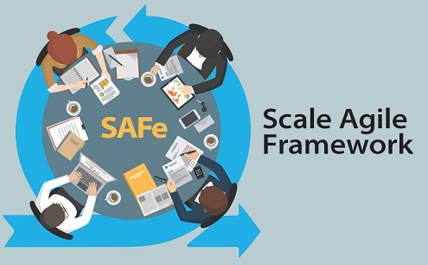
Contents of the presentation
1. What is SAFe
2. Different levels in SAFe
3. Summary

Slide 3
1. What is SAFe
The Scaled Agile Framework, or SAFe, methodology is an agile framework for development teams built on three pillars: Team, Program, and Portfolio.
SAFe is designed to give a team flexibility and to help manage some of the challenges larger organizations have when practicing agile.
It is designed not so much as a single methodology, but as a broad knowledge base of proven best practices that real teams have used to deliver successful software products.

Slide 4
1. What is SAFe
The SAFe framework was introduced in 2011. It was originally called the “Agile Enterprise Big Picture” by software-industry veteran Dean Leffingwell, who published the bestselling book Agile Software Requirements. The Big Picture described how to leverage existing agile frameworks such as Lean, Kanban, Scrum, and XP—and apply them at the Team, Program, and Portfolio.
Today, SAFe’s entire catalog of knowledge and success patterns is all available for free, and it has become one of the most popular agile frameworks.

Slide 5
1. What is SAFe
SAFe’s strengths include:
Helps cross-functional teams collaborate more effectively
Helps organizations achieve greater transparency
Aligns all aspects of a project to the broader business goals
SAFe’s weaknesses include:
Some believe the framework is not pure agile, because requires too much upfront planning and process definition
Also takes more of a top-down approach rather than a team-based approach

Slide 6
1. What is SAFe
There are two different types of SAFe implementation:
SAFe 4.0 implementation
SAFe 3.0 implementation

Slide 7
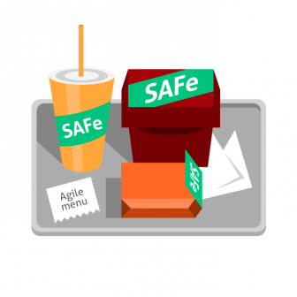
2. Different levels in SAFe
SAFe 3.0 is for smaller implementations with 100 or fewer people. Programs that do not require significant collaboration.
SAFe 4.0 is for solutions that typically require many hundreds of practitioners to develop deploy and maintain software.

Slide 8
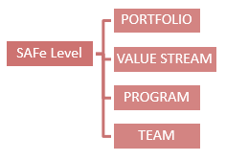
2. Different levels in SAFe
In SAFe 3.0 implementation we have 3-levels:
Team
Portfolio
Program
In SAFe 4.0 implementation we have 4-levels:
Team
Portfolio
Program
Value Stream

Slide 9
2. Different levels in SAFe – Team level
All SAFe teams are part of one or other Agile Release Train (ART).
SAFe teams are empowered, self-organizing, self-managing, cross-functional teams.
Each team is equally responsible for defining, building and testing stories from their Team Backlog in a fixed-length Iterations.
Teams plan and execute two-week time-boxed iterations in accordance with agreed-to Iteration Goals.
Teams will use ScrumXP/Team Kanban routine to deliver high-quality systems to produce a System Demo on every two weeks.

Slide 10
2. Different levels in SAFe – Team level
All different teams in the ART (Agile Release Trains) will create an integrated and tested system. Stakeholders will evaluate and respond with fast feedback.
They apply Built-in Quality practices.
Each ScrumXP team will have 5-9 team members, which includes all the roles necessary to build a quality incremental value in each Iteration.
ScrumXP roles includes:
Team(Dev+QA)
Scrum Master
Product Owner and etc..

Slide 11
2. Different levels in SAFe – Team level
SAFe divides the development timeline into a set of iterations within a PI (Program Increment).
PI duration is between 8 -12 weeks.
The team will use stories to deliver the value. The Product Owner will have content authority over their creation and acceptance of the stories.
Stories contain Customer's requirements.
Team Backlog includes user and enabler stories, which are identified during PI planning.

Slide 12
2. Different levels in SAFe – Team level
Each iteration provides:
- A valuable increment of new functionality
- Accomplish via constantly repeating pattern
- Plan the iteration
- Commit to some functionality
- Execute the iteration by building and testing Stories
- Demo the new functionality
- Retrospective
- Repeat for the next iteration

Slide 13
2. Different levels in SAFe – Team level
Teams also support the System Demo at the end of each Iteration. which is the critical integration point for the ART.
Larger Value Streams will have multiple ARTs.

Slide 14
2. Different levels in SAFe – Program level
At Program level, Value of SAFe is delivered by long-lived Agile Release Trains (ART). Iteration is for team and train is for the program.
Agile Release Trains (ART) is the primary vehicle for value delivery at the program level. It delivers a value stream to the organization.
The Program Increments (PI) duration is of 8 to 12 weeks.
ART is of 5 - 12 Agile Teams (~50 – 125+ people) which includes all the roles and infrastructure needed to deliver fully tested, working, system-level software.

Slide 15
2. Different levels in SAFe – Program level
At a Program level, Product Manager/Program Manager has content authority. He defines and prioritizes the program backlog.
Program backlog is a prioritized list of features.
System Architect role at the program level is to collaborate day to day work with the teams. It ensures that non-functional requirements are met.
Chief-Scrum Master role is played by 'Release Train Engineer'.
Various team forms 'Release Management Team'. They will approve routine releases of quality solutions to customers.
Deployment of software into customer environments and successful delivery is taken care of by DevOps team.

Slide 16
2. Different levels in SAFe – Portfolio level
Highest level of interest/ concern /involvement/ in SAFe is SAFe Portfolio.
The portfolio provides the basic blocks for organizing the Lean-Agile Enterprise flow of value via one or more Value Streams.
The portfolio helps to develop systems and solutions which are described in strategic themes (links a SAFe portfolio to the changing business strategy of an enterprise).

Slide 17
2. Different levels in SAFe – Portfolio level
SAFe Portfolio level contains people, processes and necessary build systems and solutions that an enterprise needs to meet its strategic objectives.
Value Streams are the primary objectives in Portfolio, with which funding for the people and other resources required to build the Solutions.

Slide 18
2. Different levels in SAFe – Value Stream level
The Value Stream level is optional in SAFe.
The Value Stream level is designed for organizations who are:
- Large in size
- Independent
- Have complex solutions
- Their solutions typically require multiple ARTs
- They face the largest systems challenges

Slide 19
2. Different levels in SAFe – Value Stream level
Building this kind of systems often takes hundreds, even thousands of practitioners, external and internal suppliers.
The Value Stream level supports synchronization for multiple ARTs and Suppliers. It includes Pre-and Post-PI Planning meetings and Solution Demo.
It gives additional roles which are: Value Stream Engineer, Solution Architect/Engineering, and Solution Management.

Slide 20
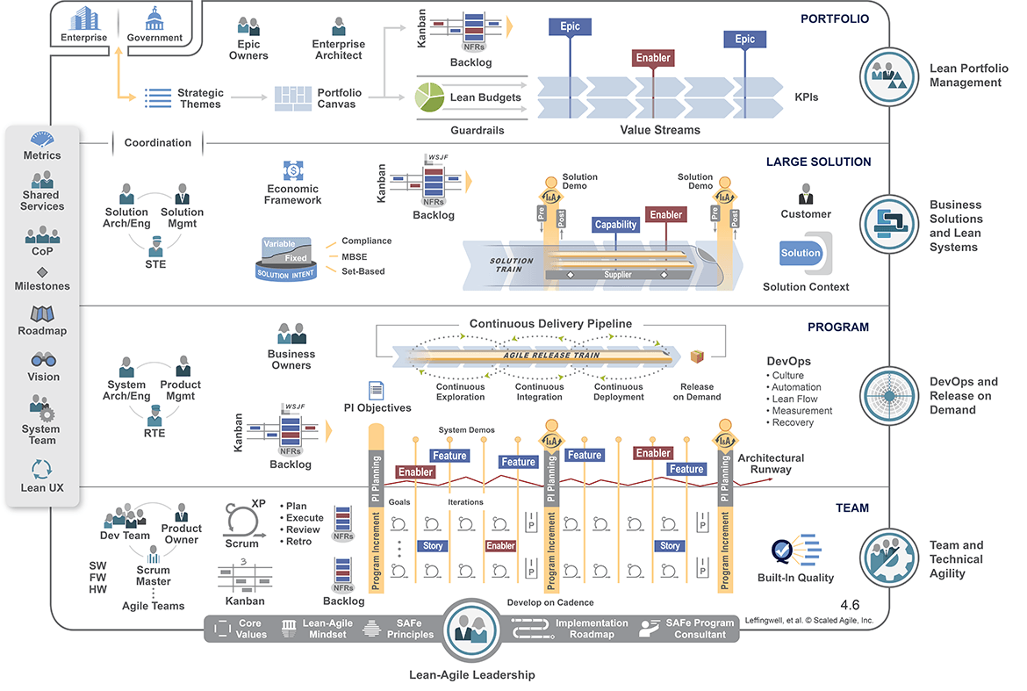
2. Different levels in SAFe – all levels

Slide 21
3. Summary
SAFe is an industry-proven, value-focused method for scaling Agile at the Enterprise level.
It answers the questions like "How do we plan?", "How do we budget?", and "How do we become cross-functional in architecture and DevOps?"
SAFe helps large organization teams to meet an organization's strategic goals, not just individual project goals.
The framework offers the ability to maintain and create a centralized strategy to deliver value.
The SAFe model has three/four levels that centralize the strategic themes of an organization.

