Slide 1
SCRUM
The agile method to manage the projects

Slide 2
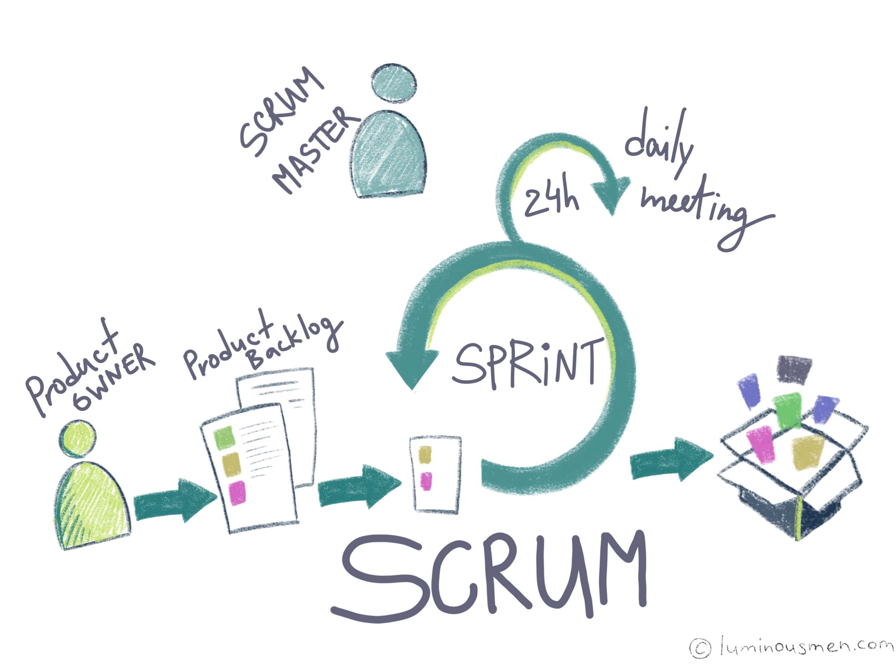
Contents of the presentation
What is Scrum
2. Main approaches
3. Main artifacts
4. Main roles
5. Main activities

Slide 3
1. What is Scrum
Scrum is a framework within which people can address complex adaptive problems, while productively and creatively delivering products of the highest possible value.
Scrum itself is a simple framework for effective team collaboration on complex products.
Scrum is:
Lightweight
Simple to understand
Difficult to master

Slide 4
2. Main approaches
Scrum is simple. It is not a methodology.
The Scrum framework based on continuous learning and adjustment to changing factors. Scrum acknowledges that the team doesn’t know everything at the start of a project and will evolve through experience.
Scrum is structured to help teams naturally adapt to changing conditions and user requirements, with re-prioritization built into the process and short release cycles so the team can constantly learn and improve.

Slide 5

2. Main approaches
The Scrum guide contains the Scrum values list.
These values include:
Courage
Focus
Commitment
Respect
Openness

Slide 6
3. Main artifacts
Let’s start with identifying the three artifacts in Scrum.
Artifacts are something that we make, like a tool to solve a problem.
Scrum’s artifacts represent work or value to provide transparency and opportunities for inspection and adaptation. Artifacts defined by Scrum are specifically designed to maximize transparency of key information so that everybody has the same understanding of the artifact.

Slide 7
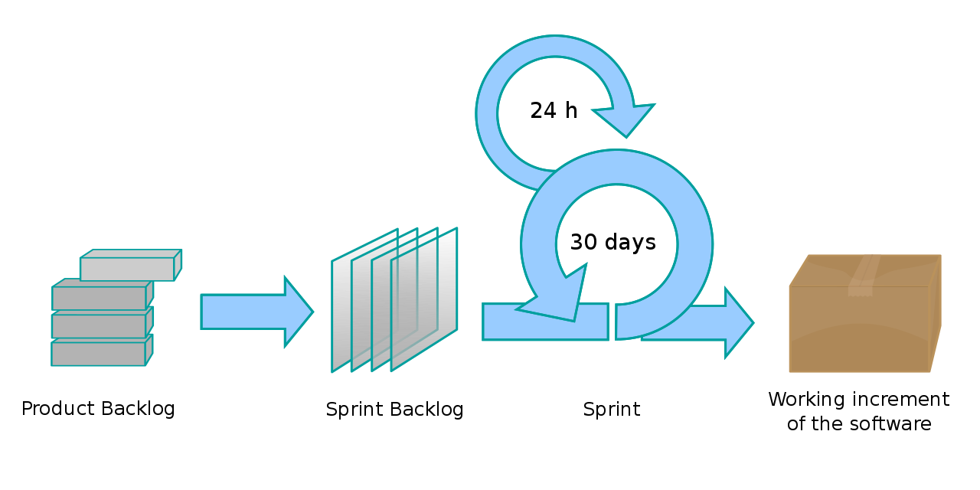
3. Main artifacts
The Scrum Artifacts are:
Product Backlog
Sprint Backlog
Increment

Slide 8
3. Main artefacts
Product Backlog
It is the master list of work that needs to get done maintained by the product owner or product manager. This is a dynamic list of features, requirements, enhancements, and fixes that acts as the input for the sprint backlog. It is, essentially, the team’s “To Do” list. The product backlog is constantly revisited, re-prioritized and maintained by the Product Owner because, as we learn more or as the market changes, items may no longer be relevant or problems may get solved in other ways.

Slide 9
3. Main artefacts
Sprint Backlog
It is the list of items, user stories, or bug fixes, selected by the development team for implementation in the current sprint cycle. Before each sprint, in the sprint planning meeting the team chooses which items it will work on for the sprint from the product backlog. A sprint backlog may be flexible and can evolve during a sprint. However, the fundamental sprint goal – what the team wants to achieve from the current sprint – cannot be compromised.

Slide 10
3. Main artefacts
Increment (or Sprint Goal)
It is the usable end-product from a sprint.
It is up to the Product Owner to decide on when an increment is released, it is the team's responsibility to make sure everything that is included in an increment is ready to be released.

Slide 11
4. Main roles
A Scrum team needs three specific roles: product owner, Scrum master, and the development team.
The team model in Scrum is designed to optimize flexibility, creativity, and productivity.
And because Scrum teams are self-organizing and cross-functional, the development team includes testers, designers, UX specialists, and ops engineers in addition to developers.

Slide 12
4. Main roles
The Scrum product owner
Product owner is the champion for their product. He/she is focused on understanding business, customer, and market requirements, then prioritizing the work to be done by the engineering team accordingly.
The product owner is not always the product manager. Product owners focus on ensuring the development team delivers the most value to the business. Also, it's important that the product owner be an individual. No development team wants mixed guidance from multiple product owners.

Slide 13
4. Main roles
The Scrum master
Scrum master is the champion for Scrum within their team. He/she coach teams, product owners, and the business on the Scrum process, and look for ways to fine-tune their practice of it.
An effective Scrum master deeply understands the work being done by the team and can help the team optimize their transparency and delivery flow. As the facilitator-in-chief, he/she schedules the needed resources (both human and logistical) for sprint planning, stand-up, sprint review, and the sprint retrospective.

Slide 14
4. Main roles
The Scrum development team
Scrum teams are the champions for sustainable development practices. The most effective Scrum teams are tight-knit, co-located, and usually five to seven members. One way to work out the team size is to use the famous ‘two pizza rule’ coined by Jeff Bezos, the CEO of Amazon (the team should be small enough to share two pizzas).

Slide 15
4. Main roles
The Scrum development team
Team members have differing skill sets, and cross-train each other. Strong Scrum teams are self-organising and approach their projects with a clear ‘we’ attitude. All members of the team help one another to ensure a successful sprint completion.
The Scrum team drives the plan for each sprint. They forecast how much work they believe they can complete over the iteration using their historical velocity as a guide. Keeping the iteration length fixed gives the development team important feedback on their estimation and delivery process, which in turn makes their forecasts increasingly accurate over time.

Slide 16
5. Main activities
Some of the more well known components of the Scrum framework are the set of sequential activities that Scrum teams perform on a regular basis.
Prescribed activities are used in Scrum to create regularity and to minimize the need for meetings not defined in Scrum. All activities are time-boxed. Once a Sprint begins, its duration is fixed and cannot be shortened or lengthened. The remaining activities may end whenever the purpose of the activity is achieved, ensuring an appropriate amount of time is spent without allowing waste in the process.

Slide 17
5. Main activities
The Scrum activities are:
Sprint
Sprint Planning
Daily Scrum
Sprint Review
Sprint Retrospective

Slide 18
5. Main activities
Sprint
A sprint is the actual time period when the Scrum team works together to finish an increment. Two weeks is a pretty typical length for a sprint. Someone advises that the more complex the work and the more unknowns, the shorter the sprint should be.
All the events — from planning to retrospective — happen during the sprint. Once a certain time interval for a sprint is established, it has to remain consistent throughout the development period. This helps the team learn from past experiences and apply that insight to future sprints.

Slide 19
5. Main activities
Sprint planning
The work to be performed (scope) during the current sprint is planned during this meeting by the entire development team. This meeting is led by the Scrum master and is where the team decides on the sprint goal. Specific use stories are then added to the sprint from the product backlog. These stories always align with the goal and are also agreed upon by the Scrum team to be feasible to implement during the sprint.
At the end of the planning meeting, every Scrum member needs to be clear on what can be delivered in the sprint and how the increment can be delivered.

Slide 20
5. Main activities
Daily Scrum
This is a daily super-short meeting that happens at the same time (usually mornings) and place to keep it simple. Many teams try to complete the meeting in 15 minutes, but that’s just a guideline. This meeting is also called a ‘daily stand-up’ emphasizing that it needs to be a quick one. The goal of the daily Scrum is for everyone on the team to be on the same page, aligned with the sprint goal, and to get a plan out for the next 24 hours.
A common way to conduct a daily Scrum is for every team member to answers three questions in the context of achieving the sprint goal:
• What did I do yesterday?
• What do I plan to do today?
• Are there any obstacles?

Slide 21
5. Main activities
Sprint review
At the end of the sprint, the team gets together for an informal session to view a demo of, or inspect, the increment. The development team showcases the backlog items that are now ‘Done’ to stakeholders and teammates for feedback. The product owner can decide whether or not to release the increment, although in most cases the increment is released.
This review meeting is also when the product owner reworks the product backlog based on the current sprint, which can feed into the next sprint planning session.

Slide 22
5. Main activities
Sprint retrospective
The retrospective is where the team comes together to document and discuss what worked and what didn’t work in a sprint, a project, people or relationships, tools, or even for certain ceremonies. The idea is to create a place where the team can focus on what went well and what needs to be improved for the next time, and less about what went wrong.
During the Sprint Retrospective, the team discusses:
What went well in the Sprint
What could be improved
What will we commit to improve in the next Sprint

