Slide 1
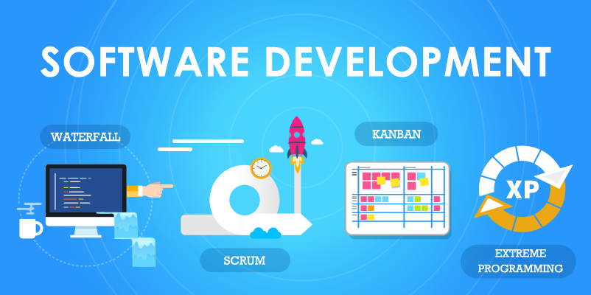
Comparative analysis of software lifecycle models

Slide 2
Waterfall vs Iterative vs Spiral vs V-model
Model and criteria | Waterfall model | Iterative model | Spiral model | V-model
Approach | Linear | Iterative | Linear+Iterative | Linear
Visibility | Low | High | High | Low
Quality | Low (due to the lack actual communication between stages) | High (due to the continuous connection between stages) | High (due to the combination waterfall model and iterative model) | Low (due to the lack actual communication between stages)
Risks | High | Low | Low | High
Ability to handling changes | Low (any change on the development or testing stage is cause to return on the development stage) | High (any change may be add, develop and testing practically at the same time without stopping of process) | High (by reason of the combination waterfall model and iterative model) | Low (any change on the development or testing stage is cause to return on the development stage)
Project time | Can’t be estimated (by reason of the previous item and impossibility to start next stage without finally end of the previous stage) | May be estimated (by reason of the previous item and customer’s possibility to get the product by iterations) | May be estimated (by reason of the combination waterfall model and iterative model) | Can’t be estimated (by reason of the previous item and impossibility to start next stage without finally end of the previous stage)

