Slide 1



EEROS with Gazebo

Slide 2
Agenda
1. Task
2. Toolchain
3. Changes in ROS-2
  3.1 Code Changes
  3.2 New Executor
4. Timedomain
5. Demo
6. Questions

Slide 3
1. Task
Eine bestehende Regelung für einen Motor soll wahlweise auf realer Hardware und in einer passenden Simulationsumgebung laufen gelassen werden können. Ein spezielles Augenmerk soll auf einer nahtlosen Integration in das bestehende EEROS Framework gelegt werden und mit passenden Werkzeugen soll alles möglichst einfach und automatisiert gestartet und demonstriert werden können. Eine komplexere Applikation mit einem kleinen Delta-Roboter soll als zweites Demonstrationsobjekt dienen.

Slide 4
2. Toolchain
ROS-1 Noetic
  Released 2020
  EOL 2025
  Last Release
Ubuntu-20.04
  EOL 2025
Gazebo 11.0
EEROS
ROS-2 Humble
  Released 2022
  EOL 2027
  Ongoing
Ubuntu 22.04
  EOL 2027
Gazebo 11.0
EEROS
ROS-1 virtually is EOL
therefore I used ROS-2
EEROS is not working wirth ROS-2

Slide 5
3. Changes in ROS-2
Messages have moved into a Sub-Namespace (msg)
Includes are snake_case and not CamelCase
ROS-2 is more Object-Oriented
C++ API is now RCLCPP and not ros.h anymore
The whole Application spins and not a single node

Slide 6
3.1 Code Changes
#include <geometry_msgs/PointStamped.h>
#include <ros.h>
geometry_msgs::PointStamped point_stamped;
#include <geometry_msgs/msg/point_stamped.hpp>
#include <rclcpp/rclcpp.hpp>
geometry_msgs::msg::PointStamped point_stamped;
#include "ros/ros.h"
#include "std_msgs/String.h"
ros::init(argc, argv, "talker");
ros::NodeHandle node;
ros::Publisher chatter_pub =
node.advertise<std_msgs::String>("chatter", 1000);
std_msgs::String msg("hello world");
while (ros::ok()) {
chatter_pub.publish(msg);
ros::spinOnce();
}
#include "rclcpp/rclcpp.hpp"
#include "std_msgs/msg/string.hpp"
rclcpp::init(argc, argv);
auto node = rclcpp::Node::make_shared("talker");
auto chatter_pub =
node->create_publisher<std_msgs::msg::String>("chatter", 1000);
std_msgs::msg::String msg("hello world");
while (rclcpp::ok()) {
chatter_pub->publish(msg);
rclcpp::spin_some(node);
}
Type:
rclcpp::Node::SharedPtr
Name on the Node
Attention: Multiple nodes with the same Name
Spinning on the node
and not the Application

Slide 7
3.2 New Executor
Subscriber has to register in the EEROS-Executor
rclcpp::CallbackGroup::SharedPtr Executor::registerSubscriber(rclcpp::Node::SharedPtr node, const bool sync) {
syncWithRosTopicIsSet = sync;
if (subscriberExecutor == nullptr) {
subscriberExecutor = rclcpp::executors::MultiThreadedExecutor::make_shared();
}
auto cb = node->create_callback_group(rclcpp::CallbackGroupType::Reentrant);
subscriberExecutor->add_callback_group(cb, node->get_node_base_interface());
return cb;
}
if (rclcpp::ok()) {
rclcpp::SubscriptionOptionsWithAllocator<std::allocator<void>> options;
options.callback_group = Executor::instance().registerSubscriber(handle, syncWithTopic);
subscriber = handle->create_subscription<TRosMsg>(topic, queueSize, std::bind(&RosSubscriber::rosSubscriberCallback, this, _1), options);
log.info() << "RosSubscriber, reading from topic: '" << topic << "' on node '" << node->get_name() << "' created.";
}
.
One Multithreaded ROS-Executor is used for all Subscribers
Every Subscriber needs a Callback-Group
// Starts spinning subscribers in an own thread to not block the program
if (subscriberExecutor != nullptr) {
subscriberThread = std::make_shared<std::thread>([this]() {
log.info() << "Starting ROS-Executor for handling RosSubscription";
subscriberExecutor->spin();
});
}
void rosSubscriberCallback(const TRosMsg& msg) {
std::lock_guard<std::mutex> lock(queue_mutex);
queue.push_back(std::move(msg));
if (syncWithTopic) {
Executor::instance().processTasks();
}
}
Subscriber-Callback calls the EEROS-Executor on every message
The ROS-Executor is starts spinning, not the node!

Slide 8
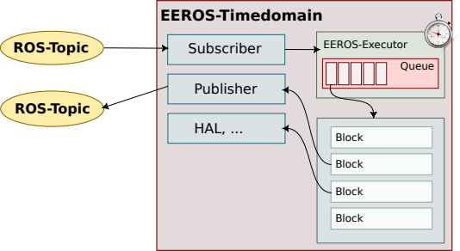
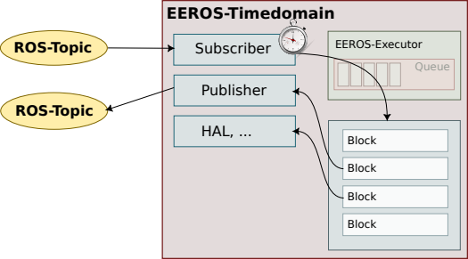
4. Timedomain

Slide 9

5. Demo

Slide 10

6. Questions

