Slide 1
Welcome to PROJECT SHOWCASE
By : Vikas denzil G(1vk16cs082)
shobhini t kumar(1vk16cs071)

Slide 2
Abstract
The main motive of our project “Project Showcase” is to display the various projects of our friends. Here we have created a user interface where people can log into out database and upload their information. They can also view the uploaded information and also edit if necessary.If the account is not created in our database, they can create an account and then get logged in. Being in one account we can serach for many other accounts by referencing their name or USN or the project name.We can other operations once we have logged in.

Slide 3
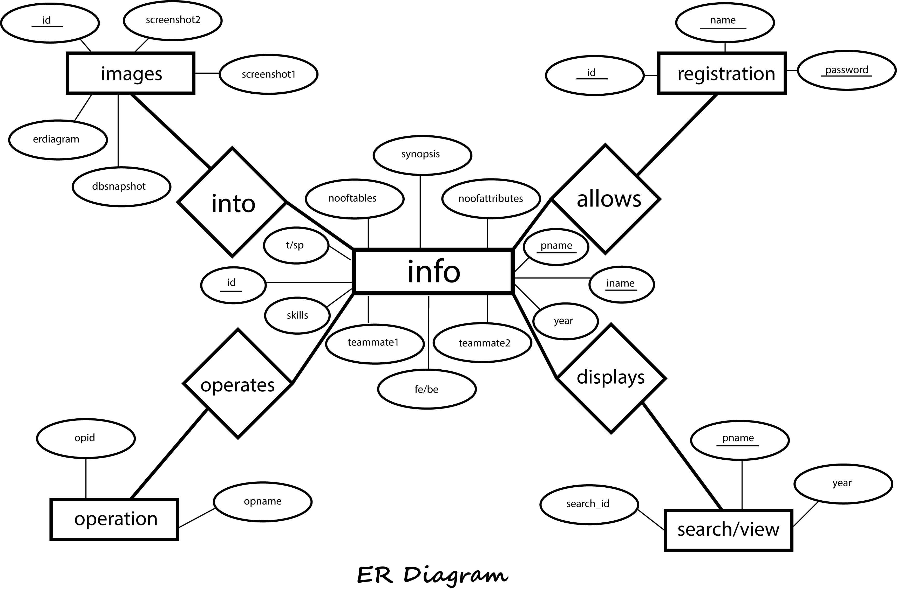
ER DIAGRAM of Project Showcase

Slide 4
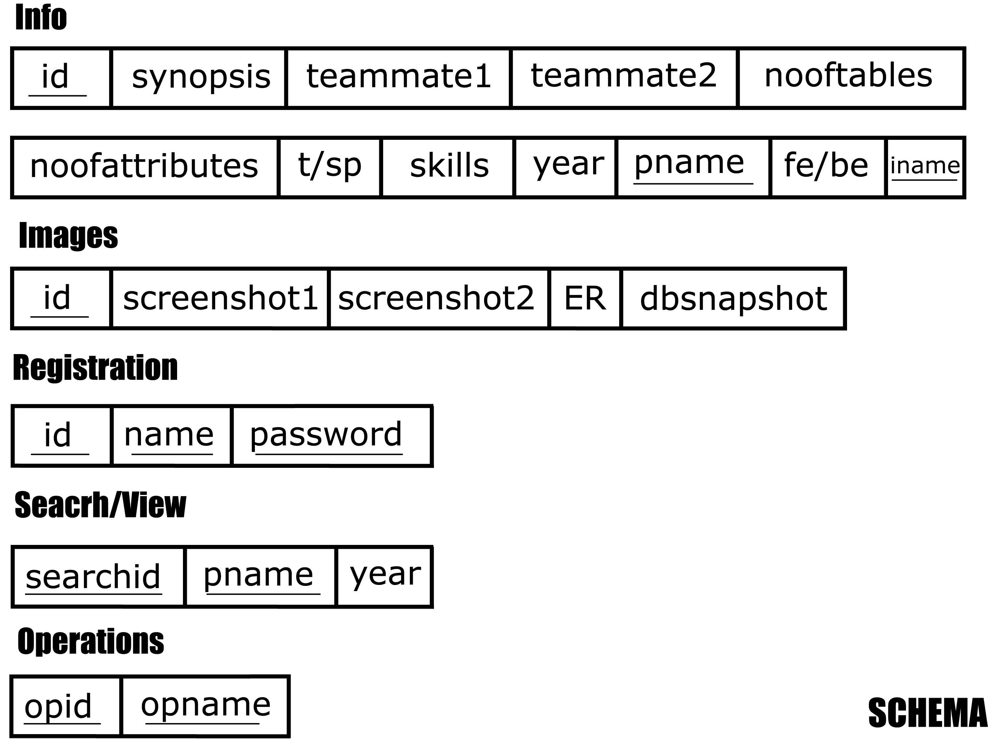
SCHEMA DIAGRAM of Project Showcase

Slide 5
Results and Snapshots
PROJECT SHOWCASE

Slide 6

WELCOME PAGE OF PROJECT SHOWCASE

Slide 7
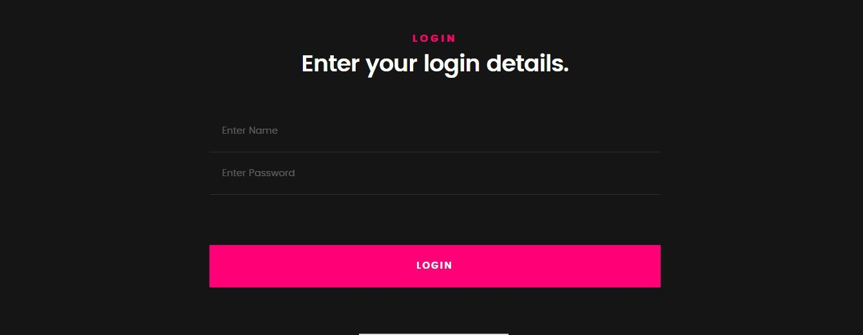
LOGIN PAGE
Used to login to the database. Is the account is created then you can directly login otherwise, you have to create an account.

Slide 8
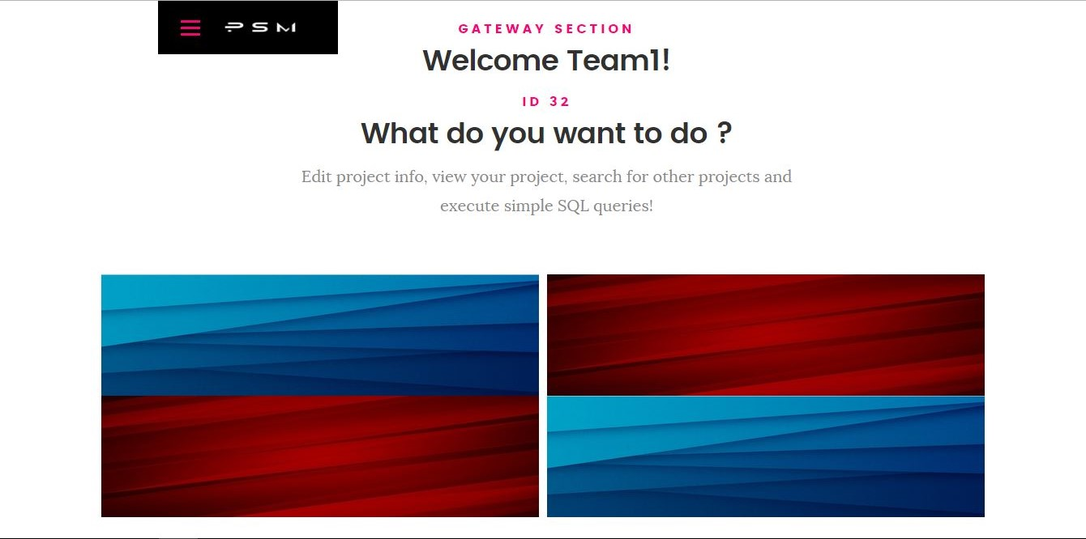
GATEWAY PAGE
It is the gateway page of project showcase. You enter into this page after getting logged in. This leads to EDIT, VIEW, SEARCH, and OPERATIONS.

Slide 9
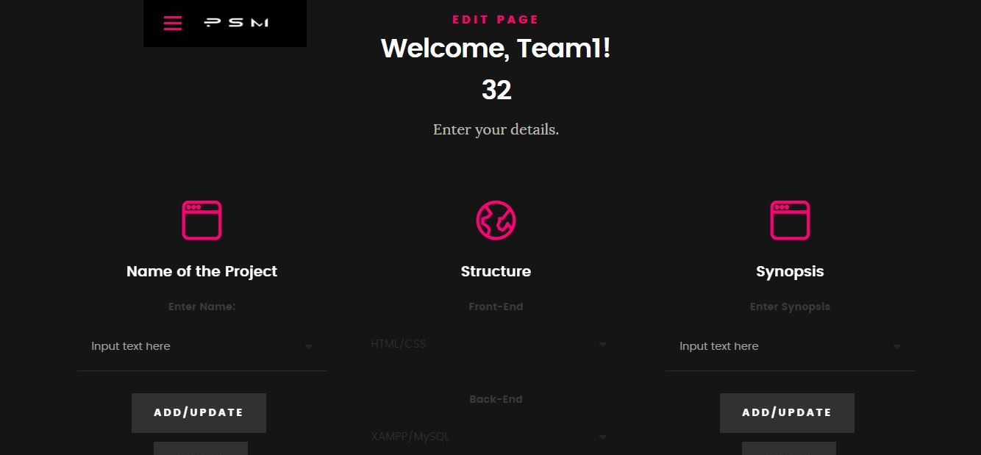
EDIT PAGE
In this page you can upload your information and you can also edit the uploaded information.

Slide 10
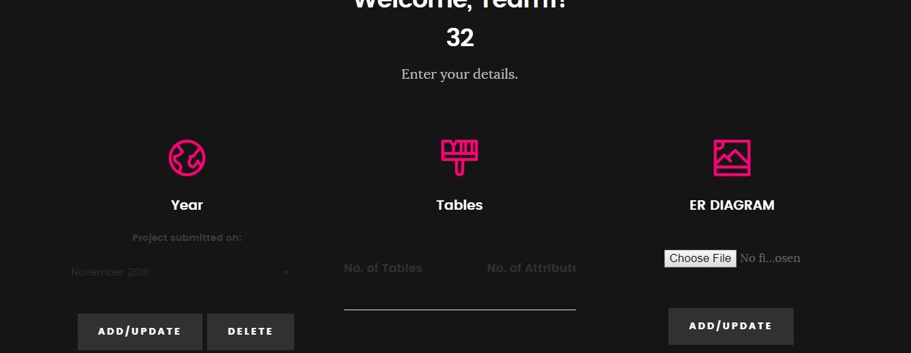
EDIT PAGE 2
This is also an edit page where you upload your information.

Slide 11
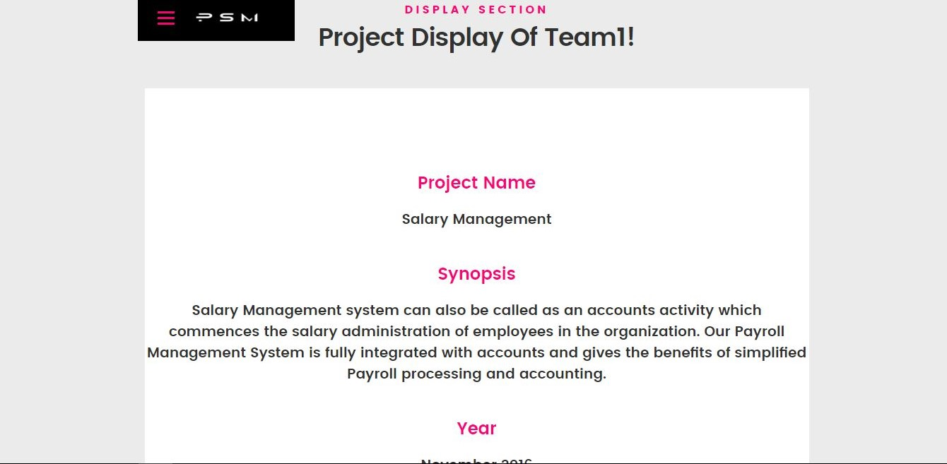
DISPLAY PAGE
This is the display page. Here you can view the information that you have uploaded.

Slide 12
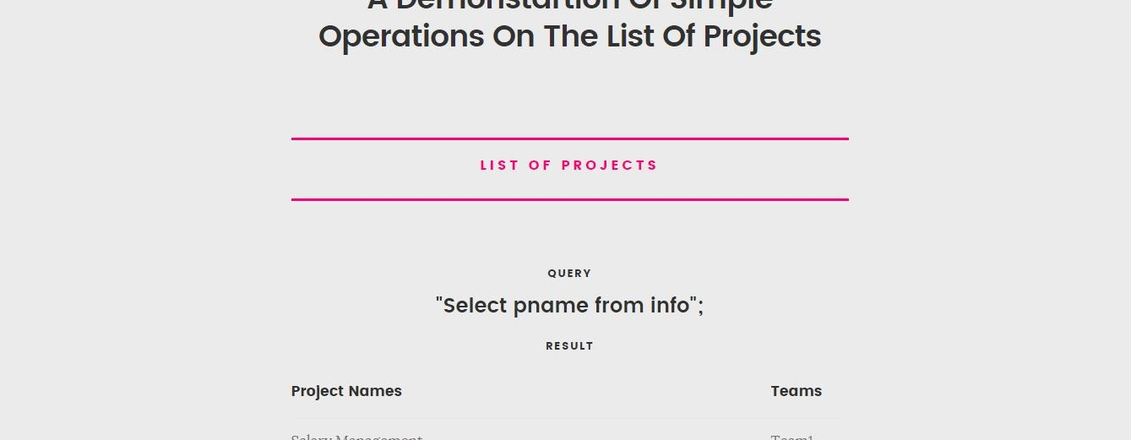
OPERSTIONS PAGE
In this page you can see the output of various queries that have been executed.

Slide 13
THANK YOU! ☺
Special thanks to our guide, Mrs. Pavithra h m , asst.professor and our beloved friend ‘Cyril’.

