Slide 1
ARSA
Airline review sentiment analysis
Danial baizak – 535000
Kairberk tamirlan - 533740

Slide 2
Introduction to Multi-Class Sentiment Analysis
What is Sentiment Analysis?
Sentiment Analysis is the automatic process of identifying the emotional tone behind a text, whether it is positive, neutral, or negative
Why Multi-Class (3 Classes)?
Many real-world applications require more than just binary classification
A three-class model can better capture complex emotions and subtle opinions expressed in text
Project Objective
The primary goal of this project is to develop, train, and evaluate machine learning and deep learning models for multi-class sentiment classification of textual data

Slide 3
Project Workflow & Model Comparison
Data Selection and Preparation
Data Preprocessing
Baseline Models (Machine Learning)
Intermediate Deep Learning Models
Transformers and State-of-the-Art Models
Model Evaluation & Comparison
Conclusion

Slide 4
Dataset: Airline Twitter Sentiment
This dataset contains real-world tweets directed at US airlines, annotated with sentiment labels
Dataset Composition:
    Total number of samples: 14640 tweets
    Number of classes: Negative, Neutral, Positive
Example Tweets:
“@united we finally just arrive to Bogota, good but long flight!!”
“@JetBlue thanks. I appreciate your prompt response.”

Slide 5
Text Preprocessing Pipeline
Why Preprocessing is Important?
Tweets are often noisy: they contain HTML tags, URLs, mentions, emojis, stop-words, and informal language.
Step | Description | Example Transformation
Remove HTML & URLs | Removes links and HTML tags | <a href="..."> → removed
Lowercase Text | Standardizes casing | “Great Flight” → “great flight”
Remove Mentions | Deletes Twitter usernames | “@user” → removed
Remove Punctuation & Digits | Cleans special characters and numbers | “Flight123!!!” → “flight”
Tokenization | Splits text into individual words | “great flight” → [“great”, “flight”]
Remove Stop-words | Deletes frequent uninformative words | “the, is, and” → removed
Lemmatization | Converts words to base form | “delays” → “delay”

Slide 6
Baseline Models: Traditional Machine Learning Approaches
Naive Bayes Classifier
  Feature Extraction Methods:
    TF-IDF (Term Frequency-Inverse Document Frequency)
    BoW (Bag-of-Words)
  Machine Learning Models Implemented:
    Logistic Regression
    Naive Bayes Classifier
    Support Vector Machine (SVM)
  Each model was trained and evaluated twice: using TF-IDF features and BoW features

Slide 7
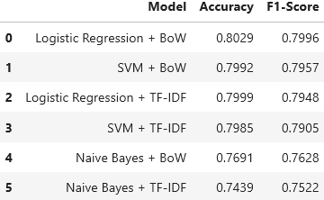
Baseline Models — Results
Hyperparameter Tuning:
All models were optimized using GridSearchCV to identify the best set of hyperparameters.
All models were assessed using standard metrics:
Standard metrics:
  Accuracy
  Precision
  Recall
  F1-Score

Slide 8
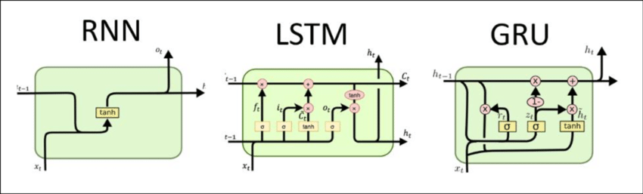
Intermediate Models: Deep Learning with Pre-trained Embeddings
Word Embeddings Used:
  GloVe Twitter (200d):
  FastText Wiki-News (300d)
Deep Learning Models Implemented:
  Vanilla RNN
  GRU
  BiLSTM
  BiLSTM + Attention
Each model was trained and evaluated using both GloVe and FastText embeddings to assess the impact of embedding choice on performance

Slide 9
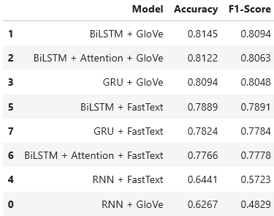
Intermediate Models — Results
Each intermediate model was trained for up to 40 epochs
To prevent overfitting and ensure the model retains its best state, Early Stopping was implemented
Standard metrics:
  Accuracy
  F1-Score

Slide 10
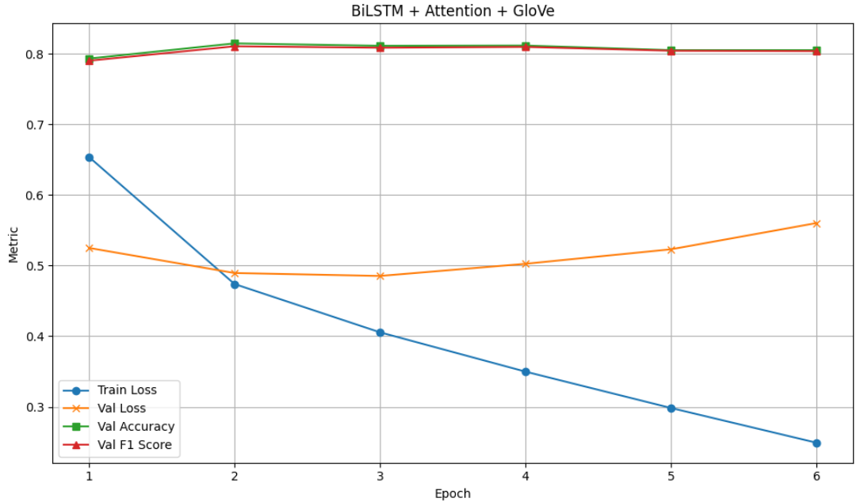
Best model

Slide 11
State-of-the-Art Models: Transformers for Sentiment Analysis
Transformer-based models represent the current state-of-the-art (SOTA) in many Natural Language Processing (NLP) tasks, including sentiment analysis
Three powerful pre-trained transformer models were trained and evaluated:
  BERT (Base, Uncased)
  DistilBERT
  RoBERTa
All models were fine-tuned specifically for the multi-class sentiment classification task.

Slide 12
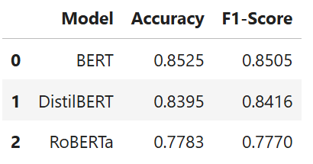
Transformers - Results
All Transformer models were fine-tuned on the sentiment classification task following the same training strategy as the intermediate models.
Standard metrics:
Accuracy
F1-Score

Slide 13
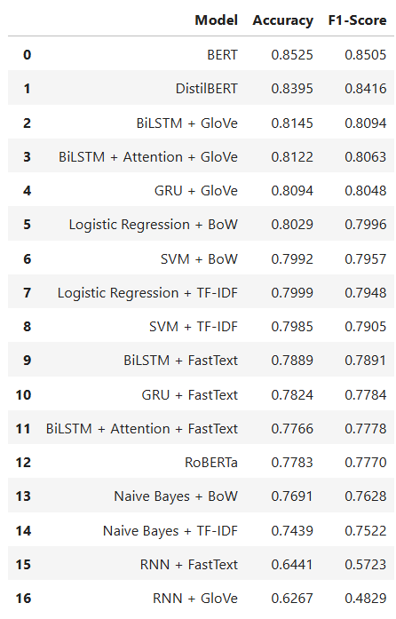
Key Takeaways
BERT achieved the highest performance, with an accuracy of 85.25% and an F1-score of 85.05%, outperforming other models.
DistilBERT followed closely with an accuracy of 83.95% and an F1-score of 84.16%.
BiLSTM + GloVe and GRU + GloVe also performed well with F1-scores of 80.94% and 80.48%, respectively
Among traditional models, Logistic Regression and SVM with BoW showed competitive results with accuracy values of 80.29% and 79.92%, respectively
The lower-performing models, such as RNN + GloVe and Naive Bayes, demonstrated lower accuracy and F1-scores, especially with embeddings like FastText.

Slide 14
Conclusion
This project examined the progression from traditional machine learning methods to deep learning and transformer-based models for multi-class sentiment analysis of airline-related tweets. While classical models such as Logistic Regression and SVM provided strong baselines with low computational cost, deep learning models leveraging pre-trained embeddings, including BiLSTM and GRU, achieved higher performance.
Transformer models, particularly BERT, delivered the best results, with an accuracy of 85.25% and an F1-score of 85.05%, demonstrating superior ability to capture complex language patterns. Future work will focus on multilingual sentiment analysis, explainable AI, and further optimization of transformer models.

