Slide 1
Chapter 3
Processes
Notes:
1

Slide 2
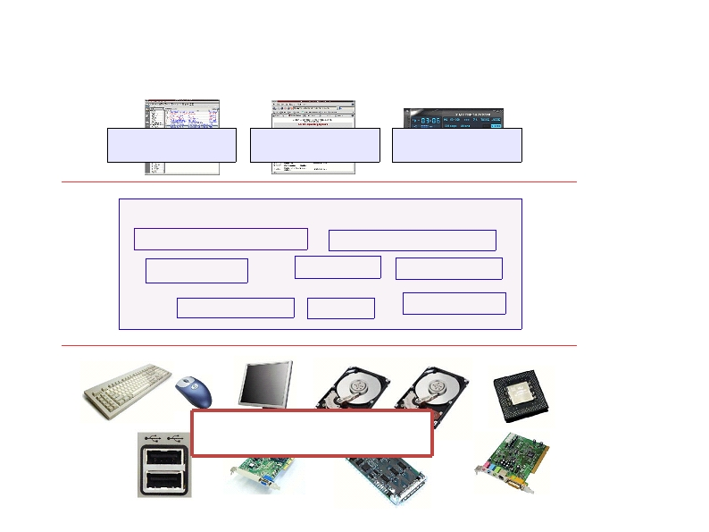
What is an OS? (remember this slide?)
User Application
User Application
User Application
Protection
Boundary
Kernel
Memory Management
CPU Scheduling
File System
Disk I/O
Process Mang.
Device Drivers
Multitasking
Networking
Hardware/
Software
interface
Hardware

Slide 3
Process management
This module begins a series of topics on processes, threads, and synchronization
Today: processes and process management
  what are the OS units of ownership / execution?
  how are they represented inside the OS?
  how is the CPU scheduled across processes?
  what are the possible execution states of a process?
    and how does the system move between them?

Slide 4
The process
The process is the OS’s abstraction for execution
  the unit of execution
  the unit of scheduling
  the unit of ownership
  the dynamic (active) execution context
    compared with program: static, just a bunch of bytes
Process is often called a job, task, or sequential process
  a sequential process is a program in execution
    defines the instruction-at-a-time execution of a program

Slide 5
What’s in a process?
A process consists of (at least):
  an address space
  the code for the running program
  the data for the running program
  an execution stack and stack pointer (SP)
    traces state of procedure calls made
  the program counter (PC), indicating the next instruction
  registers and their values
  Heap, a memory that is dynamically allocated.
  In other words, it’s all the stuff you need to run the program

Slide 6
A process’s address space
0xFFFFFFFF
stack
(dynamic allocated mem)
SP
address space
heap
(dynamic allocated mem)
static data
(data segment)
code
(text segment)
PC
0x00000000

Slide 7
Process states
Each process has an execution state, which indicates what it is currently doing
  ready: waiting to be assigned to CPU
    could run, but another process has the CPU
  running: executing on the CPU
    is the process that currently controls the CPU
    pop quiz: how many processes can be running simultaneously?
  waiting: waiting for an event, e.g., I/O
    cannot make progress until event happens
As a process executes, it moves from state to state
  *NIX: run ps, STAT column shows current state
  which state is a process in most of the time?

Slide 8
States of a process
Exit
Terminated
running
dispatch / schedule
interrupt (unscheduled)
New
Admitted
ready
exception (I/O, page fault, etc.)
interrupt
(I/O complete)
You can create and destroy processes!
Waiting

Slide 9
Listing of all processes in *nix
ps au or ps aux
  Lists all the processes running on the system
ps au
USER PID %CPU %MEM VSZ RSS TTY STAT START TIME COMMAND
bart 3039 0.0 0.2 5916 1380 pts/2 S 14:35 0:00 /bin/bash
bart 3134 0.0 0.2 5388 1380 pts/3 S 14:36 0:00 /bin/bash
bart 3190 0.0 0.2 6368 1360 pts/4 S 14:37 0:00 /bin/bash
bart 3416 0.0 0.0 0 0 pts/2 W 15:07 0:00 [bash]
PID: Process id
VSZ: Virtual process size (code + data + stack)
RSS: Process resident size: number of KB currently in RAM
TTY: Terminal
STAT: Status: R (Runnable), S (Sleep), W (paging), Z (Zombie)...

Slide 10
The process control block
There’s a data structure called the process control block (PCB) that holds all this stuff
  The PCB is identified by an integer process ID (PID)
  It is a “snapshot” of the execution and protection environment
  Only one PCB active at a time
OS keeps all of a process’s hardware execution state in the PCB when the process isn’t running
  PC, SP, registers, etc.
  when a process is unscheduled, the state is transferred out of the hardware into the PCB
Note: It’s natural to think that there must be some mysterious techniques being used
  fancy data structures that you’d never think of yourself
Wrong! It’s pretty much just what you’d think of!
Except for some clever assembly code…

Slide 11


The PCB revisited
The PCB is a data structure with many, many fields:
  process ID (PID)
  execution state
  program counter, stack pointer, registers
  address space info
  UNIX username of owner
  scheduling priority
  accounting info
  pointers for state queues
In linux:
  defined in task_struct (include/linux/sched.h)
  over 95 fields!!!
In Windows XP, 75 fields
Process
Control
Block

Slide 12
PCBs and hardware state
When a process is running, its hardware state is inside the CPU
  PC, SP, registers
  CPU contains current values
When the OS stops running a process (puts it in the waiting state), it saves the registers’ values in the PCB
  when the OS puts the process in the running state, it loads the hardware registers from the values in that process’s PCB
The act of switching the CPU from one process to another is called a context switch
  timesharing systems may do 100s or 1000s of switches/sec.
  takes about 5 microseconds on today’s hardware

Slide 13
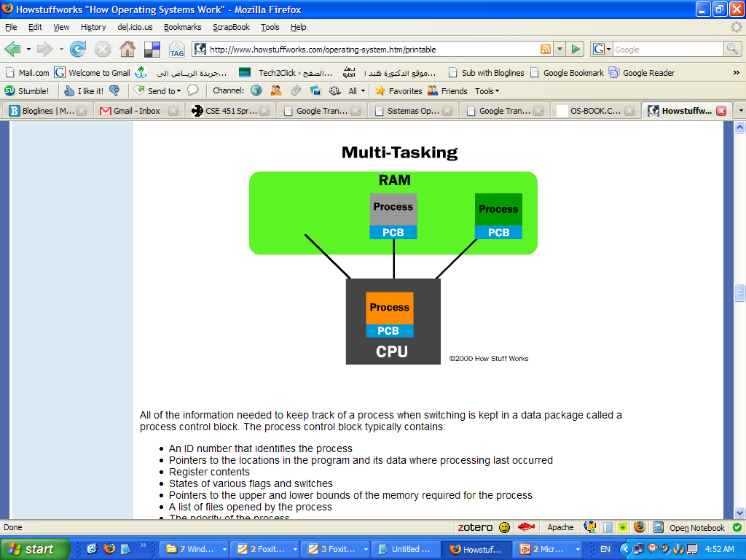
How do we multiplex processes?

Slide 14
Process Scheduling

Slide 15
How do we multiplex processes?
Give out CPU time to different processes (Scheduling):
  Only one process “running” at a time
  Give more time to important processes
Give pieces of resources to different processes (Protection):
  Controlled access to non-CPU resources
  Sample mechanisms:
    Memory Mapping: Give each process their own address space
Process
Control
Block

Slide 16
Scheduling queues
The OS maintains a collection of queues that represent the state of all processes in the system
  typically one queue for each state
    Job queue – set of all processes in the system
    Ready queue – set of all processes residing in main memory, ready and waiting to execute
    Device queues – set of processes waiting for an I/O device
  Processes migrate among the various queues
  each PCB is queued onto a state queue according to the current state of the process it represents
  as a process changes state, its PCB is unlinked from one queue, and linked onto another

Slide 17
Scheduling queues
These are PCBs!
Ready queue header
head ptr
firefox pcb
emacs pcb
ls pcb
tail ptr
Device queue header
head ptr
cat pcb
firefox pcb
tail ptr
There may be many wait queues, one for each type of wait (particular device, timer, message, …)

Slide 18

Representation of Process Scheduling
PCBs move from queue to queue as they change state
  Decisions about which order to remove from queues are Scheduling decisions

Slide 19
Schedulers
Long-term scheduler (or job scheduler) – selects which processes should be brought into the ready queue
Short-term scheduler (or CPU scheduler) – selects which process should be executed next and allocates CPU
Short-term scheduler is invoked very frequently (milliseconds) ⇒ (must be fast)
Long-term scheduler is invoked very infrequently (seconds, minutes) ⇒ (may be slow)

Slide 20
Schedulers (Cont.)
The long-term scheduler controls the degree of multiprogramming
Processes in long-term scheduler can be described as either:
  I/O-bound process – spends more time doing I/O than computations, many short CPU bursts
  CPU-bound process – spends more time doing computations; few very long CPU bursts
Medium-term scheduler - removes processes to reduce multiprogramming by swapping them out.

Slide 21

CPU Switch From Process to Process
When CPU switches to another process, the system must save the state of the old process and load the saved state for the new process
Context-switch time is overhead; the system does no useful work while switching
Time dependent on hardware support

Slide 22
Operations on Processes

Slide 23
Process Creation
Parent process create children processes, which, in turn create other processes, forming a tree of processes
Resource sharing
  Parent and children share all resources
  Children share subset of parent’s resources
  Parent and child share no resources
Execution
  Parent and children execute concurrently
  Parent waits until children terminate

Slide 24
Process creation (cont.)
New processes are created by existing processes
  creator is called the parent
  created process is called the child
  *NIX: do ps, look for PPID field
  what creates the first process, and when?
In some systems, parent defines or donates resources and privileges for its children
  *NIX: child inherits parent’s uid, environment, open file list, etc.
UNIX examples
  fork system call creates new process
  exec system call used after a fork to replace the process’ memory space with a new program.

Slide 25

A tree of processes on a typical Solaris

Slide 26
*NIX process creation
*NIX process creation through fork() system call
  creates and initializes a new PCB
  creates a new address space
  initializes new address space with a copy of the entire contents of the address space of the parent
  initializes kernel resources of new process with resources of parent (e.g., open files)
  places new PCB on the ready queue
the fork() system call “returns twice”
  once into the parent, and once into the child
  returns the child’s PID to the parent
  returns 0 to the child
fork() = “clone me”

Slide 27
Exec vs. fork
So how do we start a new program, instead of just forking the old program?
  the exec() system call!
  int exec(char *prog, char ** argv)
exec()
  discards the current address space
  loads program ‘prog’ into the address space
  initializes registers, args for new program
  places PCB onto ready queue
  note: does not create a new process!

Slide 28
Process Termination
Process executes last statement and asks the operating system to delete it (exit)
  Output data from child to parent (via wait)
  Process’ resources are deallocated by operating system
Parent may terminate execution of children processes (abort)
  Child has exceeded allocated resources
  Task assigned to child is no longer required
  If parent is exiting
    Some operating system do not allow child to continue if its parent terminates
      All children terminated - cascading termination

Slide 29

Process Creation

Slide 30
Interprocess communication
Mechanism for processes to communicate and to synchronize their actions

Slide 31
Types of Processes
Independent process cannot affect or be affected by the execution of another process
Cooperating process can affect or be affected by the execution of another process, uses two types of IPC:
  Message passing.
  Shared memory.
Advantages of process cooperation
  Information sharing (e.g. shared file)
  Computation speed-up (break up process into sub tasks to run faster).
  Modularity (dividing system functions into separate processes or threads).
  Convenience (individual user may work on many tasks at the same time)

Slide 32
Producer-Consumer Problem
Paradigm for cooperating processes, producer process produces information that is consumed by a consumer process
  unbounded-buffer places no practical limit on the size of the buffer
  bounded-buffer assumes that there is a fixed buffer size

Slide 33
Message-Passing System
Message system – processes communicate with each other without resorting to shared memory space
IPC facility provides two operations:
  send(message) – message size fixed or variable
  receive(message)
If P and Q wish to communicate, they need to:
  establish a communication link between them
  exchange messages via send/receive
Implementation of communication link
  physical (e.g., shared memory, hardware bus)
  logical (e.g., logical properties)

Slide 34

Communications Models

Slide 35
Methods of Message-Passing
Direct or indirect communication
Synchronous or asynchronous communication
Buffering

Slide 36
Direct Communication
Processes must name each other explicitly (symmetry):
  send (P, message) – send a message to process P
  receive(Q, message) – receive a message from process Q
Properties of communication link
  Links are established automatically
  A link is associated with exactly one pair of communicating processes
  Between each pair there exists exactly one link
  The link may be unidirectional, but is usually bi-directional

Slide 37
Indirect Communication
Messages are directed and received from mailboxes (also referred to as ports)
  Each mailbox has a unique id
  Processes can communicate only if they share a mailbox
Primitives are defined as:
send(A, message) – send a message to mailbox A
receive(A, message) – receive a message from mailbox A

Slide 38
Indirect Communication
Properties of communication link
  Link established only if processes share a common mailbox
  A link may be associated with many processes
  Each pair of processes may share several communication links
  Link may be unidirectional or bi-directional
Operations
  create a new mailbox
  send and receive messages through mailbox
  destroy a mailbox
Who owns the mailbox?

Slide 39
Synchronization
Message passing may be either blocking or non-blocking
Blocking is considered synchronous
  Blocking send has the sender block until the message is received
  Blocking receive has the receiver block until a message is available
Non-blocking is considered asynchronous
  Non-blocking send has the sender send the message and continue
  Non-blocking receive has the receiver receive a valid message or null

Slide 40
Buffering
Queue of messages attached to the link; implemented in one of three ways
  1. Zero capacity – 0 messages
  Sender must wait for receiver (rendezvous)
  2. Bounded capacity – finite length of n messages
  Sender must wait if link full
  3. Unbounded capacity – infinite length
  Sender never waits

Slide 41
Conclusion

Slide 42
In Summary
PCBs are data structures
  dynamically allocated inside OS memory
When a process is created:
  OS allocates a PCB for it
  OS initializes PCB
  OS puts PCB on the correct queue
As a process computes:
  OS moves its PCB from queue to queue
When a process is terminated:
  PCB may hang around for a while (exit code, etc.)
  eventually, OS deallocates the PCB

Slide 43
Conclusion
Schedulers choose the ready process to run
Processes create other processes
  On exit, status returned to parent
Processes communicate with each other using shared memory or message passing

Slide 44
References
Some Slides from
  Gary Kimura and Mark Zbikowski, Washington university.
  Text book slides

