Slide 1
React Navigation

Slide 2
Topic
Stack Navigator
Switch Navigator
Drawer Navigator
BottomTab Navigator
TopTab Navigator
Multiple Navigator

Slide 3
Preparation
Install Node.JS
Install Atom
Install React-Native Expo -> https://facebook.github.io/react-native/
Start with first React-Native Expo -> https://reactnavigation.org/

Slide 4
Stack Navigator

Slide 5
How to use
Create Page
Create StackNavigator
Add Page to StackNavigator
Add StackNavigator to AppContainer

Slide 6
Workshop

Slide 7
Switch Navigator

Slide 8
How to use
Create Page
Create SwithcNavigator
Add Page to SwithcNavigator
Add SwithcNavigator to AppContainer

Slide 9
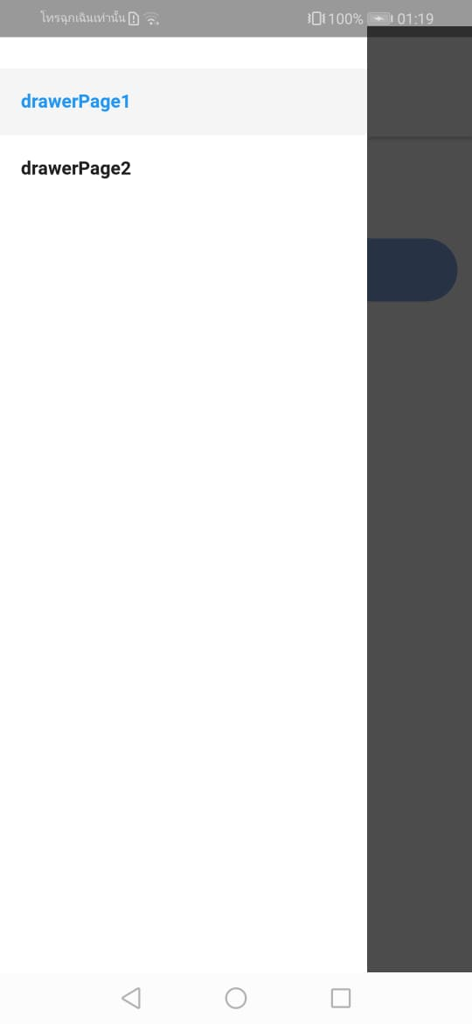
Drawer Navigator

Slide 10
How to use
Create Page
Create StackNavigator for each page
Add Page to StackNavigator
Create DrawerNavigator
Add StackNavigator to DrawerNavigator
Add DrawerNavigator to AppContainer

Slide 11
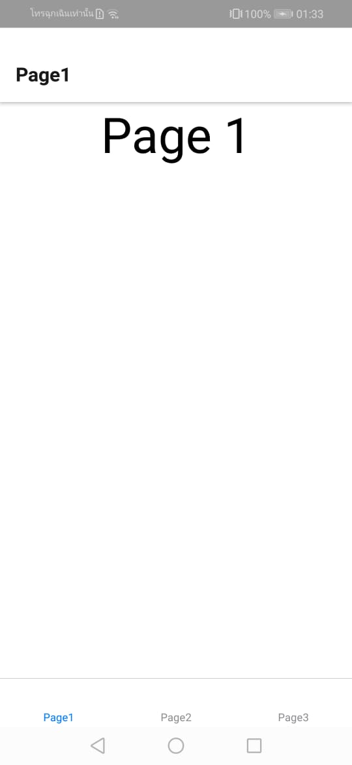
BottomTab Navigator

Slide 12
How to use
Create Page
Create StackNavigator for each page
Add Page to StackNavigator
Create BottomNavigator
Add StackNavigator to BottomNavigator
Add BottomNavigator to AppContainer

Slide 13
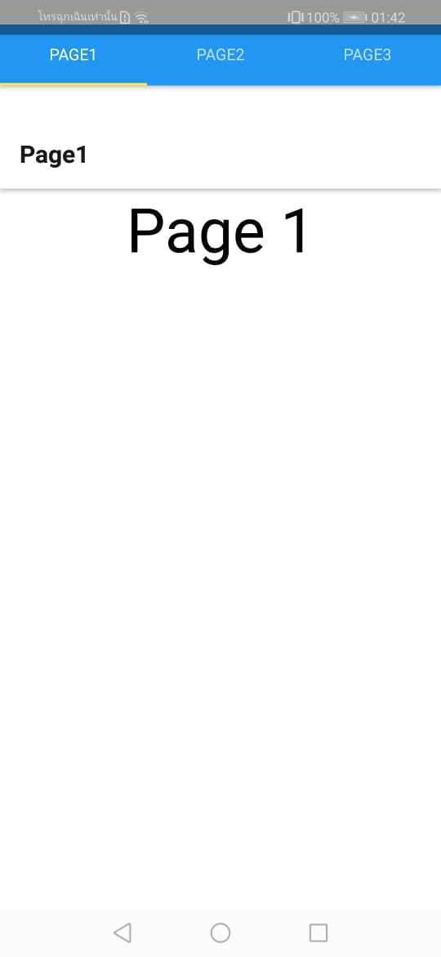
TopTab Navigator

Slide 14
How to use
Create Page
Create StackNavigator for each page
Add Page to StackNavigator
Create TopNavigator
Add StackNavigator to TopNavigator
Add TopNavigator to AppContainer

Slide 15
Multiple Navigator

Slide 16
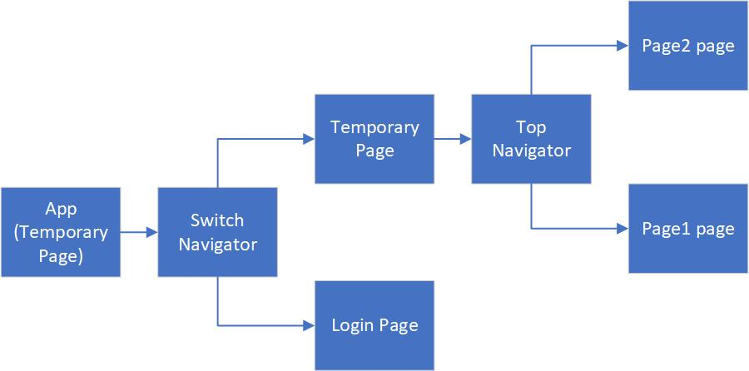
Example

Slide 17
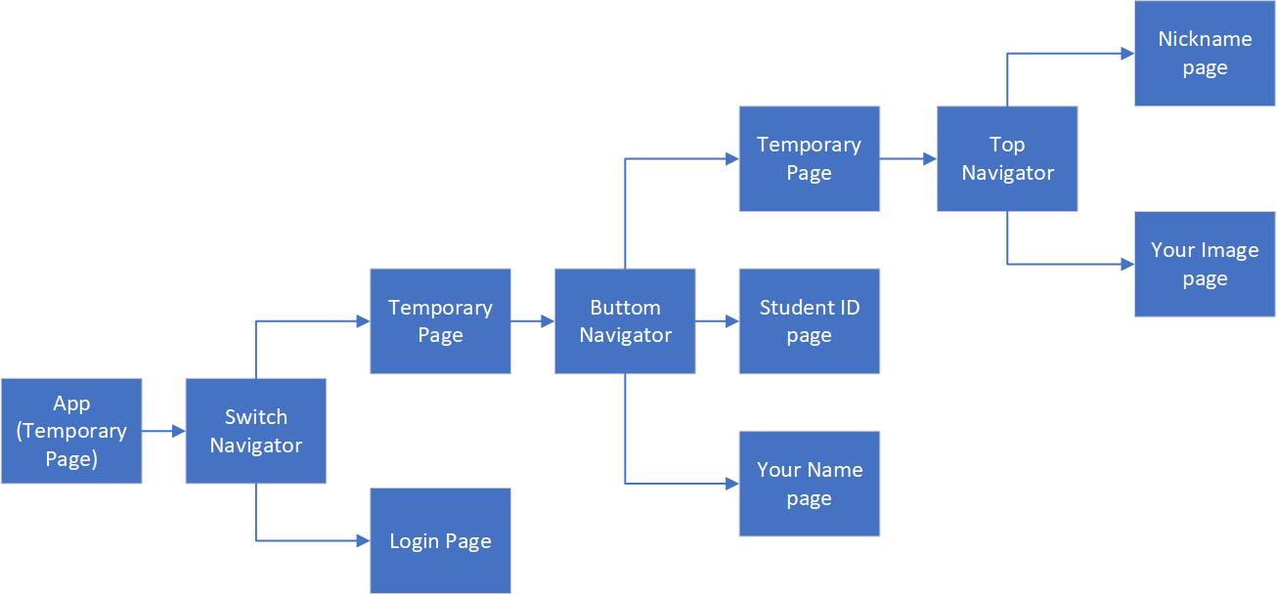
Homework

