Slide 1

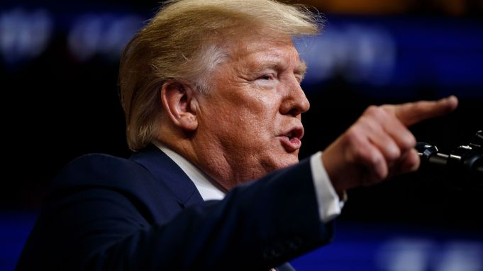
American Dream

Slide 2
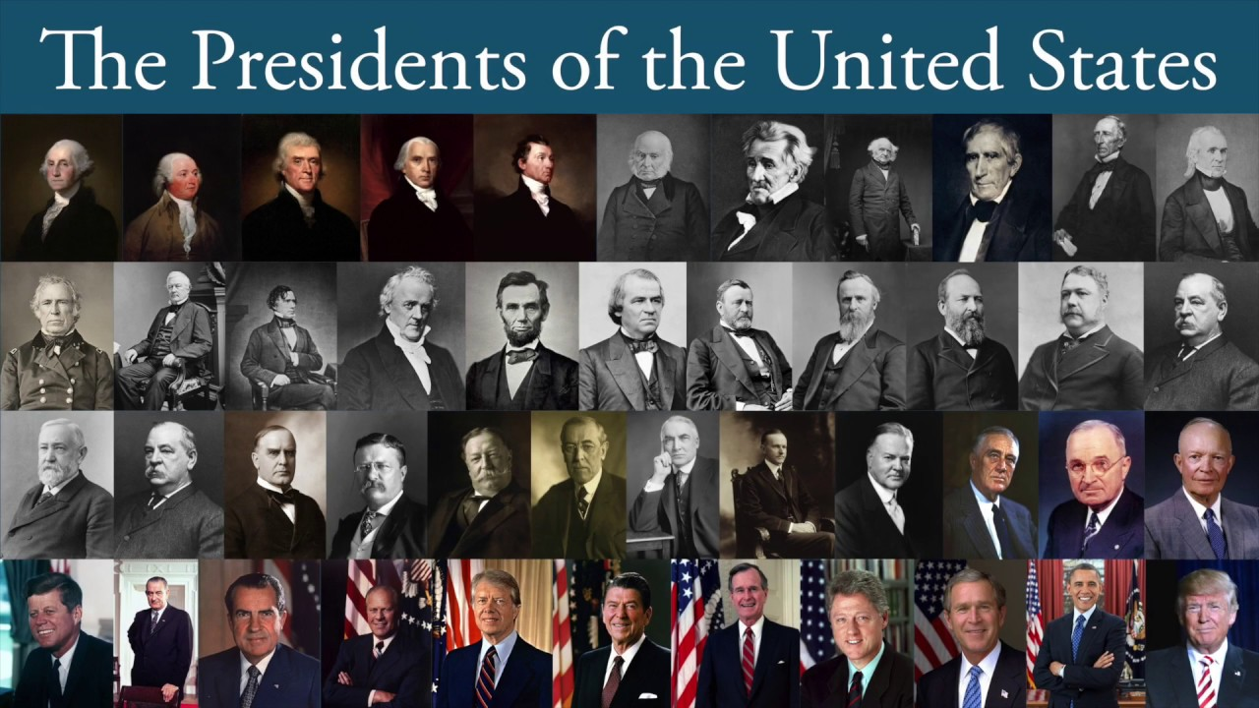
Research Question
‘Is the US, and thus, the world getting better or worse?’
Hypothesis
Why?

Slide 3


Flow
Concept Followed
Method Followed
Patience
401
Analysis
Broken
Visualisation
Broken

Slide 4
Facilitators
Barriers
Sustainable
Progress
Recycle
Refugee
Forgive
Justice
Healthcare
Medicaid
Education
Engage
Support
Open
Cooperate
Alliance
Ethical
Equality
Honest
Truth
Fair
Long-term
Ignorant
Bribe
Lobby
Unethical
Reckless
Deny
Greed
Unjust
Lie
Deficit
Weapons
Racist
War
Corruption
Deport
Spin
Barriers
Fraud
Oil
Prison

Slide 5
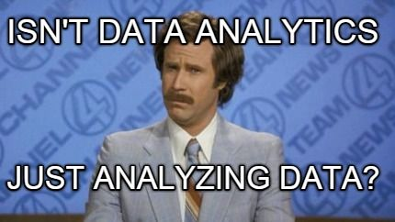
Data
Reddit (Appropriate?)
Regex
Dictionaries in lists
Wrappers

Slide 6
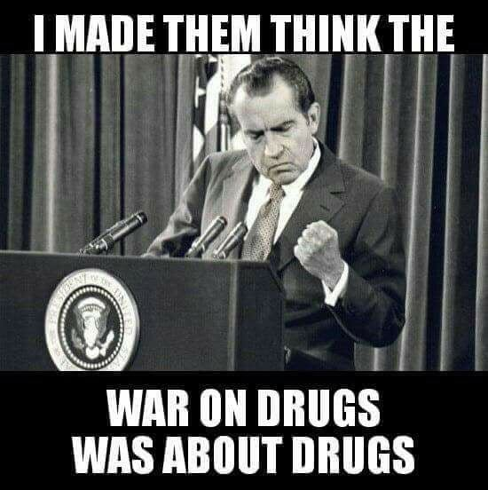

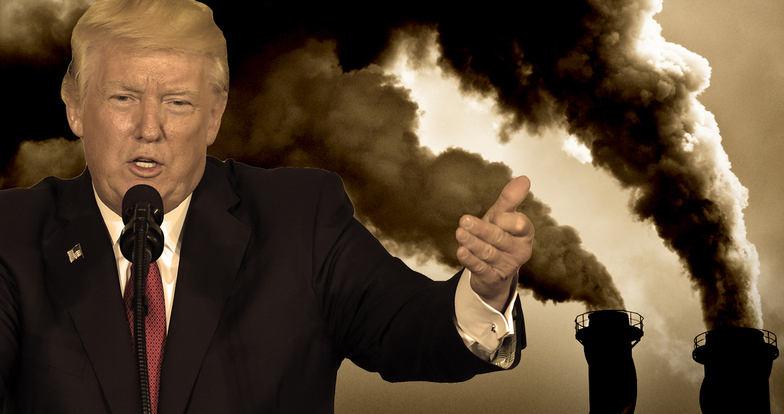
Will we survive the next?
Civil rights
Human rights

Slide 7
Positivity Ratio
Trump = 1.4
Obama = 1.37
W_Bush = 1.7
Clinton = 1.88
HW_Bush = “Omitted"
Reagan = 1.57
Carter = 1.14
Trump = "Omitted"
Nixon = 2.0
Johnson = 2.0
Coefficient of determination(R²) Intercept Slope Predicted response | 0.242 1.920 -0.064 1.85 – 1.79 – 1.72 – 1.66 – 1.60 – 1.54 – 1.47 – 1.41

Slide 8
?
Challenges
Questions
Demographics
International
Between words
Word cloud
Subjectivity (bias)
Changing culture
Uncontrollable
Cant get it all
Sampling
Missing values

Slide 9
Links
Trello: https://trello.com/invite/b/uDt0qZ1U/cb12521a4ca9df20a13c90be0a1b97e6/project-3-ironhack
Repo: https://github.com/LulleA/Project-Week-3-Data-Thieves
Slides: Patriotic-PowerPoint-Template.pptx

