Slide 1
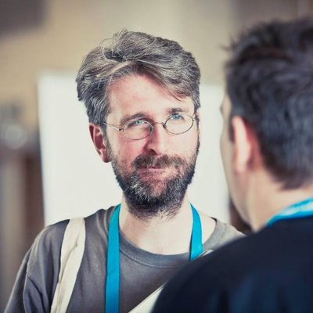
Introduction to the Command Line
Ian Miell
Twitter: @ianmiell
Ian.miell@gmail.com

Slide 2
About Me
Started in tech in 2000, Comp Sci degree
Only knew windows before
Command line was a mystery to me
Grew to love it
Book on bash, spend most of my time on the command line today

Slide 3
Pre-requisites
Access to a command line
Ideally bash
Nice to have – knowledge of basic bash
Introduction to Bash course available
Pipes most common feature likely to be used

Slide 4
Why This Course?
Command line is efficient
For people who are:
New to it
Want to learn more about it
Want to progress further
NOT a complete list of all commands used
Try to cover wide ground, beginner to expert
Try to show how to learn more

Slide 5
We Will Cover
A lot of commands
Some techniques
Some key concepts
Readline
History of terminals
Anything you want...

Slide 6
Structure of Course
Part I – The Core
Commands
Part II – Text and Files
Text and file manipulation and search
Readline
Part III – Networking and System
Web requests
Network debugging
Service management
System monitoring

Slide 7
Poll - Experience
Never used command line
Used a little (less than one year)
Use rarely (longer than a year)
Use all the time

Slide 8
Discussion
What do you want to learn about?
What problems have you faced?

Slide 9
Structure of Course
Part I - Core commands
Exercise / Break
Part II – Text and File Manipulation Commands
Exercise / Break
Part III – Networking and System Commands

Slide 10
Materials
https://github.com/ianmiell/introduction-to-the-command-line

Slide 11
Part I – Core Commands
cd
mkdir
rm
ls
cat
echo

Slide 12
Part I – Core Commands
less
How to use + tips
man
How to use + tips

Slide 13
Part I – Core Commands
cd
mkdir
rm
ls
cat
echo -n

Slide 14
Part I – Exercise / Break

Slide 15
Part II – Text and File Manipulation
Regular Expressions
grep
tr
sed
sort / uniq
tail
diff / sdiff
Readline

Slide 16
Part II – Exercise / Break

Slide 17
Part III – Networking and System
Networking:
wget vs curl
nc
ip
dig
ping

Slide 18
Part III – Networking and System
System:
systemctl
top
ps
kill
lsof
free
strace

Slide 19
Wrapup Q&A

Slide 20
Thanks!
Ian Miell
@ianmiell

