Slide 1
Pawnshop and Jewellery Store
Made by: Patrik Götz, Luca Lukács, Máté Farkas

Slide 2



Programs we used:
Visual Studio Code
Xampp
Word 2016
Trello

Slide 3


Languages we used:
HTML
JavaScript
CSS
PhP

Slide 4
Main page
There is a slideshow about the types of products
Pictures are sliding automatically
On the footer you can see the contacts
In the navbar you can choose the Webshop and the Registration or Log in buttons

Slide 5
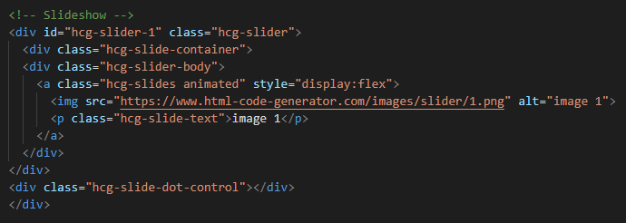
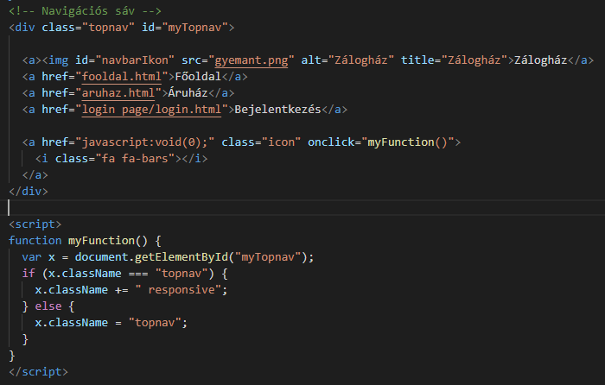
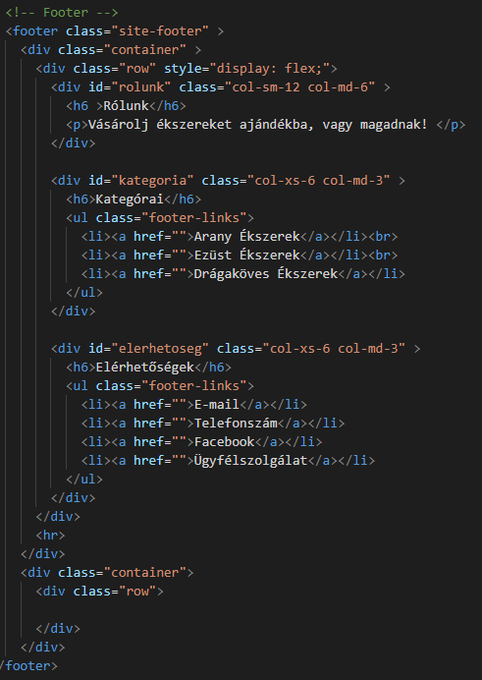

Slide 6
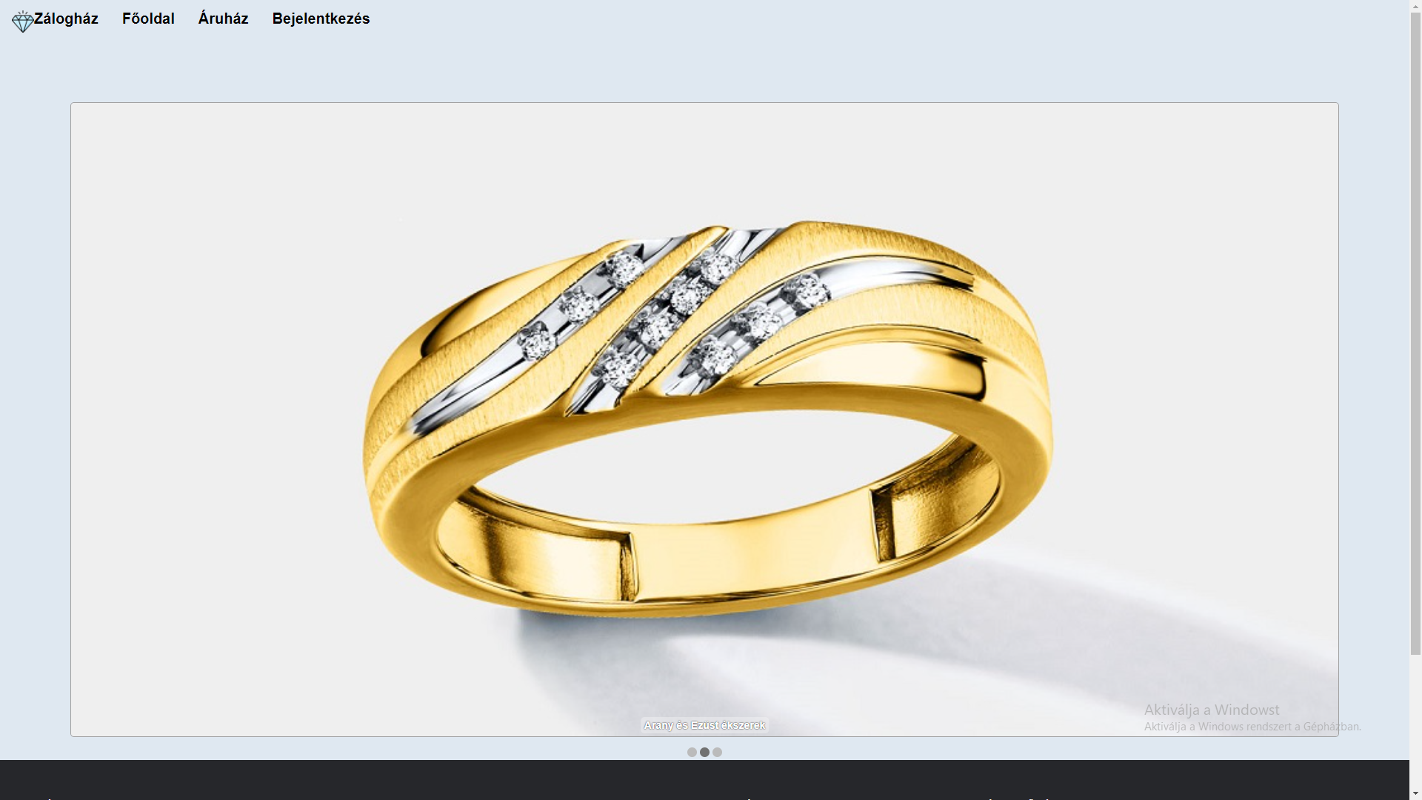

Slide 7
Webshop
You can see the products here
You can choose the products to put into the basket
The basket is at the bottom of the page

Slide 8
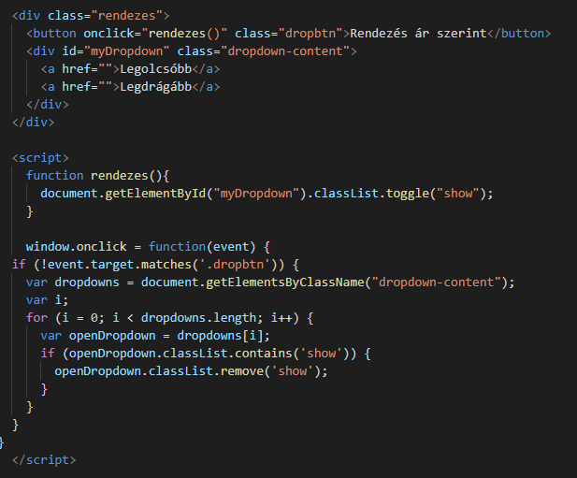
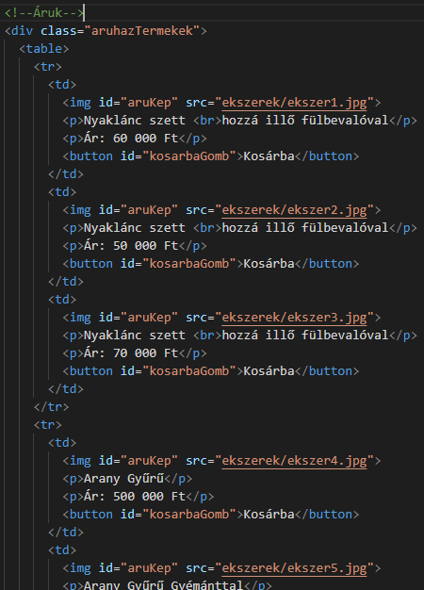
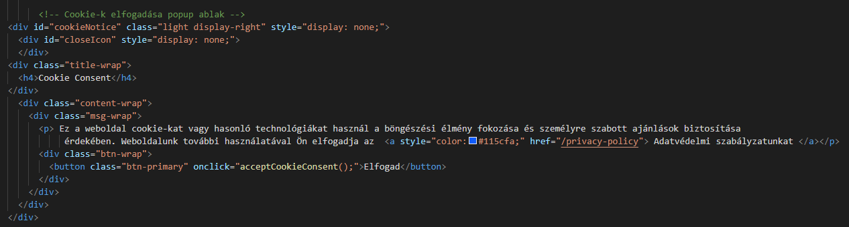

Slide 9
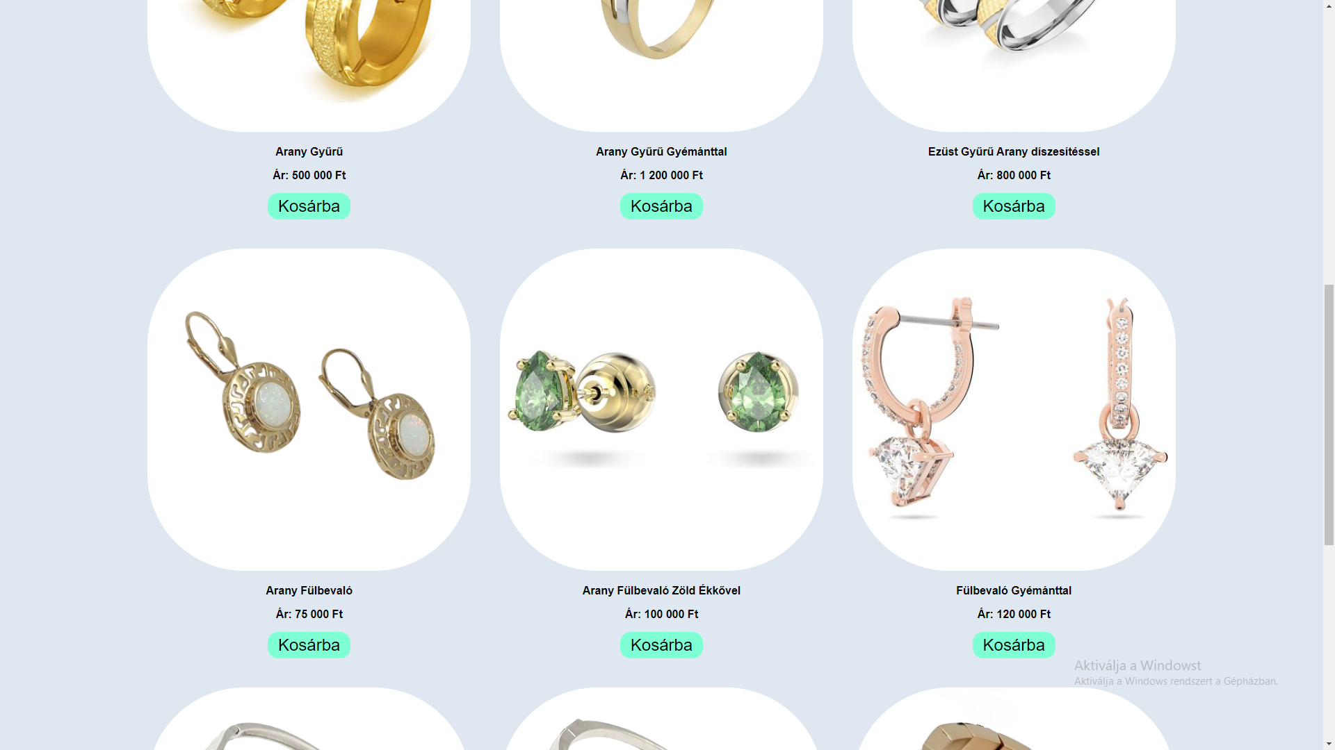
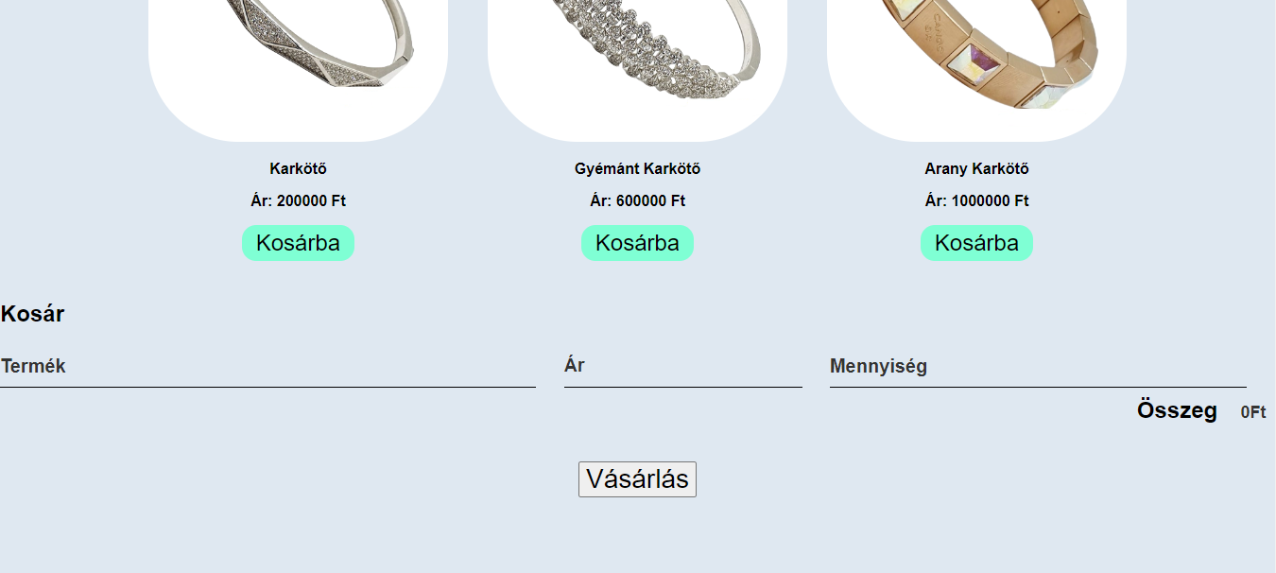

Slide 10
Work sharing
Patrik: HTML, website structure
Máté: JavaScript, PhP, clean code
Luca: CSS, design

Slide 11
Possible upgrades in the future
Creating a bidding page
Pawning of Jewellery
Registration site

Slide 12

Thank you for your attention

Slide 13
Sources
https://www.macworld.com/article/812847/how-to-switch-to-single-page-view-in-microsoft-word-and-the-preview-app.html
https://en.wikiversity.org/wiki/Visual_Studio_Code
https://upload.wikimedia.org/wikipedia/en/thumb/7/78/XAMPP_logo.svg/1200px-XAMPP_logo.svg.png
https://webcapital.hu/storage/blog-img/php-tortenete.png
https://www.p92.hu/binaries/content/gallery/p92website/technologies/htmlcssjs-details.png

