Slide 1
Pawnshop and Jewellery Store
Made by: Luca Lukács, Patrik Götz, Máté Farkas

Slide 2
Work sharing
Patrik: HTML, website structure
Máté: JavaScript, PhP, clean code
Luca: CSS, design

Slide 3



Programs we used:
Visual Studio Code
Xampp
Word 2016
Trello

Slide 4


Languages we used:
HTML
JavaScript
CSS
PhP

Slide 5
Main page
There is a slideshow about the types of products
Pictures are sliding automatically
On the footer you can see the contacts
In the navbar you can choose the Main age or the Webshop

Slide 6
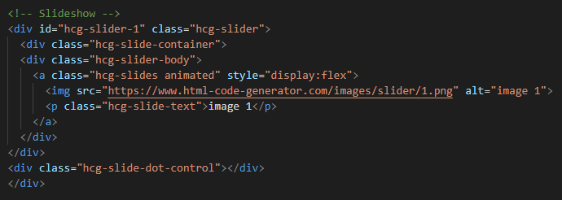
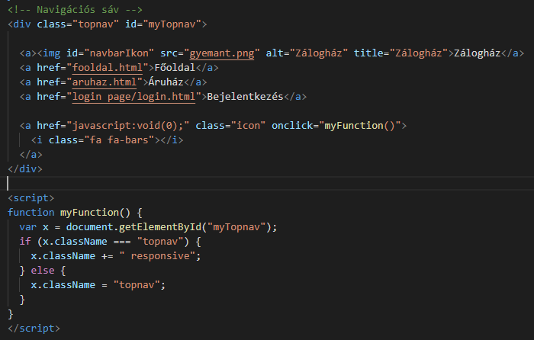
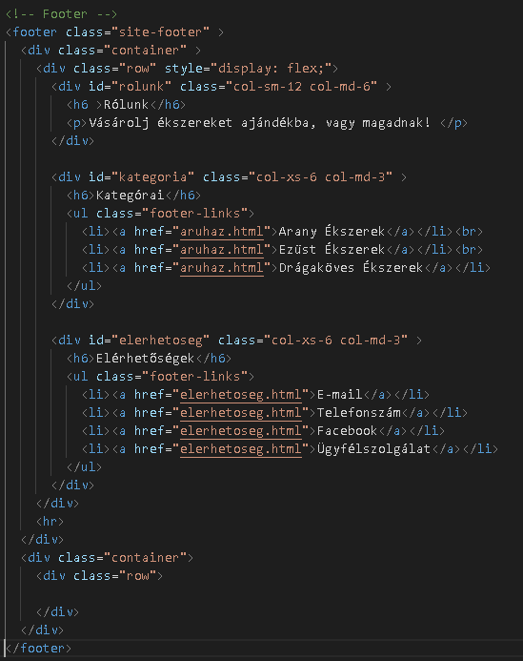

Slide 7
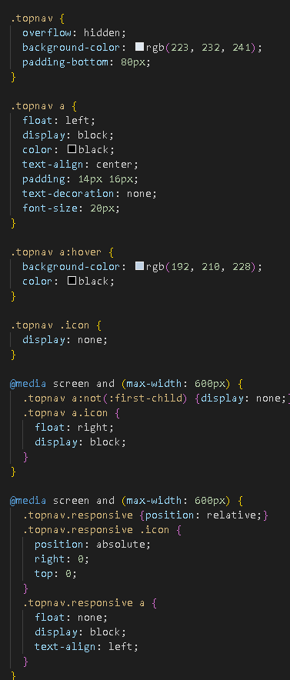
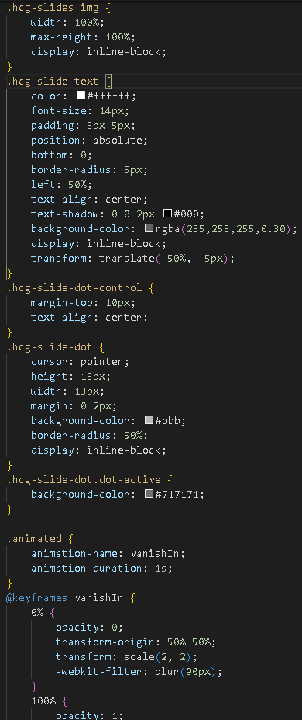
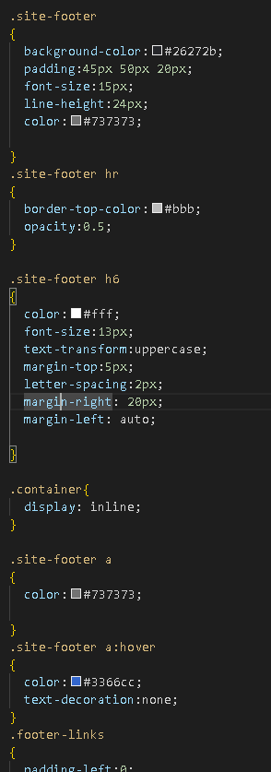
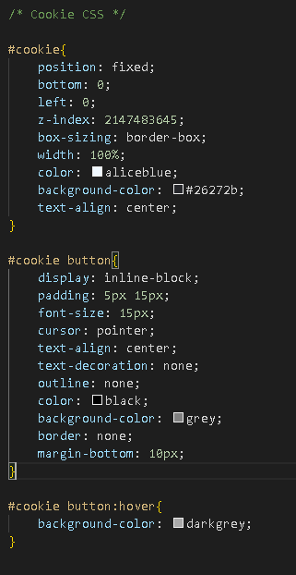

Slide 8
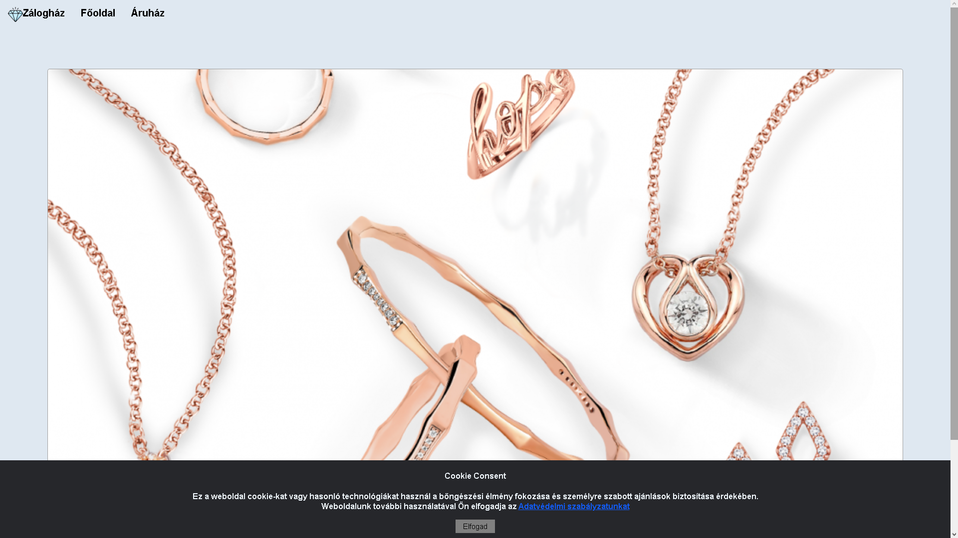

Slide 9
Webshop
You can see the products here
You can choose the products to put into the basket
The basket is at the bottom of the page

Slide 10
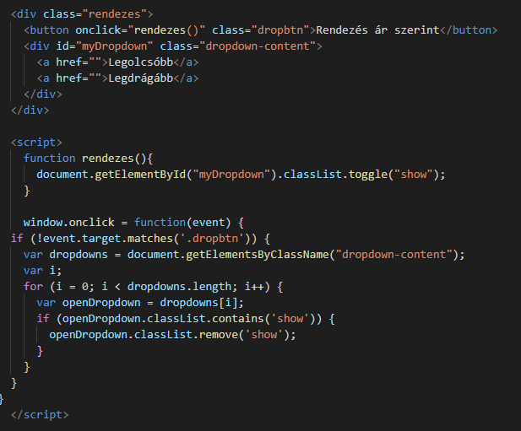
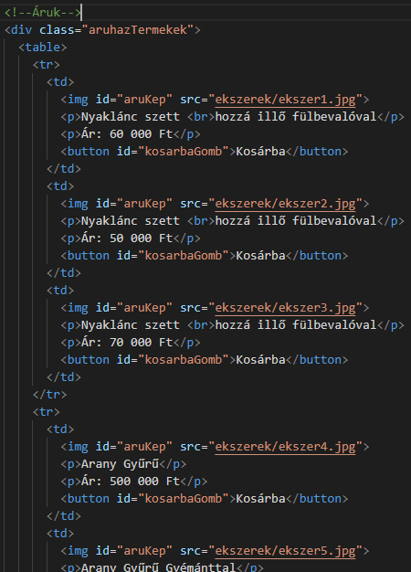
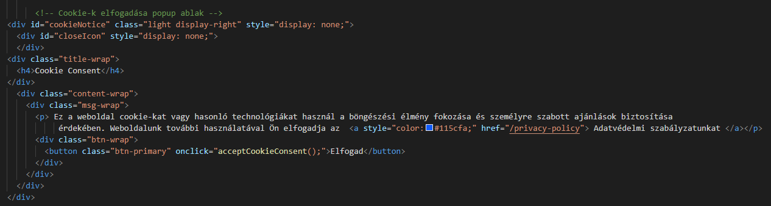

Slide 11
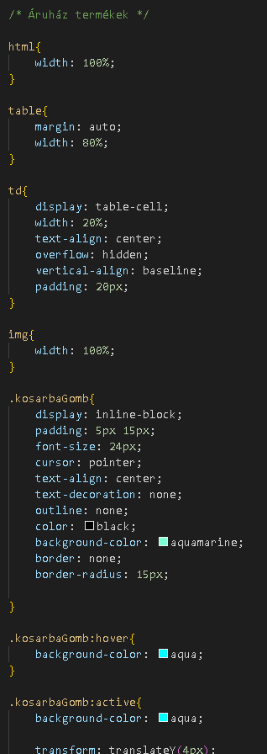
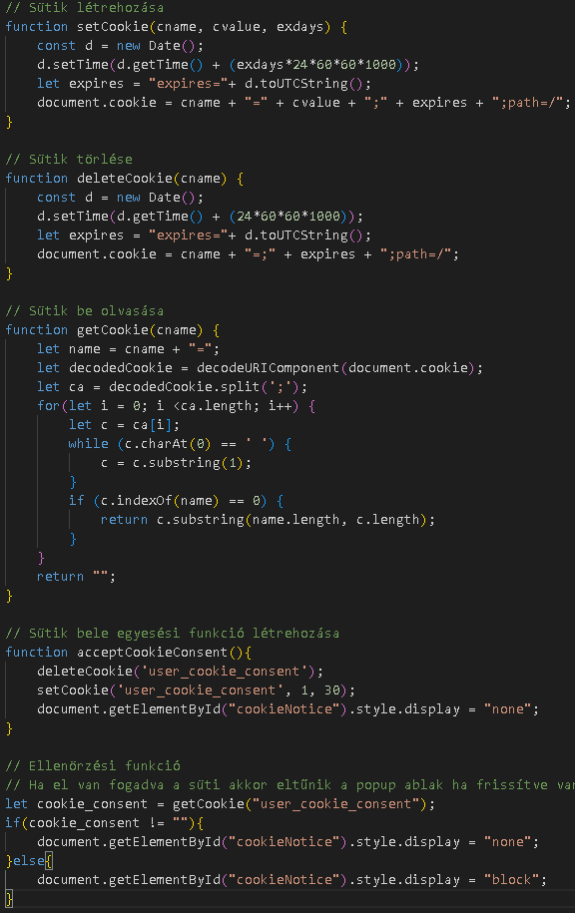
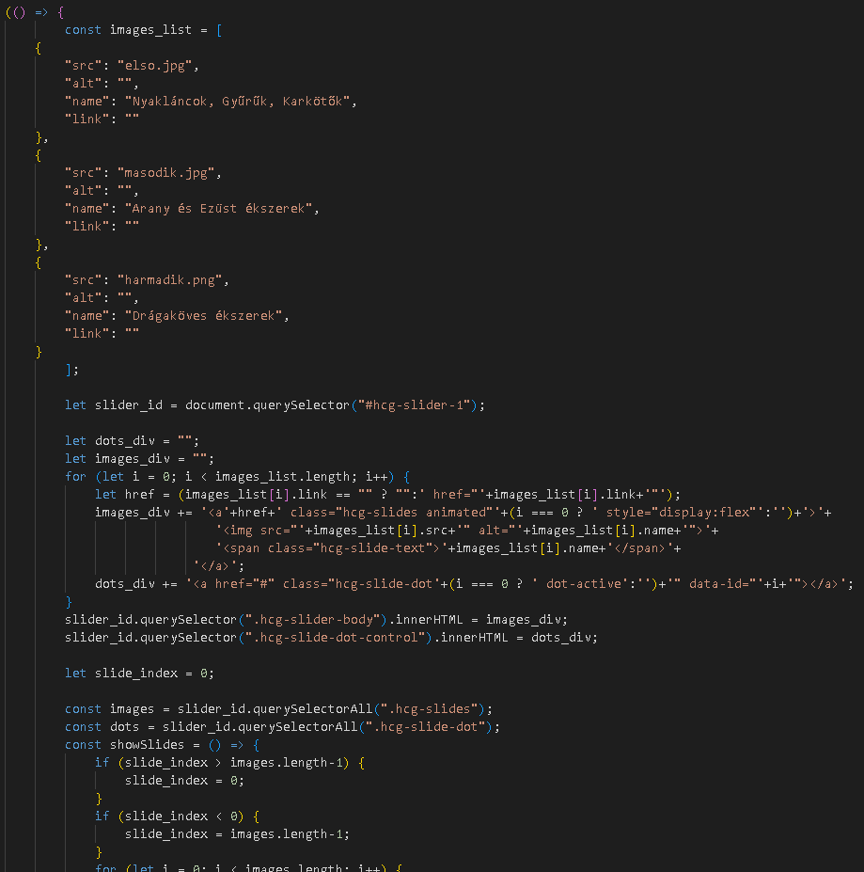

Slide 12
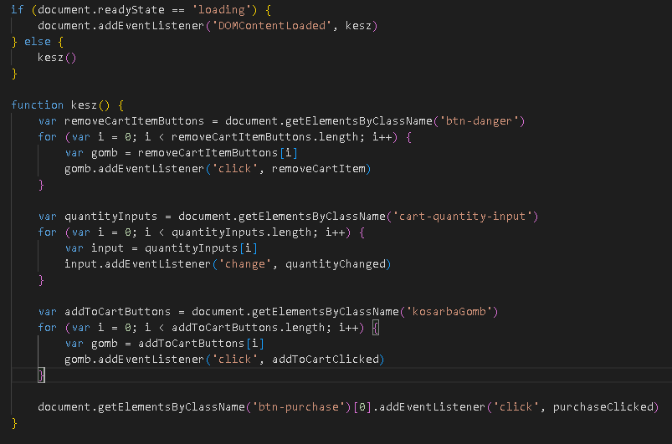
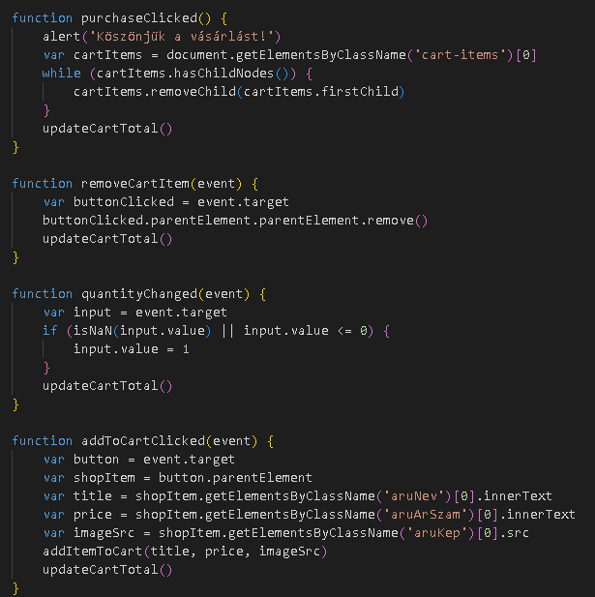
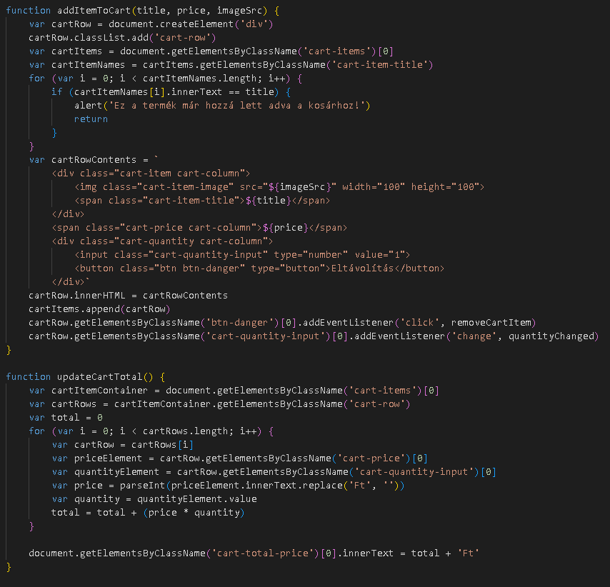

Slide 13
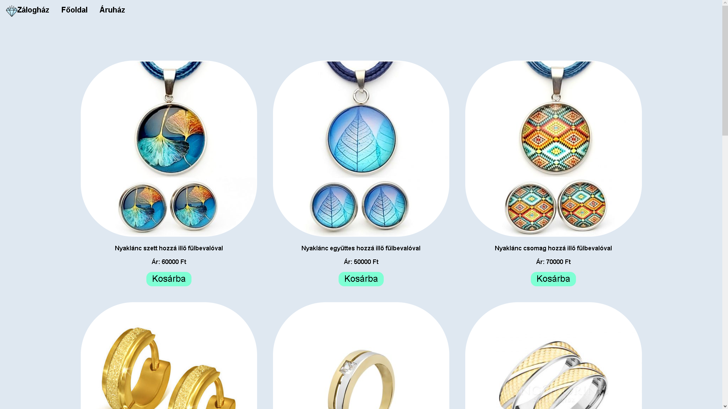
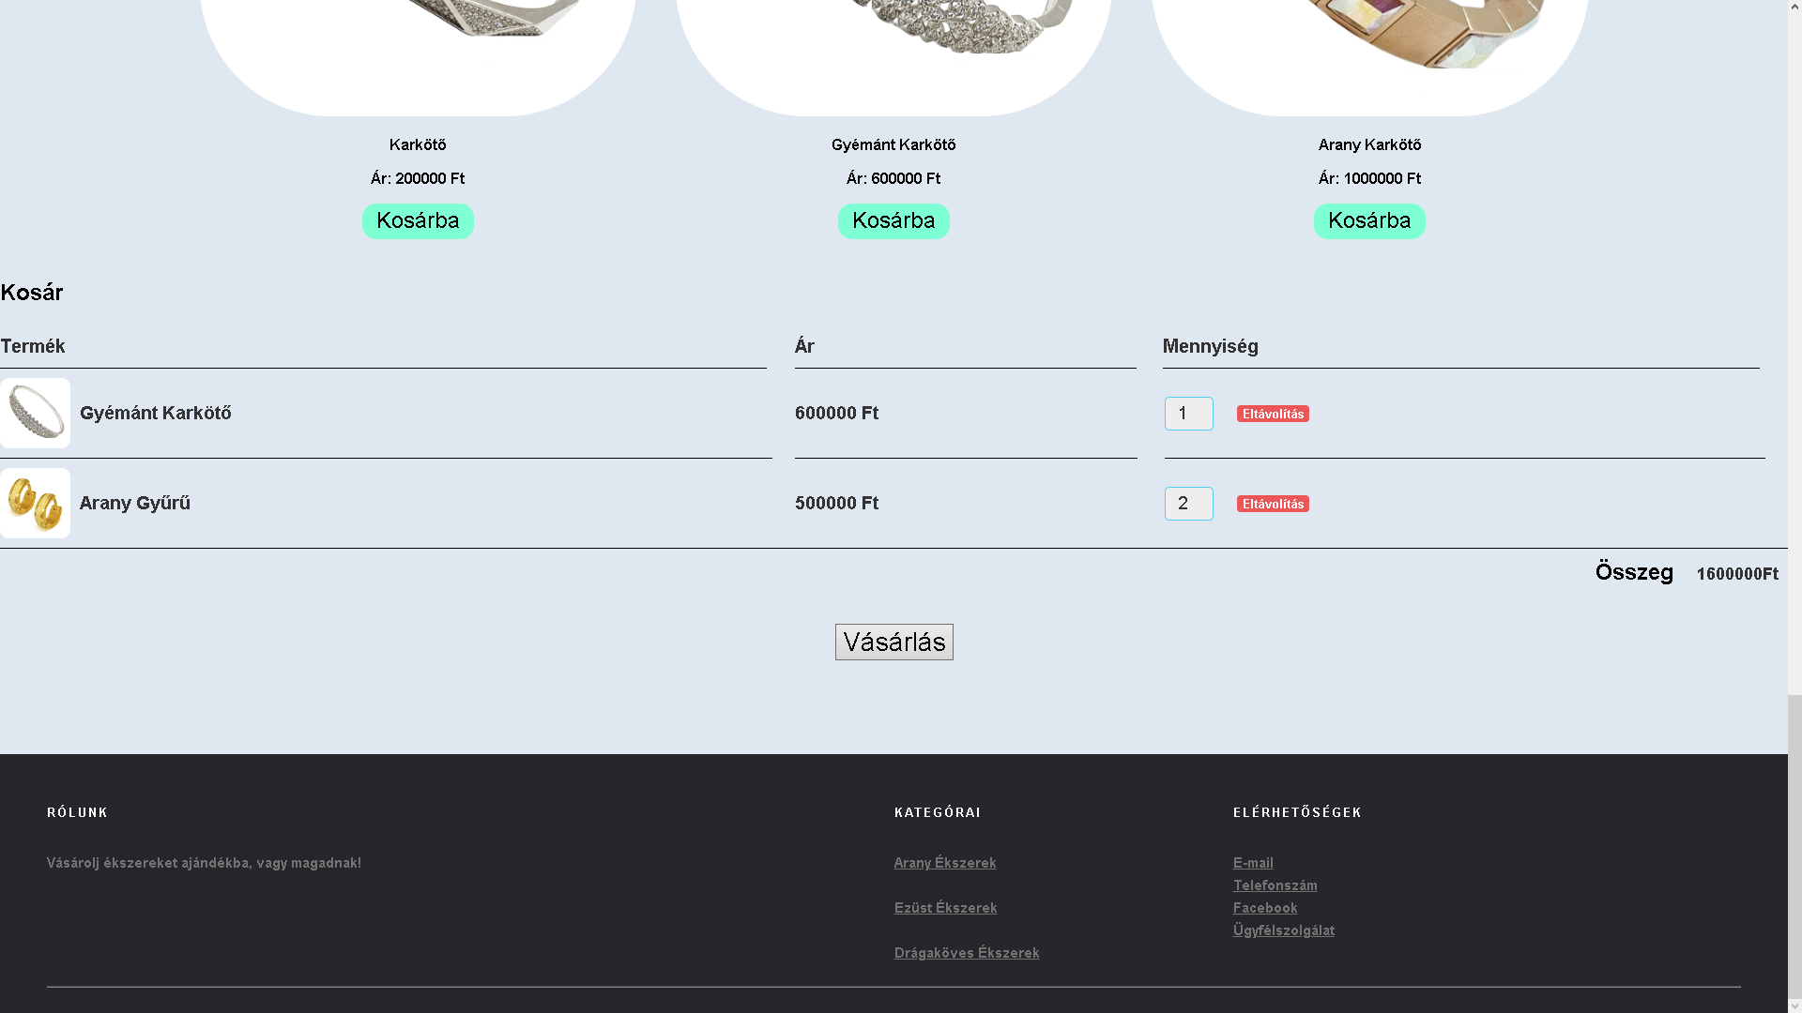

Slide 14
Registration site (Plans)
The accounts are stored in a database
You can create here your profile
You need to give your name, an e-mail address, and a password
And you can set a profile picture

Slide 15
Possible upgrades in the future
Creating a bidding page
Pawning of Jewellery

Slide 16

Thank you for your attention

Slide 17
Sources
https://www.macworld.com/article/812847/how-to-switch-to-single-page-view-in-microsoft-word-and-the-preview-app.html
https://en.wikiversity.org/wiki/Visual_Studio_Code
https://upload.wikimedia.org/wikipedia/en/thumb/7/78/XAMPP_logo.svg/1200px-XAMPP_logo.svg.png
https://webcapital.hu/storage/blog-img/php-tortenete.png
https://www.p92.hu/binaries/content/gallery/p92website/technologies/htmlcssjs-details.png

