Slide 1
Singular Value
Decomposition

Slide 2
Singular Value Decomposition (SVD) is a method for decomposing a matrix into a product of three matrices.

Slide 3
Why Decomposition?
Decomposing matrices:
Can simplify and speed up operations with them
Can assist in dimensionality reduction (PCA)
Notes:
Breaking a matrix down into simpler parts can make it simpler and faster to do certain operations on them

Slide 4
Comparing Decomposition Methods
Decomposition Method
Eigendecomposition
LU
Non-negative matrix factorization
SVD

Slide 5
Comparing Decomposition Methods
Decomposition Method | Works with rectangular matrices? | Works with non-diagonalizable matrices? | Works with matrices with negative elements?
Eigendecomposition
LU
Non-negative matrix factorization
SVD
Notes:
Note that rectangular in this context means not-square, or not n by n

Slide 6
Comparing Decomposition Methods
Decomposition Method | Works with rectangular matrices? | Works with non-diagonalizable matrices? | Works with matrices with negative elements?
Eigendecomposition | ❌ | ❌ | ✅
LU
Non-negative matrix factorization
SVD

Slide 7
Comparing Decomposition Methods
Decomposition Method | Works with rectangular matrices? | Works with non-diagonalizable matrices? | Works with matrices with negative elements?
Eigendecomposition | ❌ | ❌ | ✅
LU | ❌ | ✅ | ✅
Non-negative matrix factorization
SVD

Slide 8
Comparing Decomposition Methods
Decomposition Method | Works with rectangular matrices? | Works with non-diagonalizable matrices? | Works with matrices with negative elements?
Eigendecomposition | ❌ | ❌ | ✅
LU | ❌ | ✅ | ✅
Non-negative matrix factorization | ✅ | ✅ | ❌
SVD

Slide 9
Comparing Decomposition Methods
Decomposition Method | Works with rectangular matrices? | Works with non-diagonalizable matrices? | Works with matrices with negative elements?
Eigendecomposition | ❌ | ❌ | ✅
LU | ❌ | ✅ | ✅
Non-negative matrix factorization | ✅ | ✅ | ❌
SVD | ✅ | ✅ | ✅

Slide 10
Is SVD perfect?

Slide 11
Is SVD perfect?
No.

Slide 12
SVD is computationally expensive.
However, SVD is widely applicable and powerful.

Slide 13

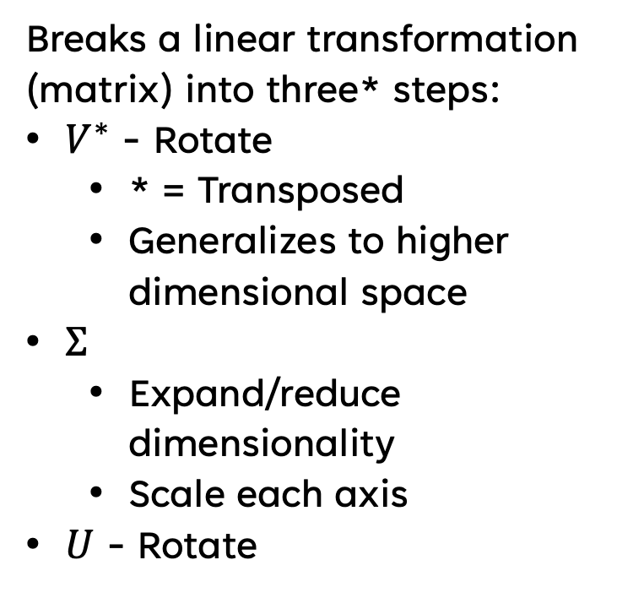
What is SVD?
Breaks a linear transformation (matrix) into three* steps:
$V^{∗}$ - Rotate
  * = Transposed
  Generalizes to higher dimensional space
$Σ$
  Expand/reduce dimensionality
  Scale each axis
$U$ - Rotate
Figure Attribution: By Georg-Johann - Own work, CC BY-SA 3.0, https://commons.wikimedia.org/w/index.php?curid=11342212
Notes:
Asterisk superscript is notation for the transpose of a matrix

Slide 14

SVD Visualized
Animation Attribution: By Lucas Vieira - Own work, Public Domain, https://commons.wikimedia.org/w/index.php?curid=11416486
Notes:
Again, remember that this generalizes to higher-dimensional spaces, we’re just using 2 dimensions because its simpler to visualize

Slide 15
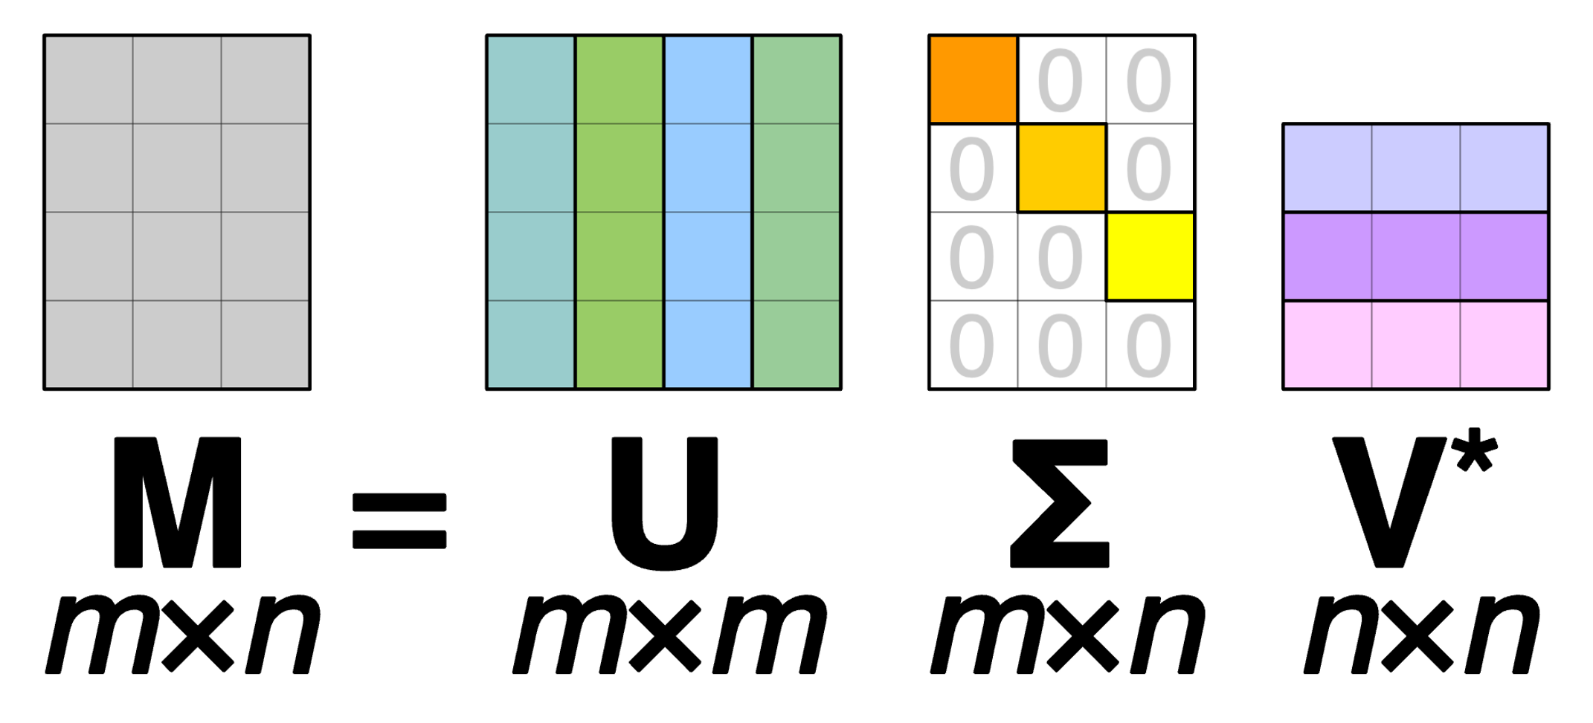
Anatomy of SVD
Figure Attribution: By Cmglee - Own work, CC BY-SA 4.0, https://commons.wikimedia.org/w/index.php?curid=67853297

Slide 16
Anatomy of SVD
A real or complex $m×n$ matrix.
Figure Attribution: By Cmglee - Own work, CC BY-SA 4.0, https://commons.wikimedia.org/w/index.php?curid=67853297

Slide 17
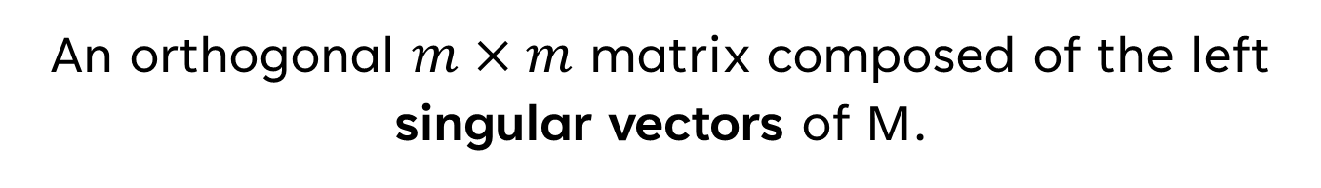
Anatomy of SVD
An orthogonal $m×m$ matrix composed of the left singular vectors of M.
Figure Attribution: By Cmglee - Own work, CC BY-SA 4.0, https://commons.wikimedia.org/w/index.php?curid=67853297
Notes:
Recall an orthogonal matrix is a matrix:
That is square
Where each column vector is a unit vector
Where every column vector is orthogonal to each other

Slide 18
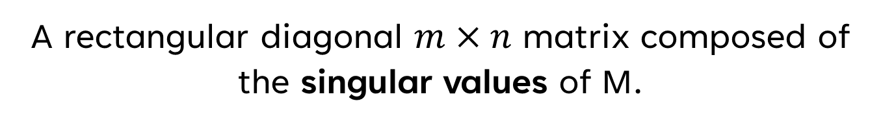
Anatomy of SVD
A rectangular diagonal $m×n$ matrix composed of the singular values of M.
Figure Attribution: By Cmglee - Own work, CC BY-SA 4.0, https://commons.wikimedia.org/w/index.php?curid=67853297

Slide 19

Anatomy of SVD
An orthogonal n$×n$ matrix composed of the right singular vectors of M.
Figure Attribution: By Cmglee - Own work, CC BY-SA 4.0, https://commons.wikimedia.org/w/index.php?curid=67853297

Slide 20
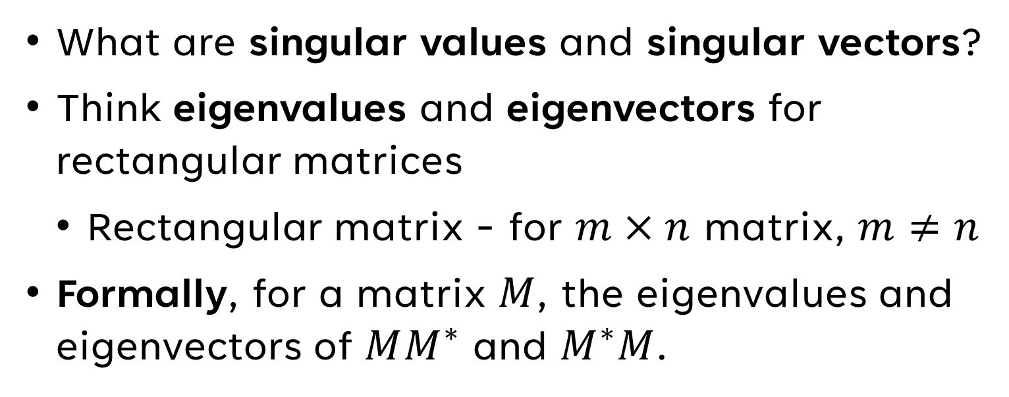
Singular Values and Vectors
What are singular values and singular vectors?
Think eigenvalues and eigenvectors for rectangular matrices
  Rectangular matrix - for $m×n$ matrix, $m≠n$
Formally, for a matrix $M$, the eigenvalues and eigenvectors of $MM^{∗}$ and $M^{∗}M$.
Notes:
Recall that eigenvalues and eigenvectors only exist for square matrices
This works because when you multiply M by its transpose in either direction, you get a symmetric, square matrix.

Slide 21
How do we get the singular values and singular vectors of a matrix?

Slide 22
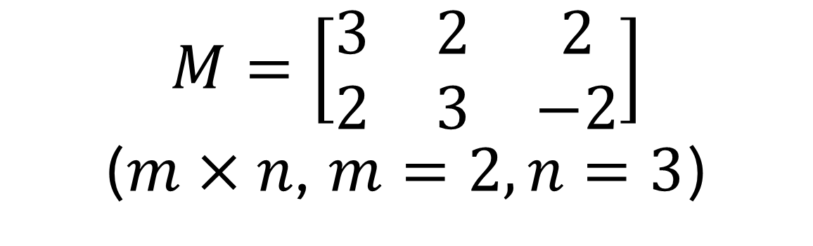
Computing Symmetric Matrices
$$M=\left[\begin{matrix}3 & 2 & 2 \\ 2 & 3 & −2\end{matrix}\right]$$
($m×n$, $m=2,n=3$)

Slide 23
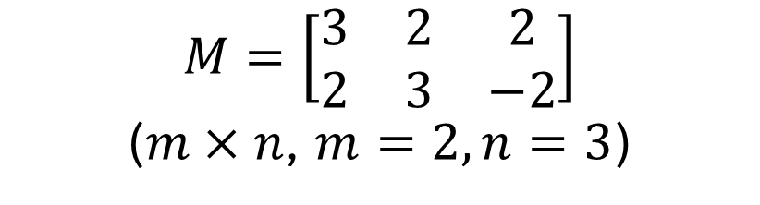
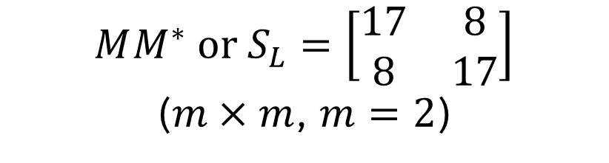
Computing Symmetric Matrices
$$M=\left[\begin{matrix}3 & 2 & 2 \\ 2 & 3 & −2\end{matrix}\right]$$
($m×n$, $m=2,n=3$)
$$MM^{∗} \text{or} S_{L}=\left[\begin{matrix}17 & 8 \\ 8 & 17\end{matrix}\right]$$
($m×m$, $m=2$)
Notes:
First, we compute the left symmetric matrix

Slide 24
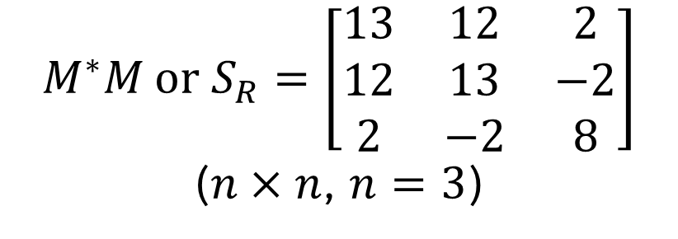
Computing Symmetric Matrices
$$M=\left[\begin{matrix}3 & 2 & 2 \\ 2 & 3 & −2\end{matrix}\right]$$
($m×n$, $m=2,n=3$)
$$MM^{∗} \text{or} S_{L}=\left[\begin{matrix}17 & 8 \\ 8 & 17\end{matrix}\right]$$
($m×m$, $m=2$)
$$M^{∗}M \text{or} S_{R}=\left[\begin{matrix}13 & 12 & 2 \\ 12 & 13 & −2 \\ 2 & −2 & 8\end{matrix}\right]$$
($n×n$, $n=3$)
Notes:
Next, we compute the right symmetric matrix

Slide 25
Now, compute the eigenvalues and eigenvectors of both.

Slide 26
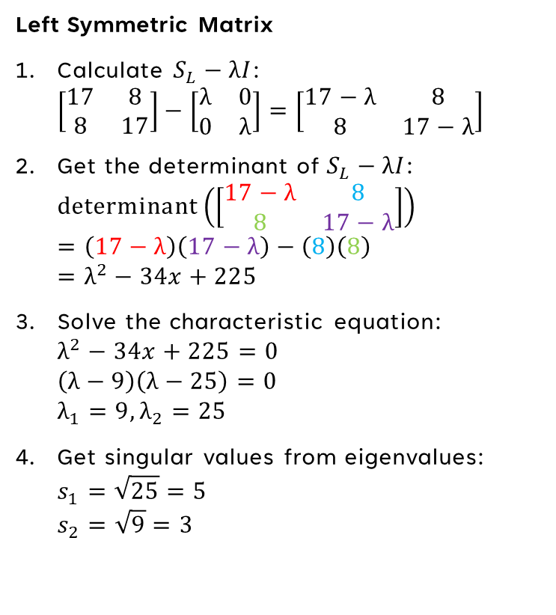
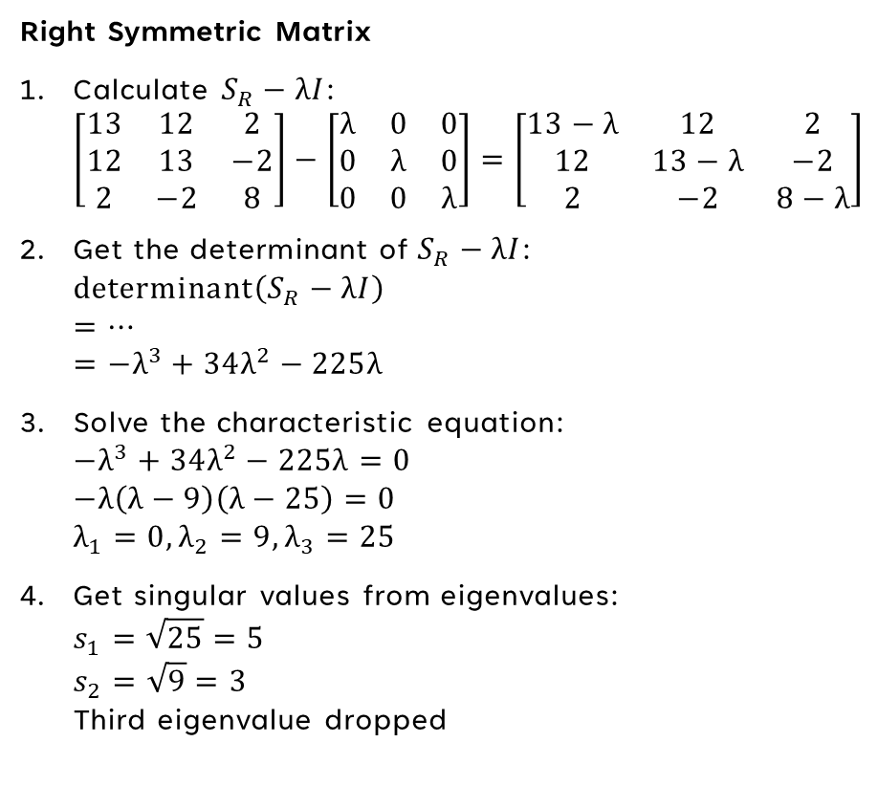
Singular Values
Left Symmetric Matrix
Calculate $S_{L}−λI$:
$\left[\begin{matrix}17 & 8 \\ 8 & 17\end{matrix}\right]−\left[\begin{matrix}λ & 0 \\ 0 & λ\end{matrix}\right]=\left[\begin{matrix}17−λ & 8 \\ 8 & 17−λ\end{matrix}\right]$
Get the determinant of $S_{L}−λI$:
$\text{determinant}\left(\left[\begin{matrix}17−λ & 8 \\ 8 & 17−λ\end{matrix}\right]\right)$
$=\left(17−λ\right)\left(17−λ\right)−\left(8\right)\left(8\right)$
$=λ^{2}−34x+225$
Solve the characteristic equation:
$λ^{2}−34x+225=0$
$\left(λ−9\right)\left(λ−25\right)=0$
$λ_{1}=9,λ_{2}=25$
Get singular values from eigenvalues:
$s_{1}=\sqrt{25}=5$
$s_{2}=\sqrt{9}=3$
Right Symmetric Matrix
Calculate $S_{R}−λI$:
$\left[\begin{matrix}13 & 12 & 2 \\ 12 & 13 & −2 \\ 2 & −2 & 8\end{matrix}\right]−\left[\begin{matrix}λ & 0 & 0 \\ 0 & λ & 0 \\ 0 & 0 & λ\end{matrix}\right]=\left[\begin{matrix}13−λ & 12 & 2 \\ 12 & 13−λ & −2 \\ 2 & −2 & 8−λ\end{matrix}\right]$
Get the determinant of $S_{R}−λI$:
$\text{determinant}\left(S_{R}−λI\right)$
$=…$
$=−λ^{3}+34λ^{2}−225λ$
Solve the characteristic equation:
$−λ^{3}+34λ^{2}−225λ=0$
$−λ\left(λ−9\right)\left(λ−25\right)=0$
$λ_{1}=0,λ_{2}=9,λ_{3}=25$
Get singular values from eigenvalues:
$s_{1}=\sqrt{25}=5$
$s_{2}=\sqrt{9}=3$
Third eigenvalue dropped

Slide 27
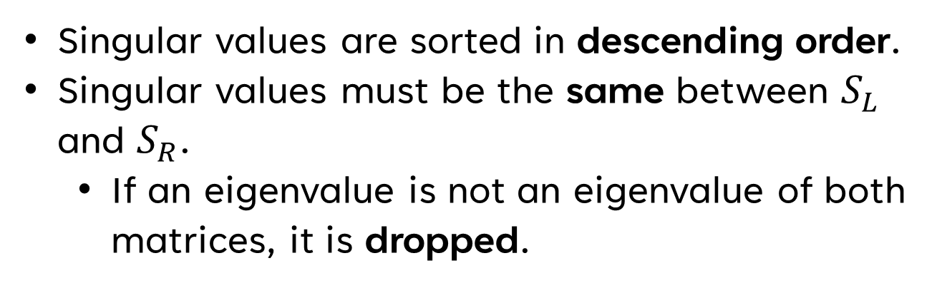
Notes About Singular Values
Singular values are sorted in descending order.
Singular values must be the same between $S_{L}$ and $S_{R}$.
  If an eigenvalue is not an eigenvalue of both matrices, it is dropped.

Slide 28
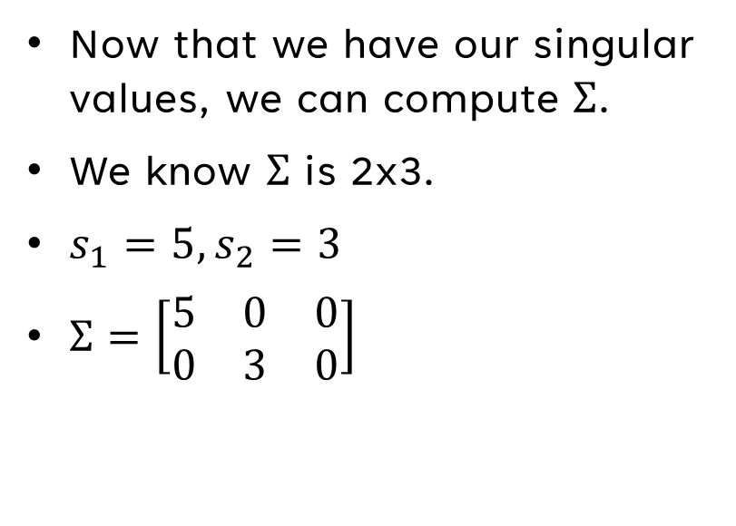
Computing Sigma
Now that we have our singular
values, we can compute $Σ$.
We know $Σ$ is 2x3.
$s_{1}=5, s_{2}=3$
$Σ=\left[\begin{matrix}5 & 0 & 0 \\ 0 & 3 & 0\end{matrix}\right]$

Slide 29
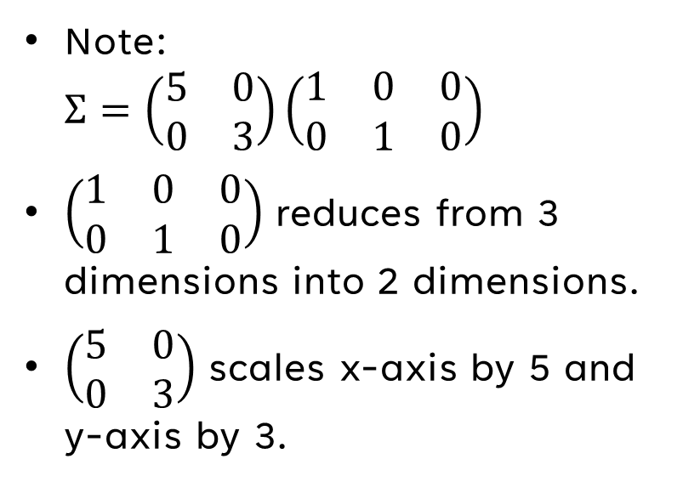
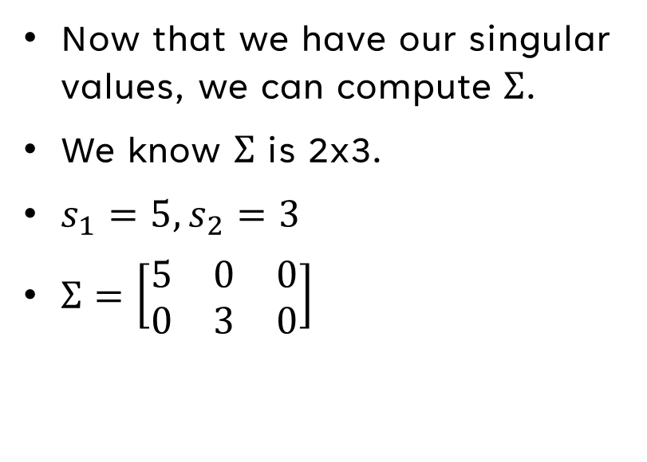
Computing Sigma
Now that we have our singular
values, we can compute $Σ$.
We know $Σ$ is 2x3.
$s_{1}=5, s_{2}=3$
$Σ=\left[\begin{matrix}5 & 0 & 0 \\ 0 & 3 & 0\end{matrix}\right]$
Note:
$Σ=\left(\begin{matrix}5 & 0 \\ 0 & 3\end{matrix}\right)\left(\begin{matrix}1 & 0 & 0 \\ 0 & 1 & 0\end{matrix}\right)$
$\left(\begin{matrix}1 & 0 & 0 \\ 0 & 1 & 0\end{matrix}\right)$ reduces from 3 dimensions into 2 dimensions.
$\left(\begin{matrix}5 & 0 \\ 0 & 3\end{matrix}\right)$ scales x-axis by 5 and y-axis by 3.

Slide 30
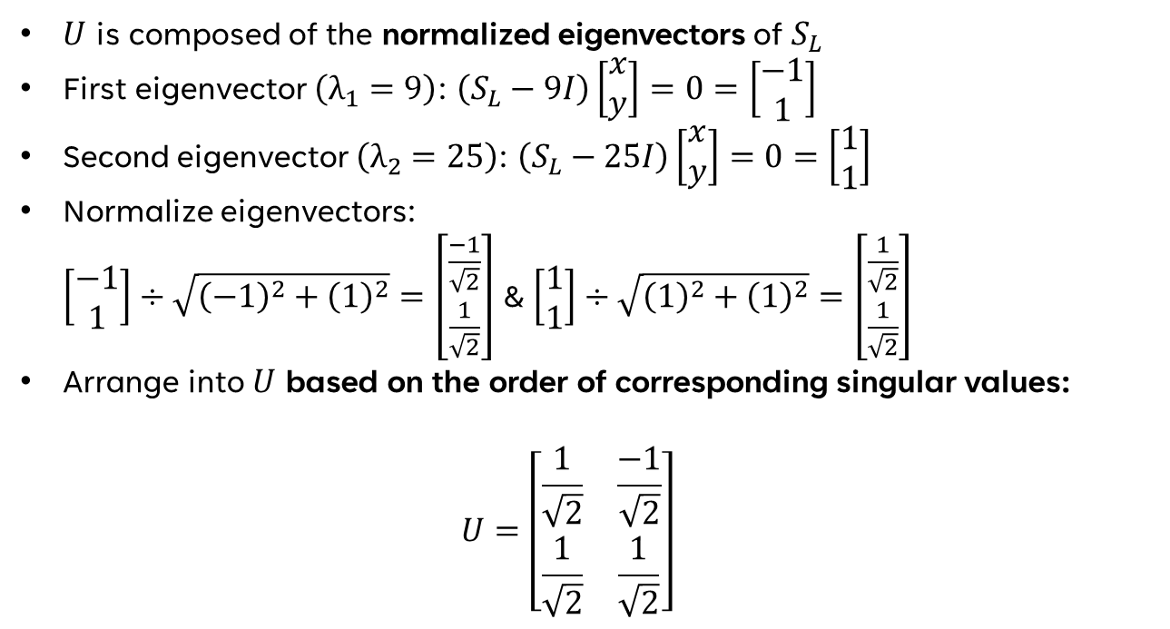
Computing U
$U$ is composed of the normalized eigenvectors of $S_{L}$
First eigenvector $\left(λ_{1}=9\right)$: $\left(S_{L}−9I\right)\left[\begin{matrix}x \\ y\end{matrix}\right]=0=\left[\begin{matrix}−1 \\ 1\end{matrix}\right]$
Second eigenvector $\left(λ_{2}=25\right)$: $\left(S_{L}−25I\right)\left[\begin{matrix}x \\ y\end{matrix}\right]=0=\left[\begin{matrix}1 \\ 1\end{matrix}\right]$
Normalize eigenvectors:
$\left[\begin{matrix}−1 \\ 1\end{matrix}\right]÷\sqrt{{\left(−1\right)}^{2}+{\left(1\right)}^{2}}=\left[\begin{matrix}\frac{−1}{\sqrt{2}} \\ \frac{1}{\sqrt{2}}\end{matrix}\right]$ & $\left[\begin{matrix}1 \\ 1\end{matrix}\right]÷\sqrt{{\left(1\right)}^{2}+{\left(1\right)}^{2}}=\left[\begin{matrix}\frac{1}{\sqrt{2}} \\ \frac{1}{\sqrt{2}}\end{matrix}\right]$
Arrange into $U$ based on the order of corresponding singular values:
$U=\left[\begin{matrix}\frac{1}{\sqrt{2}} & \frac{−1}{\sqrt{2}} \\ \frac{1}{\sqrt{2}} & \frac{1}{\sqrt{2}}\end{matrix}\right]$

Slide 31
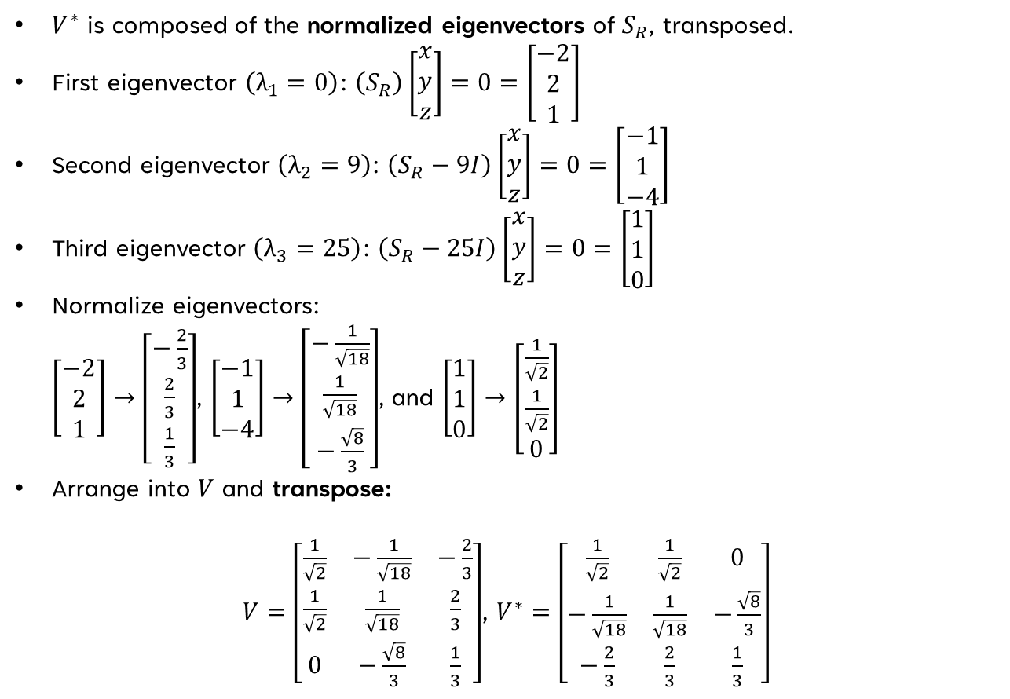
Computing V*
$V^{∗}$ is composed of the normalized eigenvectors of $S_{R}$, transposed.
First eigenvector $\left(λ_{1}=0\right)$: $\left(S_{R}\right)\left[\begin{matrix}x \\ y \\ z\end{matrix}\right]=0=\left[\begin{matrix}−2 \\ 2 \\ 1\end{matrix}\right]$
Second eigenvector $\left(λ_{2}=9\right)$: $\left(S_{R}−9I\right)\left[\begin{matrix}x \\ y \\ z\end{matrix}\right]=0=\left[\begin{matrix}−1 \\ 1 \\ −4\end{matrix}\right]$
Third eigenvector $\left(λ_{3}=25\right)$: $\left(S_{R}−25I\right)\left[\begin{matrix}x \\ y \\ z\end{matrix}\right]=0=\left[\begin{matrix}1 \\ 1 \\ 0\end{matrix}\right]$
Normalize eigenvectors:
$\left[\begin{matrix}−2 \\ 2 \\ 1\end{matrix}\right]→\left[\begin{matrix}−\frac{2}{3} \\ \frac{2}{3} \\ \frac{1}{3}\end{matrix}\right]$, $\left[\begin{matrix}−1 \\ 1 \\ −4\end{matrix}\right]→\left[\begin{matrix}−\frac{1}{\sqrt{18}} \\ \frac{1}{\sqrt{18}} \\ −\frac{\sqrt{8}}{3}\end{matrix}\right]$, and $\left[\begin{matrix}1 \\ 1 \\ 0\end{matrix}\right]→\left[\begin{matrix}\frac{1}{\sqrt{2}} \\ \frac{1}{\sqrt{2}} \\ 0\end{matrix}\right]$
Arrange into $V$ and transpose:
$V=\left[\begin{matrix}\frac{1}{\sqrt{2}} & −\frac{1}{\sqrt{18}} & −\frac{2}{3} \\ \frac{1}{\sqrt{2}} & \frac{1}{\sqrt{18}} & \frac{2}{3} \\ 0 & −\frac{\sqrt{8}}{3} & \frac{1}{3}\end{matrix}\right]$, $V^{∗}=\left[\begin{matrix}\frac{1}{\sqrt{2}} & \frac{1}{\sqrt{2}} & 0 \\ −\frac{1}{\sqrt{18}} & \frac{1}{\sqrt{18}} & −\frac{\sqrt{8}}{3} \\ −\frac{2}{3} & \frac{2}{3} & \frac{1}{3}\end{matrix}\right]$

Slide 32
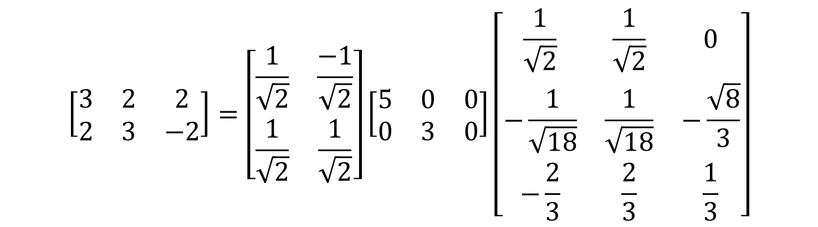
SVD
$$\left[\begin{matrix}3 & 2 & 2 \\ 2 & 3 & −2\end{matrix}\right]=\left[\begin{matrix}\frac{1}{\sqrt{2}} & \frac{−1}{\sqrt{2}} \\ \frac{1}{\sqrt{2}} & \frac{1}{\sqrt{2}}\end{matrix}\right]\left[\begin{matrix}5 & 0 & 0 \\ 0 & 3 & 0\end{matrix}\right]\left[\begin{matrix}\frac{1}{\sqrt{2}} & \frac{1}{\sqrt{2}} & 0 \\ −\frac{1}{\sqrt{18}} & \frac{1}{\sqrt{18}} & −\frac{\sqrt{8}}{3} \\ −\frac{2}{3} & \frac{2}{3} & \frac{1}{3}\end{matrix}\right]$$
Figure Attribution: By Cmglee - Own work, CC BY-SA 4.0, https://commons.wikimedia.org/w/index.php?curid=67853297

Slide 33
THANK YOU

