Slide 1
Artificial intelligence
Quantifying Uncertainty

Slide 2
Notice
Presentation slides will be available for download along with the recording of this review session.
You are free to take pictures regardless if you’d like.

Slide 3
DISCLAIMER
I have tried to pull all information from the slides, the textbook, and other authorized resources, but I cannot guarantee the veracity of any information in the slides hereafter.
See presentation notes for sources

Slide 4
Edition Differences
Chapter 13 in 3rd edition is now chapter 12 in 4th edition.
I will continue to use 4th edition pgs.
The chapter we’re covering is “Quantifying Uncertainty.”

Slide 5
Outline
Uncertainty
Probability
Syntax and Semantics
Inference
Notes:
Chapter13.pdf slide 2

Slide 6
Uncertainty
When we don’t know everything

Slide 7

Uncertainty
Uncertainty in driving to school:
Traffic
Notes:
As we translate abstract logical agents to operation in the real world, what is more real than having absolutely no idea what’s going on?
Many common actions involve uncertainty. For me, driving to school is a massive source of uncertainty.
FIT Parking - Postulated to be Dante’s forgotten 10th circle of hell.
Chapter13.pdf slide 3
Image by Ann Baldwin, from iStock (https://www.istockphoto.com/photo/senior-man-shrugging-shoulders-gm91520053-8977854 )

Slide 8
Uncertainty
Uncertainty in driving to school:
Traffic
Flat/deflated tire
Notes:
As we translate abstract logical agents to operation in the real world, what is more real than having absolutely no idea what’s going on?
Many common actions involve uncertainty. For me, driving to school is a massive source of uncertainty.
FIT Parking - Postulated to be Dante’s forgotten 10th circle of hell.
Chapter13.pdf slide 3
Image by Ann Baldwin, from iStock (https://www.istockphoto.com/photo/senior-man-shrugging-shoulders-gm91520053-8977854 )

Slide 9
Uncertainty
Uncertainty in driving to school:
Traffic
Flat/deflated tire
FIT Parking
Notes:
As we translate abstract logical agents to operation in the real world, what is more real than having absolutely no idea what’s going on?
Many common actions involve uncertainty. For me, driving to school is a massive source of uncertainty.
FIT Parking - Postulated to be Dante’s forgotten 10th circle of hell.
Chapter13.pdf slide 3
Image by Ann Baldwin, from iStock (https://www.istockphoto.com/photo/senior-man-shrugging-shoulders-gm91520053-8977854 )

Slide 10
Uncertainty
Uncertainty in driving to school:
Traffic
Flat/deflated tire
FIT Parking
When your car makes a weird noise and you’re pretty sure it’s fine but you let it run for a while to make sure there’s no popping or burning sounds, but then the car shudders, so like what is that supposed to mean? I’m a CS major, not a mechanic for heaven’s sake! I don’t have time to deal with this right now, I have a test worth 90% of my grade that I need to go take.
Notes:
As we translate abstract logical agents to operation in the real world, what is more real than having absolutely no idea what’s going on?
Many common actions involve uncertainty. For me, driving to school is a massive source of uncertainty.
FIT Parking - Postulated to be Dante’s forgotten 10th circle of hell.
Chapter13.pdf slide 3
Image by Ann Baldwin, from iStock (https://www.istockphoto.com/photo/senior-man-shrugging-shoulders-gm91520053-8977854 )

Slide 11
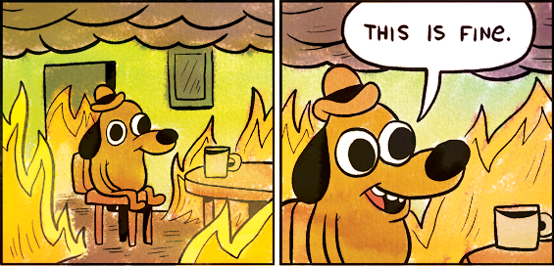


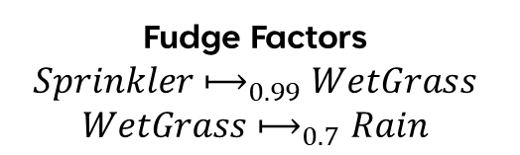
Into the Unknown (Elsa Would be Proud)
Fudge Factors
$$Sprinkler{\text{⟼}}_{0.99}WetGrass$$
$$WetGrass{\text{⟼}}_{0.7}Rain$$
Default/Nonmonotonic Logic
Probability
%
Notes:
Default/nonmonotonic logic is saying: problem? What problem? Let’s just assume my car has no problems and traffic is entirely normal and there’s no parking like always! While some assumptions are reasonable, assuming everything is clearly problematic
Fudge factors allow us to set likelihoods on our rules to account for cases where those rules aren’t true ( https://en.wikipedia.org/wiki/Fudge_factor ), but they have problematic implications, such as yard sprinklers causing rain.
What we need is probability, a rigorous framework that considers the relationships between events, establishes rules for working with them, accounts for laziness and ignorance, and gives logical quantifications for the likelihoods of queries.
Chapter13.pdf slides 4-5
Default or nonmonotonic logic image is from Gunshow #648 (https://gunshowcomic.com/648 ).

Slide 12
The Utility of Probability
Probabilistic assertions summarize effects of laziness and ignorance.
In Bayesian or subjective probability, probabilities relate propositions to one’s own state of knowledge.
This means probabilities change with new evidence.
Notes:
Laziness is the failure to enumerate exceptions, qualifications, etc.
Ignorance is the lack of relevant facts, initial conditions, etc.
Chapter13.pdf slide 5

Slide 13
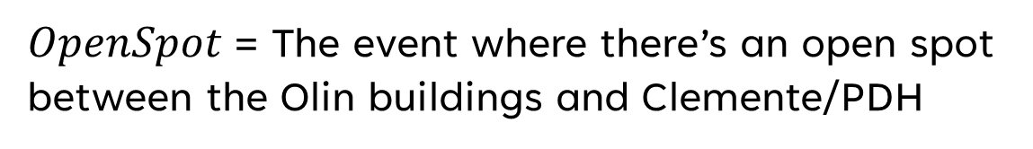
Parking with Bayes
$OpenSpot$ = The event where there’s an open spot between the Olin buildings and Clemente/PDH
$$P(OpenSpot|\text{no} \text{events}\text{, 9:50 }\text{a}\text{.}\text{m}\text{.)}=0.05$$
Driving into campus
$$P(OpenSpot|\text{career} \text{fair}\text{/}\text{senior} \text{design}\text{/}\text{other} \text{event}\text{, 9:50 }\text{a}\text{.}\text{m}\text{.)}={10}^{−6}$$
Notes:
Let’s say you’re an off-campus student driving in for your 10 a.m. class
Let’s also say you don’t remember what number each parking lot is so when you got those emails saying parking lot x is closed, you don’t know what that means and you forget to check
Now suppose you drive in and see that in the three parking lanes in our area of interest, the middle one is blocked of for one kind of event
This updates the likelihood of getting a spot in that area, and we proceed to the parking garage.
Chapter13.pdf slide 5

Slide 14
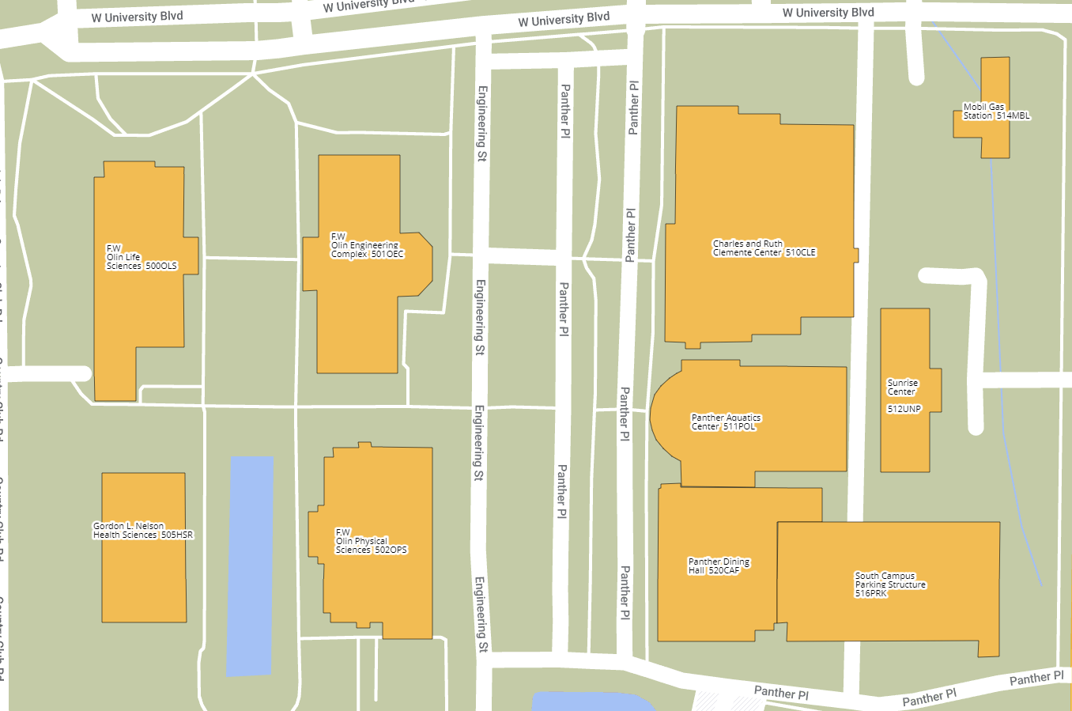

But That’s Just a Theory (A Decision Theory)
BATTLEMAP
Time of Arrival | Probability of Success
9:50 | 0.04
8:50 | 0.7
6:00 | 0.95
2:00 | 0.9999
Trying to park here
Utility Theory = Preferences
Decision Theory = Utility Theory + Probability Theory
Notes:
If we’re trying to park in this location, we can increase the probability of success based on what time we get there.
However, success is not our only metric for what is the best decision.
Let’s say, for some reason, I don’t want to get up at 1 am for my class at 10
That’s where utility theory comes in, which is used to represent and infer preferences
When we combine utility theory with probability theory, that’s how we get the theory of decisions
Chapter13.pdf slide 6

Slide 15
Probability
They never want you to tell them the odds, but what about the evens?

Slide 16



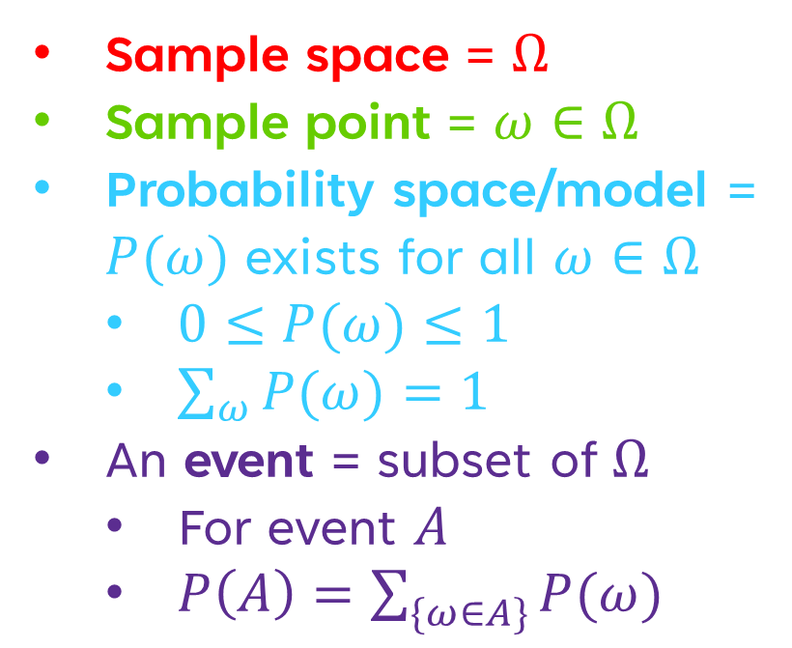

Intro to Smart Gambling Probability
Sample space = $Ω$
Sample point = $ω∈Ω$
Probability space/model = $P(ω)$ exists for all $ω∈Ω$
$0≤P(ω)≤1$
$\sum_{ω}{P(ω)}=1$
An event = subset of $Ω$
For event $A$
$P\left(A\right)=\sum_{\{ω∈A\}}{P(ω)}$
1
4
2
5
3
6
Notes:
The sample space is the set of all possible points, the universe.
A sample point is a possible world inside of the sample space. Similar to a model from logic.
A probability space/model is a type of sample space where there is a probability assigned for every sample point in the space.
In this example, our sample space is all possible rolls of a six-sided die, and it is a probability space.
A sample point is one roll. In this case, each roll has an equal probability of being rolled, which is 1/6.
Observe that every probability is between 0 and 1, and when we sum the probability of every sample point in the sample space, we get 1.
Let’s also say we have an event A, which contains the rolls 3 and 6. The probability of A is 1/3, because the probability of 3 is 1/6, the probability of 6 is 1/6, and when we add the two we get 2/6 which reduces to 1/3
Chapter13.pdf slide 7

Slide 17
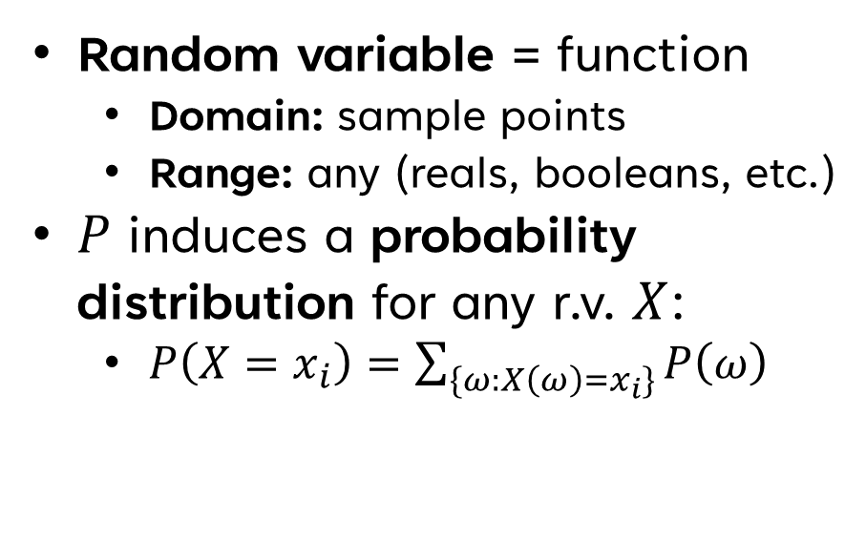
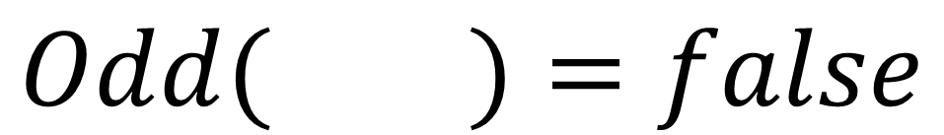
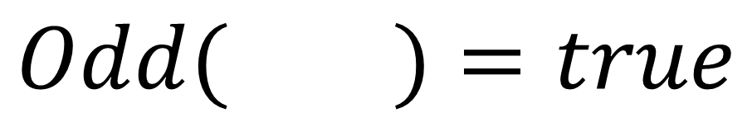
Random Variables
Random variable = function
Domain: sample points
Range: any (reals, booleans, etc.)
$P$ induces a probability distribution for any r.v. $X$:
$P\left(X=x_{i}\right)=\sum_{\{ω:X\left(ω\right)=x_{i}\}}{P\left(ω\right)}$
$$Odd( )=true$$
1
$$Odd( )=false$$
2
$$P\left(Odd=true\right)=P\left( \right)+P\left( \right)+P\left( \right)=\frac{1}{6}+\frac{1}{6}+\frac{1}{6}=\frac{1}{2}$$
1
3
5
Notes:
A probability distribution is an assignment of a probability for each possible value of the random variable (Book ch. 12 pg. 7)
So for our function, Odd can be assigned as true or false. P(Odd = true), as displayed on the slides, is ½, and P(Odd = false), is ½ as well.
With this, we have a probability for every possible value of Odd, and therefore we have a probability distribution.
Chapter13.pdf slide 8

Slide 18
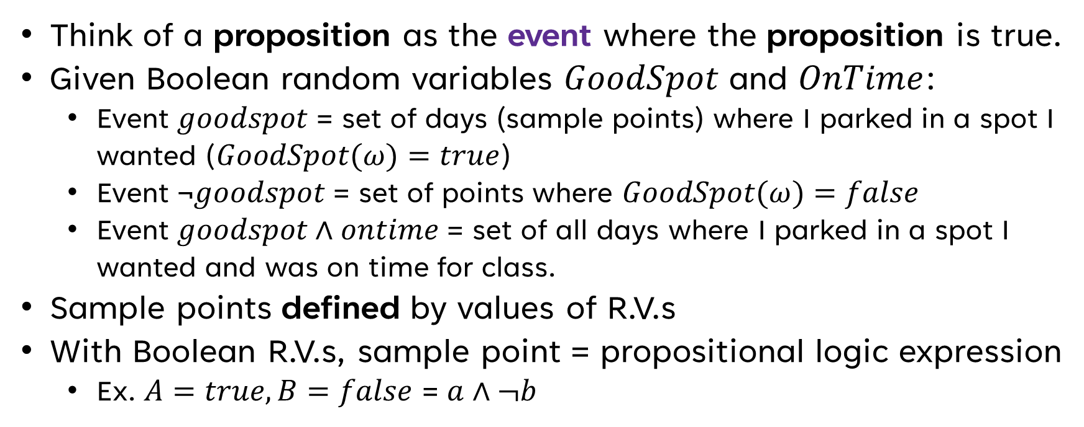
Propositions
Think of a proposition as the event where the proposition is true.
Given Boolean random variables $GoodSpot$ and $OnTime$:
Event $goodspot$ = set of days (sample points) where I parked in a spot I wanted ($GoodSpot(ω)=true$)
Event $\text{¬}goodspot$ = set of points where $GoodSpot(ω)=false$
Event $goodspot∧ontime$ = set of all days where I parked in a spot I wanted and was on time for class.
Sample points defined by values of R.V.s
With Boolean R.V.s, sample point = propositional logic expression
Ex. $A=true,B=false$ = $a∧¬b$
Notes:
Sample points defined by values of R.V.s means that you can express a sample point as an assignment of all random variables, and the sample space is the Cartesian product of the ranges of the variables (meaning, every possible combination of the assignments of the variables)
Uppercase means all possible values of the variables, lowercase means true for Boolean R.V.s
Chapter13.pdf slide 9

Slide 19
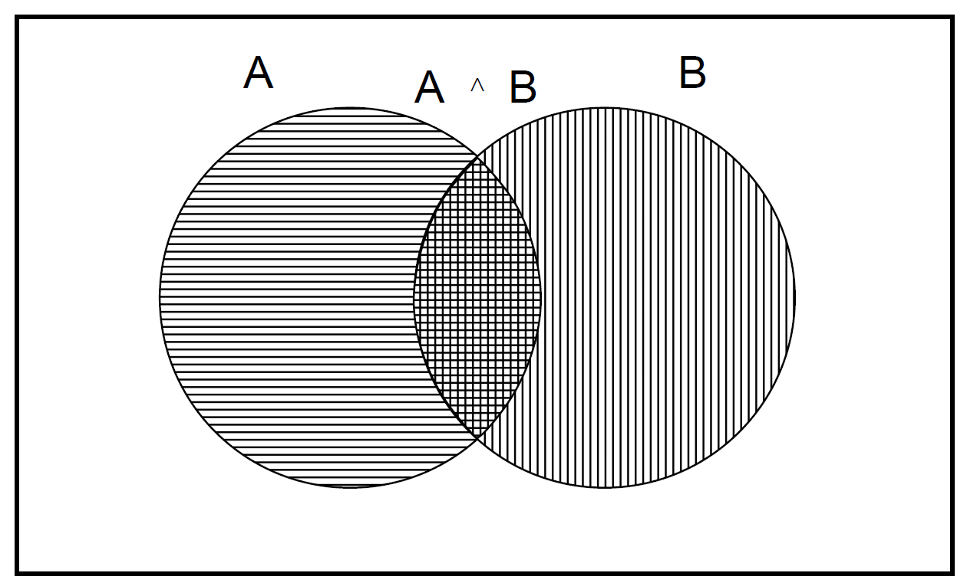
A notable Implication
$P\left(a∨b\right)=P\left(a\right)+P\left(b\right)−P\left(a∧b\right)$
Notes:
Chapter13.pdf slide 10

Slide 20
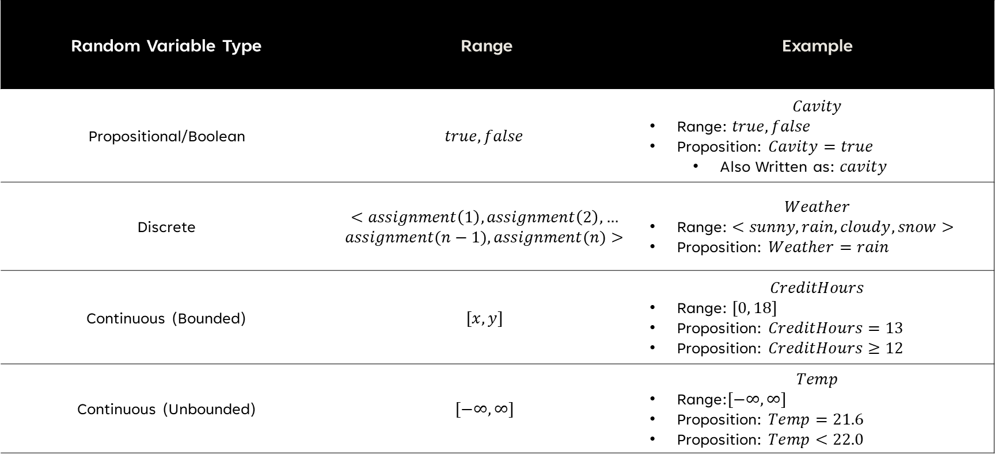
Propositional Categorization (I Just Like Using Big Words)
Random Variable Type | Range | Example
Propositional/Boolean | $$true, false$$ | $$Cavity$$ Range: $true, false$ Proposition: $Cavity=true$ Also Written as: $cavity$
Discrete | $$<assignment\left(1\right), assignment\left(2\right), …$$ $$assignment(n−1), assignment(n)>$$ | $$Weather$$ Range: $<sunny, rain, cloudy, snow>$ Proposition: $Weather=rain$
Continuous (Bounded) | $$[x, y]$$ | $$CreditHours$$ Range: $[0, 18]$ Proposition: $CreditHours=13$ Proposition: $CreditHours≥12$
Continuous (Unbounded) | $$[−∞,∞]$$ | $$Temp$$ Range:$[−∞,∞]$ Proposition: $Temp=21.6$ Proposition: $Temp<22.0$
Notes:
Chapter13.pdf slide 11

Slide 21
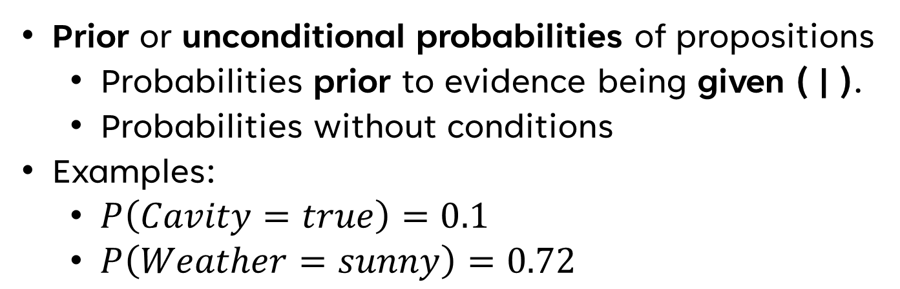
Prior Probabilities Presented
Prior or unconditional probabilities of propositions
Probabilities prior to evidence being given ( | ).
Probabilities without conditions
Examples:
$P\left(Cavity=true\right)=0.1$
$P\left(Weather=sunny\right)=0.72$
Notes:
These probabilities are typically called priors.
I want you to associate “given” with the pipe symbol ( | ), so basically, when there’s no pipe symbol, this is the probability prior to evidence being given
Chapter13.pdf slide 12

Slide 22
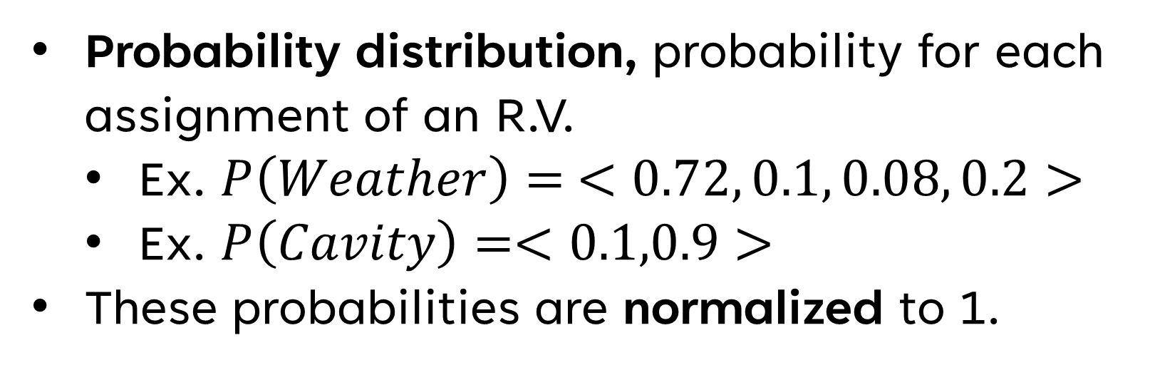
Probability Distribution
Probability distribution, probability for each assignment of an R.V.
Ex. $P\left(Weather\right)= <0.72, 0.1, 0.08, 0.2>$
Ex. $P\left(Cavity\right)=<0.1,0.9>$
These probabilities are normalized to 1.
Notes:
Chapter13.pdf slide 12

Slide 23


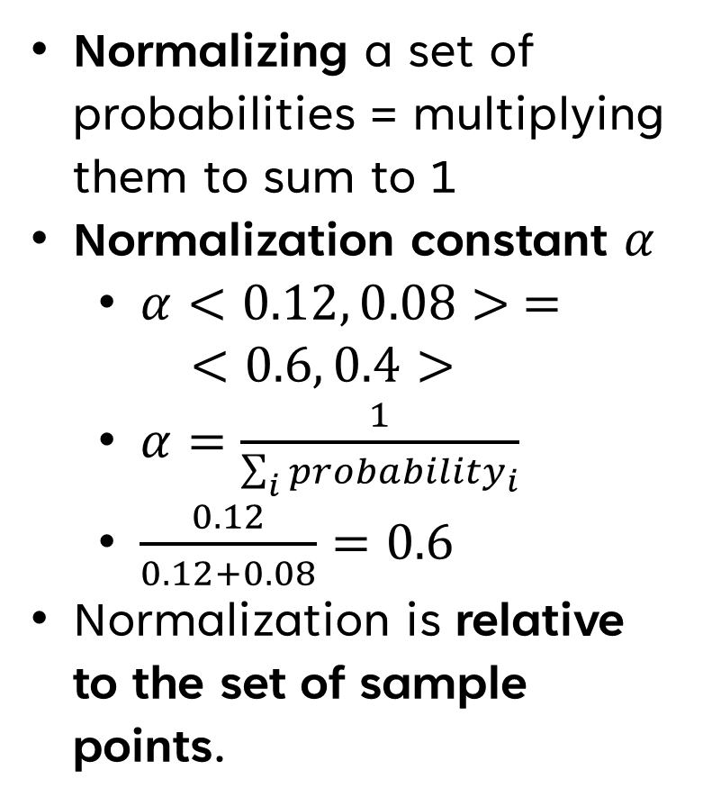
Normalization
Normalizing a set of probabilities = multiplying them to sum to 1
Normalization constant $α$
$α<0.12, 0.08> =$ $<0.6, 0.4>$
$α=\frac{1}{\sum_{i}{{probability}_{i}}}$
$\frac{0.12}{0.12+0.08}=0.6$
Normalization is relative to the set of sample points.
Your Probabilities
Normalized
Probabilities
Notes:
Normalization is relative to the set of sample points, you can normalize the probability than any given R.V. is assigned to any given value, but that doesn’t mean the probabilities are prior/unconditional probabilities.
Put in a different way, let’s say that this probability here is the probability that you have a cavity, given you have a toothache. This normalized probability is the probability that you have a cavity given that you have a toothache.
However, this is not the probability that you have a cavity over the entirety of the sample space. Remember the scope of the sample points educating your probabilities when normalizing, whether your probabilities are normalized or not, they’re still not unconditional.
It is true that the sum of all sample points in the probability space has to equal 1, but beyond that no probabilities are mandated to be normalized, and beyond that no normalized probabilities reflect the real prior/unconditional probabilities.
Chapter13.pdf slide 21
Images are of “Old Man McGucket” and “Tad Strange” from Gravity Falls

Slide 24
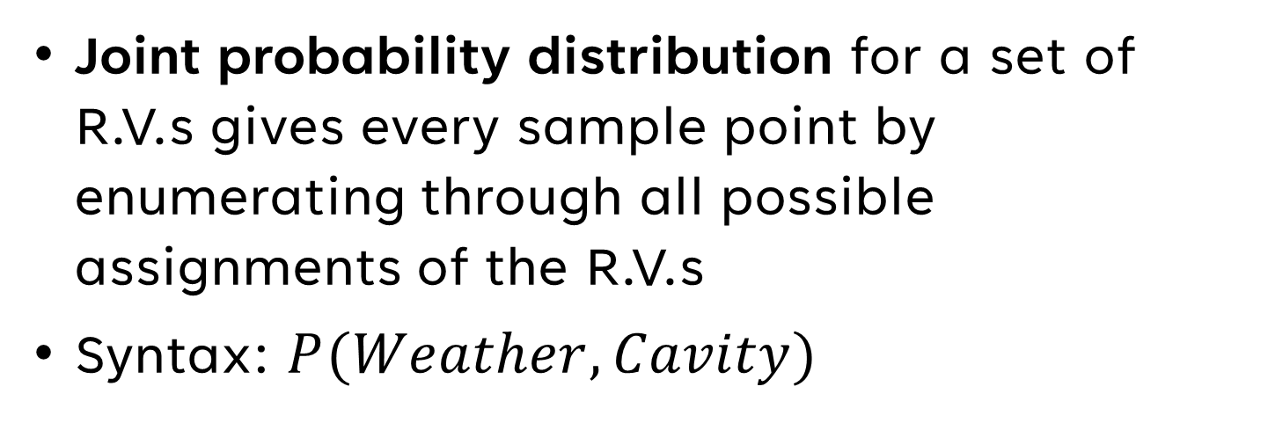
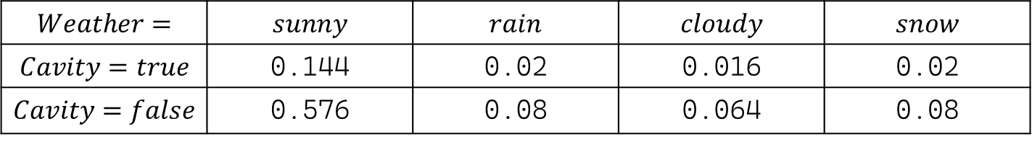
Joint Probability Distribution
Joint probability distribution for a set of R.V.s gives every sample point by enumerating through all possible assignments of the R.V.s
Syntax: $P(Weather, Cavity)$
$$Weather=$$ | $$sunny$$ | $$rain$$ | $$cloudy$$ | $$snow$$
$$Cavity=true$$ | 0.144 | 0.02 | 0.016 | 0.02
$$Cavity=false$$ | 0.576 | 0.08 | 0.064 | 0.08
Notes:
Technical Definition: The Cartesian product of the ranges of the R.V.s
Chapter13.pdf slide 12

Slide 25
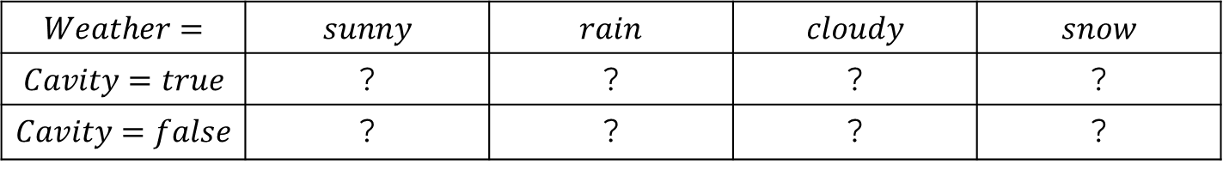
Pop Quiz!
How many values must be known to complete this table?
$$Weather=$$ | $$sunny$$ | $$rain$$ | $$cloudy$$ | $$snow$$
$$Cavity=true$$ | ? | ? | ? | ?
$$Cavity=false$$ | ? | ? | ? | ?
Notes:
Answer: 7
Because this table is comprised of prior probabilities (i.e., we’re calculating the probability that any point in the sample space matches to any of these assignments), all values add up to 1.
So, we can get value 8 by doing 1 – the sum of values 1-7
Source: Dr. Mitra in class

Slide 26
Probability for Continuous Variables
Covered in chapter13.pdf slides 13-14
Notes:
Basically says the probability of an assignment on a continuous R.V. is a slice on a density P which integrates to 1, and different continuous R.V.s may have different types of density, uniform and Gaussian
Chapter13.pdf slides 13-14

Slide 27
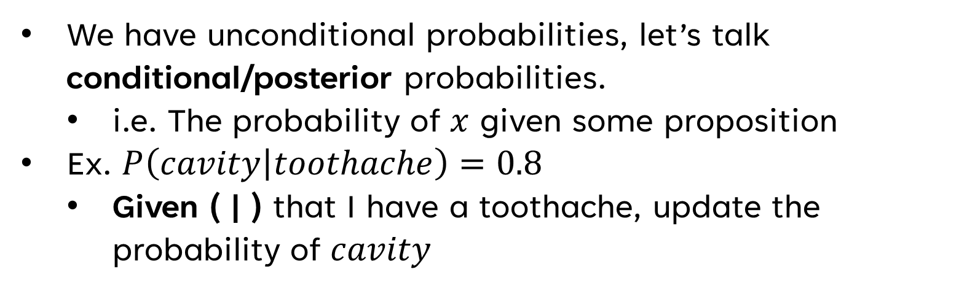


Adding Conditions
We have unconditional probabilities, let’s talk conditional/posterior probabilities.
i.e. The probability of $x$ given some proposition
Ex. $P\left(cavity | toothache\right)=0.8$
Given ( | ) that I have a toothache, update the probability of $cavity$
New Evidence
$$P\left(cavity\right)=0.1$$
$$P\left(cavity | toothache\right)=0.8$$
Notes:
An important destinction: In this example case, we’re not saying “If I have a toothache then there’s an 80% chance of a cavity”. There could be other variables that cavity is dependent on that we don’t know.
All this is saying is, before, I had a prior/unconditional probability of cavity, and now knowing that I have a toothache, this probability is updated
Chapter13.pdf slide 15

Slide 28
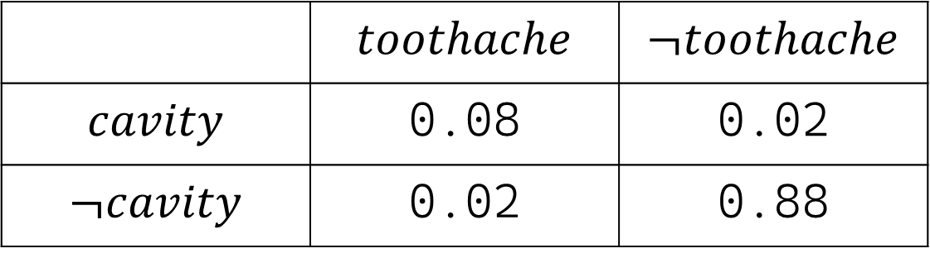
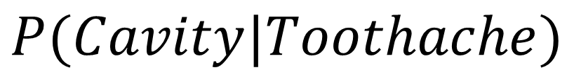
Conditional Distribution
$$P(Cavity|Toothache)$$
 | $$toothache$$ | $$¬toothache$$
$$cavity$$ | 0.08 | 0.02
$$¬cavity$$ | 0.02 | 0.88
Notes:
Numbers are example numbers
But this is an example of the fact that, even though the probability of Cavity = true is 0.1, or 10%, the probability of a cavity given toothache is 0.8, if you normalize 0.08 and 0.02, which are the two numbers in the first column then 0.08 = 80%
Chapter13.pdf slide 15

Slide 29
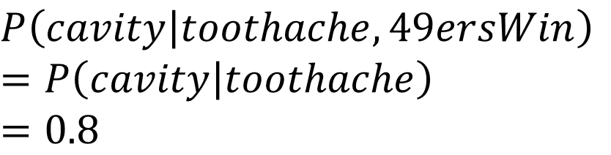
On the Topic of Uselessness
$$P\left(cavity | toothache,cavity\right)=1$$
Valid, relevant, but useless
$$P\left(cavity | toothache,49ersWin\right)$$
$$=P\left(cavity | toothache\right)$$
$$=0.8$$
Valid, but irrelevant and useless
Notes:
Not all valid evidence we obtain is helpful
Not all valid evidence we obtain is relevant
Chapter13.pdf slide 15

Slide 30
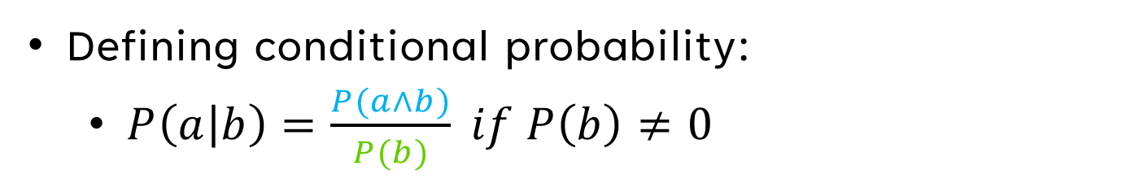
Under the Hood
Defining conditional probability:
$P\left(a | b\right)=\frac{P(a∧b)}{P(b)} if P\left(b\right)≠0$
Notes:
Because it will be useful for Bayes’, I want to lock it into our heads that putting something in the denominator is like narrowing the scope, shrinking our set from the sample space to something else.
Like in normalization, when we divide by the sum of all the values we’re normalizing, we’re narrowing the scope from the sample space to the set of values we’re normalizing, saying, these values are the new “everything”, the new 1, the new 100%
So when we’re calculating the probability of a given b, we’re diving by the probability of b, because we’re narrowing the scope of sample points we’re considering to the set of all sample points where b is true.
And we see this in the venn diagram, for instance.
So, we’re not calculating simply the probability that a and b are true, we’re calculating the probability that a and b are true in the context of b being true
Chapter13.pdf slide 16

Slide 31
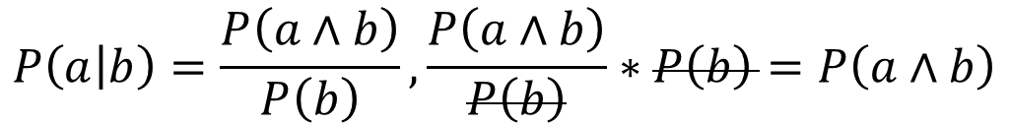

Product Rule for Conditional Probability (Not Calculus, Don’t Cry Yet)
$$P\left(a | b\right)=\frac{P\left(a∧b\right)}{P\left(b\right)},\frac{P\left(a∧b\right)}{P\left(b\right)}∗P\left(b\right)=P\left(a∧b\right)$$
Therefore,
$$P\left(a∧b\right)=P\left(a | b\right)P\left(b\right)=P\left(b | a\right)P(a)$$
Notes:
This does make sense in context of our previous example
The statement P(a|b) is saying, what’s the probability that a is true, factoring in the probability that b is true
Here, we’re saying, b is true, and that brings us to the probability that a is true and b is true
You’ll also notice that multiply P(b) undoes the narrowing of the scope, which leads to the probability P(a^b) in context of the entire sample space, it turns the conditional probability into an unconditional probability
Chapter13.pdf slide 16

Slide 32
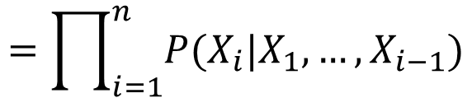
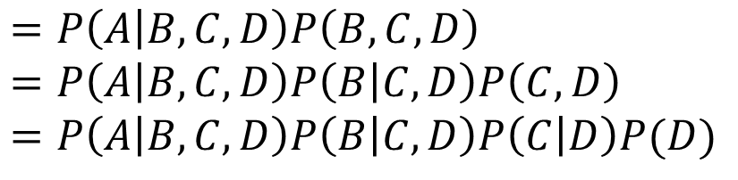

Chain Rule for Conditional Probability (For Real, Still Not Calculus)
Product Rule holds for whole distributions:
$$P\left(Weather,Cavity\right)=P\left(Weather | Cavity\right)P(Cavity)$$
Chain rule derived from successive application:
$$P(A,B,C,D)$$
$$=P\left(A | B,C,D\right)P\left(B,C,D\right) \\ =P\left(A | B,C,D\right)P\left(B | C,D\right)P\left(C,D\right) \\ =P\left(A | B,C,D\right)P\left(B | C,D\right)P\left(C | D\right)P(D)$$
$$=\prod_{i=1}^{n}{P(X_{i}|X_{1},…,X_{i−1})}$$
Notes:
Chapter13.pdf slide 16
Example taken from the Wikipedia page on Chain Rule for conditional probability: https://en.wikipedia.org/wiki/Chain_rule_(probability)

Slide 33


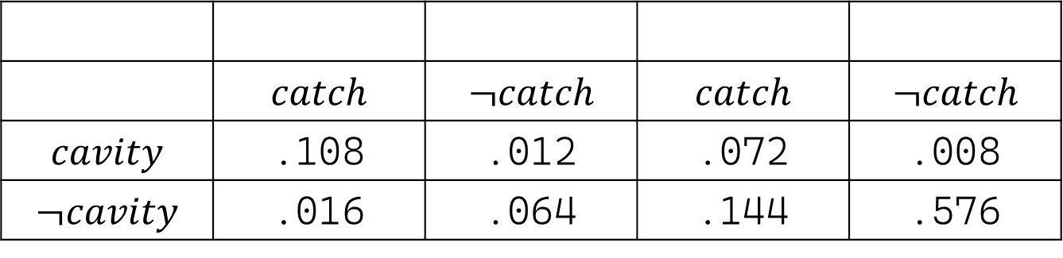
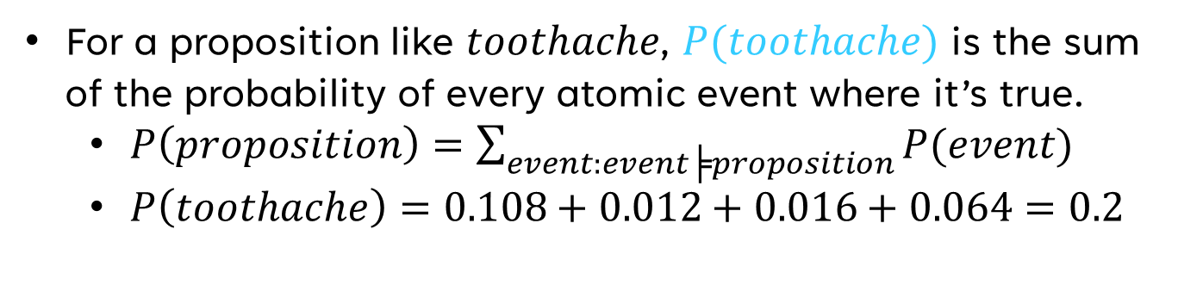


Inference by Enumeration (Our Old Friend)
 | $$catch$$ | $$¬catch$$ | $$catch$$ | $$¬catch$$
$$cavity$$ | .108 | .012 | .072 | .008
$$¬cavity$$ | .016 | .064 | .144 | .576
$$toothache$$
$$¬toothache$$
For a proposition like $toothache$, $P(toothache)$ is the sum of the probability of every atomic event where it’s true.
$P\left(proposition\right)=\sum_{event:event╞proposition}{P(event)}$
$P\left(toothache\right)=0.108+0.012+0.016+0.064=0.2$
Notes:
Chapter13.pdf slides 17-18

Slide 34
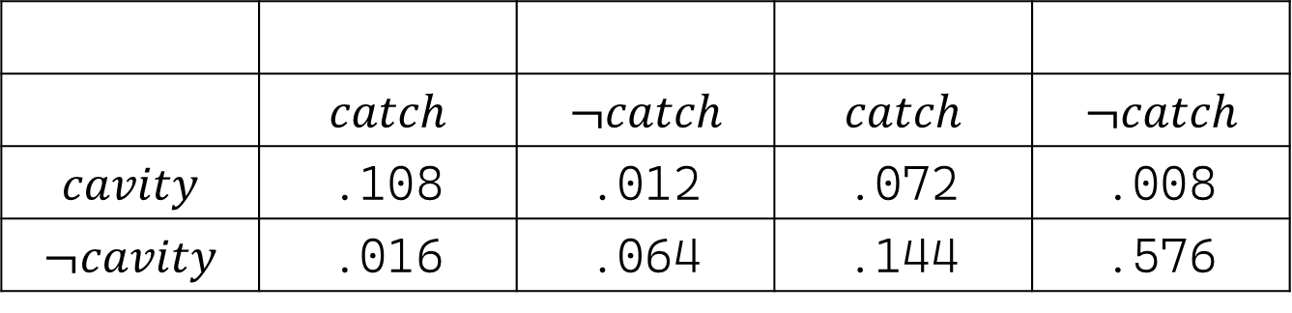
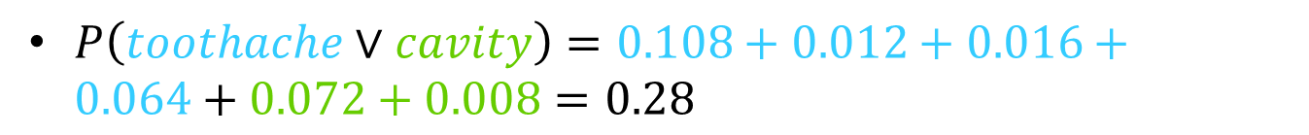


Inference by Enumeration (Our Old Friend)
 | $$catch$$ | $$¬catch$$ | $$catch$$ | $$¬catch$$
$$cavity$$ | .108 | .012 | .072 | .008
$$¬cavity$$ | .016 | .064 | .144 | .576
$$toothache$$
$$¬toothache$$
$P\left(toothache∨cavity\right)=0.108+0.012+0.016+0.064+0.072+0.008=0.28$
Notes:
Chapter13.pdf slide 19

Slide 35
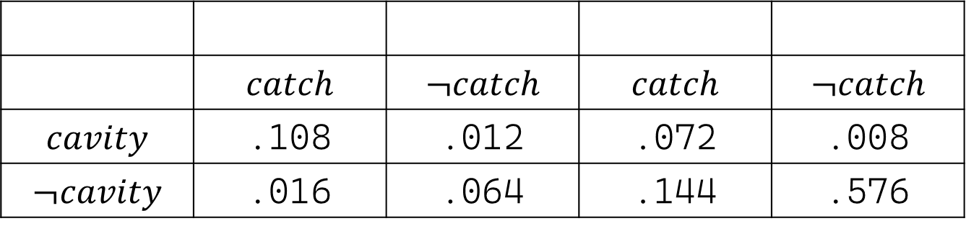
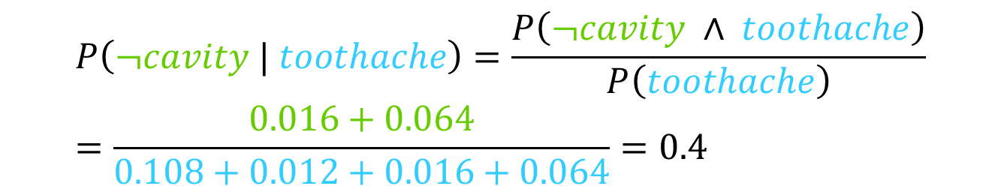


Inference by Enumeration (Our Old Friend)
 | $$catch$$ | $$¬catch$$ | $$catch$$ | $$¬catch$$
$$cavity$$ | .108 | .012 | .072 | .008
$$¬cavity$$ | .016 | .064 | .144 | .576
$$toothache$$
$$¬toothache$$
$$P\left(¬cavity | toothache\right)=\frac{P\left(¬cavity ∧ toothache\right)}{P\left(toothache\right)} \\ =\frac{0.016+0.064}{0.108+0.012+0.016+0.064}=0.4$$
Notes:
Chapter13.pdf slide 20

Slide 36
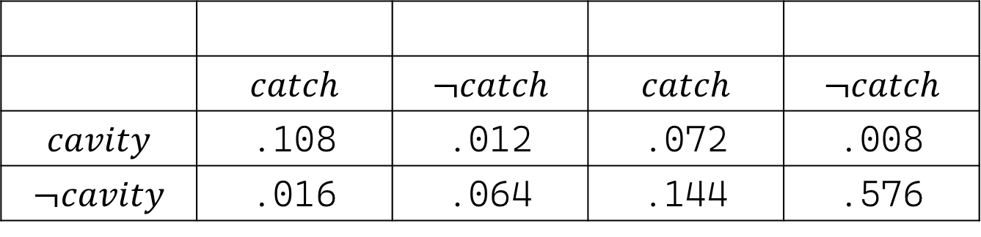
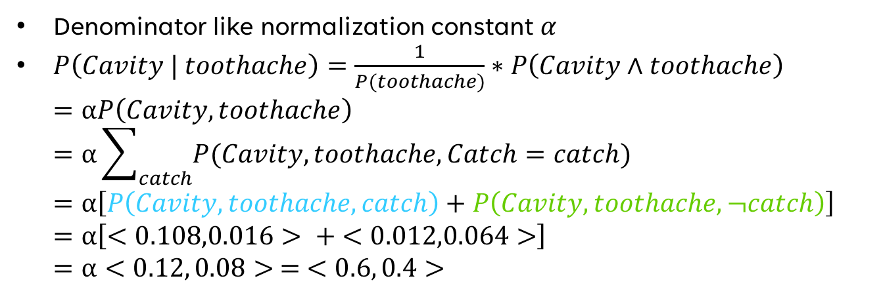


Normalization Returns
 | $$catch$$ | $$¬catch$$ | $$catch$$ | $$¬catch$$
$$cavity$$ | .108 | .012 | .072 | .008
$$¬cavity$$ | .016 | .064 | .144 | .576
$$toothache$$
$$¬toothache$$
Denominator like normalization constant $α$
$P\left(Cavity | toothache\right)=\frac{1}{P(toothache)}∗P\left(Cavity∧toothache\right)$ $=αP\left(Cavity,toothache\right)$ $=α\sum_{catch}{P(Cavity, toothache,Catch=catch)}$ $=α\left[P\left(Cavity,toothache,catch\right)+P\left(Cavity,toothache,¬catch\right)\right]$ $=α\left[<0.108,0.016> + <0.012,0.064>\right]$ $=α<0.12, 0.08> = <0.6, 0.4>$
Notes:
So here, we discover the hidden variable catch, and we calculate our probability for every possible assignment of catch, and sum them together
We do this because our initial statement doesn’t tell us anything about catch, we know that toothache is true, and we’re trying to find the probability when Cavity = true and when Cavity = false
But, because catch exists, we have to factor all of its possible assignments into our calculation as well
And again, we see that these normalized probabilities don’t account for !toothache, because our scope is limited
Chapter13.pdf slide 21

Slide 37
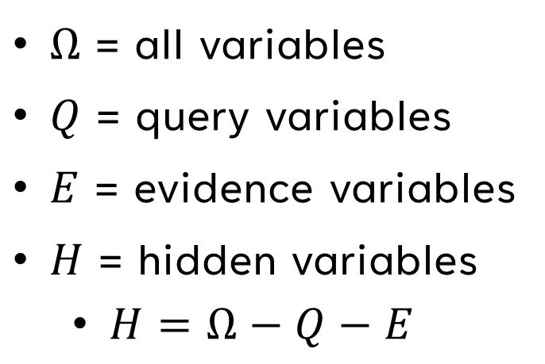
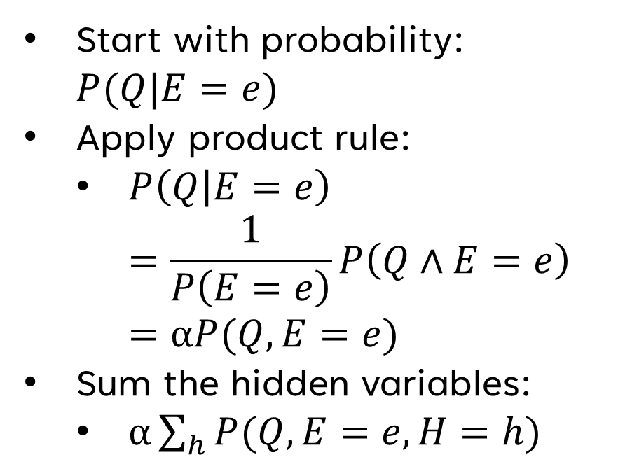
Expanding Conditional Probabilities
Start with probability: $P(Q|E=e)$
Apply product rule:
$P\left(Q | E=e\right)$ $=\frac{1}{P\left(E=e\right)}P\left(Q∧E=e\right)=αP(Q,E=e)$
Sum the hidden variables:
$α\sum_{h}{P(Q,E=e,H=h)}$
$Ω$ = all variables
$Q$ = query variables
$E$ = evidence variables
$H$ = hidden variables
$H=Ω−Q−E$
Notes:
Query variables are left of the given bar, this is what we’re trying to find
Evidence variables are right of the given bar, this is what we know
Returning back to the land of the real, we can obviously see how this can have exponential time complexity, space complexity, etc.
Chapter13.pdf slide 22

Slide 38
THANK YOU
Joshua Sheldon
jsheldon2022@my.fit.edu

