Slide 1
Artificial intelligence
Blind & Guided Search Algorithms

Slide 2
DISCLAIMER
I have tried to pull all information from the slides, the textbook, and other authorized resources, but I cannot guarantee the veracity of any information in the slides hereafter.
See presentation notes for sources (book pages are for 4th ed.)

Slide 3
ALGORITHM CLASSIFICATION
Search Algorithms
Blind/uninformed search
Guided/informed/ heuristic search
Notes:
1Intro slide 12

Slide 4
Search ALGORITHM TERMINOLOGY
Because it can never just be simple.

Slide 5


What Is Your Problem?
State Space (Typically a lot)
State
{Room204, Room217, Room302, Room303, Room310, Room311, Room402, Room410, Floor1-2Stairway, Floor2-3Stairway, Floor3-4Stairway, Elevator1, Elevator2, Floor1Main, Floor2Main, Floor3Main, Floor4Main, Floor1MensBathroom, Floor2WomensBathroom, …}
Transition Model
{Floor3Main}
Actions
RESULT(Floor3Main, GoToRoom303) = Room303
ACTIONS(Floor3Main) = {GoToRestrooms, GoToTables, GoToVendingMachines, GoToRoom302, GoToRoom303, Room310, Room311, GetLost, Cry}
Initial State
{Floor1Main}
Action Cost Function
ACTION-COST(Floor3Main, GoToRoom303, Room303) = Walking
Goal State(s)
{Room303}
Applicable in s
Can be >1
Notes:
- I ask myself the title every day.
- Example: You’re on the 3rd floor of the library and you’re trying to get to this room.
Book (pg. 83):
- A set of possible states that the environment can be in. We call this the state space.
- The initial state that the agent starts in. For example: Arad.
- A set of one or more goal states.
- The actions available to the agent. Given a state s, ACTIONS(s) returns a finite set of actions that can be executed in s. We say that each of these actions is applicable in s.
- An action cost function, denoted by ACTION-COST(s, a, s’) when we are programming or c(s, a, s’) when we are doing math, that gives the numeric cost of applying action a in state s to reach state s’.

Slide 6

SHORTEST PATH (LAWS OF PHYSICS OPTIONAL)
Floor3Main
Vending
Machine
Poisoned by
Stale Cheetos
Walk
Path
Go Up Stairs
Stairway
Room303
Paths
Optimal
Solution
Teleport
Initial State
Floor3 Main
Goal State
Go Up Stairs
Walk
Solution
Notes:
- Assuming each edge (action) costs 1.
Book (pg. 83):
- A path is any sequence of actions
- A solution is a path from the initial state to the goal state
- The optimal solution has the lowest cost across al solutions.

Slide 7
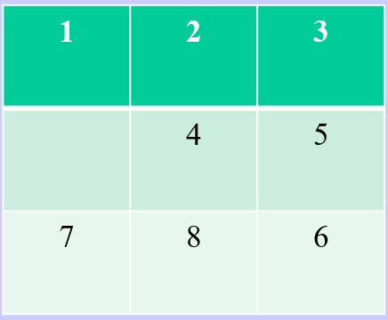




Time Complexity CALCULATION VARIABLES (This Bad Boy Can Fit So Many Branches In It)
Branching Factor (b) – The average number of actions applicable for a given state.
Input Size (n) – Typically, the number of variables within a given state. For instance, an 8-puzzle uses a 3x3 grid, n = 9.
Max Depth (m) – The maximum number of actions that can be taken on a given path (depth of search tree).
n=3x3=9
m=2
b=2
Notes:
2ProblemSolving slides 1-9

Slide 8
MEASURING PERFORMANCE (Sure, it’s O(∞) Space Complexity, But it’s O(1) Expected Time Complexity)
Completeness – Is the algorithm guaranteed to find a solution if there is one, and to correctly report failure when there is not?
(Cost) Optimality – Does it find a solution with the lowest path cost of all solutions?
Time Complexity – How long does it take to find a solution? Typically measured with O(n), with b, n, m, and d (depth of goal).
Space Complexity – How much memory is needed to perform the search?
Notes:
Book pg. 93
- A good example for this may be a Rubik’s cube solving algorithm. How many details do you need to keep track of during the algorithm (space complexity), do you solve the Rubik’s cube in the lowest number of turns ((cost) optimality), how many turns do you need to do as a factor of the size of the Rubik’s cube (time complexity), and is the algorithm guaranteed to solve the Rubik’s cube (completeness)

Slide 9
Graph Search vs. Tree Search (What Foot Would You Like To Shoot?)
Finally, we need to make an important distinction between graph search and tree search.
A graph search:
Remembers visited states and skips redundant paths
High memory, low time
A tree search:
Does not remember visited states and goes down redundant paths
Low memory, high time
Notes:
Book pgs. 92-93, 2ProblemSolving slides 5-7
- In a graph search, we remember all nodes/states we’ve previously visited, and when we consider searching a new node, we check to see if we’ve already searched it (checks redundant paths). This uses a lot of memory but reduces time complexity.
- In a tree search, we do not check redundant paths. This uses less memory than graph search but inflates time complexity.
- A good example for this may be a botanist going through a jungle, there may be one who takes detailed notes and never revisits (high memory, low time, graph search), and one who takes very lightweight notes, but may get confused and re-catalogue existing plants (low memory, high time, tree search)

Slide 10
Blind Search Algorithms
BFS/DFS/DLS/IDS

Slide 11
Breadth-First Search
Depth-First Search
1
1
2
3
2
5
4
5
6
3
4
6
Notes:
- Not going to go into significant detail because these are basic CS algorithms
- Red lines are traversal order, black lines are relationships
- Breadth first search goes layer by layer
- Depth first search goes left to right (roughly)

Slide 12
POP QUIZ!
What metrics will we use to compare Breadth-First Search with Depth-First Search?
(Hint: There’s 4)
Notes:
Completeness, (Cost) Optimality, Space Complexity, Time Complexity

Slide 13
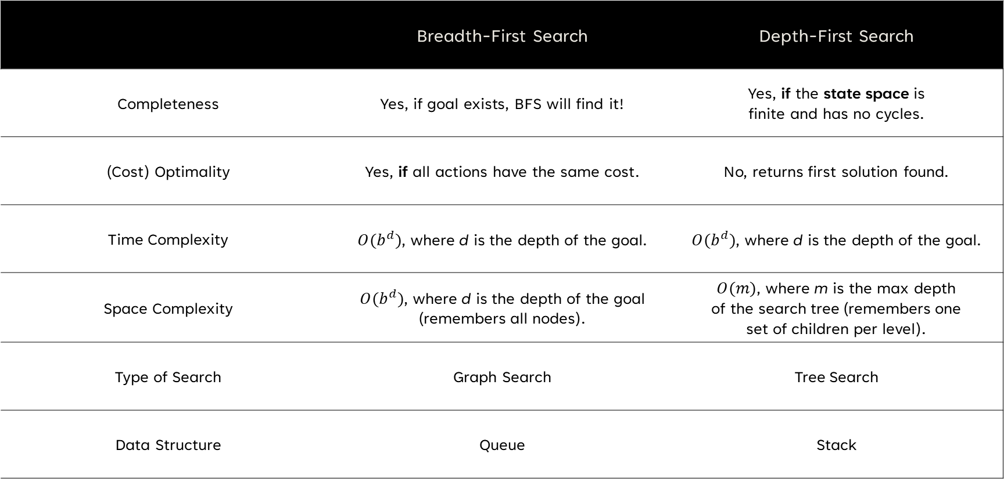
BFS vs. DFS Comparison
​ | Breadth-First Search | Depth-First Search
Completeness | Yes, if goal exists, BFS will find it! | Yes, if the state space is finite and has no cycles.
(Cost) Optimality | Yes, if all actions have the same cost. | No, returns first solution found.​
Time Complexity | $O(b^{d})$, where d is the depth of the goal. | $O(b^{d})$, where d is the depth of the goal.
Space Complexity | $O(b^{d})$, where d is the depth of the goal (remembers all nodes). | $O(m)$, where m is the max depth of the search tree (remembers one set of children per level).
Type of Search | Graph Search | Tree Search
Data Structure | Queue | Stack
Notes:
2ProblemSolving, slides 15-16, Book pgs. 94-98
- BFS is cost optimal if all actions have the same cost because each level represents one action, and breadth first search investigates earlier levels first

Slide 14
Upgrades, People, Upgrades
Remember that in computation, memory is a larger issue than time.
This is because memory complexity is bound by time complexity.
This makes memory a bottleneck.
Therefore, DFS is preferred (in general).
However, DFS can get stuck at infinite (read: large) depth.
So, let’s limit the range of DFS!
Notes:
Source is Dr. Mitra for first two bullet points, 2ProblemSolving slide 17
- Because of the operations it takes to use/allocate memory, memory usage is never going to outpace time complexity.
- Also from an intuitive sense it just really doesn’t make sense to use more memory than time spent to solve the problem.

Slide 15
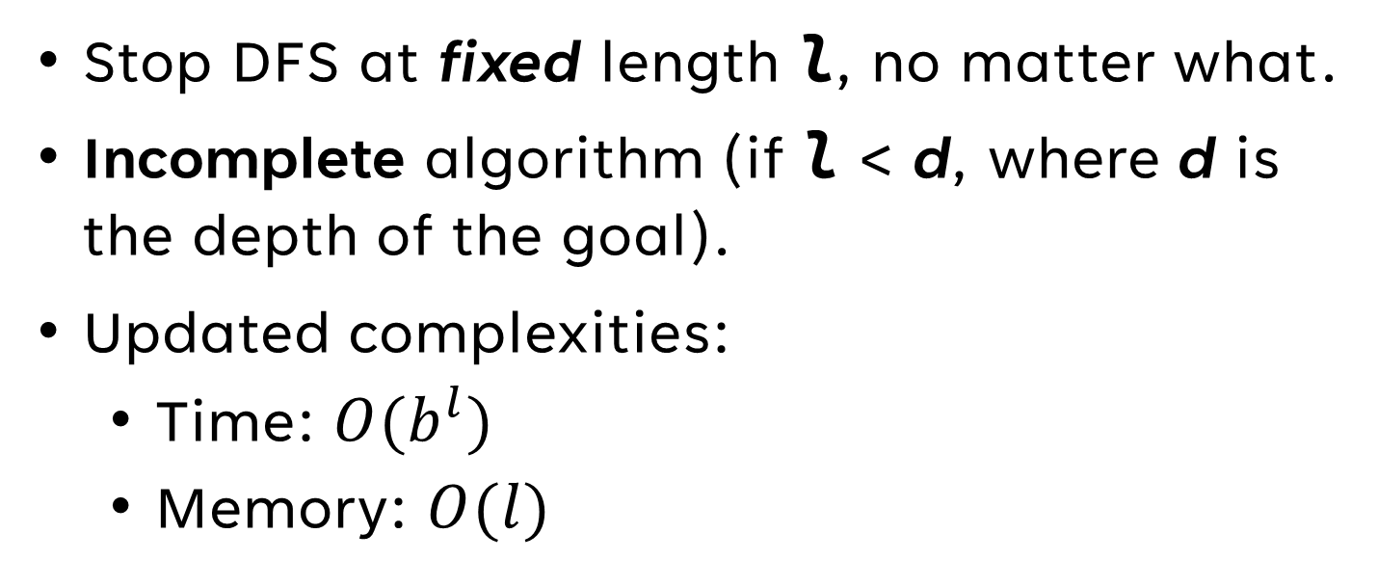
Depth Limited Search (DLS) (An Algorithm’s Guide to Giving Up)
Stop DFS at fixed length l, no matter what.
Incomplete algorithm (if l < d, where d is the depth of the goal).
Updated complexities:
Time: $O(b^{l})$
Memory: $O(l)$
Notes:
2ProblemSolving slide 17

Slide 16
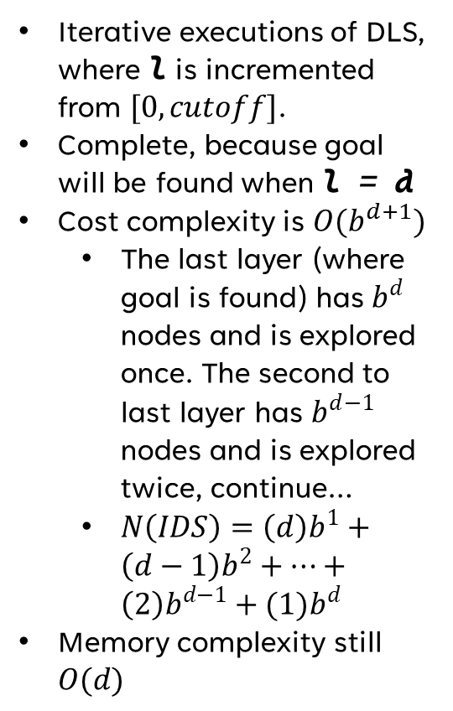


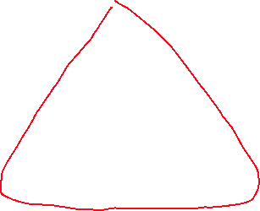
Iterative Deepening Search (But Wait, There’s More!)
Iterative executions of DLS, where l is incremented from $[0, cutoff]$.
Complete, because goal will be found when l = d
Cost complexity is $O(b^{d+1})$
The last layer (where goal is found) has $b^{d}$ nodes and is explored once. The second to last layer has $b^{d−1}$ nodes and is explored twice, continue…
$N\left(IDS\right)=\left(d\right)b^{1}+\left(d−1\right)b^{2}+…+\left(2\right)b^{d−1}+(1)b^{d}$
Memory complexity still $O(d)$
1
1
l = 0
2
5
l = 1
2
5
3
4
6
3
4
6
1
l = 2
2
5
3
4
6
Notes:
2ProblemSolving slide 18, Book pgs. 98-100

Slide 17
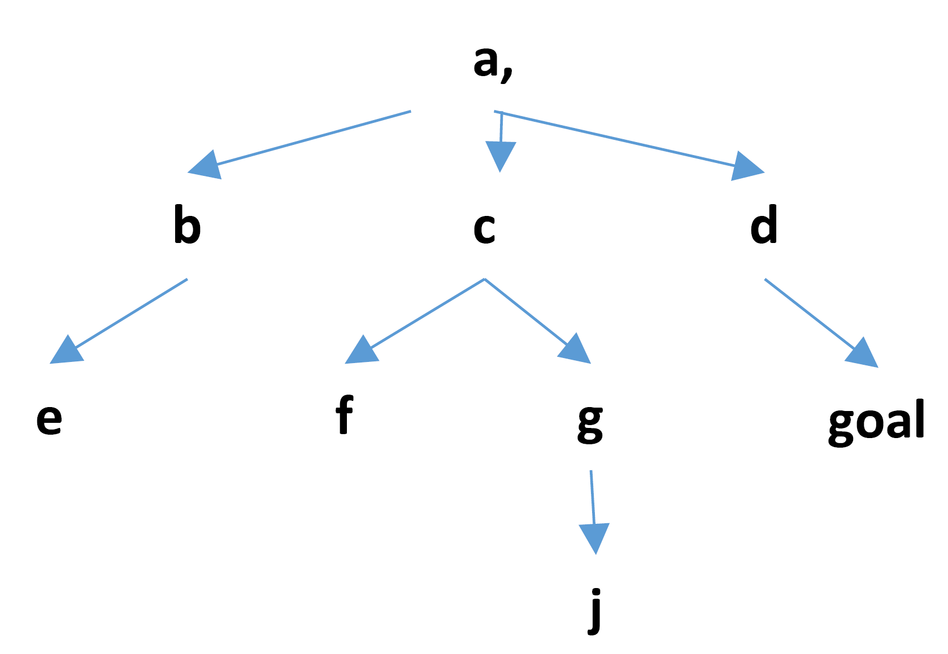
SEARCH QUIZ QUESTION 1 (TASK: APPLY IDS)
Variables
l = 0
visited = []
Stack = []
IN MOST IMPLEMENTATIONS, A WOULD BE VISITED HERE, BUT THAT IS NOT THE CASE IN THIS IMPLEMENTATION
Notes:
Figure provided by Dr. Mitra. Solution copied from my 100% Search Quiz.

Slide 18
SEARCH QUIZ QUESTION 1 (TASK: APPLY IDS)
Variables
l = 1
visited = [a]
Stack = [b, c, d]
Notes:
Figure provided by Dr. Mitra. Solution copied from my 100% Search Quiz.

Slide 19
SEARCH QUIZ QUESTION 1 (TASK: APPLY IDS)
Variables
l = 1
visited = [a, b]
Stack = [c, d]
Notes:
Figure provided by Dr. Mitra. Solution copied from my 100% Search Quiz.

Slide 20
SEARCH QUIZ QUESTION 1 (TASK: APPLY IDS)
Variables
l = 1
visited = [a, b, c]
Stack = [d]
Notes:
Figure provided by Dr. Mitra. Solution copied from my 100% Search Quiz.

Slide 21
SEARCH QUIZ QUESTION 1 (TASK: APPLY IDS)
Variables
l = 1
visited = [a, b, c, d]
Stack = []
MAXIMUM DEPTH REACHED
Notes:
Figure provided by Dr. Mitra. Solution copied from my 100% Search Quiz.

Slide 22
SEARCH QUIZ QUESTION 1 (TASK: APPLY IDS)
Variables
l = 2
visited = [a, b, c, d]
Stack = [a]
Notes:
Figure provided by Dr. Mitra. Solution copied from my 100% Search Quiz.

Slide 23
SEARCH QUIZ QUESTION 1 (TASK: APPLY IDS)
Variables
l = 2
visited = [a, b, c, d, a]
Stack = [b, c, d]
Notes:
Figure provided by Dr. Mitra. Solution copied from my 100% Search Quiz.

Slide 24
SEARCH QUIZ QUESTION 1 (TASK: APPLY IDS)
Variables
l = 2
visited = [a, b, c, d, a, b]
Stack = [e, c, d]
Notes:
Figure provided by Dr. Mitra. Solution copied from my 100% Search Quiz.

Slide 25
SEARCH QUIZ QUESTION 1 (TASK: APPLY IDS)
Variables
l = 2
visited = [a, b, c, d, a, b, e]
Stack = [c, d]
Notes:
Figure provided by Dr. Mitra. Solution copied from my 100% Search Quiz.

Slide 26
SEARCH QUIZ QUESTION 1 (TASK: APPLY IDS)
Variables
l = 2
visited = [a, b, c, d, a, b, e, c]
Stack = [f, g, d]
Notes:
Figure provided by Dr. Mitra. Solution copied from my 100% Search Quiz.

Slide 27
SEARCH QUIZ QUESTION 1 (TASK: APPLY IDS)
Variables
l = 2
visited = [a, b, c, d, a, b, e, c, f]
Stack = [g, d]
Notes:
Figure provided by Dr. Mitra. Solution copied from my 100% Search Quiz.

Slide 28
SEARCH QUIZ QUESTION 1 (TASK: APPLY IDS)
Variables
l = 2
visited = [a, b, c, d, a, b, e, c, f, g]
Stack = [d]
Notes:
Figure provided by Dr. Mitra. Solution copied from my 100% Search Quiz.

Slide 29
SEARCH QUIZ QUESTION 1 (TASK: APPLY IDS)
Variables
l = 2
visited = [a, b, c, d, a, b, e, c, f, g, d]
Stack = [goal]
Notes:
Figure provided by Dr. Mitra. Solution copied from my 100% Search Quiz.

Slide 30
SEARCH QUIZ QUESTION 1 (TASK: APPLY IDS)
Variables
l = 2
visited = [a, b, c, d, a, b, e, c, f, g, d, goal]
Stack = []
SOLUTION FOUND
abcdabecfgd-goal
Notes:
Figure provided by Dr. Mitra. Solution copied from my 100% Search Quiz.

Slide 31
Informed Search Algorithms
GBFS/A*/IDA*

Slide 32
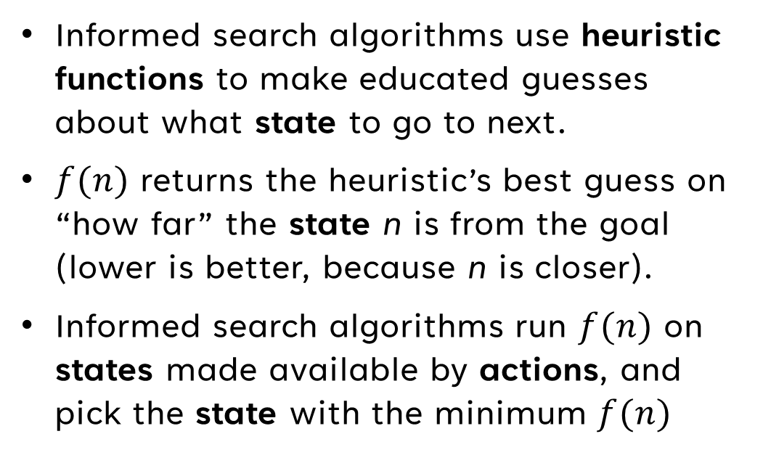
Heuristics (Adding Hunches to Your Search)
Informed search algorithms use heuristic functions to make educated guesses about what state to go to next.
$f(n)$ returns the heuristic’s best guess on “how far” the state n is from the goal (lower is better, because n is closer).
Informed search algorithms run $f(n)$ on states made available by actions, and pick the state with the minimum $f(n)$
Notes:
2ProblemSolving slide 20

Slide 33
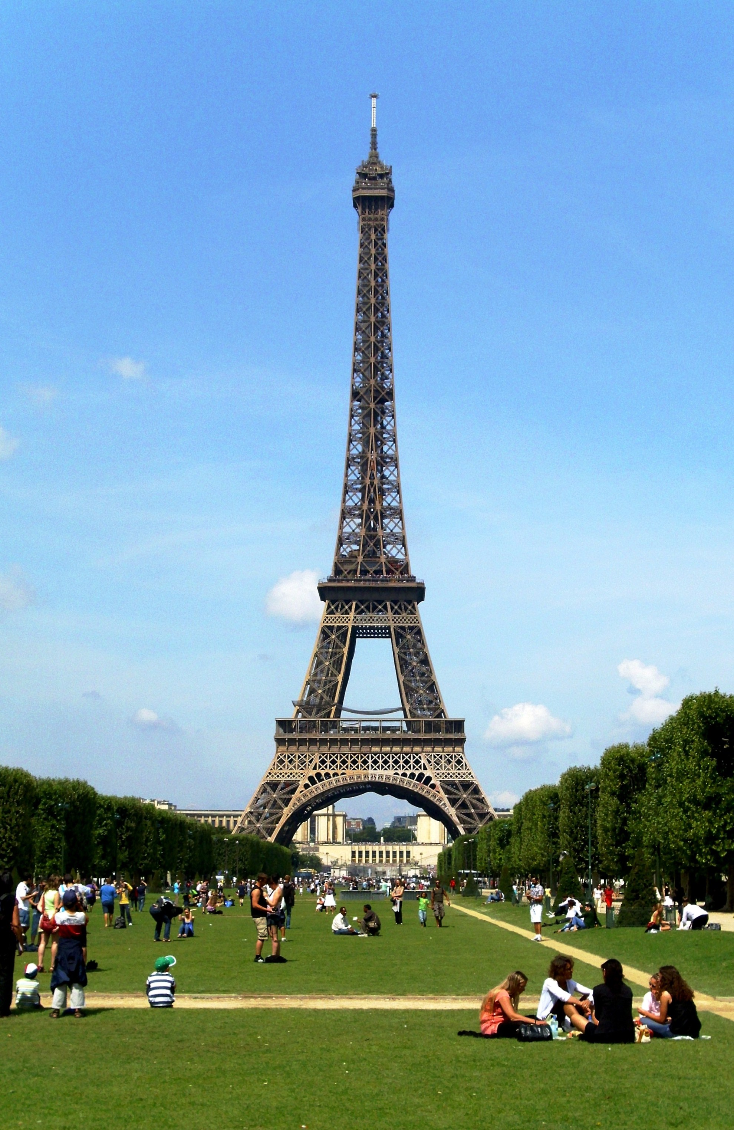
Heuristic Example (Bienvenue dans l'heuristique)
Consider you are in Paris, and you are trying to walk to the Eiffel Tower.
You are a couple streets away, but you can see it in the sky.
You don’t know the optimal solution to get the Eiffel Tower.
However, your vision is a heuristic that tells you roughly where to go (the bigger/closer it gets, the better)
Notes:
Image licensed from Waithamai (https://commons.wikimedia.org/wiki/User:Waithamai ) under the Creative Commons Attribution-Share Alike 3.0 Unported license ( https://creativecommons.org/licenses/by-sa/3.0/deed.en ).

Slide 34
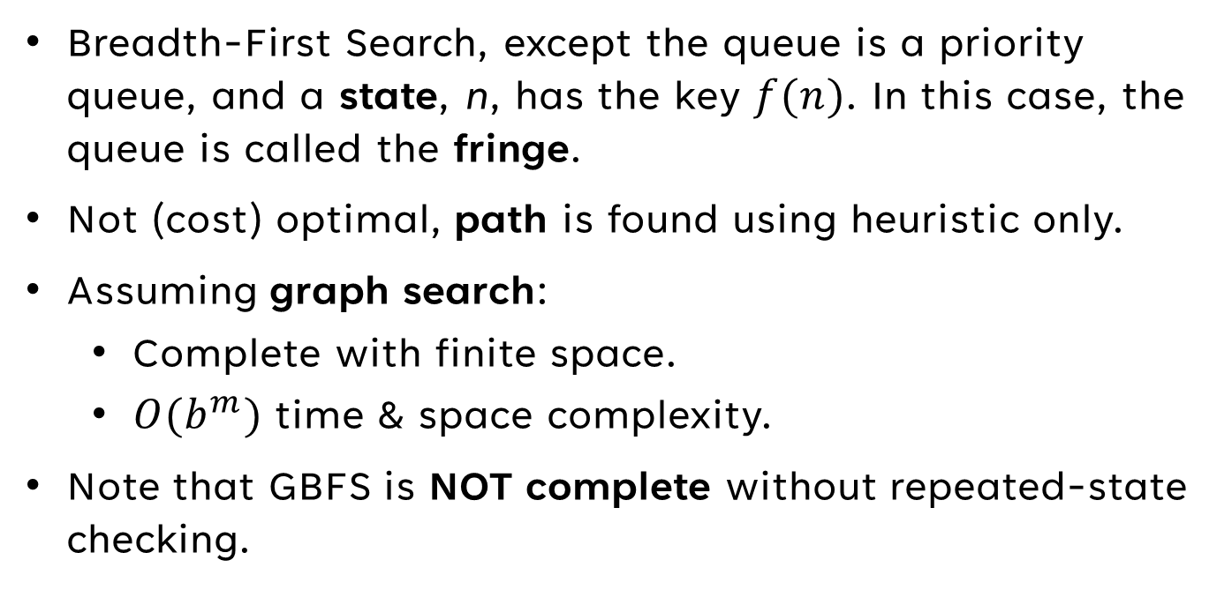
Greedy Best-First Search (GBFS) (Like NTFS, But Not At All)
Breadth-First Search, except the queue is a priority queue, and a state, n, has the key $f(n)$. In this case, the queue is called the fringe.
Not (cost) optimal, path is found using heuristic only.
Assuming graph search:
Complete with finite space.
$O(b^{m})$ time & space complexity.
Note that GBFS is NOT complete without repeated-state checking.
Notes:
2ProblemSolving 20-22, chapter04a slides 4-15, book pgs. 103
-

Slide 35
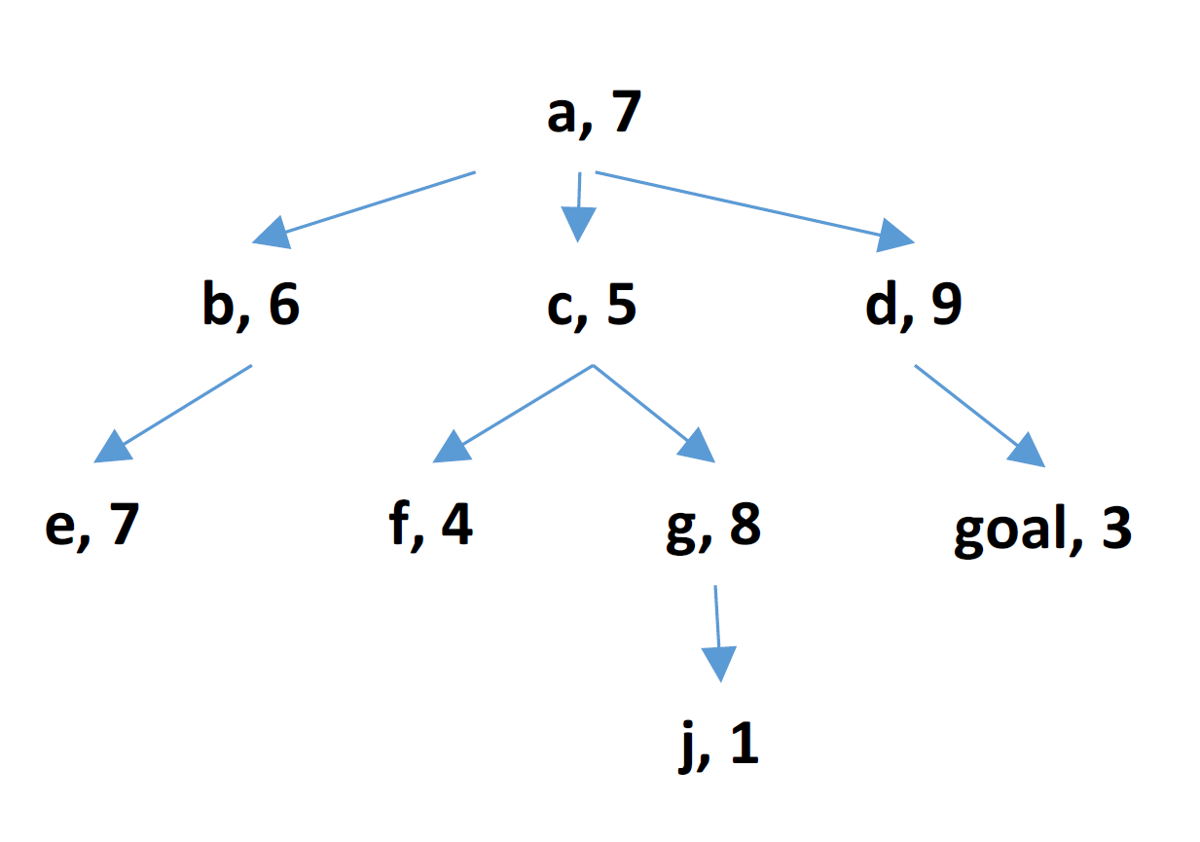
SEARCH QUIZ QUESTIONS 2 & 3 (TASK: Apply Guided/INFORMED Search)
Variables
visited = []
Queue = [a]
Notes:
Figure provided by Dr. Mitra. Solution copied from my 100% Search Quiz.

Slide 36
SEARCH QUIZ QUESTIONS 2 & 3 (TASK: Apply Guided/INFORMED Search)
Variables
visited = [a]
Queue = [c, b, d]
Notes:
Figure provided by Dr. Mitra. Solution copied from my 100% Search Quiz.

Slide 37
SEARCH QUIZ QUESTIONS 2 & 3 (TASK: Apply Guided/INFORMED Search)
Variables
visited = [a, c]
Queue = [f, b, g, d]
Notes:
Figure provided by Dr. Mitra. Solution copied from my 100% Search Quiz.

Slide 38
SEARCH QUIZ QUESTIONS 2 & 3 (TASK: Apply Guided/INFORMED Search)
Variables
visited = [a, c, f]
Queue = [b, g, d]
Notes:
Figure provided by Dr. Mitra. Solution copied from my 100% Search Quiz.

Slide 39
SEARCH QUIZ QUESTIONS 2 & 3 (TASK: Apply Guided/INFORMED Search)
Variables
visited = [a, c, f, b]
Queue = [e, g, d]
Notes:
Figure provided by Dr. Mitra. Solution copied from my 100% Search Quiz.

Slide 40
SEARCH QUIZ QUESTIONS 2 & 3 (TASK: Apply Guided/INFORMED Search)
Variables
visited = [a, c, f, b, e]
Queue = [g, d]
Notes:
Figure provided by Dr. Mitra. Solution copied from my 100% Search Quiz.

Slide 41
SEARCH QUIZ QUESTIONS 2 & 3 (TASK: Apply Guided/INFORMED Search)
Variables
visited = [a, c, f, b, e, g]
Queue = [j, d]
Notes:
Figure provided by Dr. Mitra. Solution copied from my 100% Search Quiz.

Slide 42
SEARCH QUIZ QUESTIONS 2 & 3 (TASK: Apply Guided/INFORMED Search)
Variables
visited = [a, c, f, b, e, g, j]
Queue = [d]
Notes:
Figure provided by Dr. Mitra. Solution copied from my 100% Search Quiz.

Slide 43
SEARCH QUIZ QUESTIONS 2 & 3 (TASK: Apply Guided/INFORMED Search)
Variables
visited = [a, c, f, b, e, g, j, d]
Queue = [goal]
Notes:
Figure provided by Dr. Mitra. Solution copied from my 100% Search Quiz.

Slide 44
SEARCH QUIZ QUESTIONS 2 & 3 (TASK: Apply Guided/INFORMED Search)
Variables
visited = [a, c, f, b, e, g, j, d, goal]
Queue = []
SOLUTION FOUND:
acfbegjd-goal
Notes:
Figure provided by Dr. Mitra. Solution copied from my 100% Search Quiz.
- Note that in this case, GBFS actually performs worse than regular BFS.

Slide 45
Properties OF QUALITY HEURISTICS
Notice that with the given heuristic, GBFS performed worse than regular breadth-first search!
We want quality heuristics, so we have three categories of heuristics, based on the properties of the heuristic:
Inconsistent/Inadmissible (Good)
Admissible (Better)
Consistent (inherently Admissible) (Best)

Slide 46

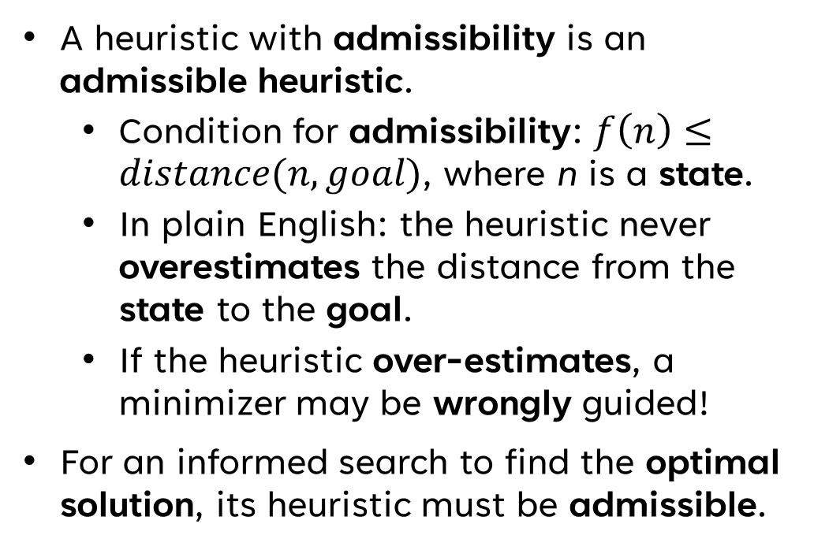
ADMISSIBLE HEURISTICS (How Do I Admit a Function?)
A heuristic with admissibility is an admissible heuristic.
Condition for admissibility: $f\left(n\right)≤distance(n, goal)$, where n is a state.
In plain English: the heuristic never overestimates the distance from the state to the goal.
If the heuristic over-estimates, a minimizer may be wrongly guided!
For an informed search to find the optimal solution, its heuristic must be admissible.
Notes:
Chapter04a slide 16, 2ProblemSolving slides 26-27, Book pgs. 104-106

Slide 47
Finding Admissible Heuristics
Step 1
Create a relaxed version of the problem you’re developing a heuristic for.
Step 2
Create a formula that gives the exact solution cost of your relaxed problem.
Step 3
Use your formula as a heuristic for the original problem.
Note
This heuristic will always be admissible.
Notes:
chapter04a slides 34-35

Slide 48
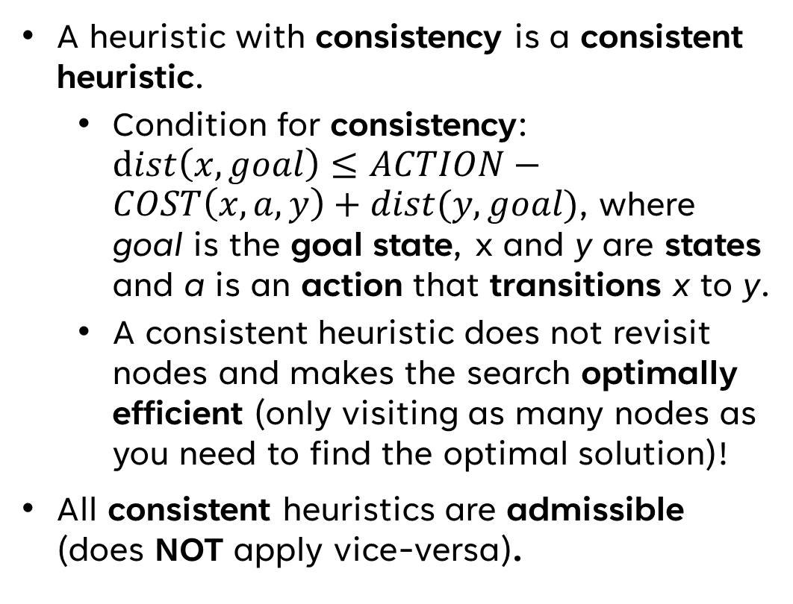
Consistent Heuristics (The Ol’ Reliable of Heuristics)
A heuristic with consistency is a consistent heuristic.
Condition for consistency: $dist\left(x, goal\right)≤ACTION−COST\left(x, a, y\right)+dist(y, goal)$, where goal is the goal state, x and y are states and a is an action that transitions x to y.
A consistent heuristic does not revisit nodes and makes the search optimally efficient (only visiting as many nodes as you need to find the optimal solution)!
All consistent heuristics are admissible (does NOT apply vice-versa).
Notes:
Chapter04a slide 30, 2ProblemSolving slides 29-30, Book pg. 106
- All consistent heuristics are admissible because consistency is a harder property to satisfy than admissibility. Another way of thinking of it is a “tighter bound.” For instance, O(n) is a tighter bound than O(n^2), but O(n) is still in O(n^2).
- Consistent heuristics are incredibly difficult to find.

Slide 49
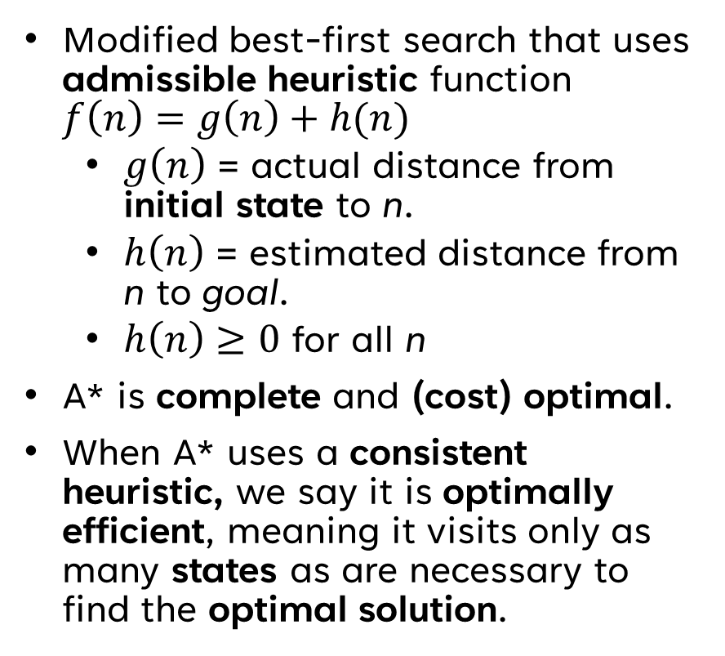
A* Search (Reaching for the *s)
Modified best-first search that uses admissible heuristic function $f\left(n\right)=g\left(n\right)+h(n)$
$g\left(n\right)$ = actual distance from initial state to n.
$h\left(n\right)$ = estimated distance from n to goal.
$h\left(n\right)≥0$ for all n
A* is complete and (cost) optimal.
When A* uses a consistent heuristic, we say it is optimally efficient, meaning it visits only as many states as are necessary to find the optimal solution.
However, A* keeps all nodes in memory, meaning it has exponential time and space complexity.
Additionally, A* may get stuck if it has an inadmissible heuristic.
Therefore, some problems may have too large of a state space or too weak of a heuristic to use A*.
Solution? IDA*
Notes:
2ProblemSolving slides 23-29, chapter04a slides 16-29, book pgs. 103-108
- If it’s not clear, for A* to work properly, the heuristic MUST BE ADMISSIBLE

Slide 50
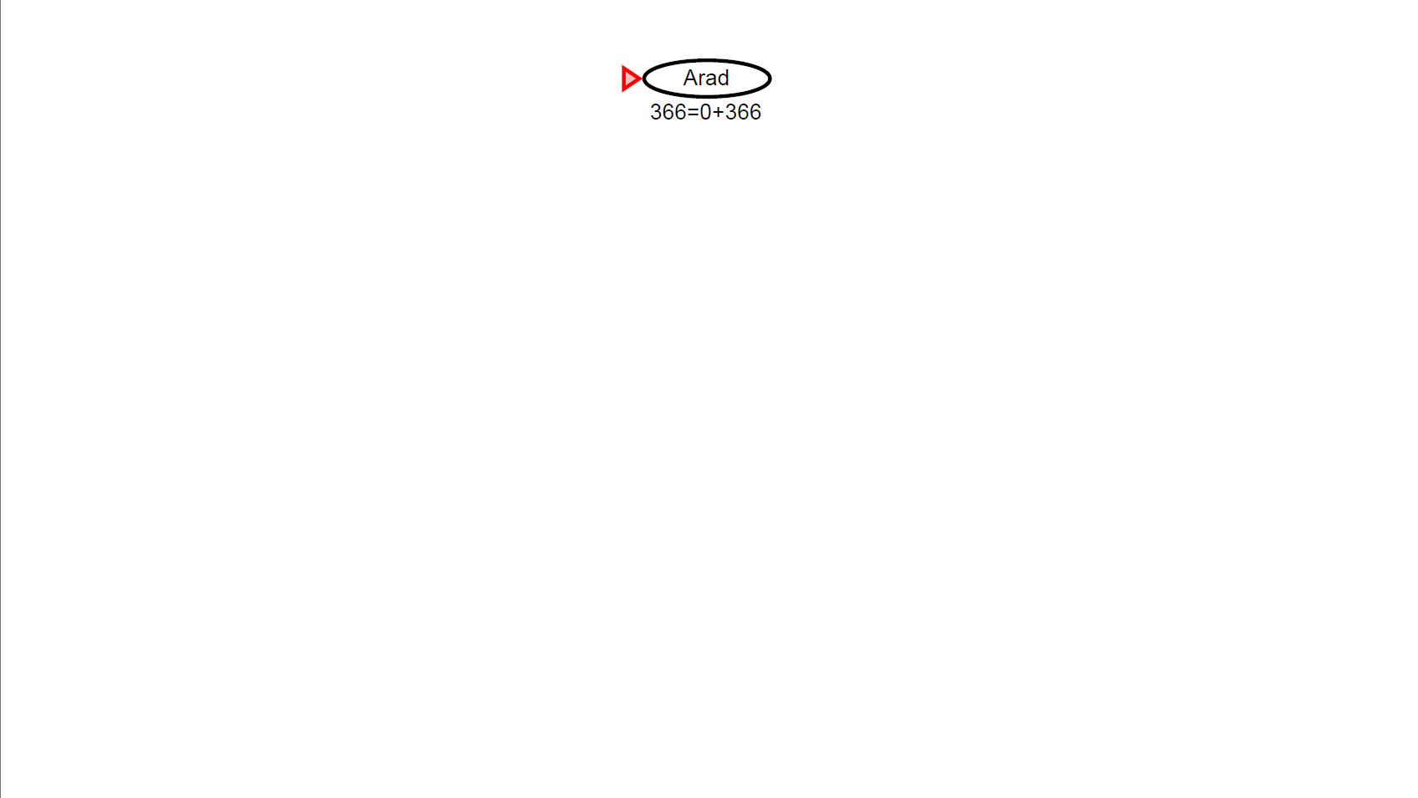
A* Search Example (Romanian Field Trip, Anyone?)
Notes:
Figures from chapter04a slides 17-22

Slide 51
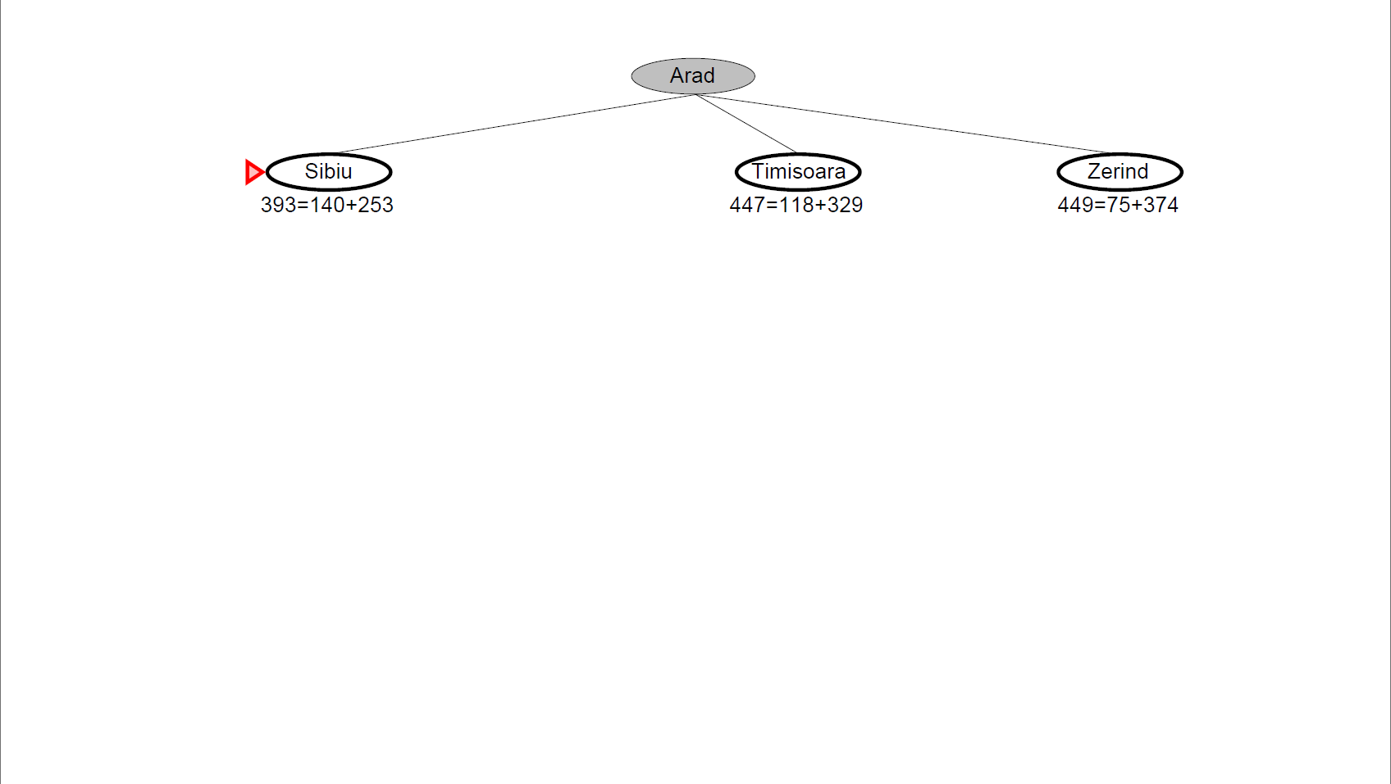
A* Search Example (Romanian Field Trip, Anyone?)
Notes:
Figures from chapter04a slides 17-22

Slide 52
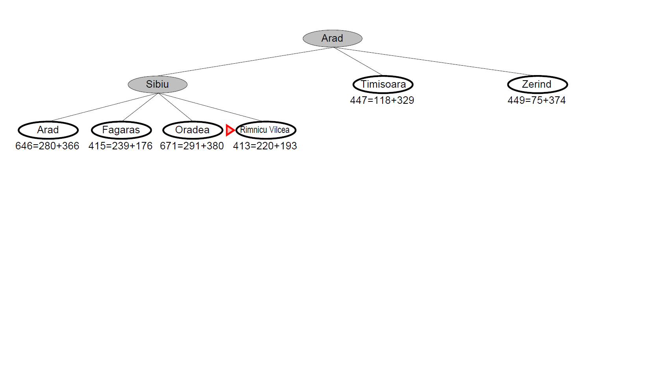
A* Search Example (Romanian Field Trip, Anyone?)
Notes:
Figures from chapter04a slides 17-22

Slide 53
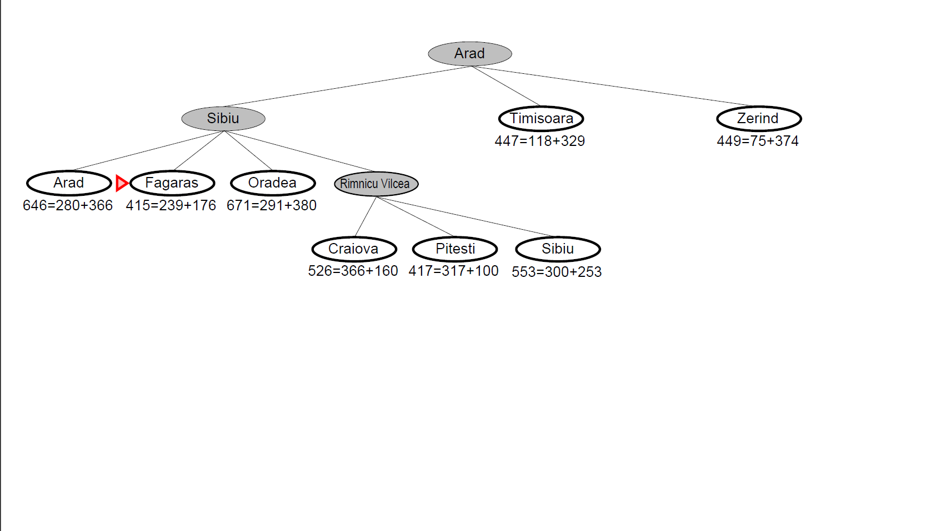
A* Search Example (Romanian Field Trip, Anyone?)
Notes:
Figures from chapter04a slides 17-22

Slide 54
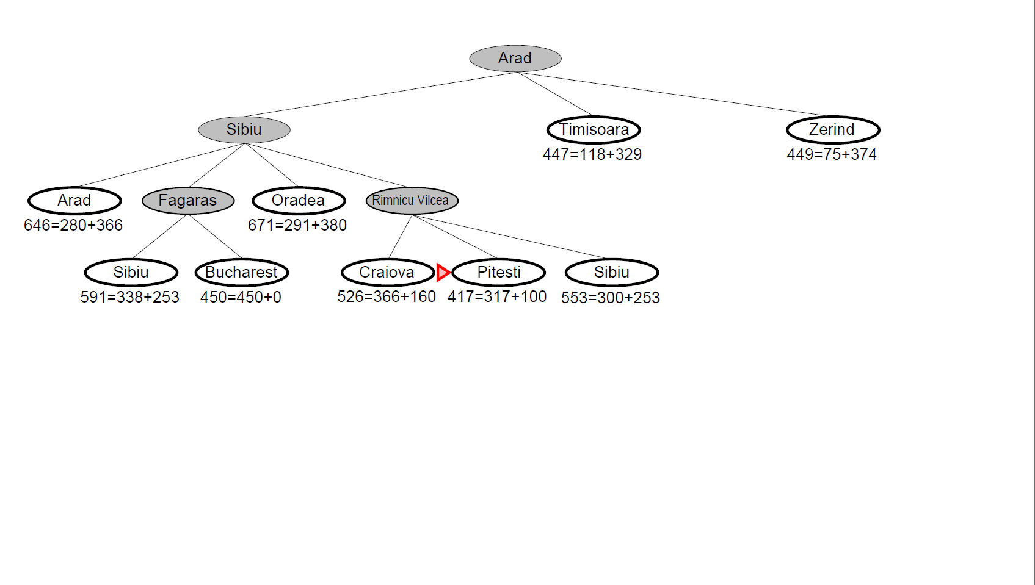
A* Search Example (Romanian Field Trip, Anyone?)
Notes:
Figures from chapter04a slides 17-22

Slide 55
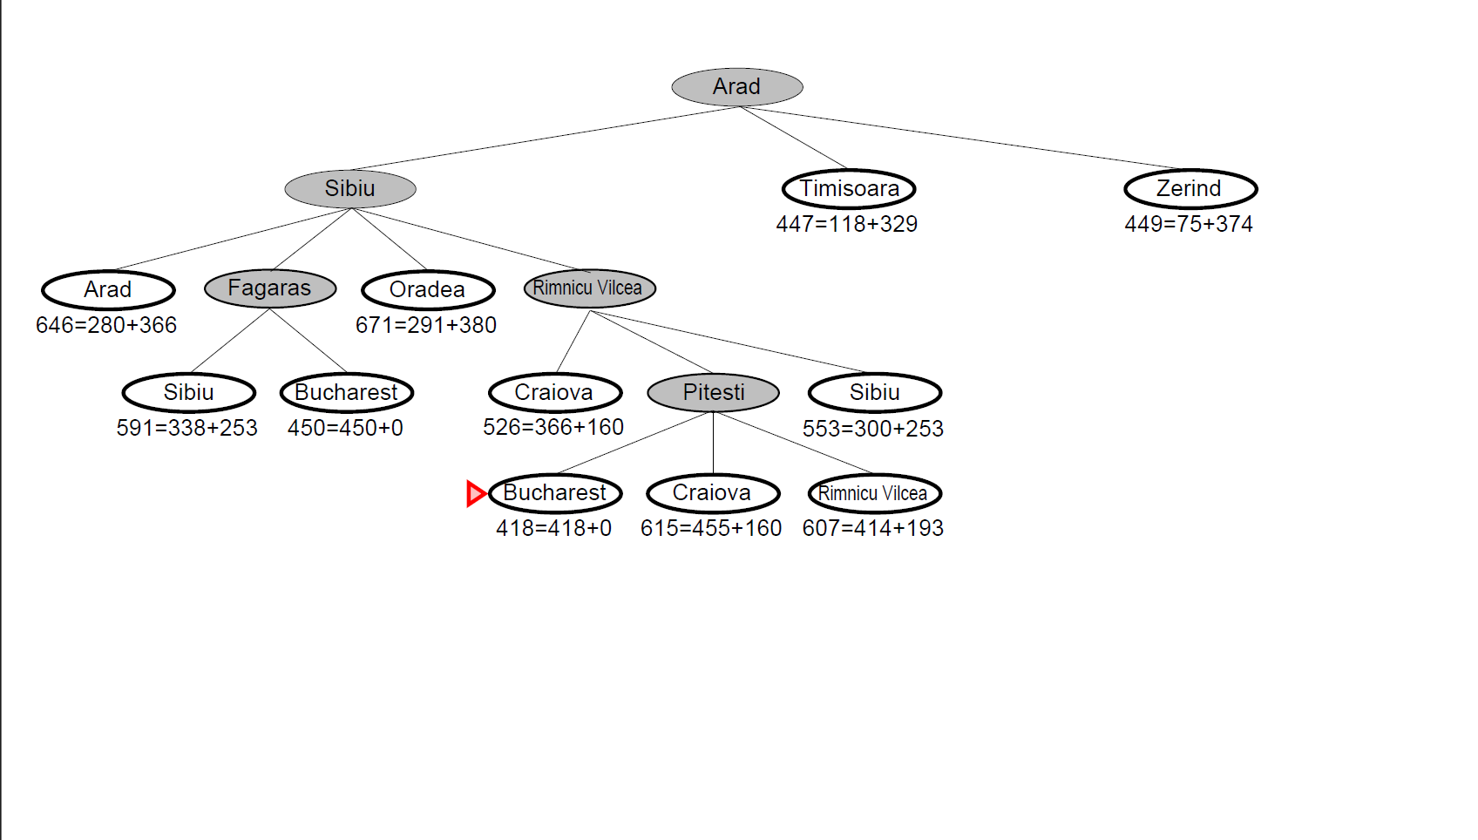
A* Search Example (Romanian Field Trip, Anyone?)
Notes:
Figures from chapter04a slides 17-22

Slide 56
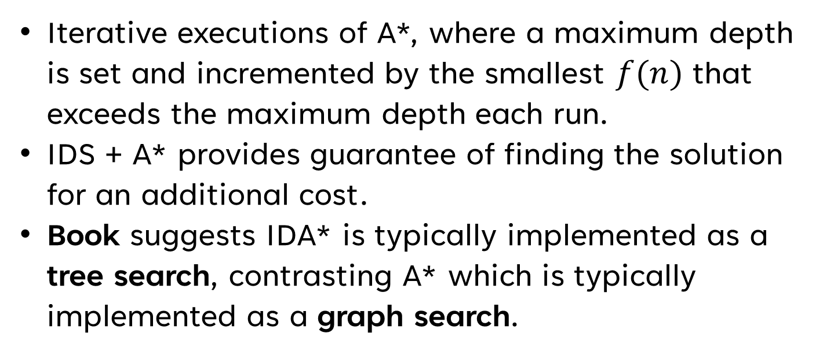
Iterative Deepening A* (IDA*) (I Mean, It Worked for DFS?)
Iterative executions of A*, where a maximum depth is set and incremented by the smallest $f(n)$ that exceeds the maximum depth each run.
IDS + A* provides guarantee of finding the solution for an additional cost.
Book suggests IDA* is typically implemented as a tree search, contrasting A* which is typically implemented as a graph search.
Notes:
Book pg. 111, 2ProblemSolving slides 30-31

Slide 57
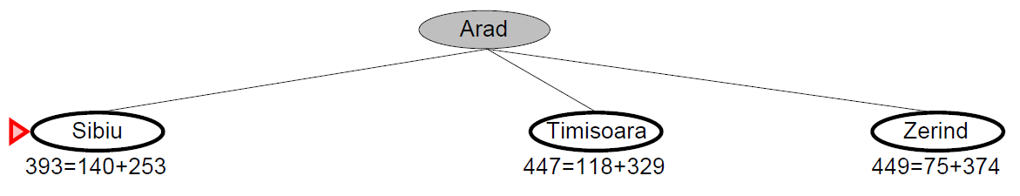

IDA* Search Example (While(!goalFound) {Romanian Field Trip, Anyone?})
Max depth: 0
Next max depth: 393
Notes:
Figures from chapter04a slides 17-22, modified by Joshua Sheldon
- IDA* finds its efficiency when multiple nodes have the same value

Slide 58
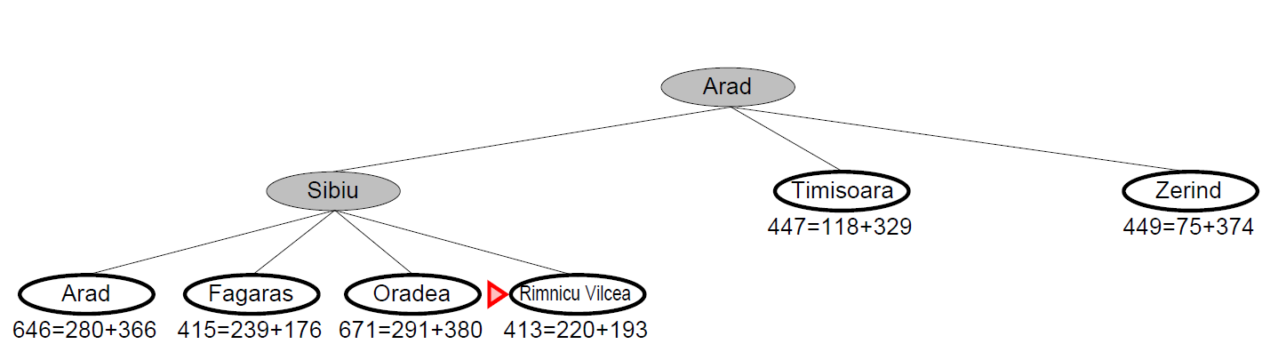
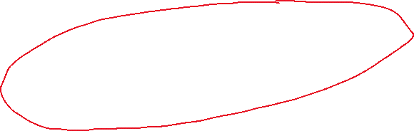
IDA* Search Example (While(!goalFound) {Romanian Field Trip, Anyone?})
Max depth: 393
Next max depth: 413
Notes:
Figures from chapter04a slides 17-22, modified by Joshua Sheldon
- IDA* finds its efficiency when multiple nodes have the same value

Slide 59
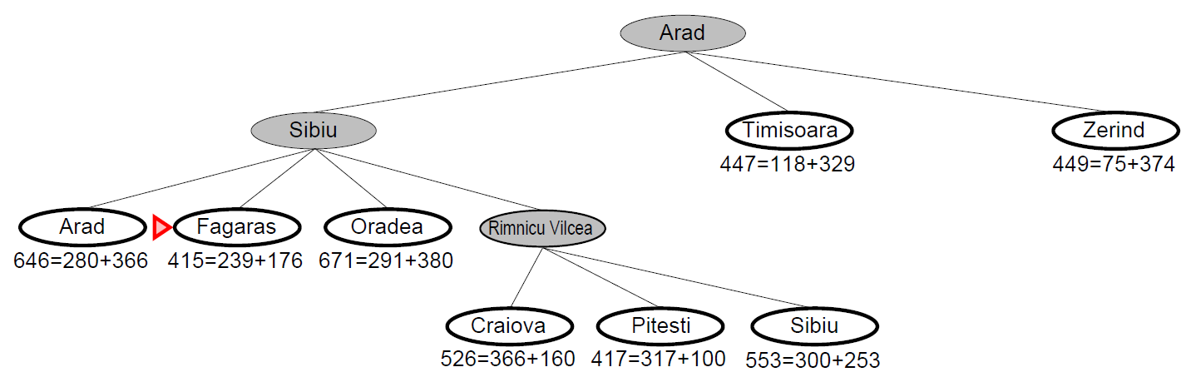
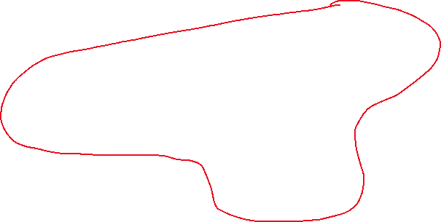
IDA* Search Example (While(!goalFound) {Romanian Field Trip, Anyone?})
Max depth: 413
Next max depth: 415
Notes:
Figures from chapter04a slides 17-22, modified by Joshua Sheldon
- IDA* finds its efficiency when multiple nodes have the same value

Slide 60
THANK YOU
Joshua Sheldon
jsheldon2022@my.fit.edu

