Slide 1
Compilation
TeachING Assistant: David Trabish

Slide 2
Administration
Final grade:
Exam: 60%
Project: 40%
For technical questions, please use the course forum
Moodle
Reception hour:
Thursday 19:00-20:00
Coordinate by email (davidtr1037@gmail.com)

Slide 3
Course Project
Build a compiler for an OOP Programming Language
Simplified version of known programming languages
Consists of 4 exercises
Exercise 1: 20 points
Exercise 2: 30 points
Exercise 3: 50 points
Exercise 4: 40 points (bonus)
Implement in Java
Work in groups of 3 students
Constitutes 40% of the final grade

Slide 4
Course Project
Week # | Subject | Project
1 | Lexical Analysis
2 | Lexical Analysis | Exercise 1 (3 weeks)
3 | Syntactic Analysis
4 | No new material
5 | Syntactic Analysis | Exercise 2 (2 weeks)
6 | Semantic Analysis
7 | IR | Exercise 3 (3 weeks)
8 | AST Annotations
9 | Code Generation
10 | Code Generation | Exercise 4 (2 weeks)
11 | Exam Questions

Slide 5
Submission Guidelines
Submission with github
Each group should create a private repository
Recommended development environment:
Ubuntu
Windows users can install a VM

Slide 6
Books
Modern Compiler Implementation in C
Andrew W Appel
Compilers: Principles, Techniques, and Tools
Aho et al.
Modern Compiler Design
Grune et al.

Slide 7
What is compilation?
Translation of code (text) to executable code (machine code)
source code
machine code
push %rbp
mov %rsp,%rbp
mov %edi,-0x4(%rbp)
mov %esi,-0x8(%rbp)
mov -0x4(%rbp),%edx
mov -0x8(%rbp),%eax
add %edx,%eax
pop %rbp
retq
int foo(int x, int y) {
return x + y;
}

Slide 8
Common compilers
GCC, LLVM
https://gcc.gnu.org/
https://llvm.org/
Useful as an implementation reference

Slide 9
Compilation Steps: Frontend
Lexical analysis
Check the validity of tokens
Syntax analysis
Check the syntactic structure
Semantic analysis
Make sure it makes sense
These steps don’t depend on the compilation target!

Slide 10
Compilation Steps: Backend
Intermediate Code Generation
Can’t be executed yet…
Machine code generation
Executed on a real hardware

Slide 11
Lexical Analysis

Slide 12
Lexical Analysis
Input: code text
Check if the input consists of valid tokens
High-level algorithm:
Set the current position to the beginning of the input
Scan
If reached end of input, done
Else, try to match with one of the defined tokens
If there is no match, fail
Otherwise
increment the current position
repeat step 2

Slide 13
Valid Tokens in C
Token | Examples
Constants | 12, 0x1234, 1.7, 2e+8
Identifiers | var, tmp1
Reserved Keywords | if, else, while, int, char
Parentheses | (,),{,}
Binary Operators | +,-,*,/
Unary Operators | -,*
Comments | /* … */, //

Slide 14
Examples
void f() {
x = 1;
}

Slide 15
Examples
void f() {
x = 1;
}
Valid

Slide 16
Examples
void f() {
x = 1;
}
Valid
tokens
void | ws | f | ( | ) | ws | { | ws | x | ws | = | ws | 1 | ; | ws | }

Slide 17
Examples
void f() {
1 = x;
}

Slide 18
Examples
void f() {
1 = x;
}
Valid

Slide 19
Examples
void f() {
x 1;
}

Slide 20
Examples
void f() {
x 1;
}
Valid

Slide 21
Examples
void f() {
x = 1
}

Slide 22
Examples
void f() {
x = 1
}
Valid

Slide 23
Examples
void f() {

Slide 24
Examples
void f() {
Valid

Slide 25
Examples
void f() {
a = 0x100;
}

Slide 26
Examples
void f() {
a = 0x100;
}
Valid

Slide 27
Examples
void f() {
a = 0u;
}

Slide 28
Examples
void f() {
a = 0u;
}
Valid

Slide 29
Examples
void f() {
a = 0y;
}

Slide 30
Examples
void f() {
a = 0y;
}
Valid

Slide 31
Examples
void f() {
900000000000000000000;
}

Slide 32
Examples
void f() {
900000000000000000000;
}
Valid

Slide 33
Examples
void f() {
int @gmail = 0;
}

Slide 34
Examples
void f() {
int @gmail = 0;
}
Invalid

Slide 35
Examples
void f() {
127.0;
}

Slide 36
Examples
void f() {
127.0;
}
Valid

Slide 37
Examples
void f() {
127.0.0.1;
}

Slide 38
Examples
void f() {
127.0.0.1;
}
Invalid

Slide 39
Examples
void f() {
127.00.00.1;
}

Slide 40
Examples
void f() {
127.00.00.1;
}
Invalid

Slide 41
Examples
void f() {
0xcafecafe;
}

Slide 42
Examples
void f() {
0xcafecafe;
}
Valid

Slide 43
Examples
void f() {
int x = 0x000000000000000007;
}

Slide 44
Examples
void f() {
int x = 0x000000000000000007;
}
Valid

Slide 45
Examples
void f() {
void g() {};
}

Slide 46
Examples
void f() {
void g() {};
}
Valid

Slide 47
Examples
void f() {
/* @@@ */
}

Slide 48
Examples
void f() {
/* @@@ */
}
Valid

Slide 49
Examples
void f() {
/* @@@
}

Slide 50
Examples
void f() {
/* @@@
}
Invalid

Slide 51
Examples
void f() {
// bla
}

Slide 52
Examples
void f() {
// bla
}
Valid

Slide 53
Examples
void f() {
/ bla
}

Slide 54
Examples
void f() {
/ bla
}
Valid

Slide 55
Examples
void f() {
“1234”;
}

Slide 56
Examples
void f() {
“1234”;
}
Valid

Slide 57
Examples
void f() {
“1234;
}

Slide 58
Examples
void f() {
“1234;
}
Invalid

Slide 59
Detecting Numerical Constants
We want an efficient algorithm for detecting numerical constants
Can you use a dictionary?
Probably not…
Too many values to store

Slide 60
Using Regular Expressions
We can use regular expressions for that
Identifiers:
[a-zA-Z ][a-zA-Z0-9]*
Hex-decimal constants:
[0][xX][0-9a-fA-F]+
Floats
…?
Every token can be represented using a regular expressions.

Slide 61
Using Regular Expressions
But what is the actual algorithm?
The plan is:
Regular Expressions
Non Deterministic Automaton
Deterministic Automaton

Slide 62
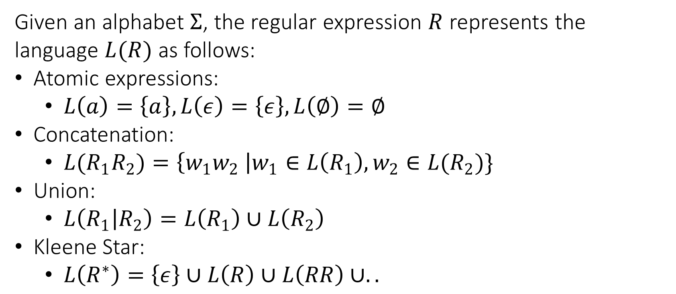
Regular Expressions: Reminder
Given an alphabet $Σ$, the regular expression $R$ represents the language $L(R)$ as follows:
Atomic expressions:
$L\left(a\right)=\left\{a\right\}, L\left(ε\right)=\left\{ε\right\}, L\left(∅\right)=∅$
Concatenation:
${L(R}_{1}R_{2})=\left\{w_{1}w_{2} \right|w_{1}∈L\left(R_{1}\right), w_{2}∈L(R_{2})\}$
Union:
$L\left(R_{1} | R_{2}\right)=L\left(R_{1}\right)∪L\left(R_{2}\right)$
Kleene Star:
$L\left(R^{∗}\right)=\left\{ε\right\}∪L\left(R\right)∪L\left(RR\right)∪..$

Slide 63
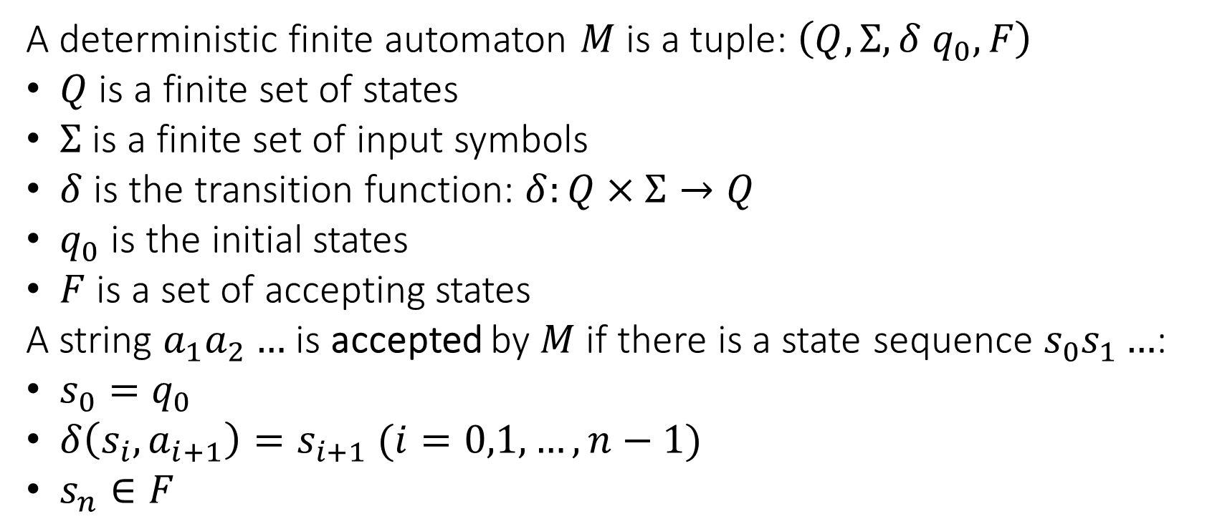
DFA: Reminder
A deterministic finite automaton $M$ is a tuple: $\left(Q, Σ, δ q_{0}, F\right)$
$Q$ is a finite set of states
$Σ$ is a finite set of input symbols
$δ$ is the transition function: $δ:Q×Σ→Q$
$q_{0}$ is the initial states
$F$ is a set of accepting states
A string $a_{1}a_{2}…$ is accepted by $M$ if there is a state sequence $s_{0}s_{1}…$:
$s_{0}=q_{0}$
$δ\left(s_{i}, a_{i+1}\right)=s_{i+1} (i=0,1,…,n−1)$
$s_{n}∈F$

Slide 64
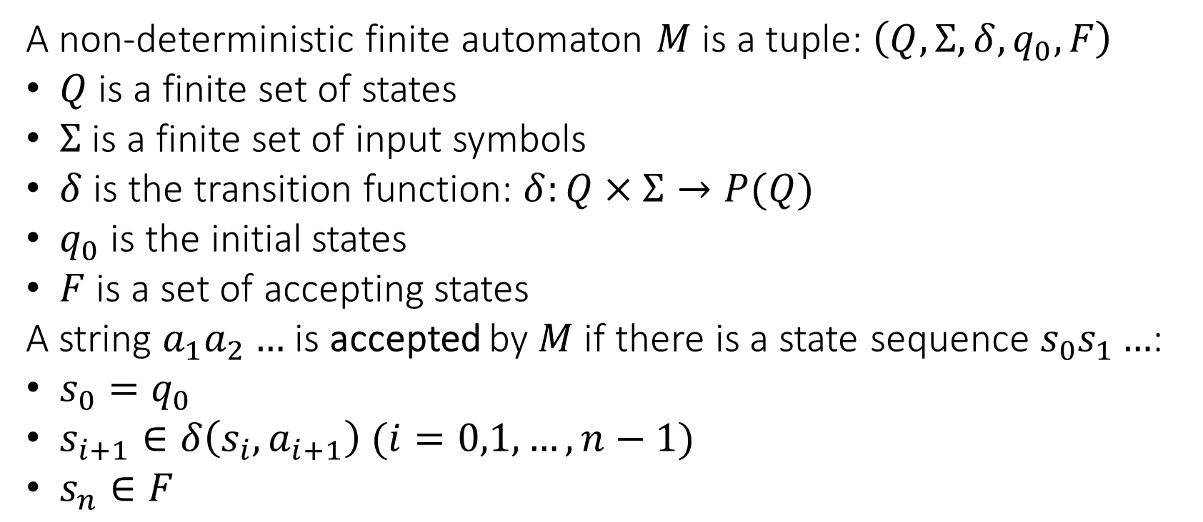
NFA: Reminder
A non-deterministic finite automaton $M$ is a tuple: $\left(Q, Σ, δ, q_{0}, F\right)$
$Q$ is a finite set of states
$Σ$ is a finite set of input symbols
$δ$ is the transition function: $δ:Q×Σ→P(Q)$
$q_{0}$ is the initial states
$F$ is a set of accepting states
A string $a_{1}a_{2}…$ is accepted by $M$ if there is a state sequence $s_{0}s_{1}…$:
$s_{0}=q_{0}$
$s_{i+1}∈δ\left(s_{i}, a_{i+1}\right) (i=0,1,…,n−1)$
$s_{n}∈F$

Slide 65
RE to DFA
For every regular expression, there is a deterministic finite automaton than accepts it’s language
Proof by construction
Once we have the DFA, we can implement using a transition table
As done in Flex

Slide 66




RE to NFA: Atomic Expressions
Accept
$$ϵ$$
Accept
$$a$$
$$a$$
$$∅$$

Slide 67
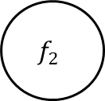


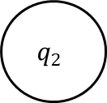


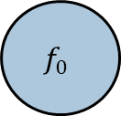
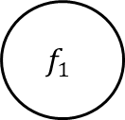
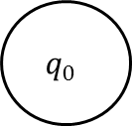
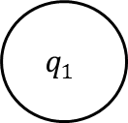


RE to NFA: Union
$$q_{1}$$
$$f_{1}$$
$$M_{1}$$
$$ϵ$$
$$ϵ$$
$$q_{0}$$
$$f_{0}$$
$$ϵ$$
$$ϵ$$
$$q_{2}$$
$$f_{2}$$
$$M_{2}$$

Slide 68


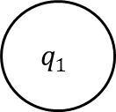
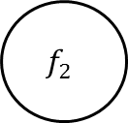

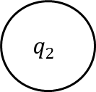


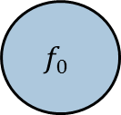
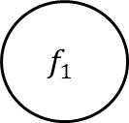
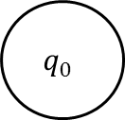
RE to NFA: Concatenation
$$q_{0}$$
$$ϵ$$
$$q_{1}$$
$$f_{1}$$
$$ϵ$$
$$q_{2}$$
$$f_{2}$$
$$ϵ$$
$$f_{0}$$
$$M_{1}$$
$$M_{2}$$

Slide 69

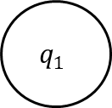

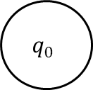



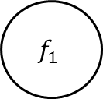

RE to NFA: Kleene Star
$$ϵ$$
$$q_{0}$$
$$ϵ$$
$$q_{1}$$
$$f_{1}$$
$$ϵ$$
$$f_{0}$$
$$M_{1}$$
$$ϵ$$

Slide 70
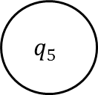

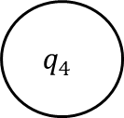

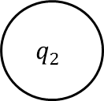

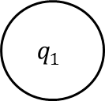

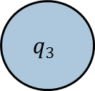

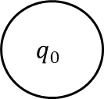

RE to NFA: Example
NFA for $a | b$
$$q_{1}$$
$$a$$
$$q_{2}$$
$$ϵ$$
$$ϵ$$
$$q_{0}$$
$$q_{3}$$
$$ϵ$$
$$ϵ$$
$$q_{4}$$
$$b$$
$$q_{5}$$

Slide 71
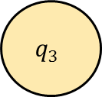
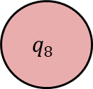



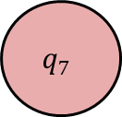




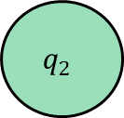







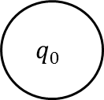
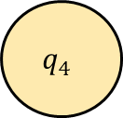


RE to NFA: Another Example
NFA for ${01}^{∗} | 1$
$$q_{1}$$
$$1$$
$$q_{2}$$
$$ϵ$$
$$ϵ$$
$$q_{0}$$
$$q_{9}$$
$$ϵ$$
$$ϵ$$
$$ϵ$$
$$q_{3}$$
$$0$$
$$q_{4}$$
$$ϵ$$
$$q_{5}$$
$$ϵ$$
$$q_{6}$$
$$1$$
$$q_{7}$$
$$ϵ$$
$$q_{8}$$
$$ϵ$$

Slide 72
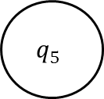

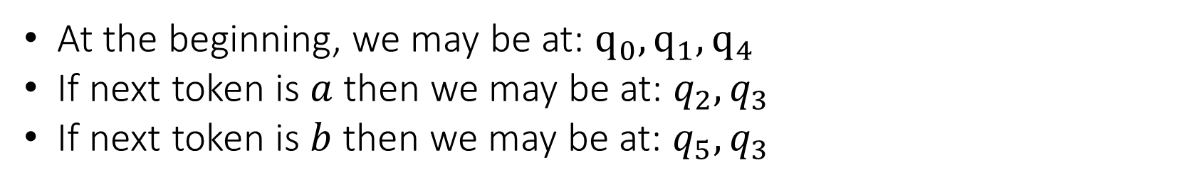
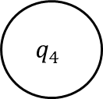

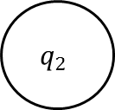

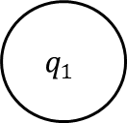



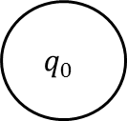

NFA to DFA: Example
At the beginning, we may be at: $q_{0},q_{1},q_{4}$
If next token is $a$ then we may be at: $q_{2},q_{3}$
If next token is $b$ then we may be at: $q_{5},q_{3}$
$$q_{1}$$
$$a$$
$$q_{2}$$
$$ϵ$$
$$ϵ$$
$$q_{0}$$
$$q_{3}$$
$$ϵ$$
$$ϵ$$
$$q_{4}$$
$$b$$
$$q_{5}$$

Slide 73
NFA to DFA: Example
At the beginning, we may be at: $q_{0},q_{1},q_{4}$
If next token is $a$ then we may be at: $q_{2},q_{3}$
If next token is $b$ then we may be at: $q_{5},q_{3}$
$$q_{1}$$
$$a$$
$$q_{2}$$
$$ϵ$$
$$ϵ$$
$$q_{0}$$
$$q_{3}$$
$$ϵ$$
$$ϵ$$
$$q_{4}$$
$$b$$
$$q_{5}$$

Slide 74

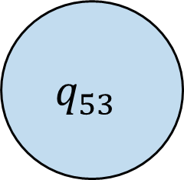
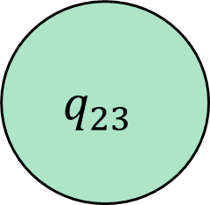

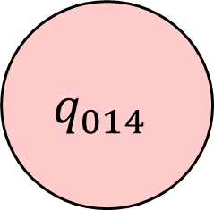
NFA to DFA: Example
So we can transform to the following DFA:
$$q_{23}$$
$$a$$
$$q_{014}$$
$$b$$
$$q_{53}$$

Slide 75
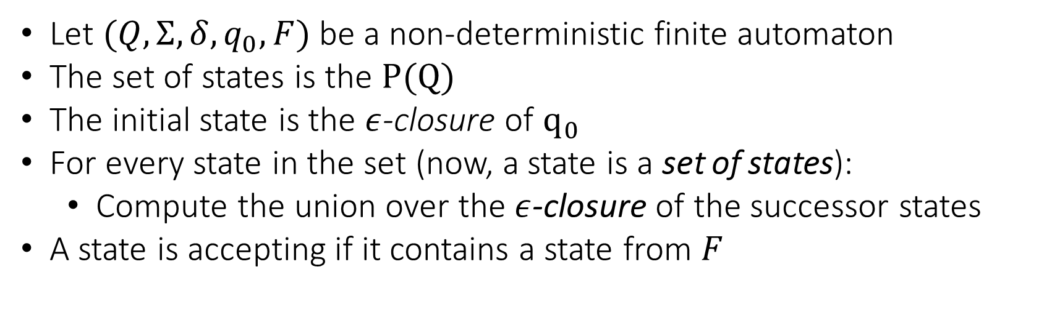
NFA to DFA: Formal Details
Let $(Q, Σ, δ, q_{0}, F)$ be a non-deterministic finite automaton
The set of states is the $P(Q)$
The initial state is the $ε$-closure of $q_{0}$
For every state in the set (now, a state is a set of states):
Compute the union over the $ε$-closure of the successor states
A state is accepting if it contains a state from $F$

Slide 76
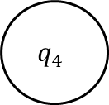
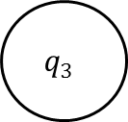
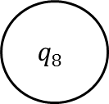
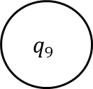
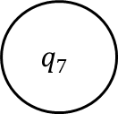
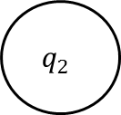
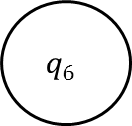
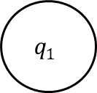
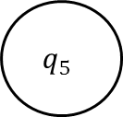
Another Example: NFA to DFA
$$q_{1}$$
$$1$$
$$q_{2}$$
$$ϵ$$
$$ϵ$$
$$q_{0}$$
$$q_{9}$$
$$ϵ$$
$$ϵ$$
$$ϵ$$
$$q_{3}$$
$$0$$
$$q_{4}$$
$$ϵ$$
$$q_{5}$$
$$ϵ$$
$$q_{6}$$
$$1$$
$$q_{7}$$
$$ϵ$$
$$q_{8}$$
$$ϵ$$

Slide 77
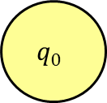


Another Example: NFA to DFA
$$q_{1}$$
$$1$$
$$q_{2}$$
$$ϵ$$
$$ϵ$$
$$q_{0}$$
$$q_{9}$$
$$ϵ$$
$$ϵ$$
$$ϵ$$
$$q_{3}$$
$$0$$
$$q_{4}$$
$$ϵ$$
$$q_{5}$$
$$ϵ$$
$$q_{6}$$
$$1$$
$$q_{7}$$
$$ϵ$$
$$q_{8}$$
$$ϵ$$

Slide 78


Another Example: NFA to DFA
$$q_{1}$$
$$1$$
$$q_{2}$$
$$ϵ$$
$$ϵ$$
$$q_{0}$$
$$q_{9}$$
$$ϵ$$
$$ϵ$$
$$ϵ$$
$$q_{3}$$
$$0$$
$$q_{4}$$
$$ϵ$$
$$q_{5}$$
$$ϵ$$
$$q_{6}$$
$$1$$
$$q_{7}$$
$$ϵ$$
$$q_{8}$$
$$ϵ$$

Slide 79





Another Example: NFA to DFA
$$q_{1}$$
$$1$$
$$q_{2}$$
$$ϵ$$
$$ϵ$$
$$q_{0}$$
$$q_{9}$$
$$ϵ$$
$$ϵ$$
$$ϵ$$
$$q_{3}$$
$$0$$
$$q_{4}$$
$$ϵ$$
$$q_{5}$$
$$ϵ$$
$$q_{6}$$
$$1$$
$$q_{7}$$
$$ϵ$$
$$q_{8}$$
$$ϵ$$

Slide 80



Another Example: NFA to DFA
$$q_{1}$$
$$1$$
$$q_{2}$$
$$ϵ$$
$$ϵ$$
$$q_{0}$$
$$q_{9}$$
$$ϵ$$
$$ϵ$$
$$ϵ$$
$$q_{3}$$
$$0$$
$$q_{4}$$
$$ϵ$$
$$q_{5}$$
$$ϵ$$
$$q_{6}$$
$$1$$
$$q_{7}$$
$$ϵ$$
$$q_{8}$$
$$ϵ$$

Slide 81








Another Example: NFA to DFA
$$q_{2,9}$$
$$1$$
$$1$$
$$q_{0,1,3}$$
$$q_{6,7,8,9}$$
$$0$$
$$q_{4,5,6,8,9}$$
$$1$$

Slide 82
Building a Lexical Analyzer
Construct a regular expressions for token types:
Identifiers, numbers, reserved keywords
If we have a collision (two or more matching tokens) :
Token with longest match wins
Order of definition

Slide 83
Regular Expressions Definitions for C
Here we can see the regular expression definitions:
http://www.lysator.liu.se/c/ANSI-C-grammar-l.html
Quite simple and modular…

Slide 84
JFlex
Java Fast Lexical Analyzer
Inspired by the original flex project (written in C)
Accepts an input file with tokens definitions
Generates Java code with a scanning API
This scanning API reads the input and returns:
The type of the read token
Or an error…

Slide 85
JFlex
LEX definitions
(Input.lex)
Auto generated code
(Output.java)

Slide 86
LEX Format
%{
// java code here
…
%}
<VAR> = <REGEX>
…
%%
<STATE> {
{REGEX} {
// java code here
}
…
}
user code
declarations
rules

Slide 87
LEX Format
%{
// java code here
…
%}
<VAR> = <REGEX>
…
%%
<STATE> {
{REGEX} {
// java code here
}
…
}
Regular Java code
Pasted to the generated file
user code
declarations
rules

Slide 88
LEX Format
%{
// java code here
…
%}
<VAR> = <REGEX>
…
%%
<STATE> {
{REGEX} {
// java code here
}
…
}
Regular Java code
Pasted to the generated file
user code
Macro definitions
Define a regex for each token
declarations
rules

Slide 89
LEX Format
%{
// java code here
…
%}
<VAR> = <REGEX>
…
%%
<STATE> {
{REGEX} {
// java code here
}
…
}
Regular Java code
Pasted to the generated file
user code
Macro definitions
Define a regex for each token
declarations
If the following holds:
Current lexical state is <STATE>
<REGEX> is matched
Then execute the action code
rules

Slide 90

Example 1
We want 2 kind of tokens:
$a$
$b^{∗}$
Everything else is rejected…

Slide 91
Example 1: LEX Definitions
User code:
%{
private Symbol symbol(int type) {
return new Symbol(type, yyline, yycolumn);
}
public int getLine() { return yyline + 1; }
public int getTokenStartPosition() { return yycolumn + 1; }
%}

Slide 92
Example 1: LEX Definitions
Declarations
A = a
B_STAR = b*

Slide 93
Example 1: LEX Definitions
Rules:
<YYINITIAL> {
{A} { return symbol(TokenNames.A); }
{B_STAR} { return symbol(TokenNames.B_STAR); }
<<EOF>> { return symbol(TokenNames.EOF);}
}

Slide 94
Example 1: LEX Definitions
%{
private Symbol symbol(int type) { return new Symbol(type, yyline, yycolumn); }
public int getLine() { return yyline + 1; }
public int getTokenStartPosition() { return yycolumn + 1; }
%}
A = a
B_STAR = b*
%% // separator…
<YYINITIAL> {
{A} { return symbol(TokenNames.A); }
{B_STAR} { return symbol(TokenNames.B_STAR); }
<<EOF>> { return symbol(TokenNames.EOF);}
}

Slide 95
Example 1: Tokens Definitions
public interface TokenNames {
/* terminals */
public static final int EOF = 0;
public static final int A = 1;
public static final int B_STAR = 2;
}

Slide 96
Example 1: Main
Lexer l = new Lexer(fileReader); // auto-generated lexer
Symbol s = l.next_token();
while (s.sym != TokenNames.EOF) {
System.out.print("[");
System.out.print(l.getLine() + ", " + l.getTokenStartPosition); System.out.print("]:");
System.out.print(s.sym + "\n");
s = l.next_token();
}

Slide 97
Example 1: Output
What will be the output for the following input?
$ababbbb$

Slide 98
Example 1: Output
What will be the output for the following input?
$ababbbb$
[1,1]:1
[1,2]:2
[1,3]:1
[1,4]:2
Format: [line,column]:<token_type>

Slide 99
Example 1: Output
What will be the output for the following input?
$ab abbbb$

Slide 100
Example 1: Output
What will be the output for the following input?
$ab abbbb$
[1,1]:1
[1,2]:2
Exception in …

Slide 101
Example 1: The EOF Token
Why do we need the EOF token?

Slide 102
Example 2: Counting Words
How can we use JFlex to count words for a given input file?
Assume only letters

Slide 103
Example 2: LEX Definitions
%{
private Symbol symbol(int type) { return new Symbol(type, yyline, yycolumn); }
public int getLine() { return yyline + 1; }
public int getTokenStartPosition() { return yycolumn + 1; }
public int words_count = 0;
%}
WORD = [a-zA-Z]+
ANY = [^a-zA-Z]+
%% // separator…
<YYINITIAL> {
{WORD} { words_count++; }
{ANY} { }
<<EOF>> { return symbol(TokenNames.EOF); }
}

Slide 104
Example 2: Tokens Definitions
public interface TokenNames {
/* terminals */
public static final int EOF = 0;
}

Slide 105
Example 2: Counting Words
Other definitions instead of ANY?

Slide 106
Example 2: Counting Words
Other definitions instead of ANY?
\n|.

Slide 107
Example 3: Calculator
How can we use JFlex to detect calculator tokens?
Numbers, parentheses, operators, …
1+1, (9), 1+(0000, …

Slide 108
Example 3: LEX Definitions
Declarations:
PLUS = "+“
L_PAREN = "(“
R_PAREN = ")“
NUMBER = [0-9]+

Slide 109
Example 3: LEX Definitions
Rules:
<YYINITIAL> {
{PLUS} { return symbol(TokenNames.PLUS); }
{L_PAREN} { return symbol(TokenNames.L_PAREN); }
{R_PAREN} { return symbol(TokenNames.R_PAREN); }
{NUMBER} {
return symbol(TokenNames.NUMBER, new Integer(yytext()));
}
<<EOF>> { return symbol(TokenNames.EOF); }
}

Slide 110
Example 3: Tokens Definitions
public interface TokenNames {
/* terminals */
public static final int EOF = 0;
public static final int PLUS = 1;
public static final int L_PAREN = 2;
public static final int R_PAREN = 3;
public static final int NUMBER = 4;
}

Slide 111

Example 3: Output
What will be the output for:
$1(+2345$
[1,1]:4 1
[1,2]:2 null
[1,3]:1 null
[1,4]:4 2345

Slide 112
Example 4: Definition Order
%{
private Symbol symbol(int type) { return new Symbol(type, yyline, yycolumn); }
public int getLine() { return yyline + 1; }
public int getTokenStartPosition() { return yycolumn + 1; }
%}
T1 = a
T2 = ab*
%% // separator…
<YYINITIAL> {
{T1} { return symbol(TokenNames.T1); }
{T2} { return symbol(TokenNames.T2); }
<<EOF>> { return symbol(TokenNames.EOF); }
}

Slide 113

Example 4: Definition Order
What will be the output for:
$aabbbba$
T1 = a
T2 = ab*
<YYINITIAL> {
{T1} { return symbol(TokenNames.T1); }
{T2} { return symbol(TokenNames.T2); }
<<EOF>> { return symbol(TokenNames.EOF); }
}

Slide 114
Example 4: Definition Order
What will be the output for:
$aabbbba$
T1 = a
T2 = ab*
<YYINITIAL> {
{T1} { return symbol(TokenNames.T1); }
{T2} { return symbol(TokenNames.T2); }
<<EOF>> { return symbol(TokenNames.EOF); }
}
[1,1]:1
[1,2]:2
[1,7]:1

Slide 115
Example 4: Definition Order
If the order is swapped?
$aabbbba$
T1 = a
T2 = ab*
<YYINITIAL> {
{T2} { return symbol(TokenNames.T2); }
{T1} { return symbol(TokenNames.T1); }
<<EOF>> { return symbol(TokenNames.EOF); }
}

Slide 116
Example 4: Definition Order
If the order is swapped?
$aabbbba$
T1 = a
T2 = ab*
<YYINITIAL> {
{T2} { return symbol(TokenNames.T2); }
{T1} { return symbol(TokenNames.T1); }
<<EOF>> { return symbol(TokenNames.EOF); }
}
[1,1]:2
[1,2]:2
[1,7]:2

Slide 117
Exam Questions
Consider the following flex-like definition:
a*b { print “1” }
ca { print “2” }
a*ca* { print “3” }
What will the lexer print for the input:
abcaacacaaabbaaabcaaca

Slide 118
Exam Questions
Consider the following flex-like definition:
a*b { print “1” }
ca { print “2” }
a*ca* { print “3” }
abcaacacaaabbaaabcaaca

Slide 119
Exam Questions
Consider the following flex-like definition:
a*b { print “1” }
ca { print “2” }
a*ca* { print “3” }
ab|caacacaaabbaaabcaaca

Slide 120
Exam Questions
Consider the following flex-like definition:
a*b { print “1” }
ca { print “2” }
a*ca* { print “3” }
ab|caa|cacaaabbaaabcaaca

Slide 121
Exam Questions
Consider the following flex-like definition:
a*b { print “1” }
ca { print “2” }
a*ca* { print “3” }
ab|caa|ca|caaabbaaabcaaca

Slide 122
Exam Questions
Consider the following flex-like definition:
a*b { print “1” }
ca { print “2” }
a*ca* { print “3” }
ab|caa|ca|caaa|bbaaabcaaca

Slide 123
Exam Questions
Consider the following flex-like definition:
a*b { print “1” }
ca { print “2” }
a*ca* { print “3” }
ab|caa|ca|caaa|b|baaabcaaca

Slide 124
Exam Questions
Consider the following flex-like definition:
a*b { print “1” }
ca { print “2” }
a*ca* { print “3” }
ab|caa|ca|caaa|b|b|aaabcaaca

Slide 125
Exam Questions
Consider the following flex-like definition:
a*b { print “1” }
ca { print “2” }
a*ca* { print “3” }
ab|caa|ca|caaa|b|b|aaab|caaca

Slide 126
Exam Questions
Consider the following flex-like definition:
a*b { print “1” }
ca { print “2” }
a*ca* { print “3” }
ab|caa|ca|caaa|b|b|aaab|caa|ca

Slide 127
Exam Questions
Consider the following flex-like definition:
a*b { print “1” }
ca { print “2” }
a*ca* { print “3” }
ab|caa|ca|caaa|b|b|aaab|caa|ca
Answer:
132311132

Slide 128
Exam Questions: Will Compile?
void f(int a) {
int i = 8;
int j = 3;
i--+--j;
}

Slide 129
Exam Questions: Will Compile?
void f(int a) {
int i = 8;
int j = 3;
i--+--j;
}
tokens
i | -- | + | -- | j

Slide 130
Exam Questions: Will Compile?
void f(int a) {
int i = 8;
int j = 3;
i--+--j;
}
Valid
tokens
i | -- | + | -- | j

Slide 131
Exam Questions: Will Compile?
void f(int a) {
int i = 8;
int j = 3;
i-----j;
}

Slide 132
Exam Questions: Will Compile?
void f(int a) {
int i = 8;
int j = 3;
i-----j;
}
tokens
i | -- | -- | - | j

Slide 133
Exam Questions: Will Compile?
void f(int a) {
int i = 8;
int j = 3;
i-----j;
}
(i--)--
tokens
i | -- | -- | - | j

Slide 134
Exam Questions: Will Compile?
void f(int a) {
int i = 8;
int j = 3;
i-----j;
}
Invalid
(i--)--
tokens
i | -- | -- | - | j

Slide 135
Exam Questions: Will Compile?
void f(int a) {
int i = 8;
int j = 3;
(i--)-(--j);
}

Slide 136
Exam Questions: Will Compile?
void f(int a) {
int i = 8;
int j = 3;
(i--)-(--j);
}
tokens
( | i | -- | ) | - | ( | -- | j | )

Slide 137
Exam Questions: Will Compile?
void f(int a) {
int i = 8;
int j = 3;
(i--)-(--j);
}
Valid
tokens
( | i | -- | ) | - | ( | -- | j | )

Slide 138
Exam Questions: Will Compile?
void f(int a) {
int i = 8;
int j = 3;
i---(--j);
}

Slide 139
Exam Questions: Will Compile?
void f(int a) {
int i = 8;
int j = 3;
i---(--j);
}
tokens
i | -- | - | ( | -- | j | )

Slide 140
Exam Questions: Will Compile?
void f(int a) {
int i = 8;
int j = 3;
i---(--j);
}
Valid
tokens
i | -- | - | ( | -- | j | )

