Slide 1
Project Round 2!

Slide 2

Happy Baby Says It Best…

Slide 3
Your Challenge

Slide 4
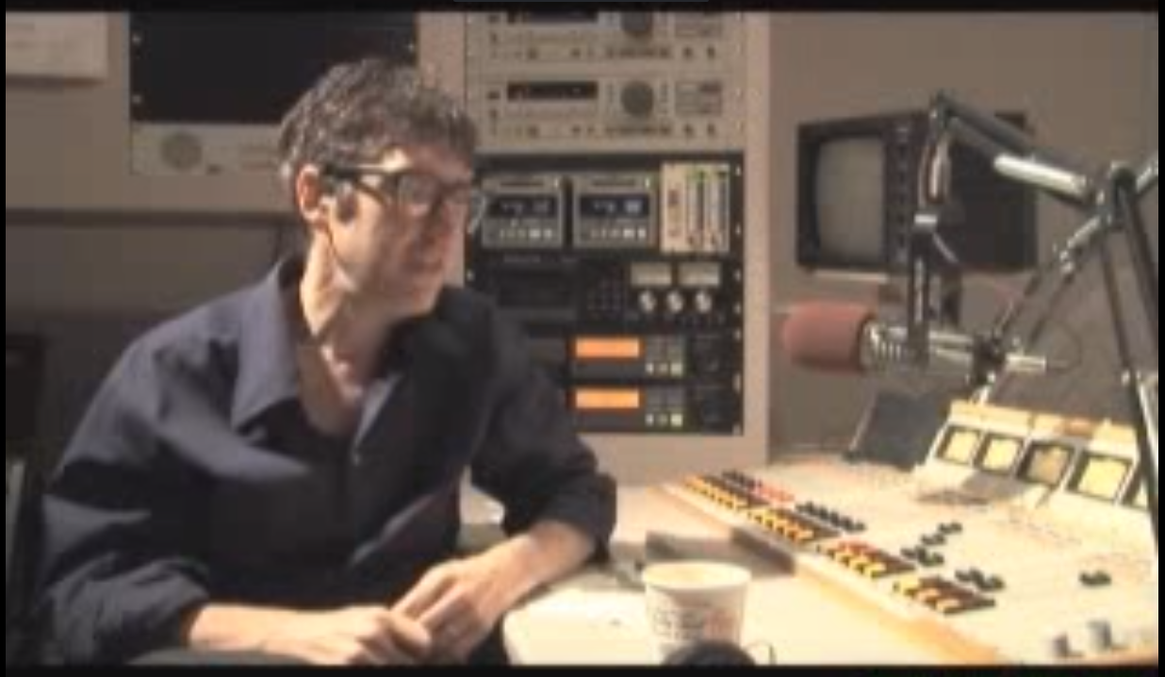
Ira Glass – On “Taste”
https://www.youtube.com/watch?v=X2wLP0izeJE

Slide 5
Your Challenge
At this point, you all have real skills.
It’s time to show it.

Slide 6
Your Challenge
Like seriously.
Be ambitious.

Slide 7
Project Week Overview

Slide 8
Project Week
Weekday Classes:
Divide into groups
Begin assessing interests and skills
Begin researching “data-sets”
Outlining project ideas
Submitting Project Proposal for Approval
Initial Design work
Saturday Class:
Learn Testing
Do more Project Work
Next Week’s Classes:
Projects

Slide 9
Teams

Slide 10
Group Teams
Group 1 (Disco Ninjas)
1. Claudia
2. Derek
3. Jim
4. Kavodel
5. Taylor B
Group 2 (Y-Nots)
1. James H
2. Curtis
3. Wilfred
4. Tony Chung
5. Phillip
Group 3 (Bits, Please)
1. Malcolm
2. Shane
3. Taylor R
4. Nic
5. Stephen
Group 4 (Blue Screens)
1. Candace
2. Jermaine
3. Jordan
4. Adam P
5. Chris
Group 5 (Nerds of a Feather)
1. Charronda
2. David L
3. Tesh
4. Steffen
5. James L
Group 6 (Memory Leak)
1. Gene
2. Rosita
3. Priscila
4. Bradshaw
5. Katherine
Group 7 (Byte Me)
1. Denise
2. Marsalis
3. Jimin
4. Daniel P
5. Shamara
Group 8 (Technocrats)
1. Matt G
2. Logan
3. Tyler
4. Limbert
5. Dean
Group 9 (Trojan Horses)
1. Matt J
2. Teresa
3. Yvonne
4. Judi
5. Anish
Group 10 (Access Denied)
1. Matthew T
2. Joshua
3. Dexter
4. David S.
5. Kishon
Group 11 (Baby Got Hack)
1. Bhanoo
2. Desmond
3. Courtney
4. Adam T
5. Daryl
Group 12 (Bit Lords)
1. Karress
2. Samantha
3. Brandon
4. Benjamin
5. Amelia
Group 13 (Poisoned Proxies)
1. Jalil
2. Jung
3. Nadia
4. Daniela
5. Darreck
Group 14 (Browser Cache Me Outside)
1. Tyler
2. Thomas
3. Cassandra
4. Akshay
5. Charles

Slide 11
Project Task
To build some awesome shiz.

Slide 12
Coding Requirements
Must use a Node and Express Web Server
Must be backed by a MySQL Database with a Sequelize ORM
Must have both GET and POST routes for retrieving and adding new data
Must incorporate Basic Testing Framework
Must be deployed using Heroku (with Data)
Must utilize at least one new library, package, or technology that we haven’t discussed
Must have a polished frontend / UI
Must have folder structure that meets MVC Paradigm
Must meet good quality coding standards (indentation, scoping, naming)

Slide 13
Coding – Nice To Haves
Utilize Handlebars for Server-Side Templating
Incorporate Authentication (JSON Web Tokens, Sessions, Etc.)
Use an existing public dataset to power the database
Create a migration strategy for sharing data across team members.

Slide 14
Presentation Requirement
You will also be responsible for preparing a 10 minute presentation.
This will be a formal presentation.
One in which you explain in detail:
Your overall application’s concept
The motivation for its development
Your design process
The technologies you used (and briefly how they work)
A demonstration of its functionality
Directions for future development
Treat the presentation seriously!
Talking intelligently about tech > doing tech sometimes.

Slide 15
Metrics

Slide 16
Metrics
Concept
Design
Functionality
Collaboration
Presentation

Slide 17
Questions

