Slide 1
Uganda Coffee Farmer
Management System
Ainomugisha Faith
Natukunda Warudata
Akampurira Aisha
Mpanga Benard
Kirabo Jorryn Edna
Lumbuye Joshua Jolly
Final exam presentation
Requirements • EERD • Database implementation • Security & views
1
Notes:
[Sources] - Requirement specification.pdf (user-uploaded) - EERD FINAL IMAGE.jpeg (user-uploaded) - Coffee_Growers_backup.sql (user-uploaded)

Slide 2
1. Problem and system objective
Milestone 1 summary
Problem being solved
Main objective
The Ministry of Agriculture needs a reliable database to know registered coffee growers and the farms they manage.
The system must track coffee production, seedling and input distribution, and extension support given to farmers.
It must also support secure access and reduce inconsistent manual records.
Register farmers with personal and location details.
Record farms, production by season, and support distributed to each farm.
Link farmers to extension workers by area and log advisory visits.
Enforce validation, access control, and useful reporting.
2
Notes:
[Sources] - Requirement specification.pdf, pages 1–4 (user-uploaded)

Slide 3
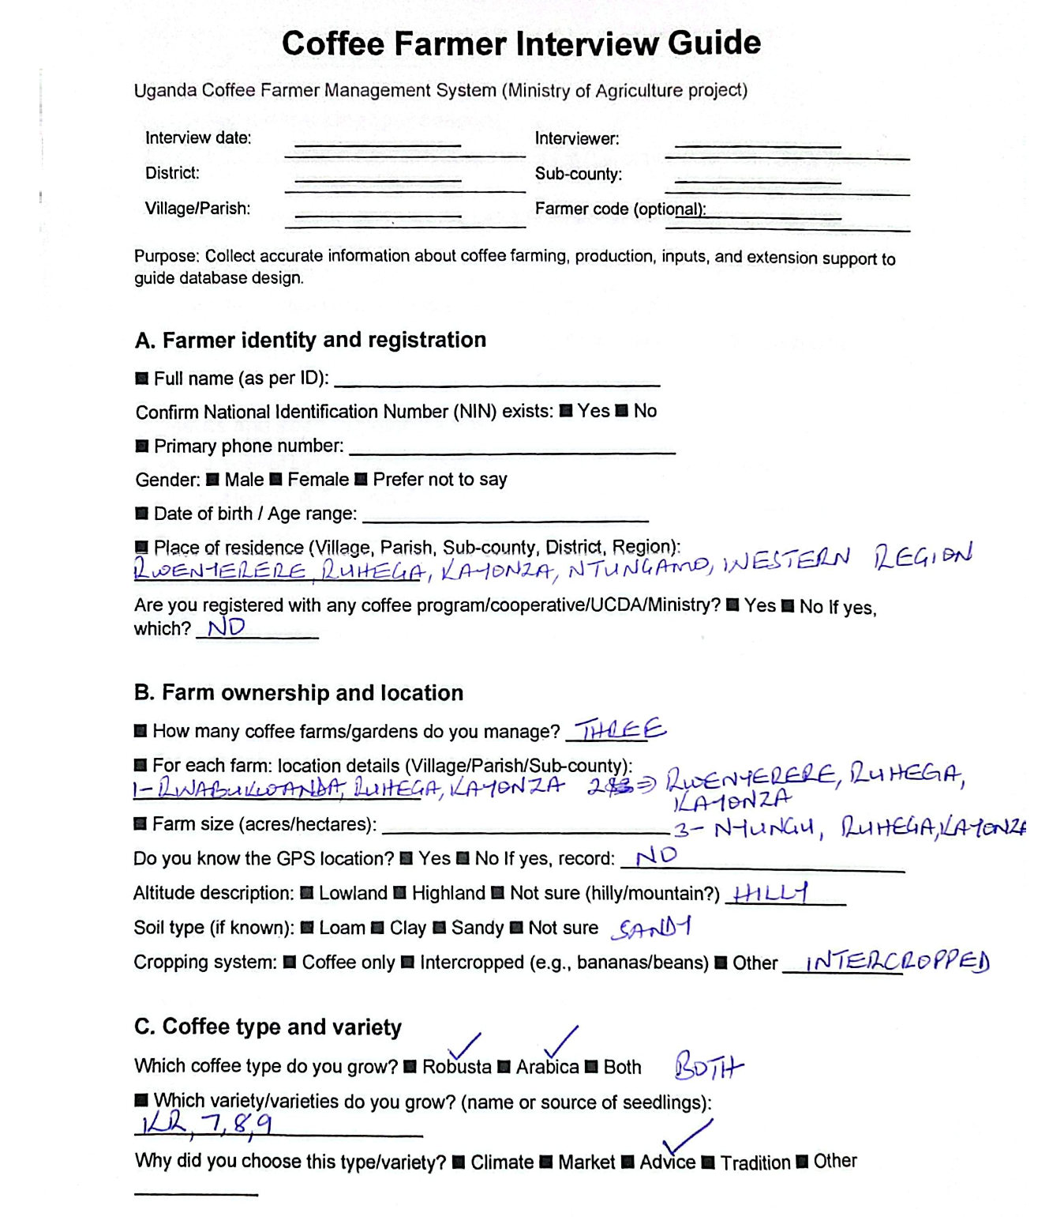
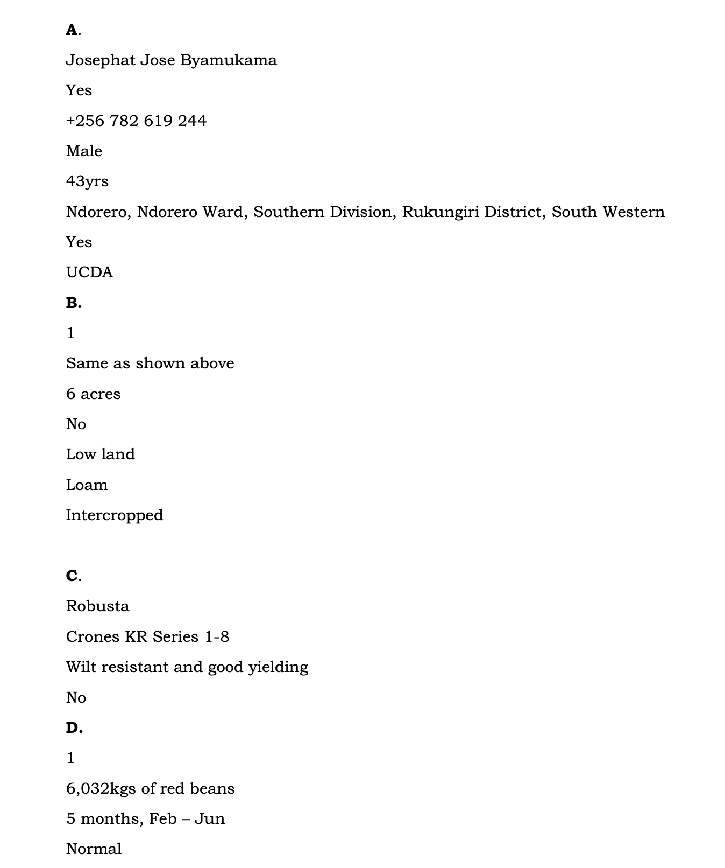

Slide 4
2. Requirements and business rules
What the database must support
Core data to capture
Coffee-domain rules
Security needs
Farmer details and NIN
Farm size, altitude and sub-county
Production by farm and season
Inputs distributed and farm visits
Only Robusta and Arabica types
Varieties belong to a coffee type
Altitude must match coffee type
Yields should be checked against benchmarks
User authentication
Role-based access
Extension workers limited to assigned areas
Reports for ministry officials
Key business rules
Design implications
A farmer must exist before any farm or production record is added.
A farm belongs to exactly one farmer.
Production must be linked to a farm and a season.
Duplicate input distribution in the same season is not allowed.
Need clear geography hierarchy: Region → District → SubCounty.
Need specialization for person roles and input categories.
Need foreign keys, checks, triggers and views to enforce rules.
3
Notes:
[Sources] - Requirement specification.pdf, pages 1–4 (user-uploaded)

Slide 5
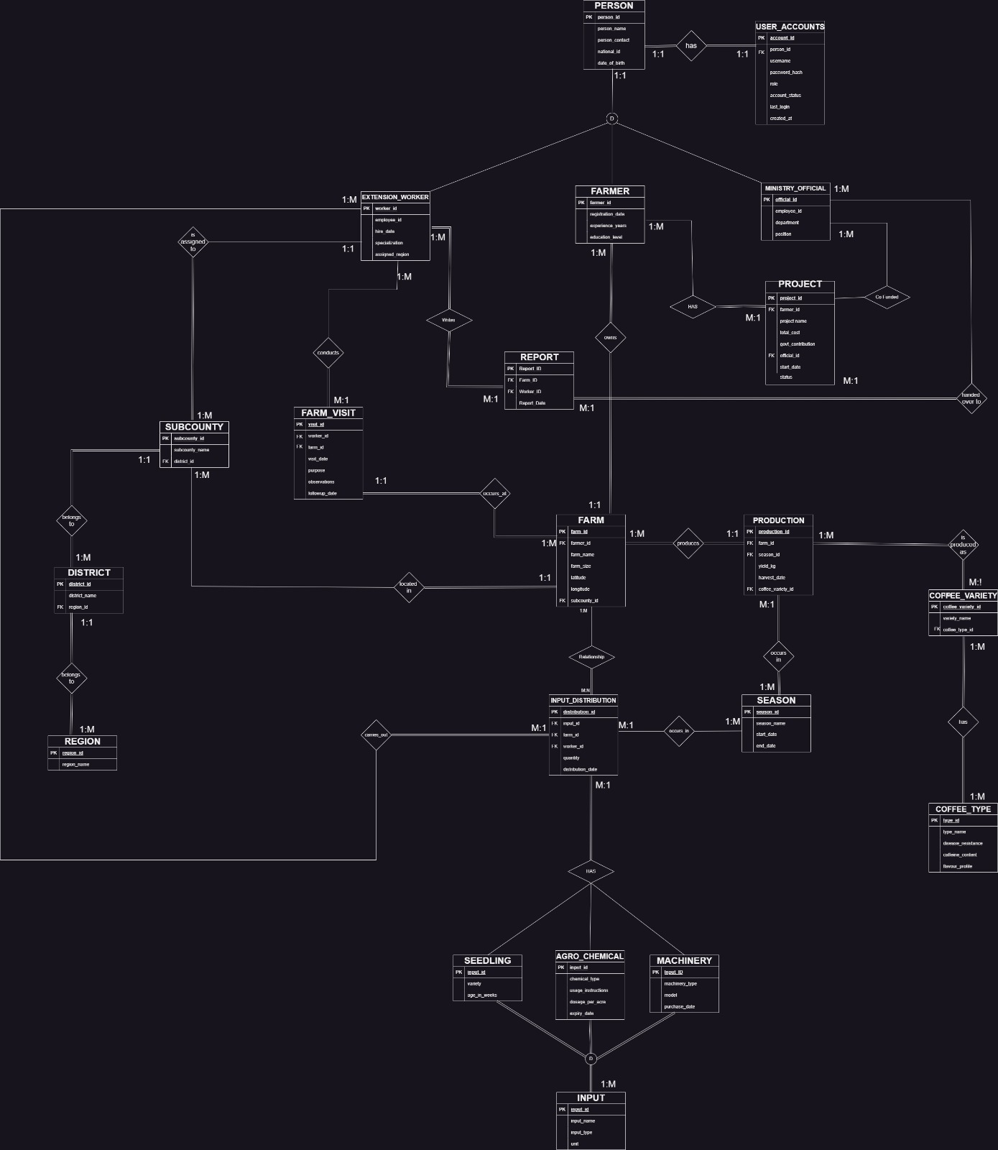
3. Final EERD
Logical model for the solution
What the diagram shows
PERSON is specialized into Farmer, Extension_Worker and Ministry_Official.
INPUT is specialized into Seedling, Agro_Chemical and Machinery.
Region, District and SubCounty handle geographic classification.
Farm is the core operational entity linked to production, inputs and visits.
Production occurs per farm, per coffee variety and per season.
Advanced EERD features used
Specialization / inheritance
Disjoint subtypes
Categorization
1:1, 1:M and M:1 relationships
4
Notes:
[Sources] - EERD FINAL IMAGE.jpeg (user-uploaded)

Slide 6
4. Database implementation
Selected tables, constraints and sample data
Implemented core tables
Region, District, SubCounty
Person, Farmer, Extension_Worker, Ministry_Official
Farm, FarmVisit
CoffeeType, CoffeeVariety, Season
Input, Seedling, Agro_Chemical, Machinery
InputDistribution, Production, User_Accounts
Validation and integrity rules in SQL
Unique national_id for Person and unique usernames in User_Accounts.
CHECK constraints for region names, farm size, altitude, quantity and season dates.
Foreign keys maintain referential integrity across farmer, farm, production, visit and input tables.
Triggers enforce disjoint subtype rules for Farmer / Worker / Official and for input subtypes.
Sample data already loaded
2 farmers, 2 farms, 1 extension worker and 1 ministry official
Coffee types, varieties, seasons, inputs and distributions loaded
Production and farm visit records present in the dump
5
Notes:
[Sources] - Coffee_Growers_backup.sql (user-uploaded)

Slide 7
5. Security and views
Role-based access control
Farmer
Extension worker
Ministry official
Admin
Reads own profile
Reads own farms
Reads own production
Reads own inputs and visits
Reads farms in assigned area
Reads own visit history
Can log farm visits
Supports farmer linkage by location
Reads production summary
Monitors farmers and support distribution
Can use reports for planning
Full privileges
Manages users, roles and backup
Oversees system maintenance
Views implemented in the Database.
v_farmer_profile, v_farmer_farms, v_farmer_production, v_farmer_inputs, v_farmer_visits, v_extension_assigned_farms, v_extension_my_visits and v_ministry_production_summary.
6
Notes:
[Sources] - Coffee_Growers_backup.sql (user-uploaded)

Slide 8
6. Testing and demonstration points
What to show live
Recommended live demo flow
Useful SQL to keep ready
Show SELECT * FROM v_farmer_profile; using farmer account.
Show SELECT * FROM v_farmer_farms; and v_farmer_production;.
Show SELECT * FROM v_ministry_production_summary;.
Show extension worker farm visits and assigned farms.
Mention trigger-based subtype protection and data checks.
SELECT * FROM v_farmer_profile;
SELECT * FROM v_farmer_farms;
SELECT * FROM v_farmer_production;
SELECT * FROM v_extension_assigned_farms;
SELECT * FROM v_ministry_production_summary;
-- optional checks
SELECT * FROM InputDistribution;
SELECT * FROM Production;
Tip: if asked about project/report tables, say they were included because the requirements add reporting and ministry-funded projects.
7
Notes:
[Sources] - Coffee_Growers_backup.sql (user-uploaded) - Requirement specification.pdf, pages 2–3 (user-uploaded)

Slide 9
7. Conclusion
Why this solution is exam-ready
Thank you
Questions?
8
Notes:
[Sources] - Requirement specification.pdf (user-uploaded) - Coffee_Growers_backup.sql (user-uploaded) - EERD FINAL IMAGE.jpeg (user-uploaded)

