Slide 1
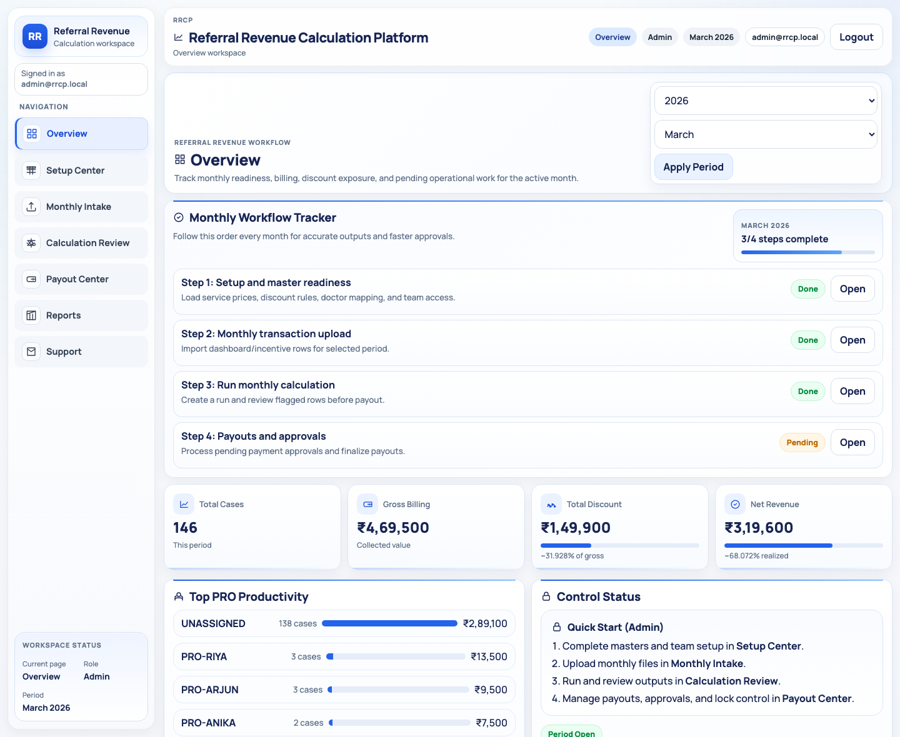
Referral Revenue Calculation Platform
Architecture walk-through | March 16, 2026
Full workflow architecture
Frontend, backend, database, approvals, page-level functioning, and end-to-end monthly data movement.
Frontend: index.php + public/app.js + public/styles.css
Backend: api/index.php routing + api/lib.php schema, upload parsing, engine, reporting
Database: SQLite file at data/app.db
Current demo dataset: 5 users, 5 doctors, 2909 transactions, 3 approvals
Workflow pages
Roles
Approval types
7 pages
4 roles
5 live
Purpose: explain how the tool starts, where each upload lands, how calculation runs, how approvals are applied, and how the month closes.

Slide 2
System Architecture
Component layout and runtime responsibilities
How the application is structured
The product is a single-page frontend on top of PHP API endpoints and a local SQLite operational database.
Client / UI layer
API / routing layer
Business logic layer
Persistence layer
index.php boots the app shell. public/app.js renders workflow pages and calls the API. public/styles.css defines the compact responsive UI.
api/index.php authenticates requests, enforces role access, handles uploads, exports, approvals, and payment actions.
api/lib.php owns schema creation, seed/demo data, Excel parsing, RRCP engine computation, payment generation, and migrations.
data/app.db stores operational tables. uploads/ stores incoming workbooks. templates/ stores sample master formats.
API
Logic
DB
Supported business inputs
Why this layout matters
Special Discount Master.xlsx seeds service prices, discount rules, doctor master, incentive groups, and PRO assignments.
Software requirement.xlsx populates the rule checklist / requirement repository used for operating guidance.
Dashboard and incentive transaction workbooks populate normalized monthly intake rows in transactions.
User logins are managed in Setup Center and linked back to doctor_master for doctor-role scope restriction.
The frontend remains simple: one JS app, one stylesheet, workflow-first navigation.
The backend remains auditable: approval events and payment edits persist in dedicated tables.
The data model is compact enough for local deployment but structured enough for future migration to MySQL/Postgres if needed.
All monthly operations revolve around a predictable path: setup -> intake -> calculation -> payout -> reporting -> support.

Slide 3
Roles And Workflow
Who uses what and where their data scope is enforced
Role model and navigation structure
The app is intentionally workflow-based, so each role sees the same monthly sequence with different permissions.
Role
Main responsibility
Scope
Workflow navigation
Admin
Owns setup, approvals, payouts, month lock
Full access
Overview
Setup Center
Monthly Intake
Calculation Review
Payout Center
Reports
Support
Mapper
Maintains masters, doctor mapping, monthly intake
No final admin controls
Accountant
Runs calculation, reviews payouts, exports reports
No user admin
Doctor
Views own linked data and report output
Doctor-linked rows only
Access control notes
Doctor users must be linked to a doctor_master record; they cannot see unrelated doctors.
Approval actions remain admin-only even when the request was created by mapper or accountant.
Search and filtering are available across the major operational tables to reduce manual scrolling.
Month lock prevents fresh processing on closed periods once finance is complete.

Slide 4
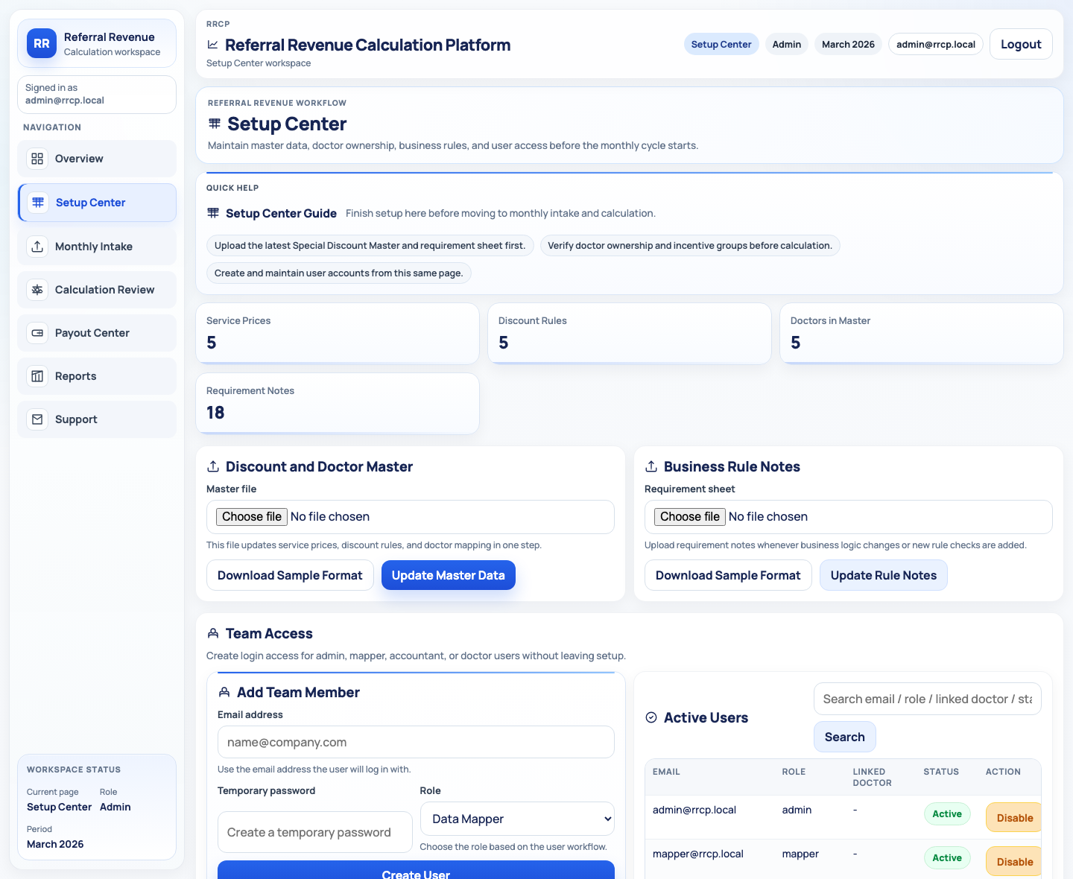
Setup Center
Master data, team access, doctor governance, and request initiation
Setup Center: where the month is prepared
This page combines user maintenance, reference uploads, doctor verification, and approval-request creation.
What happens here
Create or update users for admin, mapper, accountant, and doctor roles.
Upload Special Discount Master to refresh service_prices, discount_rules, and doctor_master.
Upload Software Requirements to refresh software_requirements.
Verify doctors and maintain fields such as incentive group, incentive cycle, reporting doctor, present PRO, and confirmation status.
Raise approval requests for PRO change, doctor-info change, and doctor addition before admin action.

Slide 5
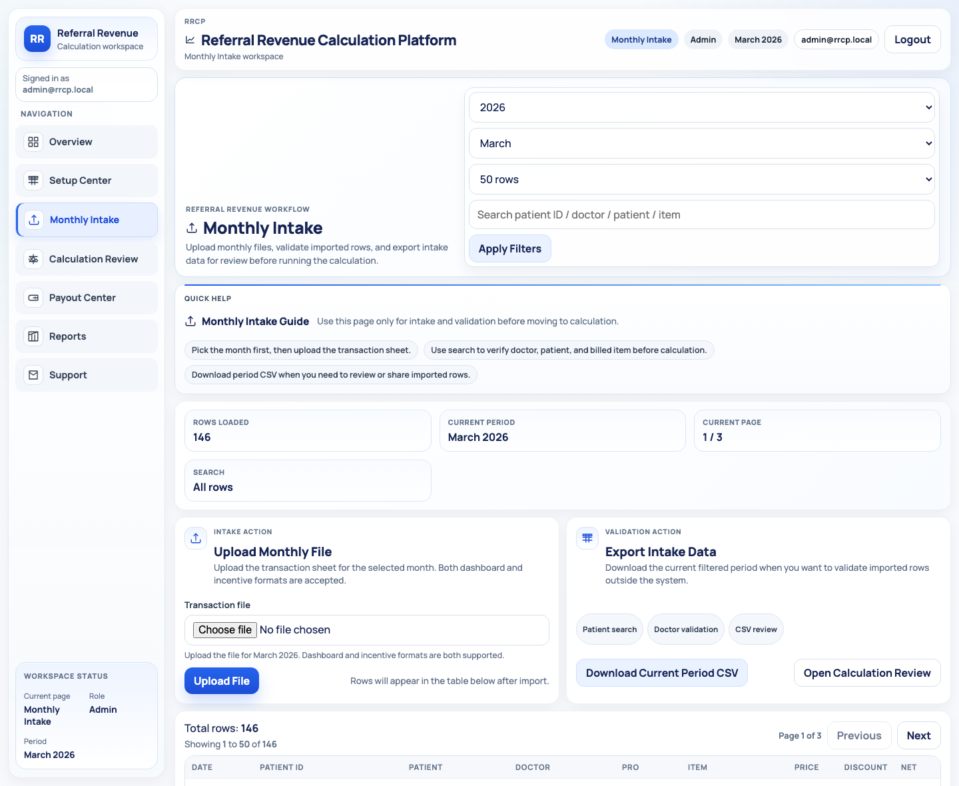
Monthly Intake
Normalization, validation, search, and export of transaction rows
Monthly Intake: where raw billing rows enter the system
Uploaded workbooks are parsed into normalized transaction records and kept searchable before the engine runs.
Data path
Input files: dashboard or incentive workbook for the selected month.
Parser maps patient ID, patient name, doctor, PRO, item, price, discount, net, total payment, payment method, and revenue booked center.
Each imported row lands in transactions with raw_json retained for audit and backfill repair.
Users can search across all visible table columns, paginate, and export a filtered CSV for offline review.

Slide 6
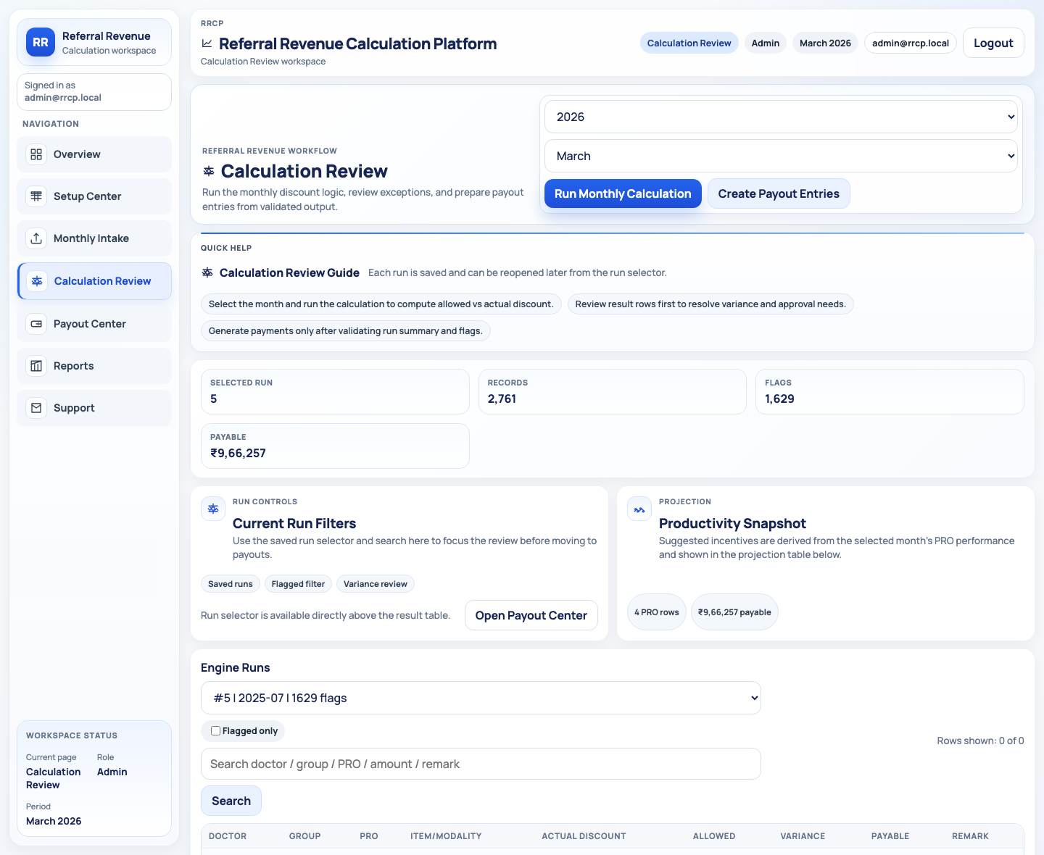
Calculation Review
RRCP engine execution, flags, variance review, and payable computation
Calculation Review: how the monthly engine works
The engine compares actual discount behavior against uploaded rules and doctor grouping to compute payable incentive.
Engine inputs and outputs
Inputs: transactions for the chosen month + doctor_master + discount_rules + service_prices.
Output header: engine_runs stores run summary, counts, and total flags.
Output rows: engine_results stores doctor, group, PRO, modality/item, allowed discount, actual discount, variance, payable amount, and remarks.
Override of incentive amount raises an approval request rather than directly mutating payout value.
Productivity projection gives a quick PRO view of cases and suggested incentive exposure.

Slide 7
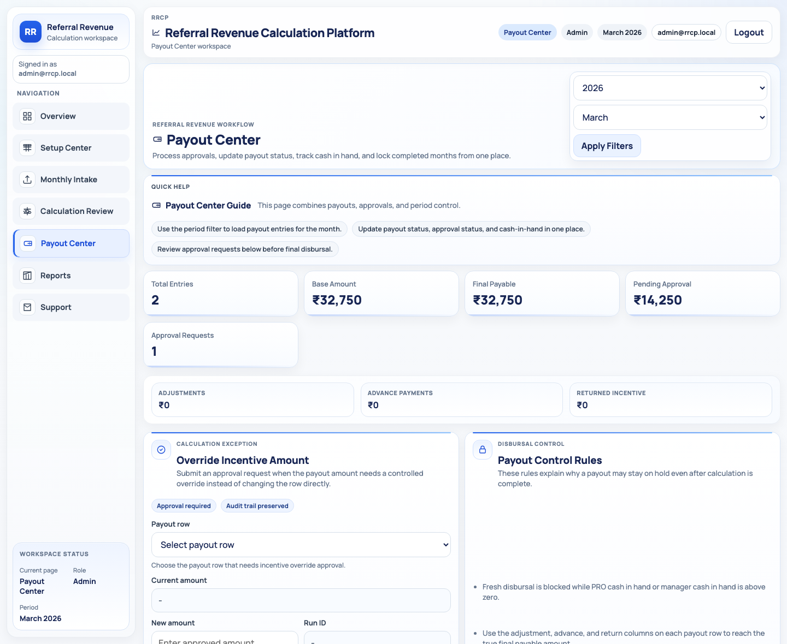
Payout Center
Payment entry creation, disbursal controls, handover tracking, and month lock
Payout Center: from engine output to controlled disbursal
Payment rows are generated from engine results, then governed through approval, cash-in-hand checks, and timestamps.
Payout controls now covered
Creates payment entries from the selected engine run into payments.
Captures adjustment amount, advance payment, return of incentive, PRO cash in hand, manager cash in hand, cashier handover time, and PRO handover time.
Fresh disbursal is blocked when PRO or manager cash in hand is not zero.
Approval of disbursal stays in approval_requests and updates payment approval_status only after admin approval.
Date lock writes into locked_periods once the month is finalized.

Slide 8
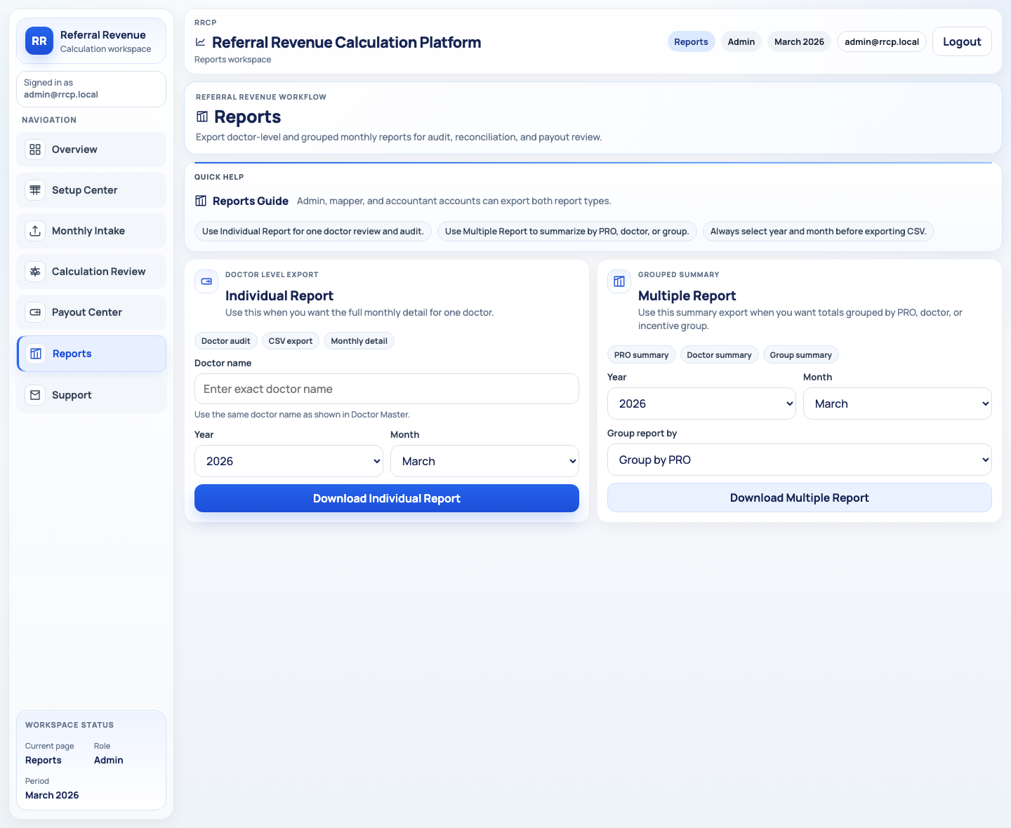
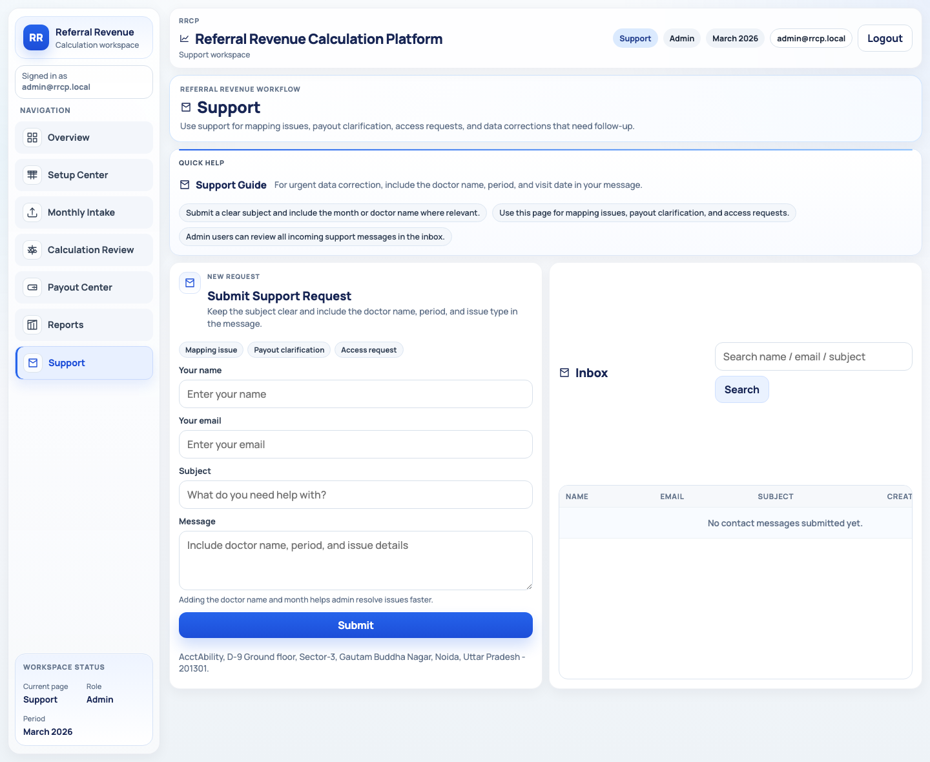
Reports And Support
Exports, audit outputs, and issue escalation
Reporting and support close the loop
After payout review, users export audit files or raise structured support requests for correction and follow-up.
What these pages do
Reports exports doctor-level or grouped CSV outputs from the latest run in the chosen period.
Doctor users are limited to their own linked individual report.
Support writes structured requests into contact_messages so admin can track mapping issues, payout clarification, and access problems.
These pages are the end-user output surface of the monthly cycle once processing is complete.

Slide 9
Approval Architecture
Requests, admin decisions, and entity updates
Approval process from request to effect
Approval requests are stored centrally so every exception stays explicit and reviewable.
Approval type
Created from
Applied to
Approval lifecycle
change_of_pro
Setup Center
doctor_master.present_pro
1. User raises request with payload_json and requester identity.
2. Request is stored in approval_requests with pending status.
3. Admin reviews readable payload details in the approval table.
4. Approve = backend mutates target entity and stamps approved_by.
5. Reject = request is kept for audit with rejected state, without applying business changes.
change_of_doctor_info
Setup Center
doctor_master profile fields
addition_of_doctor
Setup Center
new doctor_master row
override_of_incentive_amount
Calculation Review
payments.amount after approval
approval_of_disbursal
Payout Center / seeded flow
payments.approval_status + payment status

Slide 10
Data Model And Movement
Where data starts, where it lands, and what each table stores
Core tables and how data moves between them
This is the operational spine of the application. Every page writes to, reads from, or derives from these tables.
Table
Purpose
Table
Purpose
users
Login identities, role, linked doctor
engine_runs
One summary per calculation run
doctor_master
Doctor profile, PRO, group, cycle, verification
engine_results
Row-level allowed vs actual discount
service_prices
Uploaded service price list
payments
Disbursal records and finance adjustments
discount_rules
Discount ceilings per item / group
approval_requests
Exception and approval workflow queue
software_requirements
Operating requirement checklist
locked_periods
Month close control
transactions
Normalized billing intake rows with raw_json
contact_messages
Support inbox items
Transactions
Doctors
Approvals
Payments
Engine runs
2,909
5
3
2
5

Slide 11
Monthly End-To-End Flow
How the process starts and how it ends
Start-to-end monthly operating cycle
This is the practical path the team follows each month from incoming files to finalized disbursal and reporting.
1. Setup
2. Access
3. Intake
4. Validate
5. Calculate
6. Review
7. Payout
8. Approve
9. Close
10. Output
Upload master files and verify doctor ownership.
Create users and link doctor logins where needed.
Upload dashboard/incentive workbooks into transactions.
Search, paginate, and export intake rows for checking.
Run RRCP engine to produce engine_runs and engine_results.
Check flags, variance, remarks, and productivity.
Generate payments and capture finance adjustments.
Approve doctor changes, overrides, and disbursal.
Disburse, lock the month, and preserve audit state.
Export reports or raise support corrections.
Where the process starts
Where the process ends
Reference masters and transaction workbooks are the primary starting inputs.
Without updated doctor mapping and discount rules, the engine output is unreliable.
The month ends with approved payouts, locked period control, exported reports, and any unresolved issues parked in support.
Every exception remains queryable through approvals, payment notes, and preserved raw intake rows.

Slide 12
Next Improvements
What is still worth doing after this delivery
Recommended next steps
The app is operational, but a few targeted improvements would reduce future operational risk and manual cleanup.
Highest-value next work
Status after this handoff
Add duplicate-upload prevention so the same monthly workbook cannot inflate transactions twice.
Add a dedicated audit log timeline for approval decisions, payout edits, and doctor profile changes.
Add stricter upload validators with row-level error download for master files and monthly intake files.
Add richer reports in Excel/PDF format beyond CSV if stakeholders need presentation-ready output.
Add automated scheduled export or monthly deck generation once the workflow stabilizes.
Workflow pages are compacted and aligned to the monthly process.
Architecture screenshots are captured from the live local app state.
This PPT can be regenerated using the scripts in scripts/capture_architecture_screenshots.py and scripts/build_architecture_ppt.py.
Generated output path: artifacts/architecture/RRCP_Architecture_Walkthrough.pptx

