Slide 1
CSE 382/ETE 334 Internet and Web Technology
Presented By
Dr. Shazzad Hosain
Asst. Prof. EECS, NSU

Slide 2
Forms for Interface Design
Form is type of user interface where user can enter data Syntax for declaring a form is:
<Form Method=Get/Post Action=Example6.html > </Form>
Action-specifies the page that will open when submit button is pressed

Slide 3
Basic XHTML Forms
Element form
Attribute method
Specifies how the form’s data is sent to Web server
method = “post”
Appends form data to the browser request
method = “get”
Appends form data directly to the end of the URL
Attribute action
Specifies the URL of a script on the Web server
input
Specifies data to provide to the script that processes the form
http://www.cs.tut.fi/~jkorpela/forms/methods.html

Slide 4
One Line Text Box
The following tags should be placed within the form tag to place a one line text box in the form where user can enter
Syntax:
<input type=text size=20 name=user value=“John">
Size-specifies the number of character it can hold
Value-specifies the text that will initially be displayed in the textbox
single line text box with predefined value
John

Slide 5
Password type text box
To place a one line textbox in the form where user can enter password The character entered is shown like *
Syntax: <input type=password size=20 name=user >
size-specifies the number of character it can hold
*********
Password type text box

Slide 6
Check Boxes
Check Boxes are like on/off switch
The following syntax you can use to put a checkbox element in the form.
Syntax:
<input type=checkbox name=course value=CSC382 checked>
<input type=checkbox name=course value=ETE334 >
Checked-if given, the checkbox will be checked by default
√
CSC382
ETE334

Slide 7
Radio Buttons
RadioButton is like on/off switch. To put a radio button element in the form follow the syntax.
When group of radio button is given same name, only one button within the group can be "on" at a time
Syntax: <br>
<input type="radio" name="radiobutton“ value="myValue1">male<br> <input type="radio" name="radiobutton" value="myValue2" checked> female
If two or more radio buttons have the same name, the user can only select one of them at a time, This is how you make a radio button “group”

Slide 8
Text Area
To put a text area (i.e multiple line textbox) in the form where user can enter
The text within text area tags will be displayed
Syntax:
<textarea cols=30 rows=6 name=Address> Insert Address Here </textarea>
Cols-specifies the width of the textarea
Rows-specifies the number of lines
Multi-line text area

Slide 9
Drop down List
To put a drop-down list in the form
Syntax: <select name=month size=1> </select>
size-specifies the number of list items that will be displayed
The option tags should be within select tags and option tags define the fields in the list.
Syntax: <option value=1 selected>
<option value=2 >
selected-makes the item selected when form is displayed

Slide 10
Drop-down menu or list
A menu or list: <select name="select"> <option value="red">red</option> <option value="green">green</option> <option value="BLUE">blue</option> </select>
Additional arguments:
size: the number of items visible in the list (default is "1")
multiple: if set to "true", any number of items may be selected (default is "false")

Slide 11
Buttons in a Form
To put a button in the form
Syntax: <input type=button value=Go>
value-specifies the label of the button
To put a reset button in the form. By pressing this button it will clear all the things that user has entered
Syntax: <input type=reset value=Clear>
value-specifies the label of the button. It is "Reset" by default.
To put a submit button in the form. When this button is pressed, the page that is specified by action in form tag will appear.
Syntax: <input type=submit value=SubmitForm>
value-specifies the label of the button. It is "Submit" by default.

Slide 12
Hidden fields
<input type="hidden" name="hiddenField" value="nyah">
What good is this?
All input fields are sent back to the server, including hidden fields
This is a way to include information that the user doesn’t need to see (or that you don’t want her to see)
The value of a hidden field can be set programmatically (by JavaScript) before the form is submitted

Slide 13
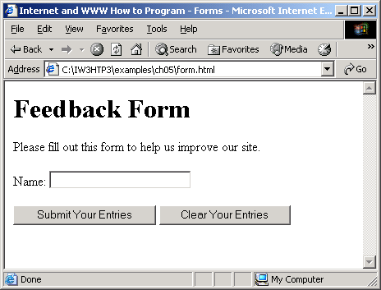
Example: form.html

Slide 14
form.html

Slide 15
form.html (2 of 3)

Slide 16
More Complex XHTML Forms
Element textarea
Inserts a multiline text box (text area)
Attribute rows
Specifies the number of rows
Attribute cols
Specifies the number columns
Input “password”
Inserts a password box with the specified size
Element checkbox
Enable users to select from a set of options
Element select
Provides a drop-down list of items
Element option
Adds items to the drop-down list
Attribute selected
Specifies which item initially is displayed as the selected item

Slide 17
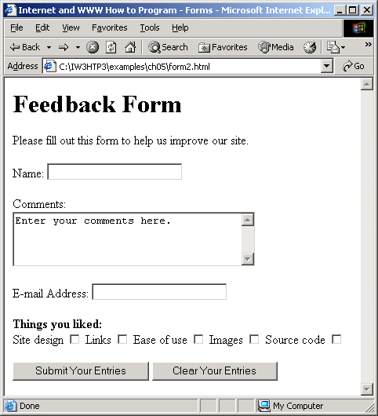
Feedback form Interface

Slide 18
Example: form2.html

Slide 19
form2.html

Slide 21
form2.html

Slide 22
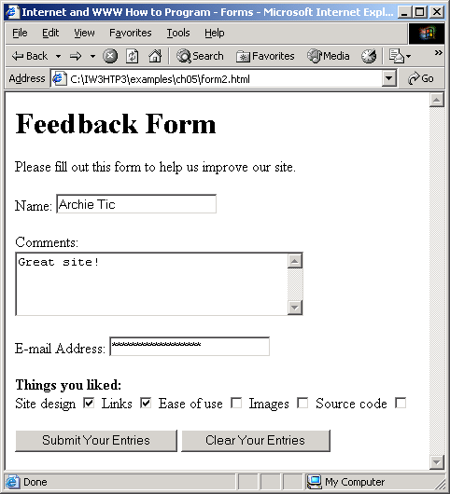
Feedback form Interface

Slide 23
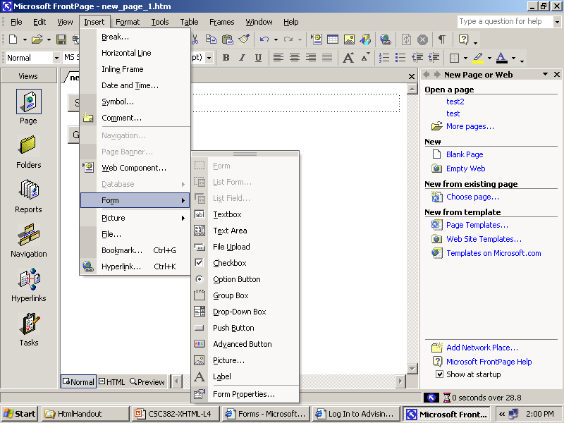
All available support

Slide 24
Special Characters and More Line Breaks
Character entity references (in the form &code;)
Numeric character references (e.g. &#38;)
del
Strike-out text
sup
Superscript text
sub
Subscript text
<hr />
Horizontal rule (horizontal line)

Slide 25
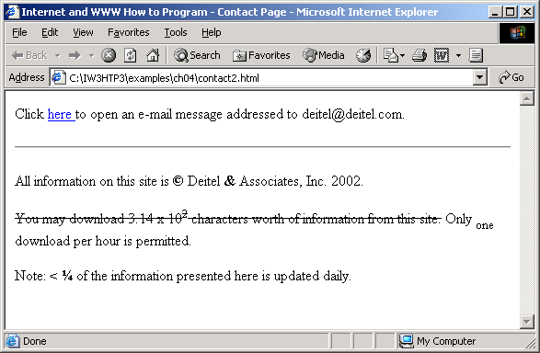
Example: contact2.html

Slide 26
Example: contact2.html
26

Slide 27
Example: contact2.html

Slide 28
Summary: Tips for Good XHTML Code
Use line breaks and indented text to make your HTML file easier to read.
Insert comments into your HTML file to document your work.
Enter all tag and attribute names in lowercase.
Place all attribute values in quotes.
Close all two-sided tags.
28
Notes:
28

Slide 29
Summary: Tips for Good XHTML Code
Make sure that nested elements do not cross.
Use styles in place of presentational elements whenever possible.
Know your market and the types of browsers that your audience will use to view your Web page.
Test your Web page on all relevant browsers.
29
Notes:
29

Slide 30
Web Resources
www.w3.org/TR/xhtml11
www.xhtml.org
www.w3schools.com/xhtml/default.asp
validator.w3.org
hotwired.lycos.com/webmonkey/00/50/index2a.html
wdvl.com/Authoring/Languages/XML/XHTML
www.w3.org/TR/2001/REC-xhtml11-20010531

Slide 31


