Slide 1
CSE 382/ETE 334 Internet and Web Technology
Presented By
Dr. Shazzad Hosain
Asst. Prof. EECS, NSU

Slide 2
Web Programming Elements Client-Side Programming
HTML: Provides formatting of text and graphics, as well as links between documents.
CSS: Cascading Style Sheets. Provide more powerful and detailed control of style and formatting.
JavaScript
a scripting language for Web pages, developed by Netscape in 1995
uses a C++/Java-like syntax, so familiar to programmers, but simpler
good for adding dynamic features to Web page, controlling forms and GUI
requires users to have this technology enabled on their browsers
Java applets
can define small, special-purpose programs in Java called applets
provides full expressive power of Java (but more overhead)
good for more complex tasks or data heavy tasks, such as graphics
Java:
a more powerful programming language for web applications on the client that can also run independently of the browser.

Slide 3
Web Programming Elements Server-Side Programming
Server-side scripting and programming permits access to databases and other information located on the server.
Common Gateway Interface (CGI) programming
programs can be written to conform to the CGI
when a Web page submits, data from the page is sent as input to the CGI program
CGI program executes on server, sends its results back to browser as a Web page
good if computation is large/complex or requires access to private data
Active Server Pages (ASP), Java Servlet, PHP, Server Side Includes, Ajax:
some of these are vendor-specific alternatives to CGI
provide many of the same capabilities but using HTML-like tags
some of these technologies might require functionality to be enabled in the client’s browser (e.g. Ajax generally requires the use of Javascript)

Slide 4
Server Software
Just connecting a computer to the Internet and giving it an IP address does not make it a web server. Server computers have to run special web server software to open TCP connections and respond to HTTP requests.
The two most common web server applications are:
Apache (UNIX-based, open source) 50%*
IIS - Internet Information Services (Microsoft) 36%*
* Percent of all websites served on the Internet: Sept, 2007

Slide 5
Home Page Naming
For…
http://www.cityu.edu.hk
…there must be a default HTML page that is displaying as the home page. In the case of CityU, it is…
http://www.cityu.edu.hk/index.html
…meaning index.html is the default HTML page in the root directory of the server.

Slide 6
Home Page Naming
Web servers will automatically serve up pages file-named
index.html index.htm default.htm default.html
…as long as ONE page by those filenames resides in the root directory of your site.
If you want to use a page by another name as the home page of the site, you will have to configure the server software to point to that page.

Slide 7
Web Page Naming (HTML naming Conventions)
All lower-case, no spaces, no special characters [other than dash ( - ) or underscore ( _ ) ].
products.html Products.html
products_sept07.html products sept/07.html
The same applies to the name of folders and sub-folders within your site.
 recommended
 ok, but not recommended (esp. in XHTML)
 recommended
 not recommended

Slide 8
Compatibility
Unfortunately, competition between software companies has often resulted in the introduction of incompatible features so that web pages that work on one browser do not look right on a different one.
The World-Wide Web Consortium (www.w3c.org) exists to develop and define standards for HTML, CSS, etc.
However, compliance with these standards is only partial at best.
Stick to features known to be compatible
Test your web pages on as many different browsers and platforms as possible.

Slide 9
HTML: The Language of the Web
A Web page is a text file written in a language called Hypertext Markup Language.
HTML (Hypertext Markup Language) is the language used to create web documents.
It defines the syntax and placement of special instructions called tags which are not displayed but tell the browser how to display the document's contents.
HTML is not a programming language or a formatting language.

Slide 10
The History of HTML
A group of Web developers, programmers, and authors called the World Wide Web Consortium, or the W3C, created a set of standards or specifications that all browser manufacturers were to follow.
The W3C has no enforcement power.
The recommendations of the W3C are usually followed since a uniform approach to Web page creation is beneficial to everyone.

Slide 11
The History of HTML
Older features of HTML are often deprecated, or phased out, by the W3C. That does not mean you can’t continue to use those—you may need to use those if you are supporting older browsers.
Future Web development is focusing increasingly on two other languages: XML and XHTML.
XML (Extensible Markup Language) is a metalanguage.

Slide 12
The History of HTML
XHTML (Extensible Hypertext Markup Language) is a strict version of HTML and is designed to confront some of the problems associated with the different and competing versions of HTML.
XHTML is also designed to better integrate HTML with XML.
SVG : Scalable Vector Graphics
MathML: Math Markup Language
HTML will not become obsolete anytime soon.

Slide 13
Tools for Creating HTML Documents
HTML/XHTML Editor – helps you create an HTML file by inserting HTML codes for you as you work.
They can save you a lot of time and help you work more efficiently.
Advantages and limitations similar to those of HTML converters.
Allow you to set up a Web page quickly.
Will usually still have to work with HTML code to create a finished document.
Basic text editor like Notepad or Frontpage or Dream Waver. Use .html or .htm file-name extension.

Slide 14
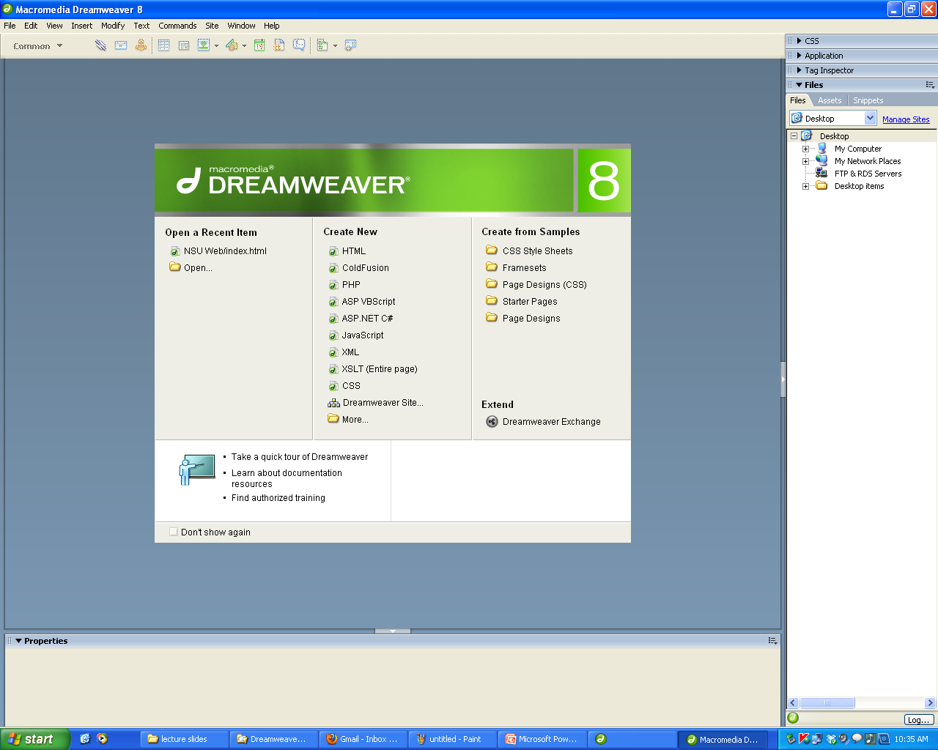

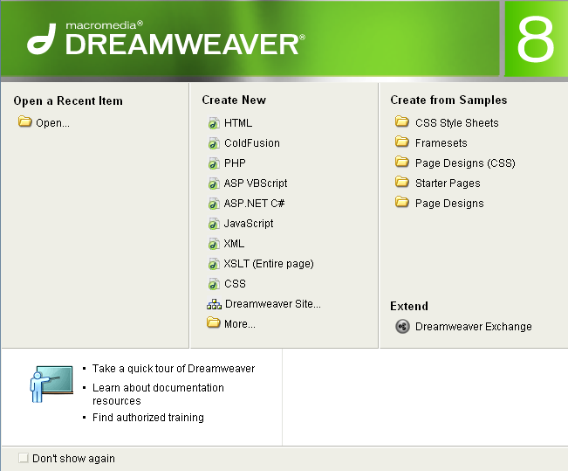

Slide 15
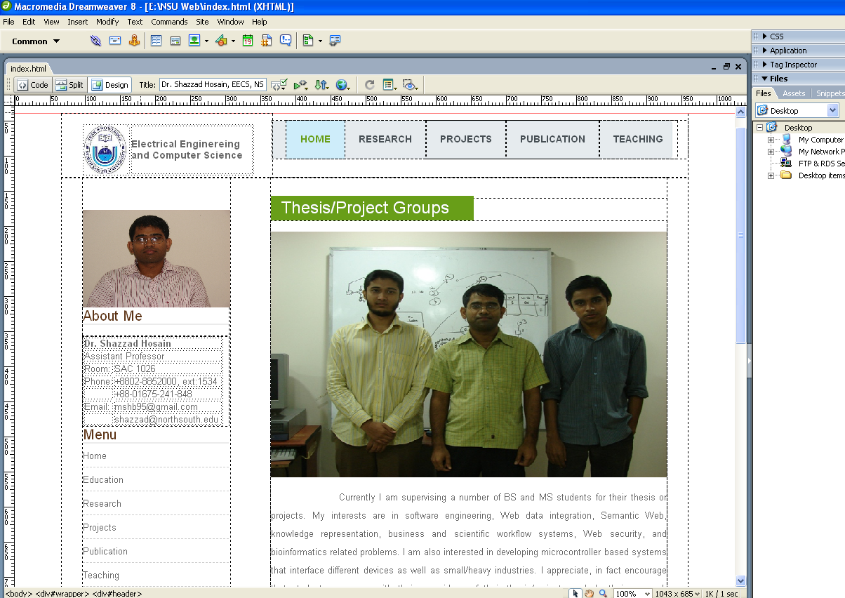

Slide 16
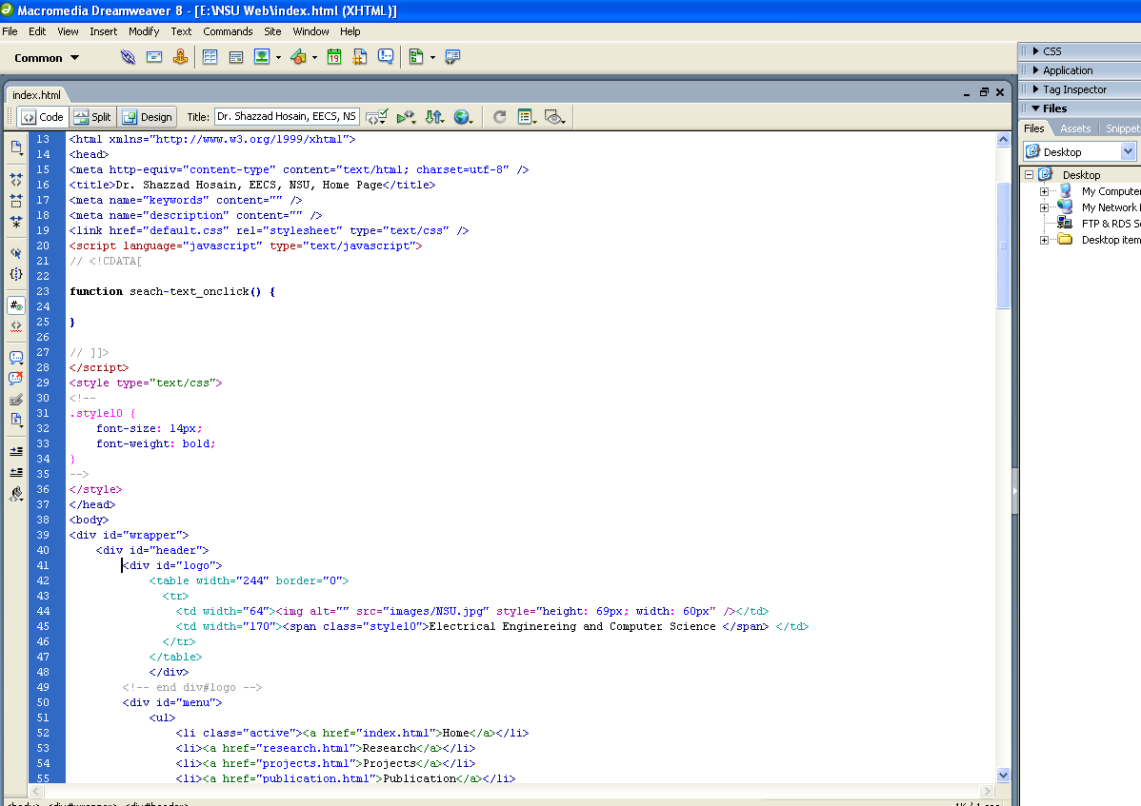

Slide 17
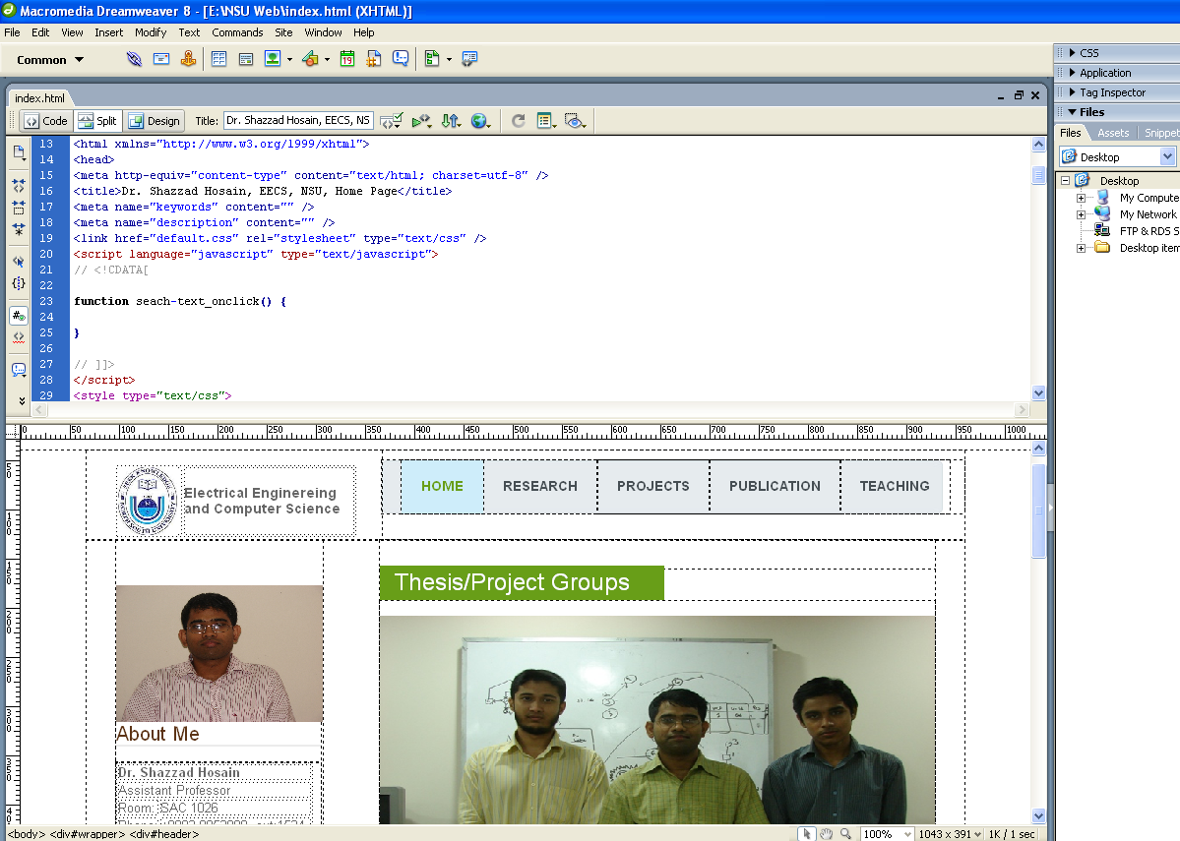

Slide 18
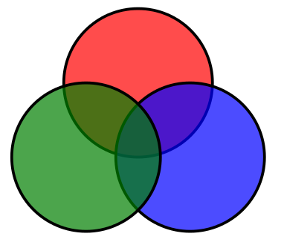
SVG
most browsers now have built-in support for some subset of SVG
Firefox, Opera, Safari, Chrome, ...
IE9; IE8 and earlier versions needed a (free) Adobe plug-in
also included in HTML5
allows drawing of various 2D shapes (and animation)
example of 3 circles: svg-example.xml
<svg>
<g style="fill-opacity:0.7; stroke:black; stroke-width:0.1cm;">
<circle cx="6cm" cy="2cm" r="100" style="fill:red;"
transform="translate(0,50)" />
<circle cx="6cm" cy="2cm" r="100" style="fill:blue;"
transform="translate(70,150)" />
<circle cx="6cm" cy="2cm" r="100" style="fill:green;"
transform="translate(-70,150)"/>
</g>
</svg>
R
G
B

Slide 19

MathML
some browsers have built-in support
Firefox, Opera, Safari
supported in IE8 using (commercial) plug-in; not supported in IE9
also included in HTML5
in MathML, the cube root of (1 minus (x over 2)) can be written as
and looks like when viewed with a MathML-capable browser
<math>
<mroot>
<mrow>
<mn>1</mn>
<mo>-</mo>
<mfrac>
<mi>x</mi>
<mn>2</mn>
</mfrac>
</mrow>
<mn>3</mn>
</mroot>
</math>

Slide 20
The First XHTML

Slide 21
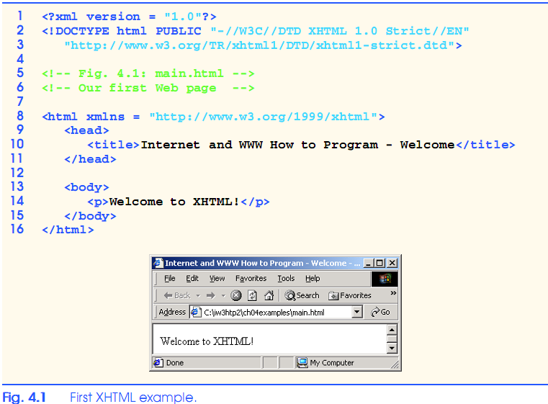
XHTML - Extensible Hypertext Markup Language

Slide 22
W3C XHTML Validation Service
22
Validation service ( validator.w3.org )
Checking a document’s syntax
URL that specifies the location of the file
Uploading a file to the site validator.w3.org/file-upload.html

Slide 23
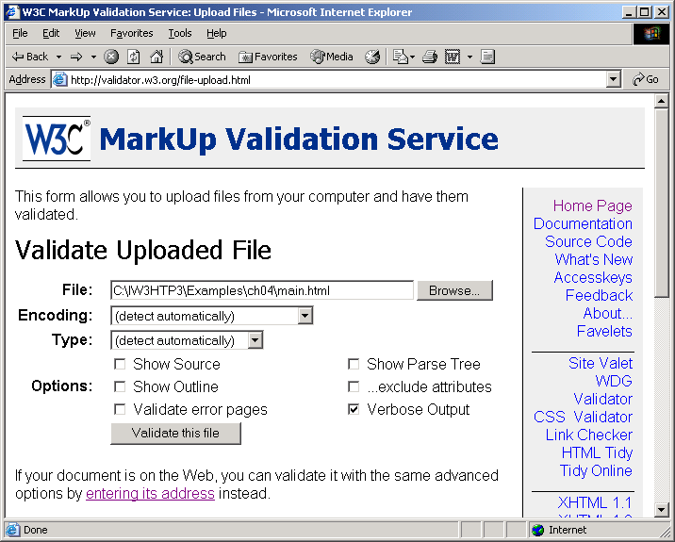
W3C XHTML Validation Service
23

Slide 24
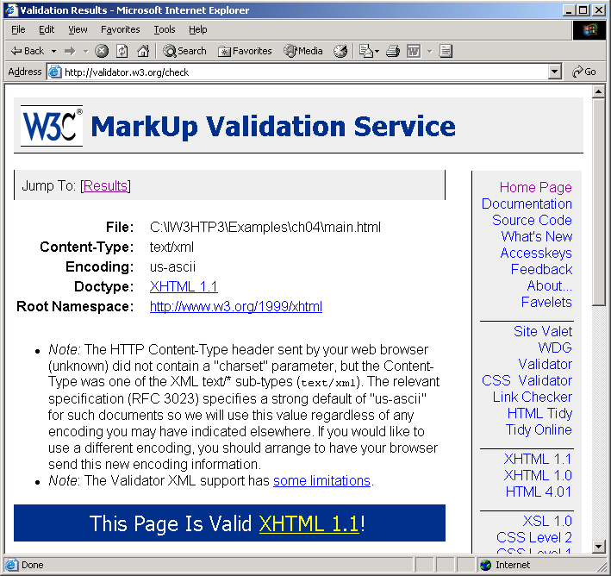
W3C XHTML Validation Service
24

Slide 25
Element Attributes
Many tags contain attributes that control the behavior, and in some cases the appearance, of elements in the page. These are known as containers
Attributes are inserted within the tag brackets.
Example: For one-side tags
<element attribute1=“value1” attribute2=“value2” …/>
For two sided tags
<element attribute1=“value1” attribute2=“value2” …> content </element>

Slide 26
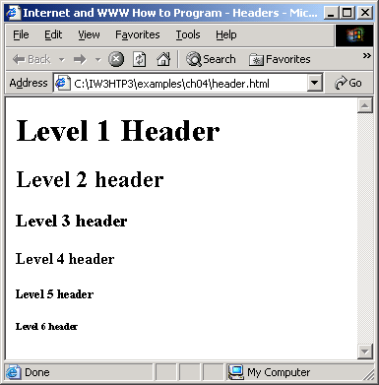
Headers
Six headers ( header elements)
h1 through h6
26

Slide 27
Linking
Hyperlink
References other sources such as XHTML documents and images
Both text and images can act as hyperlinks
Created using the a (anchor) element
Attribute href
Specifies the location of a linked resource
Link to e-mail addresses using mailto: URL
<strong> tag
Bold

Slide 28
Example: links.html

Slide 29
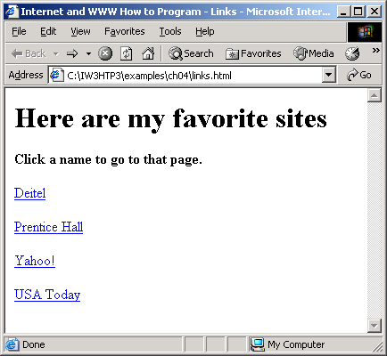
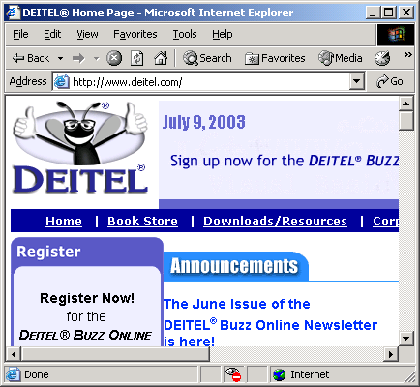
Example: links.html

Slide 30
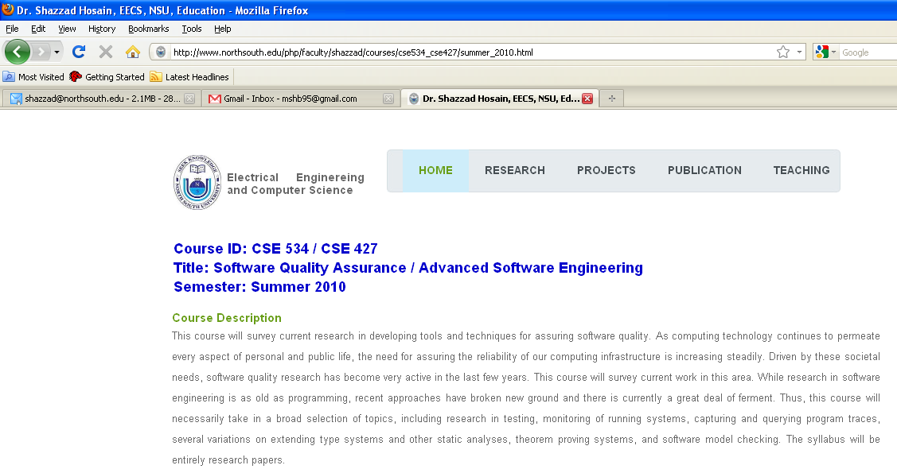
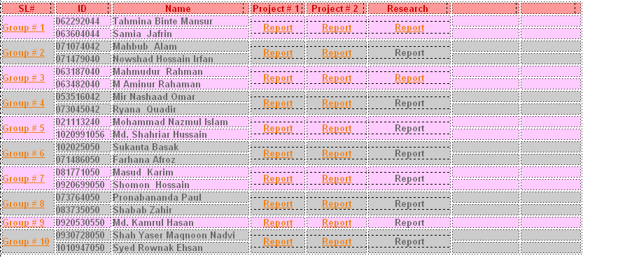
Internal Reference Links

Slide 31
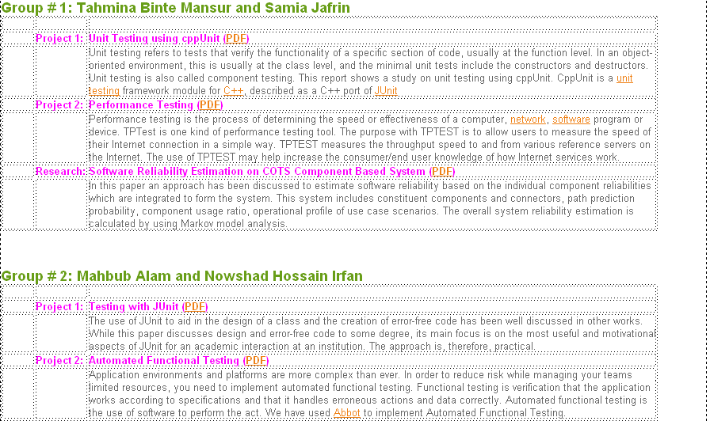

Slide 32
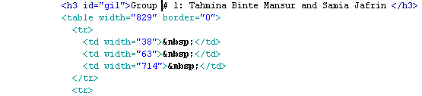
Internal Reference Link
The <A NAME="label"></A> labels a particular place in a HTML file.
You may jump to that label in current page using:
<A HREF="#label">Some Text or Graphic</A>.

Slide 33
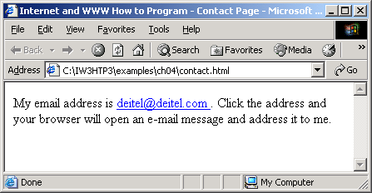
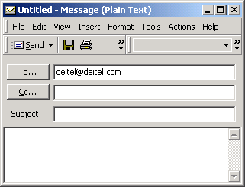
Adding Email Hyperlinks

Slide 34
Email Hyperlink Example (contact.htm)

Slide 35
Images: adding picture with XHTML
Three most popular formats
Graphics Interchange Format (GIF)
Joint Photographic Experts Group (JPEG)
Portable Network Graphics (PNG)
img element
src attribute: Specifies the location of the image file
width and height
Pixels (“picture elements”)
Empty elements: Terminated by character / inside the closing right angle bracket (>), or by explicitly including the end tag
br element : Line break

Slide 36
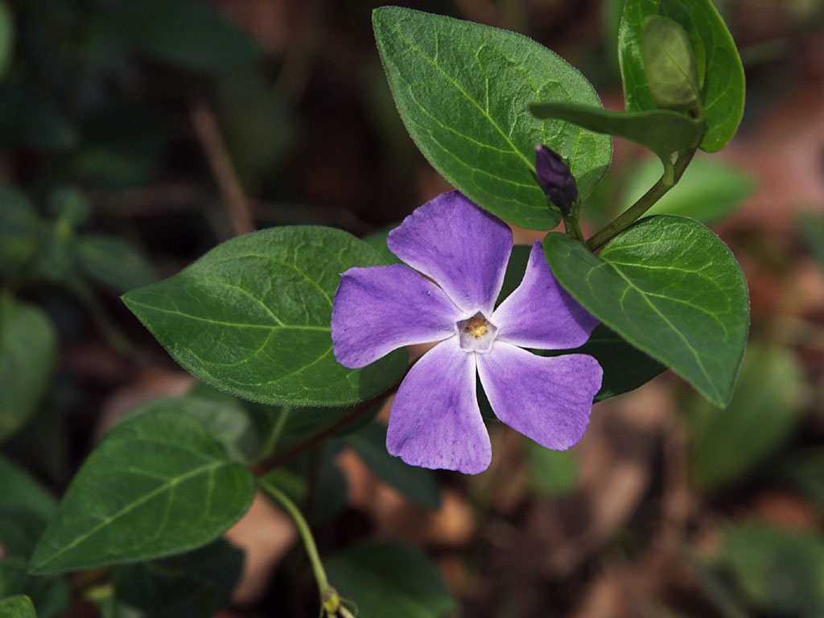
Image Tag
This is used to put a picture on the page It has the following attributes:
src: Indicates the name of image file together it's path
width: Indicates the width of the image
height: Indicates the height of the image
Syntax: <img src=“flower.jpg" width=96 height=96 >
36

Slide 37
Example: picture.html

Slide 38
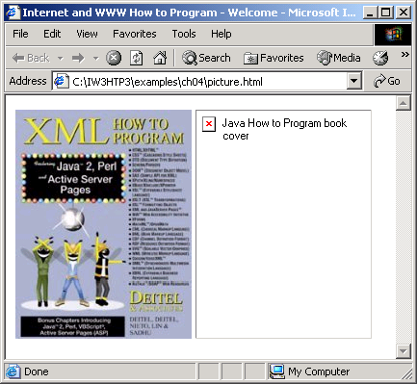
Images: adding picture with XHTML

Slide 39

Hyperlinked Image
<A HREF="index.html"> <img src=“flower.jpg" width=96 height=96 > </A>
By clicking on the image below, we can go to the index page.
39

Slide 40
Using Images as Link Anchors (nav.html)

Slide 41
Using Images as Link Anchors (con’d)

Slide 42
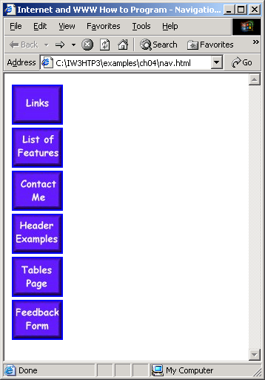
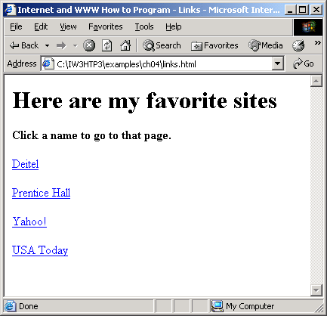
Using Images as Link Anchors (con’d)

Slide 43
Absolute and Relative Paths
An absolute path is a path that points to the same location on one file system. It is usually written in reference to a root directory.
The root directory is the first or topmost directory in a hierarchy, indicated with a single slash / or backslash \ .
Example:
C:\Documents and Settings\mnfoxall\My Documents\My Files

Slide 44
Absolute and Relative Paths
A relative path is a path relative to the current working directory, so the full absolute path may not need to be shown or referred to.
This works for creating websites, because it allows hypertext links to be made between files relative to a pre-defined working directory.
That is, they do not have to always reference the root directory or topmost directory on a server (or computer).

Slide 45
Absolute Paths
C
Example: to hyperlink from index.htm to products.htm
If an absolute pathname:
<a href=“C:\\Users\My%20Documents\Websites\Company\products.htm”>

Slide 46
Relative Paths
C
Example: to hyperlink from index.htm to products.htm
If a relative pathname, with /Company defined as the working or site root directory
root
<a href=“products.htm”>

Slide 47
Relative Paths
To hyperlink from index.htm to logo.jpg
root
<a href=“images/logo.jpg”>

Slide 48
Relative Paths
root
To hyperlink from shoes.htm to index.htm (i.e. back up one level in the directory hierarchy)
2 dots and a slash
<a href=“../index.htm”>

Slide 49
Relative Paths for Websites
In website development, it’s much easier to use relative paths.
A site developed locally on one computer (under an assigned site root directory or folder), is much easier to transfer and manage on the final web server using relative paths.
In Dreamweaver, the first thing to do is set up a new site using the ‘Site Definition’ interface. This way, a local ‘site root’ folder can be created to gather and manage all files related to the site.

Slide 50
Special Characters
Like to show the following text
‘<‘ reserved for start tags and end tags such as <p> and </p>
Special chars are written in the form of &code, such as

Slide 51
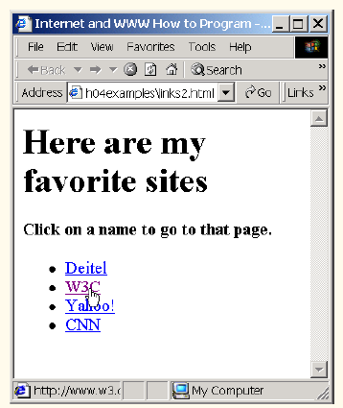
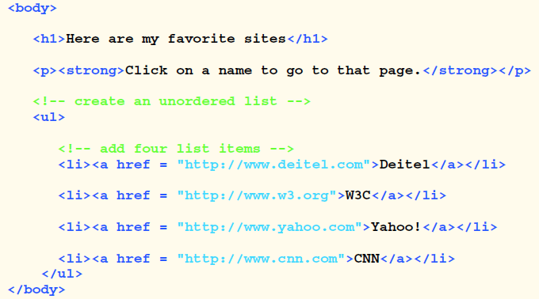
Unordered List

Slide 52
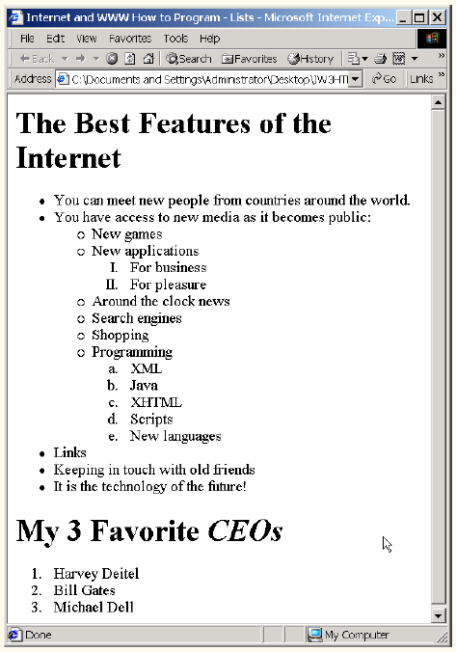
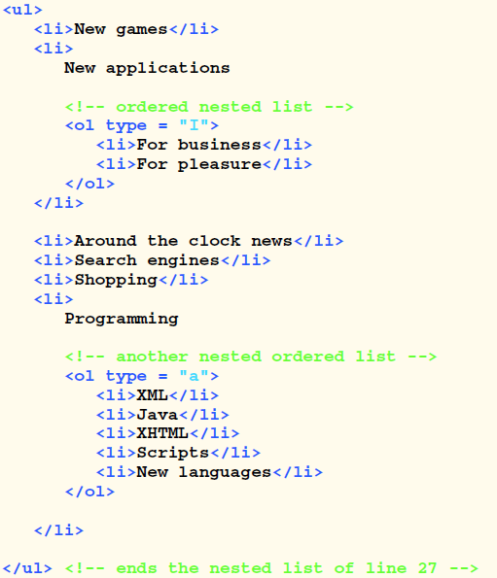
Nested and Ordered List

Slide 53
Introduction to XHTML-2
Developing a Basic Web Page
Lecture Content
More about XHTML special Tags
XHTML Table
Alignment, Height, Width, Header, Footer
Rules between cells
XHTML Frames
Frameset Page
Web page with multiple Frames
Problem with Frames
Create ordered and unordered and nested lists
More about Meta Tag

Slide 54
Some Important tags
<div>: It is a container tag. This tag is used to denote the beginning and end of a division of the page.
<big>: It is a container tag. It sets the type one font size larger than the surrounding text. It is equivalent to <font size="+1">.
<blink>: It is a container tag. It causes the contained text to flash on and off.
<cite>: It is a container tag. It is used to represent a citation.
<del>: It is a container tag. It indicates deleted text.
<u>: It is a container tag. It is used to underline a text.
<nobr>: It won't break the line. So, using this tag you can get a horizontal scrollbar

Slide 55
Tables in XHTML
<table> is a block element used to:
present tabular data
layout Web pages by aligning content & graphics in horizontal & vertical grids
organize entries in fill-out forms for user input
Tables have rows (<tr>), columns, & data (<td>)
Use <th> for a cell that contains a header for a column or row
<td> & <th> may contain any inline and block elements, including another table (table inside a table)
Table caption is optional

Slide 56
Table Example
<table border="1">
<caption>A.L. East</caption>
<tr>
<th>Team</th>
<th>Wins</th>
<th>Losses</th>
</tr>
<tr>
<td>Yankees</td>
<td>97</td>
<td>59</td>
</tr>
<tr>
<td>Red Sox</td>
<td>93</td>
<td>62</td>
</tr>
</table>
A.L. East
Team | Wins | Losses
Yankees | 97 | 59
Red Sox | 93 | 62

Slide 57
Table Attributes
border="0" would result in no border
increase number of pixels to increase border thickness
border outlines table
border also implies table rules
cellspacing="10" increases spacing between table cells
cellpadding="10" increases spacing inside cells between cell walls and contents
Change the border, cellspacing, & cellpadding in your table

Slide 58
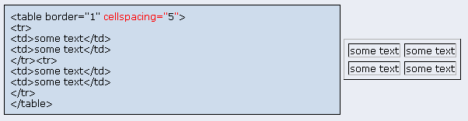
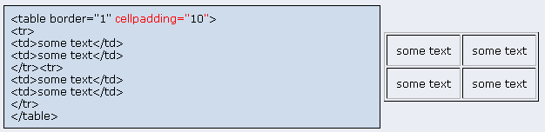
Cell Spacing vs. Cell Padding

Slide 59
Cell Content Alignment
By default, content in a cell is left aligned horizontally & middle aligned vertically inside the space for the cell
align="…" attribute of <tr> specifies horizontal alignment for all cells in a row
possible values: left, right, center, justify, & char
valign="…" attribute of <tr> specifies vertical alignment for all cells in a row
possible values: top, middle, bottom, & baseline
To control the alignment of a single cell (separate from the row), put align or valign inside <td> or <th>

Slide 60
Table Header & Body
It’s good practice to separate the table header from the table body
use <thead> and <tbody> to do so
<tfoot> may also be used for a footer
Allows you to control them separately
Improves XHTML clarity

Slide 61
Example
<table border="1" cellspacing="1" cellpadding="1">
<thead>
<tr align="center" style="background-color:#fc0">
<th>Team</th>
<th>Championships</th>
</tr>
</thead>
<tbody align="center">
<tr>
<td>Yankees</td>
<td>26</td>
</tr>
<tr>
<td>Mets</td>
<td>2</td>
</tr>
</tbody> </table>
Team | Championships
Yankees | 26
Mets | 2

Slide 62
Table Width & Height
Table width & height are automatically computed to accommodate the contents of the cells
You may also explicitly suggest table width:
<table width="..."> attribute
You may specify a width in pixels, or as a percentage of page
By default, the width of a column and height of a row are equal. They all have the width of the widest cell and height of the tallest cell
You may also suggest cell width & height using:
<td width="..." height="...">
will affect all other related rows & columns

Slide 63
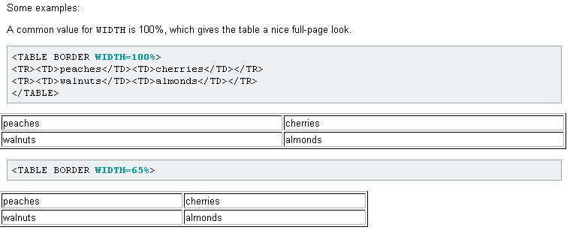
Example of Table WIdth

Slide 64
Practice the following attributes
<table border="1" width="60%" align="center">
<tbody align="right">
<tr>
<td style="width:10%">10%</td>
<td style="width:30%">30%</td>
<td style="width:60%">60%</td>
</tr>
</tbody>
</table>
10% | 30% | 60%

Slide 65
Rules between Cells
You may further specify the rules between cells
Use style= with border-bottom, top, left, & right
Specify thick or thin, color, & dashed, dotted, or solid line
Change A cell in your table to the following:
<td colspan="2" style="background-color:red;
border-bottom:thick #000 dashed;
border-top:thin #000 dashed;
border-left:thick #e34 dotted;
border-right:thin #000 solid">A</td>

Slide 66
Practice the Code
A |  | B
C | D
 | E
<table width="120">
<tr align="center">
<td colspan="2" style="background-color:red">A</td>
<td rowspan="2" style="background-color:cyan">B</td>
</tr>
<tr align="center">
<td rowspan="2" style="background-color:yellow">C</td>
<td style="background-color:green; color:white">D</td>
</tr>
<tr align="center">
<td colspan="2" style="background-color:blue;color: white"> E</td>
</tr> </table>

Slide 67
About Meta Tag
Provides additional information about the document
Should be placed in the <head> tags at the beginning of the document
Commonly used for making documents searchable (by adding keywords) and may be used for client-pull functions.
There are two types of <meta> tags, using either the name or http-equiv attribute.
Syntax:
<META HTTP-EQUIV="name" CONTENT="content">
<META NAME="name" CONTENT="content">

Slide 68
More about Meta Tag HTTP-EQUIV attribute
<Meta HTTP-EQUIV ="refresh" CONTENT="x">:
This instructs the browser to reload the page after x seconds.
<Meta HTTP-EQUIV ="refresh" CONTENT="x; URL=http://nextdoc.html">:
This instructs the browser to reload a different file after x seconds
<Meta HTTP-EQUIV ="expire" CONTENT=“February 21, 2008 06:15:00GMT">:
This indicates the date and time after which the document should be considered expired.
Web robots may use this information to delete expired documents from a search engine index.

Slide 69
More about Meta Tag Name attribute
Keywords: A list of keywords, separated by commas, are used that would be useful in indexing the document.
Example: <META name="keywords" content="html, web design, training">
Author: It identifies the author of the web page.
Example: <META NAME= "author" CONTENT=“Shazzad Hosain">
Copyright: Identifies copyright information for the document.
Example: <META NAME="copyright" CONTENT=“2008, O'Reilly & Associates">
Robots: This text was created as an alternative to the robots.txt file and is mainly used as a way to prevent the page from being indexed by search engine "spiders" .
Example: <META NAME="robots" CONTENT="noindex, nofollow">

Slide 70
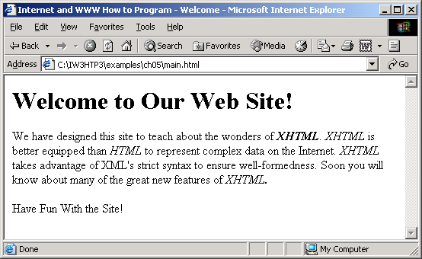
Example: Meta Element

Slide 71
main.html

Slide 72
main.html

Slide 73
Frames !!!!
Normally, a browser window displays one Web page
The frameset element, used instead of body, allows you to divide a window into rectangular regions, called frames
then display different pages in each frame
attributes control id, size, & scroll ability of each frame
typically links in one frame load content in another
Example sites with frames:
http://java.sun.com/j2se/1.4.2/docs/api/index.html
http://www.i-love-videogames.com/
Commonly misused
most Web style experts advise against using frames
when used properly, can be effective in organizing info

Slide 74
A Frameset Page
Should include the following declaration:
<!DOCTYPE html PUBLIC "-//W3C//DTD XHTML 1.0 Frameset//EN"
"http://www.w3.org/TR/xhtml1/DTD/xhtml1-frameset.dtd">

Slide 75
Rows & Columns
Use the rows & cols attributes of <frameset> to subdivide the browser window into frames, ex:
<frameset cols="25% , 75%">
<frameset rows="100,* ">
Code above means 2 columns & 2 rows:
First column with 25 percent, second column 75%
First row height 100 pixels, second row the rest
You may also specify cols or rows in relative terms, ex:
<frameset cols="*, 3*, 200" >
Code above means 3 columns:
Third column is 200 pixels wide
Second column is ¾ of whatever is left
First column is ¼ of whatever is left

Slide 76
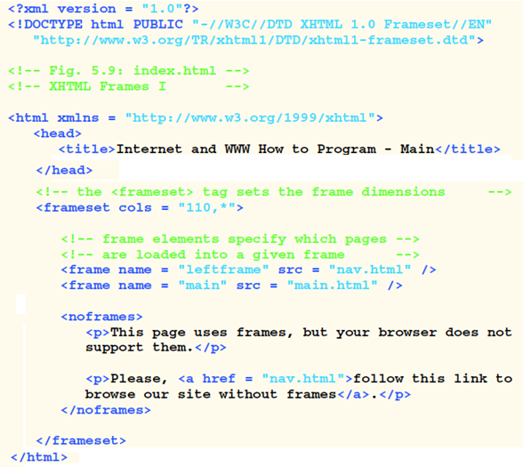
Frameset Example

Slide 77
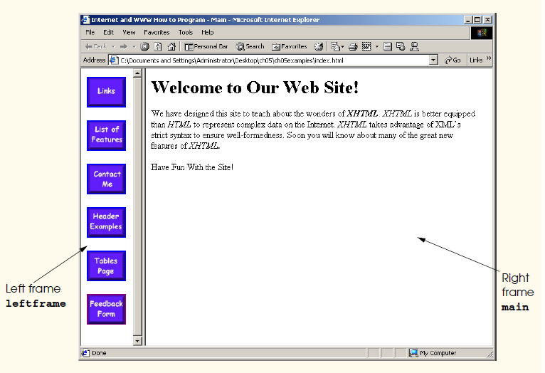

Slide 78
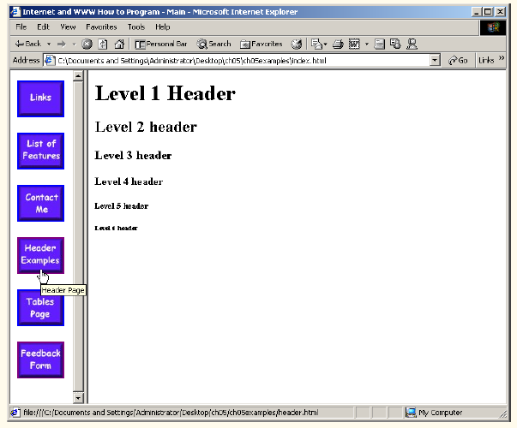

Slide 79
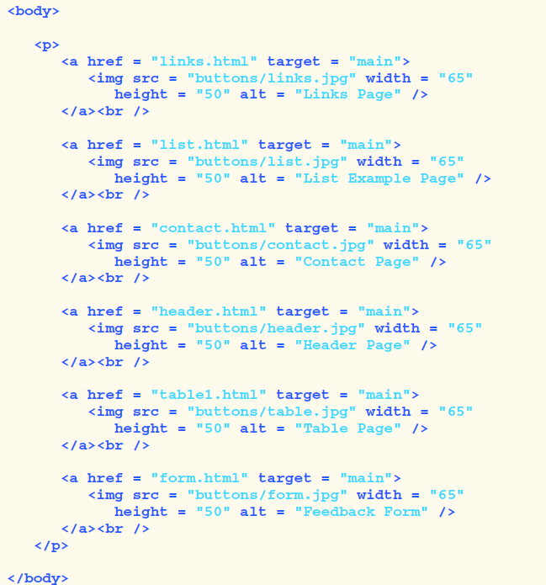
nav.html

Slide 80
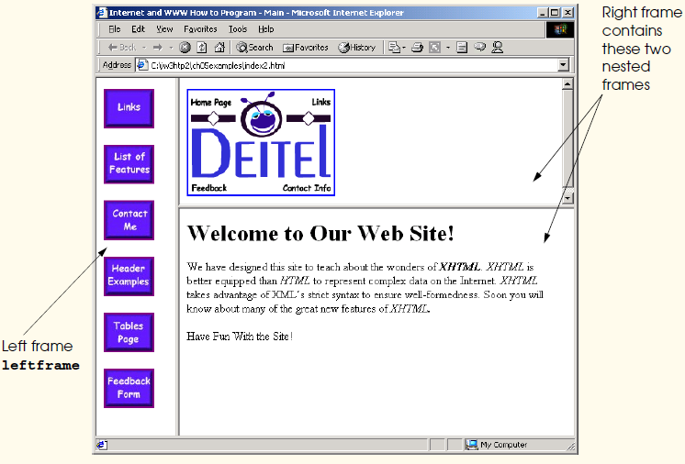
Nested Frameset

Slide 81
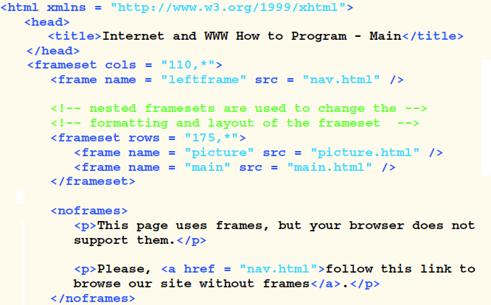

Nested Frameset

Slide 82
Problems with using frames
Some browsers do not support them
Can be confusing to surfers
Saving Web pages with frames is complicated
Bookmarking frame pages is complicated
Links out of a frame page requires a new window
Search engines have trouble with frame pages
Printing is made more difficult
Location bar is vague with frames
Plug-ins may not work

Slide 83


