Slide 1
CSE 382/ETE 334 Internet and Web Technology
Presented By
Dr. Shazzad Hosain
Asst. Prof. EECS, NSU

Slide 2
Introducing the World Wide Web
Today the Internet has grown to include hundreds of millions of interconnected computers, cell phones, PDAs, televisions, and networks.
The physical structure of the Internet uses fiber-optic cables, satellites, phone lines, and other telecommunications media.
Structure of Internet

Slide 3
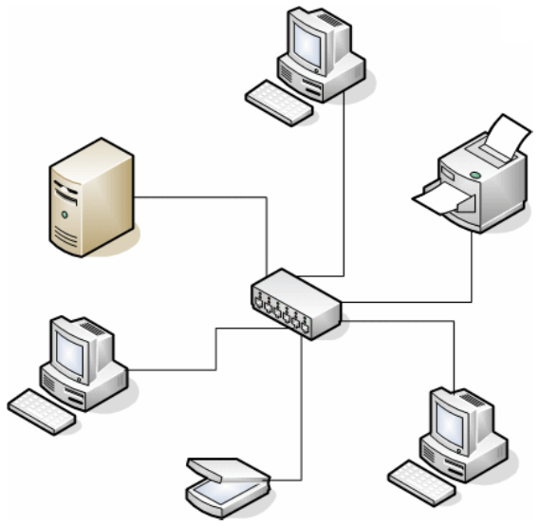
Introducing the World Wide Web
Network
Node
Host Node
client
Host Node
server
Node
Node
Client Serve Model

Slide 4
Types of servers
Web servers
Special type of file servers
Mail servers
Receive, store, and send email.
Do not require a massive amount of processing power
File servers
E.g. database of scientific data
Dispensing files when client asks
Database servers
Store large collections of structured data
Support queries made upon the database by clients

Slide 5
Types of servers
Groupware servers
Groupware is software which organises the work of a number of staff in an enterprise
Manages the time of individuals and teams
Provide reports for billing of the time spent on particular tasks
E-mail list management
Print servers
Domain Name System (DNS) Servers
DNS Server
130.182.125.66
www.refer.com

Slide 6
DNS and IP Addresses
Every computer connected to the Internet must have a unique IP address, no matter whether it’s a client or a server (or both)
An IP address is just a number that identifies a host on the Internet. Example:
212.171.218.34 or 144.214.5.218
The Domain Name System (DNS) is a database that matches unique IP addresses to host names
Domain names are organized in a hierarchical structure….

Slide 7
Top Level Domains
www.cityu.edu.hk
www.cityu.hk
www.apple.com
Top Level Domain (TLD)
Mostly country domains: .uk, .au, .hk, etc.
Generic Top Level Domain (gTLD)
.com .org .net .biz .info .name .ws .tv
(.edu, .gov, .mil restricted to US only)

Slide 8
Second Level Domains
www.cityu.edu.hk
www.cityu.hk
www.apple.com
The actual name of the organisation or service.
Can contain letters (a to z), numbers (0 to 9), dashes ( - )

Slide 9
Third Level, or Sub Domains
www.cityu.edu.hk
sweb.cityu.edu.hk
www.apple.com
store.apple.com
seminars.apple.com
Strings of characters that designate different services, or hosts within the second level domain.
E.G. “www” for the core or main website, “sweb” for SCM’s sub-network within CityU.

Slide 10
Registering Domain Names
Registered with the HKDNR in Hong Kong
www.hkdnr.hk
www.cityu.edu.hk
www.cityu.hk
www.apple.com
Registered with any global registration service
networksolutions.com register.com directNIC.com
etc.
Chinese character domain names now also available

Slide 11
Registering Domain Names
Registering a domain name can either be done directly with a registration service, such as HKDNR, or through a website hosting service.
Either way, you have to pay a fee for domain registration that is separate from any site hosting fees you may pay.
gTLD domains (.com, .org, .net): US$12 - 15 per year
Country domains in Hong Kong:
.com.hk, .org.hk, .net.hk: HK$200 per year
.hk: HK$250 per year

Slide 12
Linking Domain Names and IP Addresses
A domain name, once registered, needs to be associated with a fixed IP address of a web server on the Internet. When you register and setup a new domain name, you need to enter details of at least 2 nameservers.
These nameservers are special internet servers that implement a name service protocol.
They may be provided by a web hosting service, or a domain registration service.
They link a domain name to the specific IP address assigned for a website. Examples:
ns0.directnic.com ns1.directnic.com
Note: Most commercial hosting services provide a form of virtual hosting, placing many websites on a single server, so special software is used to route domains names to assigned IP address.

Slide 13
Domain Names… not just websites
Once your domain name is assigned a specific IP host you can:
Set up and run a website (www.cityu.edu.hk)
Set up e-mail accounts (nick.foxall@cityu.edu.hk)
Set up file transfer capabilties (ftp.cityu.edu.hk)

Slide 14
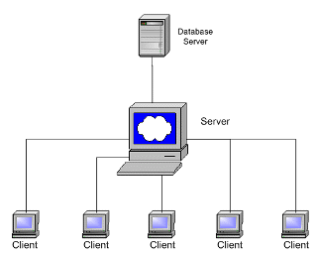
Network Architectures
Client Server Model

Slide 15
Pure P2P architecture
Any Node can perform as clients or servers
Arbitrary end systems directly communicate
Highly scalable
But difficult to manage

Slide 16
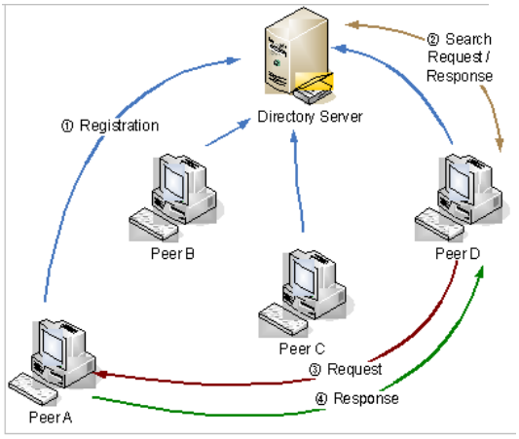
Hybrid of client-server and P2P
http://www.fidis.net/resources/deliverables/hightechid/d122-study-on-emerging-ami-technologies/doc/12/

Slide 17
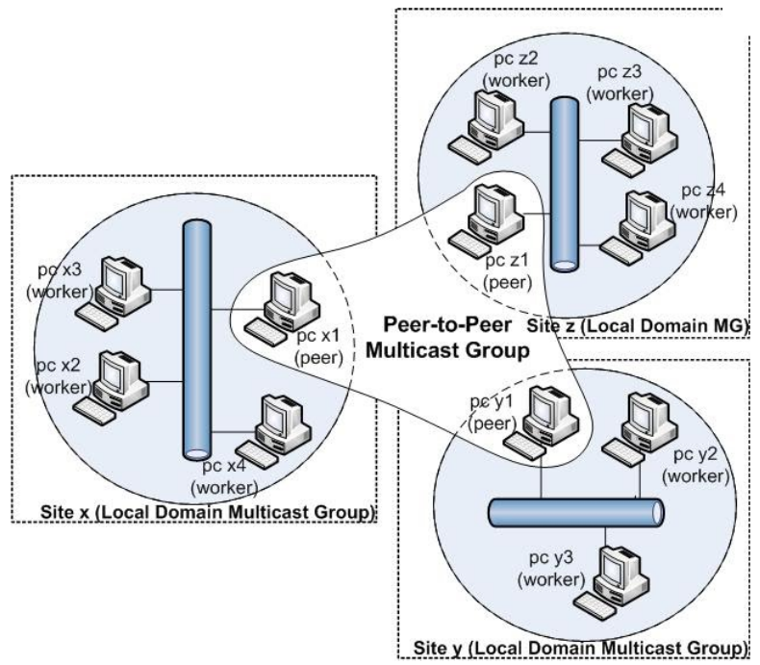
P2P Grid
http://sites.google.com/site/adhocgrid/

Slide 18
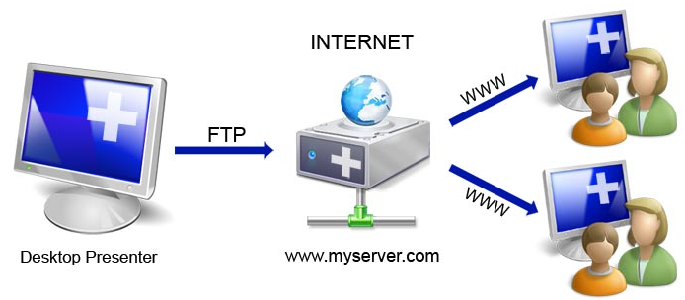
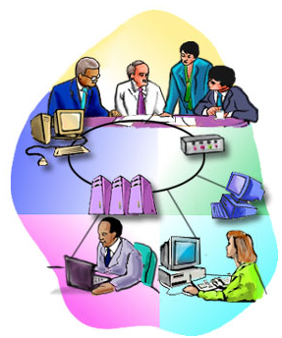
Internet vs. Intranet
Intranet is a mini private internet

Slide 19
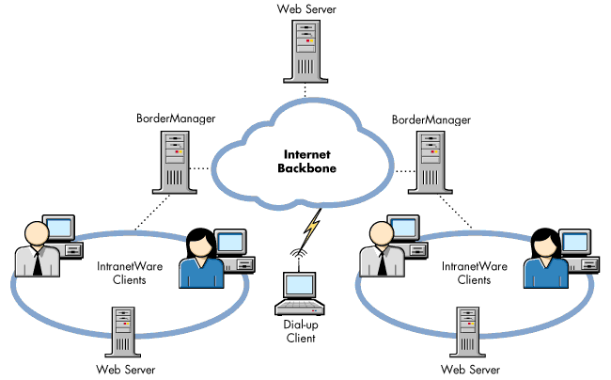
Internet vs. Intranet Cont.

Slide 20
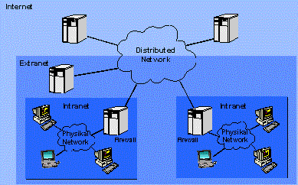
Intranet vs. Extranet vs. Internet

Slide 21
Cloud Computing
http://blog.modernista.com/?m=200908
Known as utility computing or hardware as a service (HaaS)
Instant access to dynamic and scalable resources to operate software and applications over the internet

Slide 22
Cloud Computing
Defined by six elements
Infrastructure (Infrastructure as a Service – IaaS)
Providing Servers, CPU, Memory etc.
Storage
Platform (Platform as a Service – PaaS)
Providing hardware & software for developing, testing, deploying applications
e.g. Microsoft Azure Services Platform, Amazon Web Services, Apple MobileMe, Microsoft Live Mesh,etc.
Applications
Google Docs: Document, Spreadsheet, Presentation, Form
Software/Service (Software as a Service – SaaS)
Google Maps, OpenID, PayPal, etc. provide services real-time over the Internet
Client
Is the computer hardware/software dependent on cloud computing in order to operate (e.g. Mozilla Firefox, Palm Pre webOS, Google G1 Android, Apple iPhone OS)

Slide 23
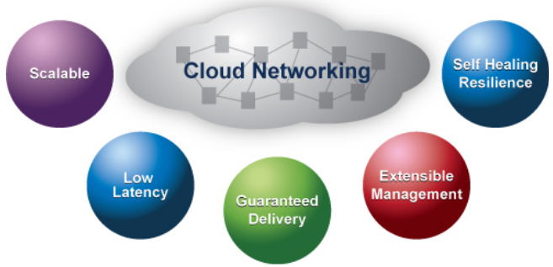
The Cloud Strengths
Many more are there

Slide 24
Development of the WWW
Timothy Berners-Lee and other researchers at the CERN European Organization for nuclear research facility near Geneva, Switzerland laid the foundations for the World Wide Web, or the Web, in 1989.
They developed a system of interconnected hypertext documents that allowed their users to easily navigate from one topic to another.
Hypertext is a method of organizing information that gives the reader control over the order in which the information is presented.

Slide 25
Hypertext Documents
When you read a book, you follow a linear progression, reading one page after another.
With hypertext, you progress through pages in whatever way is best suited to you and your objectives.
Hypertext lets you skip from one topic to another.
Linear versus hypertext documents

Slide 26
HTML: The Language of the Web
A Web page is a text file written in a language called Hypertext Markup Language.
A markup language is a language that describes a document’s structure and content.
HTML is not a programming language or a formatting language.
Styles are format descriptions written in a separate language from HTML that tell browsers how to render each element. Styles are used to format your document.

Slide 27
Hypertext Documents
The key to hypertext is the use of hyperlinks (or links) which are the elements in a hypertext document that allow you to jump from one topic to another.
A link may point to another section of the same document, or to another document entirely.
A link can open a document on your computer, or through the Internet, a document on a computer anywhere in the world.

Slide 28
Hypertext Documents
An entire collection of linked documents is referred to as a Web site.
The hypertext documents within a Web site are known as Web pages.
Individual pages can contain text, audio, video, and even programs that can be run remotely.
A Web page is stored on a Web server, which in turn makes it available to the network.

Slide 29
Web Servers vs. Web Browsers
The two most common web server applications are:
Apache (UNIX-based, open source) 50%*
IIS - Internet Information Services (Microsoft) 36%*
* Percent of all websites served on the Internet: Sept, 2007
Web browser retrieves the page from the server and displays it.
The earliest browsers were text-based browsers.
Today mostly graphical browsers displaying not only images, but also video, sound, animations, and a variety of graphical features.

Slide 30
Web Application Architecture
Client can download program with Web page, execute on client machine; simple, generic, but sometimes insecure
It can store and execute program on Web server, link from Web page.
more complex, requires server privileges, but can still be (mostly) secure
request
response
Internet
Server
Client

Slide 31
Web caches (proxy server)
Goal: satisfy client request without involving origin server
user sets browser: Web accesses via cache
browser sends all HTTP requests to cache
object in cache: cache returns object
else cache requests object from origin server, then returns object to client
origin
server
Proxy
server
HTTP request
HTTP request
client
HTTP response
HTTP response
HTTP request
HTTP response
client
origin
server

Slide 32
HTTP overview
HTTP: hypertext transfer protocol
Web’s application layer protocol
client/server model
client: browser that requests, receives, “displays” Web objects
server: Web server sends objects in response to requests
HTTP 1.0: RFC 1945
an application-level protocol with the lightness and speed
HTTP 1.1: RFC 2068
an application-level protocol for distributed environment
http://rfc.dotsrc.org/rfc/rfc2068.html
PC running
Explorer
HTTP request
HTTP response
HTTP request
Server
running
Apache Web
server
HTTP response
Mac running
Navigator

Slide 33
HTML exchanged using HTTP
A simple HTTP request is shown above

Slide 34
HTTP request message
two types of HTTP messages: request, response
HTTP request message:
ASCII (human-readable format)
request line
(GET, POST,
HEAD commands)
GET /somedir/page.html HTTP/1.1
Host: www.someschool.edu
User-agent: Mozilla/4.0 (browser)
Connection: keep-alive
Accept-language:en
(extra carriage return, line feed)
header
lines
Carriage return,
line feed
indicates end
of message

Slide 35
Method types
HTTP/1.0
GET
Get used for this purpose often (e.g. GET www.somesite.come/animalsearch?monkeys&bananas)
POST
Used when the user fills out a form (e.g. search engines)
HEAD
Request information about a document such as its last modified date so browser can decide whether to fetch it from server or from cache
Often used for debugging
It's like a GET request but no document is sent back by the server.
HTTP/1.1
GET, POST, HEAD
PUT
uploads file in entity body to path specified in URL field (uploading to the server)
Used in web publishing tools
DELETE
deletes file specified in the URL field

Slide 36
HTTP response message
status line
(protocol
status code
status phrase)
HTTP/1.1 200 OK
Connection close
Date: Thu, 06 Aug 2007 12:00:15 GMT
Server: Apache/1.3.0 (Unix)
Last-Modified: Mon, 22 Jun 2008 …...
Content-Length: 6821
Content-Type: text/html
data data data data data ...
header
lines
data, e.g.,
requested
HTML file

Slide 37

HTTP Response
HTTP/1.1 200 OK
Date: Tue, 22 Jun 2007 14:20:03 GMT
Server: Apache/1.3.29 (Win32) PHP/4.3.7
Last-Modified: Sat, 06 Dec 2007 15:38:57 GMT
ETag: "0-76-3fd1f811"
Accept-Ranges: bytes
Content-Length: 118
Content-Type: text/html
<html>
<head><title>My Home Page</title></head>
<body>
<h1>My Home Page</h1>
<img src="apache_pb.gif">
</body>
</html>
HTTP response headers
blank line is important

Slide 38
HTTP response status codes
In first line in server → client response message.
A few sample codes:
200 OK
request succeeded, requested object later in this message
301 Moved Permanently
requested object moved, new location specified later in this message (Location:)
400 Bad Request
request message not understood by server
404 Not Found
requested document not found on this server
505 HTTP Version Not Supported

Slide 39
What is TCP/IP?
TCP: Transmission Control Protocol
handles conversion between messages and streams packets
IP: Internet Protocol
handles addressing of packets across networks
TCP/IP
enables packets to be sent across multiple networks using multiple standards
HTTP
sits on top of TCP/IP as an application layer protocol that provides client-server communication.

Slide 40
Protocols

Slide 41
Protocols
Cooperative action is necessary
computer networking is not only to exchange bytes
huge system with several utilities and functions. For examples
error detection
Encryption
Routing
etc.
For proper communication, entities in different systems must speak the same language
there must be mutually acceptable conventions and rules about the content, timing and underlying mechanisms
Those conventions and associated rules are referred as “PROTOCOLS”

Slide 42
A Real World Example to Protocol Architecture philosopher-translator-secretary architecture
Issues:
peer-to-peer protocols are independent of each other
for example, secretaries may change the comm. medium to email
or the translators may agree on using another common language
Each layer adds a header

Slide 43
Protocol Architecture
Task of data transfer is broken up into some modules
Why?
How do these modules interact?
For example, file transfer could use three modules
File transfer application
Communication service module
Network access module
Notes:
Answer to Why? – Same reason as dividing a big program into smaller functions. It is difficult to attack big problems as a whole.
Answer to interaction question? – Modules have a layered structure. Each layer (module) provides service to upper layer and expects service from lower layer. Details are explained later in this ppt file.

Slide 44
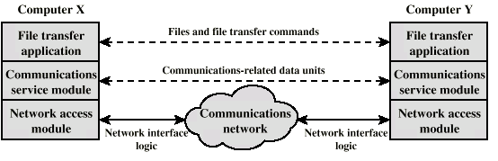
Simplified File Transfer Architecture
File Transfer Application Layer: Application specific commands, passwords and the actual file(s) – high level data
Communications Service Module: reliable transfer of those data – error detection, ordered delivery of data packets, etc.
Network Module: actual transfer of data and dealing with the network – if the network changes, only this module is affected, not the whole system

Slide 45
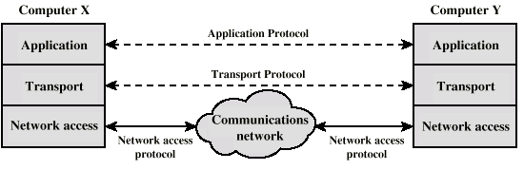
A General Three Layer Model
Generalize the previous example for a generic application
we can have different applications (e-mail, file transfer, …)
Network Access Layer
Transport Layer
Application Layer

Slide 46
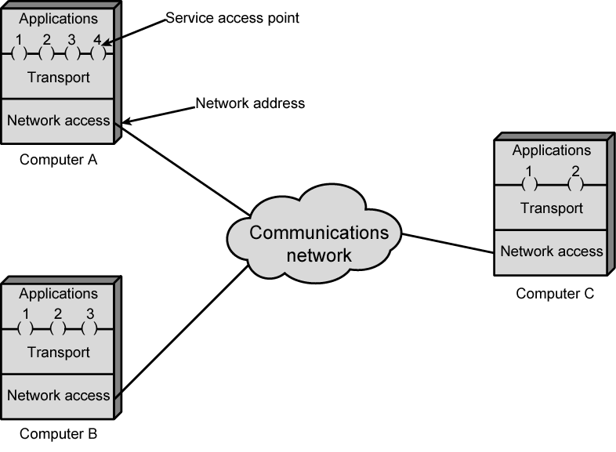
Protocol Architectures and Networks
or ports

Slide 47
General protocol architecture principles
Layered structure
Protocol stack
Each layer provides services to upper layer; expect services from lower one
Layer interfaces should be well-defined
Peer entities communicate using their own protocol
peer-to-peer protocols
independent of protocols at other layers
if one protocol changes, other protocols should not get affected

Slide 48
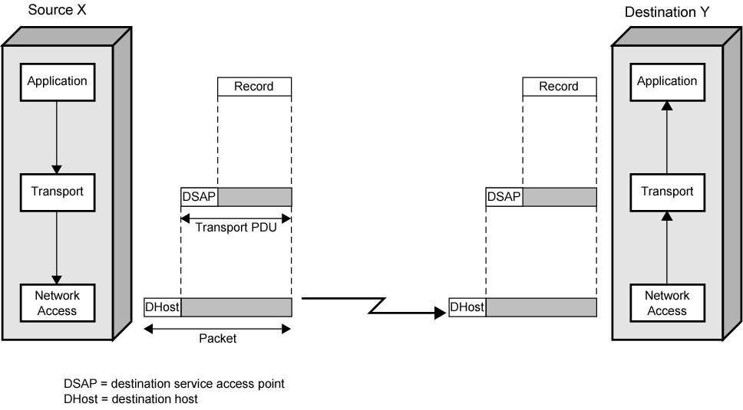
Operation of a Protocol Architecture
Transport Header
Transport Header
Network Header
Network Header
(Network PDU)

Slide 49
Protocol Data Units (PDU)
User data is passed from layer to layer
Control information is added/removed to/from user data at each layer
Header (and sometimes trailer)
each layer has a different header/trailer
Data + header + trailer = PDU (Protocol Data Unit)
This is basically what we call packet
each layer has a different PDU

Slide 50
Why Standard Protocol Architectures?
Common set of conventions
Nonstandard vs. standard protocols
Nonstandard: K sources and L receivers lead to K*L different protocols
If common protocol used, we design only once
Products from different vendors interoperate
If a common standard is not implemented in a product, then that product’s market is limited; customers like standard products
Customers do not stick to a specific vendor

Slide 51
Standard Protocol Architectures
Two approaches (standard)
OSI Reference model
never used widely
but well known
TCP/IP protocol suite
Most widely used
Another approach (proprietary)
IBM’s Systems Network Architecture (SNA)

Slide 52
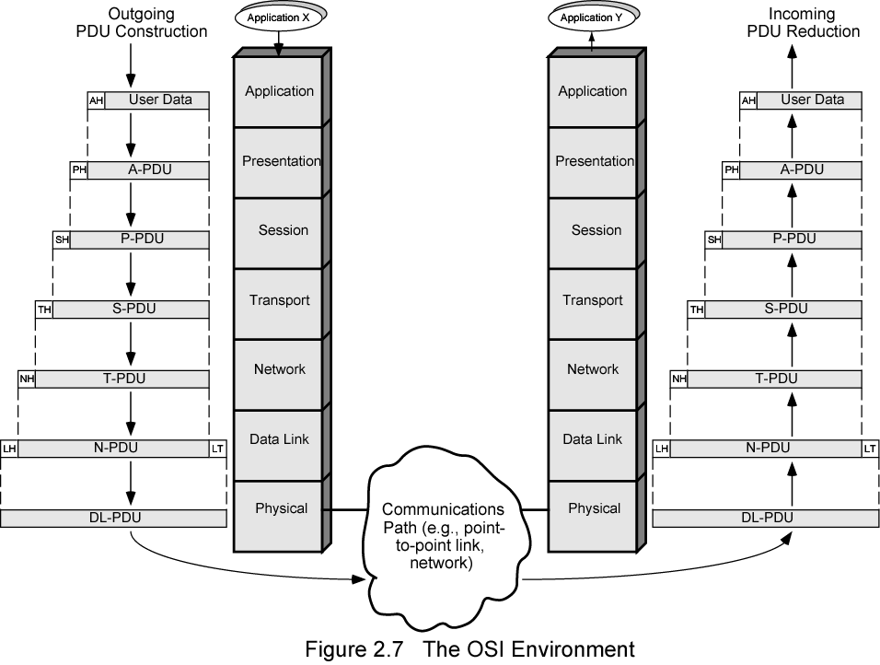
The OSI Environment

Slide 53
OSI Reference Model
Open Systems Interconnection (OSI)
Reference model
provides a general framework for standardization
defines a set of layers and services provided by each layer
one or more protocols can be developed for each layer
Developed by the International Organization for Standardization (ISO)
also published by ITU-T (International Telecommunications Union)

Slide 54
OSI Reference Model
A layered model
Seven layers – seven has been presented as the optimal number of layer
Delivered too late (published in 1984)!
by that time TCP/IP started to become the de facto standard
Although no OSI-based protocol survived, the model is still valid (in the textbooks)

Slide 55
OSI - The Layer Model
Each layer performs a subset of the required communication functions
Each layer relies on the next lower layer to perform more primitive functions
Each layer provides services to the next higher layer
Changes in one layer should not require changes in other layers

Slide 56
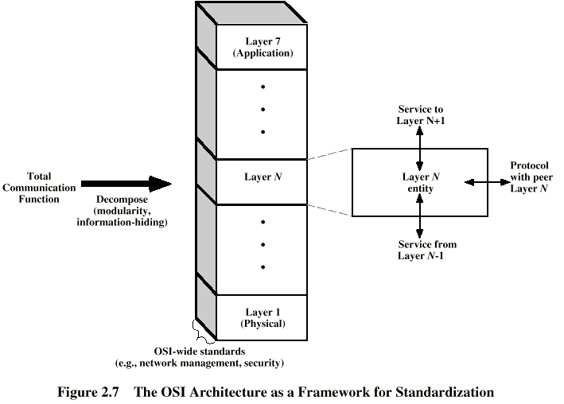
OSI as Framework for Standardization
layer functionalities are described by ISO; different standards can be developed based on these functionalities

Slide 57
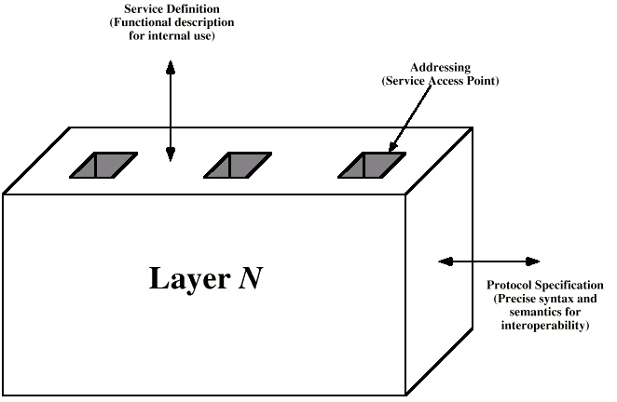
Layer Specific Standards

Slide 58
Elements of Standardization
Protocol specification
Operates between the same layer on two systems
May involve different platforms
Protocol specification must be precise
Format of data units
Semantics of all fields
Service definition
Functional description of what is provided to the next upper layer
Addressing
Referenced by SAPs

Slide 59
HTML exchanged using HTTP
A simple HTTP request is shown above

Slide 60
HTTP request message
two types of HTTP messages: request, response
HTTP request message:
ASCII (human-readable format)
request line
(GET, POST,
HEAD commands)
GET /somedir/page.html HTTP/1.1
Host: www.someschool.edu
User-agent: Mozilla/4.0 (browser)
Connection: keep-alive
Accept-language:en
(extra carriage return, line feed)
header
lines
Carriage return,
line feed
indicates end
of message

Slide 61
Method types
HTTP/1.0
GET
Get used for this purpose often (e.g. GET www.somesite.come/animalsearch?monkeys&bananas)
POST
Used when the user fills out a form (e.g. search engines)
HEAD
Request information about a document such as its last modified date so browser can decide whether to fetch it from server or from cache
Often used for debugging
It's like a GET request but no document is sent back by the server.
HTTP/1.1
GET, POST, HEAD
PUT
uploads file in entity body to path specified in URL field (uploading to the server)
Used in web publishing tools
DELETE
deletes file specified in the URL field

Slide 62
HTTP response message
status line
(protocol
status code
status phrase)
HTTP/1.1 200 OK
Connection close
Date: Thu, 06 Aug 2007 12:00:15 GMT
Server: Apache/1.3.0 (Unix)
Last-Modified: Mon, 22 Jun 2008 …...
Content-Length: 6821
Content-Type: text/html
data data data data data ...
header
lines
data, e.g.,
requested
HTML file

Slide 63
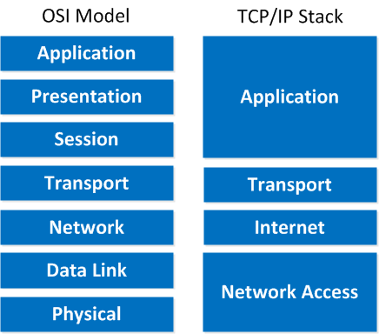
OSI vs. TCP/IP
HTTP, SMTP, POP3, Telnet, …
TCP, UDP
IP
Ethernet, ….
Notes:
UDP => User Datagram Protocol

Slide 64
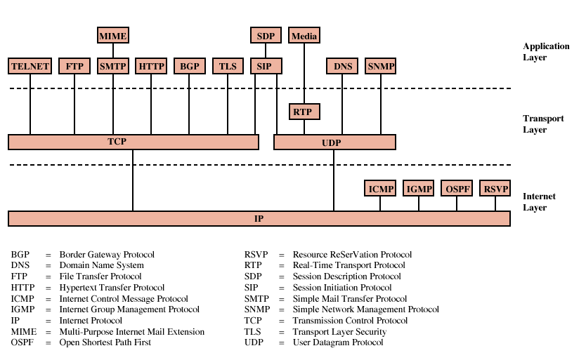
Some Protocols in TCP/IP Suite

Slide 65
App.
HTTP
SMTP
DNS
RTP
Transport
TCP
UDP
TCP/UDP Provides
a network
independent
platform
IP provides
independence
from underlying
networks
Internet
IP
Network Interface 1
Network Interface 2
Network Interface 3
(e.g., Ethernet driver)
(e.g., PPP driver)
TCP/IP protocol graph
Figure 2.12

Slide 66
Two Boundaries in the TCP/IP Model
High-level protocol address boundary
Application programs as well as all protocol s/w from the Internet layer upward use only IP addresses; the network interface layer handles physical addresses
Operating system boundary
Conceptual Layer
Boundary
Application
Software outside the operating system
Operating System
boundary
Transport
Software inside the operating system
Internet
Only IP addresses used
High-level protocol
address boundary
Network Interface
Physical addresses used
Hardware

Slide 67
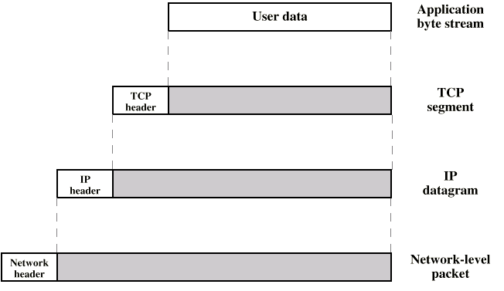
PDUs in TCP/IP
Dest. Port
Sequence number
Checksum
….
Dest. Address
Source address
….
Dest. Network Address
Priority info

Slide 68
Layering in a TCP/IP Internet Environment
Host A
Host B
Application
Application
identical
message
Transport
identical
packet
Transport
Router R
Internet
Internet
Internet
identical
datagram
identical
datagram
Network
Interface
Network
Interface
identical
frame
Network
Interface
identical
frame
Physical Net 1
Physical Net 1

Slide 69
Encapsulation
User data
Application
Application
Appl
header
User data
Appl
header
User data
User data
TCP
TCP
TCP
header
Application data
Application data
Application
IP
Application
IP
IP
header
TCP
header
Application data
TCP
header
Application data
Ethernet
driver
Ethernet
driver
Ethernet
header
IP
header
TCP
header
Application data
Ethernet
trailer
Ethernet
header
IP
header
TCP
header
Application data
Ethernet
trailer
Ethernet

Slide 70
TCP Segment
0
4
10
16
19
24
31
Source Port
Destination Port
Sequence Number
Acknowledgment Number
Len
Reserved
Flags
Window
Checksum
Urgent Pointer
Options...
Padding
Data...
Field Purpose
Source Port Identifies originating application
Destination Port Identifies destination application
Sequence Number Sequence number of first octet in the segment
Acknowledgment # Sequence number of the next expected octet (if ACK flag set)
Len Length of TCP header in 4 octet units
Flags TCP flags: SYN, FIN, RST, PSH, ACK, URG
Window Number of octets from ACK that sender will accept
Checksum Checksum of IP pseudo-header + TCP header + data
Urgent Pointer Pointer to end of “urgent data”
Options Special TCP options such as MSS and Window Scale
You just need to know port numbers, seq and ack are added
Notes:
27

Slide 71
IP Datagram
0
4
8
16
19
24
31
Vers
Len
TOS
Total Length
Identification
Flags
Fragment Offset
TTL
Protocol
Header Checksum
Source Internet Address
Destination Internet Address
Options...
Padding
Data...
Field Purpose
Vers IP version number
Len Length of IP header (4 octet units)
TOS Type of Service
T. Length Length of entire datagram (octets)
Ident. IP datagram ID (for frag/reassembly)
Flags Don’t/More fragments
Frag Off Fragment Offset
Field Purpose
TTL Time To Live - Max # of hops
Protocol Higher level protocol (1=ICMP,
6=TCP, 17=UDP)
Checksum Checksum for the IP header
Source IA Originator’s Internet Address
Dest. IA Final Destination Internet Address
Options Source route, time stamp, etc.
Data... Higher level protocol data
You just need to know the IP addresses, TTL and protocol #
Notes:
16

Slide 72
Ethernet / Network Layer
Computer <-> Computer communication on same network
Each device has unique MAC address (48-bit)
example: 00-C0-4F-48-47-93
Ethernet Packet:
Preamble
Dest.
address
Source
address
Type
Data
CRC
8bytes
6bytes
6bytes
2bytes
64 - 1500bytes
4bytes
Do not worry about this slide
MAC: Media Access Control

Slide 73
Network Access and Physical Layers
TCP/IP reference model does not discuss these layers too much
the node should connect to the network with a protocol such that it can send IP packets
this protocol is not defined by TCP/IP
mostly in hardware
a well known example is Ethernet

Slide 74
Internet Layer
Connectionless, point to point internetworking protocol (uses the datagram approach)
takes care of routing across multiple networks
each packet travels in the network independently of each other
they may not arrive (if there is a problem in the network)
they may arrive out of order
a design decision enforced by DoD to make the system more flexible and responsive to loss of some subnet devices
Implemented in end systems and routers as the Internet Protocol (IP)
Notes:
DoD implies Department of Defense

Slide 75
Transport Layer
End-to-end data transfer
Transmission Control Protocol (TCP)
connection oriented
reliable delivery of data
ordering of delivery
User Datagram Protocol (UDP)
connectionless service
delivery is not guaranteed
Can you give example applications that use TCP and UDP?
Notes:
UDP: Anything where you don't care too much if you get all data always
Tunneling/VPN (lost packets are ok - the tunneled protocol takes care of it)
Media streaming (lost frames are ok)
Games that don't care if you get every update
Local broadcast mechanisms (same application running on different machines "discovering" each other)
TCP: Almost anything where you have to get all transmitted data
Web
SSH, FTP, telnet
SMTP, sending mail
IMAP/POP, receiving mail

Slide 76
Application Layer
Support for user applications
A separate module for each different application
e.g. HTTP, SMTP, telnet

Slide 77
TCP/IP architecture-- Internet layer
Machine A
Machine B
Application
Application
Router/Gateway
Transport
Transport
Internet
Internet
Internet
Network Interface
Network Interface
Network Interface
Network 1
Network 2
Transfer of information across networks through gateways/routers
Corresponding to OSI network layer: routing and congestion control
Global unique IP address and IP packets
Best-effort connectionless IP packet transfer: no setup, routed independently, robust, out of order, duplicate, or lose of packet
Figure 2.11

Slide 78
TCP/IP architecture-- Network interface layer
Machine A
Machine B
Application
Application
Router/Gateway
Transport
Transport
IP
packet
IP
packet
Internet
IP
packet
IP
packet
Internet
Internet
Network InterfaceS
Network Interface
Network Interface
Packet
of network1
Packet
of network2
Packet
of network1
Packet
of network2
Network 1
Network 2
Concerned with network-specific aspects of the transfer of packets
Corresponding to part of OSI network layer and data link layer
Different network interfaces: X.25, ATM, frame relay, Ethernet, etc
Figure 2.11

Slide 79
The procedure executed at routers
1. Router receives a frame from one network (e.g., N1) through its physical layer
2. The data link entity for N1 extracts the IP packet from the frame and passes the IP packet up to its network entity.
3. The network entity checks destination IP address (finds the packet is not for itself) and determines the next hop based on destination IP address (i.e., routing) , this next hop router will be in another network (e.g. N2)
4. Network entity passes the IP packet down to the data link entity for N2
5. Data link entity for N2 encapsulates the IP packet in a frame of N2 and passes the frame down to physical layer for transmission to the next router through network N2.

Slide 80
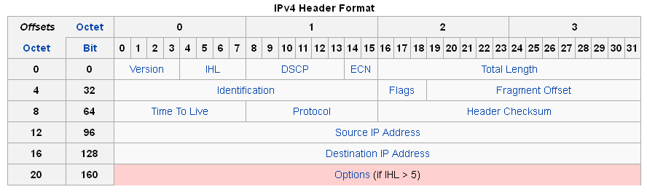
IP (Internet Protocol)
The core of the TCP/IP protocol suite
4 bytes
e.g. 163.1.125.98, Each device normally gets one (or more)
In theory there are about 4 billion available
Two versions co-exist
IPv4 – the widely used IP protocol
IPv6 – has been standardized in 1996, but still not widely deployed
IP (v4) header minimum 20 octets (20 bytes or 160 bits)

Slide 81
IPv6
IPv6
Enhancements over IPv4 for modern high speed networks
Support for multimedia data streams
But the driving force behind v6 was to increase address space
128-bit as compared to 32-bit of IPv4
Not backward compatible
all equipment and software must change
that is why it will take some more time to migrate into IPv6

Slide 82


