Slide 1

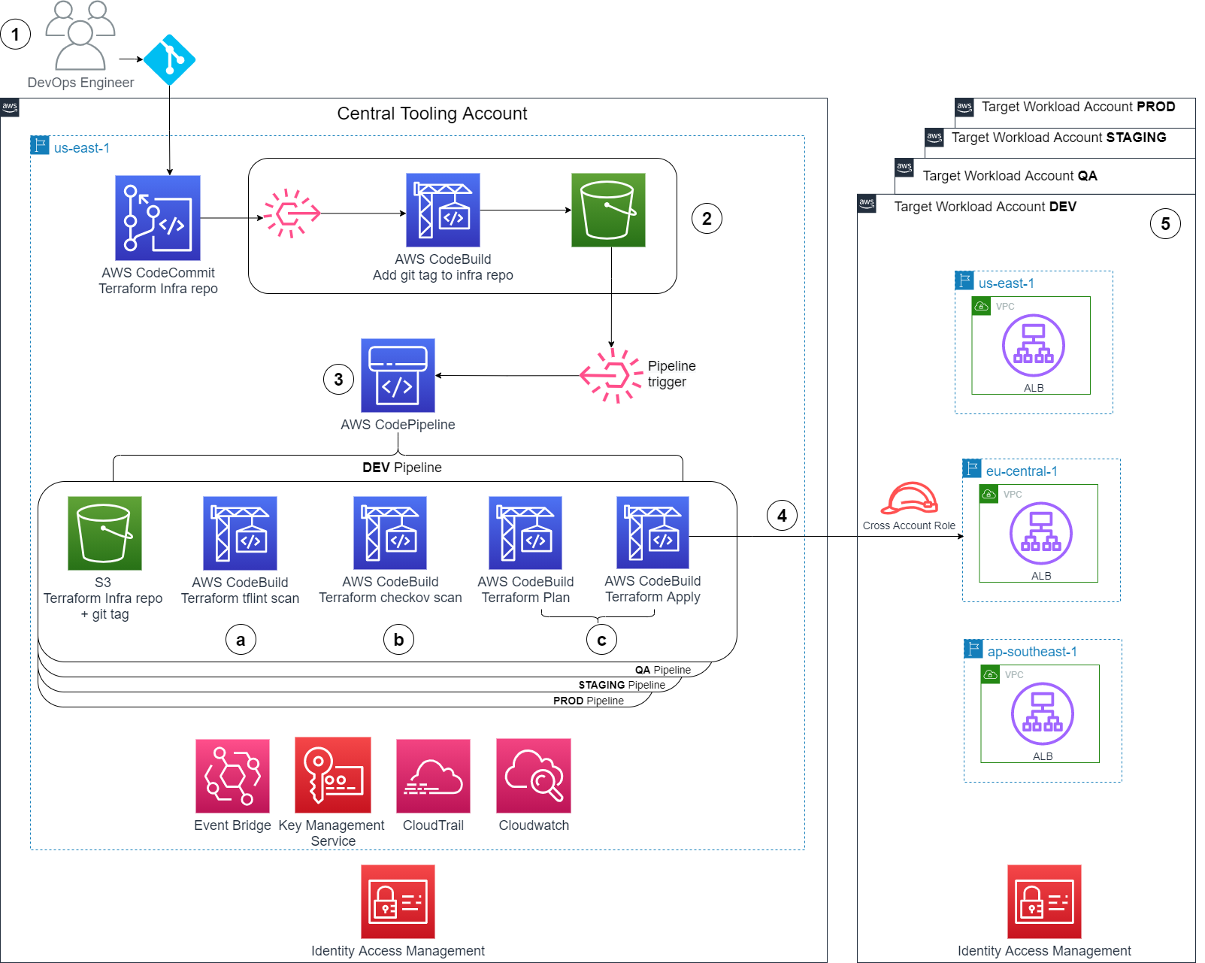
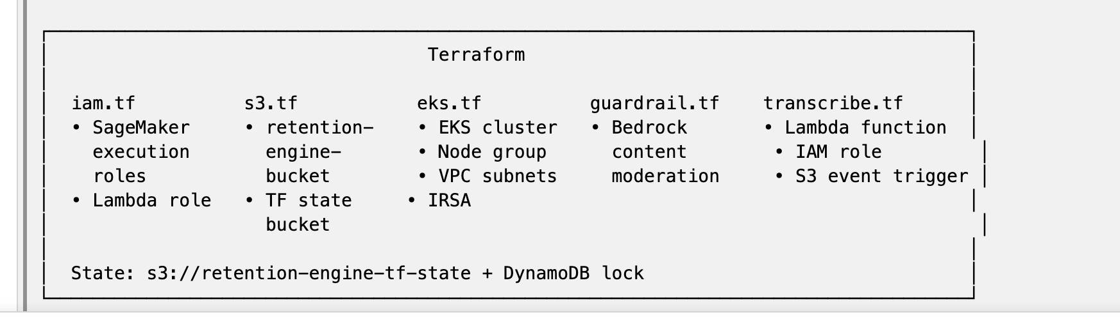
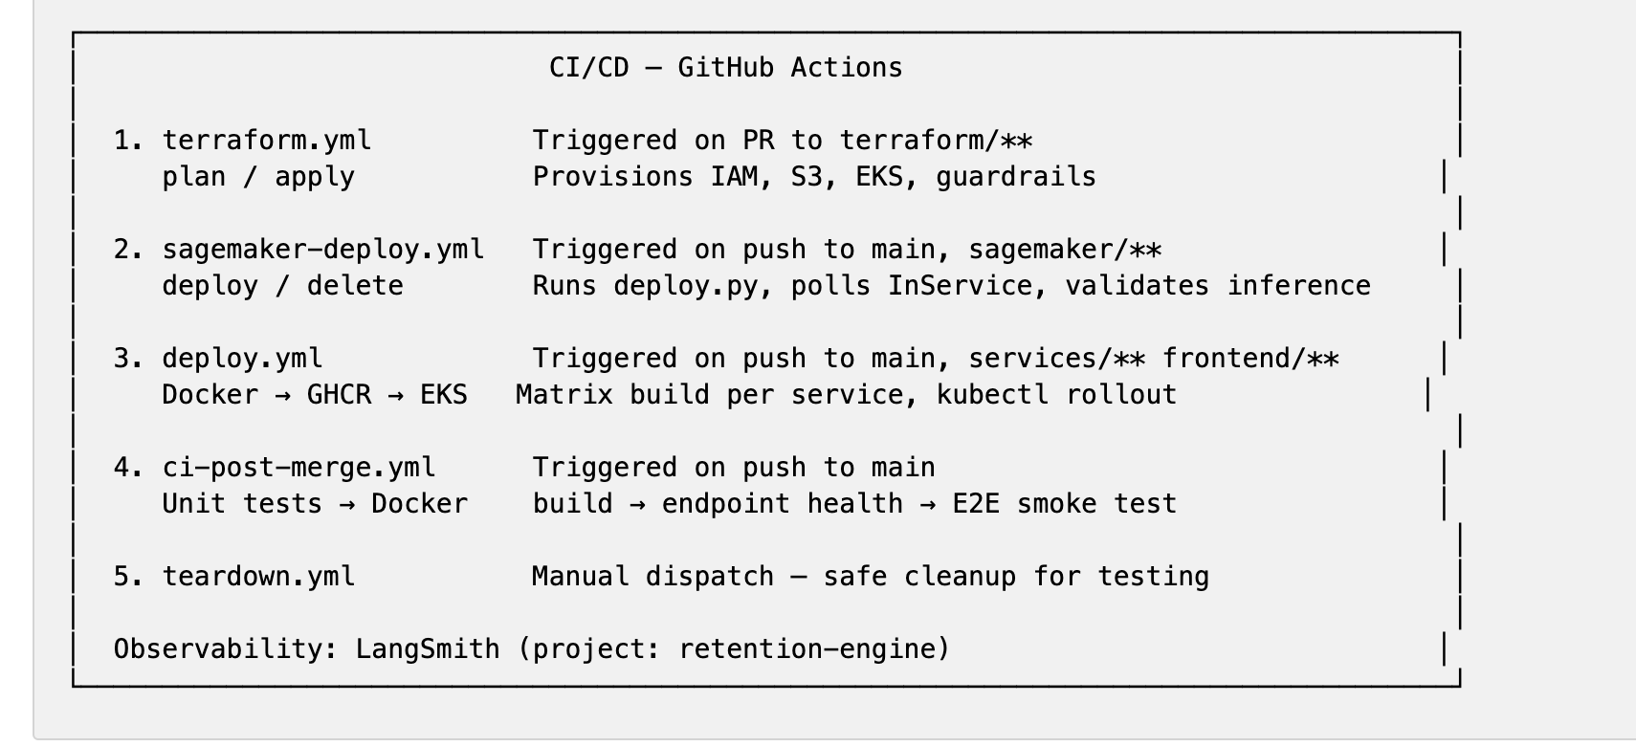
Amazon Elastic Kubernetes Service (Amazon EKS)
HTTPS
Frontend (React + Vite + Tailwind)
Port 3000
Analyze Tab
Customer Combobox
Transcript Input
Results:
Risk Card
Sentiment Card
Action Card
Chat Tab
Conversational AI
Session Memory
(session_id)
Runs Agent Service
Fallback to direct churn predictor API with simple logic
Transcribe Tab
Audio Upload
(.wav/.mp3)
Transcript List (S3)
LangGraph Orchestrator
Agent Service
FastAPI :8080
SageMaker Endpoint #1
(FastAPI :8002)
Gatherer
(Bedrock)
Claude Haiku 4.5
Strategist
(Bedrock)
Claude Haiku 4.5
POST /chat
GET /health
Tools:
get_customer_details
predict_churn
analyze_call
get_high_risk_customers
boto3
retention-sentiment-analysis-endpoint
POST /predict
GET /health
SageMaker Call
Decode Label (Neg/Neu/Pos)
Emotion Scores (Keyword NLP)
Sentiment Shift (1st half vs 2nd)
Escalation/Resolution detect
QA Score (composite)
Return Output
Output:
1. qa_score (0-10) 2. Sentiment_shift
3. sentiment (label) 4. escalation_flag
5. emotion_frustration
6. resolution_flag 7. emotion_anger
Guardrail: Bedrock content mod (hate/violence/PII)
boto3
boto3
boto3
S3: retain-engine-bucket
Routes:
GET /customers
GET /customer-details/{id}
POST /transcribe (+ customer_id)
GET /transcripts
GET /transcripts/{name}
POST /predict
POST /save-transcript
GET /high-risk
GET /health
Churn Predictor API
FastAPI :8001
/data/internet_data.csv -
internet service plans (plan_tier,
speed_mbps, monthly_cost, etc.)
/data/trilink_customers_data.csv -
customer demographics (age,
income, home ownership, etc.)
/audio/{cust_id}/{timestamp}.wav
/transcripts/{cust_id}/{timestamp}.json/models/churn
/models/sentiment
SageMaker Endpoint #2
(FastAPI :8001)
boto3
churn-predictor-endpoint
XGBoost v3 – 31 Features
31 Features
91% accuracy
0.9861 AUC
Native XGBoost Container
boto3
AWS Transcribe
Lambda: retention-transcribe-pipeline
Transcribe Job
Speaker diarization (2 speakers)
Output: S3 transcripts/{cid}

Slide 2
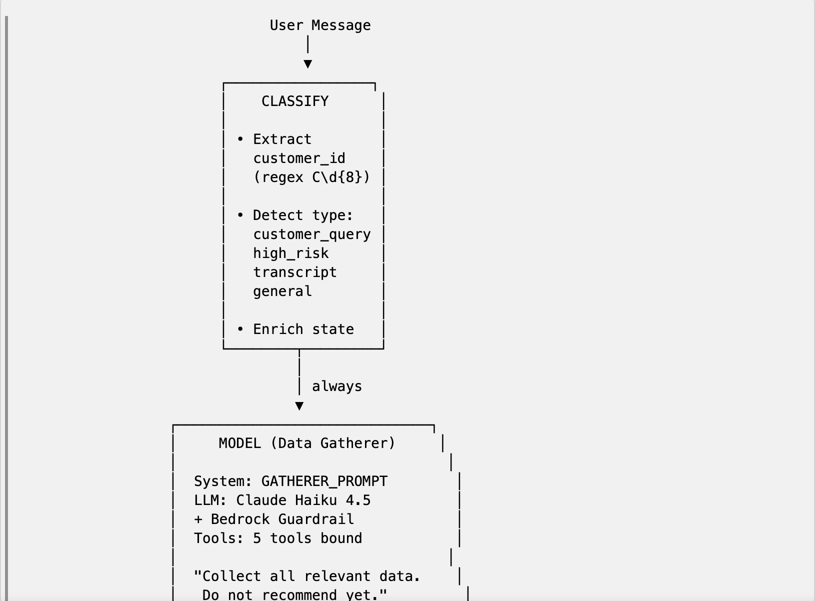
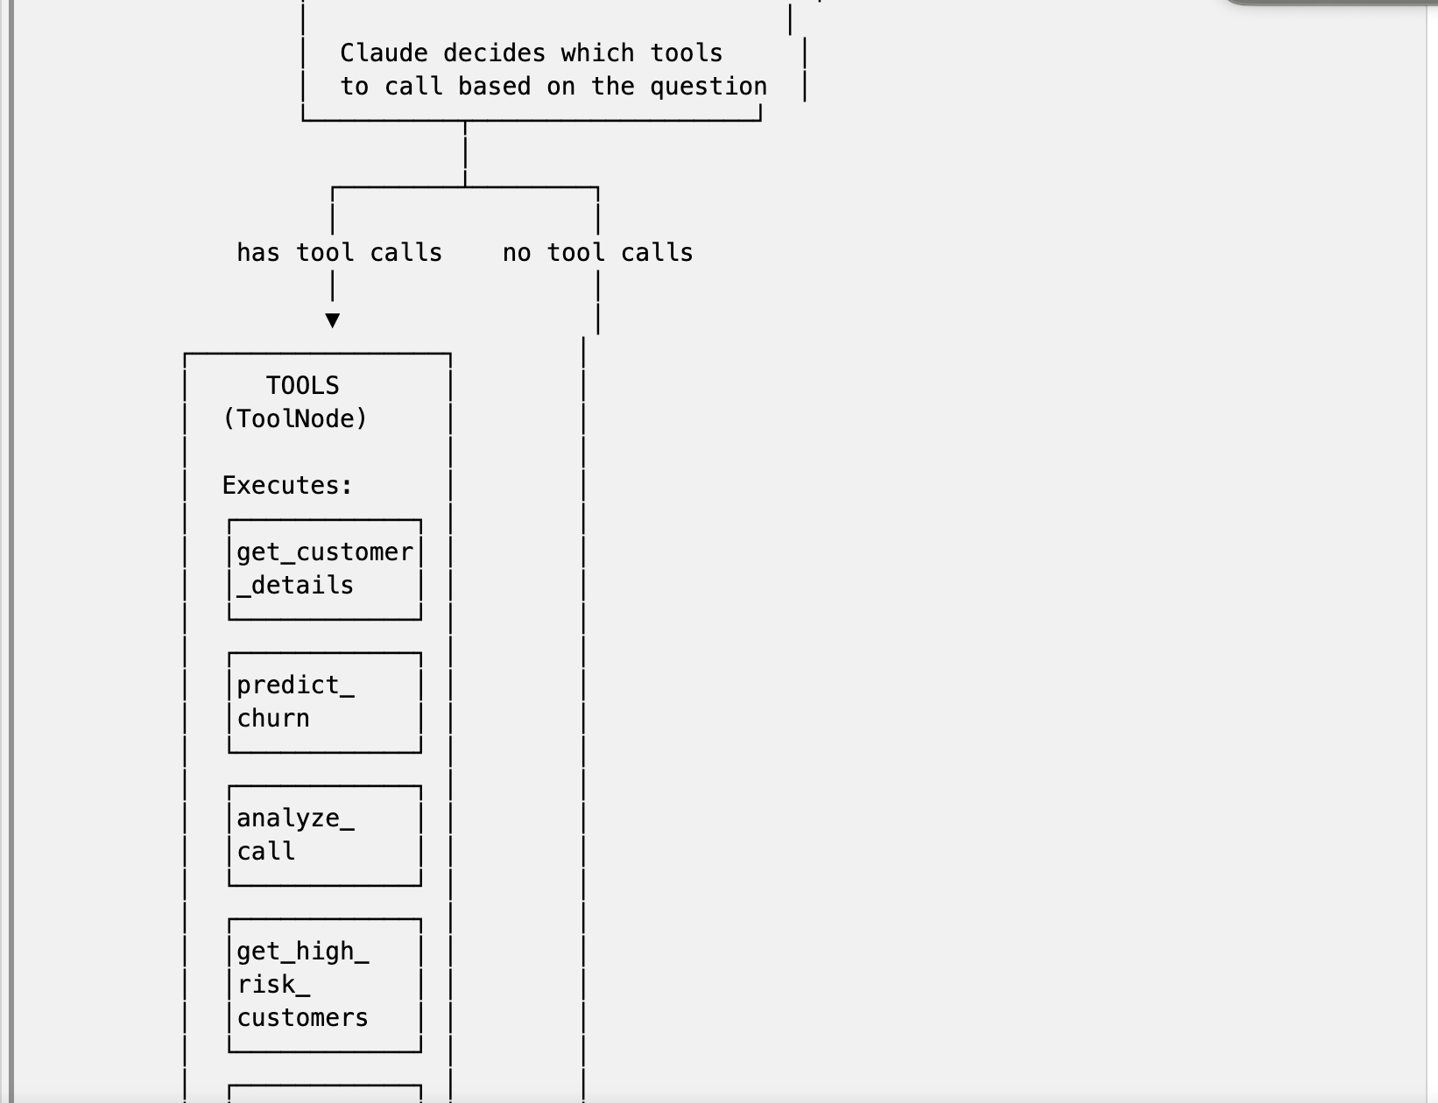
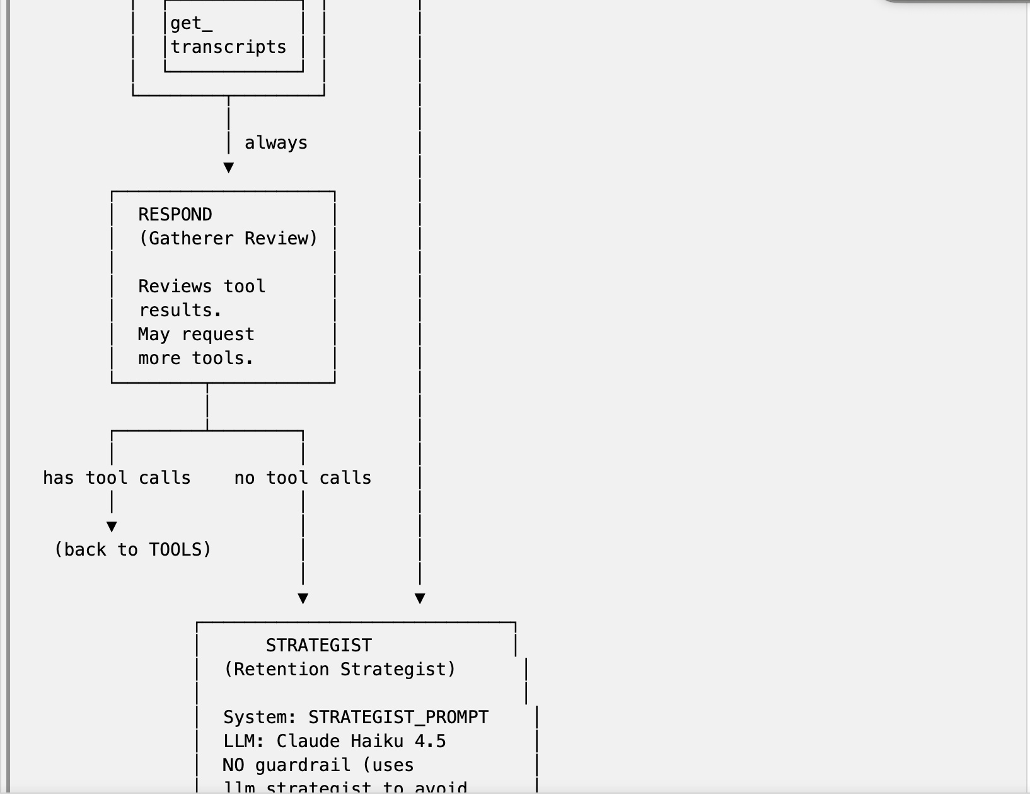
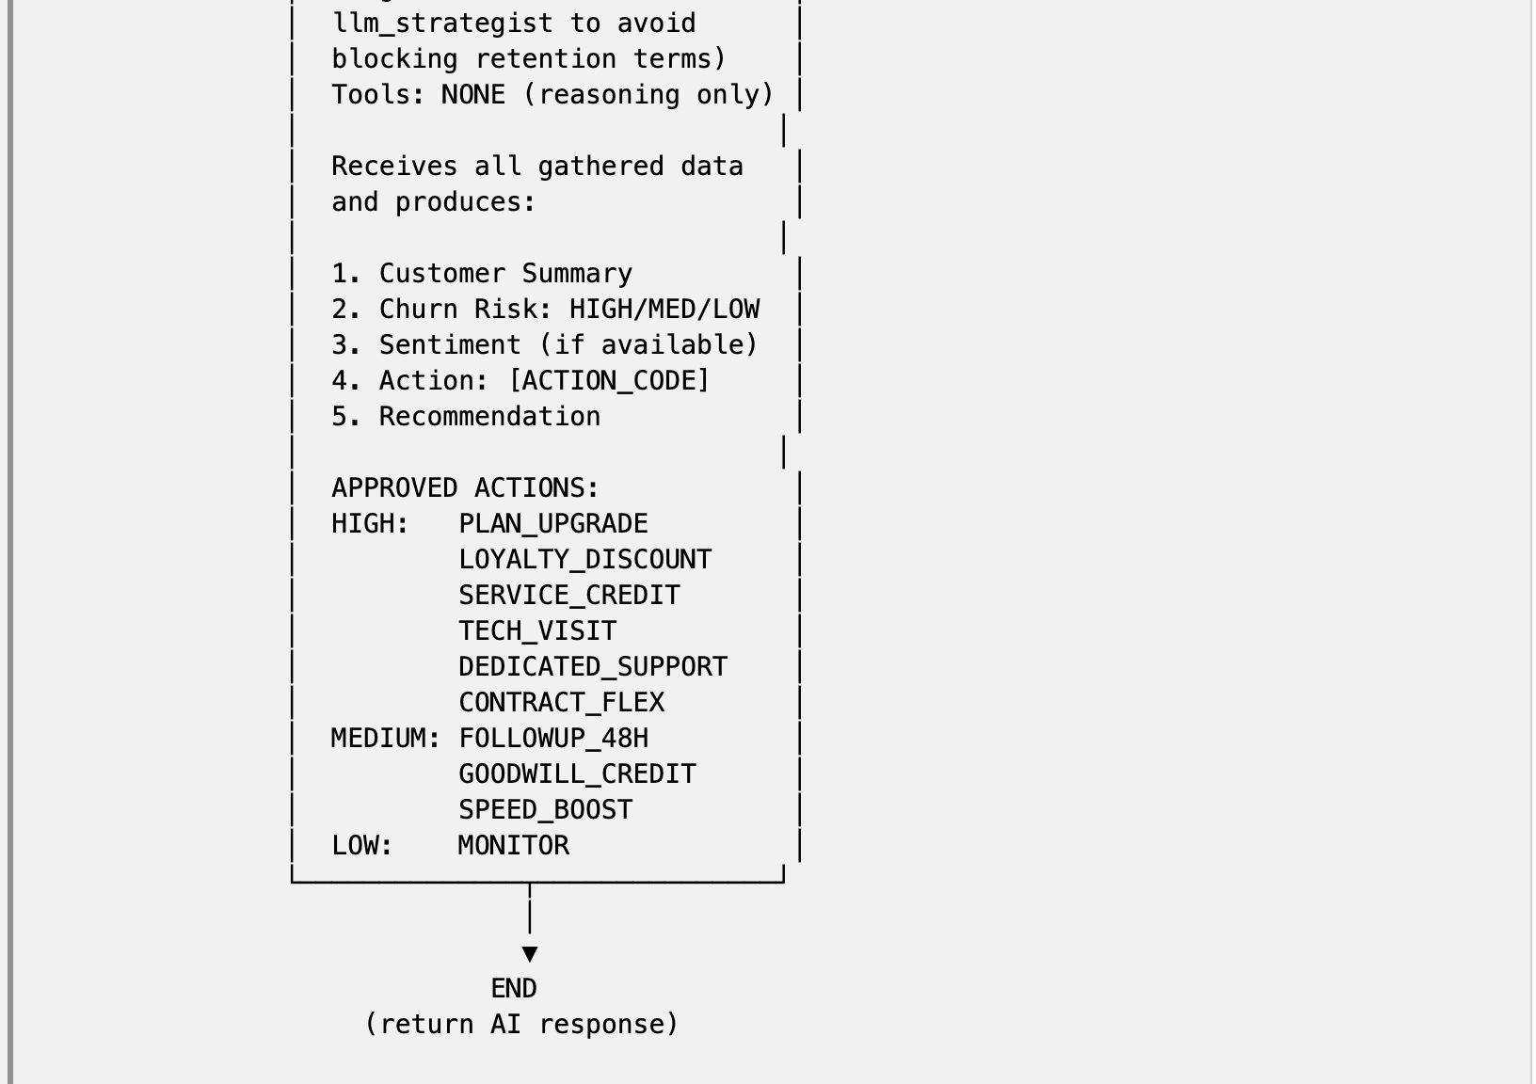

Slide 4
Potential Upgrades
1 | Historical Sentiment Trending & Cross-Call Analysis Business problem: Currently each call is analyzed in isolation. A manager sees one snapshot — is this customer frustrated right now? But the real signal is the trajectory. A customer who was positive three months ago, neutral last month, and negative today is a very different risk profile than a first-time caller who's angry about a one-time billing error. Future implementation: When a customer is analyzed, automatically pull all historical transcripts from S3, run sentiment enrichment on each, and present a sentiment timeline. The churn model could incorporate features like "number of calls in last 90 days," "average sentiment trend," and "worst sentiment delta", serving a longitudinal risk model.
2 | Persistent Conversation Memory with Semantic Search Business problem: Currently the agent's memory resets when the service restarts. A manager who discussed a customer yesterday has to re-explain the context today. There's also no way to search past conversations — "what did we decide about C00036458 last week?" has no answer. Future implementation: Replace MemorySaver (in-memory) with a persistent store like PostgreSQL + pgvector (or a managed service like Amazon MemoryDB). Store conversation history with embeddings so the agent can semantically search past interactions — not just recall the exact thread, but find related discussions. A manager could ask "have we offered loyalty discounts to any Basic_25 customers this quarter?" and get results across all sessions and managers.
3 | Retention Action Dashboard & Outcome Tracking Business problem: The current UI shows individual customer analysis. There's no aggregate view — how many high-risk customers exist today? What actions have been recommended this week? Did those actions actually work? Without outcome tracking, the retention engine is a recommendation tool with no feedback loop. Future implementation: Add a Dashboard tab with aggregate metrics: total customers by risk level, recommended actions distribution, trend charts over time. More importantly, add outcome tracking — when a retention action is taken, log it. When the customer's next call comes in, compare sentiment before and after the action. Feed this back into the model as a reinforcement signal. Over time, the system learns which actions actually reduce churn for which customer profiles, rather than relying on static rules.

