Slide 1
Zero-Downtime Releases
with Blue-Green Deployment
Eliminating release risk and instant rollback on AWS EKS
Platform Engineering · Project Approval
Notes:
Goal of this deck: get approval to adopt blue-green deployment on our EKS platform. Headline benefits: zero customer-facing downtime during releases, and rollback measured in seconds.

Slide 2





The problem we're solving
How we release today carries avoidable risk that customers feel directly.
Downtime during releases
Painful, slow rollbacks
Fear slows the cadence
Customer & revenue impact
Rolling updates briefly mix old and new pods; a bad version reaches live customers immediately.
Reverting means rebuilding and redeploying under pressure while users are already impacted.
Risky releases lead to fewer, larger, riskier deployments — the opposite of what we want.
Every minute of a broken release erodes trust and costs revenue we can't recover.
What is blue-green deployment?
GREEN
Run two identical environments side by side.
Only one serves customers at any time; the other holds the new version.
Switch all traffic to the new version in seconds — and switch back just as fast.
The old version is kept running as a safety net until the new one is trusted.
current version
LIVE
BLUE
new version
instant switch
STANDBY
Notes:
Frame the pain in business terms: downtime, slow recovery, and the cultural cost of fear-driven releases.

Slide 3
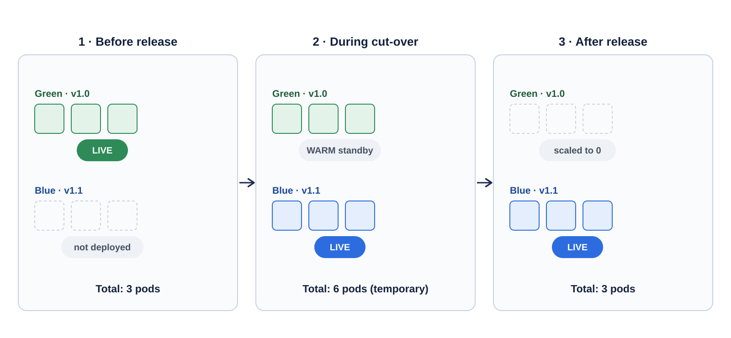
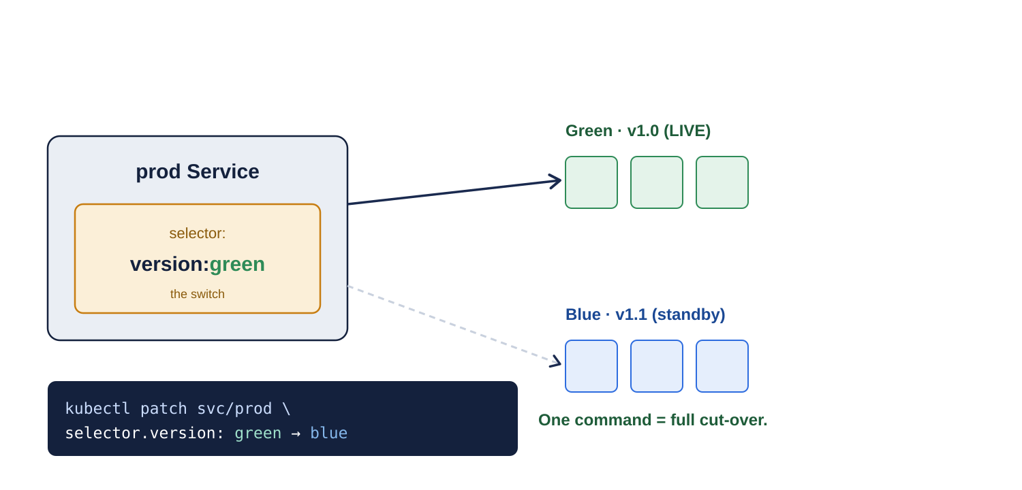
What happens to the pods
Each colour runs at full production capacity. During cut-over we briefly run double, then scale the old version down.
The switch: one line in the Service
Notes:
Important: we do NOT split one pool. We temporarily double capacity (3 to 6 to 3) so the new version is at full strength before and after the switch.

Slide 4
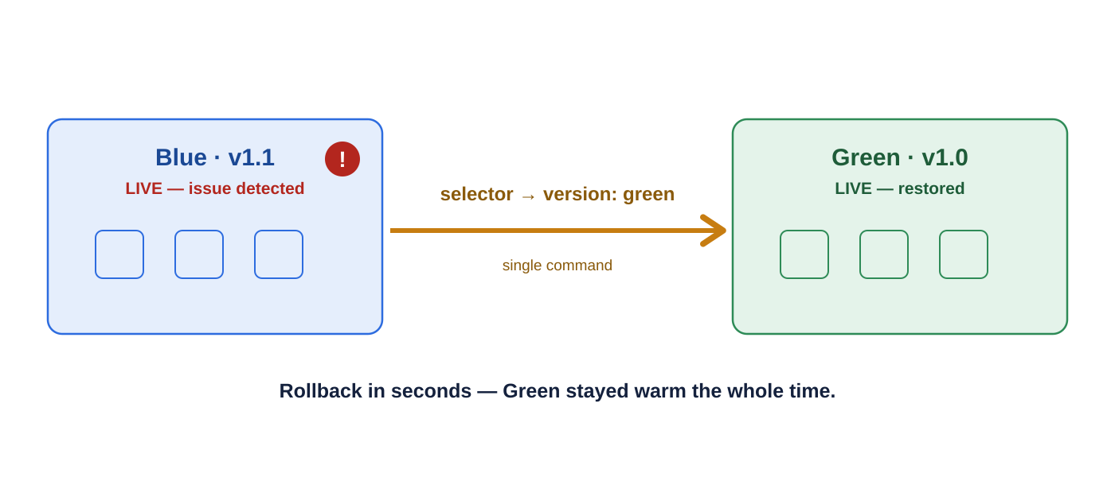

The release process, step by step
Rollback: seconds, not hours
1
Deploy Blue alongside Green
Stand up the new version at full capacity. Green keeps
serving 100% of traffic.
2
Validate Blue privately
Run automated smoke tests + QA against preview.
real cluster, real dependencies.
3
Cut over
Flip the prod Service selector to Blue.
Traffic moves in seconds.
4
Observe
If anything looks wrong, flip the selector back to Green. Because Green is still running, recovery is near-instant — no rebuild, no scramble. (After Green is scaled down, scale it back up first.)
Watch error rate, latency and logs. Green stays
warm as the rollback target.
5
Scale Green down
Only after the confidence window. Now Blue is the
new Green.
Notes:
Emphasize the gate at step 2 (no cut-over without passing smoke tests) and the discipline at step 5 (don't scale Green down too early).

Slide 5

Rules we will follow
Each colour runs at full production capacity — never split the live pool.
Readiness / health probes must pass before any pod receives traffic.
Keep Green warm through the entire confidence window.
One source of truth for the selector — GitOps / pipeline, no manual drift.
Automated smoke tests gate every cut-over.
Observability (errors, latency, saturation) reviewed before scale-down.
Database changes are backward-compatible (expand / contract pattern).
Cut-over and rollback are one-command, runbook-driven, and logged.
Notes:
These are the guardrails that make blue-green safe in practice. They become part of our deployment runbook and CI/CD checks.

