Slide 1

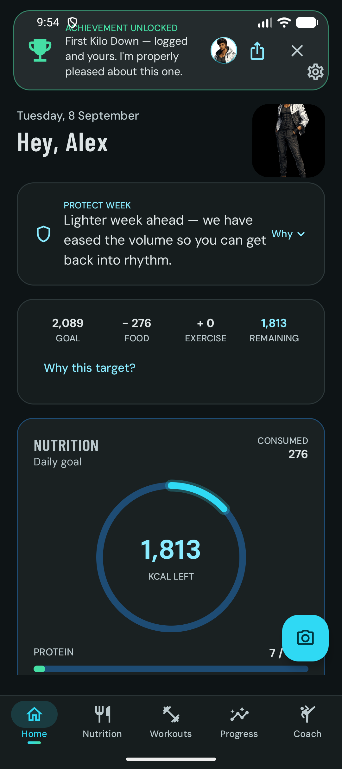
DEMONSTRATION, TECHNICAL PAPER AND WHITE PAPER IN ONE DECK
AquaZeroFit for Android
A native Kotlin and Jetpack Compose client for Google Play, built offline-first around one rule: models identify, code calculates.
Babatundji Williams-Fulwood
Student ID s8138393
NIT3213 Mobile Application Development, Victoria University, Melbourne [1]
App demonstration presentation, September 2026
Home tab, captured on a Pixel emulator running the debug build
Notes:
Opening slide. Introduce yourself, the unit and the app in one breath: AquaZeroFit is a native Android wellness app that photographs meals, sets calorie targets you can check by hand, runs guided home workouts and includes a safety-bounded AI coach. Everything on the screen to the right was captured from the real app on an emulator, not a mock-up.

Slide 2
AGENDA
Table of contents
01
Executive summary
3
13
Technical architecture (section)
15
02
The problem with fitness apps today
4
14
System context
16
03
Product tour: five tabs
5
15
Android technology stack
17
04
Photograph a meal, confirm first
6
16
Layered architecture
18
05
Four ways to log, plus barcodes
7
17
Unidirectional data flow
19
06
Targets you can check yourself
8
18
Offline-first outbox
20
07
Training: readiness and guided sessions
9
19
Networking, tokens and the Keystore vault
21
08
Exercise library with licence attribution
10
20
Dependency injection with Hilt
22
09
Aqua Coach and the persona roster
11
21
Native capabilities
23
10
Progress and the adaptive engine
12
22
Backend and AI gateway
24 to 25
11
Motivation that never punishes
13
23
Security, privacy and permissions
26
12
Why it beats the field
14
24
Quality, release and Google Play
27 to 29
25
How it was built, outcomes, limits
30 to 32
26
Conclusion, references, glossary
33 to 36
Slides 3 to 14 are written for every reader. Slides 15 to 29 go deeper for developers. Citations appear as bracketed numbers and resolve on the reference slides.
AquaZeroFit for Android | NIT3213 Mobile Application Development | Babatundji Williams-Fulwood, s8138393
2
Notes:
Two reading paths: the first half is for any audience, the second half is for engineers. Tell the room they can leave with the first half and still understand the app.

Slide 3
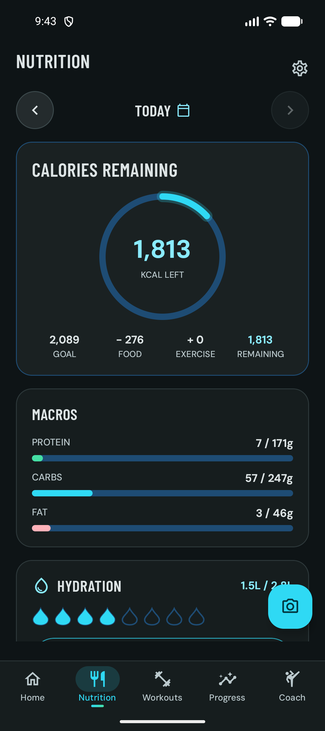
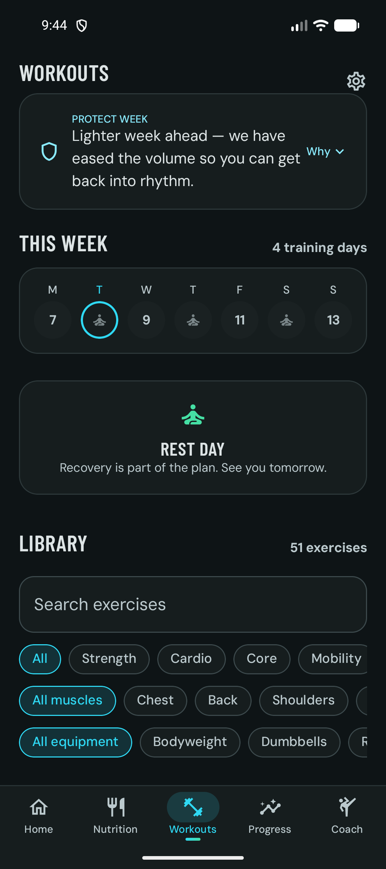



01 EXECUTIVE SUMMARY
One app, one rule: models identify, code calculates
AquaZeroFit is an AI-assisted wellness app under the AquaZero brand [2]. The Android client is a separate native application, not a wrapper around the website, written in Kotlin with Jetpack Compose and shipped through Google Play [3][4]. A user photographs a meal, confirms what the model saw, and every calorie is then multiplied by code from a reference food corpus. The language model never writes a number the user will act on [5].
21
50k
573
5.9 MB
screens in Compose
lines of production Kotlin
Android tests (518 JVM, 55 on device)
signed release APK after R8
Offline-first
Safety in code
Honest numbers
Room is the source of truth. Logs replay through an outbox with idempotency keys, so a gym with no signal still counts.
Calorie floors, allergen exclusion and crisis signposting are enforced by deterministic code, never by a model.
Every target has a Why button that shows the formula. Attribution stays on every exercise record.
Nutrition tab
Workouts tab
AquaZeroFit for Android | NIT3213 Mobile Application Development | Babatundji Williams-Fulwood, s8138393
3
Notes:
Say the rule out loud: models identify, interpret and explain; code calculates, filters and enforces. Then read the four numbers. 21 screens, about fifty thousand lines of Kotlin, 573 automated Android tests, and a 5.9 megabyte release binary. All four are measured from the repository at the commit named on the reference slide.

Slide 4
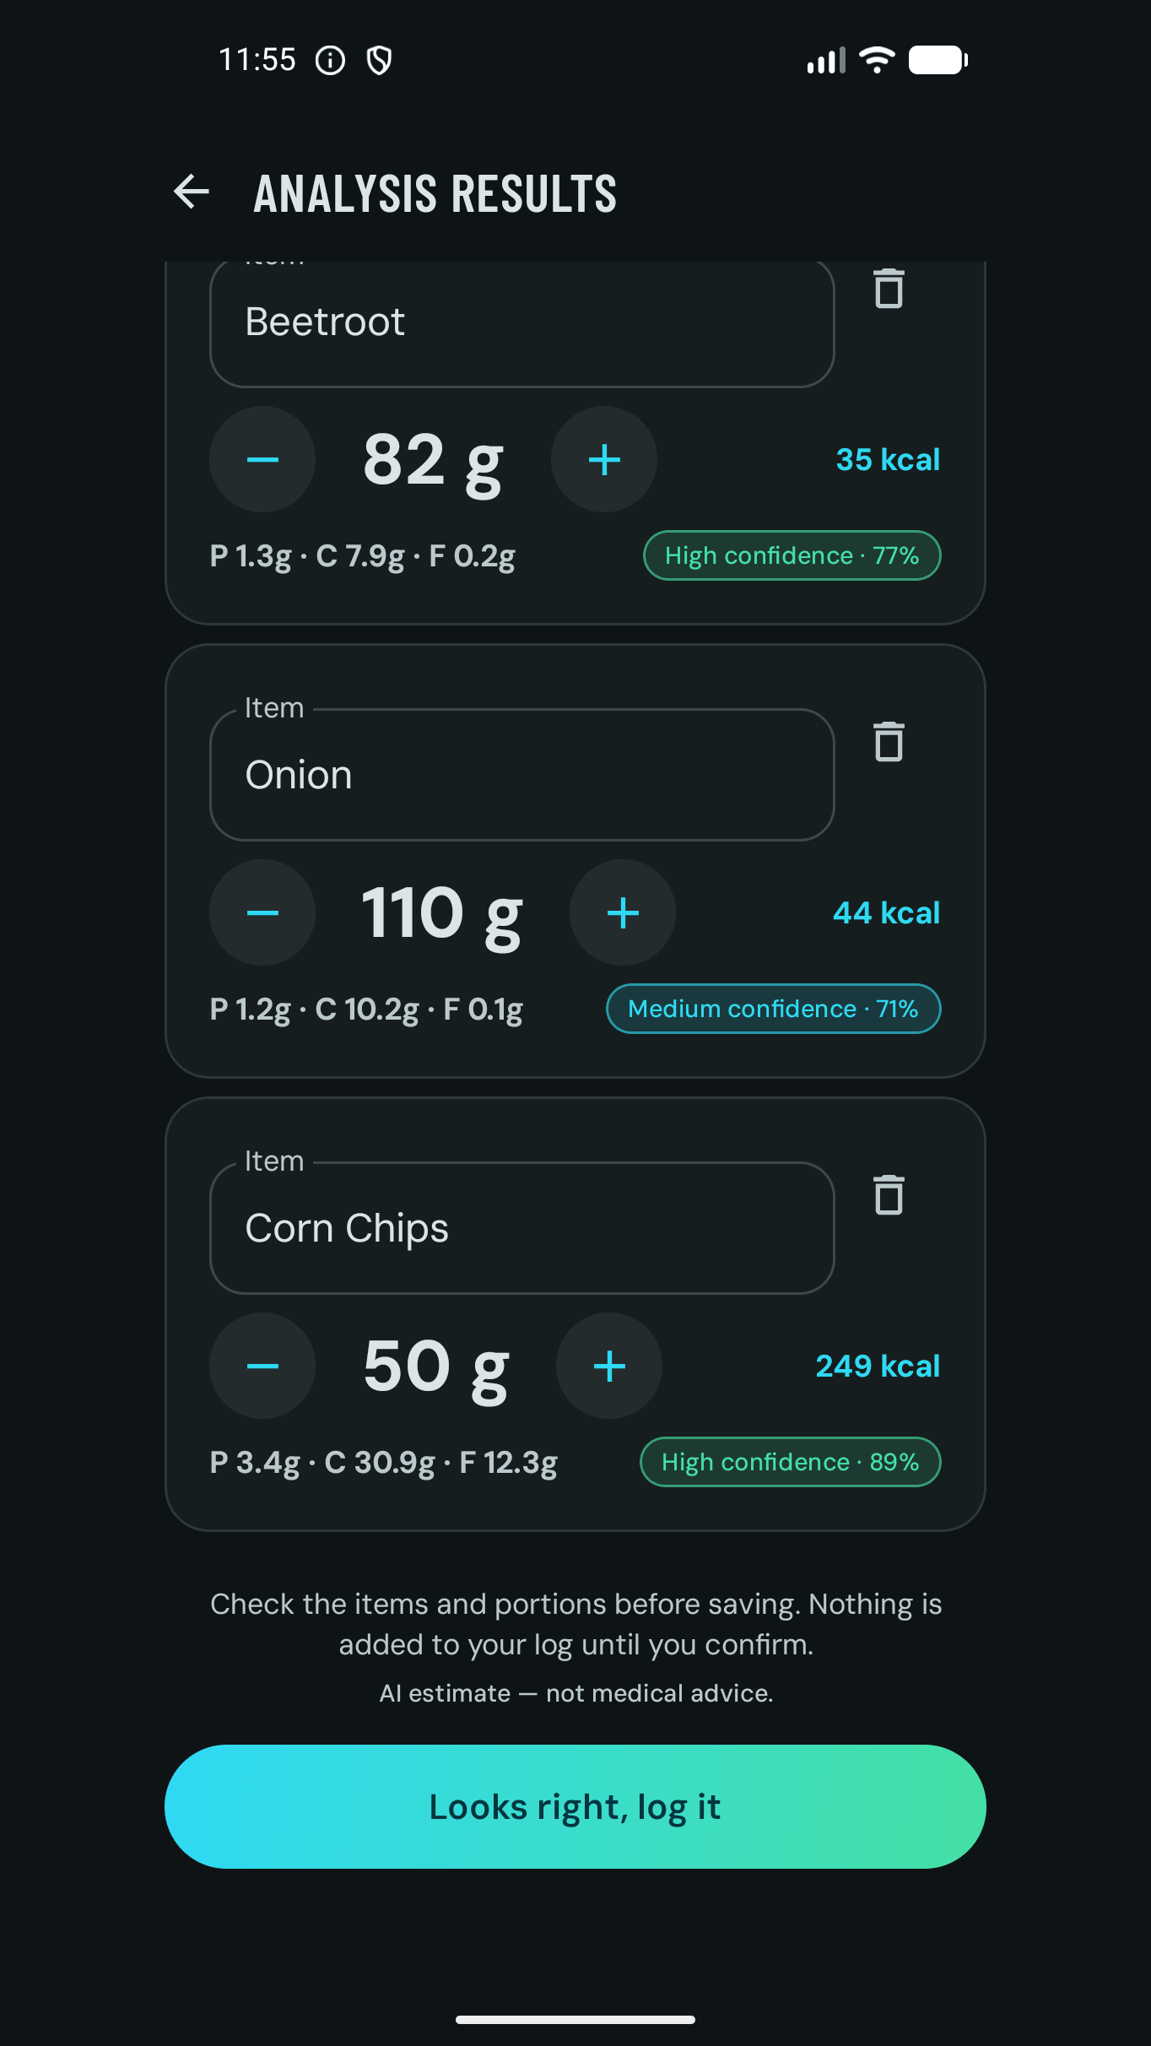




02 THE PROBLEM WITH FITNESS APPS TODAY
The four failures we designed against
Silent wrong numbers
AI that invents
Photo loggers that write a calorie figure straight into the diary teach users to distrust the diary. AquaZeroFit never logs a photo result until the user confirms each item and portion.
A language model asked for calories will produce one whether or not it knows. Here the model returns identifiers and quantities only; kcal is grams times the per-100 g value from the corpus [5].
No signal in the gym
Medical creep
Basements and planes are where logging happens. Every log lands in Room first and syncs later with an Idempotency-Key, so nothing double-counts [4][10].
Wellness apps drift into diagnosis. The coach declines medical, crisis and extreme-diet requests in code and signposts real help, and the disclaimer is pinned on screen [5].
Confirm-first: nothing is added until the user says so
AquaZeroFit for Android | NIT3213 Mobile Application Development | Babatundji Williams-Fulwood, s8138393
4
Notes:
Frame the product as a response to four concrete failures rather than a feature list. The screenshot on the right is the confirmation step after a meal photo: the app says in plain words that nothing is logged until you confirm.

Slide 5
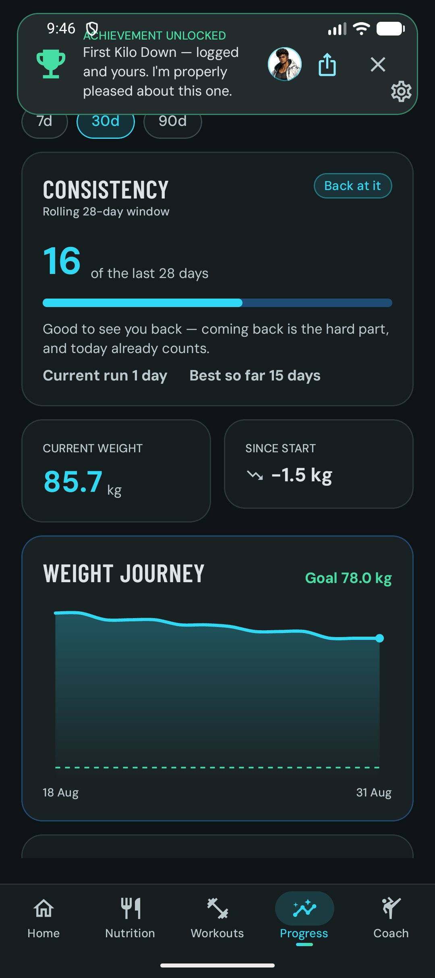
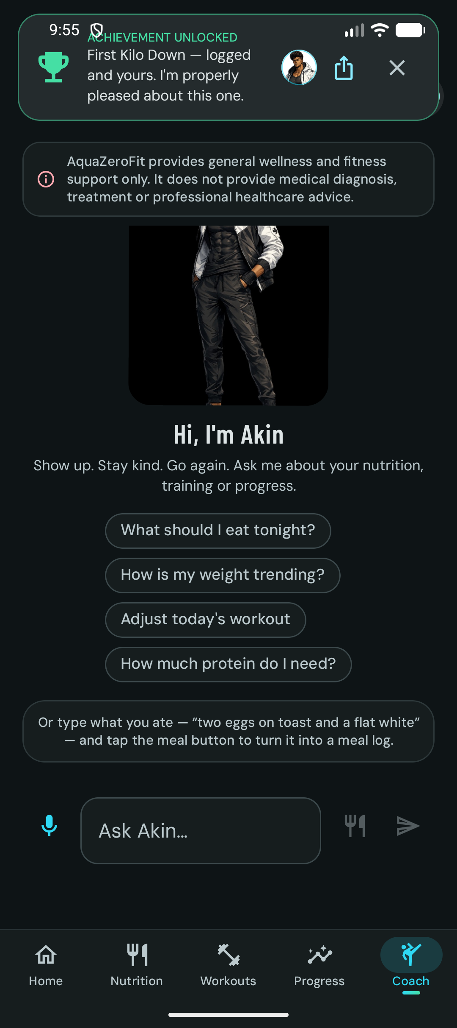
03 PRODUCT TOUR
Five tabs, one daily loop
Home
Nutrition
Workouts
Progress
Coach
Today's rings, readiness and the coach's line
Calories, macros, hydration and the meal timeline
This week's plan, readiness and the library
Consistency, weight journey and calorie trend
Akin, grounded in today's real data
AquaZeroFit for Android | NIT3213 Mobile Application Development | Babatundji Williams-Fulwood, s8138393
5
Notes:
Walk the bottom navigation left to right. The loop is daily: log food and water, do the session, watch the trend, ask the coach. Every tab reads from the local Room database, so switching tabs is instant even with no network.

Slide 6
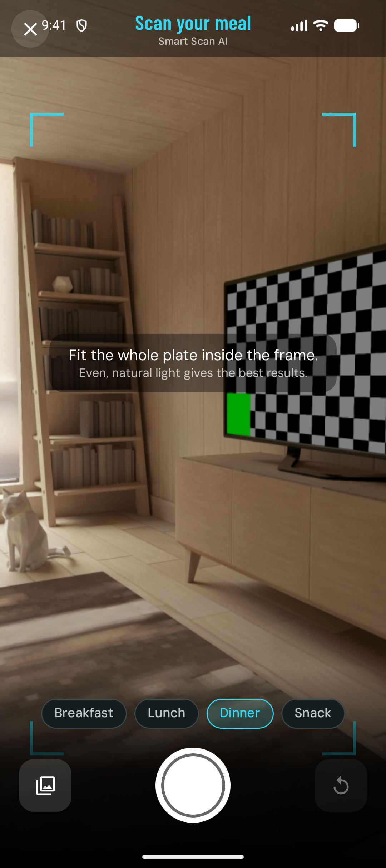
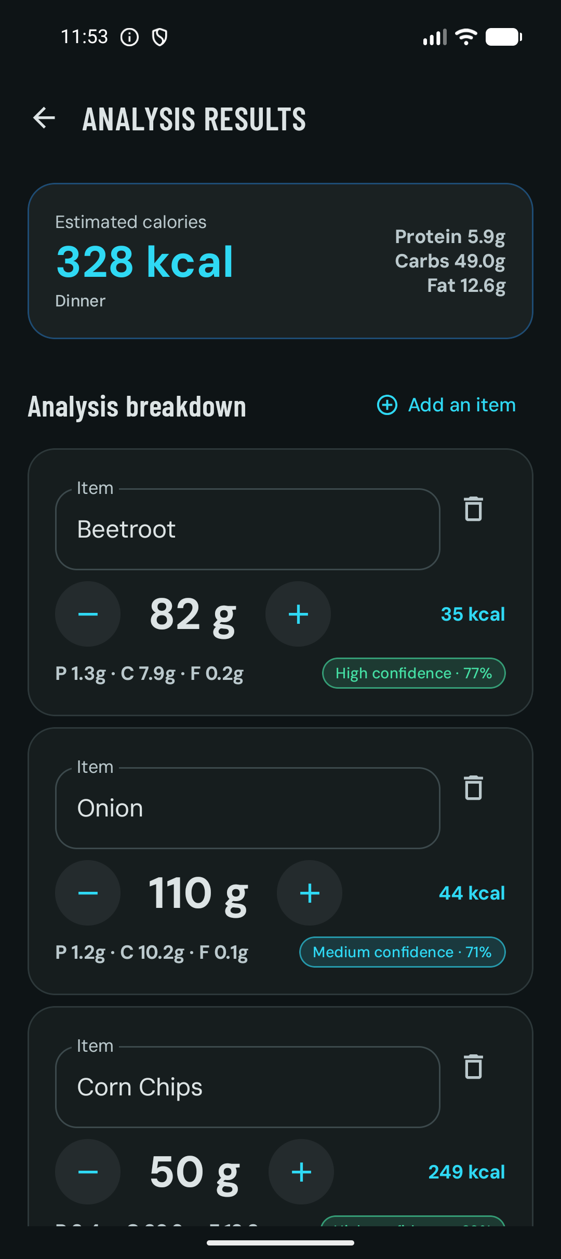
04 SMART SCAN
Photograph a meal, see it counted, confirm before it lands
How it works
The photo is stripped of EXIF, XMP and location metadata before upload and deleted from the server on confirm or after 24 hours [5].
The vision model returns food identifiers, grams and a confidence score. It has no field for calories.
Code multiplies grams by the per-100 g values in the food corpus, so 82 g of beetroot is always 35 kcal.
Confidence bands (high, medium, low) come from a pure Kotlin function, tested on the JVM.
A fat caution appears when the item names suggest frying, sauces or dressings.
1. CameraX capture
2. Items, portions, confidence
3. Edit, then confirm
AquaZeroFit for Android | NIT3213 Mobile Application Development | Babatundji Williams-Fulwood, s8138393
6
Notes:
This is the hero flow. Point at the confidence chips: seventy-seven percent high confidence on the beetroot is the model's honesty made visible. Then stress that the number next to it was computed by code, not by the model. The photo itself is deleted; only the confirmed log survives.

Slide 7
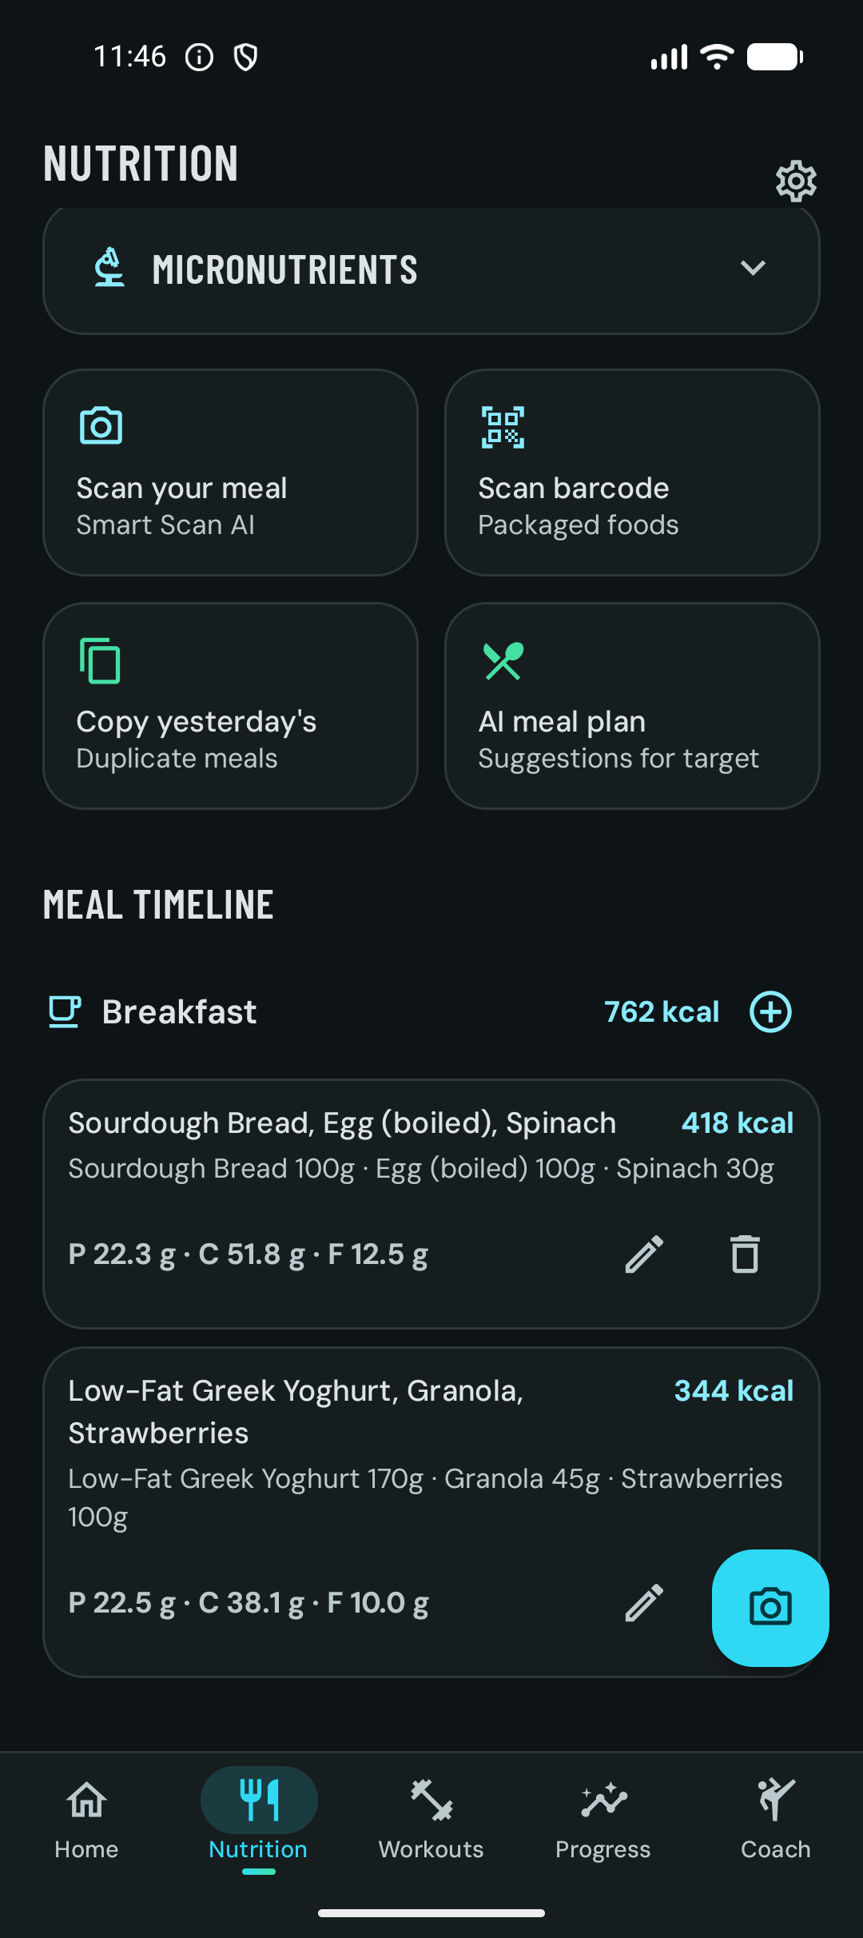
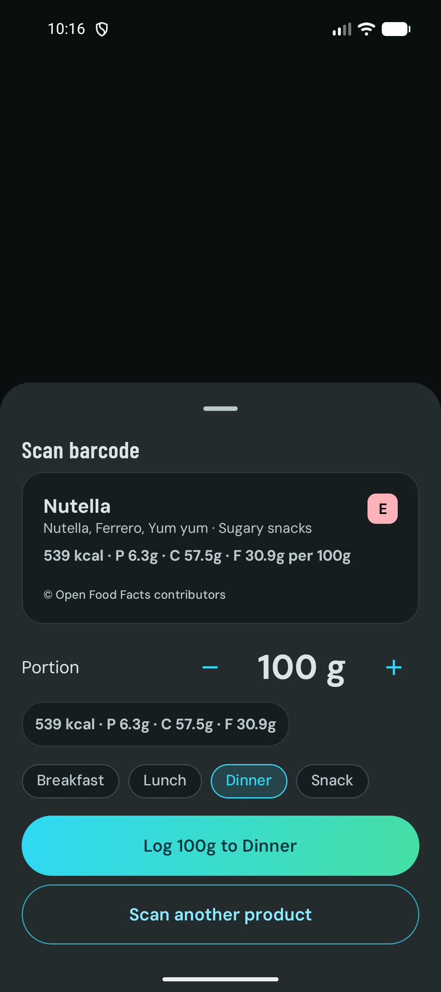
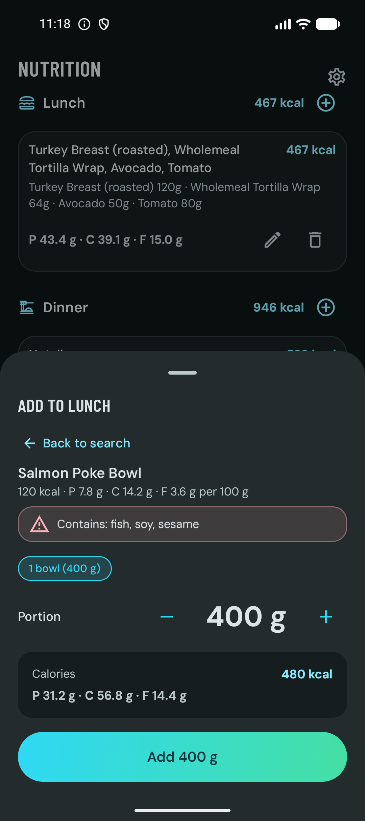




05 LOGGING WITHOUT FRICTION
Four ways to log, and every one of them is free
ML Kit barcode scanning
On-device barcode detection through Google ML Kit, then a lookup against Open Food Facts data held in its own container with the ODbL credit preserved [13][21].
Searchable food corpus
139 curated foods with per-100 g macros and household portions. Recently used items are served from Room when offline.
Copy yesterday
One tap duplicates a previous day's meals into today, the fastest path for people who eat the same breakfast.
Hydration in one tap
Log 250 ml from the Nutrition tab, the Home tab or the home-screen widget without opening the app.
Four ways to log
Barcode result with Open Food Facts credit
Search with allergen warning
AquaZeroFit for Android | NIT3213 Mobile Application Development | Babatundji Williams-Fulwood, s8138393
7
Notes:
Contrast with the market: barcode scanning is a paid feature in some of the most downloaded loggers. Here it is on-device, free, and the data source is credited on the sheet. The allergen warning in the third screenshot is a deterministic filter, not a model opinion.

Slide 8
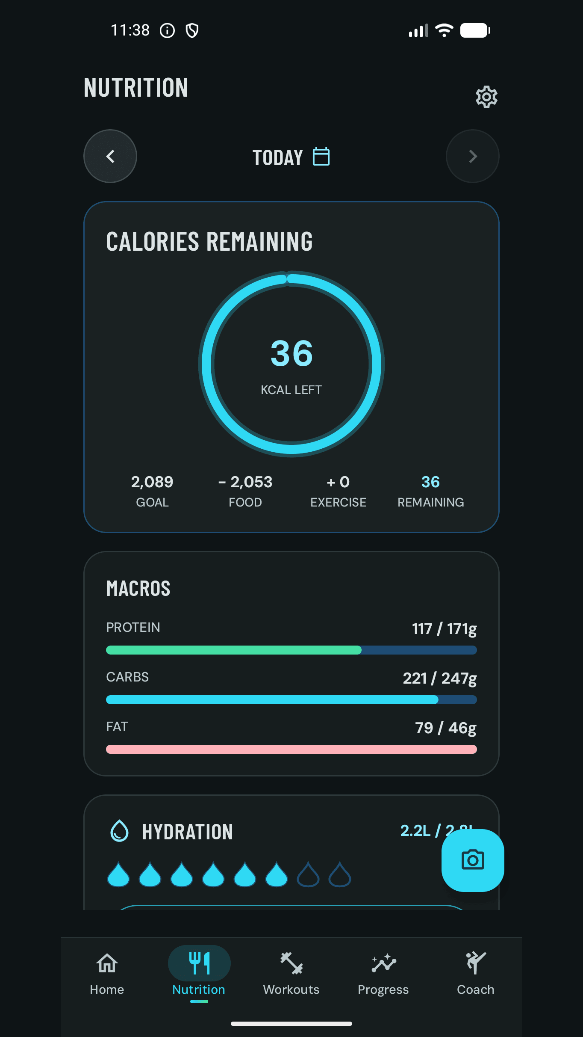

06 DETERMINISTIC NUTRITION MATHS
Targets you can check with a calculator
The formula chain
Why this matters
Basal metabolic rate: Mifflin-St Jeor equation [19]
Total daily energy: BMR times an activity factor from 1.2 to 1.9
Calorie target: energy plus or minus a bounded weekly change
Protein: 2.0, 1.6 or 2.2 g per kg by goal
Fat: at least 20 percent of calories; carbohydrates take the remainder
Water: 33 ml per kg, clamped between 1.5 and 4 litres
A number a user cannot reproduce is a number they cannot trust. Every figure on the Nutrition tab is reachable from the profile fields with a hand calculator.
The Android client re-declares the calculators in pure Kotlin under core/common and tests them on the JVM, with an injected clock so midnight rollover is deterministic [4].
The Why this target sheet in Settings shows BMR, activity and adaptive adjustments in plain language, which is the explainability most apps hide.
Mifflin-St Jeor is the equation with the strongest validation for healthy adults, which is why it was chosen over older formulas [19].
Floors that cannot be argued down
1,200 kcal for female and unspecified users, 1,500 kcal for male users, enforced in code and shown as an advisory when they clamp.
Biometrics outside 30 to 300 kg, 100 to 250 cm or 16 to 100 years are rejected at the boundary, not silently corrected.
The same constants are shared by the web client and the API from one package, so the platforms cannot drift [3].
Goal minus food plus exercise equals remaining
AquaZeroFit for Android | NIT3213 Mobile Application Development | Babatundji Williams-Fulwood, s8138393
8
Notes:
If a marker asks where a number comes from, this slide is the answer. Read the chain: Mifflin-St Jeor, activity factor, bounded weekly change, protein by goal, fat floor, water by weight. Mention that only Mifflin-St Jeor is implemented; there is no body-fat input, so no Katch-McArdle.

Slide 9
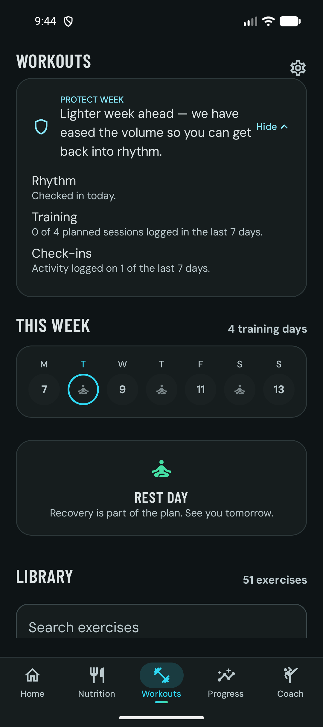
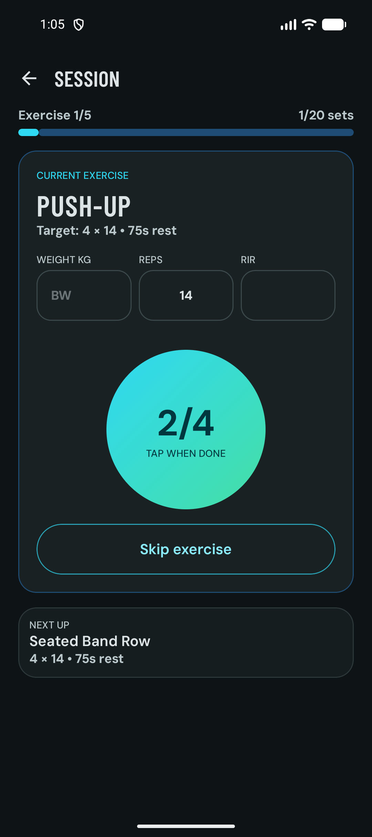




07 READINESS, GUIDED SESSIONS AND PROGRESSIVE OVERLOAD
Training that adapts to how ready you are
Readiness engine
Rhythm, training load and check-ins set a weekly volume multiplier of 0.6 (protect), 1.0 (maintain) or 1.1 (progress) [5].
Live session service
A foreground service of type health carries the rest countdown and its +30 s and skip actions to the lock screen [16].
Progressive overload
A pure Kotlin engine recommends the next load per movement class: compound lower, compound upper, isolation or bodyweight.
Session burn
Completed sessions credit calories back into the day's derivation row, offline, from the cached session entity.
Readiness week
The Why sheet
Guided session
AquaZeroFit for Android | NIT3213 Mobile Application Development | Babatundji Williams-Fulwood, s8138393
9
Notes:
The readiness chip is deliberately explainable: tap Why and it lists rhythm, training and check-ins. The session screen is a real capture mid-workout. Explain that the foreground service type is health, which is the type Google documents for exercise trackers, and that the service fails safe if the prerequisite permission is missing.

Slide 10
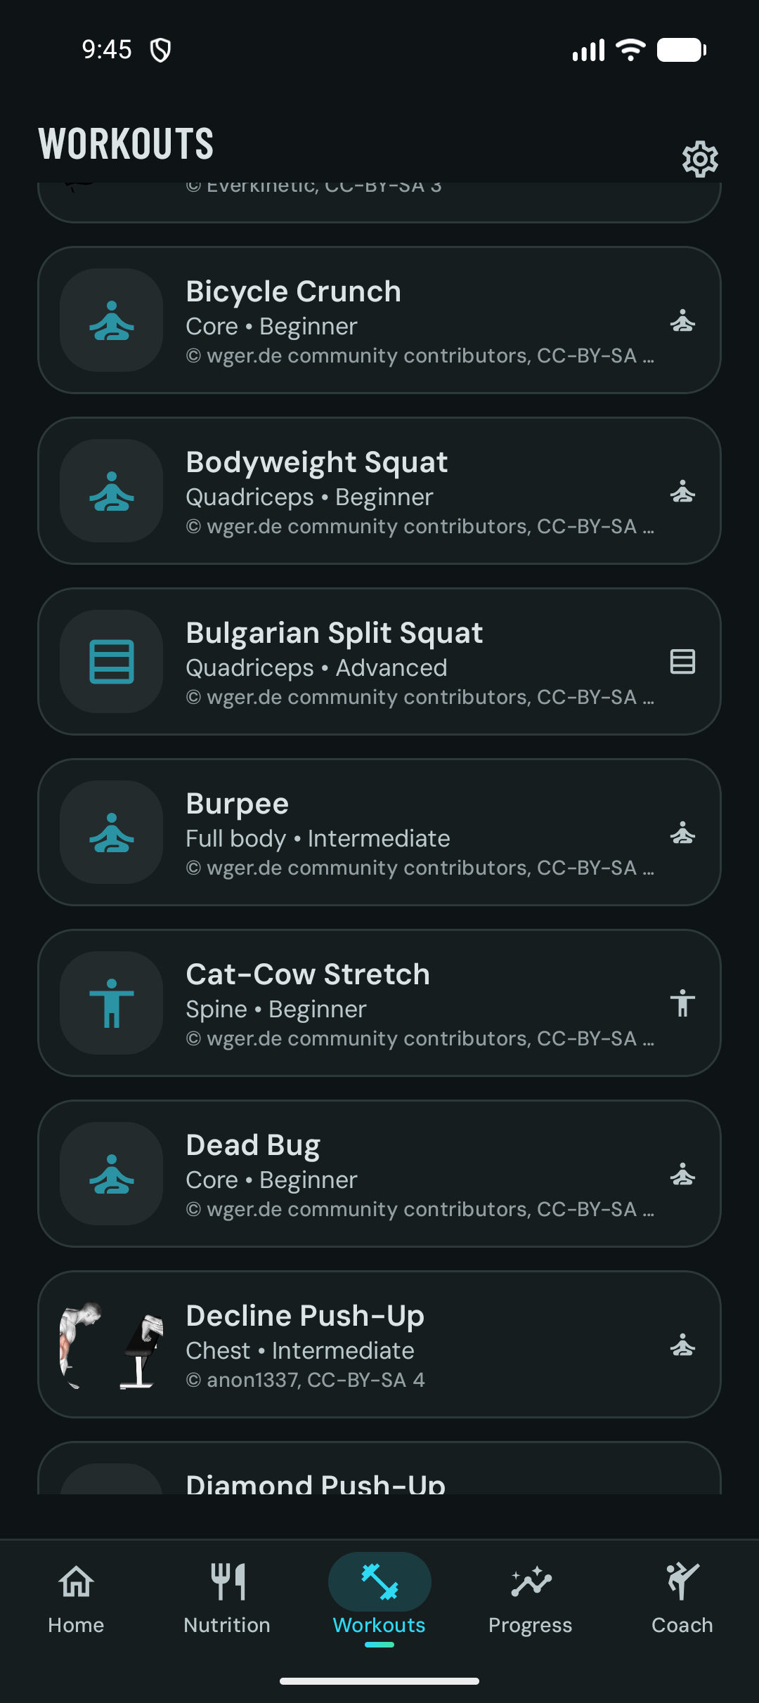
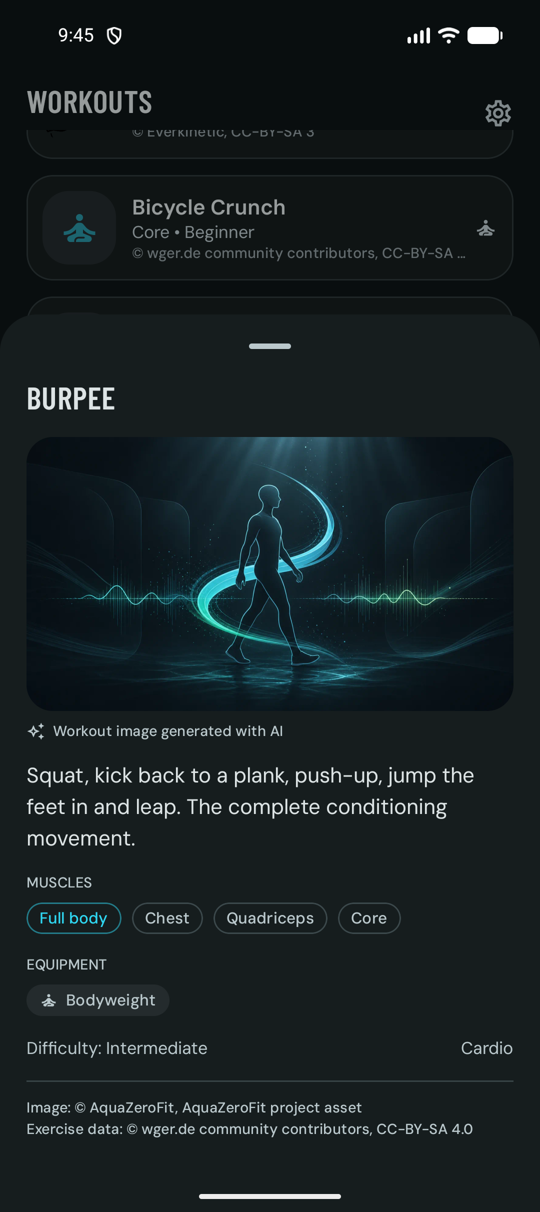


08 ATTRIBUTION AS A FEATURE
An exercise library that credits its sources on every card
Openly licensed data, handled properly
Exercise records come from the wger community corpus, licensed per record under CC-BY-SA, CC-BY or CC0 [20].
The importer copies each record's licence and author verbatim; no pipeline strips them. The card shows the credit under the description and beneath each media item.
Demonstration images are labelled as AI-generated on the card where that is the case, so users are never misled about provenance.
The app itself is AGPL-3.0-or-later, the same licence family as the ecosystem it draws from [22].
Filtering before assembly
Offline library
Equipment, then muscle group, then movement type.
Profile injuries and equipment filter the library server-side, which is why the endpoint is never cached publicly.
The catalogue is cached in Room, so the library opens with no network.
Media is mirrored from the app's own origin, never hot-linked from a volunteer-run server.
51 exercises with filters
Detail sheet with credit line
AquaZeroFit for Android | NIT3213 Mobile Application Development | Babatundji Williams-Fulwood, s8138393
10
Notes:
Attribution is normally a footnote. Here it is rendered on the card because the data licence requires it and because it is a trust signal. Mention that the wger project is itself AGPL and that no wger code is vendored: the integration is data plus an independent reimplementation.

Slide 11
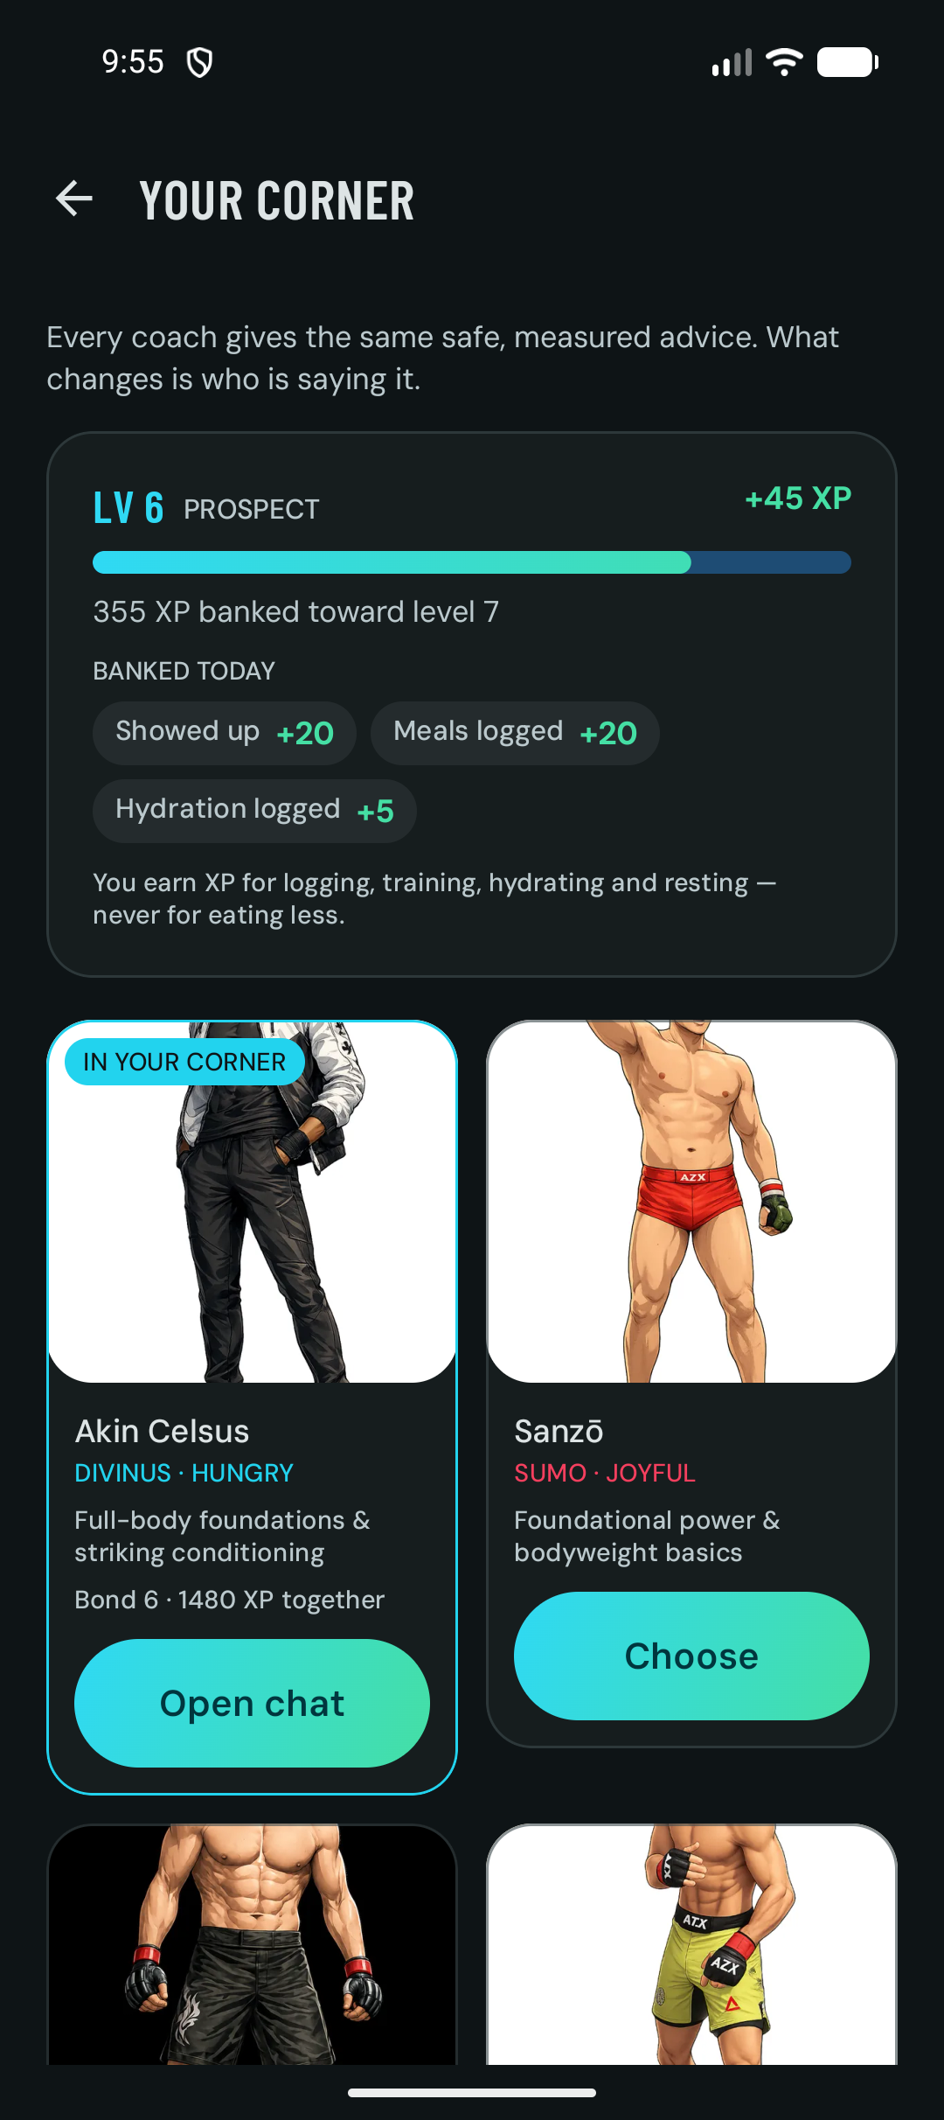


09 AQUA COACH AND THE PERSONA ROSTER
A coach that knows your day and knows its limits
Grounded every turn
Bounded in code
Today's nutrition, the current workout, the progress summary and confirmed memory facts are injected per turn.
Replies stream over server-sent events, token by token, on a dedicated OkHttp client.
Voice input through RECORD_AUDIO; a typed meal sentence becomes a draft log.
Input and output pass a deterministic classifier first: crisis beats medical beats extreme diet beats out of scope [5].
A crisis message stops the model and signposts Lifeline 13 11 14 [27].
Numeric claims are checked against the calorie floor before display.
Personas, memory and consent
28 coach identities are defined and 19 ship with character art; Akin is the default. Progression, XP and unlocks are decided by the server, never by the client.
Coach memory holds facts the user has confirmed, capped at 60, reviewable and deletable in Settings. Personalisation is off until explicit consent and revocable at any time.
Every AI action costs credits from an append-only ledger: 1 for a message, 3 for a meal photo, 5 for a plan. A degraded (template) answer is never billed [5].
Akin, boundary pinned
Coach roster and rank
AquaZeroFit for Android | NIT3213 Mobile Application Development | Babatundji Williams-Fulwood, s8138393
11
Notes:
Two points to land: the coach is grounded in real logged data, and the safety boundary is enforced by code before any model runs. If asked about jailbreaks, the answer is that the classifier is pattern-matching in TypeScript and runs on both input and output; a model cannot renegotiate it. Do not quote the persona count as twenty-eight in marketing; nineteen have art.

Slide 12
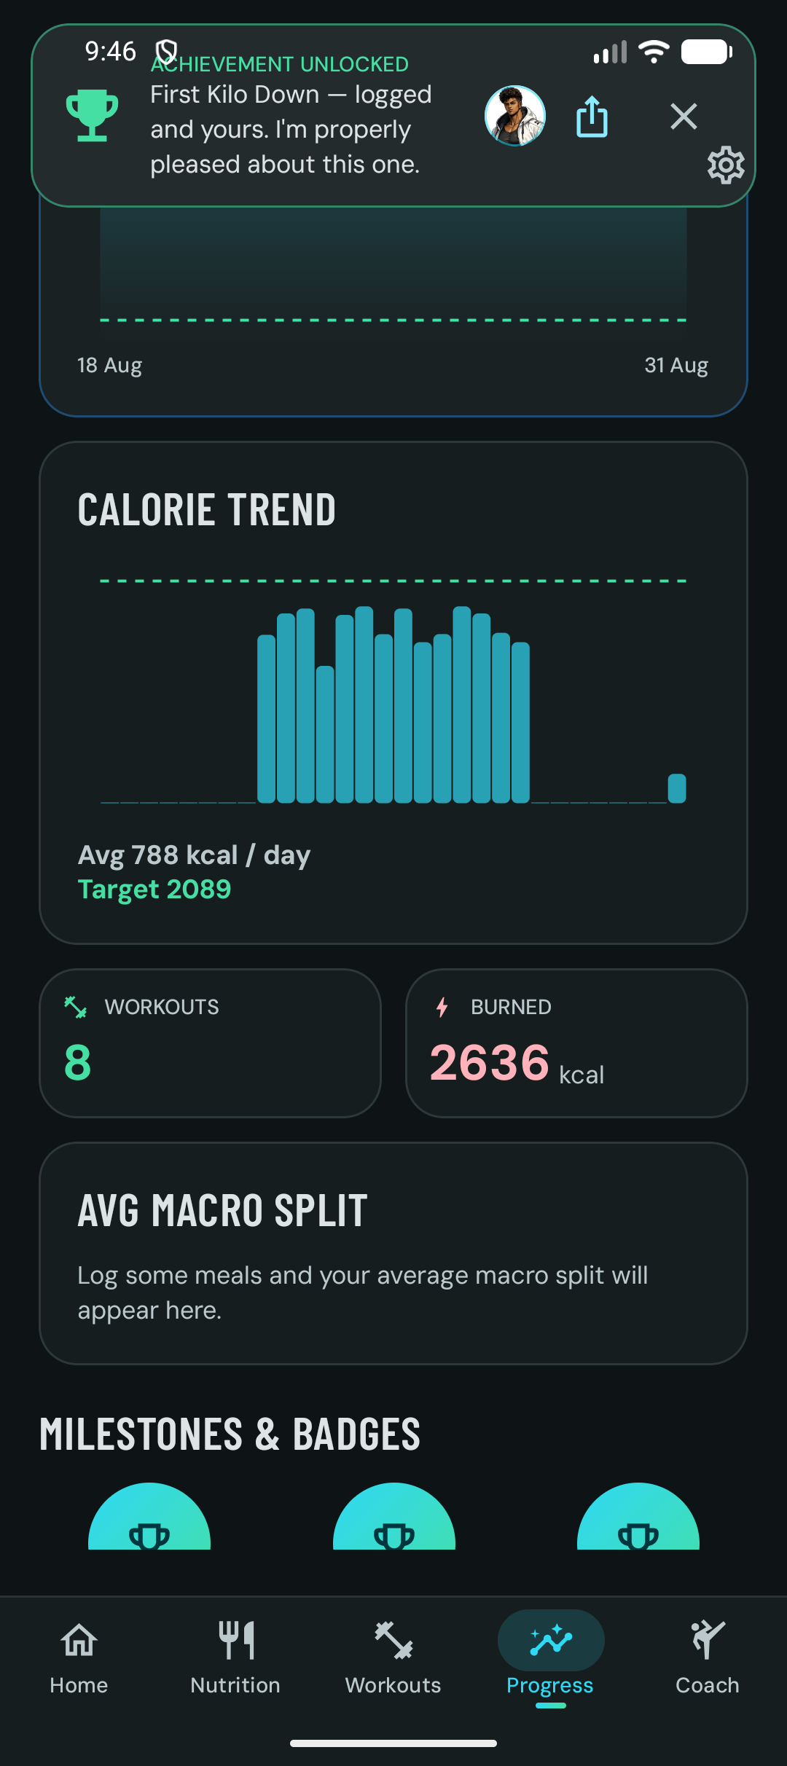
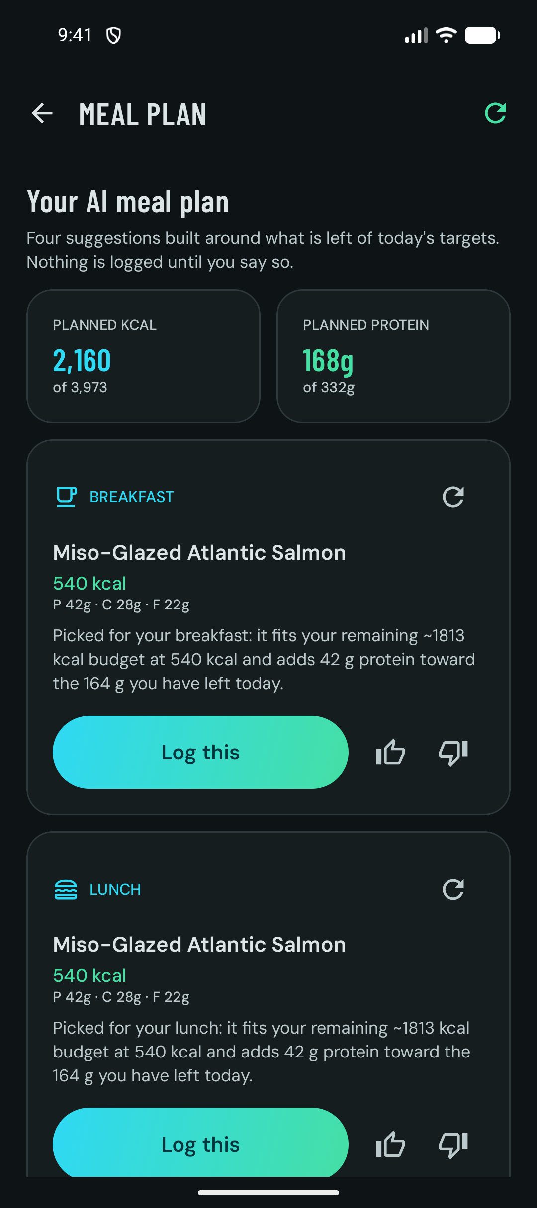

10 PROGRESS AND THE ADAPTIVE EXPENDITURE ENGINE
Readable progress and a metabolism model that explains itself
Adaptive expenditure engine
An exponentially weighted moving average smooths scale weight, then weight velocity is matched against logged intake over a rolling window.
Adjustments are clamped to plus or minus 100 kcal per week and never breach the safety floors.
Confidence is reported as high, moderate or low, with a written reason.
Honest insights
Insights describe the data. They never diagnose and never moralise.
Meal suggestions are one per slot for today, built around what is left of the targets, and nothing is logged until the user taps Log this.
Consistency and weight journey
Calorie trend and badges
Meal suggestions per slot
AquaZeroFit for Android | NIT3213 Mobile Application Development | Babatundji Williams-Fulwood, s8138393
12
Notes:
The adaptive engine is the feature that competes with subscription-only trackers. It is pure arithmetic in Kotlin under core/common with a full JVM test. Describe the meal plan honestly: it is a day of suggestions, one per slot, not a multi-day plan.

Slide 13
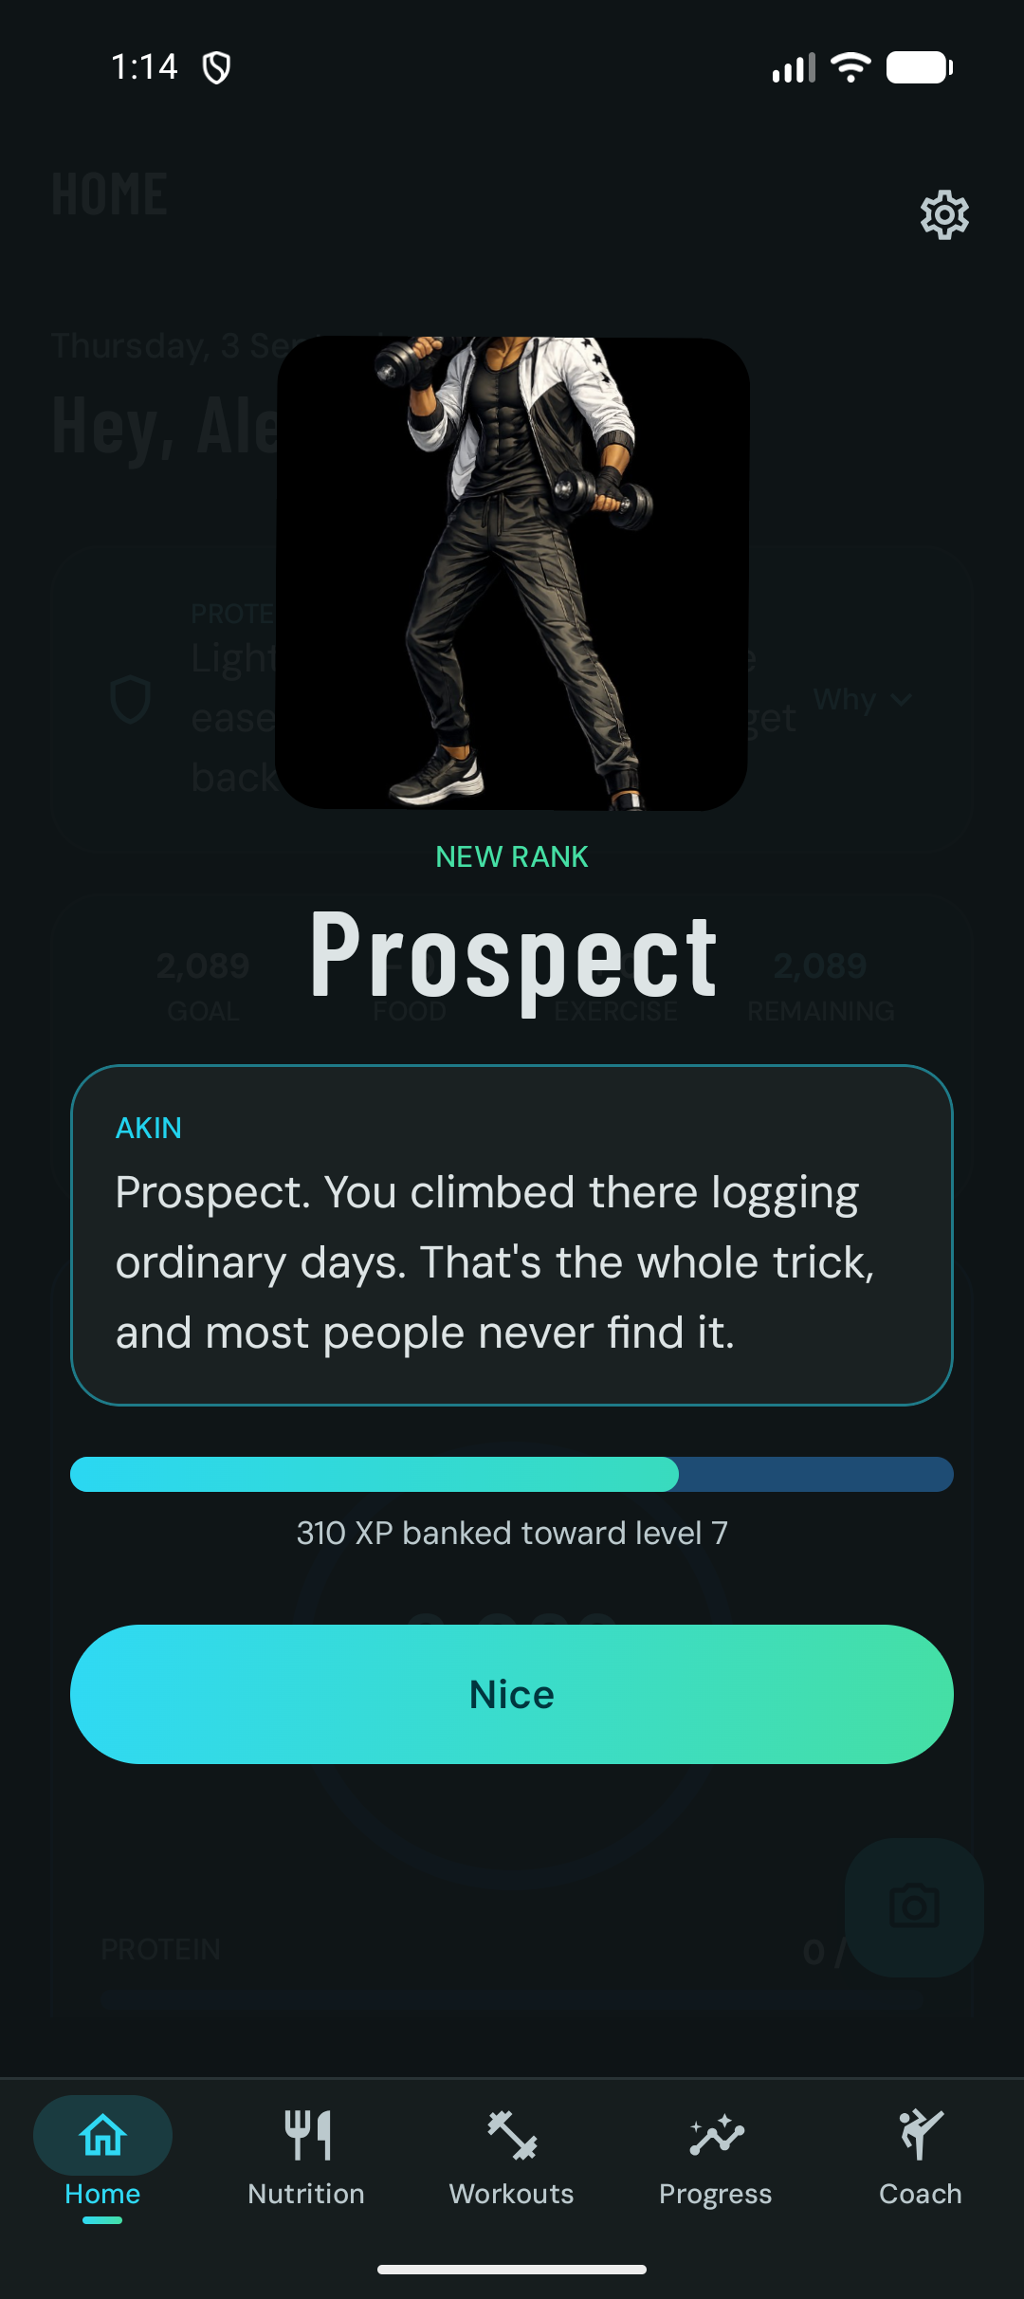




11 RANKS, EXPERIENCE AND ACHIEVEMENTS
Motivation that never punishes
Experience never decreases
A ratchet over server snapshots clamps any regression on the way in. In a product that also holds health data, taking points away is a harm, so the client refuses to render one. Levels follow a triangular curve; ranks such as Prospect unlock at fixed levels [4].
Consistency, not streaks
Celebration done right
Active days inside a rolling 28-day window with one grace day.
A best figure that never goes down; badges are judged against it, so an earned badge is never revoked [5].
A daily experience cap of 150 points keeps the loop about habits, not grinding.
Confetti, haptics and the coach's own line run through one CelebrationHost.
The server is only told a moment was delivered after it has actually been on screen, so a crash never swallows a rank-up.
Buddy huddles: private challenges of up to four people, shared by deep link.
Rank-up moment
Bond and level on Home
AquaZeroFit for Android | NIT3213 Mobile Application Development | Babatundji Williams-Fulwood, s8138393
13
Notes:
The documented harm in habit apps is the punishment shown for a missed day. Explain the consistency model: a rolling window, a grace day, and a best figure that never decreases. The rank-up screenshot is real; the persona is Akin.

Slide 14
12 COMPETITIVE POSITIONING
Why it beats the field
Capability | AquaZeroFit | MyFitnessPal | MacroFactor | Hevy / Strong | Noom
Photo logging with mandatory confirm step | Yes | Partial | Partial | No | Partial
Barcode scanning on the free tier | Yes | No | No free tier | n/a | Yes
Formula shown for every target (Why sheet) | Yes | No | Partial | n/a | No
Adaptive expenditure model | Yes | No | Yes | No | No
Guided sessions with lock-screen rest timer | Yes | No | No | Yes | Partial
AI coach with coded crisis and medical guardrails | Yes | Undocumented | Undocumented | n/a | Undocumented
Offline-first logging with idempotent sync | Yes | Partial | Partial | Yes | No
Per-record data licence shown in the app | Yes | No | No | No | No
Every feature available on the free tier | Yes | No | No | Partial | No
Open source (AGPL-3.0-or-later) | Yes | No | No | No | No
Competitor cells summarise features each vendor documents publicly on its own website and support pages, reviewed in September 2026 [24]. Partial means the capability exists with a material restriction, such as a paid tier or no confirmation step. Undocumented means the vendor does not publish how the behaviour works, which is itself the point: AquaZeroFit publishes its classifier, its formulas and its source.
AquaZeroFit for Android | NIT3213 Mobile Application Development | Babatundji Williams-Fulwood, s8138393
14
Notes:
Be fair and specific. MacroFactor's adaptive model is excellent and is credited as such; the difference is that AquaZeroFit adds guided training, an AI coach with coded guardrails, a free tier that keeps every feature, and open source. MyFitnessPal moved barcode scanning behind its paid tier in 2022. Hevy and Strong are strength loggers with no nutrition. Noom is coaching-led and subscription-only.

Slide 15

PART TWO
Technical architecture
How the Android client is put together: the stack, the layered package graph, unidirectional state, the offline outbox, networking and secrets, dependency injection, native platform features, the backend it speaks to, and the engineering that gets it onto Google Play.
Numbers on the following slides are measured from the repository, not estimated [3][4].
AquaZeroFit for Android | NIT3213 Mobile Application Development | Babatundji Williams-Fulwood, s8138393
15
Notes:
Transition slide. Warn non-technical listeners that the next fifteen slides are for developers, and that the conclusion returns to plain language.

Slide 16
13 ARCHITECTURE OVERVIEW
System context: three clients, one frozen API contract
Android app
Kotlin, Compose, Room, Hilt
API SERVICE, /API/V1
Document store
JSON files in dev, PostgreSQL in production
10 logical containers
Node.js 20, Express, TypeScript
22 feature modules, 58 route handlers
Helmet CSP, per-IP rate limits
JWT access 15 min, rotating refresh 30 days
Idempotency-Key replay window 24 h
Append-only credit ledger
Web app
React 18, TypeScript, Vite
AI gateway
Groq, OpenAI, Gemini, NVIDIA NIM, Ollama
deterministic mock as the final fallback
Telegram Mini App
same React build
The Android client is the surface where offline matters, so it is the only client with a local database, an outbox and a background sync worker. Shared safety constants live in one package consumed by web and API; Android re-declares them in Kotlin with tests that pin the values [3].
Production host: app.aquazero.fit on Google Cloud Run with Cloud SQL. The debug build points at 10.0.2.2:4000, the emulator's route to the developer's machine [4].
Open data: wger exercises, Open Food Facts
AquaZeroFit for Android | NIT3213 Mobile Application Development | Babatundji Williams-Fulwood, s8138393
16
Notes:
Read left to right: three clients, one API, storage and AI behind it. Emphasise that the Android app is a peer of the web client, not a WebView, and that it is the only client with a local database because it is the only one used where there is no signal.

Slide 17
14 TOOLCHAIN AND LIBRARIES
Android technology stack, pinned versions
Layer | Technology | Version | Role in the app
Language | Kotlin, JVM target 17 | 2.3.20 | All production and test code; coroutines and Flow for async [29]
UI | Jetpack Compose, Material 3, Compose BOM | 2026.08.00 | Every one of the 21 screens is declarative; no XML layouts [7]
Navigation | Navigation 3 | 1.1.7 | Type-safe back stack; Hilt ViewModel integration without the Nav 2 artifact
Persistence | Room 3 with KSP | 3.0.2 | 23 entities, 9 DAOs, exported schema, migration tests [8]
DI | Hilt (Dagger) | 2.60.1 | 14 modules, 25 HiltViewModels, constructor injection only [9]
Network | Retrofit, OkHttp, kotlinx.serialization | 3.0.0 / 5.5.0 | Three clients: api, authless refresh, SSE streaming
Background | WorkManager | 2.11.2 | Outbox replay with constraints and backoff [10]
Camera and ML | CameraX, ML Kit barcode | 1.6.2 / 18.3.1 | Meal capture and on-device barcode scanning [13][14]
Platform | Health Connect, Glance, Play Billing | 1.1.0 / 1.2.0 / 9.1.0 | Steps and heart rate in, weight out; widget; premium subscription [11][12][15]
Build | Android Gradle Plugin, Gradle, detekt, ktlint | 9.3.2 / 9.5.0 | compileSdk 37, targetSdk 36, minSdk 26; R8 minified signed release
minSdk 26 covers Android 8.0 and later; targetSdk 36 satisfies Google Play's current target API requirement. Versions are read from gradle/libs.versions.toml in the repository [4].
AquaZeroFit for Android | NIT3213 Mobile Application Development | Babatundji Williams-Fulwood, s8138393
17
Notes:
Do not read every row. Point out three things: it is Compose only with no XML, Navigation 3 rather than the older Navigation component, and Room 3 with exported schemas so migrations are testable. Everything is pinned in a version catalogue.

Slide 18

15 LAYERED ARCHITECTURE
One Gradle module, layered by package, one-way graph
app: MainActivity, navigation shell, Glance widget, DI wiring
The invariant
No feature imports another feature, and nothing under core imports a feature.
Phase 1 of the modularisation plan removed every feature-to-feature edge; the graph is now measured, not assumed [4].
Until Gradle modules enforce it, a two-line grep in the README prints nothing when the graph is clean.
FEATURE: 21 SCREENS, 25 VIEWMODELS
dashboard
nutrition
training
progress
coach
settings
onboarding
challenges
CORE: SHARED, FEATURE-AGNOSTIC
Why one module today
model
common
database
network
DTOs, ApiResult; no Android imports
energy, nutrition, overload, XP maths
Room 3, 23 entities, schemas
Retrofit, 3 OkHttp clients, SSE
Build files for empty modules would never be validated by Gradle, so they are deliberately not kept on disk ahead of the move.
The split is specified with the measured dependency graph and execution order in docs/plans; it follows Google's recommended layering [6].
auth
sync
designsystem
ui
Keystore vault, session lifecycle
outbox, WorkManager, connectivity
Compose primitives, motion
shared composables, formatters
gamification
health
vision
telemetry
celebration, confetti, brag cards
Health Connect gate
pose landmark maths
crash and analytics seams
AquaZeroFit for Android | NIT3213 Mobile Application Development | Babatundji Williams-Fulwood, s8138393
18
Notes:
This mirrors Google's guide to app architecture: UI layer, domain logic in pure Kotlin, data layer underneath. The unusual discipline is the grep-enforced rule that features never import each other; that is what makes the future module split mechanical rather than a rewrite.

Slide 19


16 PRESENTATION PATTERN
State flows one way: UiState out, events in, effects on a channel
Composable screen
renders an immutable UiState
user events
@HiltViewModel
StateFlow<UiState>
Channel<Effect>
suspend calls
Repository interface
Room first, API second
StateFlow, Channel
Flow from Room
Rules the code keeps
Testing at the seam
Sample of the shape
ViewModels emit string resource ids, never formatted text, so they hold no Context and run on the JVM.
One-shot effects (toast, navigation, share sheet) go through a Channel so a recomposition cannot replay them.
An injected java.time.Clock makes midnight rollover deterministic in tests.
Hand-written fakes at each @Binds interface: FakeDashboardData, FakeNutritionData, FakeCoachesRepository.
StandardTestDispatcher with Dispatchers.setMain for every ViewModel test.
518 JVM tests across 63 classes run in CI on every push [4].
data class DashboardUiState(
val kcalTarget: Int,
val kcalConsumed: Int,
val readiness: Readiness?,
val messageRes: Int? = null,
)
sealed interface Effect {
data class Toast(val res: Int) : Effect
}
AquaZeroFit for Android | NIT3213 Mobile Application Development | Babatundji Williams-Fulwood, s8138393
19
Notes:
This is the standard Android recommendation for UI state, applied strictly. The detail worth saying aloud is the string resource id rule: because ViewModels never format text, they never need a Context, and that is what keeps five hundred tests on the JVM instead of on an emulator.

Slide 20

17 SYNC DESIGN
Offline-first: Room first, outbox replay, idempotent sync
1
2
3
4
5
6
User logs a meal, water or weight
Row written to Room, UI updates instantly
Outbox row created with a fresh Idempotency-Key
WorkManager job runs when connected
POST replayed; server dedupes by sha256(user, path, key)
Row marked SYNCED; pruned after 7 days
Why it cannot double-log
Separation for testability
What stays online-only
The key is generated once per operation and never reused with a different payload; the server replays the cached response for 24 hours [4].
A double-send after a dropped response therefore returns the original result instead of a second row.
OutboxDrainer decides what to send and needs no Context, so it is tested on the JVM.
SyncWorker is only the shell that maps DrainResult onto a WorkManager Result with retry and backoff [10].
A ConnectivityMonitor triggers a drain the moment the network returns.
Coach chat, meal photo analysis and meal suggestions call models, so they require a connection by design.
Meal photos queue through their own upload worker so a capture in a basement is analysed later, not lost.
Failures are never pruned; they stay visible until the user resolves them.
AquaZeroFit for Android | NIT3213 Mobile Application Development | Babatundji Williams-Fulwood, s8138393
20
Notes:
Walk the six steps. The interesting engineering is step five: the server fingerprints the user, the path and the key, not the body, so the client must never reuse a key with a different payload, and the code comments say so. Instrumented tests cover the outbox state machine on a real device.

Slide 21


18 NETWORK AND AUTHENTICATION
Networking and secrets: three clients, one refresh path, one vault
api
Headers plus TokenAuthenticator. Every authenticated call.
Token lifecycle
Keystore vault
Access token: JWT, 15 minutes, held in memory [25].
Refresh token: opaque, 30 days, single use, rotated; reuse revokes the family.
401 triggers one refresh in flight; callers wait on it rather than racing.
Refresh tokens are sealed with AES-GCM using a key generated inside the Android Keystore, StrongBox when available [28].
A failed StrongBox provisioning falls back rather than crashing the sign-in tap.
KeystoreAead is an interface so tests substitute a fake.
authless
Headers only. Used by the refresh coordinator so a refresh can never trigger itself.
sse
The api client with a 180 s read gap for streaming coach replies.
The deadlock that was designed out
Session and isolation
Deriving the clients from one builder copied the Dispatcher reference, so five concurrent 401s filled the per-host budget and the refresh queued behind the calls waiting on it. Each client now owns its Dispatcher; only the connection pool is shared. The comment in NetworkModule records why [4].
SessionManager owns sign-in, refresh failure and sign-out; a different user signing in purges every user-scoped table and the outbox before the first read.
Debug builds talk to the local API; legal pages always open the published site so a privacy policy is never served from a laptop.
Default cache policy is private, no-store; only byte-identical catalogue reads opt into a five-minute public cache, per RFC 9111 [25].
AquaZeroFit for Android | NIT3213 Mobile Application Development | Babatundji Williams-Fulwood, s8138393
21
Notes:
The three-client split is load-bearing. Tell the deadlock story briefly: shared dispatcher, five concurrent 401s, refresh starved. Then the vault: the token is encrypted with a key that never leaves hardware, and the interface is faked in tests.

Slide 22

19 WIRING
Dependency injection with Hilt, end to end
14
25
73
0
@Module classes
@HiltViewModel classes
files with @Inject
service locators or static singletons
Interfaces where a seam is needed
Hilt in tests too
The one exception, on purpose
DashboardData, NutritionData, CrashReporter, AnalyticsTracker, KeystoreAead and CoachVoiceEngine are bound with @Binds.
Tests substitute fakes at exactly those seams; nothing else is mocked.
@Named qualifiers separate the three OkHttp clients and two Retrofit instances [9].
AzfTestRunner swaps the Application for instrumented runs.
FakeNetworkModule replaces the entire network graph, so device tests never touch the real API.
HiltWorker lets WorkManager workers take constructor dependencies.
EntryPointAccessors appears exactly once: in the Glance widget, because a widget receiver cannot be @AndroidEntryPoint [15].
Everything else is constructor injection, which is what keeps 518 tests on the JVM.
AquaZeroFit for Android | NIT3213 Mobile Application Development | Babatundji Williams-Fulwood, s8138393
22
Notes:
The numbers are counted from the source tree. The talking point is discipline: interfaces exist only where a fake is needed, and the single service-locator style access is documented and justified by a platform limitation.

Slide 23




20 PLATFORM INTEGRATION
Native superpowers the web client cannot match
CameraX meal capture
ML Kit barcode
Health Connect
Glance widget
In-app capture with framing guidance; gallery import goes through the system Photo Picker, so no storage permission [14].
On-device scanning through a Play Services dynamic module, prefetched when the Nutrition tab opens [13].
Steps, heart rate, sleep and total calories read; weight written back. Nothing is read until the user connects, re-checked on every call [11].
Today's rings and a one-tap water log drawn from Room, so it is correct with no network [15].
Foreground live workout
Google Play Billing
Coach voice
On-device form check
A health-type foreground service carries the rest countdown and its actions to the lock screen [16].
Server-verified subscriptions through purchases.subscriptionsv2; renewals self-heal and the account id is obfuscated [12].
RECORD_AUDIO for spoken questions to the coach, behind a swappable CoachVoiceEngine interface.
Pose landmark maths for squat depth runs locally; no frame ever leaves the phone.
Each capability sits behind an interface or a repository so a screen degrades to an honest empty state when the capability is absent, rather than crashing [4].
AquaZeroFit for Android | NIT3213 Mobile Application Development | Babatundji Williams-Fulwood, s8138393
23
Notes:
This is the slide that justifies building native rather than wrapping the website. Pick three to say aloud: Health Connect with consent re-checked on every read, the widget that works with no network, and Play Billing verified on the server so a leaked token cannot entitle another account.

Slide 24

21 API SERVICE
The backend the app speaks to
Helmet CSP
CORS
JSON body
Request log
Rate limiter
/api/v1 routers
Store
Error envelope
Modules
Storage abstraction
Operational posture
auth, me, foods, logs, analytics, plans, workouts, progress, recipes, admin, chat, vision, recommendations, challenges, coaches, payments, billing, export, mfa, memory, ai.
22 module directories, 58 route handlers, all validated at the boundary with shared zod schemas [3].
One document-store interface with two backings: JSON files for development and tests, PostgreSQL for production.
Ten logical containers; user-scoped ones are what export and purge iterate.
Single-instance durability by design; scale-out requires moving reads off the local working set, and that limit is recorded, not hidden [5].
Health and readiness probes outside the rate limiter.
Request-id correlation through the stack and persisted error records.
Graceful shutdown with a 25 second drain budget; background sweeps for photo TTL and account deletion grace.
Production refuses to boot on dev secrets [3].
AquaZeroFit for Android | NIT3213 Mobile Application Development | Babatundji Williams-Fulwood, s8138393
24
Notes:
Keep this short for an Android unit: the point is that the app targets a frozen versioned contract, so the client can be tested against fakes and the API can evolve behind it. The store abstraction is why the whole stack runs locally with no database installed.

Slide 25
22 RESILIENT, BOUNDED, BILLED HONESTLY
AI gateway and safety pipeline
visionPrimary
chatFast
planStructured
safetyCheap
insightBatch
What the model may and may not do
Application code names only these logical lanes; providers, timeouts and fallbacks live in one file.
May: identify foods, propose quantities, write a coaching sentence, summarise a week, suggest a swap.
May not: write a calorie figure, override a floor, choose an allergen exclusion, decide an entitlement, or answer a crisis message.
Every call, real or mock, is logged with its lane, provider and outcome.
Prompts are versioned files P-01 to P-12 at the repository root; changing one is a reviewed commit [3].
Consent gates: personalisation and memory extraction never run for an account that has not opted in.
Groq
OpenAI
Gemini
NVIDIA NIM
Ollama
Deterministic mock
Ordered fallback chain: retries with jittered backoff, a per-provider circuit breaker, one overall deadline, and a degraded flag when only the mock answered.
Two-stage classifier
Credit ledger
Stage one is deterministic pattern matching in code on both input and output.
Priority: crisis, then medical, then extreme diet, then out of scope [5].
498 evaluation cases gate the pipeline: 50 assistant, 319 plan, 129 recommendation.
Append-only; the balance is a fold over transactions, never a mutable counter.
Reserve before work, commit after, release on failure, so a crashed job returns its hold.
Free tier 10 credits a day, premium 150, banked to a cap.
AquaZeroFit for Android | NIT3213 Mobile Application Development | Babatundji Williams-Fulwood, s8138393
25
Notes:
The most important sentence: every AI feature works with zero API keys because the deterministic mock is the last link in the chain, and a mock answer is flagged degraded and never billed. Then the classifier: crisis has the highest priority so a distress signal always wins over a food question in the same message.

Slide 26

23 TRUST
Security, privacy and a deliberately lean permission set
CAMERA
INTERNET
Data handling
meal and barcode capture
API access
POST_NOTIFICATIONS
RECORD_AUDIO
Meal photos: size-capped, MIME allow-listed, EXIF and location stripped, unguessable names, streamed only to the owner, deleted on confirm and swept after 24 hours.
Export my data as JSON and a 30-day account deletion grace period are in Settings, matching the Australian Privacy Principles on access and correction [26].
Consents are granular and revocable: wellness processing, AI personalisation, anonymised analytics, reminders.
reminders, live session
coach voice
FOREGROUND_SERVICE_HEALTH
ACTIVITY_RECOGNITION
live workout timer
prerequisite for the health service
health.READ_* (4)
health.WRITE_WEIGHT
steps, heart rate, sleep, calories
weigh-ins back to Health Connect
Not requested, on purpose
Defence in depth
No READ_MEDIA_*: gallery import uses the system Photo Picker.
No location, no storage, no exact alarms, no QUERY_ALL_PACKAGES, and the advertising id permission is stripped from the merged manifest and verified in the release report.
Every permission is a Play review surface, so each one has to earn its place [23].
Rate limiting per IP with a separate authentication lane; bcrypt password hashing; HS256 JWTs with short life; rotating refresh tokens with family revocation.
Client secrets sealed in the Android Keystore; the FileProvider for export is not exported and grants a read-only URI for one file.
R8 minification on release; the release build refuses to package unsigned [4][17].
AquaZeroFit for Android | NIT3213 Mobile Application Development | Babatundji Williams-Fulwood, s8138393
26
Notes:
Read the list of permissions not requested; that is where reviewers relax. Then photos: stripped, private, deleted. The advertising id removal is verified in the manifest merger report of the signed build, which is the kind of evidence Play reviewers respond to.

Slide 27

24 VERIFICATION
Quality: 1,343 automated tests, four gates on every push
ktlintCheck
formatting and import order
detekt
complexity and smells, every raised threshold has a recorded reason
lintDebug
Android Lint: 0 errors, 156 warnings each classified in the README
testDebugUnitTest
518 JVM tests in 63 classes
What the device tests cover
Room DAOs and the outbox state machine, schema-migration readiness against the exported schema, navigation through the signed-in and pre-auth shells, the workout library screen, and purge-on-user-switch. The README warns to trust the test count over the green banner, because a poisoned build cache once ran a truncated suite [4].
Android counts from the README at the cited commit; platform counts from the presentation guide [4][5]. These are test counts, not a coverage percentage; line coverage has not been measured.
AquaZeroFit for Android | NIT3213 Mobile Application Development | Babatundji Williams-Fulwood, s8138393
27
Notes:
Give the honest framing: one thousand three hundred and forty-three passing tests, not a coverage percentage. Then the four gates, which are exactly what CI runs. The anecdote about the build cache is worth thirty seconds: it is why the README tells you to count result files.

Slide 28

25 FROM TAG TO SIGNED BUNDLE
Release engineering: a build that refuses to ship wrong
Signing guard
Version from the tag
A missing keystore used to degrade silently to an unsigned APK with a green build. It is now a hard failure at packaging time; the only escape hatch is an explicit local flag CI never passes.
versionCode and versionName come from the release tag. Play rejects a re-used versionCode, so a constant would have failed every upload after the first.
Two workflows
Static analysis
Measured locally on 29 August 2026; the minified build launched clean with Hilt, Room and serialization intact [17].
android-verify runs the four gates on every push touching apps/android and references no secrets. android-release runs on a tag: gates, signed APK and AAB, then apksigner verification.
detekt pinned to a 2.0 pre-release because the last 1.x cannot run on the JDK 25 shipped with Android Studio; the reason is recorded beside the pin.
Release builds point at https://app.aquazero.fit; debug builds point at the developer machine. The full procedure is in docs/PLAY_STORE_RELEASE_GUIDE.md [3].
AquaZeroFit for Android | NIT3213 Mobile Application Development | Babatundji Williams-Fulwood, s8138393
28
Notes:
Two stories: the silent unsigned build, and the constant versionCode. Both were real defects found before they reached Play, and both are now impossible by construction. The size chart is the R8 payoff.

Slide 29
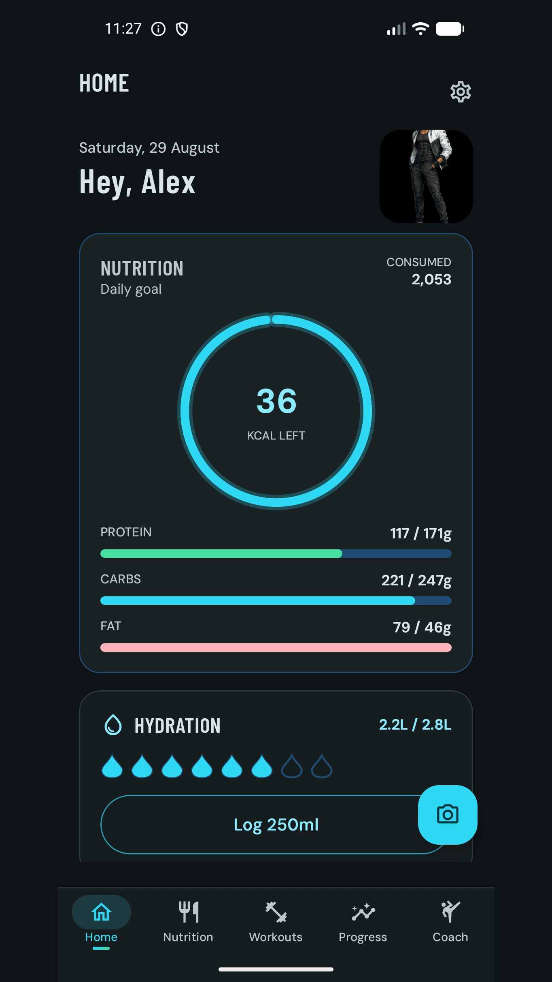
26 STORE LISTING, DECLARATIONS AND THE PATH TO PRODUCTION
Google Play readiness
Console task | Status | Basis
App identity | fit.aquazero.app, Luminara Digital Pty Ltd | Matches applicationId and launcher label
Category and health | Health and fitness; activity and nutrition declared | Chosen over Medical; the app disclaims medical advice in 11 places
Data safety | Submitted, 14 data types | Encrypted in transit; deletion via the support page
Content rating | Rated 3+, in-app purchases declared | IARC questionnaire; AI content answered as online content
Target audience | 16 to 17 and 18 and over | Matches the Terms and the minimum age constant
Advertising id | Not used, verified in the signed binary | Stripped in the manifest merge report
Store listing | Name, 76-character short description, 3,687-character full description, icon, feature graphic, 7 screenshots | Every number traceable to the shared constants
Remaining | Upload AAB, closed testing with 20 testers for 14 days, Health Connect declaration if in scope | Play policy for new developer accounts [23]
Screenshot order is deliberate: the first answers what the app is; the scan and the confirm step sit side by side; the fourth is the trust close [3].
Play listing screenshot 1 of 7, padded to 9:16 in the app's own surface colour
AquaZeroFit for Android | NIT3213 Mobile Application Development | Babatundji Williams-Fulwood, s8138393
29
Notes:
State plainly what is done and what is not. The console is prepared and the listing saved; the bundle upload and the closed-testing period are the remaining policy steps for a new developer account. That honesty is worth more than an implied launch.

Slide 30



27 PROCESS
How it was built: Android Studio, Gradle and agent tooling
Specify first
Build in Android Studio
Run on the emulator
A document set from charter to test plan (AQF-01 to AQF-29) fixed the API contract, the data model and the safety invariants before the first Kotlin file.
Kotlin 2.3 with the Compose compiler plugin, KSP for Room and Hilt, a version catalogue, and the bundled JBR as the JDK on Windows.
A Pixel virtual device against the local API on 10.0.2.2; the debug build is installed with installDebug or the Android CLI [18].
Verify the same way CI does
Agent tooling
Write it down
ktlint, detekt, lint and the JVM suite locally, then instrumented tests on the device, then a minified release smoke test.
The Android CLI for agents was used to describe the project, drive the emulator and capture the screens in this deck, alongside code review by an AI assistant with a human in charge of every decision [18].
Every non-obvious decision is a comment in the code or a line in a README, so the next engineer inherits the reason, not just the rule.
Development diary, progress report and final report are in docs/specs; the Android implementation plan and modularisation plan are in docs [3].
AquaZeroFit for Android | NIT3213 Mobile Application Development | Babatundji Williams-Fulwood, s8138393
30
Notes:
Be transparent about tooling. AI-assisted review and the Android CLI were used as instruments; the architecture, the code and the decisions are the author's, and every claim in this deck was checked against the source tree.

Slide 31
28 COURSE ALIGNMENT [1]
Evidence against the NIT3213 learning outcomes
Learning outcome | Where this project demonstrates it
1. Design and develop mobile applications using current software technologies | A complete native Android application in Kotlin 2.3 and Jetpack Compose with Room, Hilt, WorkManager, CameraX, ML Kit, Health Connect and Play Billing, built, tested and packaged for Google Play (slides 17 to 28).
2. Create graphical user interfaces that follow design principles and guidelines | Material 3 components, a documented design system (Modern Aquatic Wellness), consistent card tiers and motion, dark-surface contrast, unidirectional state, and Compose screens captured live on a Pixel emulator (slides 5 to 13).
3. Explain core concepts underlying contemporary mobile platforms | Activity lifecycle and process death handled through ViewModel state, foreground services and their permission gates, background work with WorkManager constraints, the Keystore, permissions as review surfaces, and R8 shrinking (slides 18 to 26).
4. Apply ethical considerations relevant to mobile application development | Confirm-first logging, calorie floors enforced in code, crisis signposting, consent-gated personalisation, metadata stripping, a lean permission set, per-record data attribution and an AGPL licence that returns to the commons (slides 4, 11, 25, 26).
The unit description on the Victoria University site lists these four outcomes for NIT3213 Mobile Application Development [1].
AquaZeroFit for Android | NIT3213 Mobile Application Development | Babatundji Williams-Fulwood, s8138393
31
Notes:
Map each outcome to a slide range so the marker can find the evidence. Outcome four is where this project is strongest; spend the most time there.

Slide 32
29 LIMITATIONS AND ROADMAP
Known limits, stated plainly, and what comes next
Limits we record rather than hide
Roadmap
Single Gradle module: layering is enforced by convention and a grep until the planned module split lands.
The API scales as a single instance because each instance serves reads from its own in-memory working set; scale-out needs reads moved off the local copy [5].
Lint reports 156 warnings; 36 are plural-string candidates that must be fixed before any locale beyond English.
Test counts are not coverage; line coverage has not been measured.
Health Connect ships behind a Play declaration that may be deferred from version 1.
Closed testing with 20 testers for 14 days has not started; the store is prepared, not live.
Phase 2 and 3 of modularisation: per-layer Gradle modules with the compiler enforcing the graph.
Closed testing track, staged rollout from 10 to 100 percent.
Portion memory: remember a user's corrections to portion sizes.
Squat form check from the on-device pose engine, squat only at first.
Health Connect signals feeding readiness, and a protein-floor mode for users on appetite-suppressing medication, with clinician sign-off on the copy.
Localisation once the plural-string work is done.
AquaZeroFit for Android | NIT3213 Mobile Application Development | Babatundji Williams-Fulwood, s8138393
32
Notes:
Markers reward candour. Each limit here is documented in the repository as an accepted trade-off with a first hardening step, which is different from a gap discovered late.

Slide 33

30 IN ONE BREATH
Conclusion
AquaZeroFit for Android is a native, offline-first Kotlin client that lets a language model do only what it is good at, identifying and explaining, while deterministic code owns every number, every floor and every safety decision. It is built on the current Android toolchain, verified by 573 Android tests and four CI gates, packaged as a signed 5.9 MB release, and prepared for Google Play with a lean permission set and an honest data-safety declaration.
Trustworthy
Resilient
Targets you can check, confirm-first logging, attribution on every record.
Room as the source of truth, idempotent sync, AI that degrades honestly.
Safe by construction
Open
Floors, allergens and crisis handling in code, consent before personalisation.
AGPL-3.0-or-later, open data credited, decisions written down.
Thank you. Questions are welcome; the code is public [3].
AquaZeroFit for Android | NIT3213 Mobile Application Development | Babatundji Williams-Fulwood, s8138393
33
Notes:
Close with the rule one more time, then the four words: trustworthy, resilient, safe by construction, open. Invite questions and point to the repository.

Slide 34
REFERENCES
References (1 of 2)
[1] Victoria University. (2026). NIT3213 Mobile Application Development, unit description and learning outcomes. https://www.vu.edu.au/units/mobile-application-development-nit3213
[2] AquaZero. (2026). AquaZeroFit official website. https://aquazerofit.com/
[3] Luminara Digital. (2026). aquazerofit: source repository, documentation set AQF-01 to AQF-29, Play Store guides and plans. https://github.com/LuminaraDigital/aquazerofit
[4] Williams-Fulwood, B. (2026). AquaZeroFit for Android, README and source (apps/android), repository commit 17faa2d, 8 September 2026.
[5] Williams-Fulwood, B. (2026). AquaZeroFit Architecture and Presentation Guide, and Architectural and Technical Report (docs/plans, docs/ARCHITECTURE.md), Victoria University.
[6] Android Developers. (2026). Guide to app architecture. https://developer.android.com/topic/architecture
[7] Android Developers. (2026). Jetpack Compose. https://developer.android.com/compose
[8] Android Developers. (2026). Save data in a local database using Room. https://developer.android.com/training/data-storage/room
[9] Android Developers. (2026). Dependency injection with Hilt. https://developer.android.com/training/dependency-injection/hilt-android
[10] Android Developers. (2026). Schedule tasks with WorkManager. https://developer.android.com/topic/libraries/architecture/workmanager
[11] Android Developers. (2026). Health Connect. https://developer.android.com/health-and-fitness/guides/health-connect
[12] Android Developers. (2026). Google Play Billing Library. https://developer.android.com/google/play/billing
[13] Google. (2026). ML Kit: Scan barcodes. https://developers.google.com/ml-kit/vision/barcode-scanning
[14] Android Developers. (2026). CameraX overview. https://developer.android.com/media/camera/camerax
[15] Android Developers. (2026). Build app widgets with Glance. https://developer.android.com/develop/ui/compose/glance
AquaZeroFit for Android | NIT3213 Mobile Application Development | Babatundji Williams-Fulwood, s8138393
34
Notes:
Reference list. Bracketed numbers throughout the deck resolve here. Repository claims cite the commit named in reference 4.

Slide 35
REFERENCES
References (2 of 2)
[16] Android Developers. (2026). Foreground services and foreground service types. https://developer.android.com/develop/background-work/services/fgs
[17] Android Developers. (2026). Shrink, obfuscate, and optimize your app (R8). https://developer.android.com/build/shrink-code
[18] Android Developers. (2026). Android CLI for agents. https://developer.android.com/tools/agents/android-cli
[19] Mifflin, M. D., St Jeor, S. T., Hill, L. A., Scott, B. J., Daugherty, S. A., and Koh, Y. O. (1990). A new predictive equation for resting energy expenditure in healthy individuals. American Journal of Clinical Nutrition, 51(2), 241 to 247. https://doi.org/10.1093/ajcn/51.2.241
[20] wger Workout Manager. (2026). Open exercise database and REST API, licensed per record under Creative Commons. https://wger.de and https://github.com/wger-project/wger
[21] Open Food Facts. (2026). Open food products database, Open Database License 1.0. https://world.openfoodfacts.org
[22] Free Software Foundation. (2007). GNU Affero General Public License, version 3. https://www.gnu.org/licenses/agpl-3.0.html
[23] Google Play Console Help. (2026). Health apps policy, data safety section, and app testing requirements for new developer accounts. https://support.google.com/googleplay/android-developer
[24] MyFitnessPal (https://www.myfitnesspal.com), MacroFactor (https://macrofactorapp.com), Hevy (https://www.hevyapp.com), Strong (https://www.strong.app) and Noom (https://www.noom.com). Product feature pages and support documentation, accessed September 2026.
[25] Jones, M., Bradley, J., and Sakimura, N. (2015). RFC 7519: JSON Web Token. IETF. Fielding, R., Nottingham, M., and Reschke, J. (2022). RFC 9111: HTTP Caching. IETF. https://www.rfc-editor.org
[26] Office of the Australian Information Commissioner. (2026). Australian Privacy Principles. https://www.oaic.gov.au/privacy/australian-privacy-principles
[27] Lifeline Australia. (2026). Crisis support, 13 11 14. https://www.lifeline.org.au
[28] Android Developers. (2026). Android Keystore system. https://developer.android.com/privacy-and-security/keystore
[29] Kotlin Foundation. (2026). Kotlin programming language documentation. https://kotlinlang.org/docs/home.html
AquaZeroFit for Android | NIT3213 Mobile Application Development | Babatundji Williams-Fulwood, s8138393
35
Notes:
Reference list. Bracketed numbers throughout the deck resolve here. Repository claims cite the commit named in reference 4.

Slide 36
APPENDIX
Glossary for non-technical readers
Term | Plain meaning
Native app | Software written for Android itself, in Kotlin, rather than a website shown inside an app shell.
Jetpack Compose | Google's current way of drawing Android screens from code, replacing XML layouts.
Room | The on-phone database. Here it is the source of truth, so the app works without a network.
Outbox and idempotency key | A queue of unsent changes, each tagged with a one-time code so a retry can never create a duplicate.
Hilt | The wiring that hands each part of the app the pieces it depends on, so parts can be swapped in tests.
Foreground service | A background task Android lets keep running with a visible notification, used for the live workout timer.
Health Connect | Android's shared health data store, used only after the user connects it and re-checked on every read.
R8 | The build step that removes unused code and shrinks the app from 32 MB to 5.9 MB.
Mifflin-St Jeor | The published equation used to estimate resting energy needs from weight, height, age and sex.
AGPL-3.0-or-later | An open-source licence: anyone who runs a modified version as a service must publish their changes.
AquaZeroFit for Android | NIT3213 Mobile Application Development | Babatundji Williams-Fulwood, s8138393
36
Notes:
Optional appendix for non-technical markers. Not intended to be presented; leave it for the reader.

