Slide 1


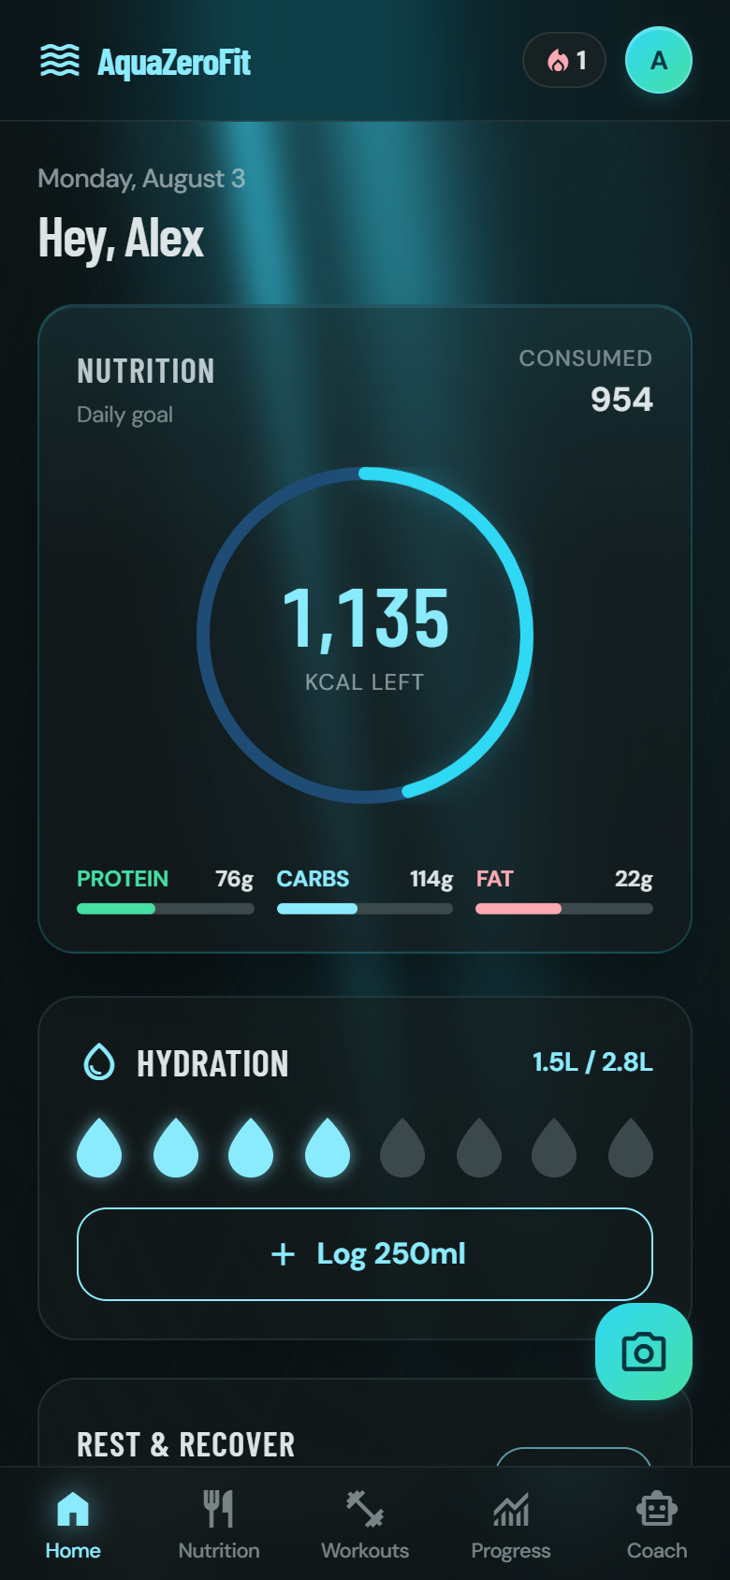
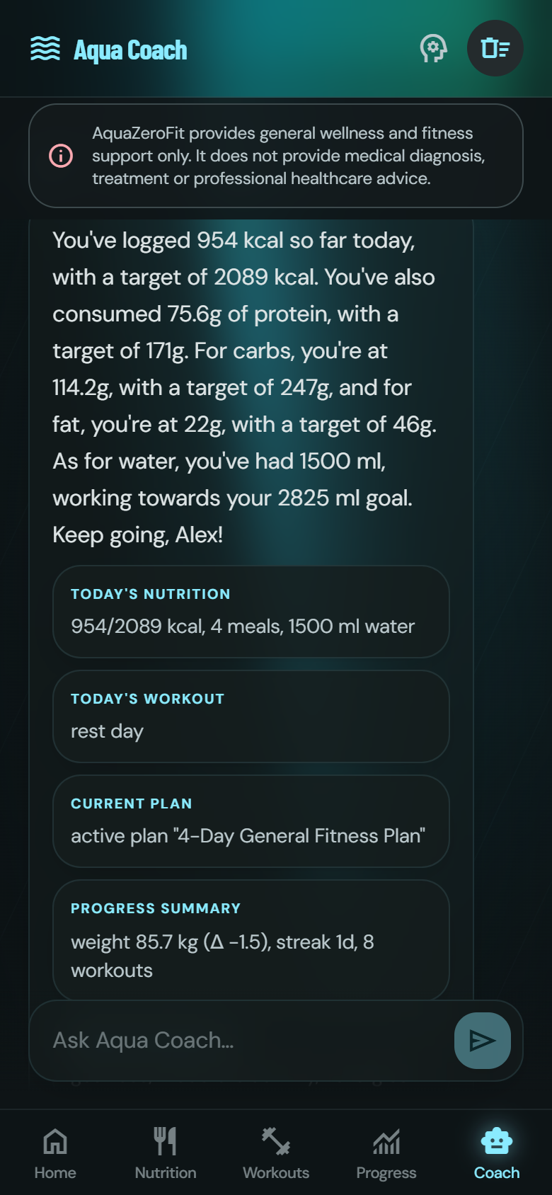
AquaZeroFit
AI-powered wellness, on the open web and inside Telegram, from one codebase.
Babatundji "Tundji" Williams-Fulwood s8138393 Platform, AI, Safety & Operations (Lead Architect)
Eric La s8147350 Training & Workout System
Victor Hong s4685483 Nutrition & Dietary System
NIT3004 IT Capstone Project 2 · Group 15 · Victoria University, Melbourne
AquaZeroFit · NIT3004 IT Capstone Project 2 · Group 1
1
Notes:
TUNDJI opens (15 s): "Good morning. We are Group 15 and this is AquaZeroFit, an AI-assisted wellness app that runs as a normal website and as a Telegram Mini App, from one codebase. I'm Tundji, the lead architect; Victor built the nutrition system and Eric built the training system."

Slide 2

RUNNING ORDER | PRESENTER: WHOLE TEAM
Ten minutes, three engineers, one system
VH
VICTOR HONG s4685483
EL
ERIC LA s8147350
TW
TUNDJI WILLIAMS-FULWOOD s8138393
Nutrition & Dietary System
Training & Workout System
Platform, AI, Safety & Operations
Calorie & macro engine with a safety floor
Photo, barcode and one-tap logging
Allergen filtering the AI cannot override
Licensed exercise corpus
Deterministic plan generator & progression
Adaptive readiness and the session logger
The AI Gateway and offline resilience
Safety, security and privacy architecture
Quality: 806 automated tests
~2:30
~2:30
1:00 + ~3:30
THE 10-MINUTE CLOCK
Opening 1:00
Nutrition 2:30
Training 2:30
Platform & AI 3:30
Close 0:30
Followed by 5 minutes of Q&A, every slide names its presenter, so questions can go straight to the person who built that part.
AquaZeroFit · NIT3004 IT Capstone Project 2 · Group 1
2
Notes:
TUNDJI (20 s): walk the clock once. Point out that each slide carries the presenter's name so the assessor can direct Q&A. Then move straight into the opening frame.

Slide 3




OPENING | PRESENTER: TUNDJI WILLIAMS-FULWOOD
One app that knows your numbers, and never guesses them
AquaZeroFit calculates a personal daily calorie, macro and hydration target, lets you log meals by photo, barcode, chat or a single tap, generates a training plan for the equipment you actually own, and answers questions through Aqua Coach, an AI assistant that only ever speaks from your real data.
A DAY WITH THE APP
Morning
Photograph breakfast. A draft comes back in seconds, you correct a portion and confirm before anything is saved.
Midday
Scan a packaged lunch. The barcode is validated and the label’s calories are cross-checked, not trusted.
Afternoon
Today’s workout is already resolved, and quietly eased because last week was a hard week.
Evening
Ask the coach how the week is going. It answers with your numbers, because you consented to that.
AquaZeroFit · NIT3004 IT Capstone Project 2 · Group 1
3
Notes:
TUNDJI (45 s): One sentence on what it is, then the day-in-the-life. Keep it human, no jargon yet. This slide is the "what"; the next slide is the "how we kept it safe". Time check: ~1:00 total when leaving slide 4.

Slide 4


OPENING · THE CORE IDEA | PRESENTER: TUNDJI WILLIAMS-FULWOOD
The one rule every other decision follows
“Models identify. Code calculates.”
An AI can look at a plate and say “that’s rice and grilled chicken”. It cannot be trusted to say “412 calories”, it will produce a fluent, confident, wrong number. Applied to someone’s food every day for months, that is not a software bug. It is a health outcome.
THE MODEL MAY
THE MODEL MAY NEVER
Name a food it sees in a photo or reads in a sentence
Estimate a portion, which code then clamps to a sane range
Rank options that code has already declared safe
Phrase a summary of statistics code has already computed
Write a calorie or macro figure into your diary
Decide whether a food is safe for your allergy
Decide how much training you are prescribed
Move a credit, grant an entitlement, or unlock a coach
AquaZeroFit · NIT3004 IT Capstone Project 2 · Group 1
4
Notes:
TUNDJI (30 s): Land the one message: "Models identify, code calculates. Every other decision in this system follows from that." Then signpost: "Victor will show that rule in nutrition, Eric in training, and I'll show the platform that enforces it." HANDOVER: "We'll start where the user starts, with food. Victor."

Slide 5





OPENING · DIFFERENTIATION | PRESENTER: TUNDJI WILLIAMS-FULWOOD
Why we built a Telegram Mini App
Zero-install distribution
The app opens inside a chat like a message: no app store, no download, no sign-up form. Telegram identity signs you in, verified cryptographically on our server.
Payments built in
Coach unlocks are Telegram Stars invoices. The server sets every price and verifies every payment webhook; the client is never trusted.
Feels native, stays safe
The app adopts the host’s theme colours, but only after a WCAG contrast check passes. It uses haptics and deep links like a first-class Telegram citizen.
Still a real website
The same codebase serves a full responsive web app. The Telegram SDK loads only on a genuine Mini App launch, so the public site stays fast for everyone else.
1
2
0
Stars
codebase
delivery surfaces
installs required
in-chat payments
AquaZeroFit · NIT3004 IT Capstone Project 2 · Group 1
5
Notes:
TUNDJI (35 s, if time allows in opening, otherwise fold into slide 6): This is the differentiator. Most teams ship a website; we shipped a distribution channel. A Mini App removes every step between "curious" and "using it".

Slide 6






OPENING · TECHNOLOGY CHOICES | PRESENTER: TUNDJI WILLIAMS-FULWOOD
The stack, and why each piece earned its place
TypeScript, end to end
React 18 + Vite
Node.js + Express
One language for client, server and shared packages. A change to an API shape breaks the other side at compile time, not in front of a user.
Fast, component-based UI with a build step we extended ourselves, our own plugin prerenders real HTML for search engines.
A small, well-understood API framework whose middleware chain maps one-to-one onto our seven-step AI safety sequence.
zod validation
Tailwind + design tokens
Vitest: 806 tests
One schema in a shared package validates every request on the server and types the client. The contract cannot silently drift.
Every colour lives in one token layer, which is exactly what makes Telegram theme binding possible without touching components.
One test runner across the API and web workspaces, fast enough to run the whole suite on every change.
Everything is TypeScript on purpose: three engineers reviewing each other’s work in one shared vocabulary, with one type system keeping all of it honest.
AquaZeroFit · NIT3004 IT Capstone Project 2 · Group 1
6
Notes:
TUNDJI (30 s): One line per card, plain English. The theme of every choice: small, boring, checkable technology so the interesting risk (the AI) is the only risk.

Slide 7


OPENING · ARCHITECTURE | PRESENTER: TUNDJI WILLIAMS-FULWOOD
The whole system on one slide
Browser
Telegram Mini App
any device, no install
opens from a chat
WHY IT IS SHAPED THIS WAY
Modules stay in their lane
apps/web, React 18 + TypeScript + Vite
No module ever touches another’s storage, they talk through service functions.
one client, two delivery surfaces; detects Telegram at bootstrap
HTTPS · JSON · JWT
One door to the AI
apps/api, Node + TypeScript · /api/v1
Every model call passes the same 7-step admission sequence. No exceptions, no fast paths.
15 feature modules (auth, foods, logs, plans, workouts, chat, vision, progress…) over a thin platform layer
Licences never mix
Document store
AI Gateway
External systems
Open-licence food data lives in its own containers so it can never contaminate our curated corpus.
10 containers · JSON files locally, Postgres in production. Licensed data segregated.
5 logical lanes · 5 providers · retries, circuit breakers, offline fallback.
Telegram Bot API · Open Food Facts · wger corpus · Resend mail.
AquaZeroFit · NIT3004 IT Capstone Project 2 · Group 1
7
Notes:
TUNDJI (30 s): Trace one request top to bottom, then the three "why" bullets. Close the opening here (~1:00–1:30 elapsed). HANDOVER: "We'll start where the user starts, with food. Victor."

Slide 8
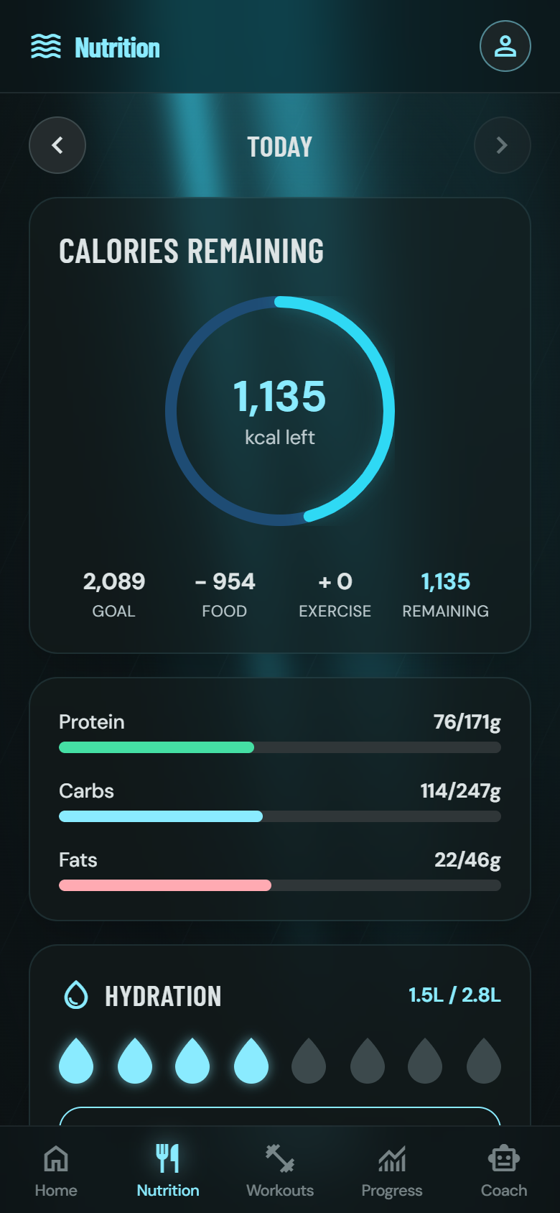




NUTRITION 1/3 | PRESENTER: VICTOR HONG
Your daily targets are arithmetic, never an AI guess
Science first, in deterministic code
Basal rate via the Mifflin-St Jeor equation, scaled by an activity factor (1.2–1.9), then adjusted toward your goal only within a safe band, 0.5–1% of bodyweight per week.
A floor the app will not cross
Targets are clamped to 1,200 kcal (1,500 for men). When the clamp fires, the app tells you why. It never silently overrules you, and never lets you under-eat by design.
Macros and hydration included
Protein set per kilogram by goal (1.6–2.2 g/kg), fat at least 20% of energy, carbohydrate takes the rest, water at 33 ml per kg.
Every number is accountable
The formula version is stored with every set of targets, so we can always say exactly which mathematics produced a figure a user acted on.
1,200 kcal
1.2–1.9
2.0 g/kg
33 ml/kg
safety floor (1,500 men)
activity factors
protein (weight-loss goal)
hydration target
AquaZeroFit · NIT3004 IT Capstone Project 2 · Group 1
8
Notes:
VICTOR (50 s): "I'm Victor, and I built the nutrition system." Open with the rule applied: every calorie figure in this product is arithmetic we did ourselves. Explain BMR->TDEE->goal in one breath; spend the saved time on the floor and the visible reason, that's the judgement the marker rewards.

Slide 9
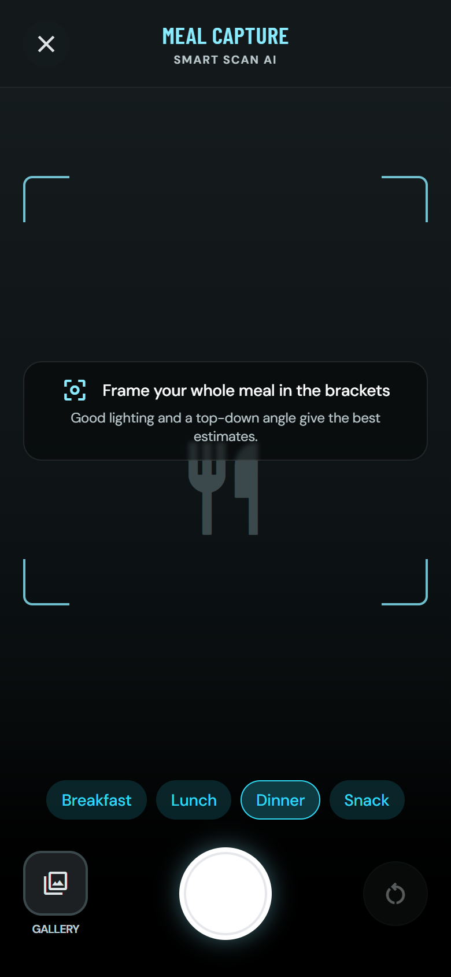




NUTRITION 2/3 | PRESENTER: VICTOR HONG
Logging a meal takes seconds: four ways in
Photo → draft → confirm
The model only names the food; the app recomputes calories from its own 139-record corpus. Nothing is saved until you confirm. Then the photo is deleted, its GPS and camera metadata already stripped on upload.
Barcodes are checked, not trusted
EAN-8/13 check-digit validated locally, our mirror first, Open Food Facts as fallback. Then the label’s calories are recomputed from its own macros, and a label that lies outside 30% tolerance is flagged.
History does the typing
“Copy yesterday” duplicates a whole day of meals in one request, and a month calendar steps back through everything you’ve logged.
Retry-safe by design
Every creation route honours an idempotency key, so a flaky connection can retry forever and never double-log a meal.
139
10 MB
30% + 5 kcal
24 h
foods, each with source + licence
JPEG / PNG / HEIC uploads
label cross-check tolerance
orphaned photos swept
AquaZeroFit · NIT3004 IT Capstone Project 2 · Group 1
9
Notes:
VICTOR (50 s): The confirmation gate is the star: "an automatic commit means a wrong estimate silently becomes your history." Mention the EXIF strip as a privacy measure, not a feature. If short on time, drop the idempotency row from speech, it stays on the slide.

Slide 10
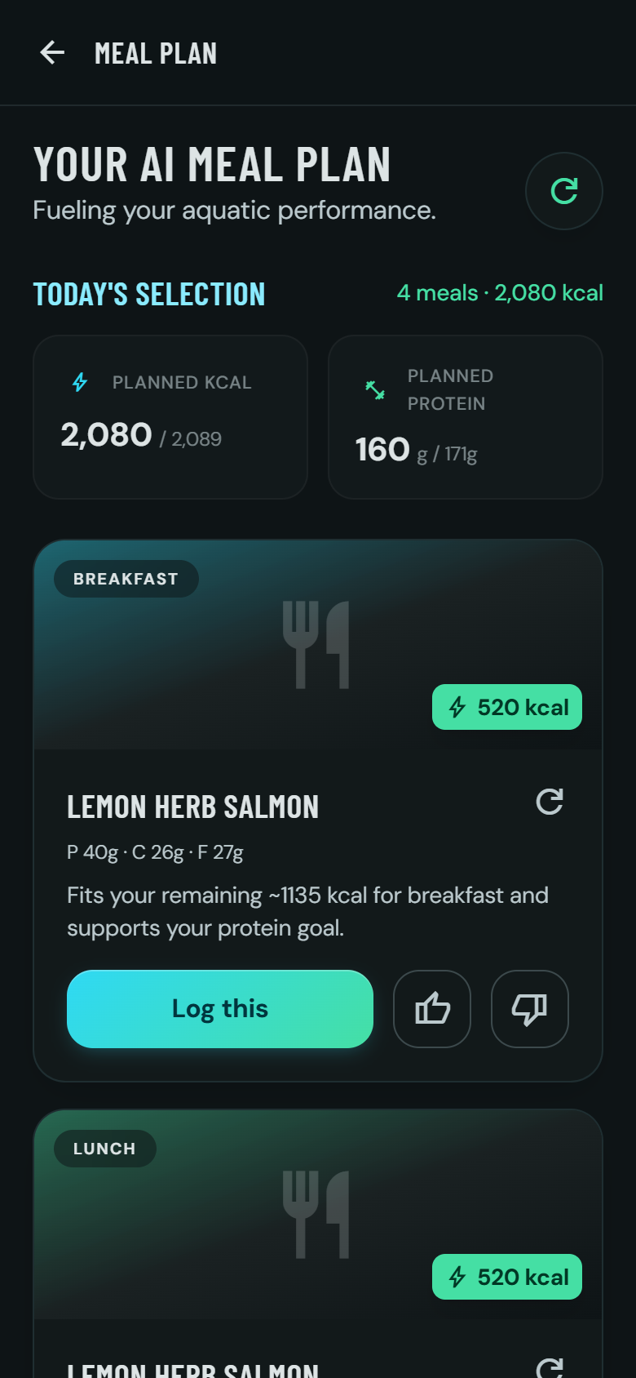



NUTRITION 3/3 | PRESENTER: VICTOR HONG
The safety net you never see
Allergens: two independent nets, zero AI
Nine allergen classes filtered in code, the record’s declared field, plus a keyword net that catches untagged records (satay → peanuts, tahini → sesame). Over-blocking is acceptable; under-blocking never is.
Suggestions the model cannot sabotage
Code computes your remaining budget and filters candidates for diet and allergens; the model only ranks the survivors, and even its pick is re-checked against the safe list.
Depth without clutter
Six micronutrients (fibre, sugar, sodium, potassium, calcium, iron) folded live from your log; 17 curated, licensed recipes loggable in one tap.
Your data leaves with you
Full diary export in JSON or CSV (meals, macros, micronutrients, hydration), ready for a dietitian or another app. Data rights you can exercise, not just read about.
9
2
6
JSON/CSV
allergen classes
independent filter nets
micronutrients tracked
one-request export
AquaZeroFit · NIT3004 IT Capstone Project 2 · Group 1
10
Notes:
VICTOR (40 s): One message to land: "a model never gets a vote on allergen safety." Close nutrition on data portability. HANDOVER: "That's the nutrition module. I'll hand over to Eric for training."

Slide 11
NUTRITION · UNDER THE HOOD | PRESENTER: VICTOR HONG
Where the safety lives in code
apps/api/src/modules/me/targets.ts
apps/api/src/modules/recommendations/allergenFilter.ts
export function computeTargets(profile) {
const bmr = computeBmr(profile); // Mifflin-St Jeor
const tdee = bmr * ACTIVITY_FACTORS[profile.activityLevel];
const rawTarget = tdee + dailyAdjustment(profile.goal, ...);
// Safety clamp: the engine never proposes intake below
// the floor (FR-031).
const floor = KCAL_FLOOR[profile.sex]; // 1200 / 1500
const clamped = rawTarget < floor;
const kcalTarget = clamped ? floor : rawTarget;
const clampReason = clamped
? `Calculated target (... kcal) is below the safe
minimum of ${floor} kcal, so the target was raised
to the floor. Consider a gentler rate of change.`
: null;
return { ..., clamped, clampReason,
formulaVersion: FORMULA_VERSION }; // mifflin-stjeor-v1
}
/**
* Deterministic allergen exclusion (AQF-11 §2: zero
* tolerance for false negatives). This filter runs in
* CODE, after candidate selection and before any model
* involvement, a model NEVER decides allergen safety.
*
* Two independent nets:
* 1. The record’s declared `allergens` field.
* 2. A name/ingredient keyword fallback map that catches
* records with missing tagging ("satay" → peanuts).
* False positives (over-blocking) are acceptable;
* false negatives are not.
*/
export const ALLERGEN_NAME_KEYWORDS = {
peanuts: ['peanut', 'satay', 'groundnut', ...],
treeNuts: ['almond', 'praline', 'marzipan', ...],
milk: ['whey', 'casein', 'ghee', 'halloumi', ...],
... // 9 classes, both nets applied in code
};
WHY IT MATTERS No AI import anywhere in this file. The target is pure arithmetic, and when it overrules the user, it says why, in a sentence stored beside the number.
WHY IT MATTERS The safety policy is written at the top of the file that enforces it, and a test fails if either net stops firing.
AquaZeroFit · NIT3004 IT Capstone Project 2 · Group 1
11
Notes:
VICTOR (only if asked, or 20 s flash): "This is the actual shipped code." Point at the clamp ternary and the keyword net. Full listings appear in section 9 of our report.

Slide 12
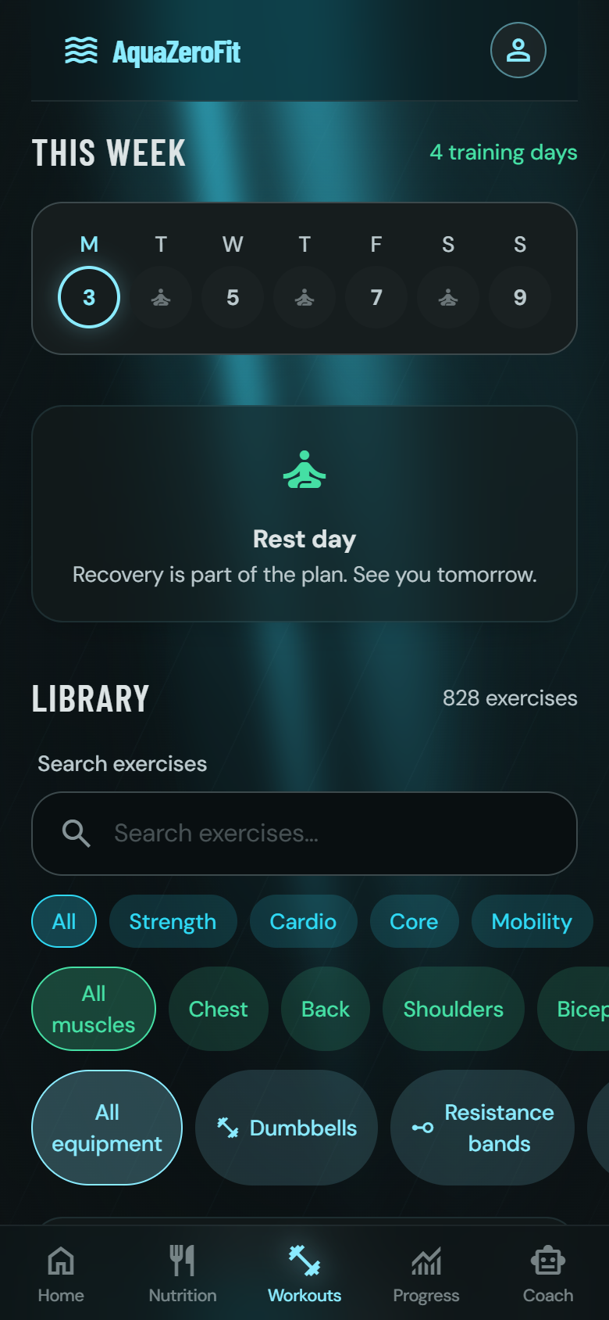



TRAINING 1/3 | PRESENTER: ERIC LA
A movement library with a licence, not just a list
51 seeded movements, extended from wger
Each categorised strength / cardio / mobility / core, with primary and secondary muscles, required equipment, difficulty and demonstration media.
Attribution survives every refactor
The upstream corpus is Creative Commons share-alike, so licence, author and deed URL are fields on the record itself, never stripped, and rendered to the user in the app.
Variation groups
Interchangeable movements share a group ID. That one field is what makes safe in-session swaps possible without breaking historical progression.
Filtered to your reality
Plans only ever draw from movements whose equipment you actually own and whose difficulty matches your experience.
51 + wger
CC BY-SA
4
seeded & imported movements
honoured on every record
movement categories
AquaZeroFit · NIT3004 IT Capstone Project 2 · Group 1
12
Notes:
ERIC (45 s): "Thanks Victor, I'm Eric, I built the training system." The licensing discipline is the differentiator here: most student projects scrape data; we govern it. Point at the attribution visible in the screenshot.

Slide 13




TRAINING 2/3 | PRESENTER: ERIC LA
Plans are deterministic first; the AI has to earn its way in
A generator you can predict
Calendar patterns place 2–6 sessions a week so rest days fall sensibly; focus rotates with your goal; a beginner is never given two high-intensity days in a row.
Progression is data, not hidden code
“Week 2: more reps. Week 3: more volume. Week 4: tighter rest.” Rules are inspectable data, resolved by a pure engine with hard caps, so the user can see what week five will ask of them.
Progression fails closed
Autoregulated steps apply only when your logs prove last week’s targets were actually met. No evidence, no increase, and no percentage step may exceed 50%.
The AI lane is optional, and audited
A model may draft the week from the same pre-filtered pool, but the draft is validated structurally and semantically. Any failure falls back to the deterministic engine, invisibly.
2–6
Sets 1–20 · Reps 1–100
≤50%
100%
sessions per week
hard caps in the resolver
max percentage step
of AI drafts validated before use
AquaZeroFit · NIT3004 IT Capstone Project 2 · Group 1
13
Notes:
ERIC (50 s): The message: "prescribing training load has real consequences, so the guaranteed path is deterministic." Progression-as-data gives three wins: users can see it, the AI can speak it, and a pure function can test it.

Slide 14
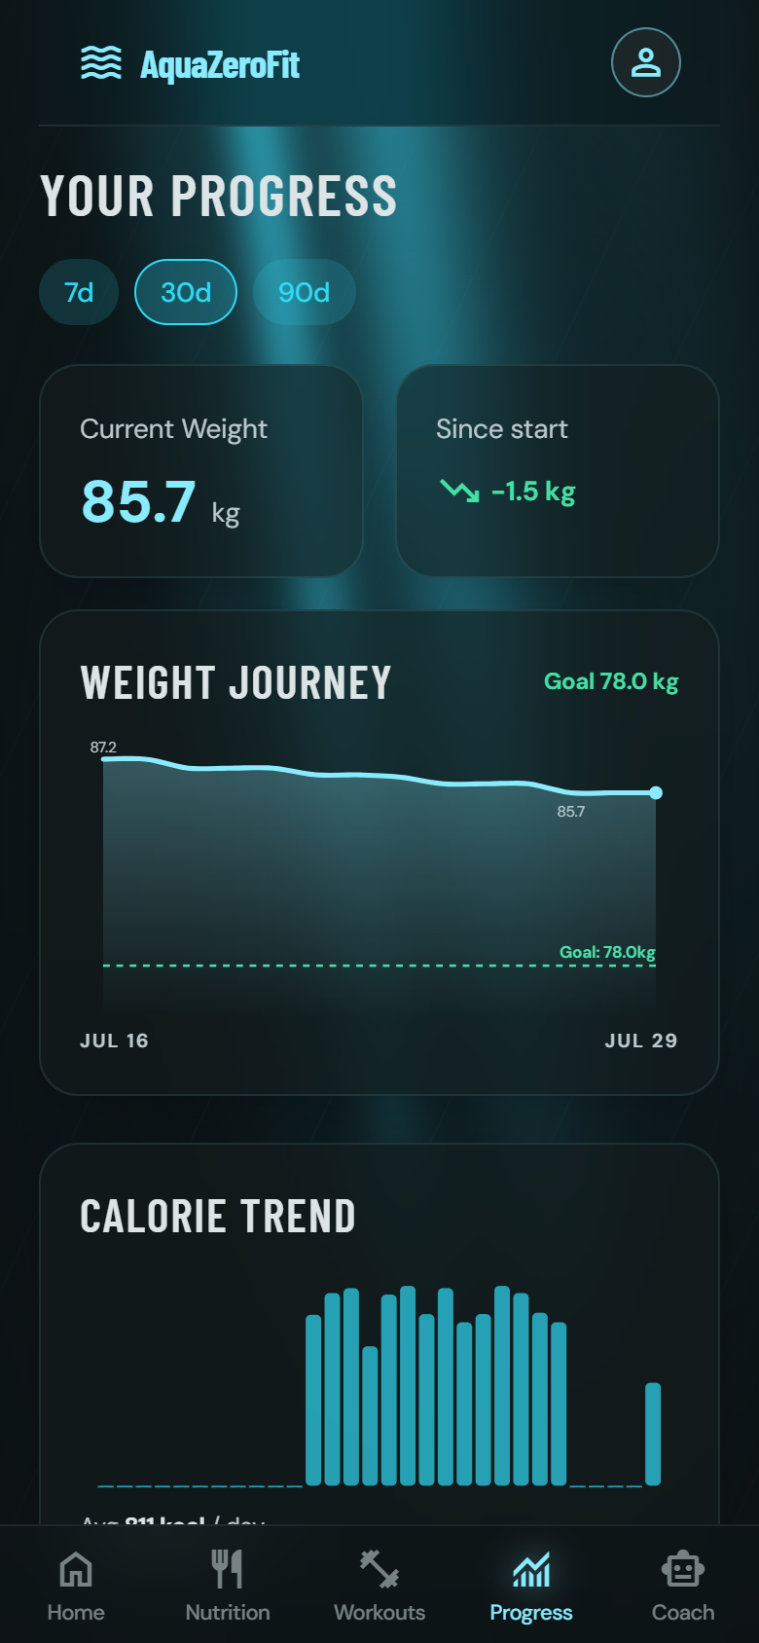




TRAINING 3/3 | PRESENTER: ERIC LA
The plan adapts to the week you actually had
Protect · Maintain · Progress
Four weighted signals from your last 7 days (completion 45%, activity 25%, recency 20%, intake 10%) scale next week’s working volume ×0.6, ×1.0 or ×1.1. A hard week quietly eases the next one; a quiet week is never framed as failure.
A guided session logger
Pre-resolved targets, weights rounded to real plates, a rest countdown between sets, actuals recorded set by set, and swaps constrained to genuine alternatives you have equipment for.
Analytics with no AI in it
Weekly volume and set counts per muscle, and a Brzycki estimated one-rep max with the formula version pinned so history can never silently shift.
Achievements are never revoked
Streaks evaluate against your best-ever run, not your current one. A badge earned stays earned; we removed the punishing reset-to-zero counter entirely.
×0.6 / 1.0 / 1.1
45 / 25 / 20 / 10
11
protect · maintain · progress
readiness signal weights
achievement definitions
AquaZeroFit · NIT3004 IT Capstone Project 2 · Group 1
14
Notes:
ERIC (55 s): Readiness is the most sophisticated thing in training, give it the time. Note the smallest weight (intake, 10%) is deliberate: it's the noisiest signal and the easiest to turn into food-moralising. HANDOVER: "That's the training system. Over to Tundji for the platform underneath it."

Slide 15
TRAINING · UNDER THE HOOD | PRESENTER: ERIC LA
Progression and readiness, exactly as shipped
apps/api/src/modules/plans/readiness.ts
apps/api/src/modules/plans/progression.ts
/* completion 45: the only signal that measures the
* thing we are modulating.
* recency 20: four quiet days in a row read worse
* than four scattered through the week.
* intake 10: smallest weight ON PURPOSE: the
* noisiest signal, and the one most easily
* turned into food moralising. It may nudge
* the band but never decide it. */
const WEIGHTS = {
completion: 45, logging: 25, recency: 20, intake: 10,
} as const;
/* Applied to the ABSOLUTE deviation: eating well under
* target costs exactly as much as eating well over it.
* Under-eating is never scored as virtue, that is the
* disordered-eating pattern this product must not reward. */
const INTAKE_ZERO_AT_DEVIATION = 0.3;
// Autoregulation: if the logs cannot confirm the previous
// iteration’s targets were met, the step is skipped.
if (rule.requires && rule.requires.length > 0) {
if (!gate || !gate(atIteration, rule)) continue;
} // no evidence → no increase
// Hard caps mirror the shared validation schemas:
// sets 1–20, reps 1–100, rest 0–900 s, weight 0–1000 kg.
function clamp(value, kind) {
return Math.min(CAPS[kind].max,
Math.max(CAPS[kind].min, value));
}
// Rules are DATA, resolved by this pure engine, so the
// user can inspect week 5, an AI draft can speak the same
// vocabulary, and a unit test can pin the reference example.
WHY IT MATTERS Every weight is justified in a comment beside it. A marker can audit our judgement, not just our arithmetic.
WHY IT MATTERS The gate fails closed and the caps are unconditional, even a model-drafted plan physically cannot prescribe past them.
AquaZeroFit · NIT3004 IT Capstone Project 2 · Group 1
15
Notes:
ERIC (flash or Q&A): the intake-weight comment is the strongest 10 seconds here, engineering judgement written where it executes. Section 10 of the report has the full listings.

Slide 16

PLATFORM & AI 1/4 | PRESENTER: TUNDJI WILLIAMS-FULWOOD
Every AI call goes through one door and survives failure
Lanes, not vendors
Features ask for a capability (“vision”, “chat fast”, “plan structured”), never a brand. The gateway maps each lane onto whichever providers actually have API keys.
ONE CALL’S JOURNEY
request → lane
Engineered resilience
Retries with jittered backoff; a circuit breaker sidelines any provider that fails 3 calls in a row for a 60-second cooldown; one 12-second deadline bounds the whole call.
provider 1 · retry
An offline brain of last resort
provider 2 … 5 · breaker
If every provider fails, or no keys are configured at all, a deterministic engine answers instead. Every core journey works with the AI completely gone.
offline engine
Degraded output is never billed
A fallback answer carries a degraded flag and the reserved credit is returned. Template text is not a model answer anyone should pay for.
reply + degraded flag
5
5
12 s
0
logical model lanes
providers in the chain
overall deadline
credits charged when degraded
AquaZeroFit · NIT3004 IT Capstone Project 2 · Group 1
16
Notes:
TUNDJI (50 s): "Thanks Eric." The lane abstraction is the architecture story; the offline engine is the reliability story. Say it plainly: unplug every AI key and the demo still runs. That is also our answer if the venue Wi-Fi fails.

Slide 17



PLATFORM & AI 2/4 | PRESENTER: TUNDJI WILLIAMS-FULWOOD
Safety is architecture: seven steps in front of every model
1
2
3
4
5
6
7
Authenticate
Rate limit
Reserve credits
Input guardrail
Gateway call
Output guardrail
Respond & settle
The same sequence guards chat, meal photos, meal suggestions, plan generation and the weekly insight. No endpoint is exempt; there are no fast paths.
Crisis always wins
The input classifier prioritises crisis above medical, above extreme diet, above everything. A user in distress never receives diet content: no model is called, and the reply contains real helpline contacts.
Jailbreaks refused, floors enforced
“Pretend you’re not an AI” framing is refused outright. “Help me eat 600 calories a day” is refused on input, and numeric rules re-screen every reply on the way out.
A refused turn is free
Credits are reserved before the guardrail and released when it blocks, so safety never costs the user anything.
5
12
70 cases
input categories, priority-ordered
versioned prompt files (P-01…P-12)
in 3 CI-gated safety evaluation sets
AquaZeroFit · NIT3004 IT Capstone Project 2 · Group 1
17
Notes:
TUNDJI (55 s): Walk the seven boxes once, fast. Then the crisis priority, this is the most important safety judgement in the product. If we demo, this is the moment to promise "you'll see this live: I'll ask it something medical."

Slide 18
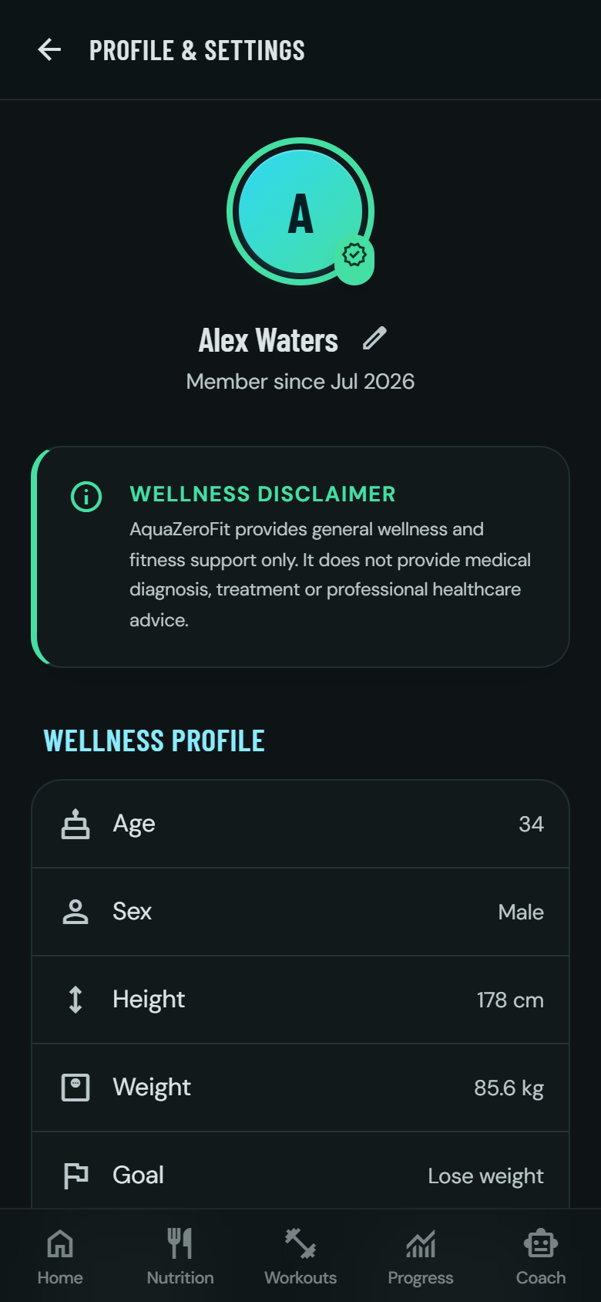

PLATFORM & AI 3/4 | PRESENTER: TUNDJI WILLIAMS-FULWOOD
Locked down by default, private by default
SECURITY
PRIVACY
Access tokens live 15 minutes; refresh tokens are single-use, stored only as hashes
A replayed refresh token revokes the whole token family: attacker and victim are both signed out
Telegram sign-in: HMAC recomputed server-side, compared in constant time, stale after 10 minutes
Four rate-limit lanes; five failed logins lock the account for 15 minutes
All four consents default OFF; with personalisation off, not even your name reaches a model
AI memory is proposed by the model but approved by you; only approved facts ever enter a prompt
Full data export in one request
Two-step deletion: 30-day grace, then a purge that anonymises even audit trails and hashes leftover identifiers
15 min
4
30 days
access-token lifetime
consents, all default off
deletion grace period
AquaZeroFit · NIT3004 IT Capstone Project 2 · Group 1
18
Notes:
TUNDJI (50 s): Two headlines: token-family revocation (a stolen session dies the moment it's replayed) and the load-bearing consent (privacy off means the model literally receives nothing, and the app still works). Point to the consent toggles in the screenshot.

Slide 19



PLATFORM & AI 4/4 | PRESENTER: TUNDJI WILLIAMS-FULWOOD
Motivation that cannot hurt you, money that cannot drift
XP for behaviour, never outcomes
Logging, training, hydrating and resting earn experience. Nothing scores a calorie deficit or a kilogram lost; that is a safety decision, not a design preference. Capped per lane and at 150 XP a day.
Consistency, not punishing streaks
A 28-day window with a grace day replaces the reset-to-zero streak. The figure cannot count down, and a badge once earned is never revoked.
Nine coach personas, honestly gated
Tournament fighters as coaching voices, unlocked by level. Telegram Stars is only a shortcut, and the server (never the client) decides every entitlement and price.
An append-only credit ledger
AI usage is metered by transactions (reserve, commit, release) and the balance is computed from history. A counter can drift and cannot be audited; a ledger can.
150
28 + 1
9
50
max XP per day
consistency window + grace day
coach personas
free AI credits daily
AquaZeroFit · NIT3004 IT Capstone Project 2 · Group 1
19
Notes:
TUNDJI (45 s): The line that lands: "nothing in this product awards points for losing weight, in a wellness app, that's a safety property." Then the ledger: balances are folds over transactions, so they can't drift and a crashed job refunds itself.

Slide 20
PLATFORM & AI · UNDER THE HOOD | PRESENTER: TUNDJI WILLIAMS-FULWOOD
The gateway’s last line, and the classifier’s first
apps/api/src/modules/ai/gateway.ts
apps/api/src/modules/ai/guardrails.ts
outer: for (const provider of PROVIDERS) {
const credentialed = !!process.env[provider.keyEnv];
if (circuitIsOpen(provider.name)) continue;
... // retries w/ jittered backoff,
// one 12 s deadline overall
}
// Deterministic offline engine, the product must work
// with zero keys. It is never retried and never timed out:
// the eval runner and test suite depend on its output
// being byte-identical.
const degraded = realProviderInPlay;
const degradedReason = degraded
? deadlineExceeded ? 'deadline_exceeded'
: 'provider_failure'
: undefined; // degraded ⇒ credit released
/** Pure classifier, no I/O, usable from tests and eval
* runners. Priority: crisis > medical > extremeDiet. */
const crisis = findMatch(text, CRISIS_PATTERNS);
if (crisis) return { category: 'crisis', ... };
const medical = findMatch(text, MEDICAL_PATTERNS);
if (medical) return { category: 'medical', ... };
if (hasSubFloorTarget(text)) { // "600 kcal a day"
return { category: 'extremeDiet', ... };
}
// A pure instruction-override attempt with no unsafe
// payload is still refused: the assistant never
// renegotiates its scope.
if (jailbreak) return { category: 'outOfScope', ... };
WHY IT MATTERS Application code never names a vendor. Unplug every API key and this loop falls through to an engine that always answers, at no charge.
WHY IT MATTERS The priority order IS the code order: crisis returns first, so nothing can pre-empt it. This function runs before any credit is spent on a model.
AquaZeroFit · NIT3004 IT Capstone Project 2 · Group 1
20
Notes:
TUNDJI (flash or Q&A): two files, two guarantees, the app survives the AI dying, and a person in crisis never reaches the AI at all. Full listings in section 11 of the report.

Slide 21



ENGINEERING QUALITY | PRESENTER: TUNDJI WILLIAMS-FULWOOD
How we know all of this is true
806
650 + 156
12
70
automated tests, all passing
API tests (54 files) + web tests (24 files)
versioned prompt files
safety evaluation cases across 3 sets, gate passing
Tests that defend decisions, not just lines
A test fails if anyone merges the coach persona into the rules prompt, if a refresh token stops revoking its family, or if a safety evaluation set regresses. The pipeline is gated on all of it.
A service that refuses to boot broken
In production it will not start without real secrets, HTTPS-only origins and a working mail transport, so misconfiguration becomes a loud failure, never a silent one.
Honest about limits
Single-instance scaling and the pure-JS password hash are recorded as deliberate trade-offs with a stated hardening path, decided early, not discovered late.
Run it yourself: npm run verify
AquaZeroFit · NIT3004 IT Capstone Project 2 · Group 1
21
Notes:
TUNDJI (35 s): 806 is the headline (650 API + 156 web, re-run on 17 Aug 2026; the AQF-24 report says 770 because more tests were added after it was written). Say exactly "806 automated tests, all passing", never a coverage percentage. Note: a few web tests can time out if the machine is busy with another dev server; run the suite on an idle machine before the demo. The refuse-to-boot guards are the ops story. Close: "That's the system." Move to the demo.

Slide 22
LIVE DEMONSTRATION | PRESENTER: WHOLE TEAM
Three minutes, seven screens, each one proves something
1
Dashboard with the calorie ring
Targets are personalised and today’s arithmetic is live
2
Photograph a meal, then pause on the draft
Nothing is saved yet; the calories on screen were computed by the app, not the model
3
Adjust a portion, then confirm
The user controls what enters their record
4
Today’s workout: one set + the rest timer
The plan resolves per day and records what you actually did
5
Ask the coach about today
Grounding: the answer contains the user’s real numbers
6
Ask the coach something medical
The safety boundary, live: a warm refusal and a signpost to real help
7
The progress screen
What changed and why, a sentence, not just a chart
If the network fails, nothing changes: the offline engine answers and every journey still completes.
AquaZeroFit · NIT3004 IT Capstone Project 2 · Group 1
22
Notes:
Step 6 is the most persuasive fifteen seconds of the whole demo, never cut it. Rehearse the demo once end-to-end on the machine that will be used. Do not quote the on-screen diagnostics strip.

Slide 23


TRY IT YOURSELF | PRESENTER: WHOLE TEAM
Open AquaZeroFit on your phone right now
Scan the code with your camera
It opens a Telegram chat with the AquaZeroFit bot. No app store, no download.
Tap Start
The Mini App launches inside Telegram and signs you in with your Telegram identity, verified on our server.
Set up your profile once
Enter height, weight, age and goal. Your calorie, macro and hydration targets are computed on the spot.
Prefer a browser?
The same product runs as a website from the same codebase, so anyone can review it without Telegram.
Assessors are welcome to scan during Q&A. Every feature shown today is live in this build.
AquaZeroFit · NIT3004 IT Capstone Project 2 · Group 1
23
Notes:
TUNDJI (15 s): "Before questions: if you would like to try it, this QR opens the Mini App on your phone in about ten seconds." Leave the slide up while moving to the Q&A slide if the room is scanning.

Slide 24
Questions: ask the person who built it
VH
VICTOR HONG s4685483
EL
ERIC LA s8147350
TW
TUNDJI WILLIAMS-FULWOOD s8138393
Nutrition & Dietary System
Training & Workout System
Platform, AI, Safety & Operations
Calorie & macro engine, the 1,200 kcal floor
Photo pipeline & the confirmation gate
Barcodes, allergens, recipes, export
Exercise corpus & licence governance
Plan generator & progression-as-data
Readiness, session logger, analytics
AI Gateway, guardrails, offline fallback
Auth, privacy, consent & deletion
Gamification, payments, testing, ops
BUILT ON THE SHOULDERS OF
Data: wger exercise database (CC BY-SA 4.0, attribution rendered in-app) · Open Food Facts (ODbL) · USDA FoodData Central (CC0)
Platform: Telegram Bot & Mini App platform · React 18 · Node.js + Express · TypeScript · zod · Tailwind CSS · TanStack Query · Vitest · sharp
Project: AquaZeroFit v1.0.0 · licensed AGPL-3.0-or-later · full licence and attribution register in the repository (ATTRIBUTION.md, THIRD_PARTY_NOTICES.md)
Thank you. Group 15: Babatundji Williams-Fulwood s8138393 · Eric La s8147350 · Victor Hong s4685483
AquaZeroFit · NIT3004 IT Capstone Project 2 · Group 1
24
Notes:
TUNDJI closes: "That's the system. We're happy to take questions." Each member fields questions on their own modules, the cards say who owns what. Shared questions (the invariant, the admission sequence, headline figures) can go to anyone.

Slide 25
APPENDIX
Code deep dives for Q&A
Kept out of the ten minutes on purpose. Every listing on the next slides is real shipped code, quoted (and lightly abridged) from the repository. Full listings are documented in sections 9 to 11 of our Software Architecture and Contribution Report (AQF-24).
Meal-photo privacy: the re-encode Victor Hong
Stolen sessions die on replay Tundji Williams-Fulwood
Balances that cannot drift Tundji Williams-Fulwood
AquaZeroFit · NIT3004 IT Capstone Project 2 · Group 1
25
Notes:
Only open these if a question calls for them. Each maps to a question in Appendix C of the report.

Slide 26
APPENDIX · NUTRITION | PRESENTER: VICTOR HONG
One line that is both the privacy measure and the type check
apps/api/src/modules/vision/router.ts
/**
* Decode the upload and write a fresh JPEG from the pixels.
*
* Privacy: a phone photo carries EXIF GPS at home-address precision, the capture timestamp and the
* camera serial number. Persisting that verbatim would bolt a location trail onto health-adjacent
* records that only need the picture of the food. Re-encoding rebuilds the file from decoded pixels,
* so every metadata block (EXIF, XMP, IPTC, ICC) is discarded.
*
* Security: this is also the real upload type check, `file.mimetype` is an unverified client claim.
*/
async function toStorableJpeg(buffer: Buffer, declaredMime?: string): Promise<Buffer> {
return await sharp(buffer).rotate().jpeg({ quality: 82 }).toBuffer();
}
WHY IT MATTERS If the bytes are not really an image, sharp throws and the upload is rejected. The photo itself is deleted on confirm, or swept within 24 hours.
Likely Q&A pairing: “How do you protect a user’s photos?”, and the answer is a file path, not a promise.
AquaZeroFit · NIT3004 IT Capstone Project 2 · Group 1
26
Notes:
VICTOR owns this. The one-liner does three jobs: EXIF strip, orientation fix, and real type validation. Report §9.3.

Slide 27
APPENDIX · SECURITY | PRESENTER: TUNDJI WILLIAMS-FULWOOD
A stolen session dies the moment it is replayed
apps/api/src/platform/auth.ts
/**
* Rotate a refresh token: single use. A second presentation of the same token is treated as
* theft, the entire family is revoked (AQF-07 §2.1). Atomic compare-and-swap ensures only one
* concurrent refresh can succeed.
*/
if (existing.usedAt !== null || existing.revokedAt !== null) {
revokeFamily(existing.familyId);
throw new AppError('AUTH_INVALID', 'Refresh token reuse detected; session revoked');
}
// Atomic CAS: mark token as used only if still unused.
const marked = await store.compareAndSwapRefreshToken(existing.id, tokenHash, new Date().toISOString());
if (!marked) { revokeFamily(existing.familyId); throw new AppError('AUTH_INVALID', ...); }
WHY IT MATTERS Attacker and victim hold the same family, so revoking it signs BOTH out, which is exactly the property you want when you cannot tell which one is the thief.
Likely Q&A pairing: “What happens if someone steals a token?”, tokens are hashed at rest, live 15 minutes, and reuse kills the family.
AquaZeroFit · NIT3004 IT Capstone Project 2 · Group 1
27
Notes:
TUNDJI owns this. Report §11.6; there is a test that fails if family revocation on reuse ever stops working.

Slide 28
APPENDIX · PLATFORM | PRESENTER: TUNDJI WILLIAMS-FULWOOD
Balances that cannot drift, and an SDK that earns its load
apps/api/src/modules/ai/creditLedger.ts
apps/web/src/lib/telegram.ts
/**
* Append-only credit ledger. Every movement is a
* CreditTransaction document; balance is a plain fold
* (sum of amounts) over the user’s transactions:
* grant / purchase → +amount
* reserve → −cost (hold deducted now)
* release → +cost (cancels a hold)
*/
/** Balance = fold. No cached counters, ever. */
async balance(userId: string): Promise<number> {
const txs = await userTxs(userId);
return txs.reduce((sum, t) =>
sum + (typeof t.amount === 'number' ? t.amount : 0), 0);
}
/** Does this page load look like a Telegram Mini App
* launch? Answered WITHOUT the SDK, so it can decide
* whether to fetch it at all. */
export function looksLikeTelegramLaunch(): boolean {
if (getWebApp()?.initData) return true;
const surface = `${location.hash}${location.search}`;
if (/[#&?]tgWebApp(Data|Version|Platform)=/.test(surface))
return true;
...
}
// The SDK used to be a blocking <script> fetched from
// telegram.org on every page load, stalling the marketing
// site for exactly the corporate networks that block
// telegram.org, whose users need the browser fallback most.
WHY IT MATTERS A crashed job returns its hold; an auditor can replay history to any balance. Experience points obey the same contract.
WHY IT MATTERS The comment records the cost that drove the design. That is what a decision register looks like inside the code.
AquaZeroFit · NIT3004 IT Capstone Project 2 · Group 1
28
Notes:
TUNDJI owns both. Ledger: report §11.10. Telegram detection: §6.5 / §11.1. Good answers for "why not just a counter?" and "why a Mini App?"

